Slide 1
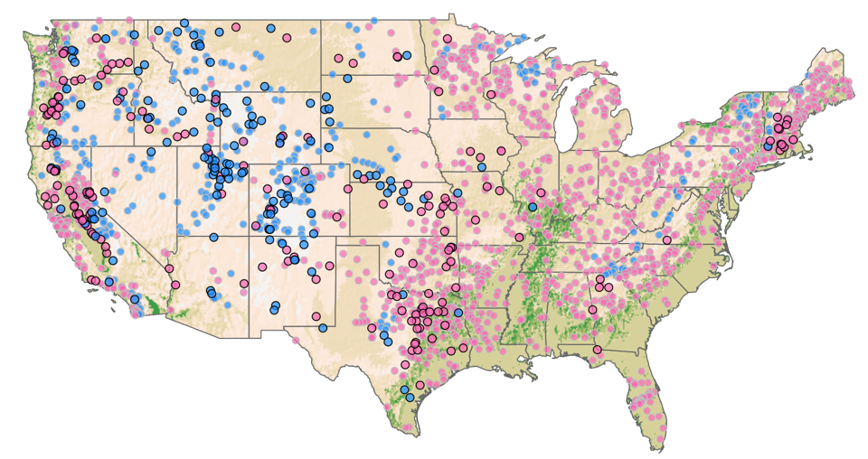
Detecting Forecast Contribution to the Water Release Decisions of Dams Throughout the U.S.
Objective
Detect the contribution of forecasts in water reservoir operations across the United States
Approach
Collect records of reservoir operations, including daily resolution inflow, storage, and release time series
Analyze operations for each dam during each week of the water year to identify the seasonal forecast horizon that best explains release decisions taken
Determine the characteristics of dams that lead to detection of forecast use in operations
Impact
Determined approximately 80% of large U.S. dams adjust water releases in response to forecasted flows
Advanced large-scale hydrological modeling to incorporate data-driven release rules tailored to individual dams
Could provide enhanced capability for simulating water availability under conditions of drought
With limited storage, run-of-river hydro dams on the Columbia River cannot benefit from long-range forecasting
Large dams in high-elevation regions benefit from forecasts informed by snowpack
PNNL’s horizon tool detects possible use of forecasts in reservoir release decisions
Turner S, W Xu, and N Voisin. 2020. “Inferred inflow forecast horizons guiding reservoir release decisions across the United States,” Hydrology and Earth System Sciences 24:1275–1291.
DOI: 10.5194/hess-24-1275-2020
Notes:
http://www.pnnl.gov/science/highlights/highlights.asp?division=749

