Slide 1
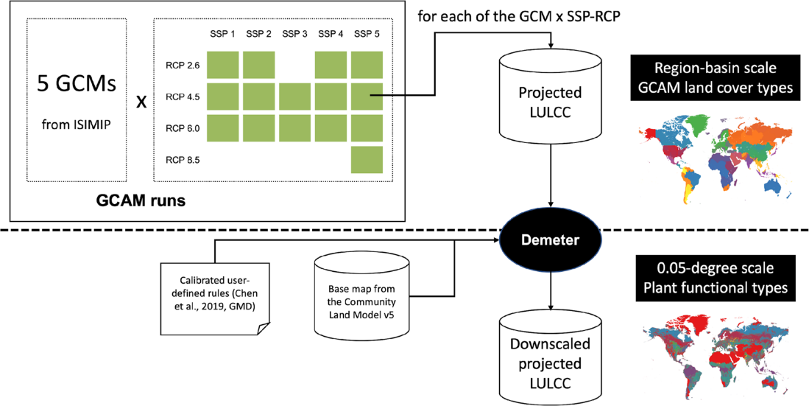
A New Global Land Use Dataset for Advancing Earth System Science
Objective
Create a global, gridded, and high-resolution land use dataset that can be directly utilized by a range of Earth system models employing diverse socioeconomic and climate scenarios.
Approach
Develop a process to apply a spatial disaggregation model, Demeter, to increase the spatial resolution (to 0.05 degrees) of projected future regional land use by downscaling while incorporating a land classification system that can be more directly used by existing Earth system models.
Generate the land use dataset with diverse socioeconomic and climate scenarios (15 combinations of Shared Socioeconomic Pathways and Representative Concentration Pathways).
Validate the dataset with existing independent databases and quantify the associated uncertainties.
Impact
The published dataset can be widely applied in Earth system modeling, land-atmosphere interactions, agriculture, energy market, water resources management, and socioeconomic analysis. The data can be applied in investigations of the complex feedbacks between these Earth system components, as well as better understand how human activities impact these processes.
Researchers produced a new global high-resolution global gridded land use dataset under diverse socioeconomic (i.e., Shared Socioeconomic Pathways) and climate (i.e., Representative Concentration Pathways) scenarios for the years 2015-2100. The land classification in the dataset was designed for direct use in existing Earth system models.
Chen, M., Vernon, C.R., Graham, N.T. Hejazi, M, Huang, M, Cheng, Y. and Calvin K. ”Global land use for 2015–2100 at 0.05° resolution under diverse socioeconomic and climate scenarios.” Sci Data 7, 320 (2020). https://doi.org/10.1038/s41597-020-00669-x

