Slide 1
ACME V1 BGC Experiments: right-sizing to fit compute allocation
Peter Thornton, Bill Riley, and the BGC Experiment Team

Slide 2
Science question: What effect does the global phosphorus cycle have on climate-biogeochemistry feedbacks?

Slide 3
Primary motivation:
Improved prediction of future GHG concentrations and associated climate change
Fossil Fuel Emissions & LULCC
Atm CO₂
Climate
(T, P, q, rad)
α

Slide 4
CO₂ concentration feedbacks, land and ocean
Ocean carbon
β_{O}
Fossil Fuel Emissions
Atm CO₂
Climate
(T, P, q, rad)
α
β_{L}
Land carbon

Slide 5
Climate – carbon feedbacks, land and ocean
Ocean carbon
β_{O}
γ_{O}
Fossil Fuel Emissions
Atm CO₂
Climate
(T, P, q, rad)
α
γ_{L}
β_{L}
Land carbon

Slide 6
Major climate-carbon and climate-ecosystem feedbacks
Ocean carbon
β_{O}
γ_{O}
Fossil Fuel Emissions
Atm CO₂
Climate
(T, P, q, rad)
α
γ_{L}
β_{L}
Land carbon

Slide 7
Human feedbacks…
Ocean carbon
β_{O}
γ_{O}
Fossil Fuel Emissions
Atm CO₂
Climate
(T, P, q, rad)
α
γ_{L}
β_{L}
Society
Land carbon
Land use /
land cover change

Slide 8
Carbon cycle
Nitrogen cycle
Atm CO₂
Internal
(fast)
External
(slow)
photosynthesis
denitrification
Plant
N deposition
respiration
assimilation
litterfall & mortality
Litter / CWD
Soil Mineral
N
N fixation
decomposition
mineralization
Soil Organic Matter
N leaching
Thornton et al., 2009
Notes:
Mention the hypothesis of demand-based competition between plants and heterotrophs
Mention plant stoichiometric constraints
Mention that warming increases PSNS, respiration, and N mineralization – contrast tropics and boreal zone

Slide 9
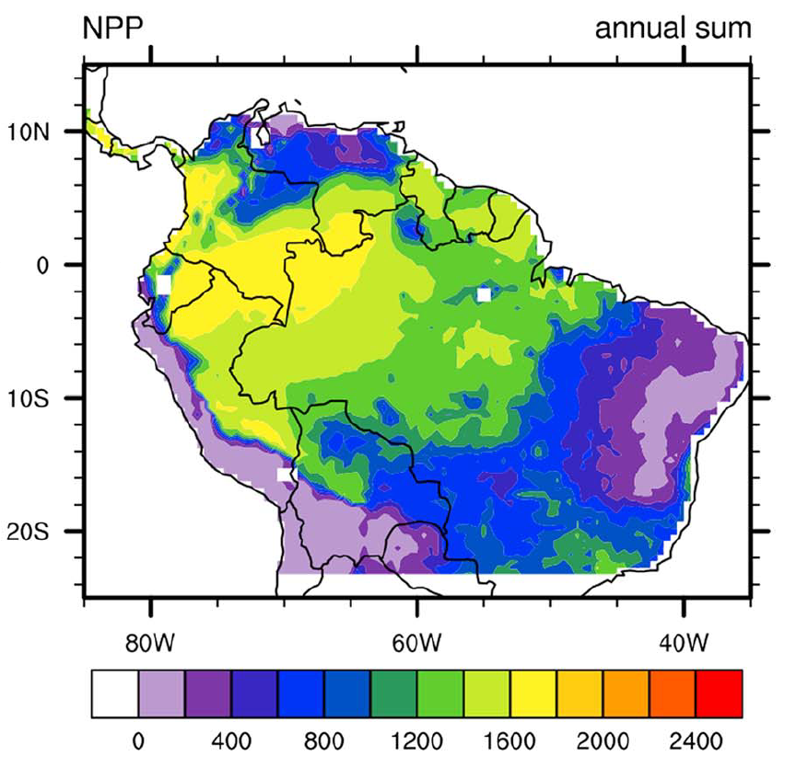
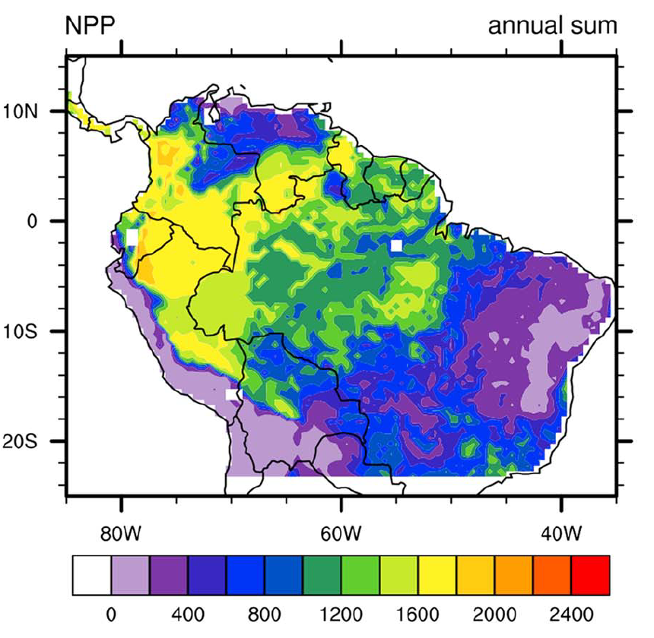
Predicted patterns of plant growth depend on soil type and phosphorus availability, especially in the tropics
C and N
C, N, and P
Results from Yang et al., 2016

Slide 10
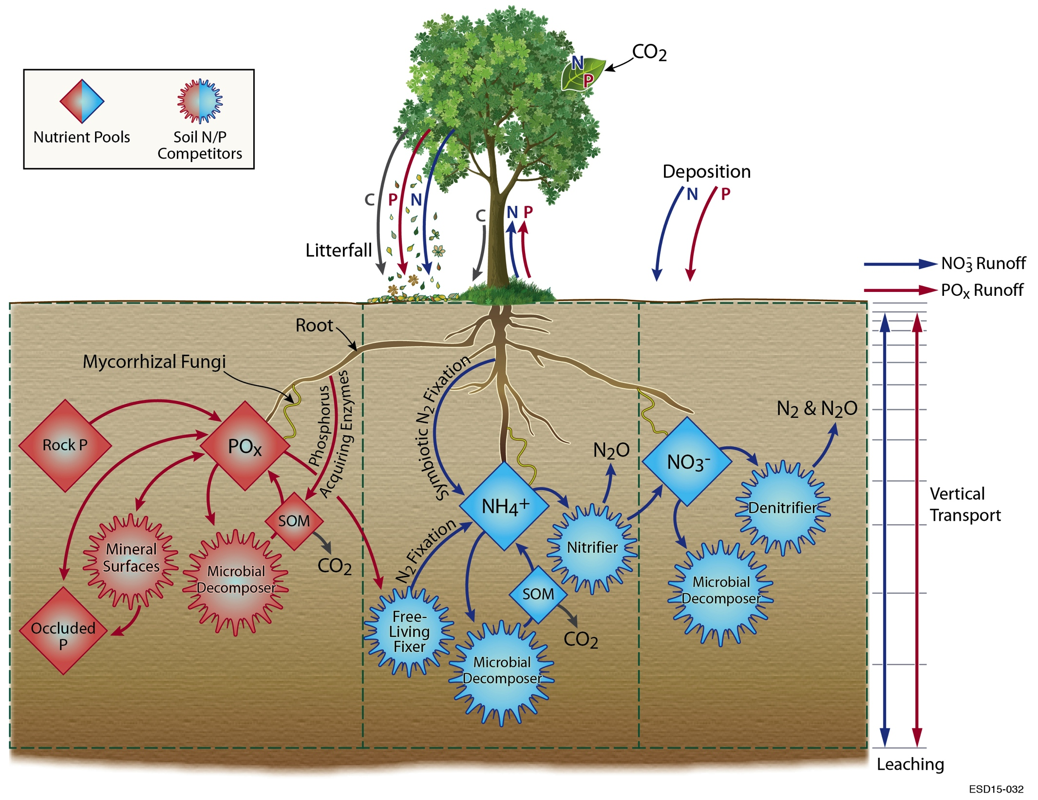
Adding phosphorus (land model)
  Schematic of the ALMv1-ECA-CNP model (based on Tang et al. 2013; Ghimire et al. 2016a,b; Tang and Riley 2016a,b; Zhu et al. 2015,2016a,b,c)

Slide 11
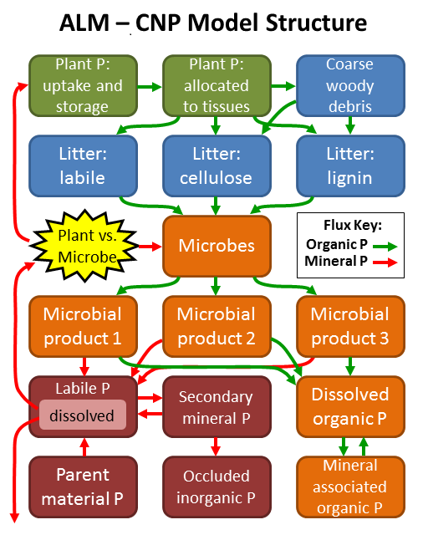
ALM-CTC-CNP Model Structure
Phosphorus cycle is also represented in ALM v1 by the ALMv1-CTC-CNP model, based on Yang and Post, 2011; Yang et al., 2013; Yang et al., 2014; Yang et al., 2016; Thornton et al., 2002, Thornton and Rosenbloom, 2005; Thornton et al., 2007; Thornton et al., 2009.
One key difference between the two model implementations is the treatment of competition among plants, microbes, and mineral surface binding sites for available nutrients (N and P).

Slide 12
V1 BGC: Experimental design
Work as much as possible with the fully coupled system
  Including land and ocean BGC components
Perform experiments that can put the new CNP models in the context of previous feedbacks studies based on C-only and CN models

Slide 13
Computational constraints
The fully coupled model, with ocean and land BGC active, has the following performance profile:
  SYPD: 5+ on Titan, 5+ on Cori Phase 1, 10+ on Edison
  30K (Edison) to 80K (Titan) core-hours per simulated year
ALCC 2017 proposal was written to service the operational demands of the ACME v1 BGC experiment.
Broke experiment into 3 priority blocks, so that de-scoping would be simpler if the proposal was successful but with a reduced allocation
Final allocation was 60M core hours, about 2x less than our Priority 1 block of simulations… further de-scoping needed.

Slide 14
Based on discussion at this all-hands meeting: New scope for ACME v1 BGC Experiments
Perform on CNP experiments, not CN or C-only
Experiments to quantify “beta” and “gamma” for land and ocean, but not experiments to quantify interactions of beta and gamma.
Only have the ocean BGC active for a subset of the experiments
  Ocean BGC about doubles the cost of the coupled model
  Using one, not both, of the land BGC components (ALMv1-ECA-CNP)
Focus on a single forcing scenario (SSP5-85)
Have a set of Priority 2 experiments ready, in case we have additional time

Slide 15
Priority 2 ACME v1 BGC experiments
Emissions-forced experiment(s)
Evaluation of alternative feedbacks calculation methods
Long-term simulations (out to 2300)
Offline (land-only) simulations to explore some of the beta-gamma interactions, and other topics that got dropped from the original experiment plan.

Slide 16
Organization: Coupled BGC team being formed
Team Lead: Susannah Burroughs (PNNL)
Science points of contact: Qing Zhu (LBNL), Xiaojuan Yang (ORNL), Nicole Jeffery (LANL)
Weekly coordination telecon
Monthly science talk

