Slide 1
Representing Climate Impacts in GCAM Scenarios (or GCAM Scenarios within E3SM) opportunities, grand challenges and coordinated activities
Claudia Tebaldi
B. O’Neill
A. Snyder, K. Dorheim, N. Prime, M. Zhao
Joint Global Change Research Institute/PNNL
claudia.tebaldi@pnnl.gov
EESM-PI Meeting August 2024
Bethesda, MD

Slide 2
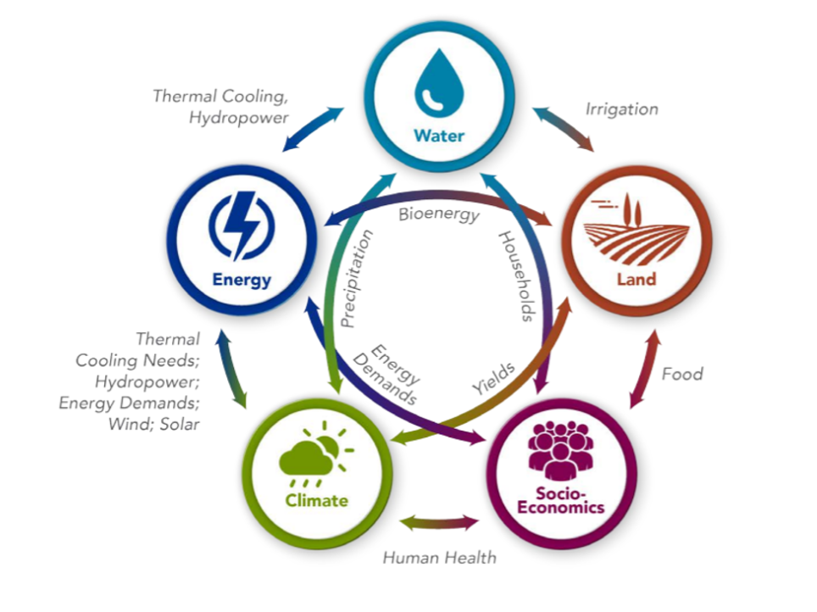
Coupling an Earth system model to a multisector dynamics model
We take the perspective of
GCAM modelers
And we are concerned with
this component
How to best represent the Earth system in a model like GCAM?
Note that some of these thoughts should be also relevant to the ESM modelers thinking about hardwiring GCAM to E3SM

Slide 3
Impact models
(hydrology, agriculture,
human health
energy system)
Runoff, Agricultural Productivity, CDD/HDD, …
Climate variables driving impacts
GCAM
Climate System model
Emissions, Land Use

Slide 4
Easy part thanks to emulators: Hector, STITCHES
Hard Part
Impact models
(hydrology, agriculture,
human health
energy system)
Runoff, Agricultural Productivity, CDD/HDD, …
Climate variables driving impacts
GCAM
Climate System model
Emissions, Land Use

Slide 5
The hard part (Challenges)
Which impacts should we model?
At which scale (GCAM works by regions, impacts happen at local scales)?
At which frequency? (how do high frequency impacts manifest themselves in a 5-year time step (current GCAM frequency)? In a 1-year time step?)
What type of impact models?
Process-based?
Empirical?
Damage functions?
How do we account for uncertainties?

Slide 6
Opportunities
We have started from a set of impacts for which previous modeling work provided a template for implementation.
We plan to continue adding impacts:
Labor productivity (ongoing)
Wildfires
More impacts linked to extremes (damages from natural disasters)
Sea level rise…
Non-climate impacts are impacts too! E.g., air pollution.
We plan to shorten the time step of GCAM (from 5 year to 1 year) to better represent short term disturbances (extremes)
We also plan to revisit all this with the macro implementation (GDP becomes endogenous) Based on our initial scenarios, endogenous GDP, which itself is indirectly affected by physical impacts, will be potentially affected at a scale that may produce global effects.
Notes:
We are working on better representation of storage and decisions (e.g, planting/harvesting; reservoir/hydro development)

Slide 7
Coordinated activities
Use a hierarchy of models, from emulators to process models, to model hazards and impacts and represent them into GCAM at the right spatial and temporal scale.
The same applies to representing impacts within E3SM and GCAM coupled system.
Damages from extremes;
sea level rise
climate induced migration
impacts of climate on land-based mitigation solutions (afforestation, CDR, ocean carbon sinks)
From scenarios to storylines and back: how do we represent uncertainties when the modeling system becomes more and more complex? Can we use storylines instead of full-blown exploratory modeling? Can we connect the former to the latter?

Slide 8
Thank you
claudia.tebaldi@pnnl.gov
This research was supported by the U.S. Department of Energy, Office of Science, as part of research in MultiSectorDynamics, Earth and Environmental System Modeling Program. The Pacific Northwest National Laboratory is operated for DOE by Battelle Memorial Institute under contract DE-AC05-76RL01830. The views and opinions expressed in this paper are those of the authors alone.

Slide 9
Hard Coupling (hard-wiring model within model) or Soft Coupling (give inputs/take outputs to/from a model run offline)?
When feedbacks leave a footprint at the global scale, altering the trajectory of a scenario from its reference case (without climate impacts), full integration, hard coupling, should be implemented.
When feedbacks are not as large to influence the trajectory of global temperature/GHG emissions soft coupling should suffice. In this case, we are still interested in regional and distributional impacts, changes in trade patterns, food availability, food prices, food security, other measures of well being that only an integrated model can represent, but that integration does not need to be step by step.

