Slide 1
Advancing Modeling and Understanding of Hydroclimate Extremes in the Puget Sound Coastal Region
Ning Sun, L. Ruby Leung, Sourav Taraphdar, Xiaodong Chen, Ian Kraucunas
EESM PI Meeting 2024

Slide 2
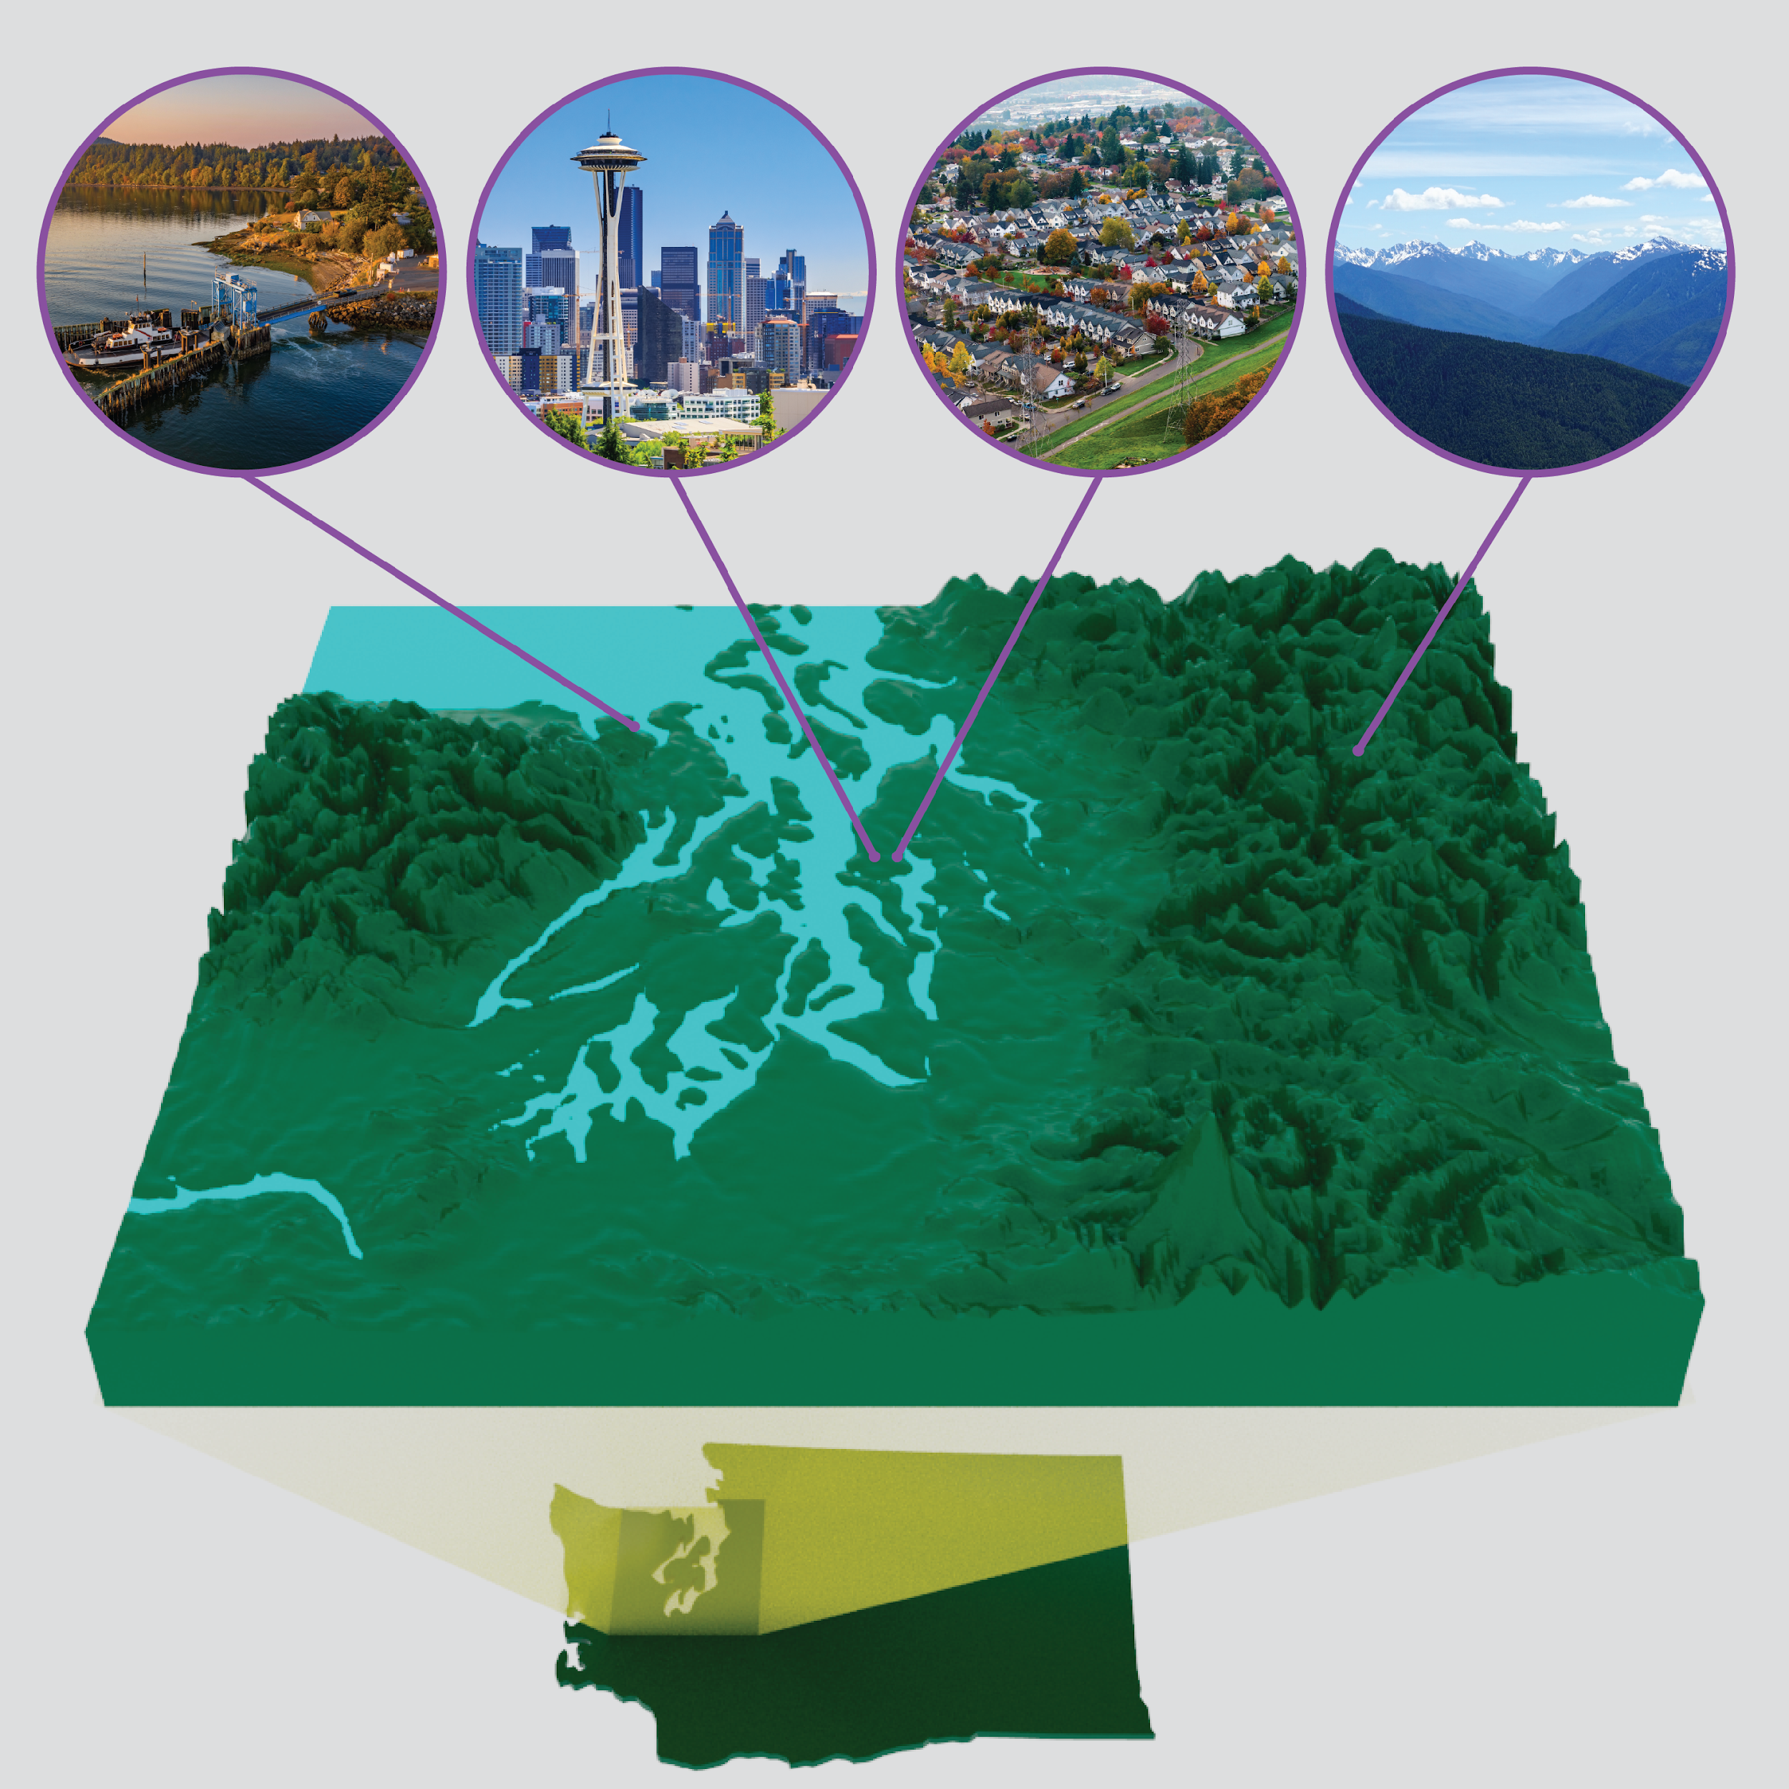
Overview of Puget Sound Coastal Region
Second largest estuary in the U.S.
Maritime climate system
Sharp rural-urban gradient constrained by orography
Mountain-coast terrain
Extreme events – Atmospheric Rivers, Rain-on-Snow, Flooding, Heatwave
Hydropower-dominated power system
Notes:
what makes it an important and unique testbed for coastal research.
The Puget Sound region is located in the northwest of Washington State.

Slide 3
ENSO/MJO impact on regional hydroclimate extremes
Linking Large-Scale Climate Variabilities with
Regional Hydroclimate Extremes
Regional Weather systems connect ENSO and regional hydroclimate extremes
Deep learning model identifies 12 weather patterns with unique P and T responses
Weather patterns reveal two flooding mechanisms: precipitation-driven and rain-on-snow driven flooding
More snow droughts following El Niño winter
MJO phases 6-7 cause more hydrologic extremes
(Chen et al., 2023, GRL)
(Chen et al., in rev, JHM)
Notes:
The initial question we aimed to address was the impact of large-scale climate variability, such as ENSO and MJO, on regional hydroclimate extremes. Through our analysis, we were able to confirm the linkage, such as:.
With an understanding of the connection, the next question we naturally explored was, "What is driving the ENSO and MJO effects on regional hydroclimate and hydrological extremes?
We used a deep learning approach which identified 12 weather patterns in this region. Through this weather systems, we were able to connect ENSO with ... and linked specific weather patterns to the generation of flooding, uncovering the mechanisms

Slide 4
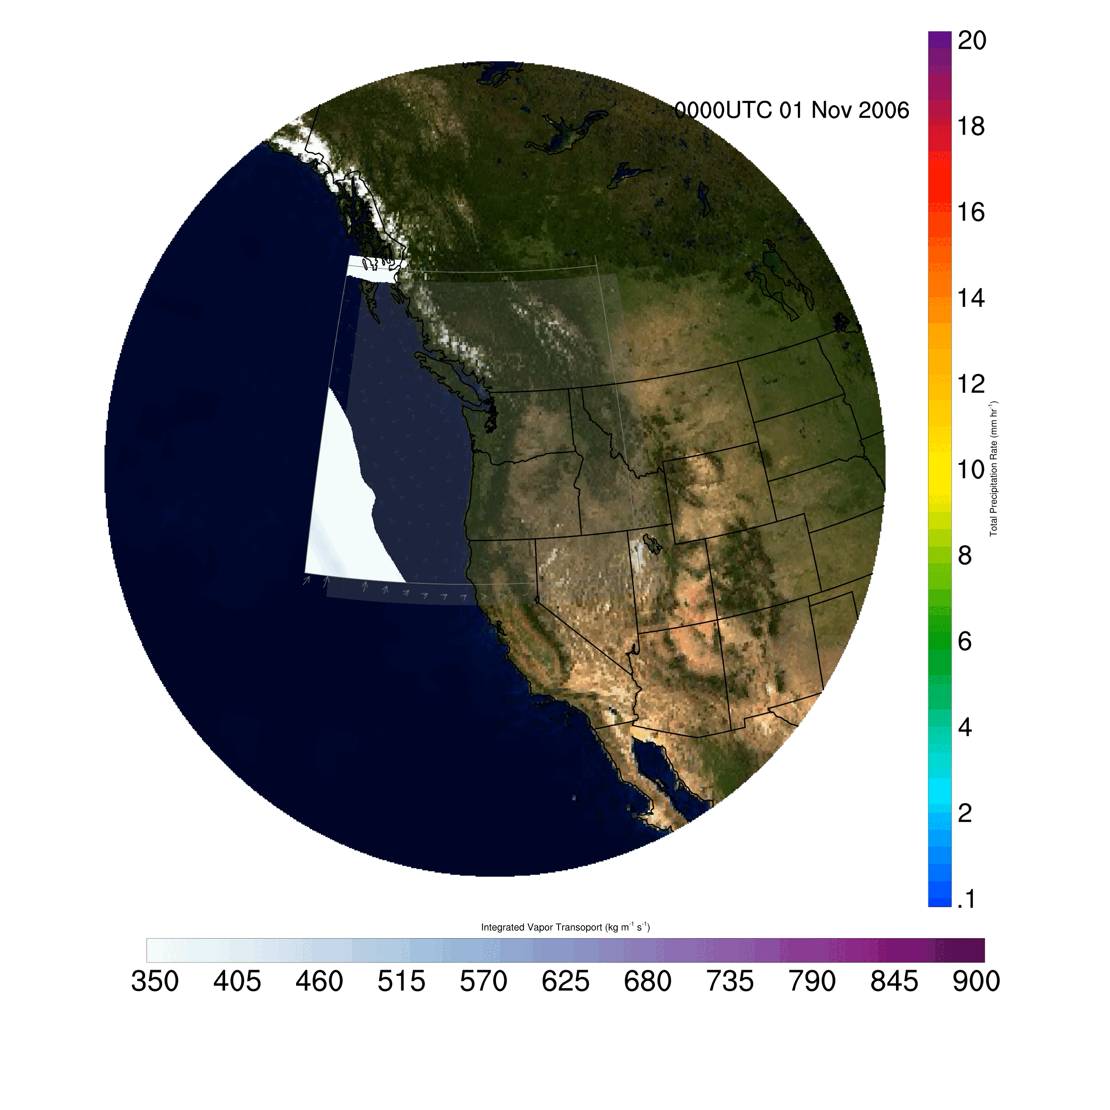
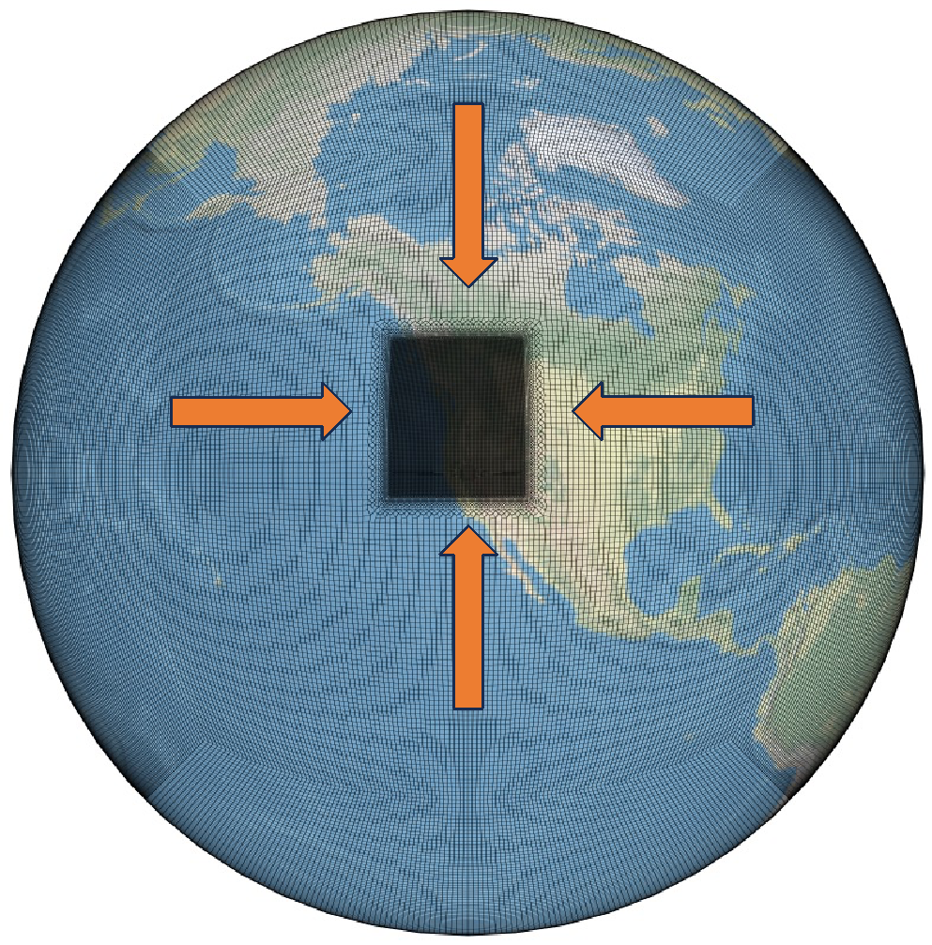
SCREAM Simulation of the 2006 Atmospheric River (AR) Event
SCREAM 3-km Simulation of Regional Weather during AR Events
AR Precipitation
Physics parameterizations: (1) P3 for cloud microphysics; (2) SHOC for shallow convection and turbulence; (3) RTE + RRTMGP for radiative transfer
SCREAM domain:
25 km outside;
3.125 km inside;
128 vertical levels
White – Violet Shading: IVT
Notes:
- IVT is a way to quantify how much water vapor is being moved and how fast.

Slide 5
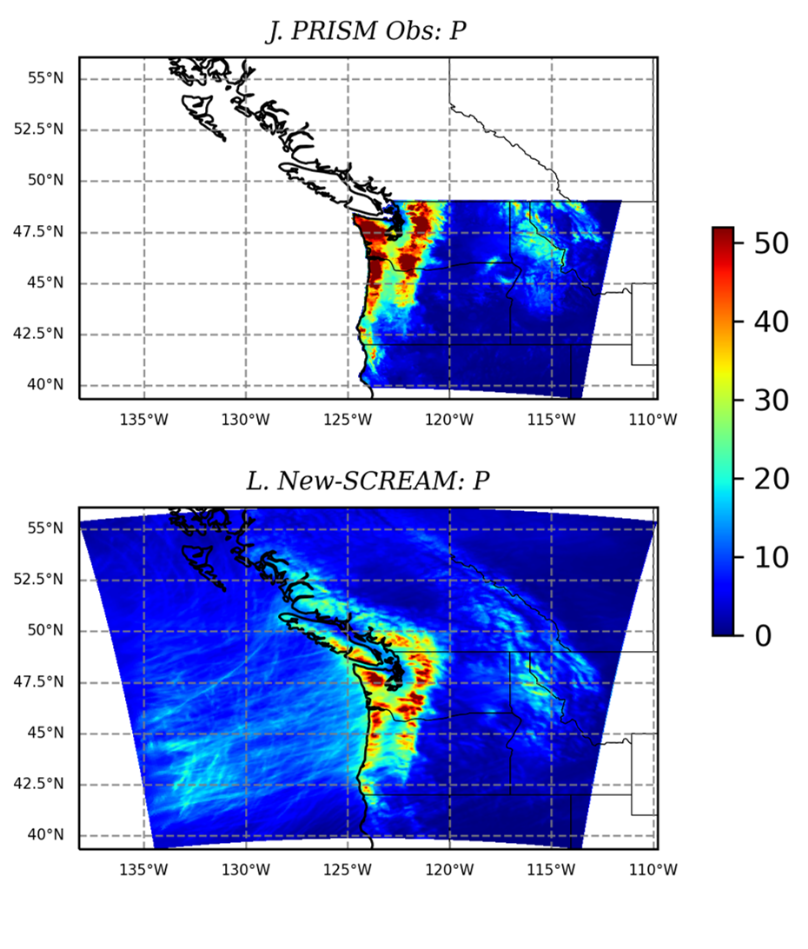
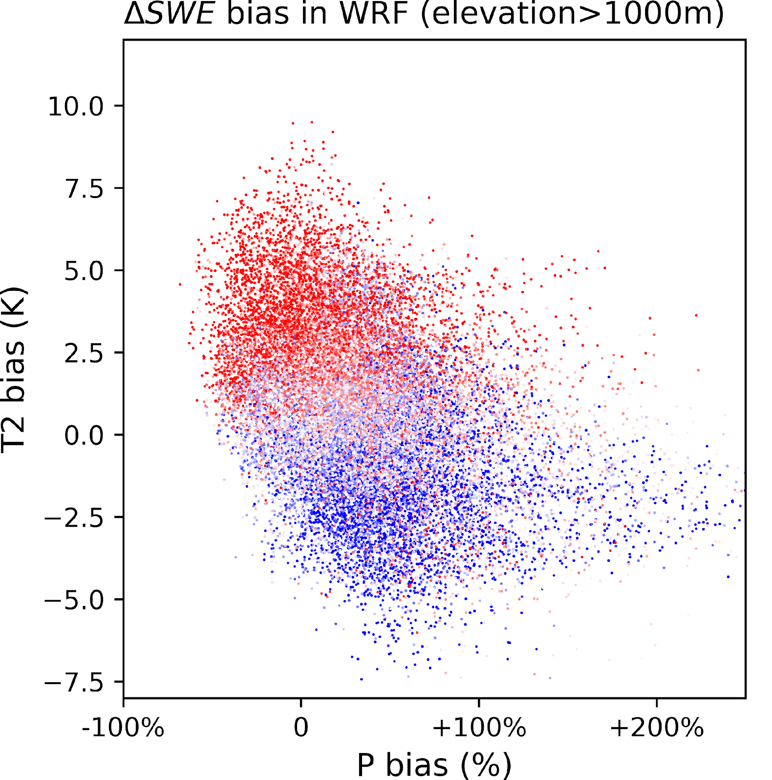
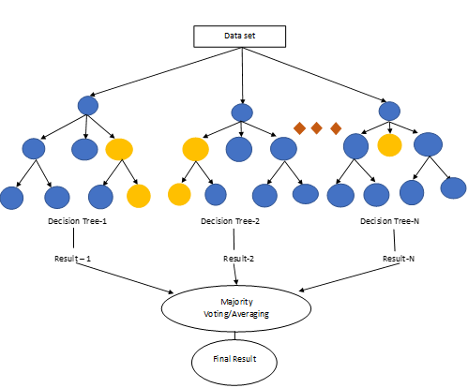
Improved 3-km SCREAM simulation of AR precipitation along Mountain Ranges
Changes in cloud microphysics in SCREAM impact modeling orographic precipitation in the region
PRISM Observed Precipitation
Ice Number Concentration
Understanding and predicting the bias of
SCREAM in AR modeling through AI/ML
3-km SCREAM Precipitation
Atmospheric River: 2006 Nov
Notes:
while climate models show biases in orographic precipitation, we also observe significant differences in Precipitation when we compare between other Observational datasets – confirming the widely recognized challenges of getting orographic precipitation right.
adjustments to cloud microphysics parameters could enhance the accuracy of modeling orographic precipitation in the Pacific Northwest region.
AI/ML techniques to analyze the structure of the bias in snowpack and runoff simulations during AR events by WRF and SCREAM, with the goal of improving the predictability of the bias based on climate simulation bias.

Slide 6
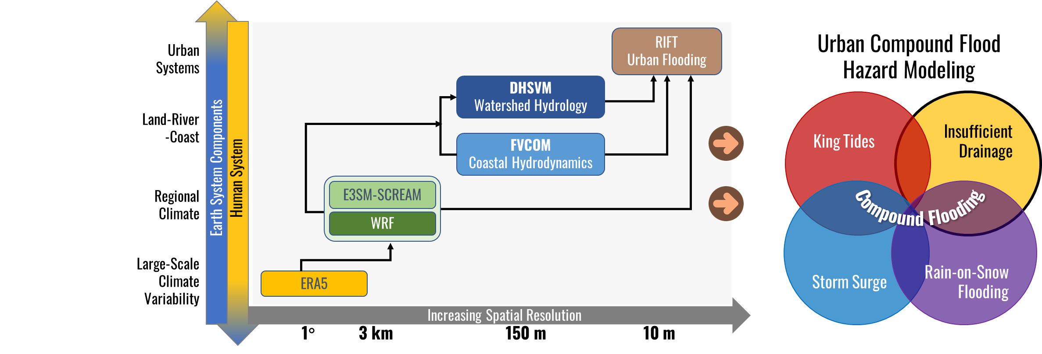
Multi-Scale Atmospheric-Terrestrial-Coastal Modeling Framework
Notes:
Understand the AR impacts on flooding in coastal urban areas, we leveraged the coupled flood modeling framework from ICoM to link the large-scale climate ...
In the context of atmospheric river modeling, We have the climate models –WRF and E3SM SCREAM, dhsvm fvcom ... .... These model are LINKED to model the cascading effect of ARs through systems and across scales.
We used a range of analytical methods, including AI/ML, model bias evaluations, model comparisons between WRF and SCREAM

Slide 7
Challenges and Opportunities
in Modeling Puget Sound Human-Earth System
Steering Committee
Workshop Participation
Predictive understanding of extreme events
Atmospheric River
Rain-on-snow
Flooding (compound)
Heatwave
Snow drought
Human system modeling on the terrestrial-coastal interface
Human-Earth interactions
Voisin N., D.J. Rose, D.P. Broman, N. Sun, I.P. Kraucunas (2023). “Exploring Multiscale Earth System and Human-Earth System Dynamics in the Puget Sound Region”. https://doi.org/10.2172/1906804
Notes:
as part of the scoping study, we organized a workshop to collect insights from scientists working in different institutions and agencies regarding knowledge gaps and modeling challenges in the context of coastal human-earth system dynamics. We synthesized the workshop discussions and key points into a scoping report.

Slide 8
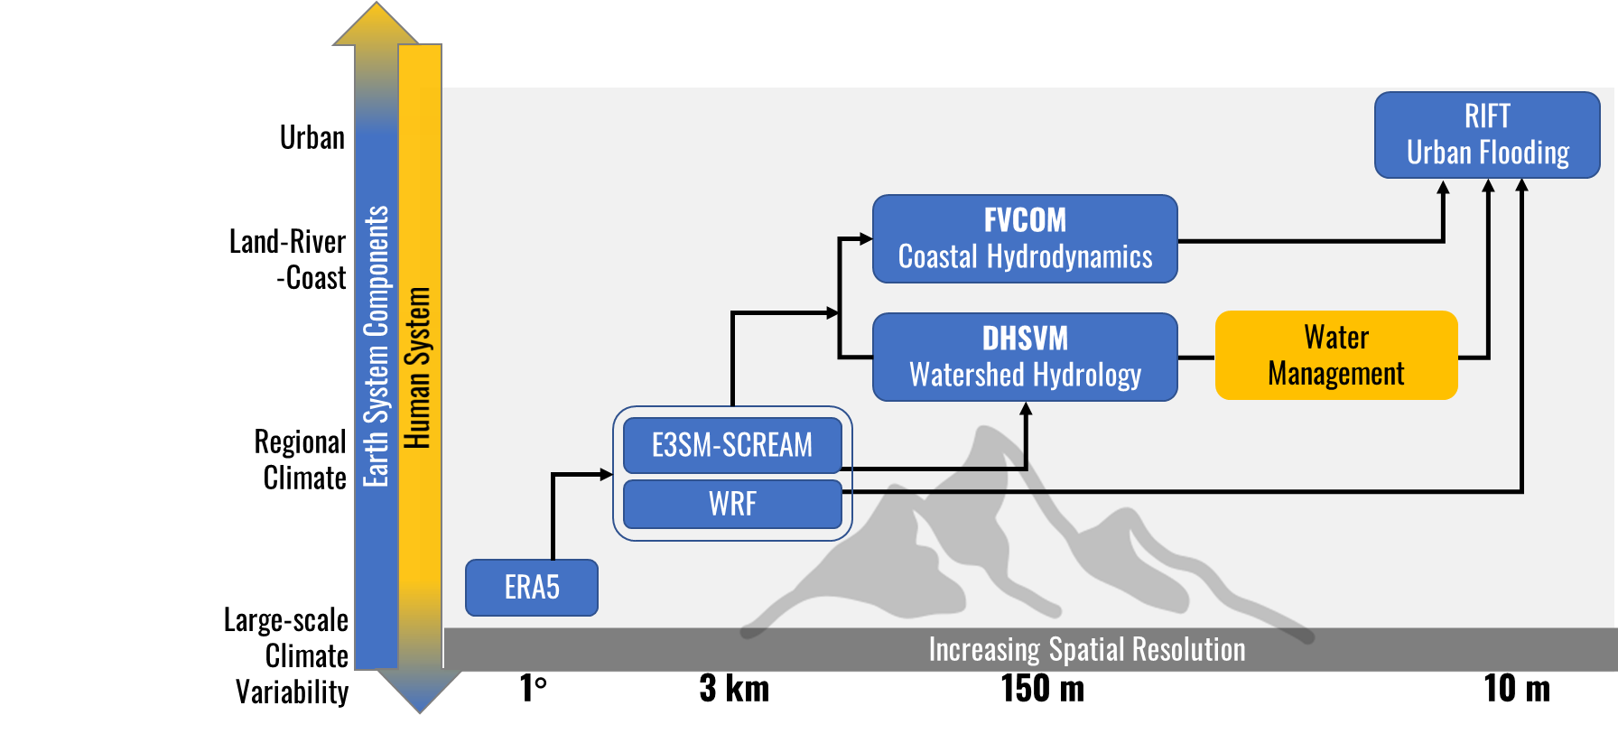
Research Opportunities: Coupled Earth-Human Modeling
in a Mountain-to-Coast Regional Hydroclimate
Improve understanding and modeling of Earth-Human System in Puget Sound Coastal Environments, and their vulnerability to climate change and other stresses.
GCAM-USA
Flash flood
Heat extremes (e.g., 2021 PNW heatwave)
Snow drought
Climate Change
Demeter*
Tethys*
LULCC
Water Demand
Urban
Flood Risk
Infrastructure Development
*Chance-C
Human System
Water Availability
Notes:
- expand this framework to encompass both natural and human-induced impacts on hazards, along with human responses to hazards, incorporating feedback mechanisms in regional land-use and land-cover change (LULCC), urban expansion, coastal infrastructure, and water management. This approach presents collaborative opportunities with various projects, such as leveraging and enhancing tools and datasets in conjunction with GCAM-USA within IM3, GCMIS, Chance-C with IM3, and others.

