Slide 1
Combined climate and hydrologic uncertainties shape
projections of future soil moisture extremes
David Lafferty & Ryan Sriver, University of Illinois
Danielle Grogan & Shan Zuidema, University of New Hampshire
Atieh Alipour & Klaus Keller, Dartmouth College
Iman Haqiqi, Purdue University
2024 EESM PI Meeting
Model Bias, Model Uncertainties, and Fitness-for-Purpose
Thursday, August 8, 2024
Combined climate and hydrologic uncertainties shape projections of future soil moisture extremes; Lafferty, Grogan, Zuidema, Haqiqi, Alipour, Keller, and Sriver [in prep.]

Slide 2
How do climate and hydrologic uncertainties combine to shape future soil moisture projections? Which factors are important?
Approach:
Develop a simple soil moisture model based on the UNH Water Balance Model (WBM)
Utilize a large ensemble calibration approach sampling multiple climate models/forcings, soil moisture parameters, and observational data sets
Conduct sensitivity analysis to identify sources of uncertainty (utilizing multiple error metrics)
Grogan, D.S., et. al., Water balance model (WBM) v.1.0.0: a scalable gridded global hydrologic model with water-tracking functionality, Geosci. Model Dev. (2022). https://doi.org/10.5194/gmd-15-7287-2022

Slide 3
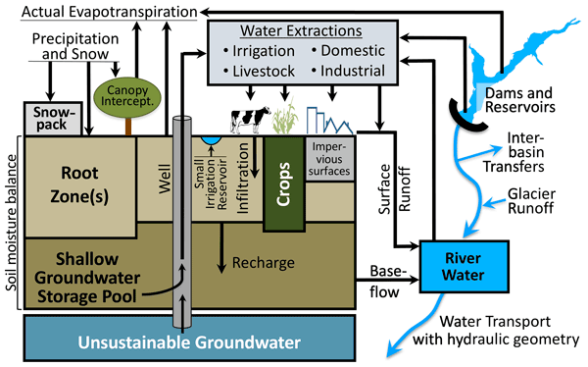
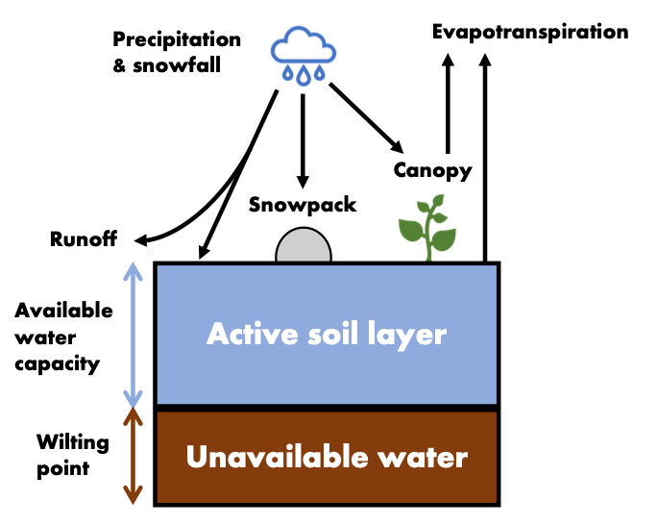
Modeling framework: Water Balance Model and pyWBM
WBM: University of New Hampshire Water Balance Model
Process-based gridded global hydrologic model
Simulates land surface components of the global water cycle
Captures multi-scale interactions/impacts including water extraction for use in agriculture and domestic sectors.
pyWBM: Python-based soil moisture submodule of WBM
Simple bucket model with water storage and flux components
Represents snowpack, canopy, and runoff
Inputs-precip/snowmelt ; Outputs-evapotranspiration
Meteorological forcings include daily temperature and precipitation
Grogan, D.S., et. al., (2022)

Slide 4
We encode pyWBM in JAX
Provides automatic differentiation, just-in-time compilation, and vectorization
Parameters are calibrated via gradient descent
Parameter uncertainty is introduced via two methods:
Calibrating against 4 different “observational” datasets
Soil Moisture Active Passive Satellite (SMAP) Level 4 product
NLDAS-2 model outputs: VIC, NOAH, MOSAIC
Calibrating with 13 different evaluation metrics
Root Mean Square Error, Kling-Gupta Efficiency, …

Slide 5
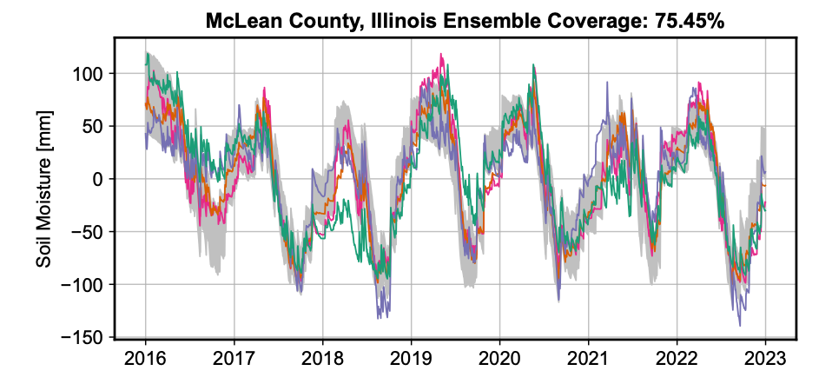
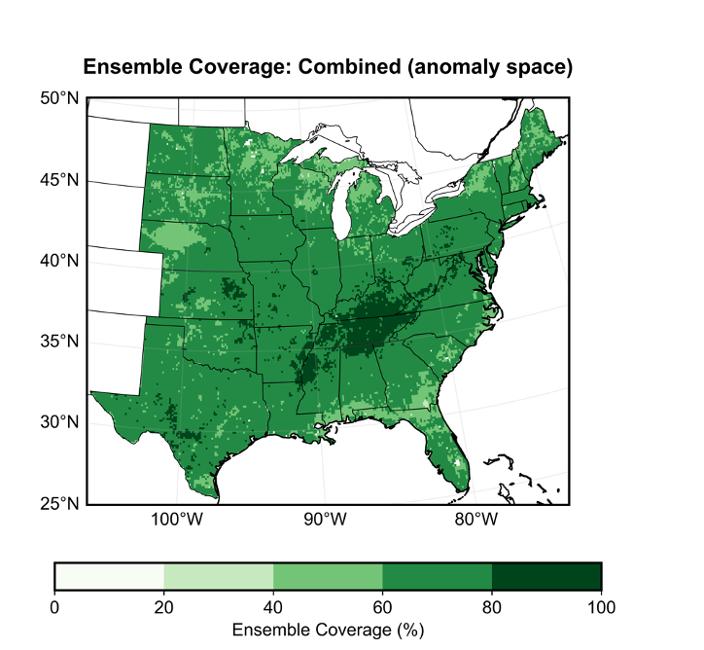
pyWBM Perturbed Physics Ensemble
Parameter | Relevance
Available water capacity (W_cap) | Determines soil storage capacity
Wilting point (W_wp) | Determines minimum soil moisture
Drying coefficient (α) | Controls evapotranspiration efficiency
Runoff shape parameter (β_R) | Controls runoff partitioning
PET coefficients | Modifies potential evapotranspiration throughout the year
We generate reasonable ensemble coverage of soil moisture variability using more complex hydrologic models and observation networks
These simple pre-calibration tools can be useful for emulation and uncertainty propagation in MSD systems
Notes:
Klaus

Slide 6
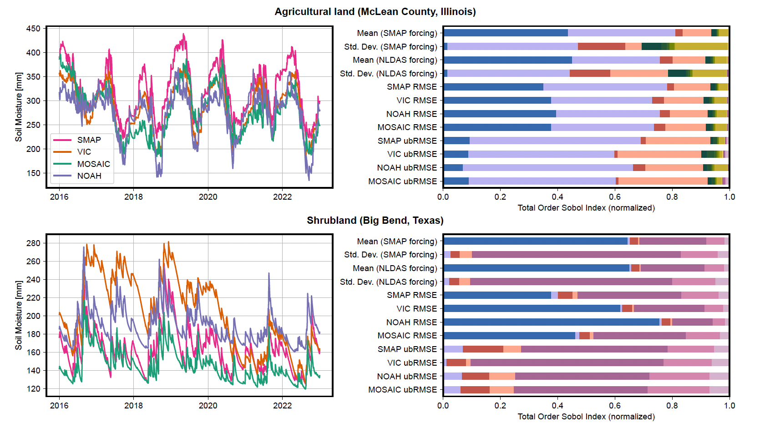
pyWBM Sensitivity Analysis
Left: Historical time series of daily soil moisture for 2 different locations (land types) and 4 data products
Right: Total order Sobol sensitivity index for each model parameter (color) and outcome metric (sub-rows)
Key Points: Significant differences occur in observations at local scales; parameter importance varies based on error metric

Slide 7
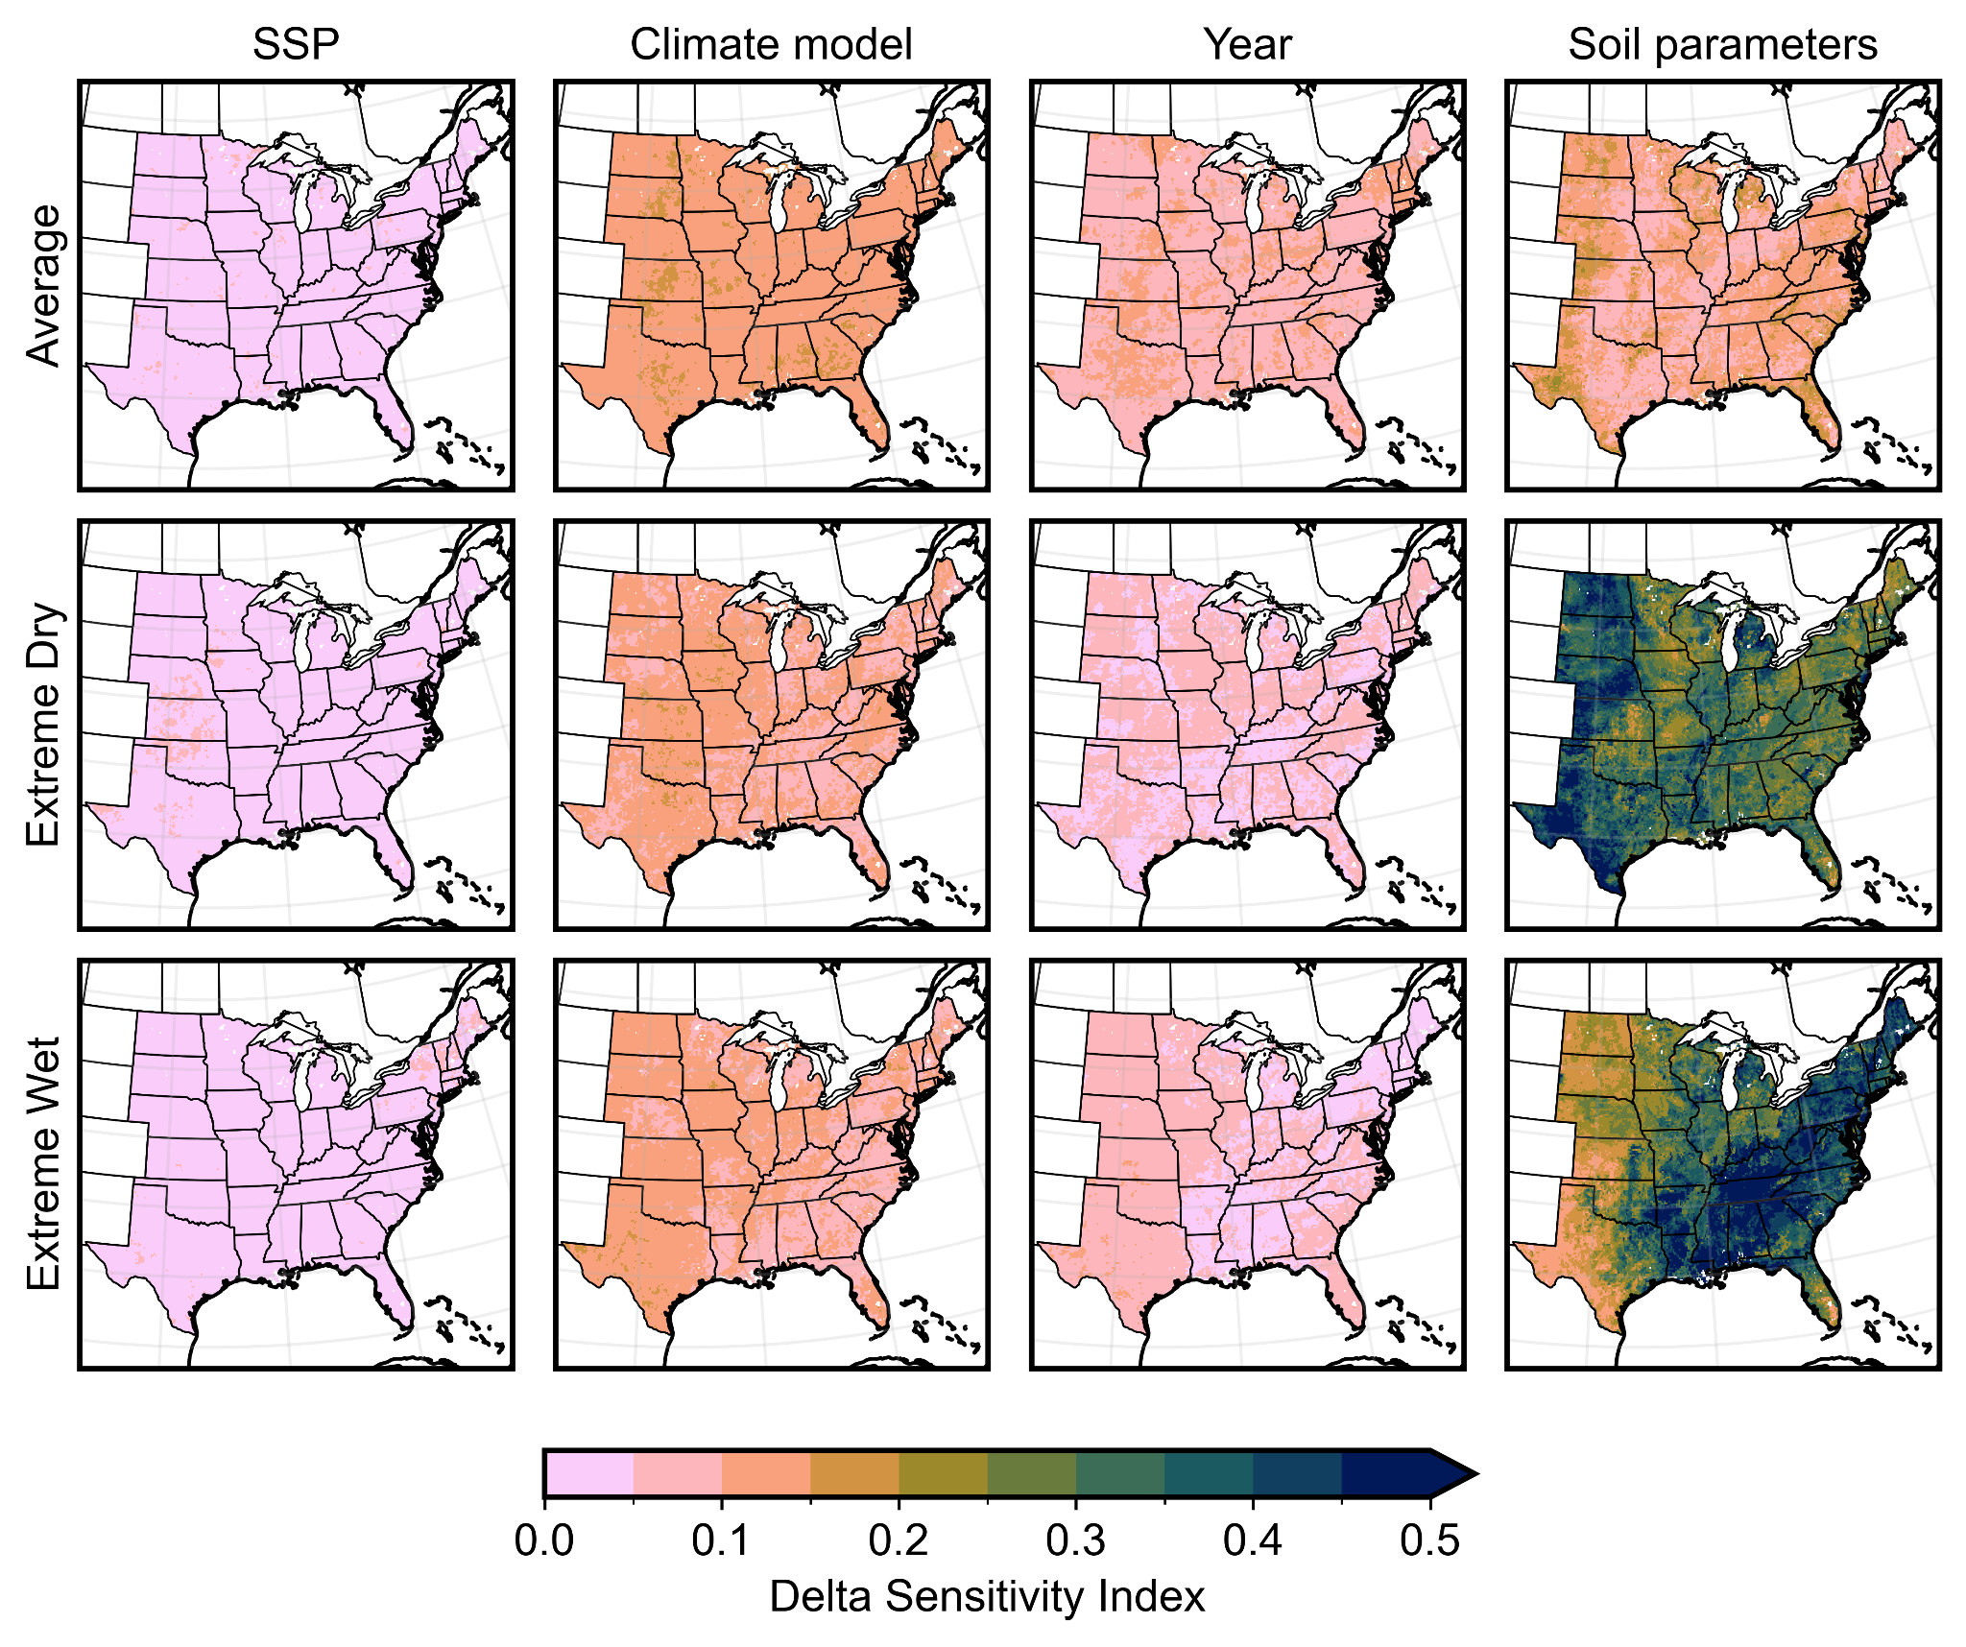
pyWBM Soil Moisture Projections
Full projection ensemble contains ~2200 members of central/eastern soil moisture
Daily outputs, 12.5 km resolution
2 SSP scenarios x ~23 climate models x 52 soil parameters
Climate scenarios from LOCA2 (CMIP6)
Delta moment-independent sensitivity measure quantifies sources of uncertainty
Group observational products and error functions into “Soil parameters”
Soil parameters are the primary source of 2100 projection uncertainty, particularly for extreme dry/wet conditions
Spatial distribution of Delta sensitivity indices for soil moisture variables (rows), grouped by different sources of uncertainty (columns).

