Slide 1
Exploring climate change impacts on US hurricanes through storylines
Kevin A. Reed
Ishrat Jahan Dollan, Annika S Huprikar,
Dian-Yi Li, Alyssa M. Stansfield,
Michael F. Wehner, and Colin M. Zarzycki

Slide 2
Motivation
Can the impact of climate change (past and future) on the rainfall associated with individual hurricanes or hurricane seasons be quantified?
How can these storyline frameworks be utilized to help translate the impacts of climate change to the public and decision-makers?

Slide 3
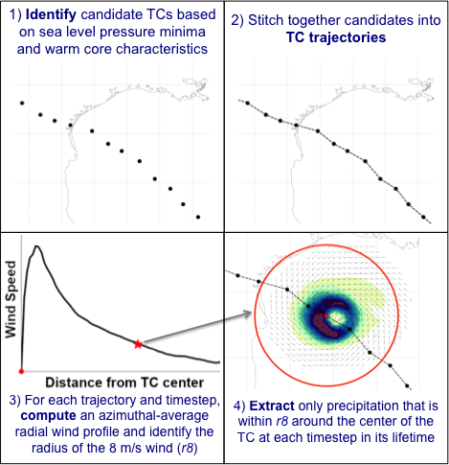
Methodology
We use TempestExtremes to:
identify,
track, and
analyze the storms
Available on Github:
https://github.com/ClimateGlobalChange/tempestextremes
[Ullrich et al. 2021, GMD]

Slide 4
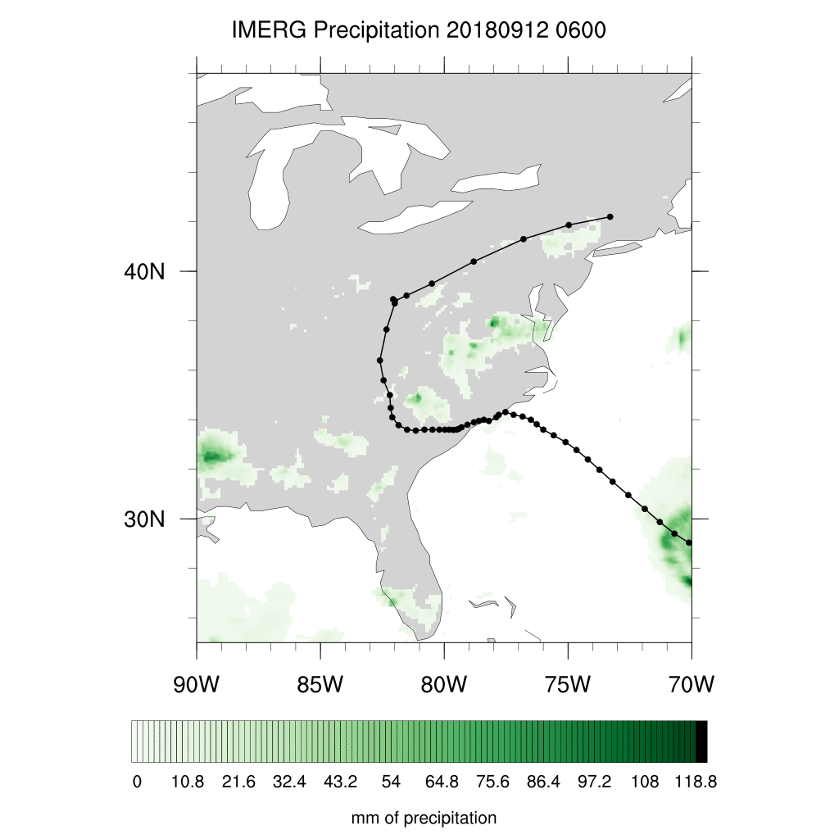
Storyline Approach
Variable resolution (CESM or E3SM) is used over region of interest with 30 vertical levels is used at the local horizontal resolution of: Δx = ~100 > ~25 km
Actual: Similar to full physics AMIP simulation, but initialized at specific times in advance of hurricane landfall. Initial conditions taken from operational NOAA GFS.
Counterfactual: Temperature, specific humidity, and SST from the observed initial conditions are modified to remove effects of climate change (using C20C+ or Large Ensembles).
Prescribed observed SSTs, ozone,CO₂, solar forcing.

Slide 5
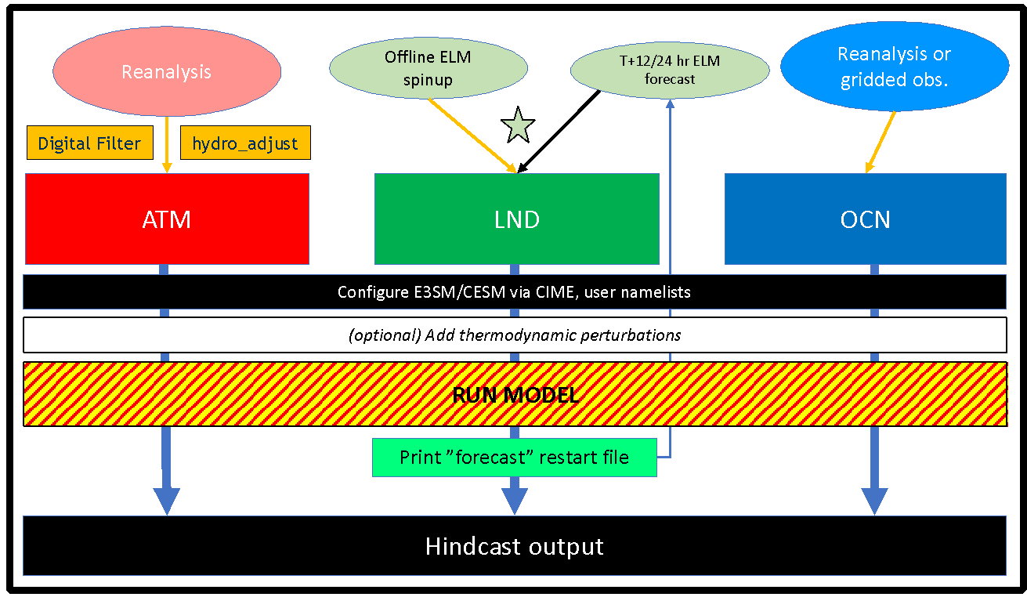
Utilize Betacast
Available on Github:
https://github.com/zarzycki/betacast

Slide 6
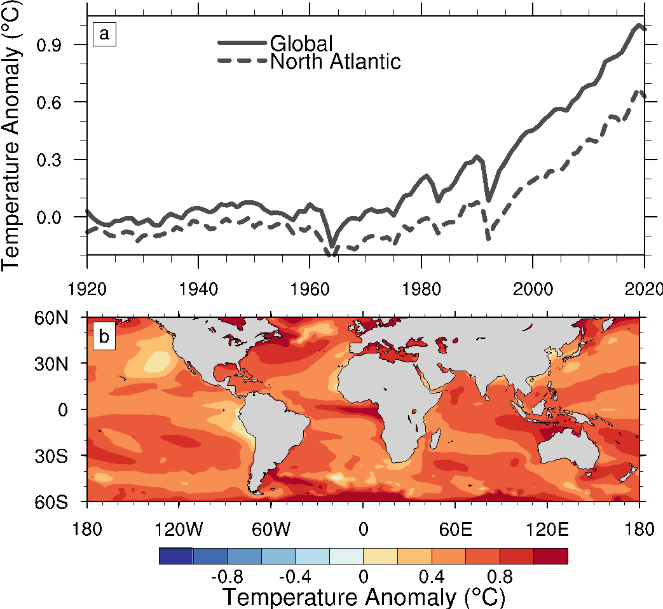
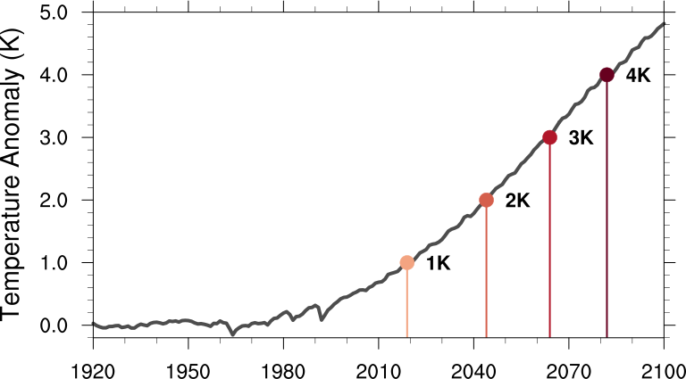
Building a Counterfactual
Historical Change
Future Change
Use the 40-member CESM Large Ensemble
Update T, Q and PS for initial and boundary conditions.

Slide 7
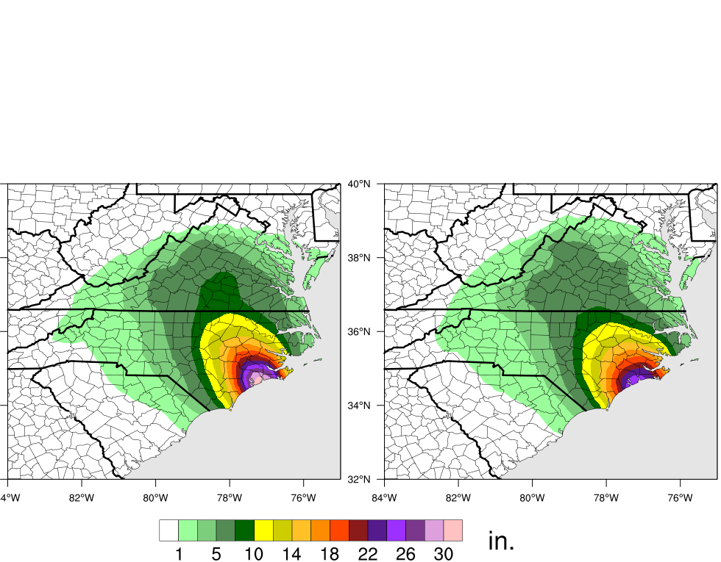
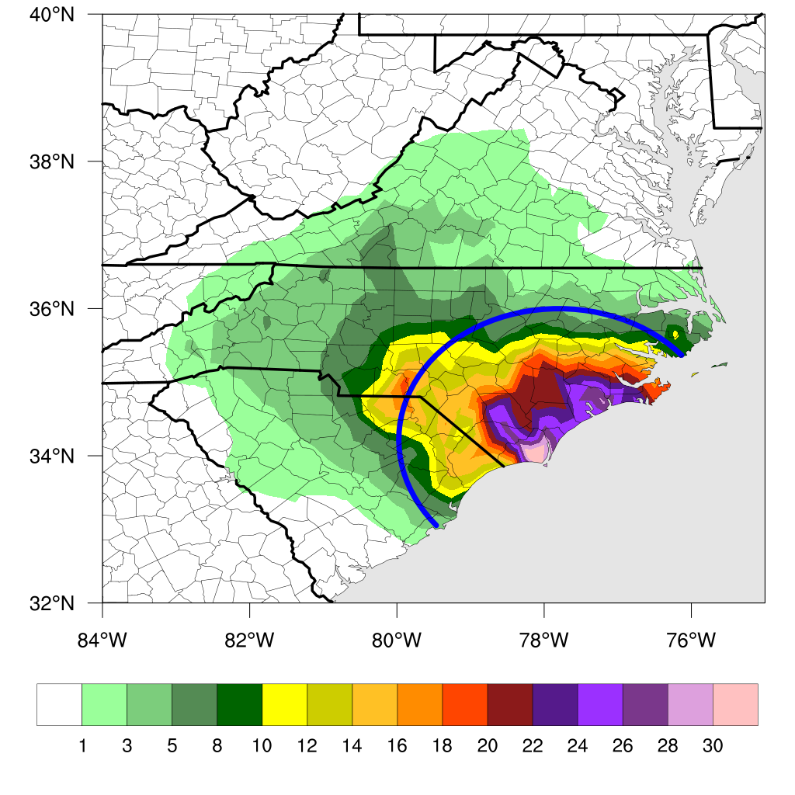
Historical Climate Change: Hurricane Florence (2018)
Observed
Actual
Forecast
Counterfactual Forecast
Actual forecast can reproduce Florence rainfall amounts reasonably well.
Rainfall is increased by 5% due to observed warming.
Reed et al. (2020)

Slide 8
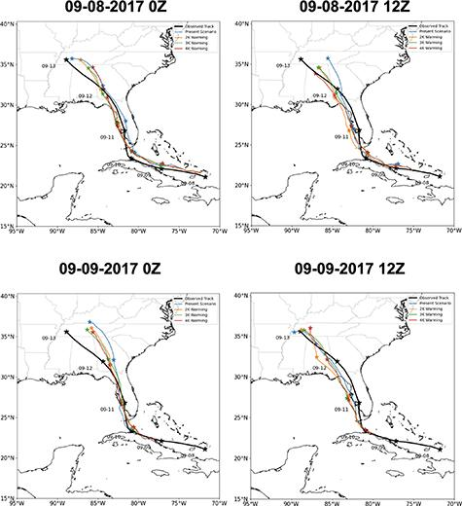
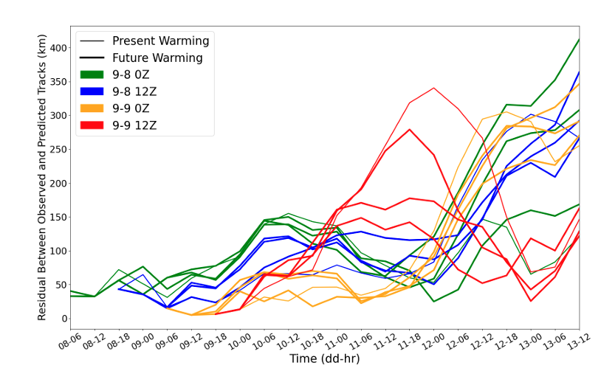
Future Climate Change: Hurricane Irma (2017)
Completed storyline simulations at:
4 different initialization times
4 different temperatures
We identify if model is fit-for-purpose
Huprikar et al. (2023)

Slide 9
Future Climate Change: Hurricane Irma (2017)
Accumulated increases with warming!
Huprikar et al. (2023)

Slide 10
Takeaways
Storyline approaches suggest a consistent conclusion with conventional climate simulations: TC rainfall per hour of storm impact will increase under a warming climate.
There is a growing effort in the scientific community – with direct stakeholder needs – to quantify the impact of climate change on recent extreme events and how these events will change in the future. Storylines are a promising approach.
Work suggests there is a pathway toward more operational storyline frameworks in the future.

Slide 11
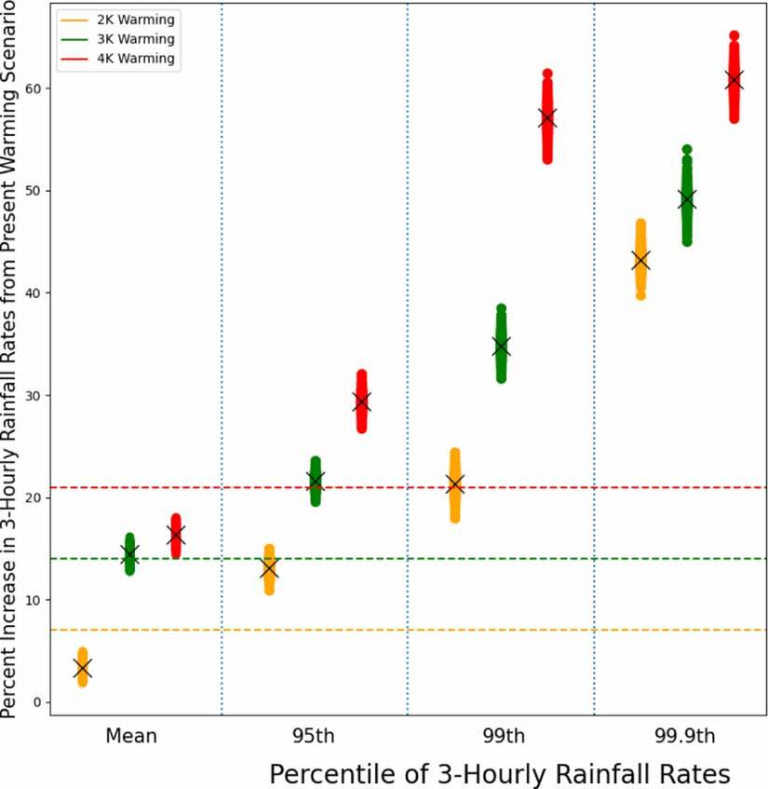
Future Climate Change: Hurricane Irma (2017)
Mean 3-hourly rainfall rates in the simulated storms increase by 3–7%/K compared to present!
95th and 99th percentile 3-hourly rates, intensify by 10–13%/K and 17–21%/K, respectively.
All percent changes increase monotonically with warming level.
Huprikar et al. (2023)

Slide 12
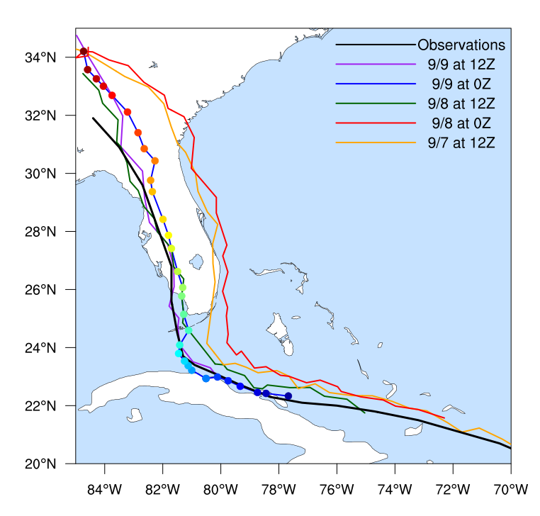
Ongoing Work
Simulations of Irma project an increase in the mean and extreme precipitation when forced with future thermodynamic signals:
Hindcasted tracks for Irma compare well to observations (black) for certain initializations:
This work will shift focus to the other initialization times, when the simulated storm impacts eastern Florida, to explore the impact of "what if” events from last 10 years and in the future.

Slide 13
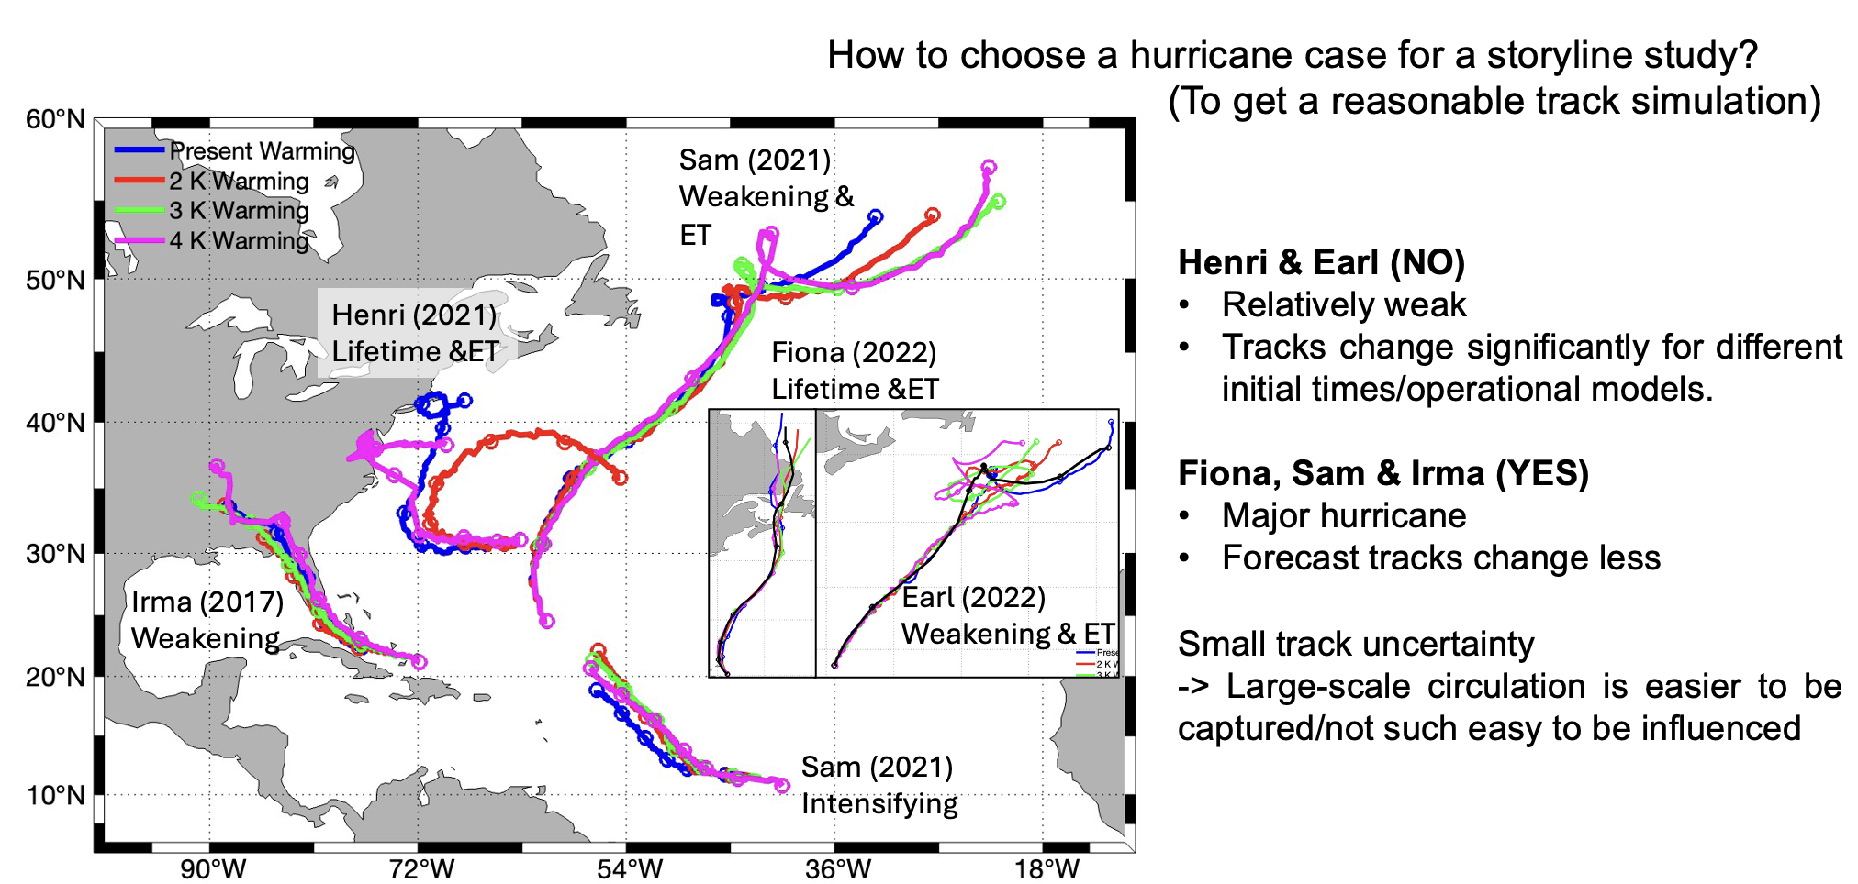
Ongoing Work

Slide 14
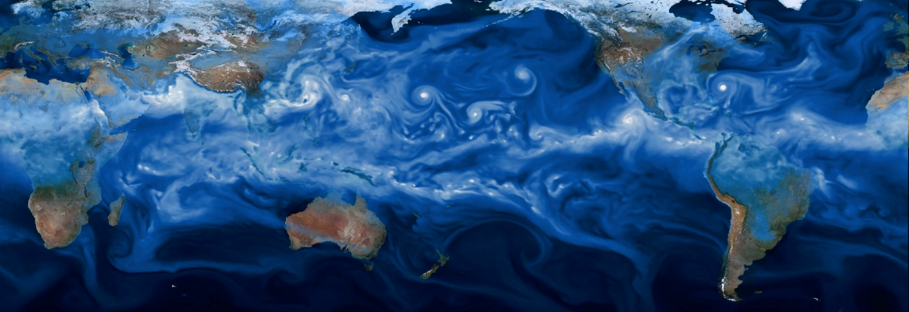
Thanks!
To understand changes in extreme precipitation in the future, we need to understand the changes in the events responsible for extreme precipitation.
kevin.reed@stonybrook.edu

Slide 15
References
Huprikar, A., A. M Stansfield, and K. A. Reed (2023), A Storyline Analysis of Hurricane Irma's Precipitation Under Various Levels of Climate Warming, Environ. Res. Lett., 19, 014004, doi: 10.1088/1748-9326/ad0c89.
Reed, K.A and M. F. Wehner (2023), Real-time attribution of the influence of climate change on extreme weather events: A storyline case study of Hurricane Ian rainfall, Environ. Res.: Climate, 2, 043001, doi: 10.1088/2752-5295/acfd4e.
Reed, K. A., M. F. Wehner, and C. M. Zarzycki (2022), Attribution of 2020 hurricane season extreme rainfall to human-induced climate change, Nature Communications, 13, 1905, doi: 10.1038/s41467-022-29379-1.
Reed, K. A., A. M. Stansfield, M. F. Wehner and C. M. Zarzycki (2020), Forecasted attribution of the human influence on Hurricane Florence, Science Advances, 6, 1, doi: 10.1126/sciadv.aaw9253.

