Slide 1
Evaluating aerosol-cloud interactions in E3SMv3 using a perturbed parameter ensemble
Jacqueline Nugent, Daniel McCoy, Andrew Kirby, August Mikkelsen
University of Wyoming Dept. of Atmospheric Science
EESM PI Meeting
7 August 2024
Breakout Session J: Strengthening EESM Integrated Modeling Framework – Towards a Digital Earth
Notes:
Note - this project is in the early stages

Slide 2
PROCEED Perturbed physics ensemble regression optimization center for ESM evaluation and development
Susannah Burrows, Andrew Gettelman, Lai-yung Ruby Leung, Johannes Mülmenstädt, Mikhail Ovchinnikov, Israel Silber, Yun Qian, Damao Zhang
Gabrielle Allen, Hunter Brown, Dana Caulton, Daniel McCoy, Jacqueline Nugent, Andrew Kirby
Mark Zelinka
Jennifer Small Griswold, Jiakun Liang
Benj Wagman
Notes:
PROCEED collaborators

Slide 3
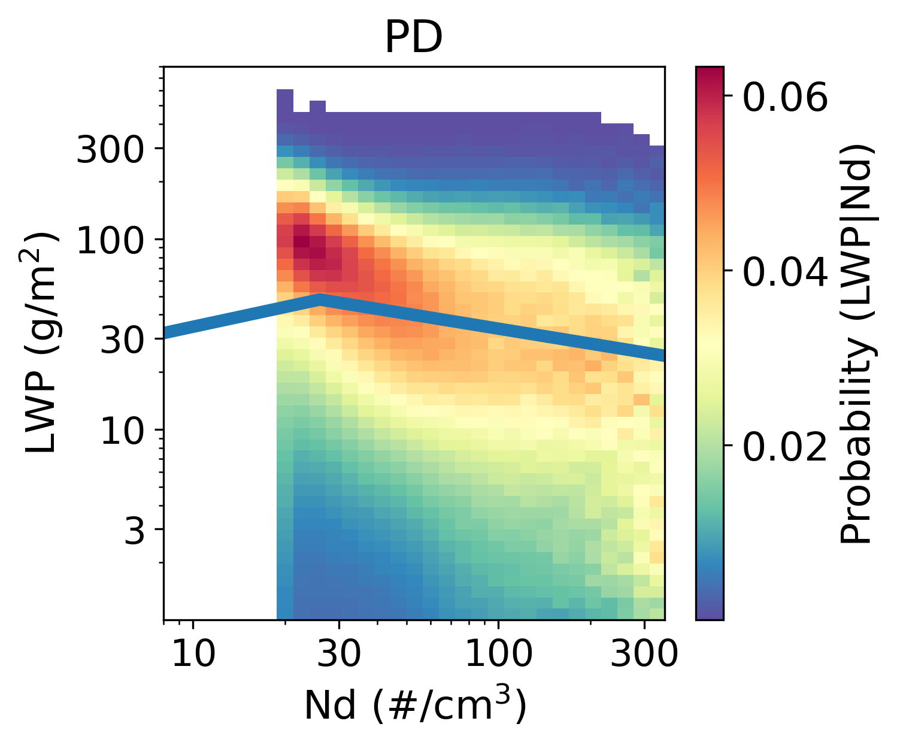
Our focus: aerosol-cloud interactions from pre-industrial (PI) to present-day (PD) conditions in the Nd-LWP relationship
Increases in cloud drop number concentration (Nd) lead to changes in cloud macrophysics, especially liquid water path (LWP)
“Inverted-v” relationship between LWP and Nd
Precipitation suppression. (+ correlation) vs. size-dependent entrainment (- correlation)
Where does this relationship come from in earth system models? Can we constrain it with observations?
Fig., 2.9, K. Carslaw (2022), Aerosols and Climate
MODIS
E3SMv3
Fig. 2b, Gryspeerdt et al. 2019, ACP
Notes:
Increases in cloud drop number concentration (Nd) from preindustrial to present-day conditions lead to changes in cloud albedo, but also cloud macrophysics – size, extent, etc.liquid water path, etc.
Physically: two competing effects: precip suppression, size-dependent entrainment
Gryspeerdt plot: satellite observations, see b/w Nd and LWP forming “inverted v”
Can see in models too (E3SMv3 default here)… roughly the same relationship
Precip suppression explicitly parameterized, size-dependent entrainment (maybe) not
This is one of the main problems of interest we’re working towards addressing with the PROCEED framework

Slide 4
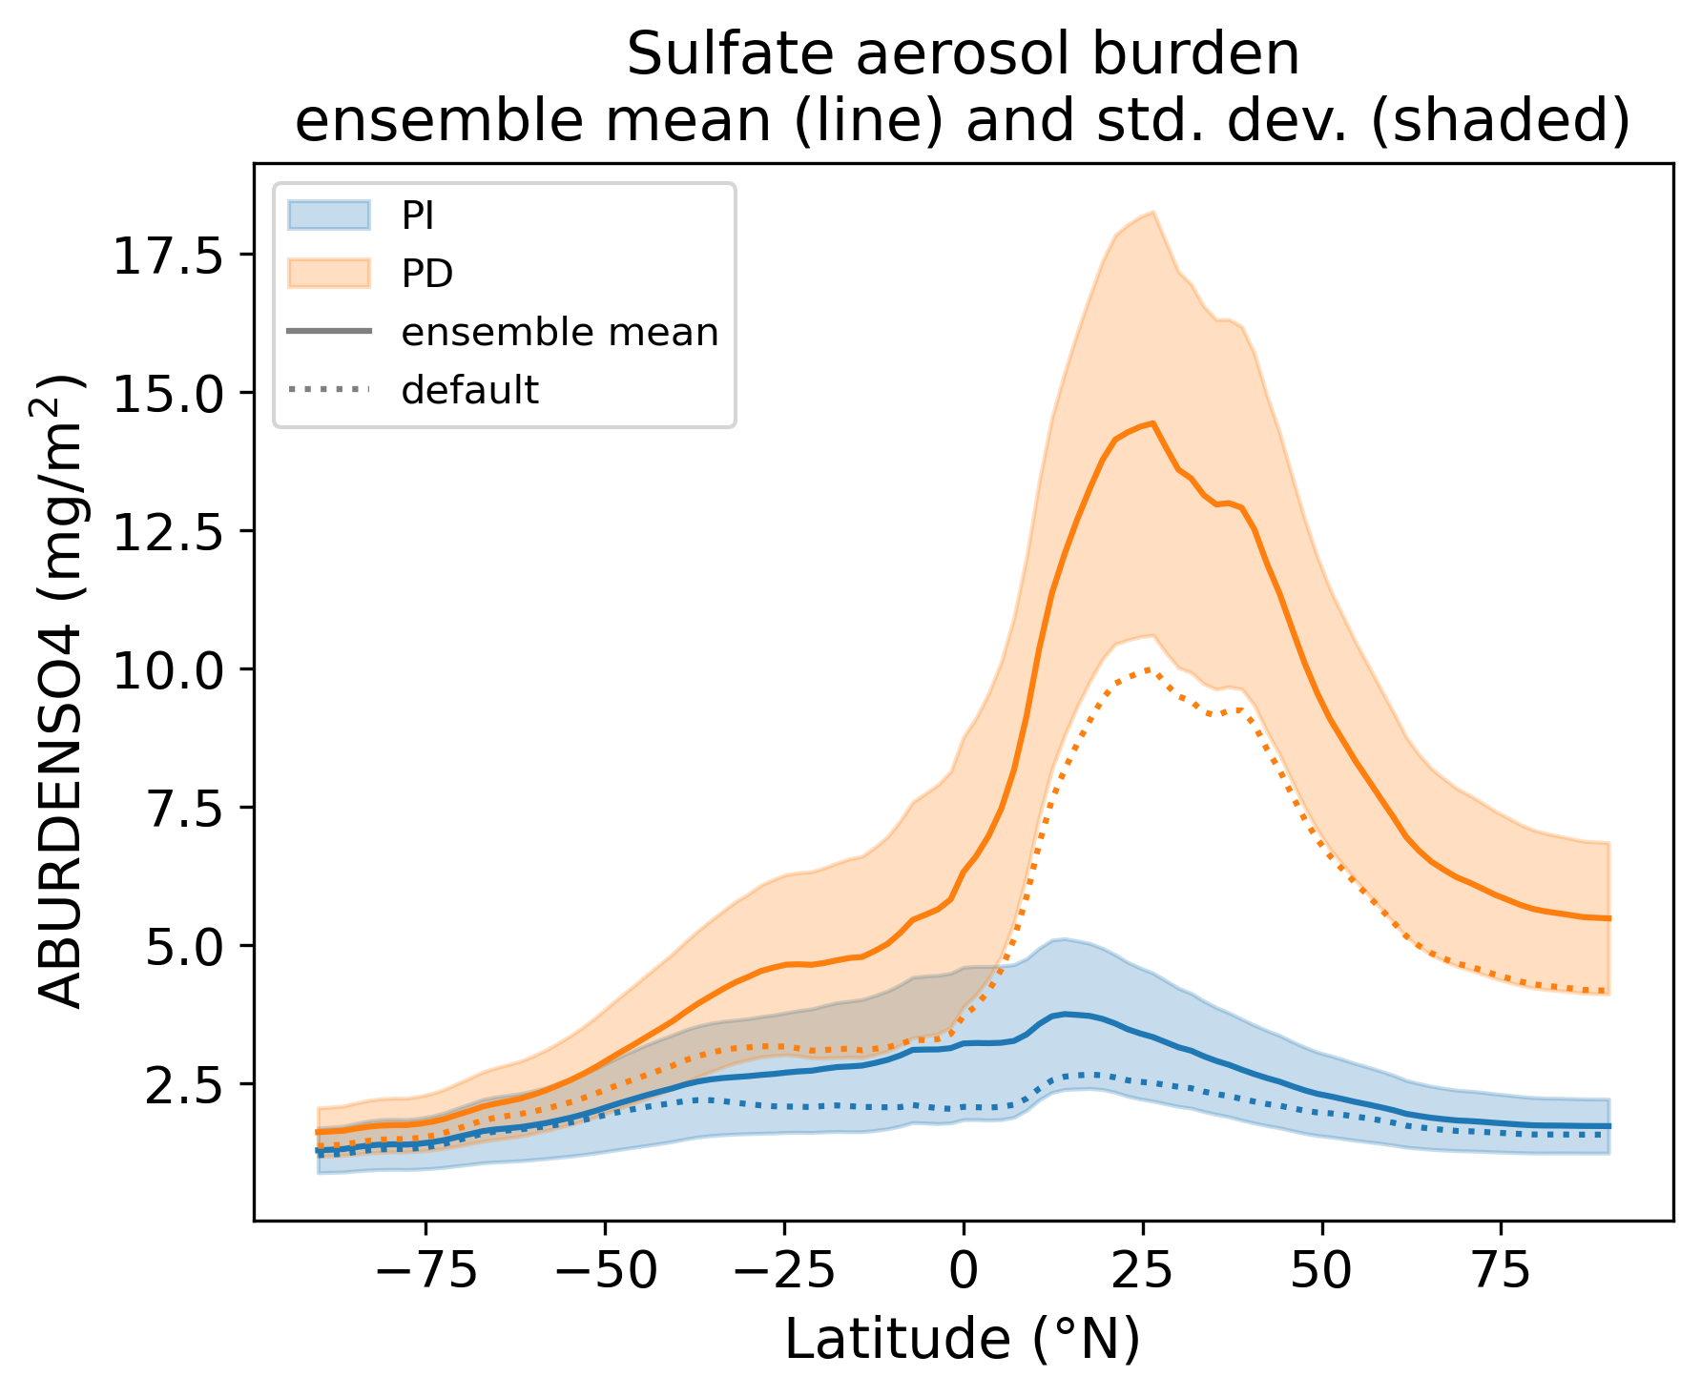
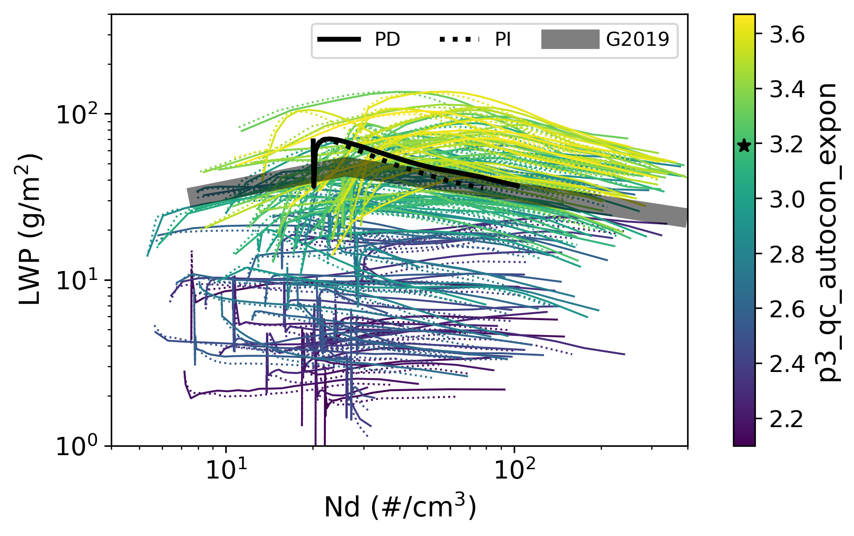
We develop a perturbed parameter ensemble (PPE) in E3SMv3 to address parametric uncertainty and causality
PI and PD versions
126 ensemble members (default + 125 parameter combinations perturbed with Latin Hypercube sampling)
2-year nudged simulations, atmosphere-only configuration
Varied 25 parameters: 7 microphysics, 7 convective microphysics, 11 aerosol
Large spread across the PPE in both PI and PD aerosols
“inverted v” across all PPE members
Notes:
multiscale issue - & lots of microphysical-scale processes go into forming the clouds that drive these interactions, and those are parameterized, lots of parametric uncertainty
Primary tool = PPE to address that in E3SM
Parameters – specific to aerosols, and aerosol-cloud interactions; lots on autoconversion and accretion bc of relationship with Nd-LWP
SO4: see spread in PI vs. PD difference in aerosols; spread in PI bc of our parameter choices
Inverted v: black line is the default line you saw before, grey is from the Satellite
Colored this one by qc autoconversion exponent: explain why we expect it to be important… really can see how this parameter plays a role in the LWP-Nd relationship (others less strong)
Importantly – can’t get the PI-PD difference from the inverted v plot… why obs aren’t enough

Slide 5
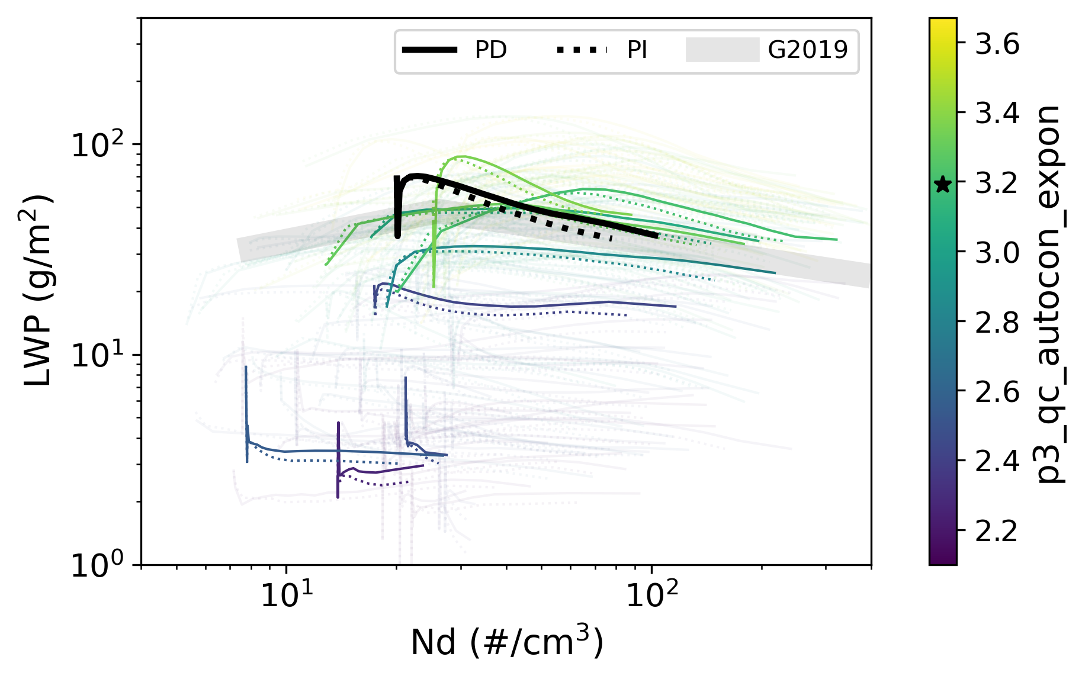
We develop a perturbed parameter ensemble (PPE) in E3SMv3 to address parametric uncertainty and causality
PI and PD versions
126 ensemble members (default + 125 parameter combinations perturbed with Latin Hypercube sampling)
2-year nudged simulations, atmosphere-only configuration
Varied 25 parameters: 7 microphysics, 7 convective microphysics, 11 aerosol
Large spread across the PPE in both PI and PD aerosols
“inverted v” across all PPE members
Notes:
highlighting default & a few random ensemble members to point out – the “inverted v” Nd-LWP relationship doesn’t have much to do with adjustment strength;
i.e., we can’t really use it to predict PI to PD changes – bc PI & PD curves aren’t consistent (with each other w/in a simulation)
the Nd-LWP relationship itself changes so can’t use the PD relationship to predict was PI was

Slide 6
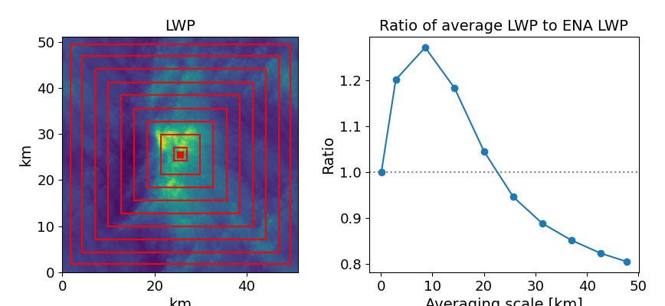
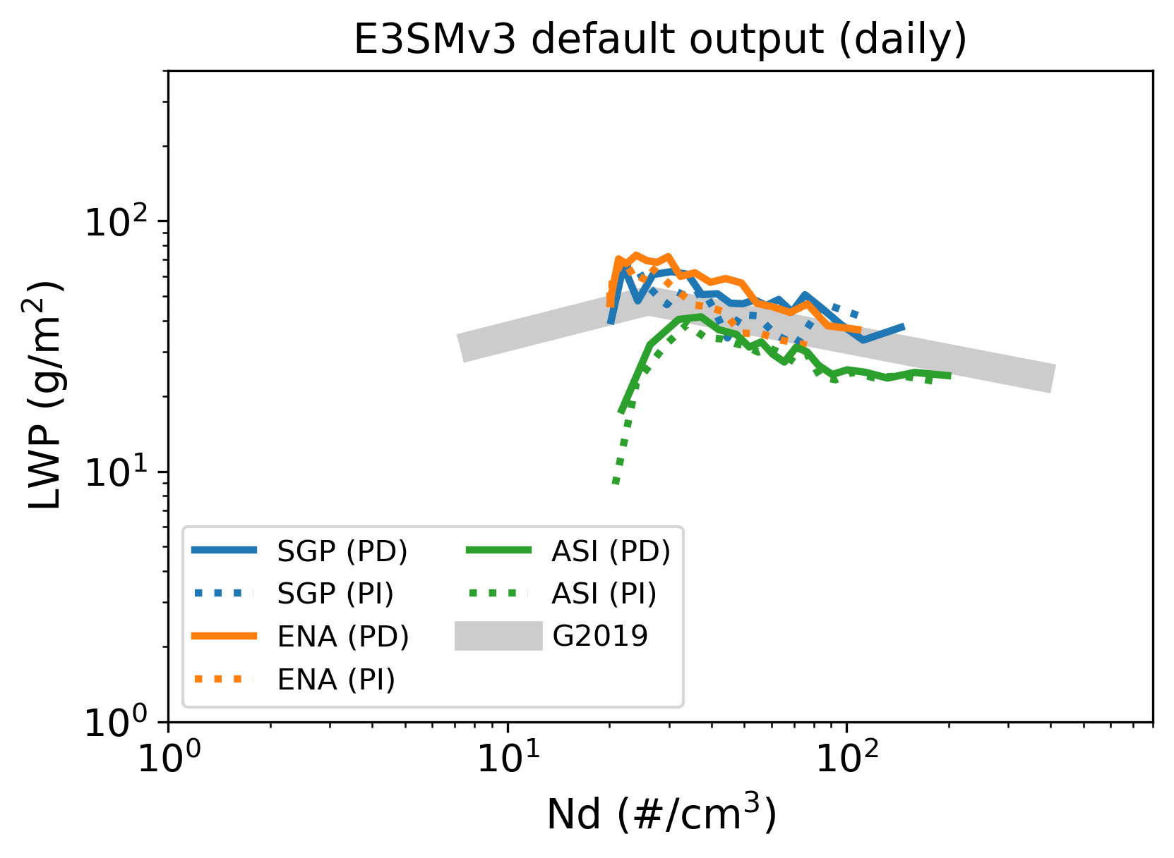
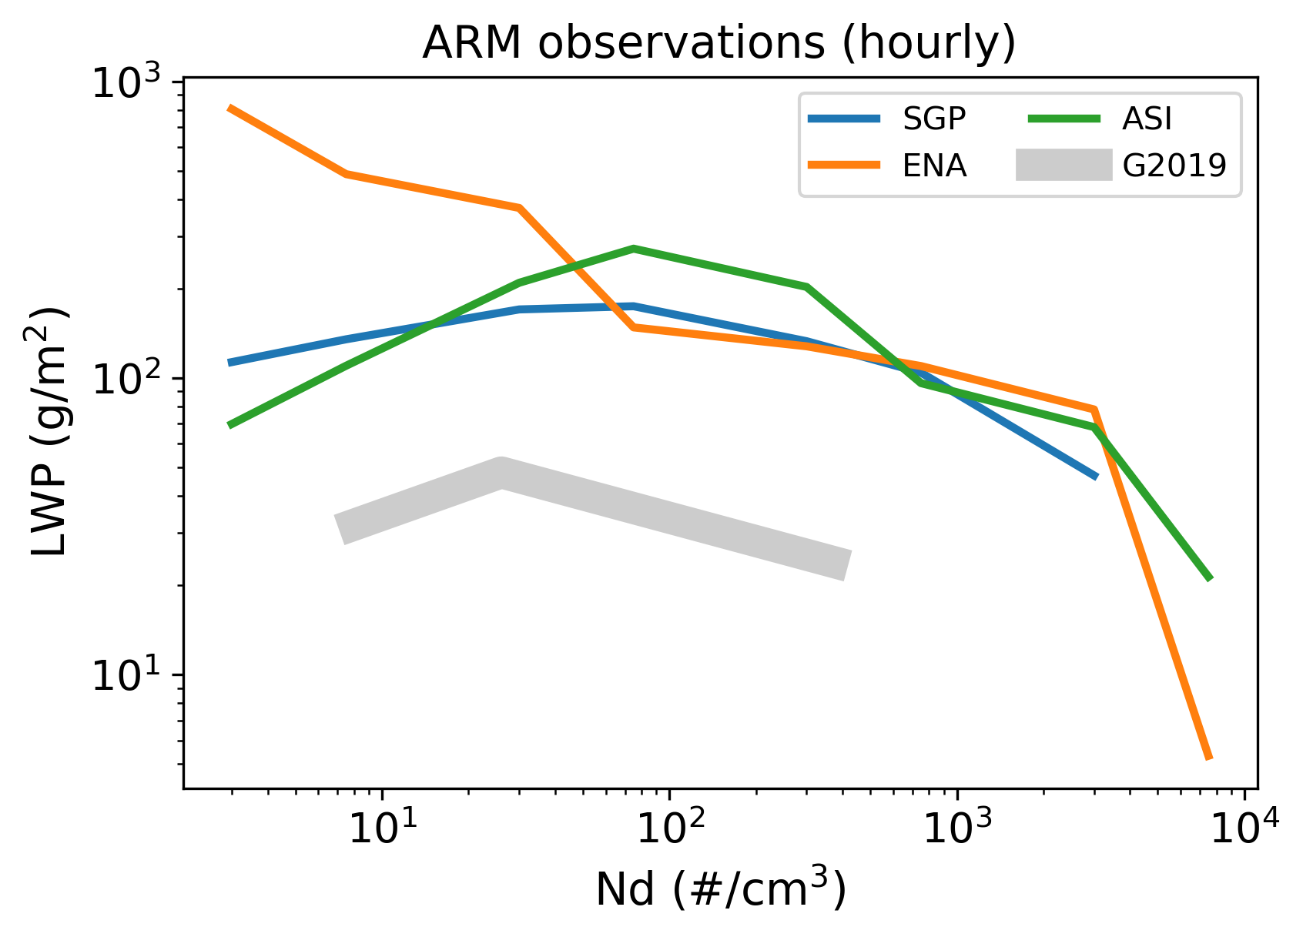
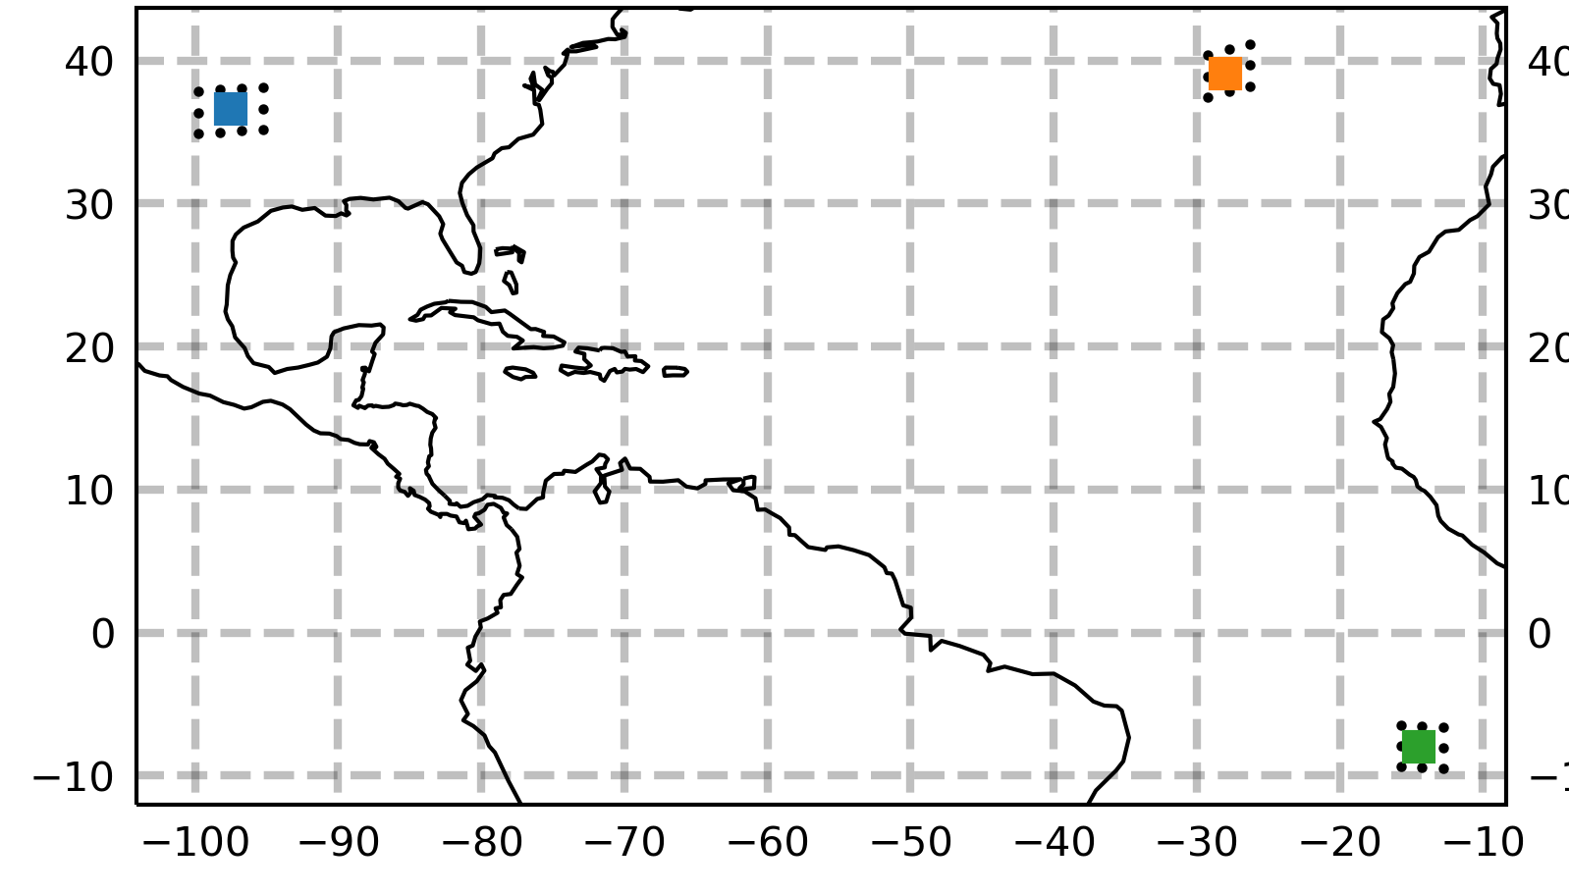
Multiscale issue: we need to constrain the (relatively) coarse E3SMv3 PPE to reality
Process-level ARM observations help us ground the model to the real world
LES output to address sampling bias from averaging over the E3SM grid
dx = dy = 100m
SGP
ENA
km
Averaging scale [km]
ACE-ENA LES simulations from McCoy et al. (2024), JGRA
doi: 10.5281/zenodo.8088444
ASI
Notes:
We need to constrain the PPE results with observations to ground the model to reality
Compare to ARM observations from several sites
Can’t get PI-PD difference with just observations, but need the obs to keep models in check – need both!
scale/sampling issue… E3SMv3 grid is ~1.75°, but process-level observations from ARM measure at much smaller scales
Bring in LES simulations too to help constrain the PPE and link ARM observations to the global model
Eventually want to use LASSO simulations from ARM over ENA, but for now we’ve been messing around the ACE-ENA LES simulations from Isabel McCoy & others
Scale plot - we’re looking at averaging LWP over the center of the domain (at the ENA site) and looking at how the LWP changes when you take averages over increasingly large grids; sampling bias
we need to be cautious comparing the E3SM PPE to observations, & use LES to quantify the effect of the scale differences

Slide 7
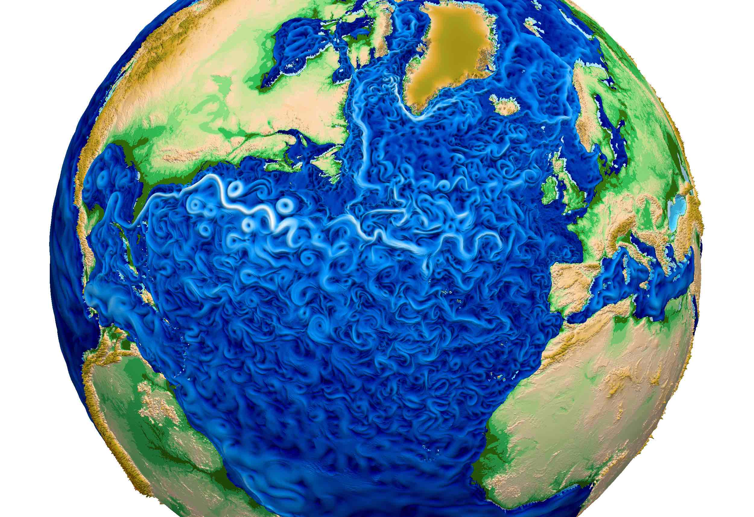
Digital Earth – Where We Might Go
Notes:
Where we should focus our attention on as a modeling community

Slide 8
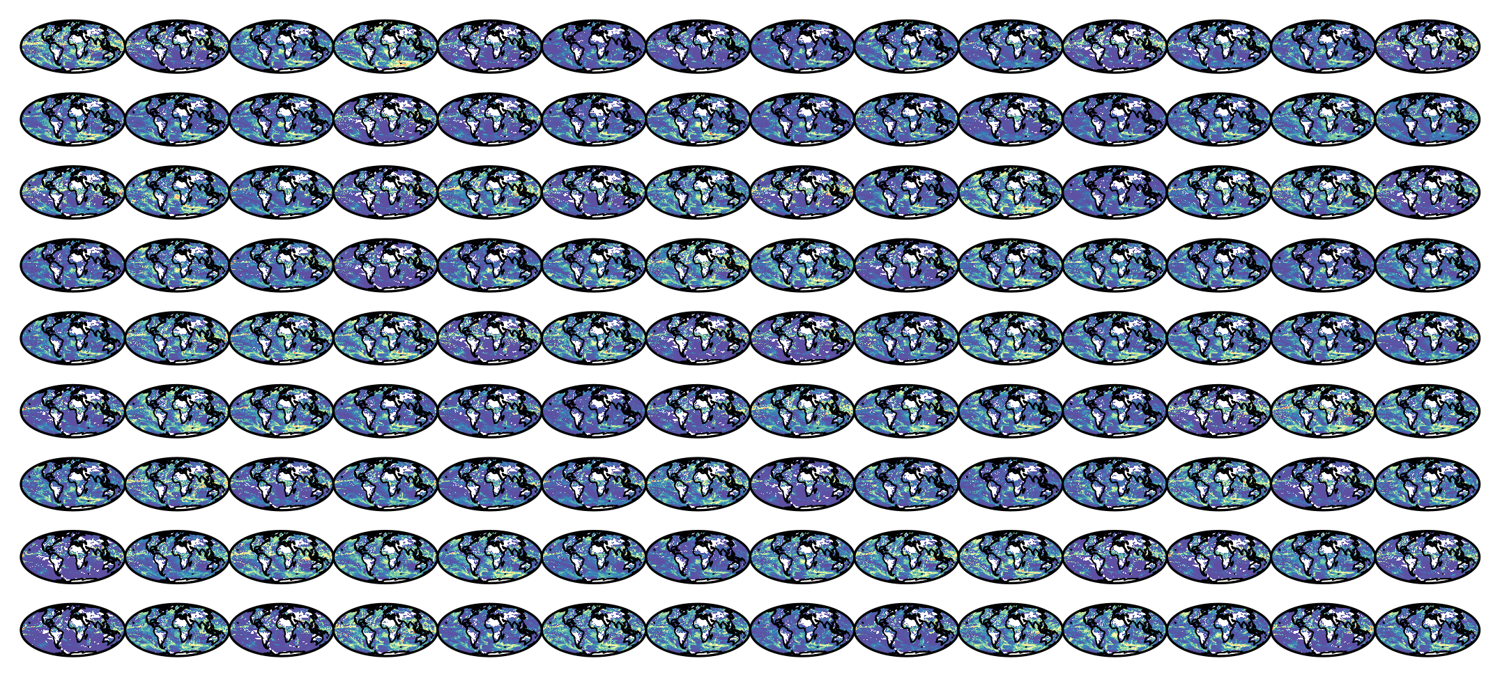
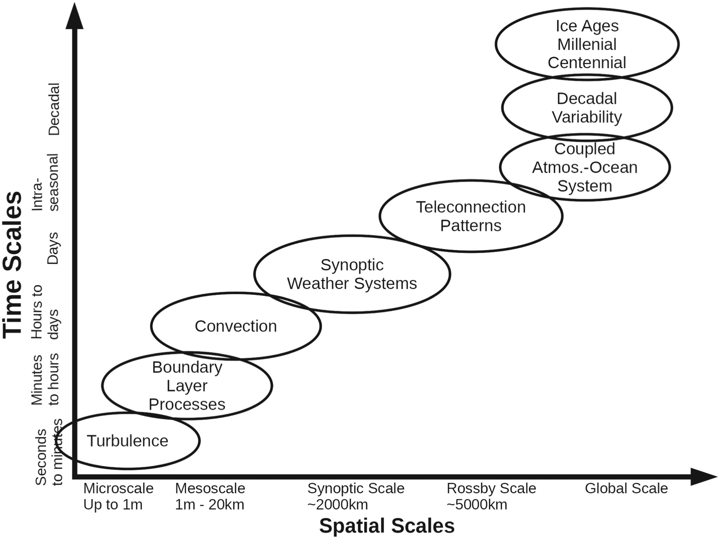
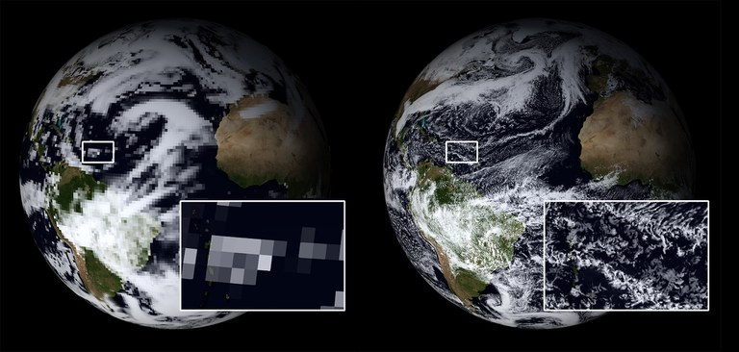
Development across scales: earth system models in the “model hierarchy” serve different (but equally important) purposes
GCMs
GSRMs
E3SMv3 PPE: 2x126 simulations, ~2.2 million core hours
LES
Franzke et al. (2020), Rev. Geophys.
80 km vs. 2.5 km horizontal resolution (ESiWACE)
Notes:
Overarching goal of getting these earth system models as close to reality as we can – but there’s still a place for the coarser, parameterized GCMs
Diagram: time/space scales of phenomena that are important to the climate system…
These are the phenomena important to the climate system, per this paper – different models in the hierarchy for different purposes
Need to develop at different levels of the model hierarchy together; keep bringing closer to reality at all scales
Across scales – have value for tackling earth system science problems
Ex fig: PPE – can’t do this with a GSRM, but not too expensive with the GCM
Ex fig: DYAMOND resolution – but there’s a lot we just can’t get at with the coarser resolution because it’s not resolved!

Slide 9
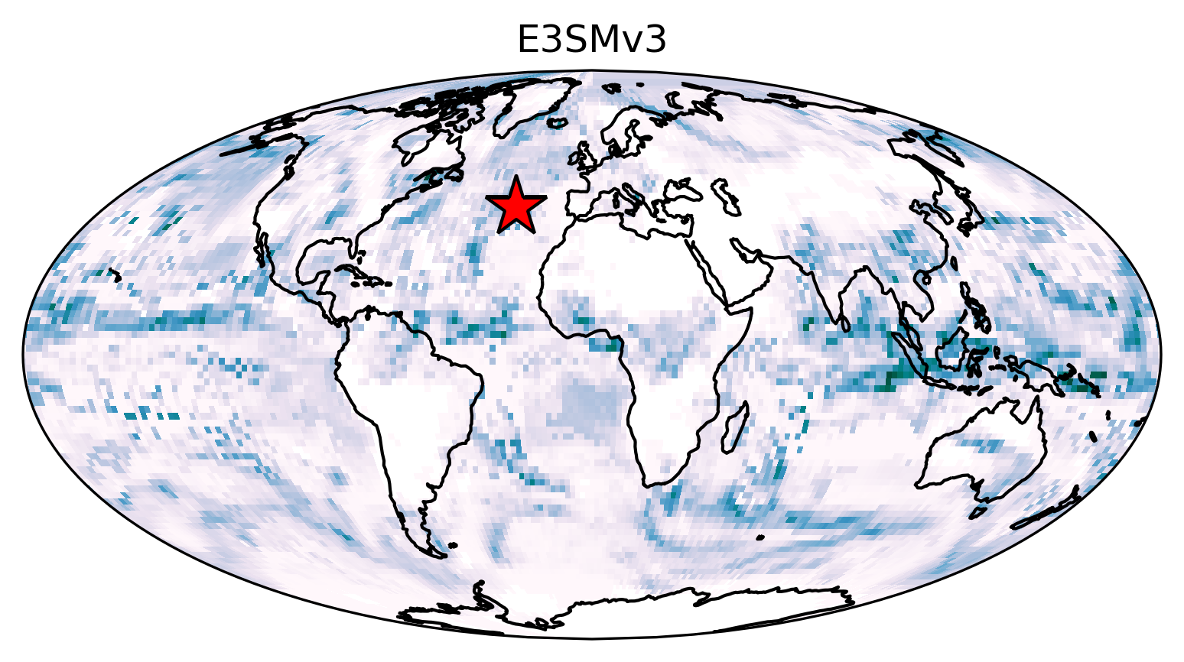
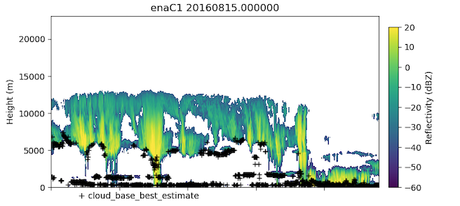
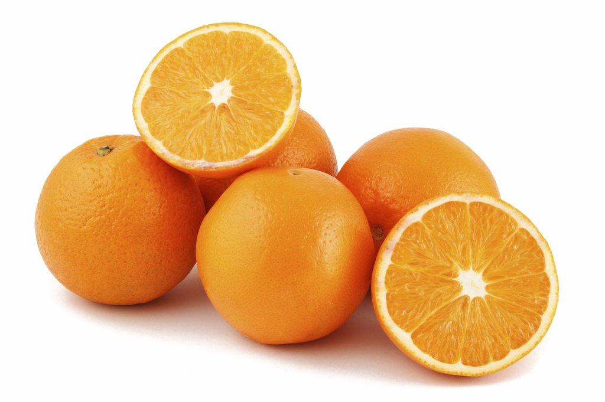
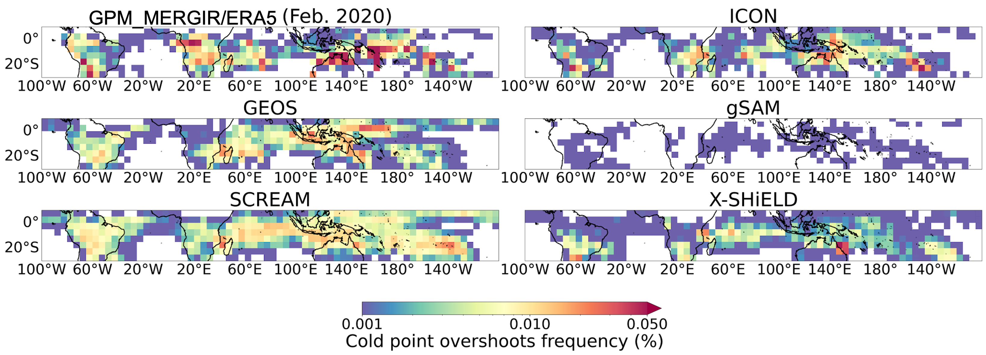
Ongoing challenge: effective model-observation intercomparisons
Earth System Model Output
Observations
Prioritize keep simulators up to pace with the latest & greatest models
Develop more unified ways to compare models to observations in situations where existing simulators won’t work?
instrument/satellite simulators, proxies, etc.
(ARM)
DYAMOND2 GSRMs vs. Observations
Overshooting convection proxy based on brightness temperature: compare GSRM output to observations at the km scale
Freq. of overshooting convection
(Nugent et al., in prep)
Notes:
What we’re measuring isn’t always directly comparable to what we’re simulating – temporal frequency, spatial sampling, the variable itself, etc.
These tools/methods don’t always keep the pace with the current versions of models (ex – need P3 in EMC2, work in progress)
DYAMONOD ex – looked at overshooting convection in the DYAMOND GSRMs – something we can do with km-scale models… here plotted in 5x5deg for clarity but those stats are made up of ~3-5 km data
Had to get creative with a proxy to compare to obs
Need to develop more unified, simple ways to compare models & obs

Slide 10
Summary
Contact: jnugent2@uwyo.edu
Ongoing work: E3SMv3 PPE
Study the Nd-LWP relationship in E3SMv3 across a perturbed parameter ensemble
Parametric uncertainty
Causality (PI-PD)
Constrain with observations from ARM sites
LES output: resolve coarse grid with fine-scale observations
“Where we might go”
Synchronous development across the model hierarchy
Prioritize effective ways to compare models with observations

Slide 11
Bonus Slides

Slide 12
Parameter Ranges
Scheme | Parameter | Min | Max | v3 default
Microphysics (P3) | p3_mincdnc | 5e6 | 30e6 | 20e6
 | p3_nc_autocon_expon | -2 | 0 | -1.1
 | p3_qc_autocon_expon | 2.10 | 3.67 | 3.19
 | p3_autocon_coeff | 15250 | 45750 | 30500
 | p3_accret_coeff | 58 | 235 | 117.25
 | p3_wbf_coeff | 0.1 | 1 | 1
 | p3_embryonic_rain_size | 1.50e-5 | 4.00e-5 | 2.5e-5
Convective microphysics (Zhang-McFarlane) | zmconv_accr_fac | 0.1 | 10 | 1.5
 | zmconv_auto_fac | 0.1 | 10 | 7
 | zmconv_micro_dcs | 50e-6 | 1000e-6 | 150e-6
 | zmconv_autocon_coeff | 15250 | 45750 | 30500
 | zmconv_accret_coeff | 58 | 235 | 67
 | zmconv_nc_autocon_expon | -2 | 0 | -1.2
 | zmconv_qc_autocon_expon | 2.10 | 3.67 | 3.19
Aerosol | n_so4_monolayers_pcage | 1 | 8 | 3
 | seasalt_emis_scale | 0.5 | 2.5 | 0.55
 | sol_facti_cloud_borne | 0.5 | 1 | 1
 | dms_emis_scale | 0.5 | 3 | 2
 | microp_aero_wsubmin | 0 | 0.5 | 0.001
 | microp_aero_wsub_scale | 0.1 | 5 | 1
 | POM_hygroscopicity_param | 0 | 0.1 | 0.04
 | aer_sol_factb | 0.03 | 0.1 | 0.1
 | so2_oh_gprx_scale | 0.3 | 3 | 1
 | so2_o3_aqrx_scale | 0.5 | 2 | 1
 | so2_h2o2_aqrx_scale | 0.5 | 2 | 1
Many ranges borrowed from the CAM6 PPE
(Eidhammer et al. 2024, doi:10.5194/egusphere-2023-2165)

