Slide 1
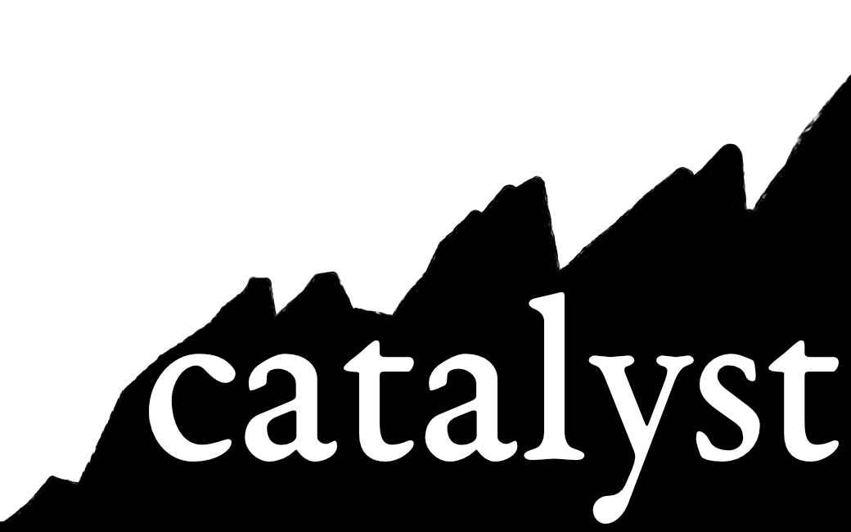
Tightening the belt
investigating the impact of high resolution at reduced computational cost
Brian Medeiros
Thanks to: Max Bouman, John Truesdale, Patrick Callaghan, Adam Herrington, Rich Neale, Peter Lauritzen

Slide 2
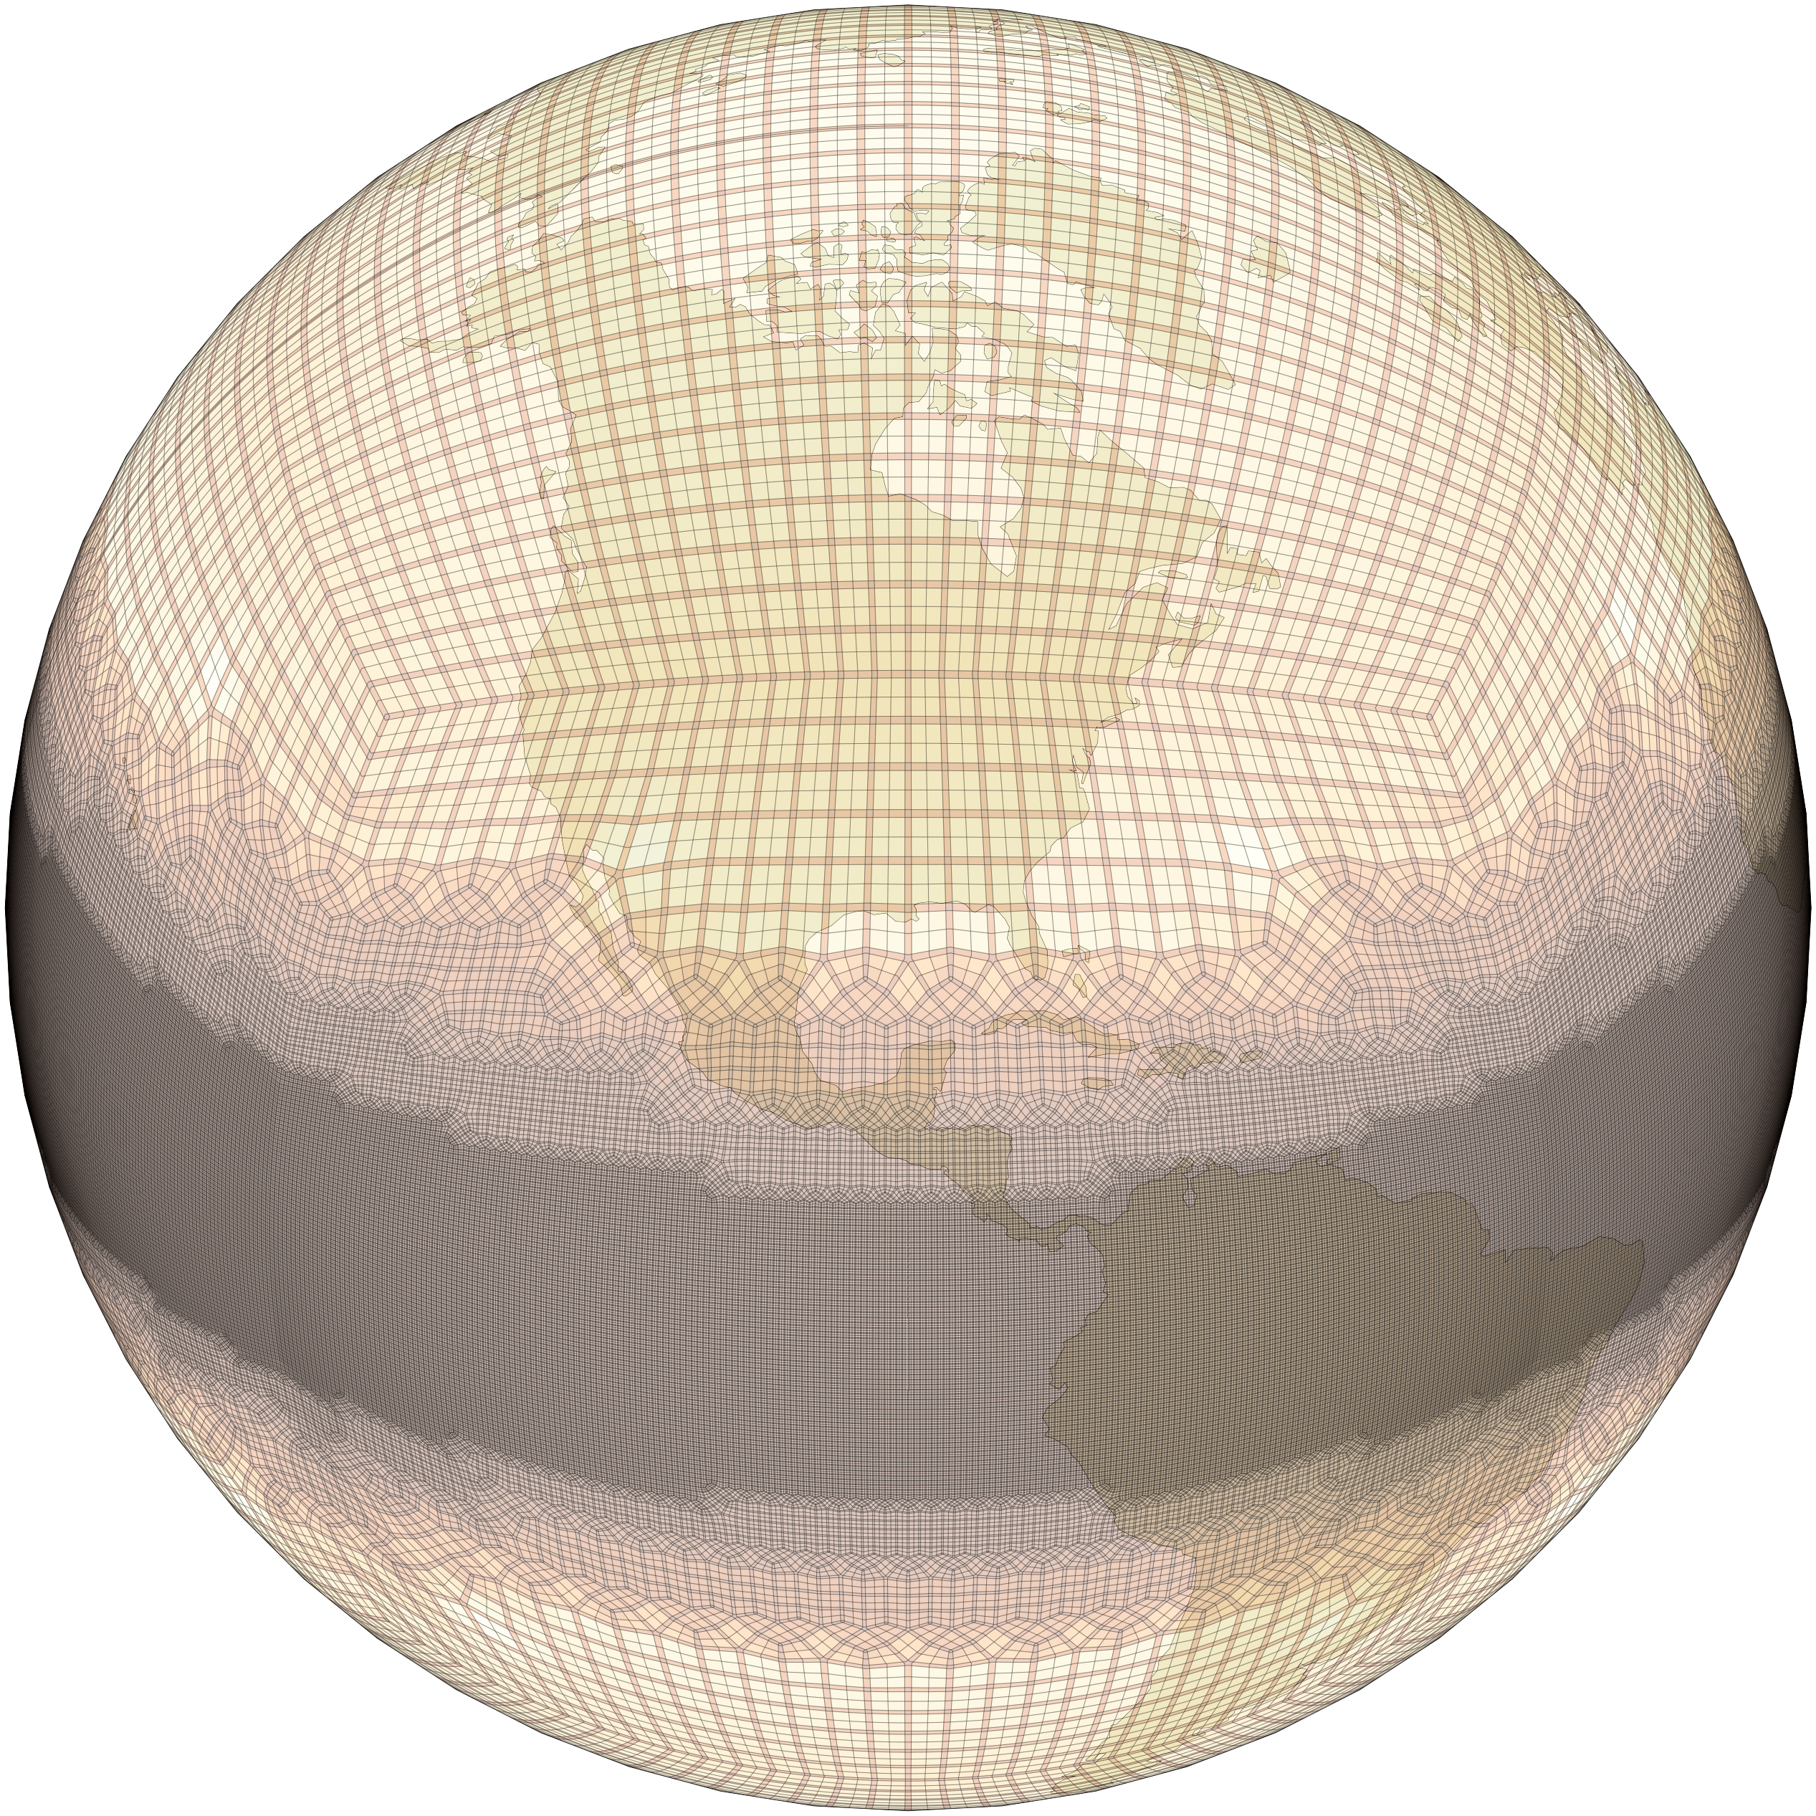
CAM-SE Tropical Belt
 | dx | #columns
ne30 | 110km | 48,600
ne60 | 54km | 194,400
ne120 | 27km | 777,600
ne240 | 15km | 3,110,400
ne480 | 7.5km | 12,441,600
TRBELT | 100→15km | 710,858

Slide 3
Effective Resolution
tropics vs extratropics
Kinetic energy spectra show the expected scales of the local grid spacing
Confirmed even when remapping to 100km grid

Slide 4
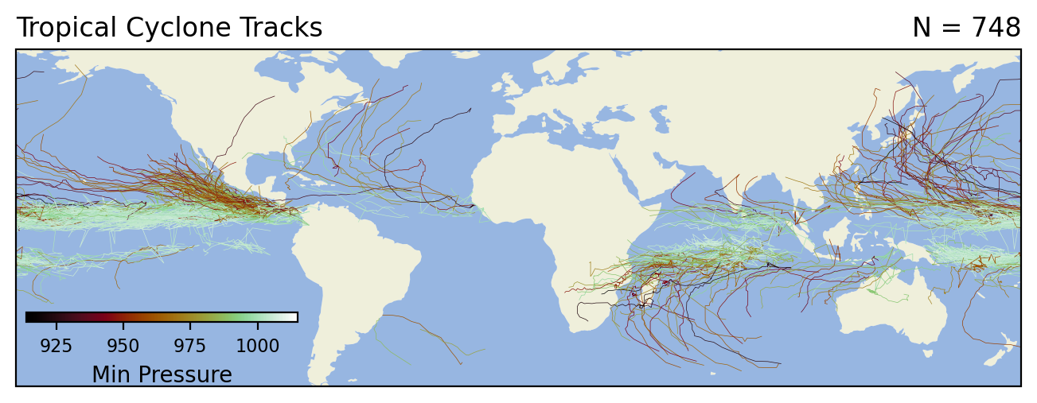
Example Applications
Tropical cyclones / cyclogenesis
Convectively-coupled equatorial waves (and organized convection within them)
Precipitation extremes (and other extremes)
Teleconnections
Potential coupled topics
Total Precipitation, 15°S-15°N
frequency (cycles/day)
zonal wavenumber

Slide 5
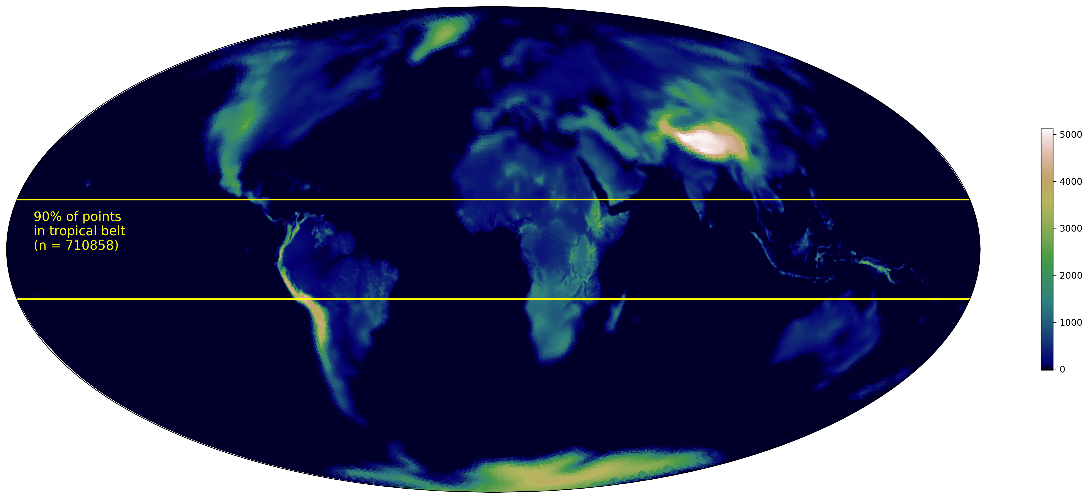
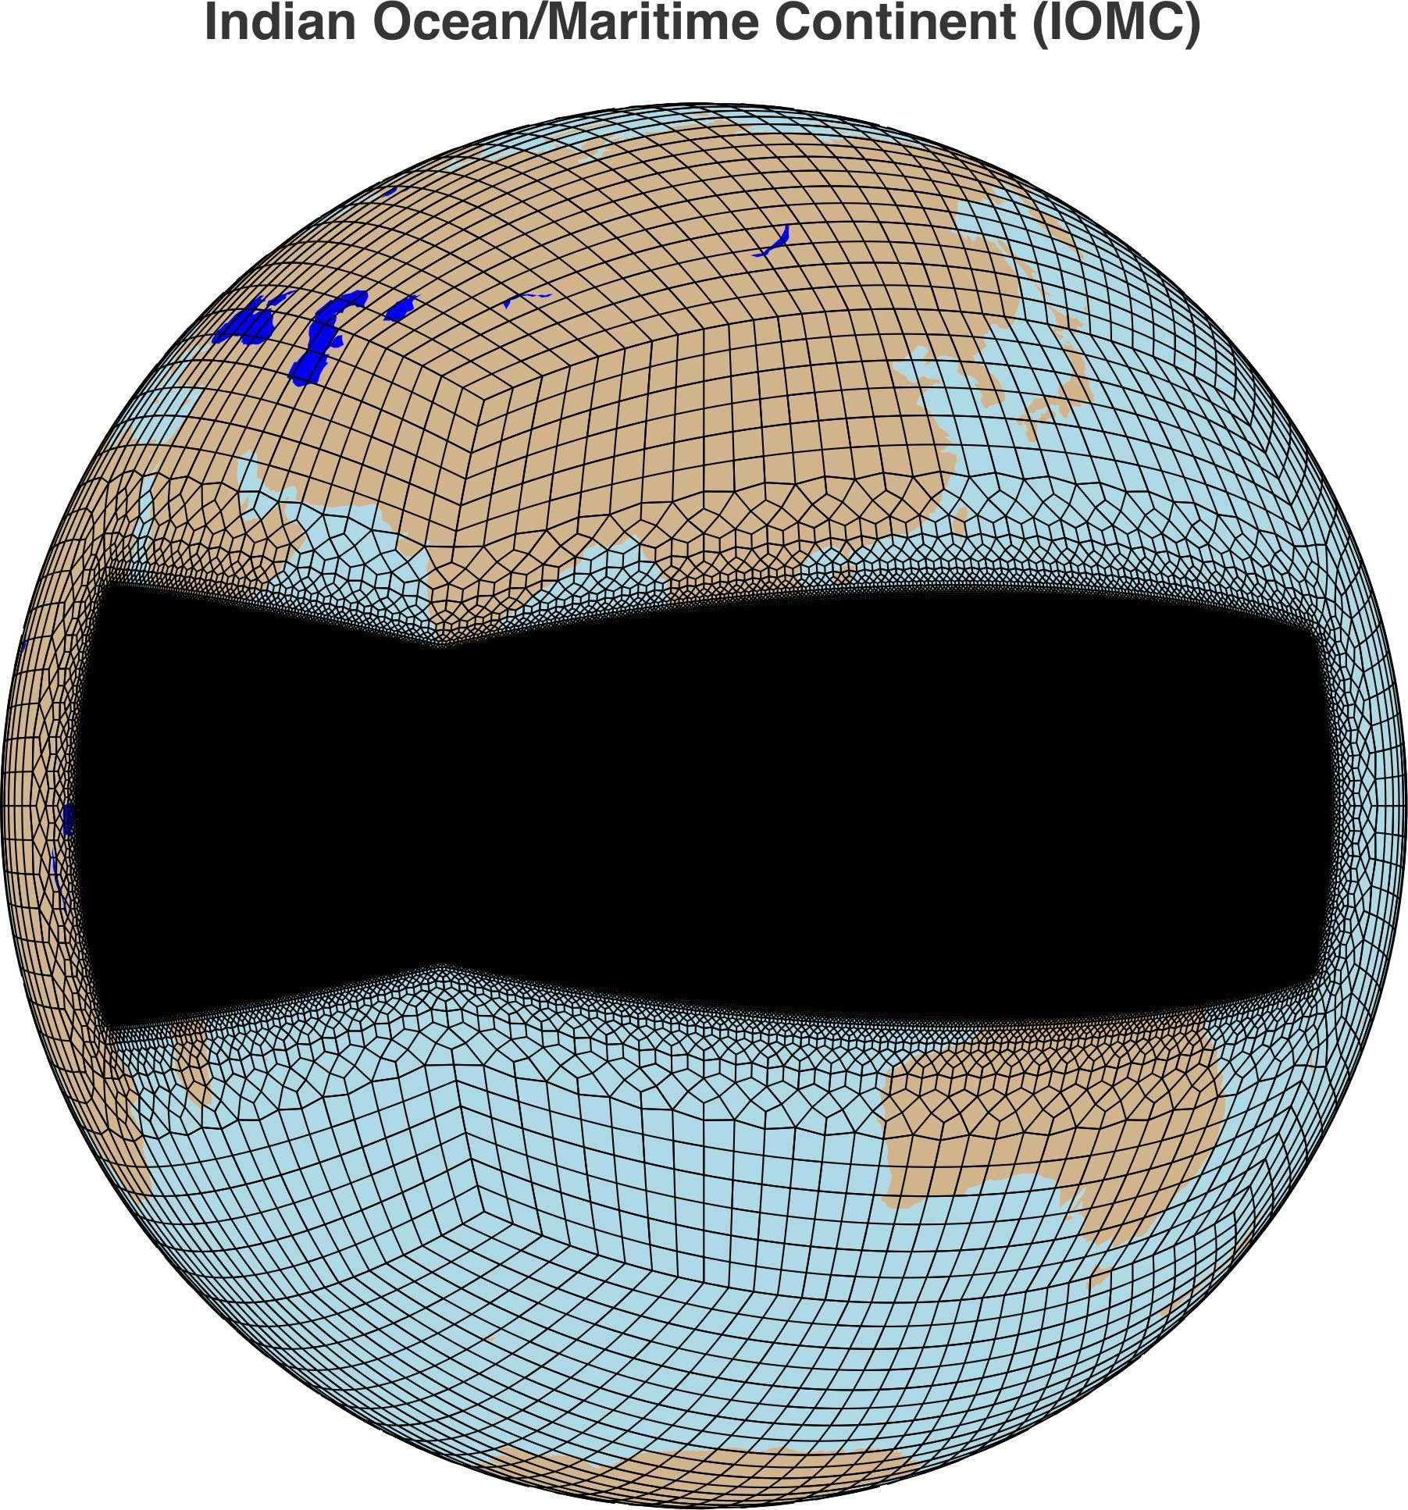
E3SM extension of TRBELT
100 → 15 / 100 → 3 / 28 → 3 ?
Δx ≈28km
Δx ≈3.25km
Δx ≈100km
26% of surface area
Δx ≈15km
Hierarchy of simulations: aquaplanet → amip → coupled

Slide 6
Current capabilities (AFAIK)
Coarse climate experiments
regionally refined experiments with asymmetric configurations
global uniform storm-resolving demonstration simulations
Toward storm-resolving climate experiments via tropical belt configuration
Achievable storm-resolving resolution in significant fraction of globe
Circumglobal equatorial circulation
Idealized & realistic simulations
Can scale to multi-year, multi-simulation experiments for research projects.

