Slide 1
Coastal Session
Everyone:
Enter comments addressing core questions of meeting here.
Rapporteurs:
Enter notes here.

Slide 2
Extreme sea level events Induce accelerated increase in flooding time along U.S. east coast in recent decades
W. Han¹, Y. Zhu¹, A. Subramanian¹, R. Leung², K. Balaguru², and O. Garuba²
¹Department of Atmospheric and Oceanic Sciences, the University of Colorado
²The Pacific Northwest National Laboratory (PNNL)
DOE EESM PI Meeting, Maryland, August 6-9, 2024

Slide 3
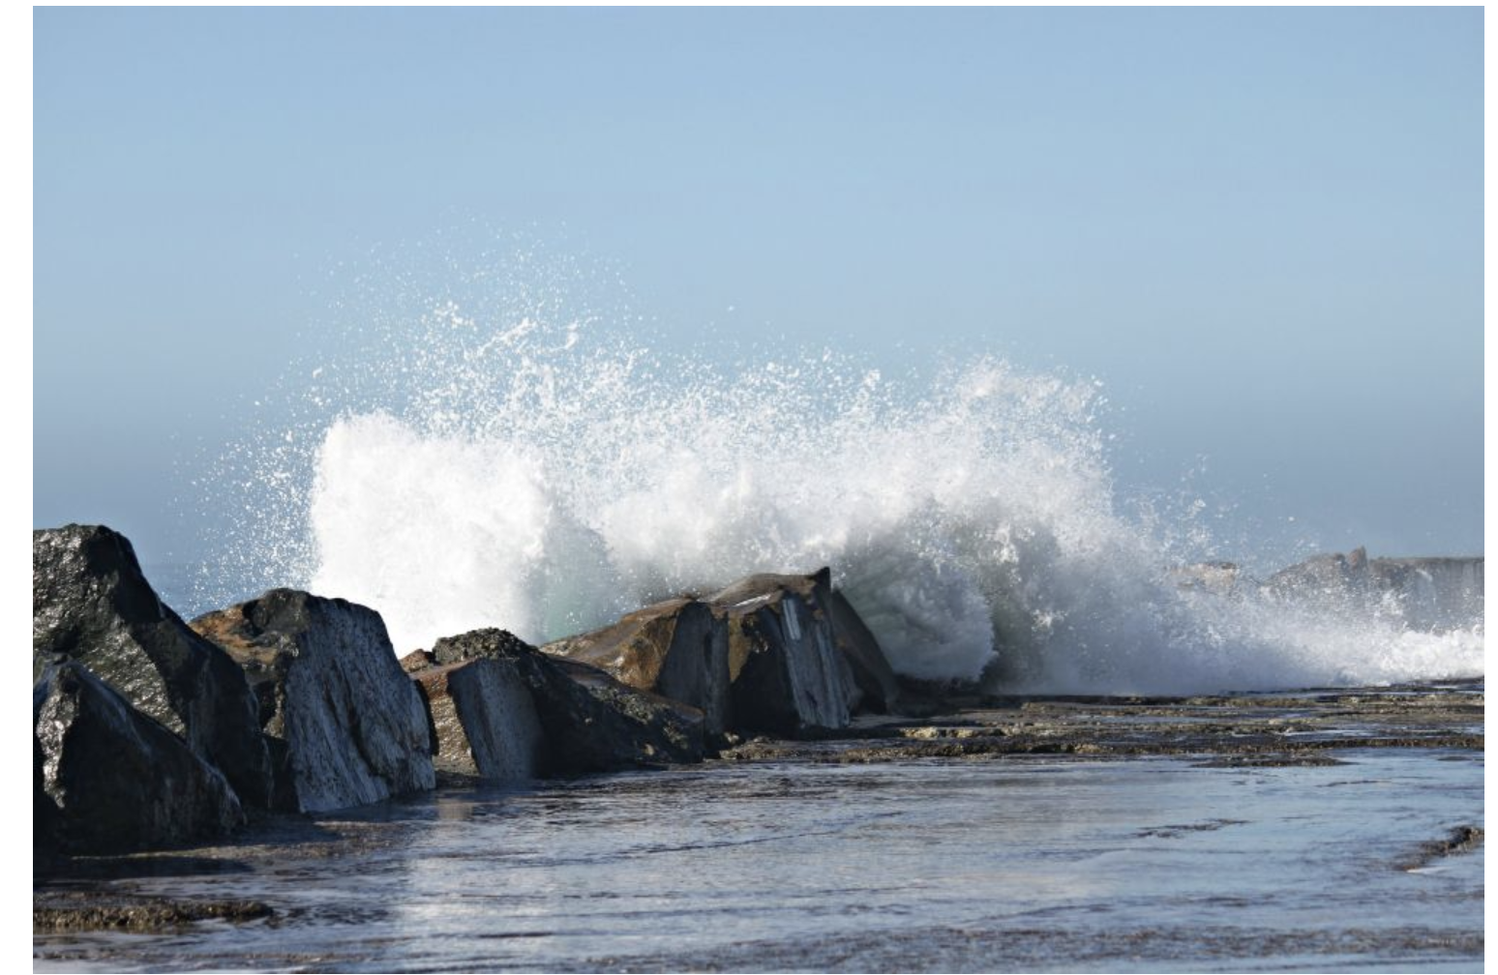
Background
Sea level rise (SLR) at USEC
increased frequency and severity of nuisance flooding (i.e., clear-sky flooding) in recent decades;
compounded by modes of climate variability, they cause changes in location, strength and time of the extremes.
Goal of our project:
Investigate the impacts of climate modes and external forcing on spatial and temporal evolutions of sea surface Height EXtremes (HEXs) at USEC using E3SM HR & other CMIP6 HR models;
This understanding is crucial for regional prediction & near-term projection of coastal inundation.
GoM (Gulf of Maine)
MAB (Mid-Atlantic Bight)
SAB (South Atlantic Bight)
Notes:
Tide gauges (1950-2020): All data values are relative to the MLLW.

Slide 4
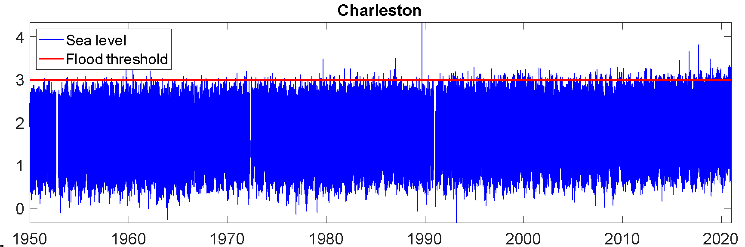
Results
Tide gauge data 1950-2020: flooding time (FT)
GoM
Flooding time (FT): Total time in a year when relative sea level (RSL) exceeds the NOAA flooding threshold
Flood intensity (FI): Total sea level exceedance/FT
MAB
SAB
m
Daily sea level relative to MLLW (NOAA)
Notes:
Here, I’ll report some of the results we obtained so far.
All data values are relative to the MLLW. Daily SLA
Flood threshold: NOAA MHHW
Flooding intensity (FI): cumulative RSL exceedance/FT

Slide 5
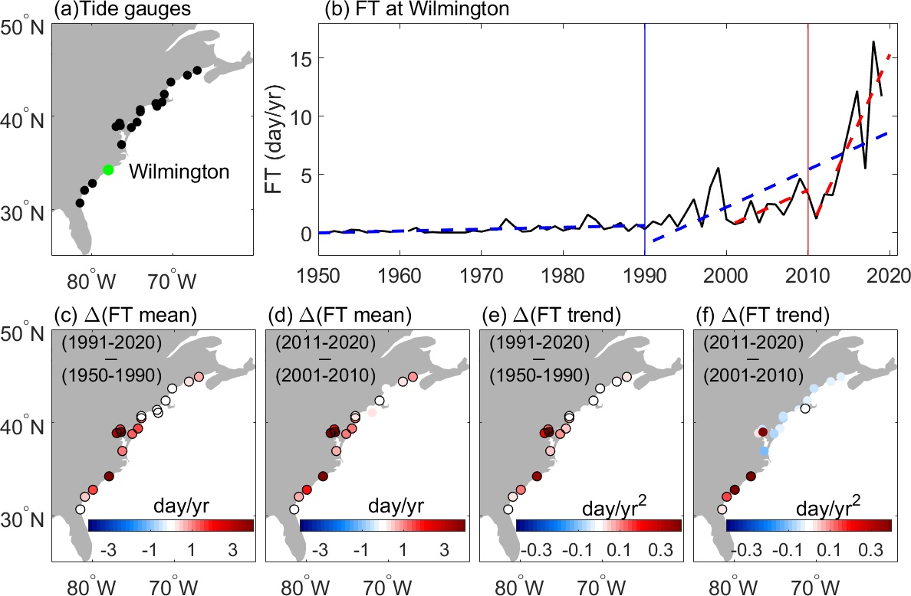
Accelerated increase in flooding time (FT)
1990 2010
GoM
MAB
SAB
FT increase FT acceleration
Notes:
All data values are relative to the MLLW.

Slide 6
Causes for accelerated increase in sea level & FT:
SLR trend: Linear trend ~ global SRL (climate change)
Tides: Tidal harmonics (Utide Matlab software)
Decadal SLA: >10year variability
Interannual SLA: 90 days-10year variability (detrend & remove seasonal cycle)
Seasonal SLA: annual+semiannual+120day
Intraseasonal SLA: 10-90 days variability
Synoptic SLA: <10 days variability (including storms)
Climate variability
(modes)
Notes:
Located at the confluence of the Indian & Pacific Oceans,

Slide 7
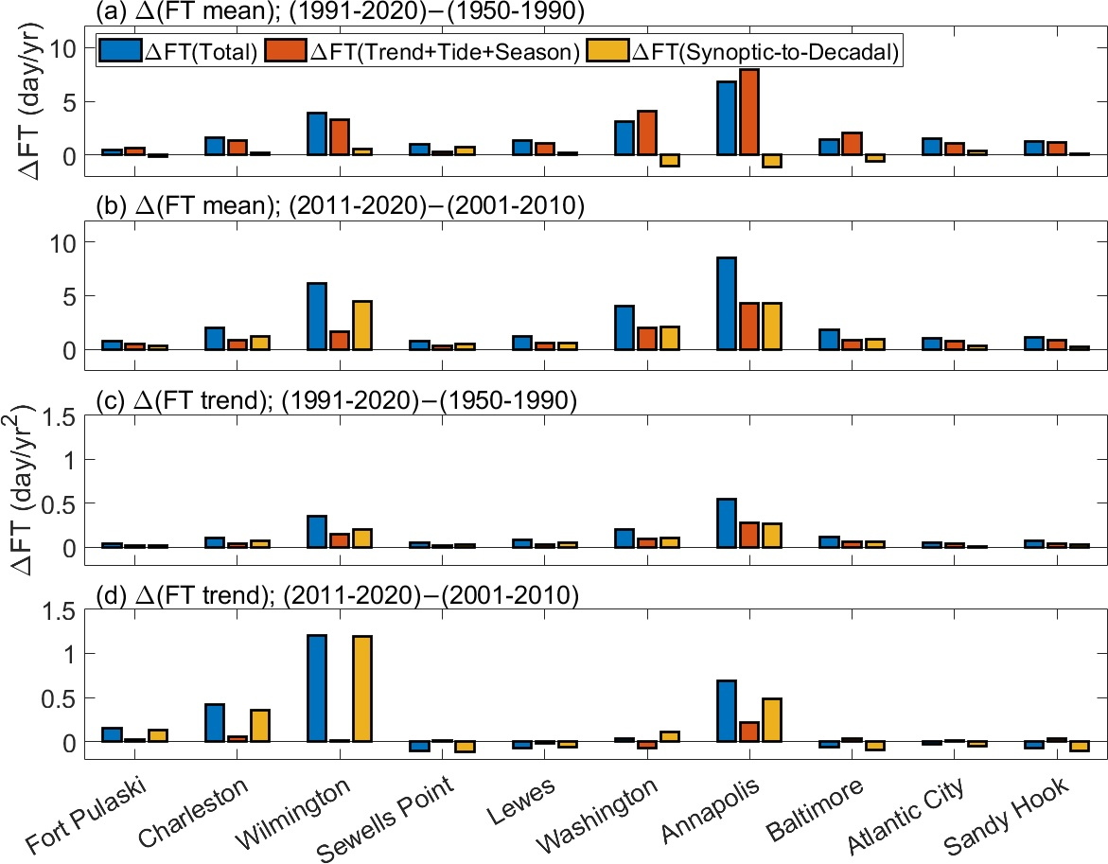
Results
Roles of trend+tide vs synoptic-decadal sea level anomalies (SLAs)
FT increase: post1990
FT increase: post2010
FT acceleration: post1990
FT acceleration: post2010
Notes:
Differences of temporally averaged FT (blue bars) between two periods, FT(1991-2020)-FT(1950-1990), those induced by sea level trend, tide and seasonal SLAs (brown bars), and those induced by synoptic, intraseasonal, interannual and decadal SLAs (orange bars). (b) The same as (a) but for the differences of mean FL between two periods, FT(2011-2020)-FT(2001-2010). (c-d) The same as (a-b) but for the trend difference of FT between two periods. The ten tide gauges are selected based on their significant mean or trend differences of FT between two periods (Figs. 1c-f).
Li et al. (2023): HTF – amplified tides due to human alteration of estuerary (Annaplis, Wilmington) – increased HTF;
Sun et al. (2023): long-term land sinking – which is included in our “trend” - increased HTF

Slide 8
Decadal sea level anomalies (SLAs) induces accelerated
FT increase in the past decade:
post2010=(2011-2020) – (2001-2010)
FT increase:
FT Acceleration:
Notes:
(a) Differences of temporally averaged FT (blue bars) between two periods, FT(1991-2020)-FT(1950-1990), induced by sea level trend, tide and seasonal SLAs (brown bars), respectively. (b) The same as (a) but for the differences of mean FL between two periods, FT(2011-2020)-FT(2001-2010). (c-d) The same as (a-b) but for the trend difference of FT between two periods.
Correlation coefficients between decadal SLAs and four climate mode indices, the North Atlantic Oscillation (NAO) index, the Atlantic Niño index (ATL3), the Interdecadal Pacific Oscillation (IPO) index, and the Indian Ocean Dipole Mode Index (DMI). Significant values (p<=0.1) in (c-f) are marked with black circles.

Slide 9
CMIP6 HR: Hist-1950
(11 models/21 members)
S. MAB N. SAB
CMIP6 LR: Hist
(41 models/372 members)
NAO Atlantic Niño IPO IOD (Indian Ocean Dipole)
Notes:
SLAs with 1950-1979 mean removed; IB and GIA are corrected to tide gauge data.

Slide 10
Summary
Tide gauge data detected accelerated increase in flooding time (FT) since 1990, especially since ~2010, in N. SAB & S. MAB region;
While SLR trend and tide dominate the multi-decadal FT increase since 1990, decadal sea level variability is the major cause for the the accelerated FT increase in the past decade (2011-2020) compared to the previous decade (2001-2010);
The decadal SLAs in S. MAB are significantly correlated with decadal indices of IOD, IPO and Atlantic Niño, while in N. SAB SLAs are more linked to decadal variability of IOD & NAO.
Understand causes for decadal SLAs & impacts of climate modes: observation, HR E3SM (MPAS-O) & CESM1 Pacemaker exp

Slide 11
Thank you!
Acknowledgement
The work is supported by DOE RGMA DE-SC0024263

Slide 12
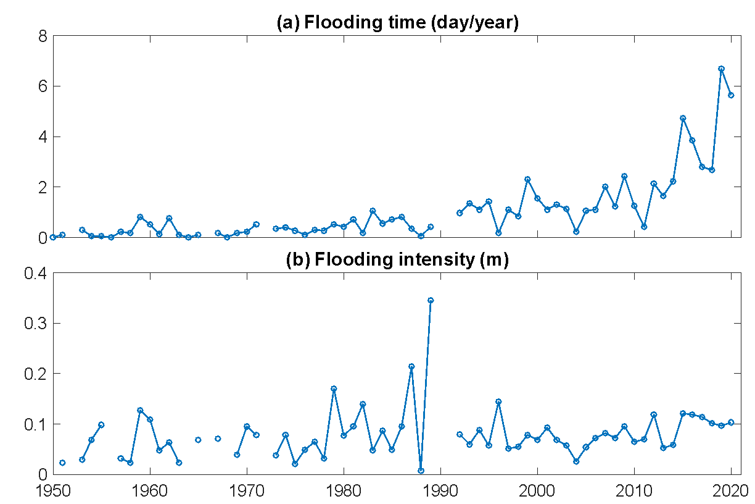
Charleston

Slide 13
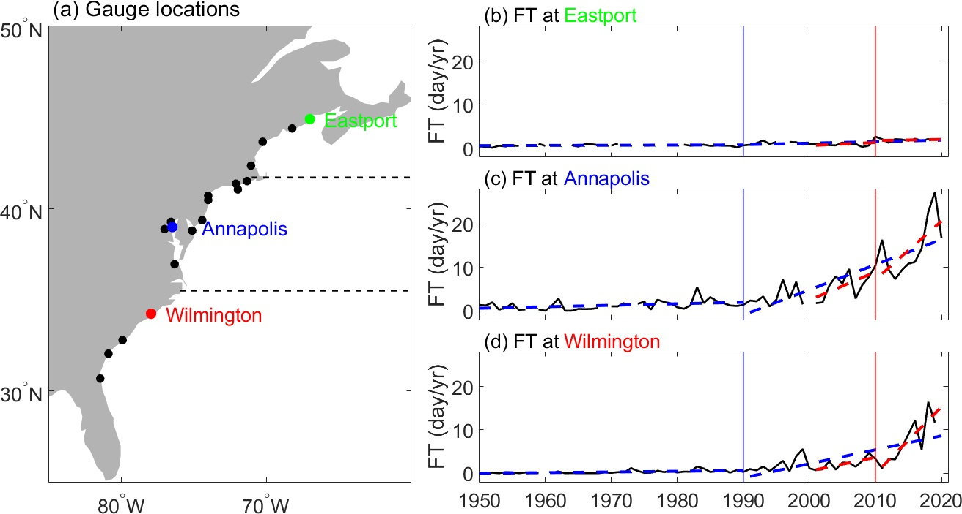
Tide gauge observations: dots in (a) show tide gauge locations; (b)-(d) show time series of annual FT based on
tide gauge data (defined below).
Flooding time (FT): Total time (days) when tide gauge sea level exceeds the NOAA flooding threshold in each year
Rapid increase in FT is detected in the past decade compared to any previous decades in the northern part of the
South Atlantic Bight (SAB) and Southern Part of the Mid-Atlantic Bight (MAB), but not in the Gulf of Maine (GoM)
GoM
MAB
SAB

Slide 14
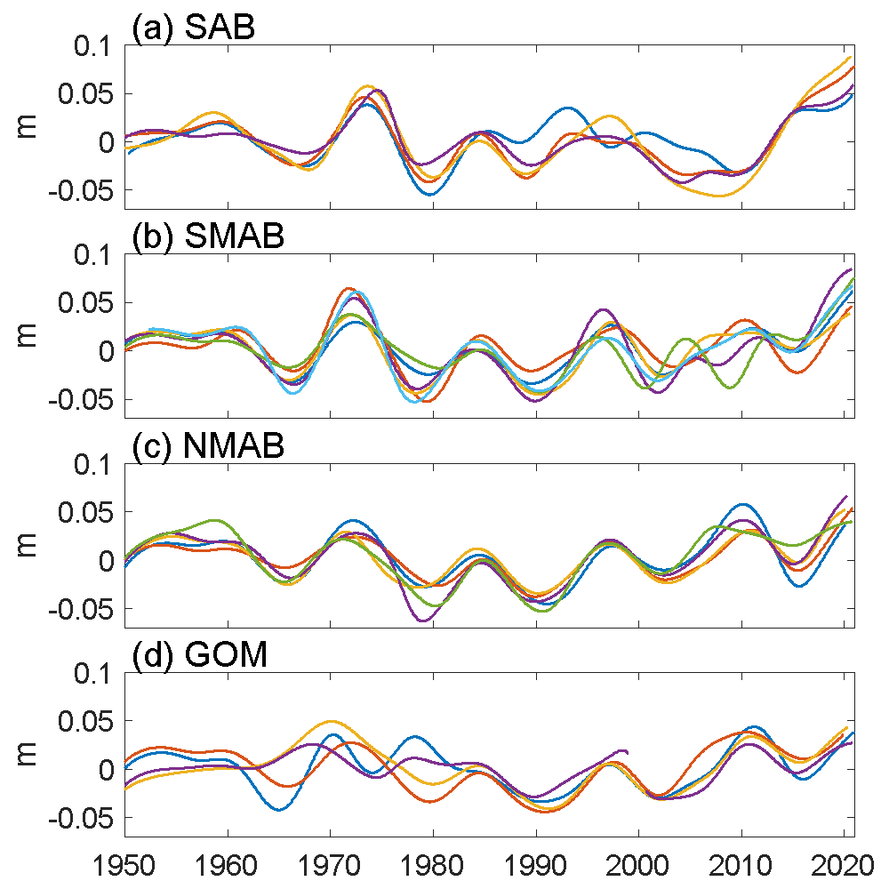
Decadal variability
(>10 years)

