Slide 1
ESMD Coastal Overview
LeAnn Conlon, Gautam Bisht, Steven Brus, Rich Fiorella, Nicole Jeffery, Luke Van Roekel

Slide 2
ESMD Coastal efforts are very broad
E3SM, ICoM, InteRFACE, SciDAC, COMPASS-GLM, ECR
No time to cover them all!
Highlight a few important efforts and topics in the coastal space
Tracking water in the coupled system
Tides
Coastal inundation
Coastal BGC
Arctic watersheds
Rivers
Great Lakes

Slide 3
Coastal Water Cycle

Slide 4
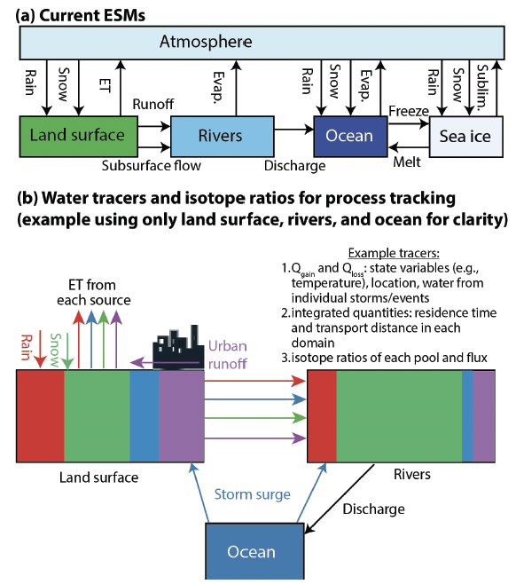
Probing water-cycle processes and extremes in coastal and urban environments using water isotope ratio tracers and numerical tags
This project will add water tracers/isotopes to EAMxx, ELM (in collaboration), and MOSART, and work toward coupling these systems
The new tracer infrastructure will increase capability to understand coastal-urban change, the impacts of urbanization on coasts and extreme events, and the efficacy of urban-coastal resilience strategies
PI: Rich Fiorella

Slide 5
Ocean and Sea ice

Slide 6
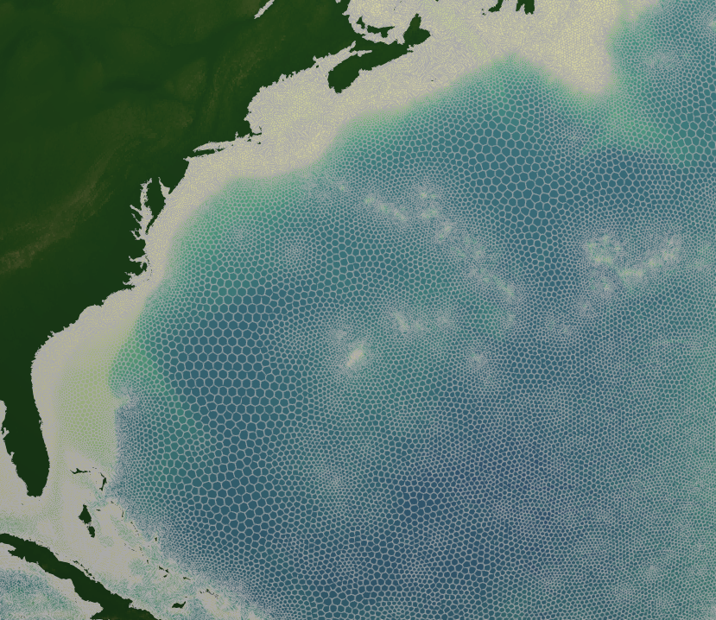
Tides in MPAS-Ocean
Variable resolution mesh: 45 to 5 km
MPAS-Ocean is capable of accurately simulating tides
Computationally efficient inline self attraction and loading (Barton et al. 2022, Brus et al. 2023)
Ice shelf cavities (Pal et al. 2022)
Topographic wave drag parameterization
Variable resolution meshes are required to resolve coasts, shelf-breaks, mid-ocean ridges.
Tides are dynamically changing: SLR, ocean stratification, ice shelf geometry (Barton et al. in prep).
Tidal Potential
Inline SAL

Slide 7
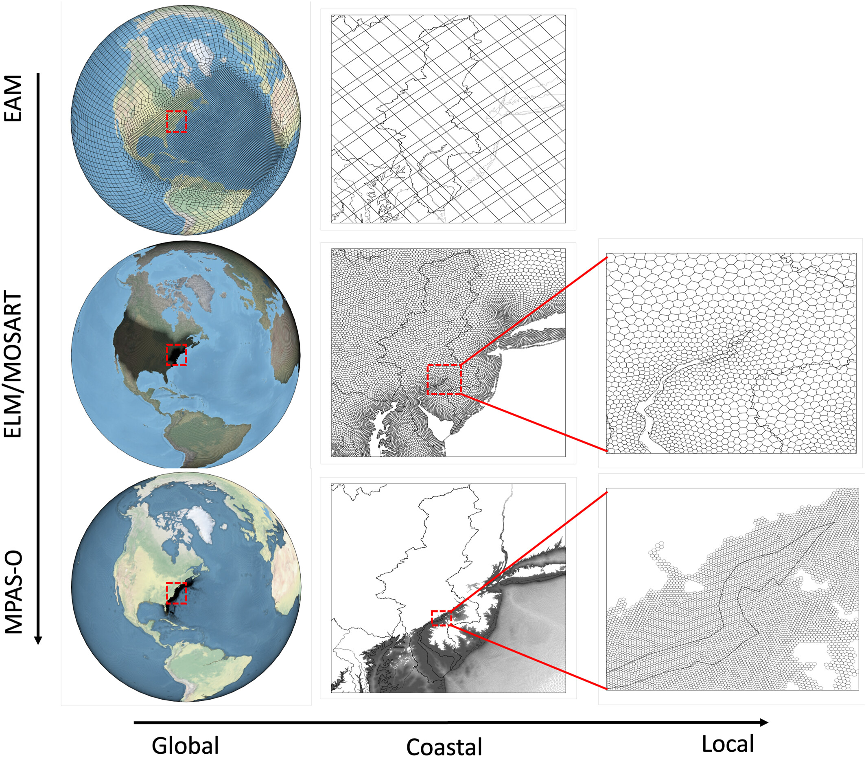
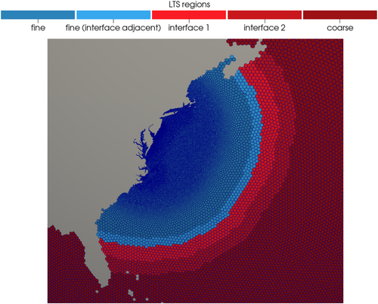
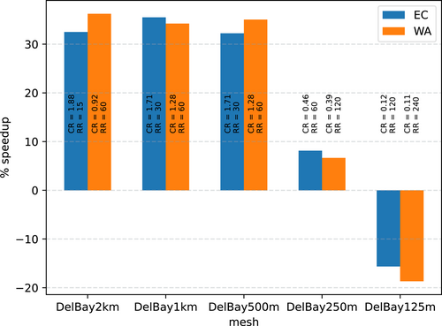
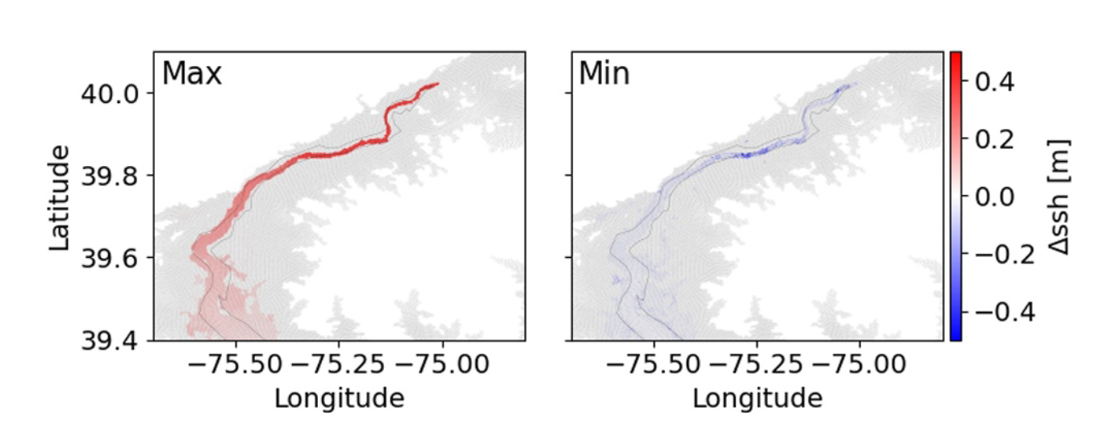
Coastal Inundation in E3SM
Unified framework for two-way land/river/ocean coupling allows for assessment of compound flooding effects
Local time-stepping (LTS) is a promising approach for increasing the efficiency of high coastal resolution
LTS speedup
Differences between 1-way and 2-way coupling
Lilly et al. 2023
Feng et al. 2024

Slide 8
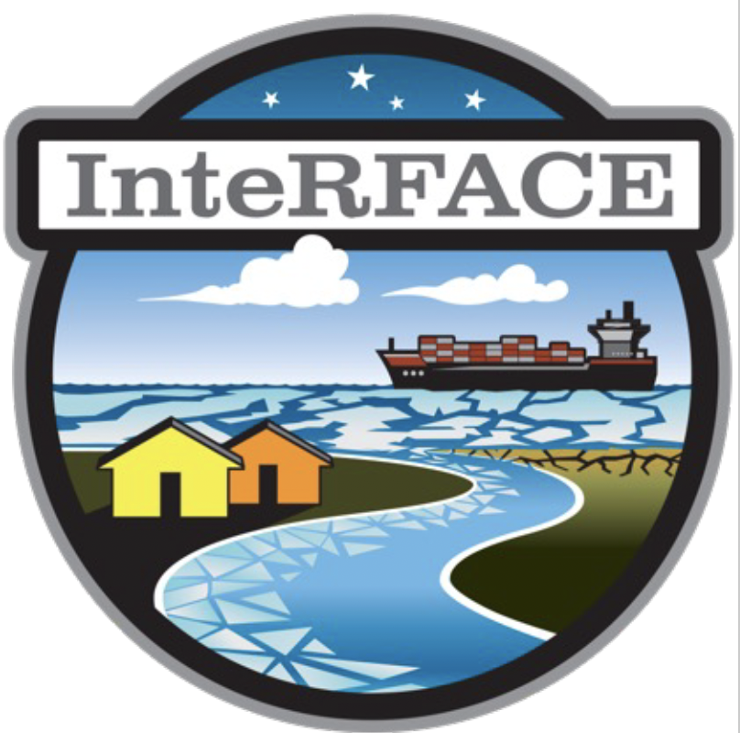
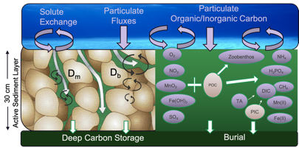
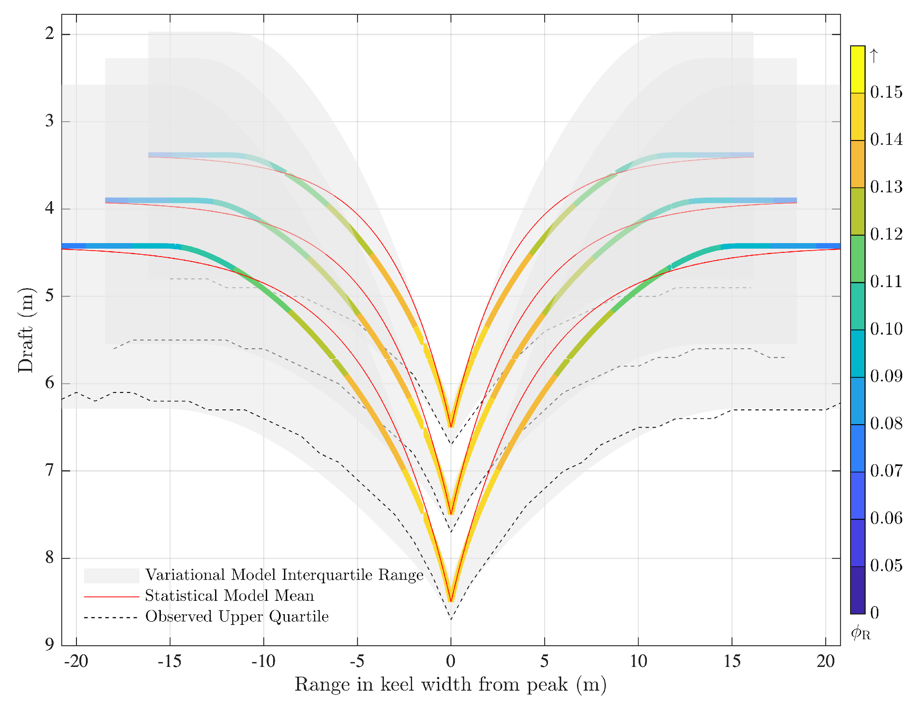
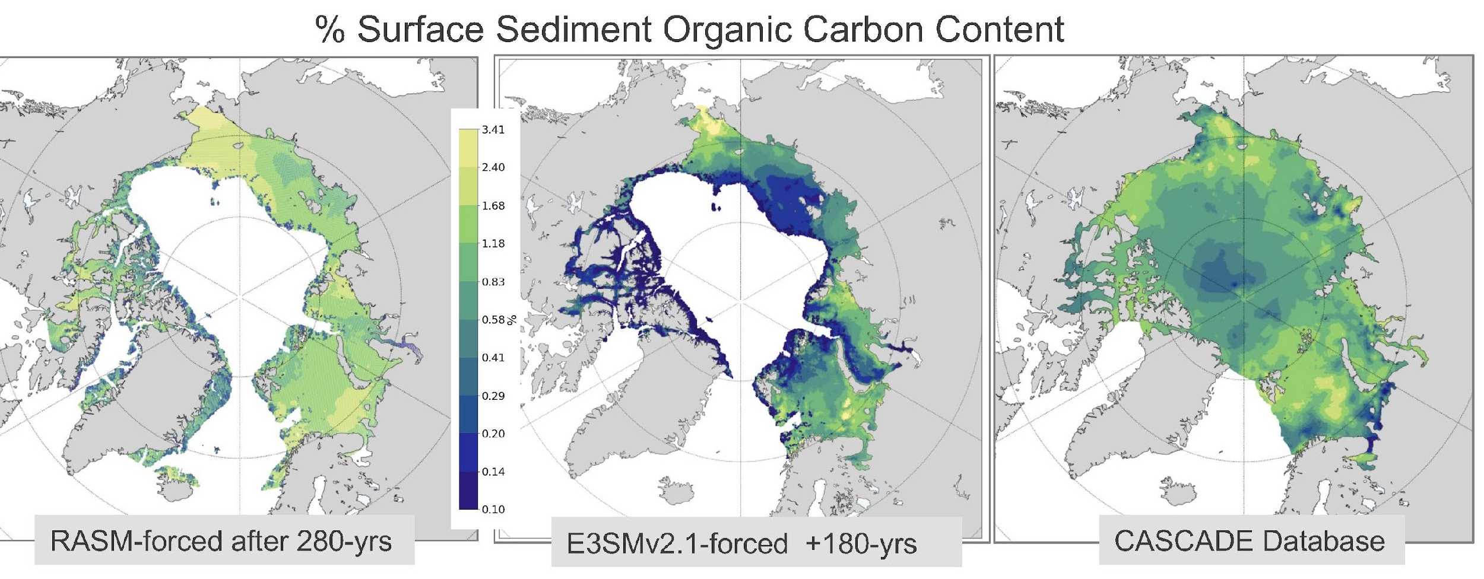
MPAS-Ocean: New Seafloor (benthic) BGC submodule for Arctic coastal and shelf waters – dynamic modeling of sediment diagenesis
MPAS-Seaice: Improving the shape of Sea ice ridges for coastal sea ice model
Validating Keel shape
Equilibrium % Organic Carbon in Surface Sediments
Metzger et al. 2021
Future efforts – Improving Multi-phase coupling in E3SM in the littoral zone for landfast sea ice modeling
Obs
Landfast
Sea ice
RASM-forced
E3SMv2-forced
Jeffery
Future efforts 2-way coupling with MarBL for evaluating ocean biogeochemical feedbacks with the seafloor
Notes:
First work is paper showing validation of an improved representation of ridged sea ice – this work contributes to the development of a landfast sea ice parameterization and more broadly to an overall effort to improved Multiphase coupling in E3SM in the littoral zone
Benthic BGC submodule in MPAS-Ocean is of the upper 30 cm of the ocean seafloor. There are 35 BGC tracers. The simulations are 200+ years of spin-up forced by ocean bgc and physics climatology from a 1) RASM historical run and an 2) E3SMv2 JRA simulation. Future work is to fully couple MaRBL with the Benthos.

Slide 9
Rivers, Lakes, and Watersheds

Slide 10
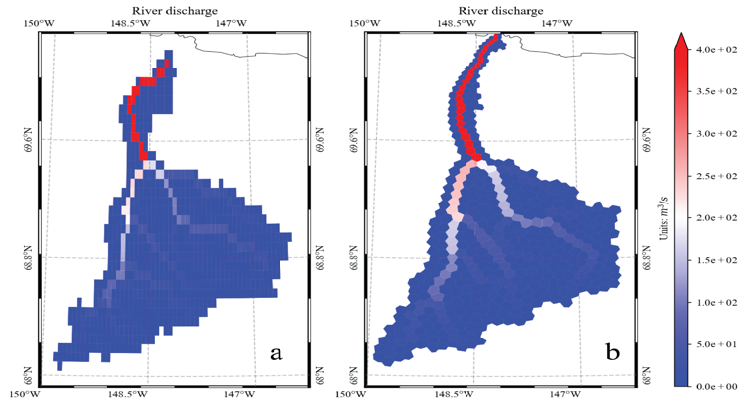
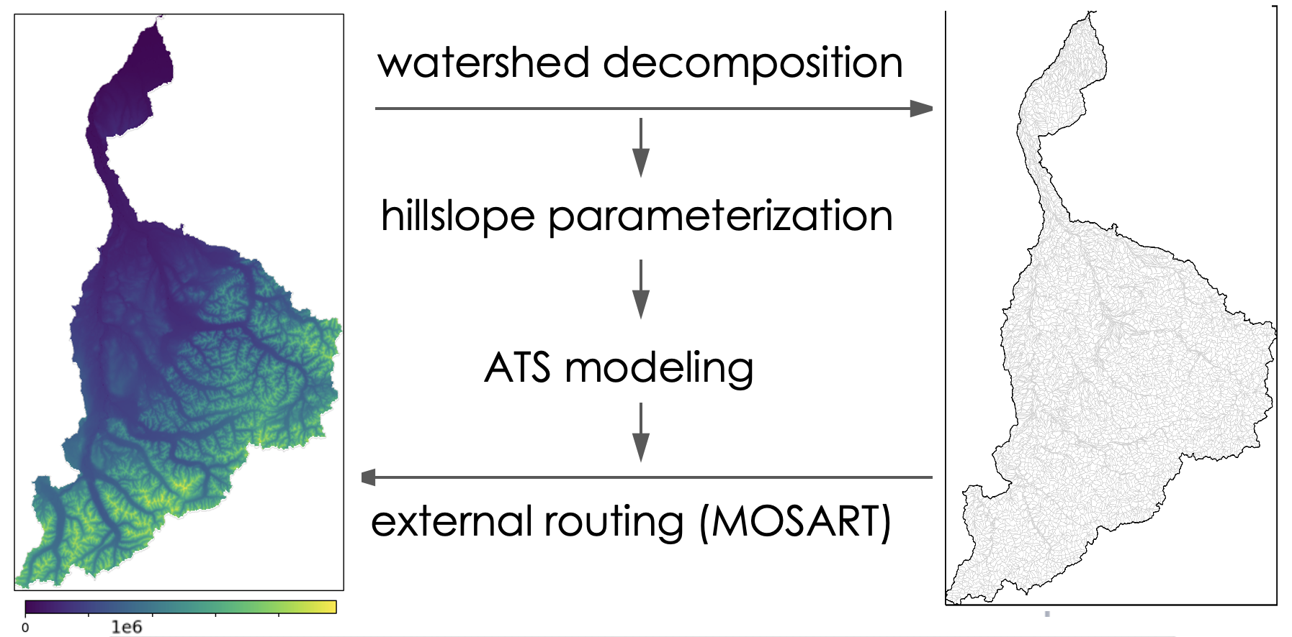
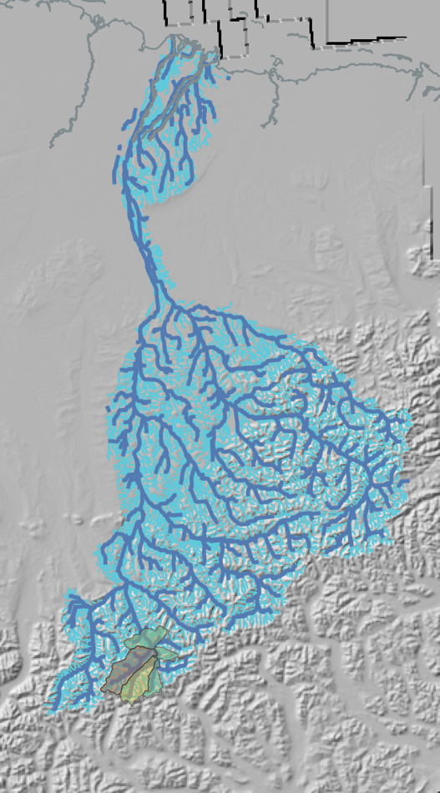
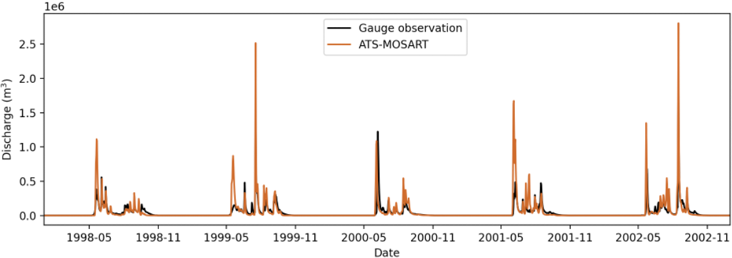
Arctic Watersheds
Multi-scale methods for Arctic watershed modeling – Coupling process-rich models (ATS) to understand the impacts of lateral flow on Arctic river outflow (MOSART) with RGMA
MOSART: A novel approach to construct mesh-independent river networks (with ICoM)
Sagavanirktok River Basin, AK
Regular mesh
Unstructured Mesh
Gao & Coon 2022
Future efforts - Towards a Land-River-Marine Unified Mesh for the Arctic
Future efforts use ML approaches to reduce the hillslope number by an order of magnitude to enable multiple watersheds and century simulations
ICOS30 Land Mesh
Zhou & Liao
Notes:
ATS is the Advanced Terrestrial Simulator – Process level hydrological model capable of 3D flow and freeze/thaw dynamics - The coupling method decomposes a watershed into 2D hillslopes, ATS simulates flow in these 2D regions, results funnel to MOSART and are compared with E3SM simulations for the Sag River Basin. (validation with Gauge observations is below)
Unified mesh work is with ICoM. They’ve developed a novel approach to construct mesh-independent river networks and we’ve applied to the Sag river basin. Future work allows for the development of a land-river-ocean-ice unified mesh. This example shows the a land mesh generated from the ICOS30 unstructured Mesh

Slide 11
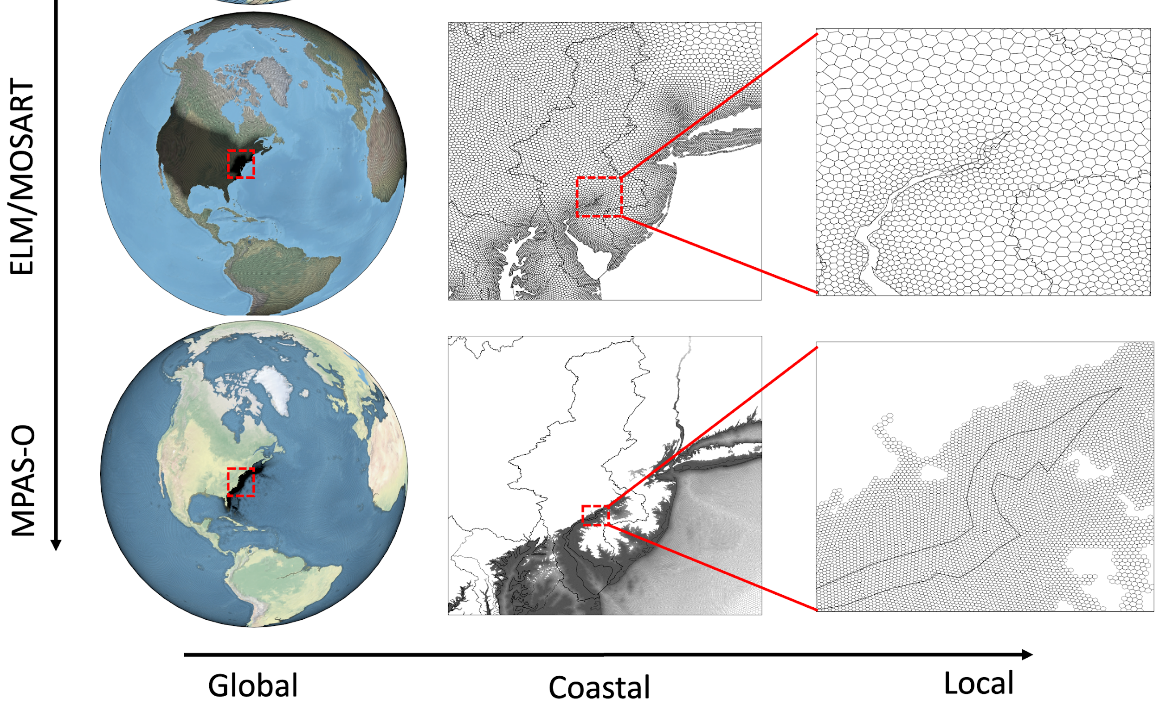
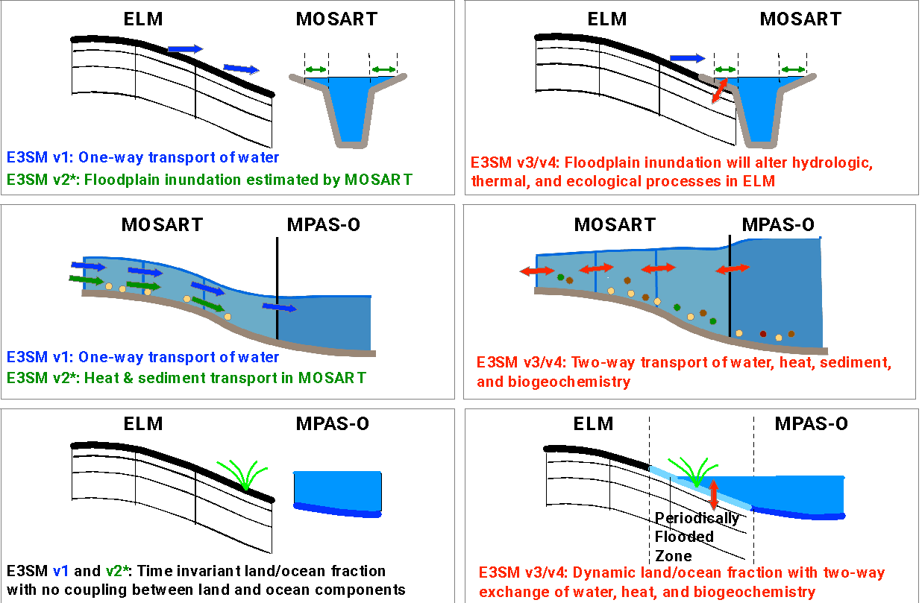
New & Upcoming Modeling Capabilities across the land-river-ocean interface in E3SM
Unified Surface Mesh: ICoM
Two-way transport of water, nutrients, and sediments between land, river, and ocean: ICoM & E3SM
A River Dynamical Core (RDycore) is being developed to model compound flooding, sediment dynamics, and saltwater intrusion: SciDAC5
Notes:
Unified Mesh: Through ICoM Project
The land and river models can both use JIGSAW-generated Voronoi polygonal meshes. This allows a seamless transition at the coastal interface.
Two-way coupling:
In the default E3SM configuration, fresh water is transported from the land to the ocean via rivers. This transport is unidirectional.
The ICoM project has already developed the following capabilities:
A two-way exchange of fresh water between land and river is a model in which the river can overflow its bank and then infiltrate the soil.
A two-way exchange of fresh water between river and ocean to enable the simulation of backwater effects due to storm surge.
A one-way exchange of fresh water between the land and data-ocean model to enable the simulation of sea level rise on coastal
In E3SM and ICoM:
Transport of nutrients and sediment from the land to the ocean through rivers is being added.
A SciDAC5 project is developing a new river dynamical core (RDycore) that will solve 2D Shallow Water Equations and will include support of heterogeneous computing

Slide 12
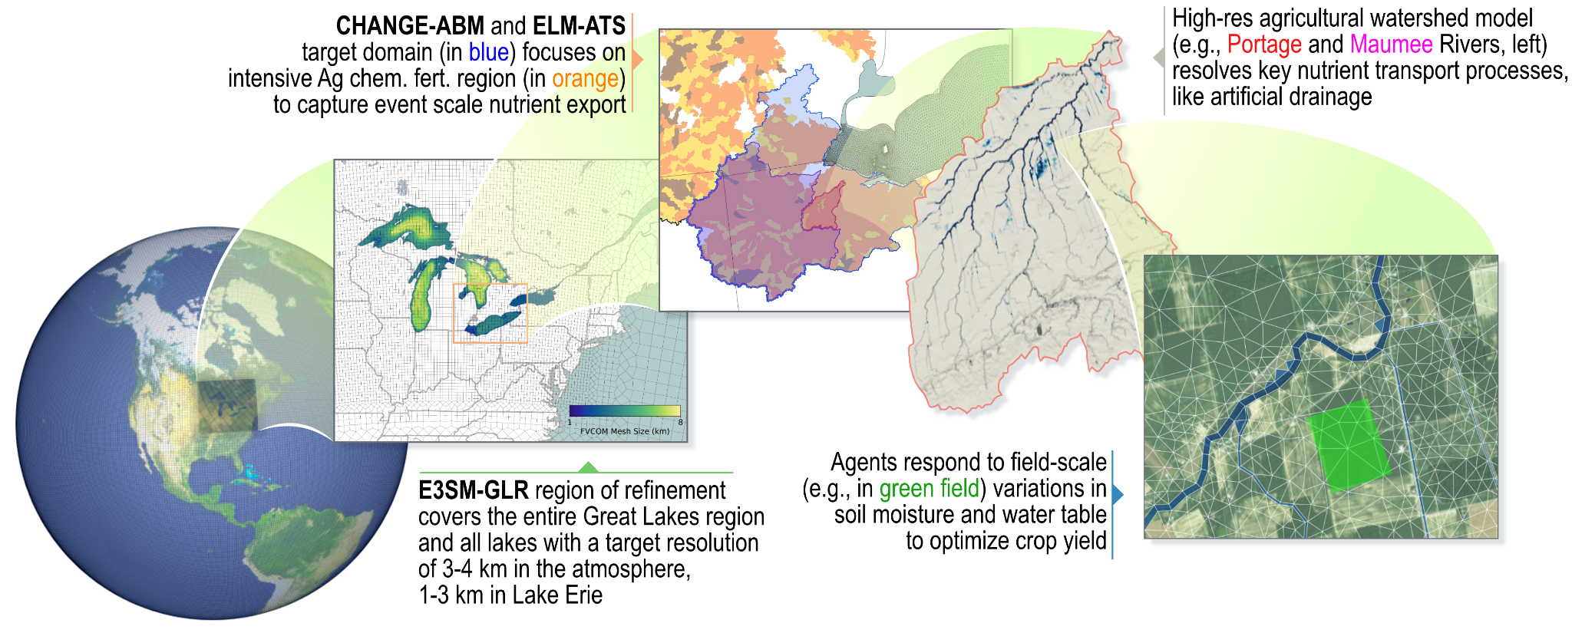
COMPASS-GLM brings together a hierarchy of models with a broad range of resolution

Slide 13
Outstanding Questions and Grand Challenges
E3SM and ESMs more broadly are likely not the right tools for all coastal questions
Time steps
Missing couplings and physics
Model assumptions
Feedback from coast to large scale may be small
How can the full range of models/tools be interfaced to answer important science questions?
Data formats? In situ vs. offline coupling?
What key model developments are needed for coastal zones?
A few ideas: Regional complexity for BGC, scale aware physics, coupling capability to MSD ‘use case’ models, improved wave physics. Computational improvements (performance, stability, etc…)

