Slide 1
Science Plan for V2 and V3
L. Ruby Leung

Slide 2
Summary of tropics and arctic discussions for ACME v2 science plan
Science questions/themes of ACME and collaborative projects:
  ACME v2 science questions for the regions
  Common themes/interests across projects
Capabilities and model development needs
  Relevant capabilities (model parameterizations, model-data integration framework, metrics, analysis and diagnostic tools, measurement data)
  Gaps in v1 models relevant to the science
Experiments
  Model configurations
  Groups of experiments

Slide 3
Questions for v2 tropics focus
Water cycle/cryosphere: How do soil-plant-atmosphere interactions influence water recycling in tropical forest and plant response to the perturbations such as LULCC? What are the local and remote influence of the plant response in the Amazon?
Stomatal conductance response dominates the changes in Amazon precipitation under warming
15-30% of precipitation in the Amazon comes from local recycling
(Trenberth 1997)
(Kooperman et al. 2017 in review)

Slide 4
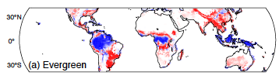


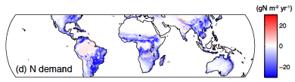
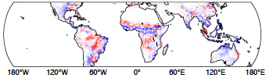

Questions for v2 tropics focus
Biogeochemistry: What is the relative influence of plant phenology and vegetation dynamics of tropical forests on cycling of carbon in the Amazon?
Large difference in carbon-climate feedback between simulations with prescribed vs. dynamic vegetation. Difference in N demand and production among different PFTs combined with changes in the PFTs determine the carbon-climate feedback
N production
(Sakaguchi et al. 2016)
Notes:
Forest dynamics and nitrogen cycle are important for determining carbon-climate feedback

Slide 5
Numerical experiments
Water cycle and cryosphere:
  Combined coupled experiments for water cycle and cryosphere questions using a tropical RR configurations without BGC
  Include simulations with multiple forcings (GHG, aerosols, LULCC)
  Multiple ensemble members of 1970-2050
Biogeochemistry:
  Coupled experiments using the tropical RR configuration with coupled BGC cycle and prescribed CO2 (B case) for 1850-2100
  Include multiple simulations with vegetation dynamics on/off in FATES

Slide 6
Atmosphere and land grid
Same grid for atmosphere and land
Leveraging experience from v1 water cycle experiments for low and high resolution: Amazon: 25 km; outside: 100 km
RR grid computational saving relative to global 25 km grid ~ x6.5
Notes:
13,266

Slide 7
Collaborative projects: NGEE tropics
Capabilities
  FATES (a demographic vegetation model) and FATES-hydro models for ALM
  Datasets (stream hydrology, fluxes, traits) for assessing coupled system dynamics
Science interests
  Understanding effect of structural heterogeneity, plant hydraulics, and plant functional variation on coupled system behavior:
    Mean-state diurnal and seasonal cycles of water and energy
    Forced response of precipitation to biophysical CO₂ effects

Slide 8
Collaborative projects: BGC-Feedbacks
Capabilities:
  Community open source benchmarking software systems
  Framework for decadal predictions of biogeochemistry and ecosystem response
Science interests:
  Understanding how changes in water availability influence regional temperatures
  Decomposing continental influences on global precipitation
  Understanding the influence of tropical biomass burning, deforestation, and afforestation on global biogeochemical cycles
  Constraining ecosystem responses by confronting models with land, ocean, and atmosphere measurements and informing field activities
  Developing tropical-specific metrics for evaluating ACME and community models

Slide 9
Questions for v2 Arctic focus
Water cycle: What controls extreme moisture transport to the Arctic and its impacts on seasonal melting of sea ice? How may sea ice and other high latitude changes influence extreme events worldwide
Extreme moisture to the Arctic in winter/spring reduces sea ice in the summer – increasing trend of moisture transport explained half of the sea ice loss in the Atlantic sector between 1979-2011
A slowed and more sinuous jet stream due to loss of sea ice is hypothesized to increase frequency of blocking and cold air outbreaks
(Park et al. 2015a&b)
(Francis and Vavrus 2012)

Slide 10
Questions for v2 Arctic focus
Cryospheric processes: How do trends and variability in ocean water mass transformation in the Arctic, as driven by changes in seasonal extent of sea ice, Greenland melt and river runoff, air-sea interaction and Arctic precipitation, impact the Arctic ocean circulation and the AMOC, with remote influence on weather extremes?
Melt water focusing in the Labrador Sea and in a short time period may have significant effect on AMOC
New estimates of Greenland freshwater flux and heat and salt flux from the North Atlantic into the Labrador Sea suggest a direct link of Labrador Sea Water formation to recent freshening, and a possible link to AMOC weakening
(Yang et al. 2016)

Slide 11
Questions for v2 Arctic focus
Biogeochemistry: How does surface heterogeneity, including sea-ice, snowpack, permafrost, and vegetation cover interact with changes in seasonality of temperature and precipitation to influence biogeochemistry and ecosystems in the Arctic
Sea ice coverage in 1980 (bottom) and 2012 (top) from satellite
Changes in vegetation (NDVI) between 1982 and 2011 showing greening in the tundra
Permafrost distribution
(NRC 2015)

Slide 12
Numerical experiments
Water cycle and cryosphere:
  Combined coupled experiments for water cycle and cryosphere questions using an Arctic RR configurations without BGC
  Multiple ensemble members of 1970-2050
Biogeochemistry:
  Coupled experiments using the Arctic RR configuration with coupled BGC cycle and prescribed CO2 (B case) for 1850-2100
  Include some experiments using offline land and ocean/ice models

Slide 13
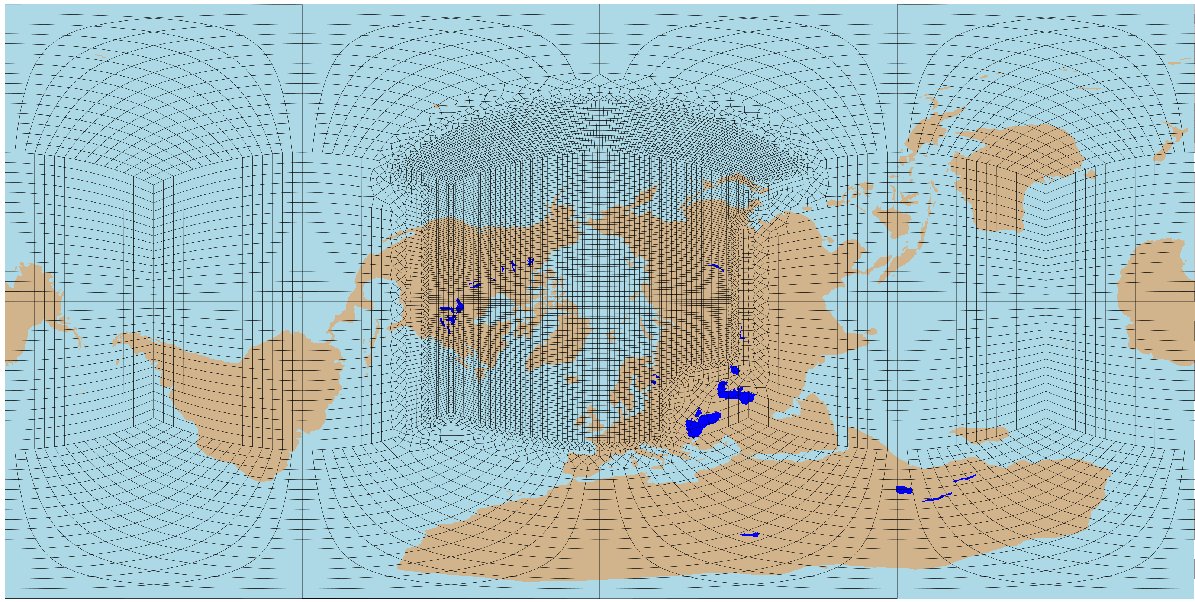
Atmosphere and land grid
Leveraging experience from v1 water cycle experiments for low and high resolution: Arctic: 25 km; outside: 100 km
Computational saving relative to global 25km grid ~ x4

Slide 14
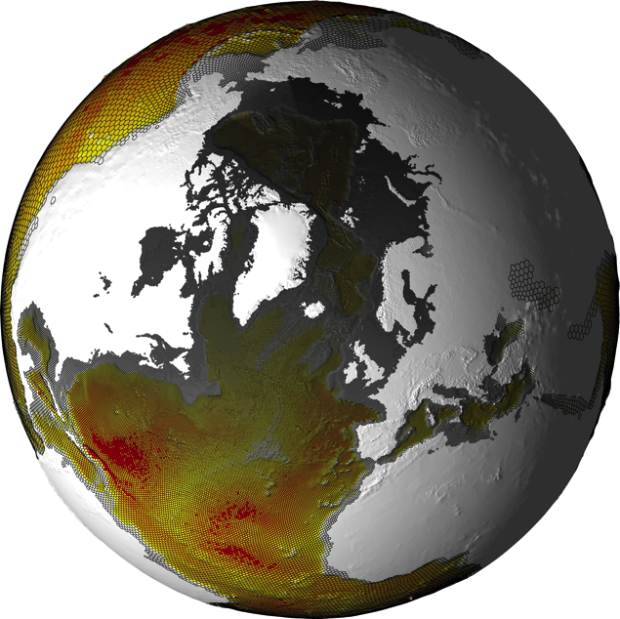
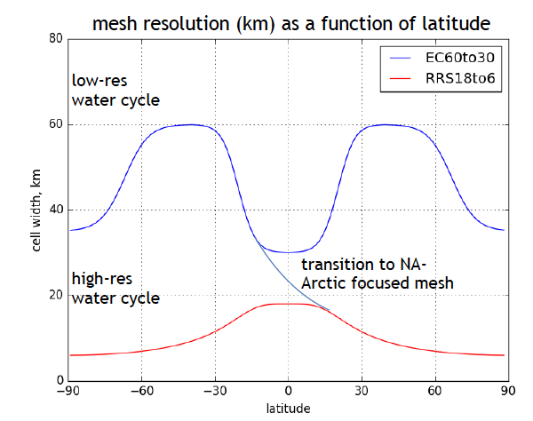
Ocean/ice grid
A hybrid v1 water cycle low and high resolution meshes
North Atlantic / Arctic ocean domain scales from 18 km at Equator to 6 km in the Arctic
Computational saving relative to global high resolution ~ x4

Slide 15
Collaborative projects: HiLAT
Capabilities:
  Analysis tools, observations, diagnostics
  Understanding of Arctic system
Science interests:
  Make use of ACME for science investigations:
    What are the mechanisms responsible for thermodynamic and water changes in high latitude? What are connections with Arctic Sea Ice change? What are the consequences to the rest of the planet?
    How do ocean constituents affect the Earth System? What implications does this have for high latitude climate dynamics?
  Contributions to ACME:
    Identify deficiencies relevant to high latitude ES features
    Identify tuning changes that might address some deficiencies
    Identify opportunities for improvement (e.g. a missing process, or alternative formulation for a process)
    These insights might be useful for ACME V3

Slide 16
Collaborative projects: RASM
Capabilities:
  Satellite sea ice emulator for an adaptive grid
  Variational form drag for sea ice
  Scale-aware sea ice dynamics
  Evaluation and tuning of model components and their coupling
  Additional DOD HPC resources for multi-decadal simulations
Science/modeling interests:
  By resolving unresolved or under represented processes in individual system components.
  By addressing inadequacies along coupling channels between different system components
  By exploring space-dependent sensitivities in the parameter space
  Through a hierarchical modeling approach using regional and global models to help quantify uncertainty for seasonal to decadal prediction

Slide 17
Collaborative projects: NGEE Arctic
Capabilities:
  Scale-specific models where each exploits approximations, parameterizations, and understanding derived from finer scales
  Nested subgrid heterogeneity to capture details from scale-specific models
  Coupling strategies that link permafrost-enabled thermal hydrology to Arctic vegetation dynamics and biogeochemical cycles
  Robust data-passing interfaces that link core functions and are implemented by software engineers and land model developers (e.g., CMDV)
Science/modeling interests:
  Landscape heterogeneity in surface and subsurface properties and processes
  Biogeochemical feedbacks due to thawing permafrost, landscape evolution, and consequences for microbial dynamics that drive CO2 and CH4 emissions
  Biophysical feedbacks due to shrubs and shrub expansion, and regional changes in energy balance for evolving landscapes, and
  Hydrology at watershed scales and importance of active layer, permafrost, and bedrock interactions that drive water distribution in Arctic ecosystems

Slide 18
Collaborative projects: BGC Feedbacks
Capabilities:
  Permafrost prediction capabilities
  Evaluate predictions of CH4 emissions against measurements
  Lake model and observational constraints
  Using measurements to evaluate high latitude soil carbon
  Modeling high latitude vegetation

Slide 19
Collaborative projects: Zeng’s project
Capabilities:
  Model evaluation and diagnostics of simulation of high latitude processes
  Modeling soil thickness and evaluation over the arctic

Slide 20
Next steps
Prioritization of v2 roadmaps
  Alignment with v2 science questions (e.g., snow processes across components; fire modeling)
  Fixing critical issues in v1
Development of experiment plan and timeline, with inputs from collaborating projects
  ACME-NGEE liaisons developing combined roadmaps related to land model development
  Plan for integrating model features and diagnostic tools to ACME
Development of collaboration plan
  Discussion with project leads

Slide 21
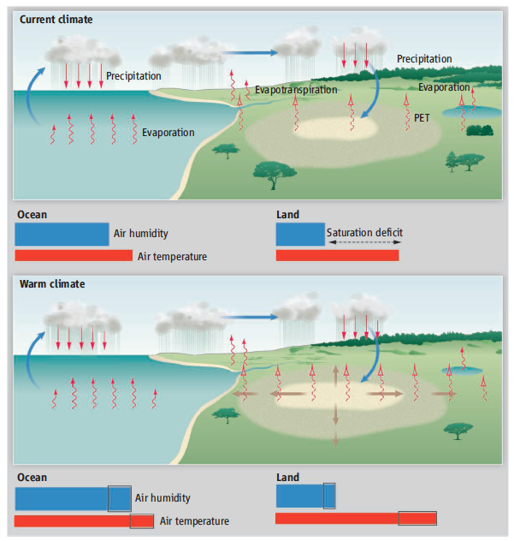
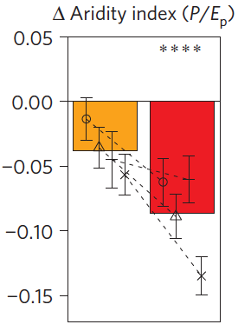

V3 - Water Cycle
Moisture supply for precipitation over land
What controls the moisture sources and their spatial distribution for seasonal and extreme precipitation over land? How may they change in the future in response to perturbations?
What are the uncertainties associated with model resolution (from a few km to 100 km) and physics parameterizations?
Ocean / atmosphere processes dominate aridity changes
Land-atmosphere feedbacks amplify aridity
(Sherwood and Fu 2014, Science)
(Berg et al. 2016, Nature Climate Change)

Slide 22
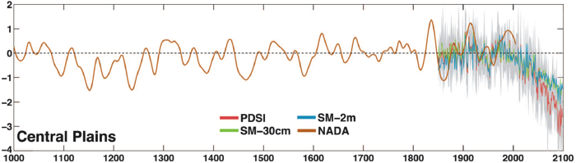
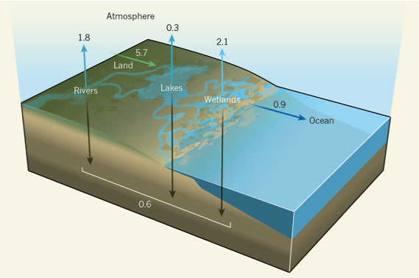
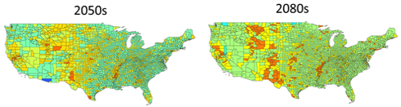


V3 - Biogeochemistry
Impacts of energy and landuse future on biogeochemistry and water availability
What are the impacts of different energy and landuse future on terrestrial biogeochemistry and water availability?
How might terrestrial-aquatic processes associated with the energy and landuse future combined with extreme events and regional sea level rise influence hypoxia in the coastal zone?
CMIP5 models projected future drought risks exceeding the driest centuries of the Medieval Climate Anomaly (1100–1300CE)
Carbon fluxes related to inland aquatic ecosystems (Streams, Rivers, Lakes, and Wetlands) have the potential to explain a large portion of the unknown residual land sink
(Cook et al. 2015 Sci. Rep.)
Increased irrigation water demand from bioenergy crops increases water deficits
Water deficit as a fraction of demand
(Hejazi et al. 2015 PNAS)
(Wehrli, 2013, Nature; Raymond et al., 2013, Nature)

Slide 23
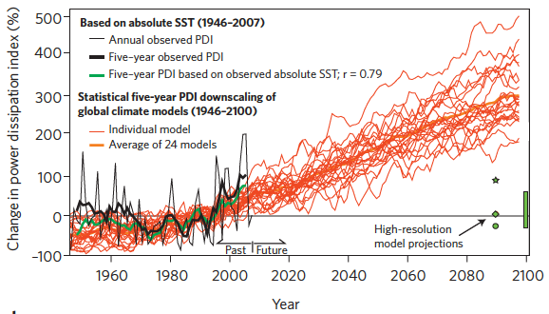
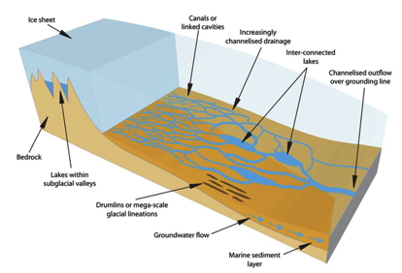
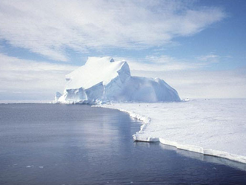
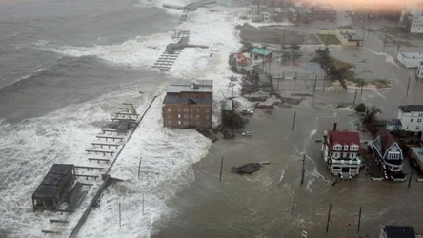
V3 - Cryosphere Systems
Regional sea level rise and implications to coastal inundation
What processes contribute to key uncertainty in projecting regional SLR?
What are the implications to coastal inundation that result from interactions between SLR and extreme storms?
Projected increase in Atlantic hurricane intensity
Sources of uncertainty in SLR
Water mass transformation and deep water creation around Antarctica
Solid and liquid discharge from ice sheets
Snow processes on sea ice
(Knutson et al., 2010, Nature Geosci.)
(Ashmore and Bingham 2014)

Slide 24
Discussion
Water mass transformation and deep water creation around Antarctica

Slide 25
Development timeline
Relevant dates:
  V1 release: 12/1/2017 – collaborators may have earlier access once the LR model is finalized for the DECK experiment
  V2 feature freeze: 6/1/2018
  V2 release: 6/1/2020
ACME-Arctic development
  10/2017: Arctic RR grid configured for atmosphere, land, and ocean
  1/2018: Test run of RR grid for G case complete using v1 (share with collaborators)
  6/2018: Model development for v2 complete
  9/2018: Arctic RR grid coupled simulation established
  3/2019: Tuning of coupled simulation complete
  3/2019: Submit manuscript(s) on Arctic RR G case simulations
  9/2019: Control simulation for water cycle/cryosphere and BGC experiments complete
  3/2020: Sensitivity simulations for water cycle/cryosphere and BGC experiments complete
  3/2020: Submit manuscript(s) on Arctic RR coupled control simulations
  6/2020: Release of v2 and Arctic configuration and simulation outputs
Analysis of simulations (3/2019 – 6/2020) and more publications

