Slide 1
The myriad Arctic influence

Slide 2
Questions for v2 Arctic focus
Water cycle: What controls extreme moisture transport to the Arctic and its impacts on seasonal melting of sea ice? How may sea ice and other high latitude changes influence extreme events worldwide
Extreme moisture to the Arctic in winter/spring reduces sea ice in the summer – increasing trend of moisture transport explained half of the sea ice loss in the Atlantic sector between 1979-2011
A slowed and more sinuous jet stream due to loss of sea ice is hypothesized to increase frequency of blocking and cold air outbreaks
(Park et al. 2015a&b)
(Francis and Vavrus 2012)

Slide 3
Questions for v2 Arctic focus
Cryospheric processes: How do trends and variability in ocean water mass transformation in the Arctic, as driven by changes in seasonal extent of sea ice, Greenland melt and river runoff, air-sea interaction and Arctic precipitation, impact the Arctic ocean circulation and the AMOC, with remote influence on weather extremes?
Melt water focusing in the Labrador Sea and in a short time period may have significant effect on AMOC
New estimates of Greenland freshwater flux and heat and salt flux from the North Atlantic into the Labrador Sea suggest a direct link of Labrador Sea Water formation to recent freshening, and a possible link to AMOC weakening
(Yang et al. 2016)

Slide 4
Questions for v2 Arctic focus
Biogeochemistry: How does surface heterogeneity, including sea-ice, snowpack, permafrost, and vegetation cover interact with changes in seasonality of temperature and precipitation to influence biogeochemistry and ecosystems in the Arctic
Sea ice coverage in 1980 (bottom) and 2012 (top) from satellite
Changes in vegetation (NDVI) between 1982 and 2011 showing greening in the tundra
Permafrost distribution
(NRC 2015)

Slide 5
Numerical experiments
Water cycle and cryosphere:
  Combined coupled experiments for water cycle and cryosphere questions using an Arctic RR configurations without BGC
  Multiple ensemble members of 1970-2050
Biogeochemistry:
  Coupled experiments using the Arctic RR configuration with coupled BGC cycle and prescribed CO2 (B case) for 1850-2100
  Include some experiments using offline land and ocean/ice models

Slide 6
Discussion
Science questions for ACME and collaborative projects
ACME Arctic regional refined (RR) grids
  Science requirements
  Computational requirements
Development and model configuration
  New development
  Parameterization improvements
  Biogeochemistry
Timeline
  Which ACME version
  Timeline

Slide 7
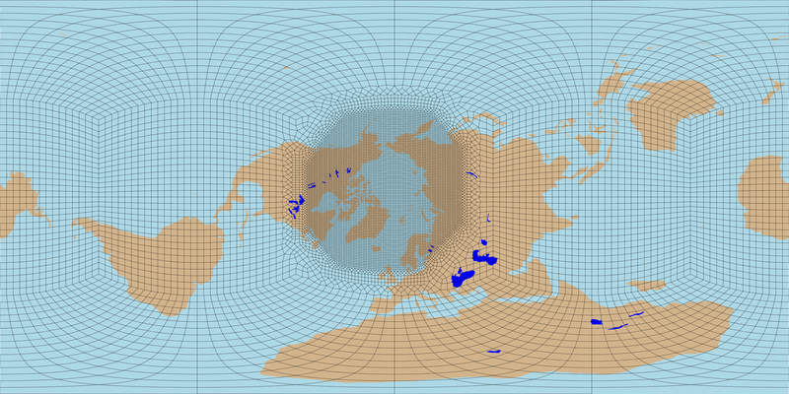
Atmosphere and land grid
Same grid for atmosphere and land
Leveraging experience from v1 water cycle experiments for low and high resolution: Arctic: 25 km; outside: 100 km
Important features to include in the RR domain: aerosol/cloud/radiation, storm tracks, land-atmosphere interactions, permafrost, thermokarst lakes, basins draining to the Arctic, …

Slide 8
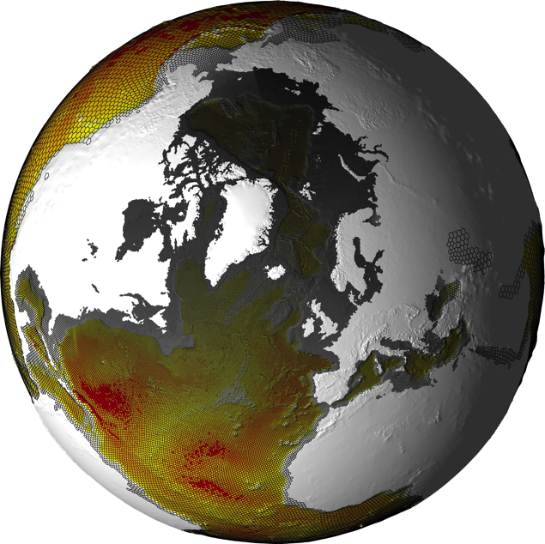
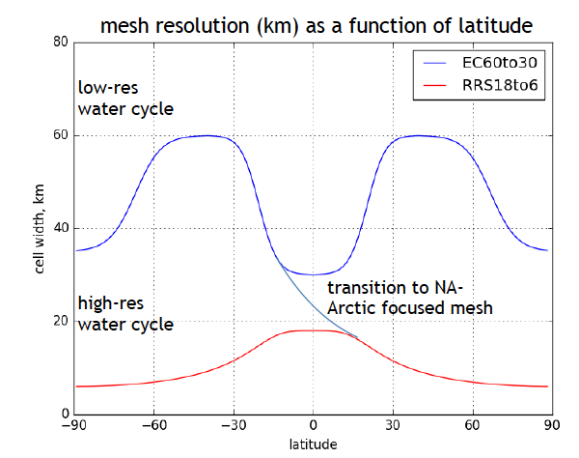
Ocean/ice grid
A hybrid v1 water cycle low and high resolution meshes
North Atlantic / Arctic ocean domain scales from 18 km at Equator to 6 km in the Arctic
Science requirements:

Slide 9
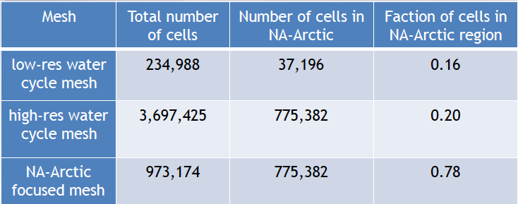
Computational requirements
Low-res water cycle mesh: 5,400 elements
High-res water cycle mesh: 86,400 elements
RR Arctic atmosphere/land grid: 14,191 elements = x6 computational savings
Ocean/ice grid: Arctic ~ 4x computational savings
Overall, computational savings relative to the high-res water cycle mesh is about x5
Reallocate computational resources to increasing the ensemble size

Slide 10
Development and model configuration
New development
Parameterization improvements
  Aerosol deposition on snow/ocean/ice
  Improved cloud ice nucleation
Model configuration
  Atmosphere, land, ocean, sea ice, land ice
  Complete biogeochemistry cycle?

Slide 11
Development timeline
Relevant dates:
  V1 release: 12/1/2017 – collaborators may have earlier access once the LR model is finalized for the DECK experiment
  V2 feature freeze: 6/1/2018
  V2 release: 6/1/2020
ACME-Arctic development
  10/2017: Arctic RR grid configured for atmosphere, land, and ocean
  1/2018: Test run of RR grid for G case complete using v1 (share with collaborators)
  6/2018: Model development for v2 complete
  9/2018: Arctic RR grid coupled simulation established
  3/2019: Tuning of coupled simulation complete
  3/2019: Submit manuscript(s) on Arctic RR G case simulations
  9/2019: Control simulation for water cycle/cryosphere and BGC experiments complete
  3/2020: Sensitivity simulations for water cycle/cryosphere and BGC experiments complete
  3/2020: Submit manuscript(s) on Arctic RR coupled control simulations
  6/2020: Release of v2 and Arctic configuration and simulation outputs
Analysis of simulations (3/2019 – 6/2020) and more publications

