Slide 1
Outline
Status of component models
  Component model breakout group discussion (Mon-Wed)
Status of coupled model (low and high resolution)
  V0 initialization and results (Mon)
  V1 science campaign (Tue)
  Coupled BGC discussion (Tue)
  Diagnosing v1 coupled model problems (Wed)
v2 science goals
  Tropics (Mon)
  Arctic (Tue)
  V2 and v3 science (Wed)

Slide 2
Atmosphere model features
Increased resolution:
  Δx=25km with 72 layers up to ~60km to better resolve atmospheric structures
New parameterizations:
  Aerosols: MAM3 → MAM4; revisions to convective transport, aerosol nucleation, scavenging, resuspension and sea spray aerosol
  Shallow convection and turbulence: → CLUBB
  Cloud microphysics: → Morrison Gettelman (MG2)
  Simple Ozone: linearized production and loss
  Ice microphysics: conversion to precipitation; ice nucleation (v2); subgrid vertical velocity (v3); pre-existing ice (v3)
  Convective gustiness (v2)
  Subgrid orographic effects: sub-columns for atmosphere and land (v3)
New capabilities:
  Regional refined model: e.g., RRM-CONUS and RRM-Arctic (v2)
  Short-term hindcast technique (CAPT) and Perturbed Parameter Ensemble (PPE)
  COSP: satellite simulators and ARM radar simulator

Slide 3
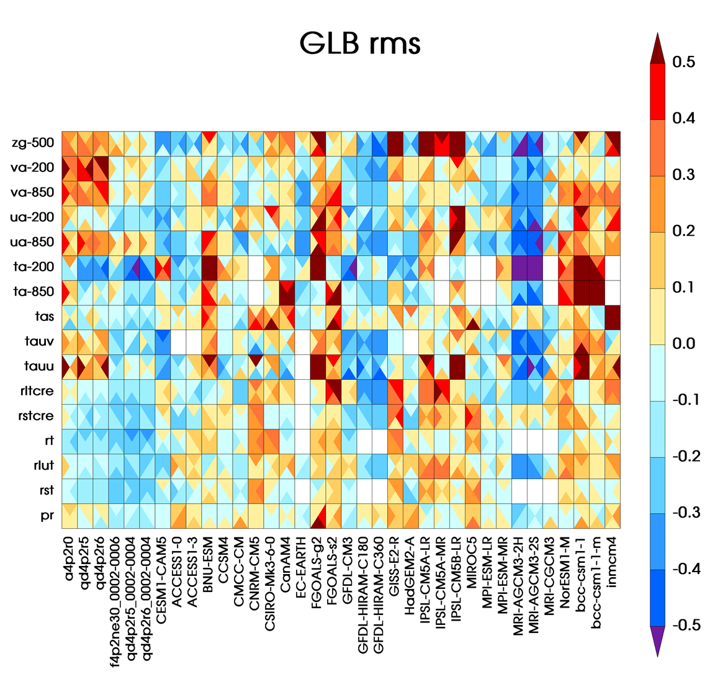

V1 Atmosphere – Better Than Most CMIP5 Models
V1-atm-L
V1-atm-H
CAM5
Worse
Better
Compared to CAM5:
  Overall improved simulation of cloud, radiation, and precipitation
  Slightly worse in large-scale circulation
Better than most of the CMIP5 atmosphere models
V1-atm-H being fine tuned for RESTOM

Slide 4
Ocean/ice model configuration
Components:
  Land-ice: MPAS-LI, ~20 to <1 km in regions
  Ocean: MPAS-Ocean, RRS 18-6 km (or ~1 km in regions)
  Sea-ice: MPAS-CICE, same mesh as ocean
Initial conditions:
  land-ice: N/A
  ocean: from CORE-II spin-up
  sea-ice: from CORE-II spin-up
Ice sheet and shelves:
  Static; ISM forced offline by ESM output

Slide 5
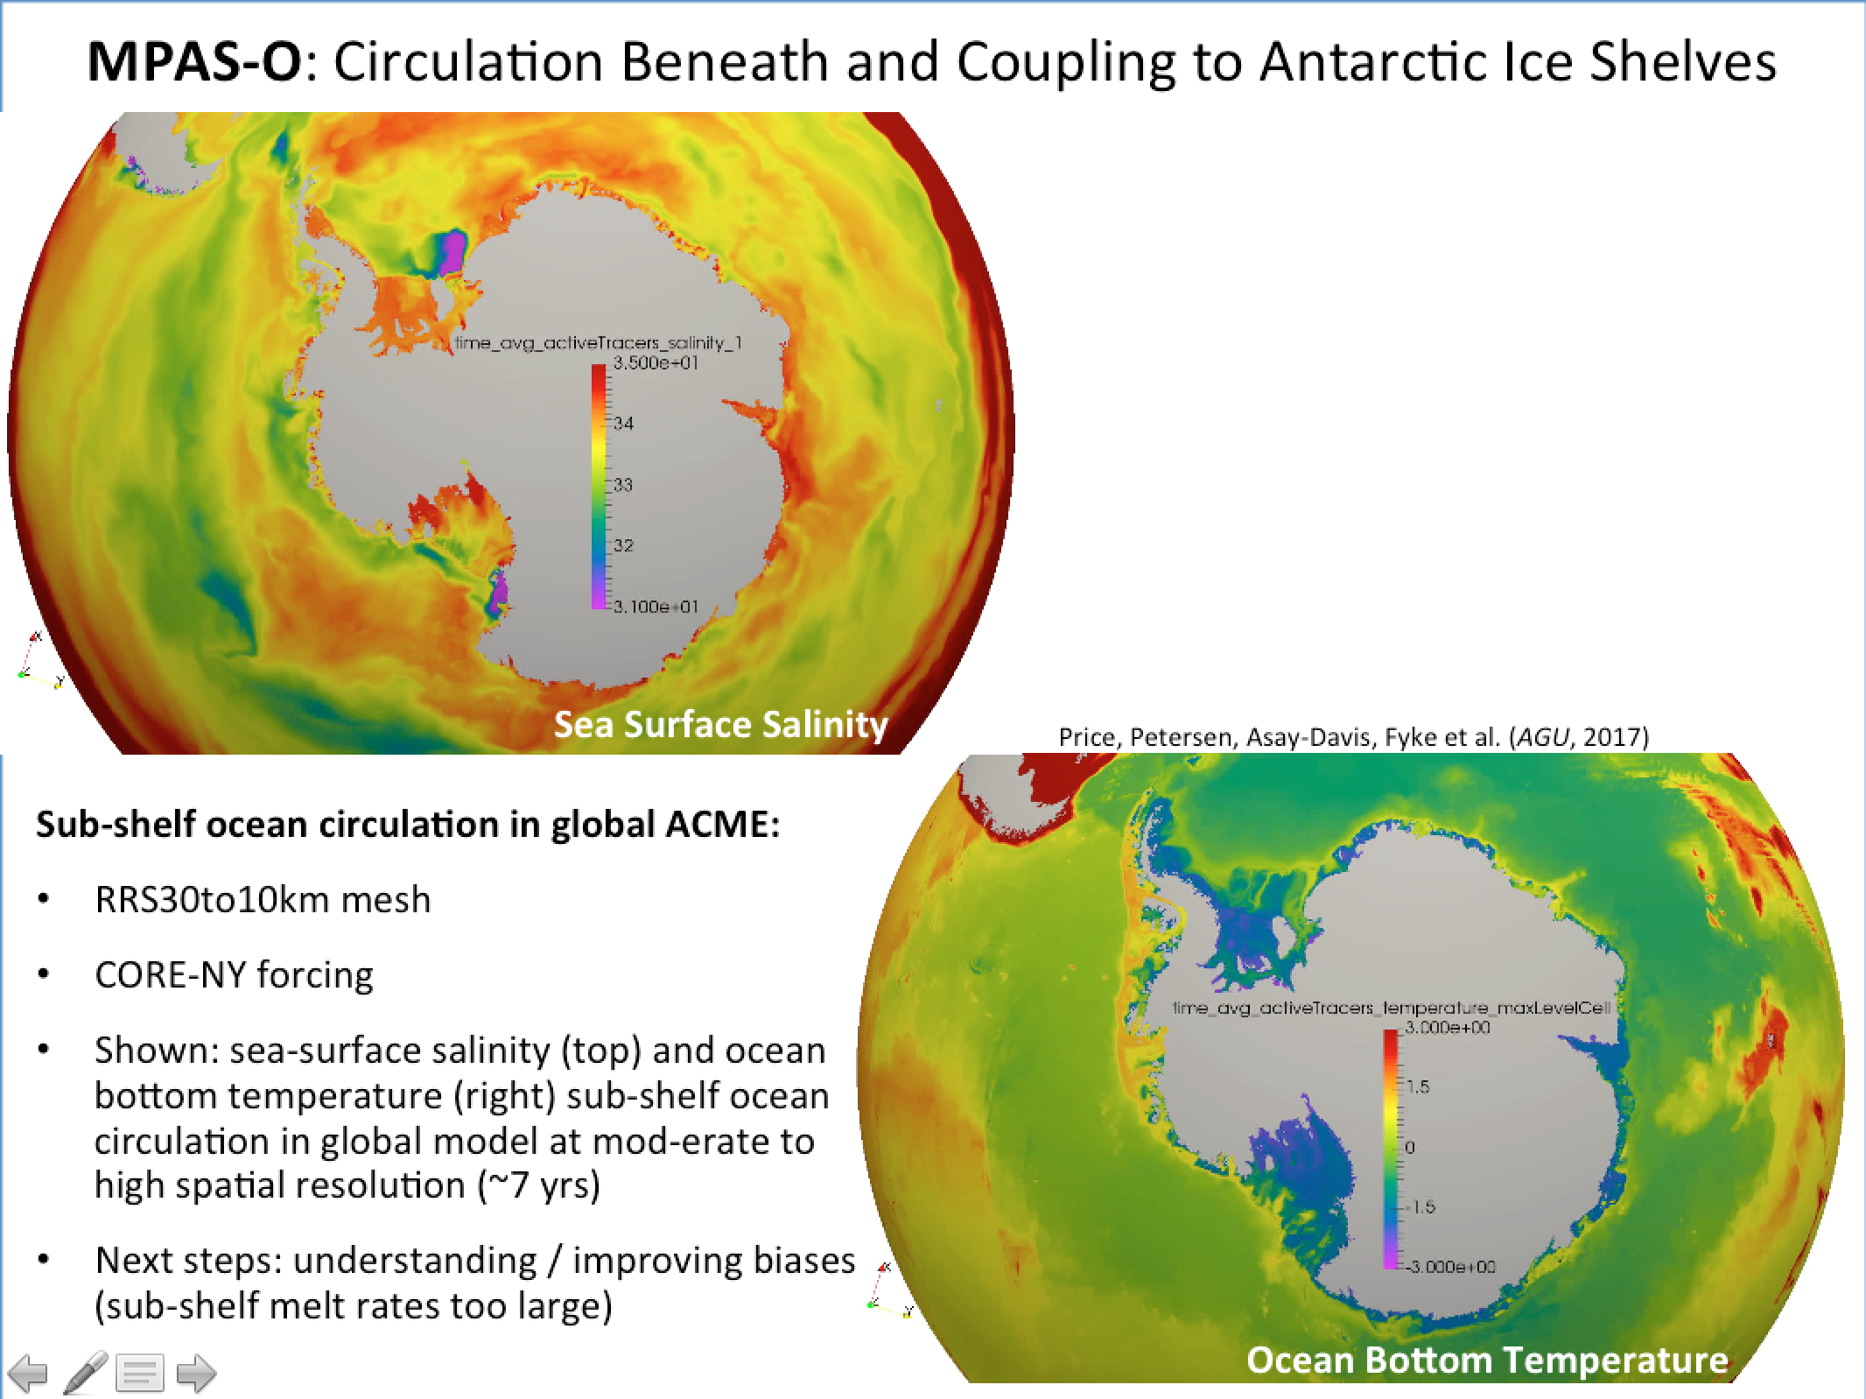

Slide 6
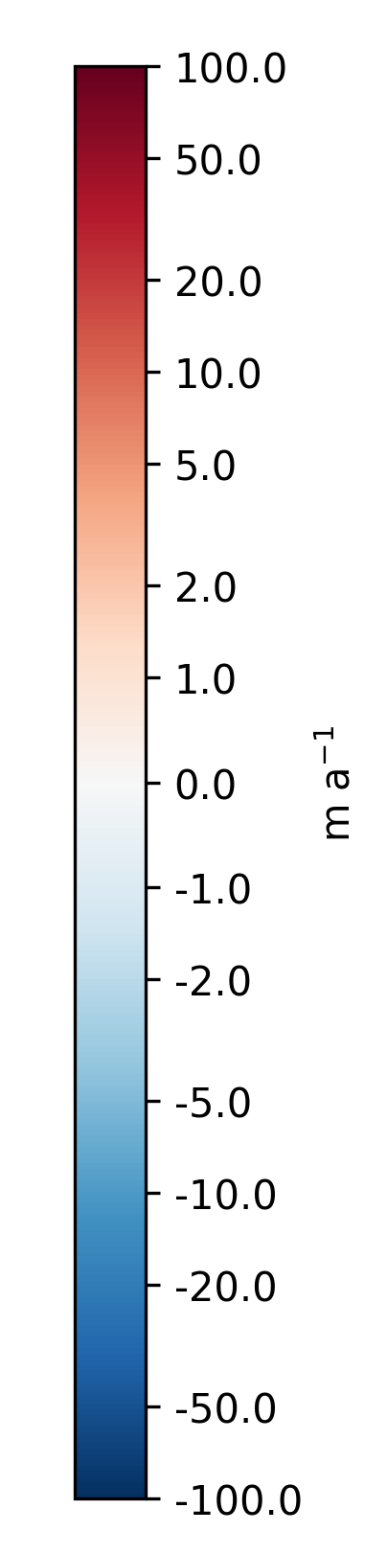
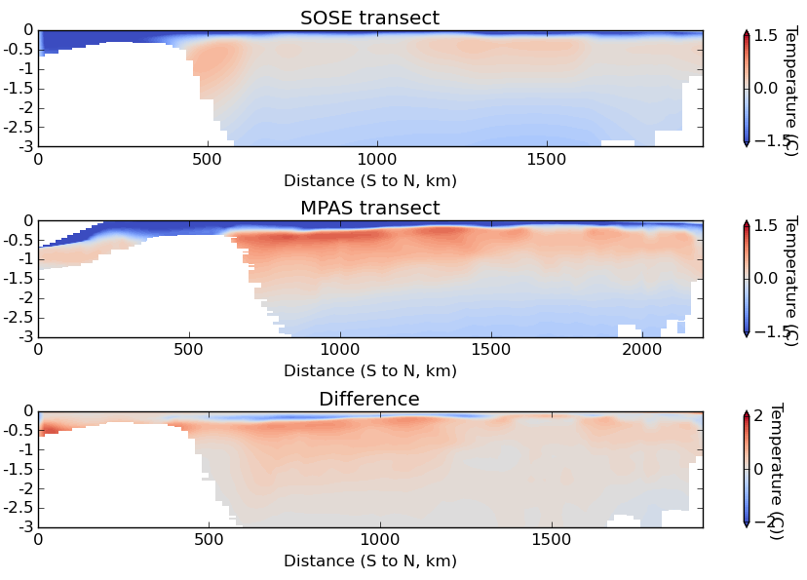
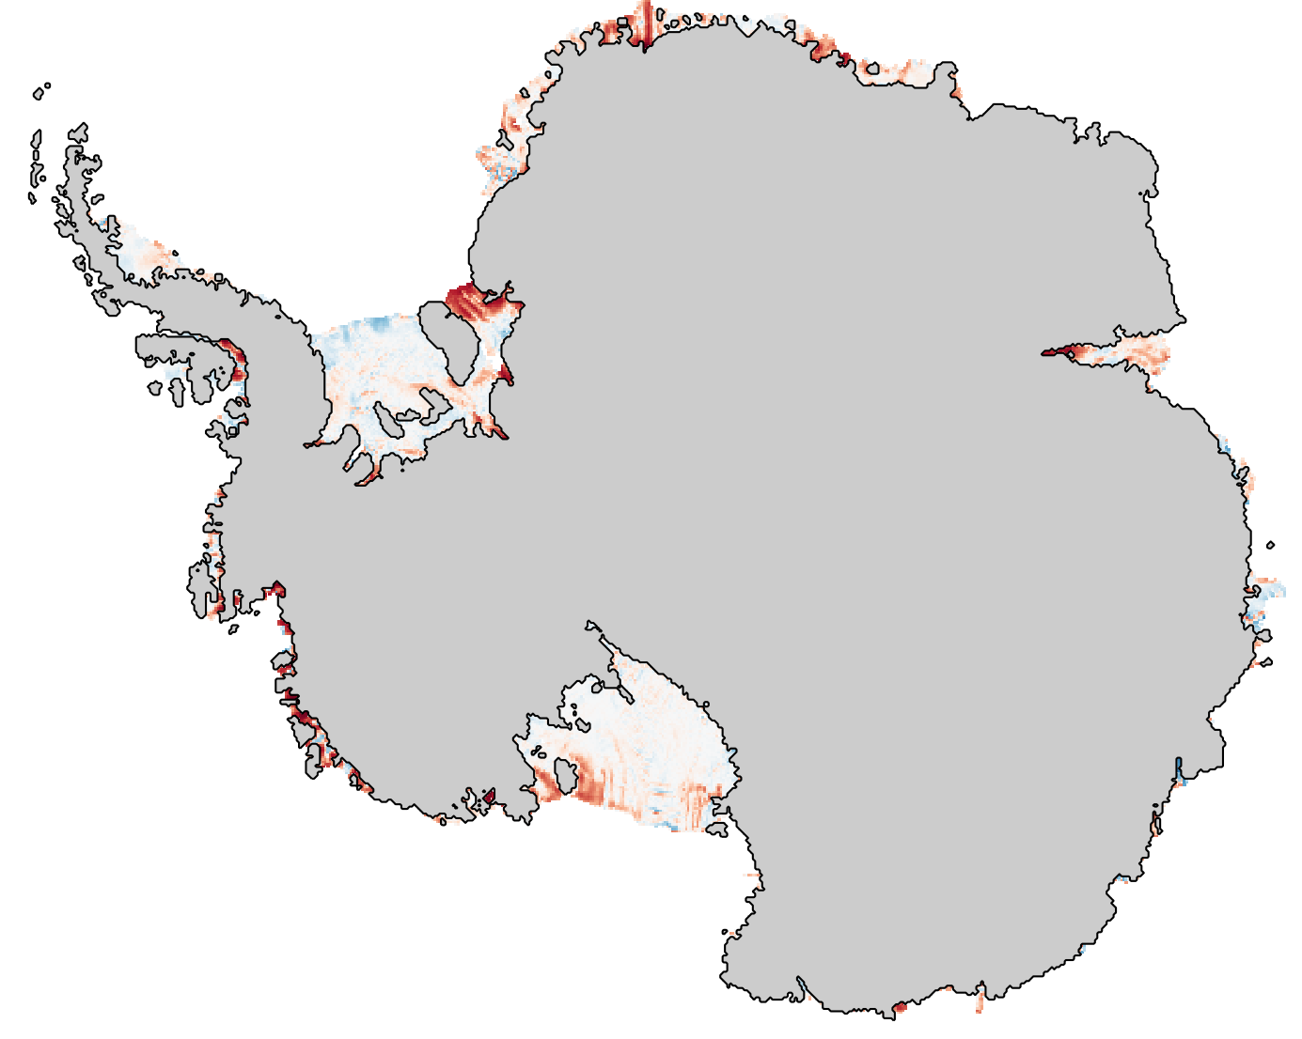
MPAS-Analysis: New Analysis for Ocean-Ice Simulations
Melt Rate Bias (model – obs.)
Ocean Temperature Profiles
SOSE temperature
RRS30to10km
model temperature
model - SOSE
Work by: X. Asay-Davis and J. Fyke

Slide 7
Land model features
Coupled carbon-nitrogen-phosphorus models
  ALMv1-CTC-CNP
  ALMv1-ECA-CNP
BeTR vertically-resolved reactive transport
Variably Saturated Flow Model (VSFM)
  Extension of VSFM to the soil-root-xylem continuum and thermal and 3D (v2)
  Variable depth to bedrock (v2)
Uncertainty quantification framework, improved spinup and offline performance
Updated land use / land cover change inputs
ALM-PFLOTRAN thermal-hydrology and biogeochemistry (v2)
New module FATES coupled to ALM (v2)
Sub-grid topographic classes (v2)
Explicit microbial processes, including CH₄ dynamics; explicit rhizosphere and bulk soil coupling (v2)
Option for contiguous domain decomposition; generic sub-model interfaces; new data architecture (v2)

Slide 8
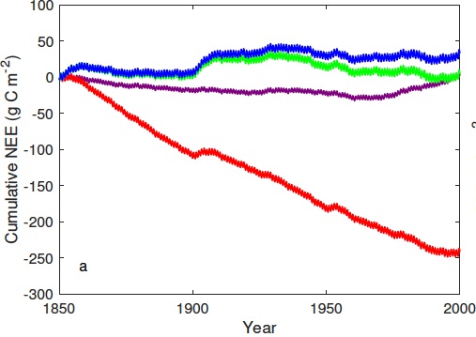
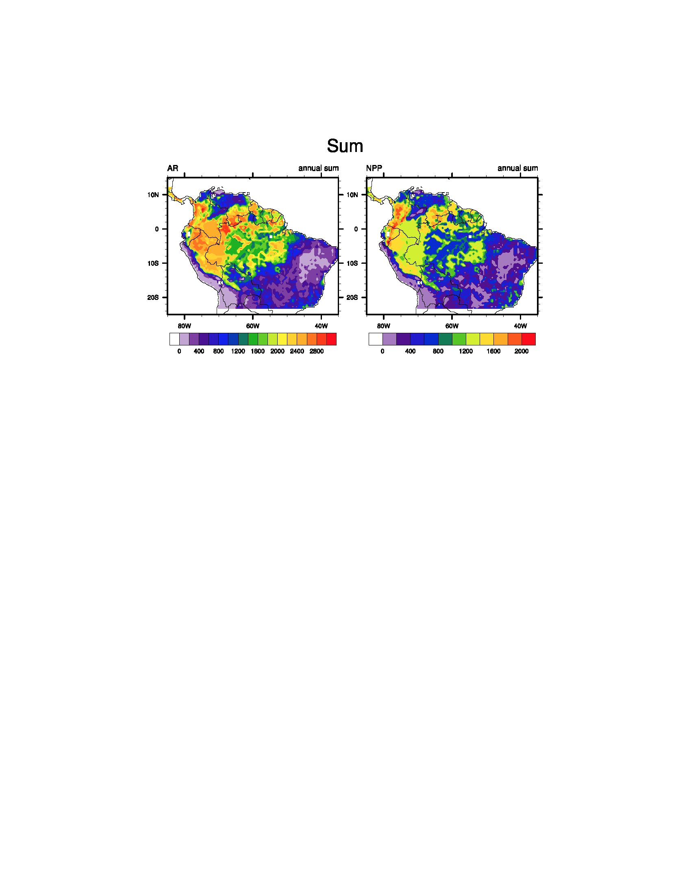
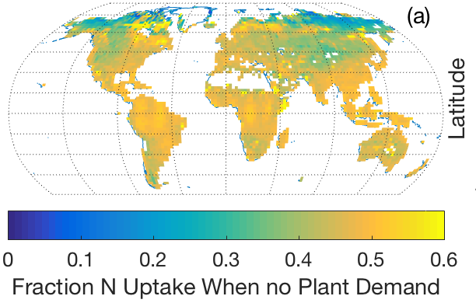
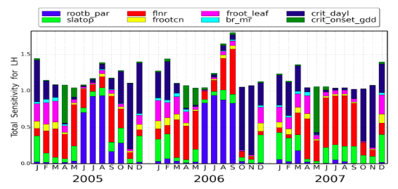
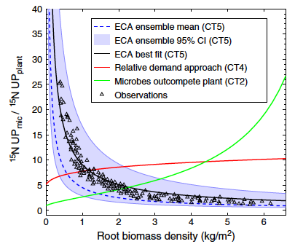
Highlights of ALM results
We used ALMv1-BeTR to show that N cycle representation leads to uncertainties as large as any other in ALM.
Tang and Riley (in review)
ALMv1-ECA-CNP demonstrates that about half of global plant nutrient uptake occurs in the absence of plant demand.
We use ALM-v1-CTC-CNP and multiple observational datasets to quantify and represent controls on productivity and biomass in tropical forests
Zhu et al. (2017) demonstrated that the approach to represent nutrient regulation of the C cycle in ALMv1-ECA-CNP accurately matches observations, while other approaches do not.
We use the ALM UQ framework to explore month-to-month variation in parameter sensitivity.

Slide 9
Human component model features
Land Use-Land Cover Change (available for v1):
  Scenario generation
  LULCC datasets (historic and future)
Crop modeling (targeted for v2/v3):
  Dynamic roots: code completed
  Climate-driven planting dates: code completed
  Additional crop functional types: some progress on a new surface dataset
Irrigation effects (targeted for v2):
  Irrigation scheme representing different irrigation water sources and irrigation methods
  Coupling of ALM with MOSART and water management to represent effects of reservoir regulation
Human-Earth System Interactions (targeted for v2/v3):
  Coupling between GCAM & ACME: code porting underway

Slide 10
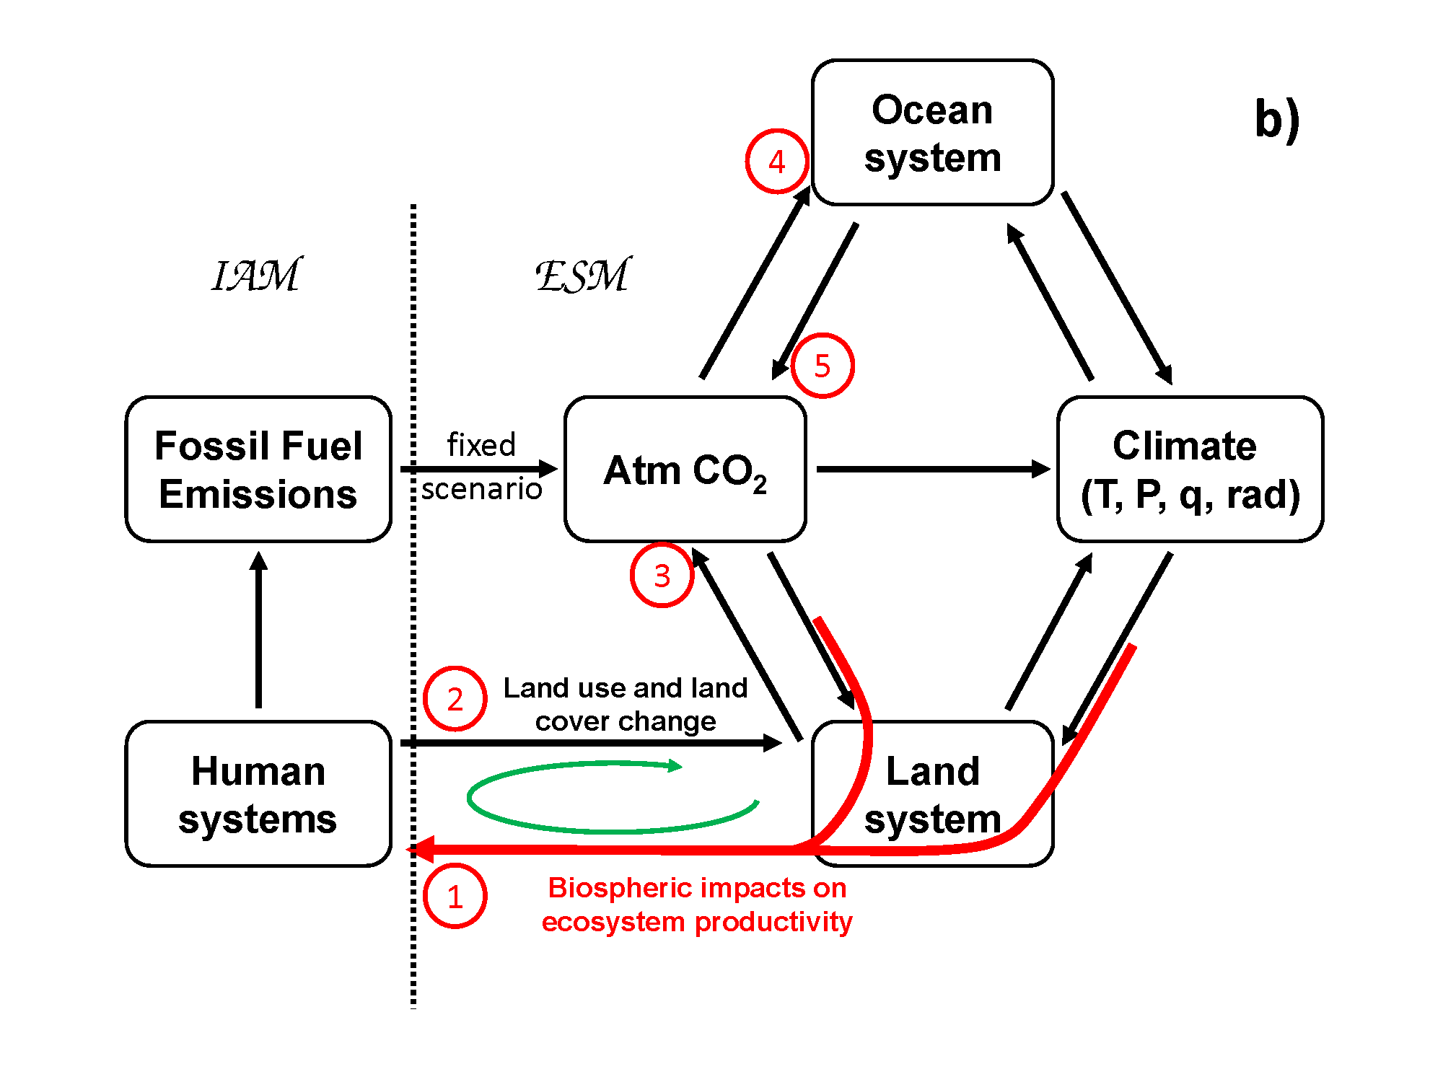
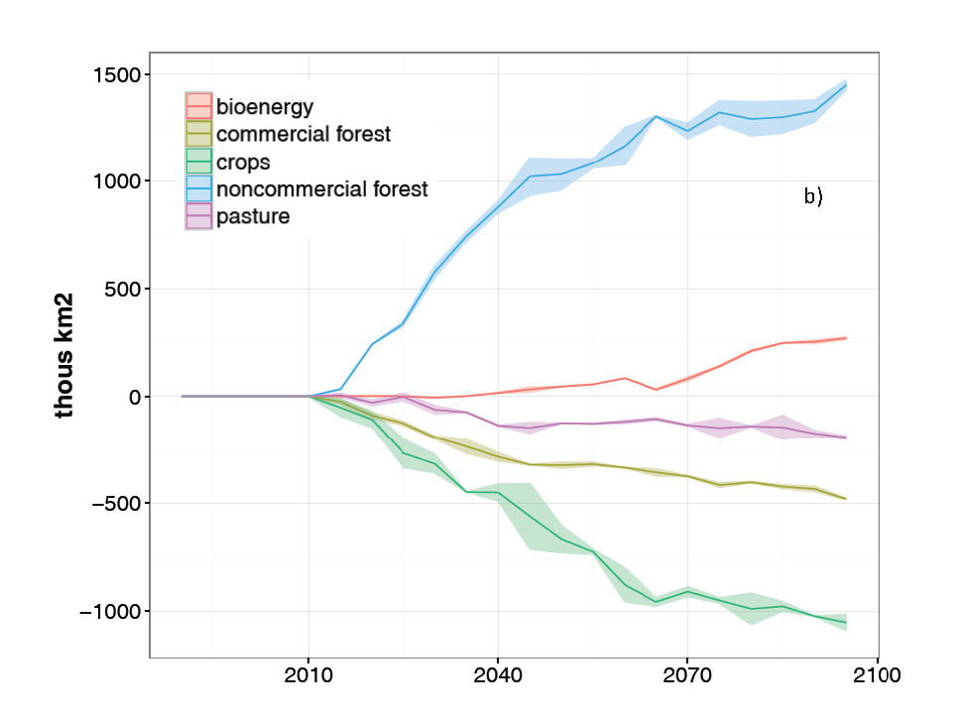
Insights from human-earth system modeling
Coupling Schematic
Change in Land Cover due to Climate Feedbacks
Source: Thornton et al. (accepted) Nature Climate Change.

Slide 11
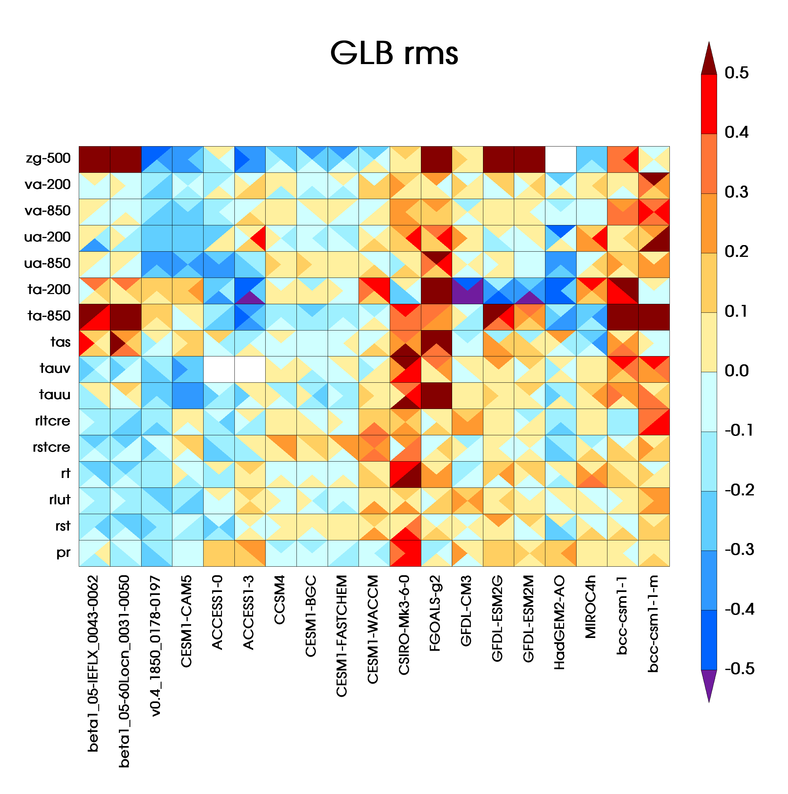
Low-res coupled model
worst
Comparison:
Normalized global RMSE for historical simulations
ACME v1 (100, 60 level ocean)
ACME v0.4
CMIP5
ACME v1 (100L ocn)
ACME v1 (60L ocn)
ACME v0.4
Qi Tang
best

Slide 12
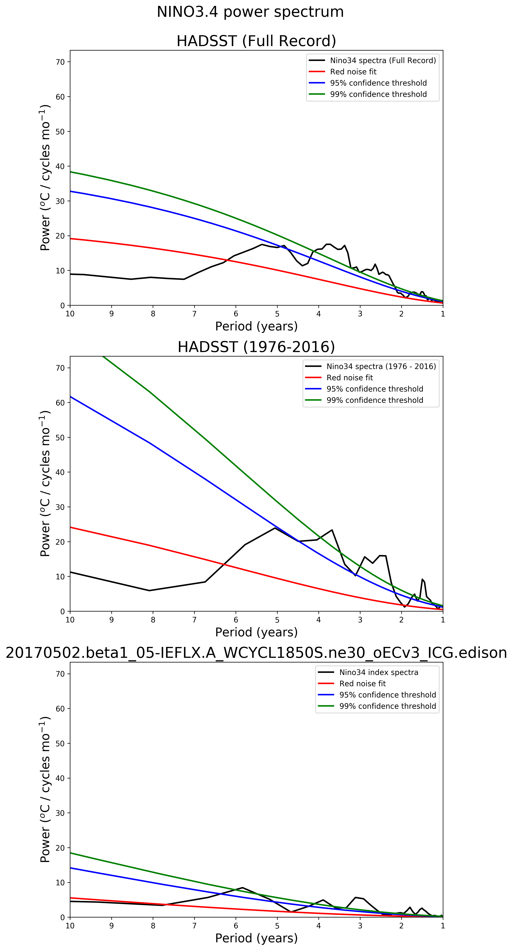
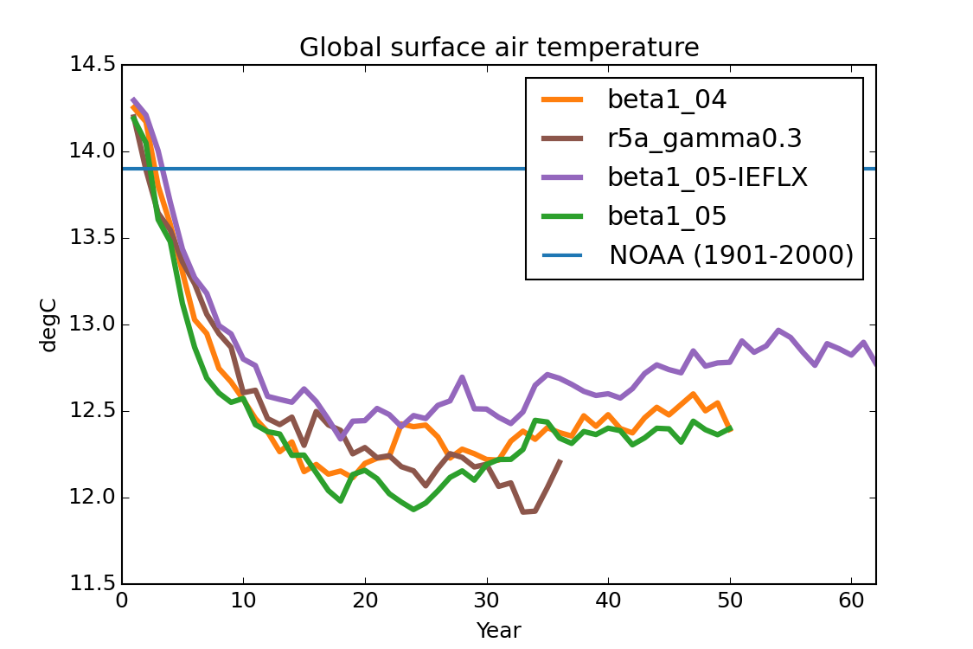
Low-res coupled model
Outstanding problems
ENSO
Initial cooling
More on diagnosing the problems: approach and challenges (Wed)

Slide 13
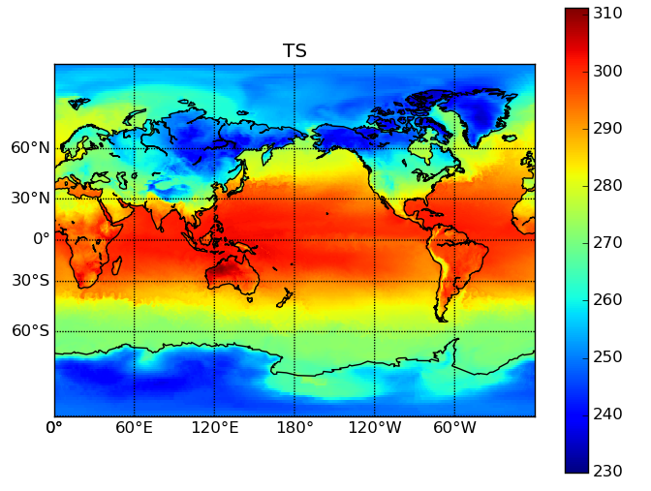
Coupled High-Res Status
Team: Peter Caldwell, Noel Keen, Jon Wolfe, & Qi Tang with help from other Performance team members
5 day high-res coupled runs looks like Earth
Completed 5-day test runs on mira, titan, and Cori-KNL
  COSP seems to work fine
Unable to write restart files prevents longer tests
  The longest simulation is 45 days on Cori-KNL
Writing output ruins performance (see table)
Initialization takes hours, preventing use of debug queues
Progress suffers from a lack of dedicated staff – everyone is focusing on fixing low-res problems
Machine | SYPD | Output? | Cores Used
mira | 0.09 | daily atm | 32768
titan | 0.52 | none | 28000
cori-KNL | 0.92 | none | 52800
cori-KNL | 0.4 | 5 day atm | 59200
Table: Timings from 5-day high-res coupled runs

Slide 14
V2 science
Strategy:
  Focus more on computational advances
  Parallel efforts on v2 (minor) and v3 (more substantive) model development
Science goals:
  Better understand and document v1 model behaviors and address uncertainty
  Feature ACME variable resolution model capability for the Arctic and tropics, climatically important regions, with potential for collaborations with other DOE projects
Experiments:
  Add ensemble members for v1 LR and HR experiments
  V2 experiments using regional refined grids over the Arctic and tropics

Slide 15
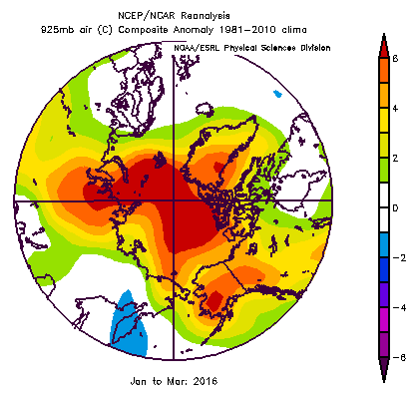
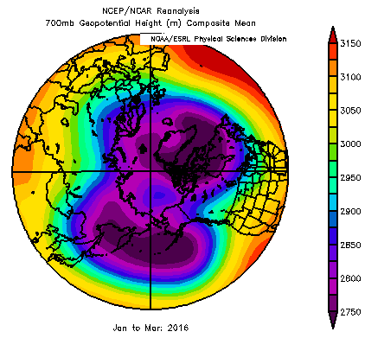
Record warm Arctic temperature anomalies in winter 2016
+6 C
+6 C
Proximate Cause:
Warm Air Advection From Midlatitudes
Nearly Double Previous Record
(James Overland, PMEL)

Slide 16
The myriad Arctic influence

Slide 17
Severe drought in the Amazon during the 2015/16 El Niño
El Nino drought of 2015/16 in Amazon
Terrestrial water storage anomaly (March)

Slide 18
Some science and modeling issues
The longstanding Amazon precipitation bias and implications to water cycle and biogeochemistry cycle is an important challenge for modeling
Deforestation has important local and remote effects through changes in the Hadley circulation and southern hemisphere jet and Rossby waves
Tropical forest response to climate anomalies (e.g., El Niño) and radiative forcing has important implications to biogeochemistry and ecosystem
Freshwater and sediment inputs from Amazon and Orinocco rivers have potential impacts on stratification of western Tropical Atlantic Ocean and Atlantic tropical cyclones

