Slide 1
Modulation of Regional Carbon Uptake by AMOC and Alkalinity Changes in the Subpolar North Atlantic under a Warming Climate
Qi Zhang, Takamitsu Ito, Annalisa Bracco
Georgia Tech Ocean Science & Engineering
08/06/2024

Slide 2
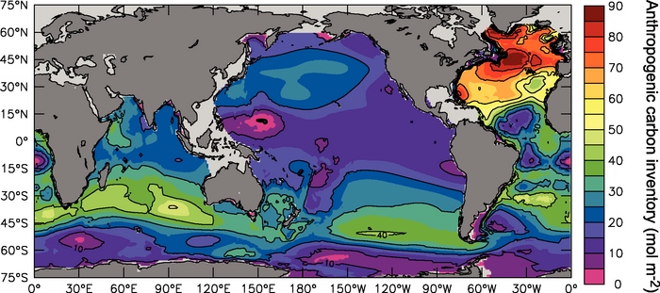
Motivations
Column inventory of anthropogenic carbon (mol m^{–2})
Impact of AMOC Slowdown
The AMOC is a crucial component of Earth's climate system and its alteration has significant implications for temperature, salinity, and the carbon cycle.
(credit: IPCC AR4 WGI, 2007)

Slide 3
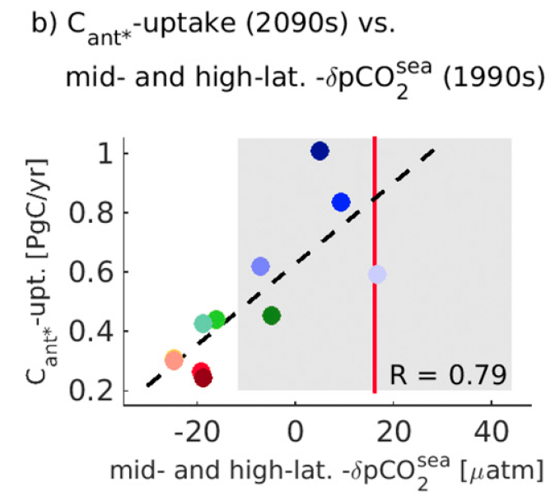
Motivations
(Goris et al., 2018)
Investigating Mechanisms Behind Reduced CO₂ Uptake
Impact of AMOC Slowdown
The AMOC is a crucial component of Earth's climate system and its alteration has significant implications for temperature, salinity, and the carbon cycle.
AMOC contributes to the vertical transport of DIC from the surface to interior ocean, which modulates the air-sea difference in partial pressure of CO₂ (pCO₂).

Slide 4
Motivations
Investigating Mechanisms Behind Reduced CO₂ Uptake
Role of Alkalinity and Other Factors
Impact of AMOC Slowdown
The AMOC is a crucial component of Earth's climate system and its alteration has significant implications for temperature, salinity, and the carbon cycle.
AMOC contributes to the vertical transport of DIC from the surface to interior ocean, which modulates the air-sea difference in partial pressure of CO₂ (pCO₂).
The trends of pCO₂ are driven by SST, SSS, alkalinity, and DIC. The amount of CO₂ uptake reduction contributed by surface alkalinity and diminished subduction remains uncertain.

Slide 5
Motivations
Investigating Mechanisms Behind Reduced CO₂ Uptake
Role of Alkalinity and Other Factors
Impact of AMOC Slowdown
The AMOC is a crucial component of Earth's climate system and its alteration has significant implications for temperature, salinity, and the carbon cycle.
AMOC contributes to the vertical transport of DIC from the surface to interior ocean, which modulates the air-sea difference in partial pressure of CO₂ (pCO₂).
The trends of pCO₂ are driven by SST, SSS, alkalinity, and DIC. The amount of CO₂ uptake reduction contributed by these variables remains uncertain.
Two plausible mechanisms linking the AMOC slowdown to the decline of regional CO₂ uptake:
diminished subduction and reduction in surface alkalinity

Slide 6
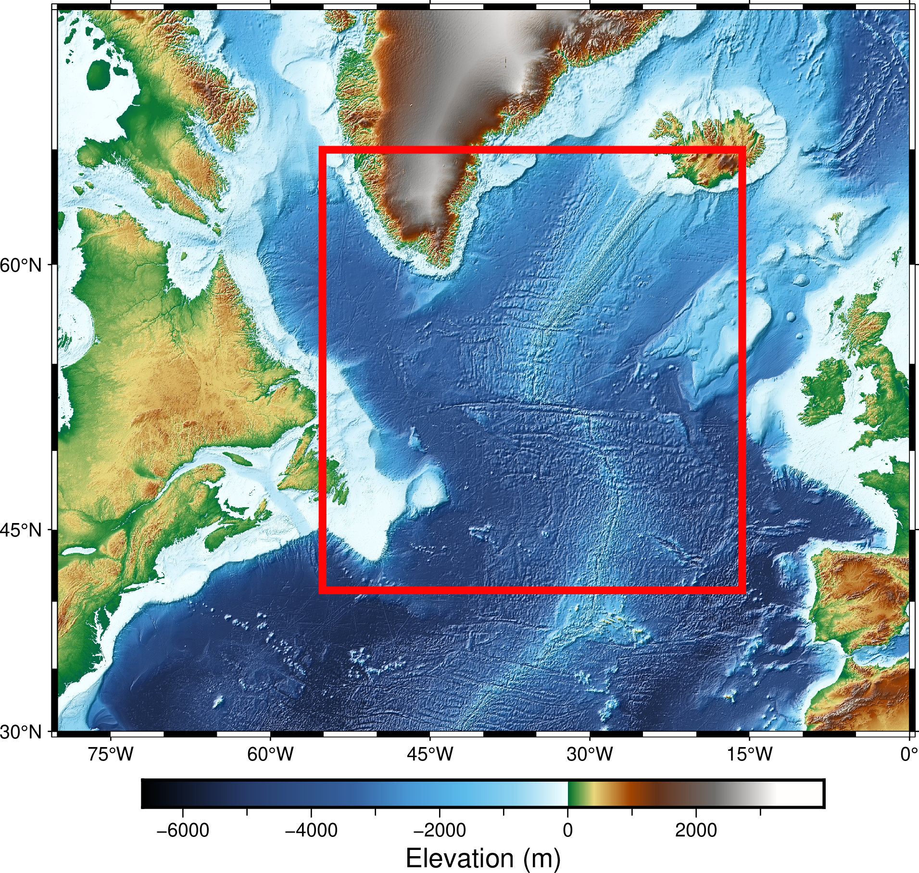
Methods
lat: 40°N to 65°N
lon: 55°W to 15°W
Data - CMIP6
Time Periods
Geographic Area
CESM2
NorESM2-LM
ACCESS-ESM1-5
MPI-ESM1-2-LR
CMCC-ESM2
CNRM-ESM2-1
UKESM1-0-LL
MIROC-ES2L
CanESM5
IPSL-CM6A-LR
Historical
1950-2014
SSP5-8.5
2015-2100

Slide 7
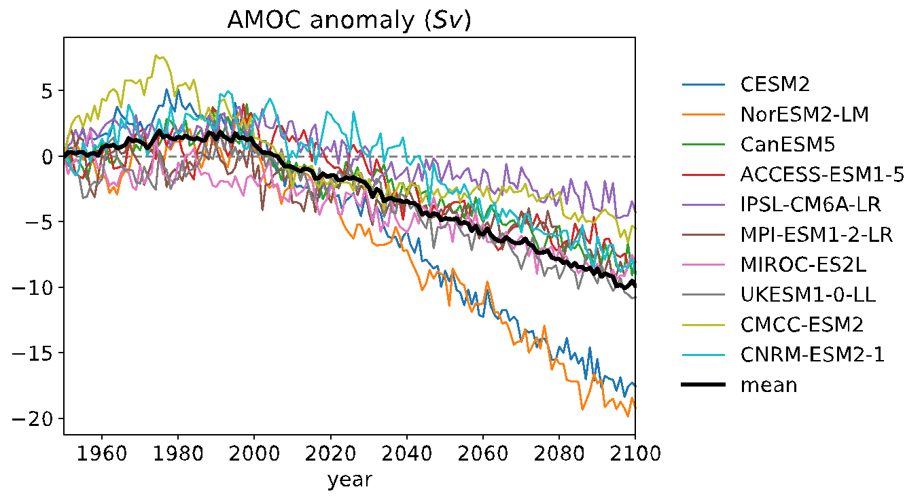
Anomalies of AMOC, Salinity and Alkalinity
AMOC

Slide 8
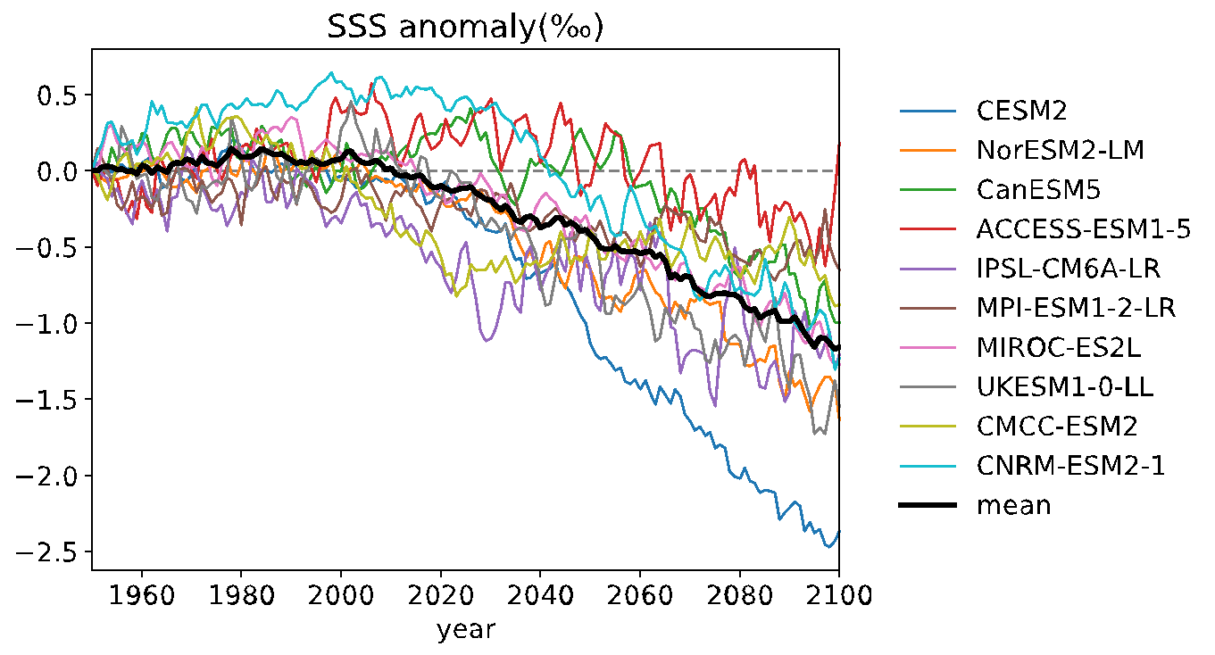
Anomalies of AMOC, Salinity and Alkalinity
AMOC
SSS

Slide 9
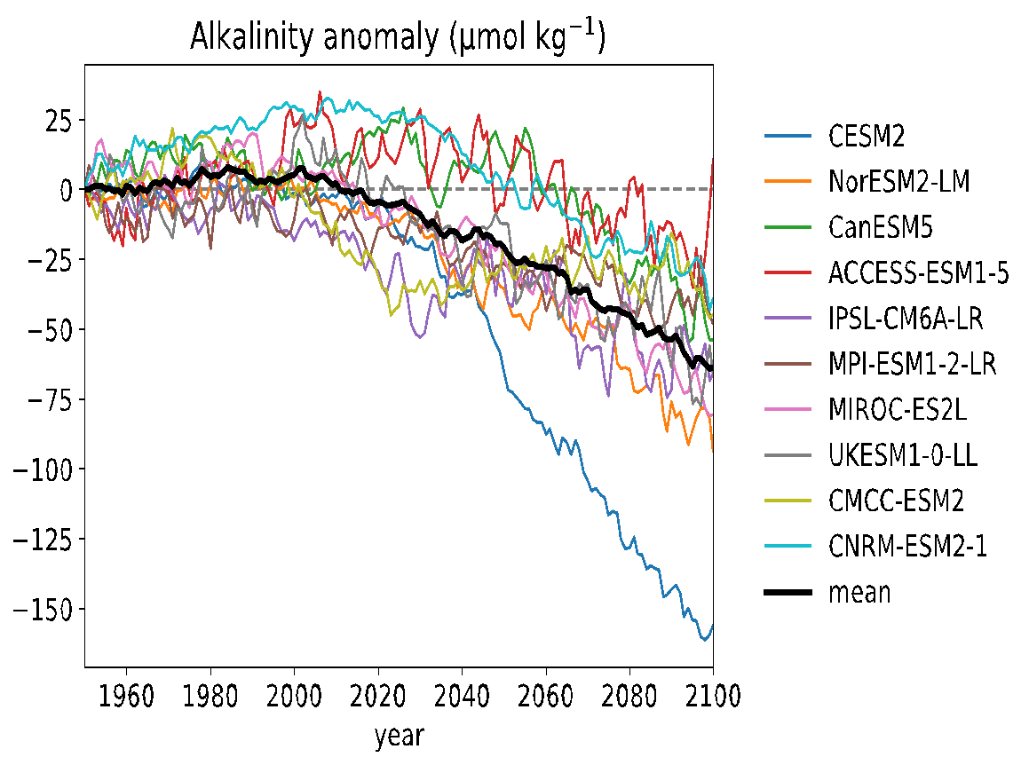
Anomalies of AMOC, Salinity and Alkalinity
AMOC
Alkalinity
SSS

Slide 10
Anomalies of AMOC, Salinity and Alkalinity
AMOC
Alkalinity
SSS

Slide 11
CO₂ uptake and pCO₂
fgCO₂ vs ALK
fgCO₂ vs AMOC

Slide 12
CO₂ uptake and pCO₂
fgCO₂ vs ALK
fgCO₂ vs AMOC
fgCO2 vs △ pCO₂

Slide 13
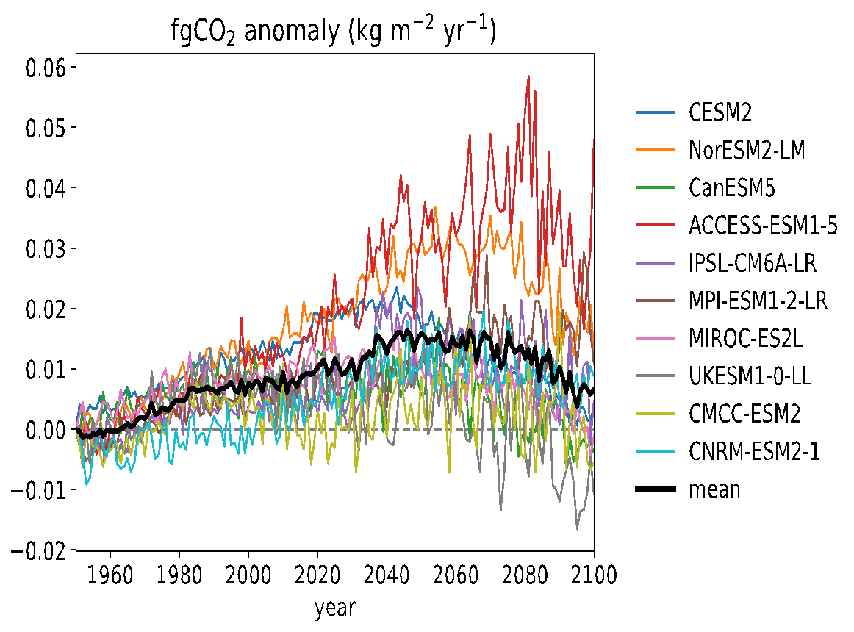
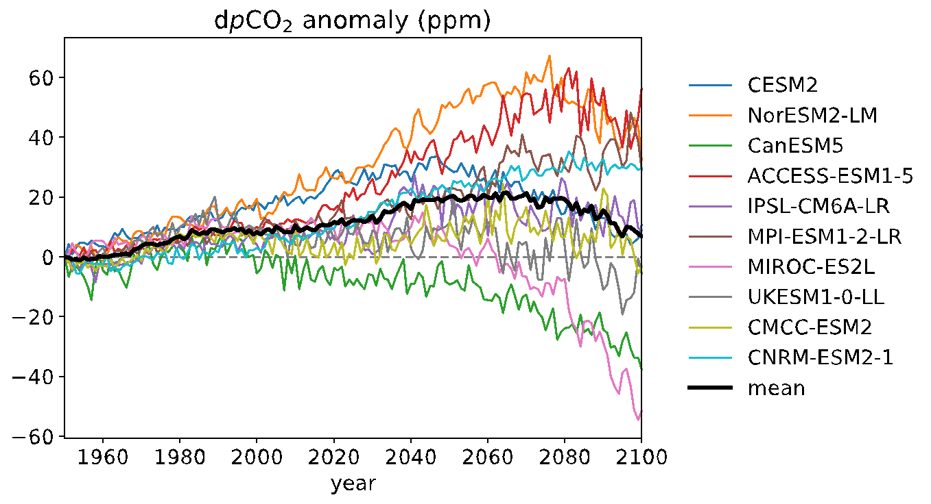
CO₂ uptake and pCO₂
fgCO₂ vs ALK
fgCO₂ vs AMOC
fgCO2 vs △ pCO₂
CO₂ flux
△ pCO₂

Slide 14
pCO₂ decomposition
(Sarmiento and Gruber, 2006)

Slide 15
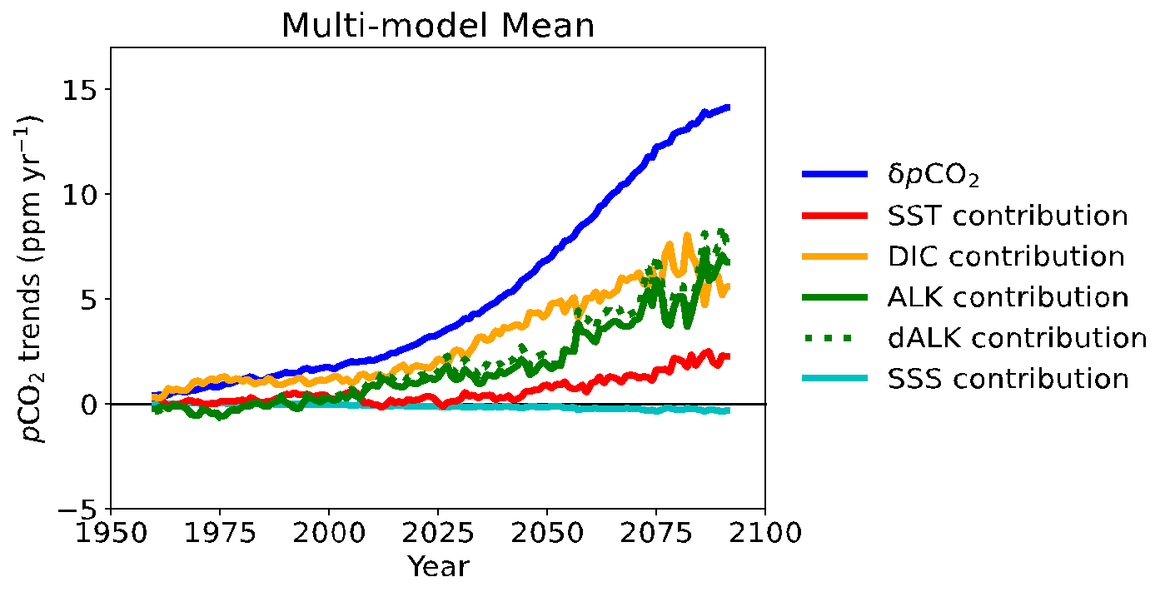
pCO₂ decomposition
(Sarmiento and Gruber, 2006)
dALK: diluted ALK
Diluted effect (freshwater)

Slide 16
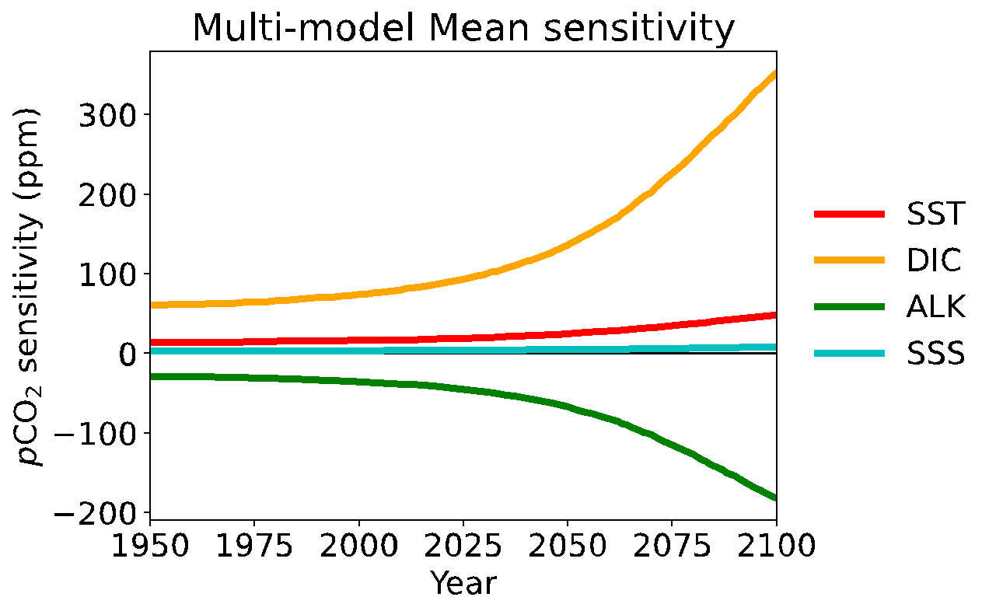
pCO₂ decomposition
(Sarmiento and Gruber, 2006)
dALK: diluted ALK
Diluted effect (freshwater)

Slide 17
pCO₂ changes between 2070-2100 and 1970-2000
△pCO₂ trends
△AMOC
△CO₂ uptake trends

Slide 18
pCO₂ changes between 2070-2100 and 1970-2000
△pCO₂ trends
△AMOC
△CO₂ uptake trends

Slide 19
pCO₂ changes between 2070-2100 and 1970-2000
△pCO₂ trends
△AMOC
△CO₂ uptake trends

Slide 20
pCO₂ changes between 2070-2100 and 1970-2000
△pCO₂ trends
△AMOC
△CO₂ uptake trends
Stronger AMOC slowdown
More salinity reduction
Stronger dilution effect on ALK

Slide 21
pCO₂ changes between 2070-2100 and 1970-2000
△pCO₂ trends
△AMOC
△CO₂ uptake trends
Stronger AMOC slowdown
More salinity reduction
Stronger dilution effect on ALK
Stronger pCO_{2_ocean} increasing
More CO₂ uptake slowdown

Slide 22
Take home messages
Models with stronger AMOC slowdown generally exhibit weaker surface warming and larger decline of surface salinity and alkalinity.

Slide 23
Take home messages
Models with stronger AMOC slowdown generally exhibit weaker surface warming and larger decline of surface salinity and alkalinity.
Alkalinity is the most important driver of regional pCO₂ change by 2100.

Slide 24
Take home messages
Models with stronger AMOC slowdown generally exhibit weaker surface warming and larger decline of surface salinity and alkalinity.
Alkalinity is the most important driver of regional pCO₂ change by 2100.
AMOC slowdown and surface alkalinity reduction, primarily due to dilution effects, impacts the ocean's capacity to absorb CO₂ and drives the future decrease in regional carbon uptake.
Thanks and Welcome Questions!
qzhang459@gatech.edu
Wednesday Poster Session
Poster #34
doi: 10.3389/fmars.2024.1304193

Slide 25
Acknowledgments
We acknowledge the World Climate Research Programme, which, through its Working Group on Coupled Modelling, coordinated and promoted CMIP6. We thank the climate modeling groups for producing and making available their model output, the Earth System Grid Federation (ESGF) for archiving the data and providing access, and the multiple funding agencies who support CMIP6 and ESGF. We acknowledge the support by the U.S. Department of Energy, through grant DE-SC0021300.

