Slide 1
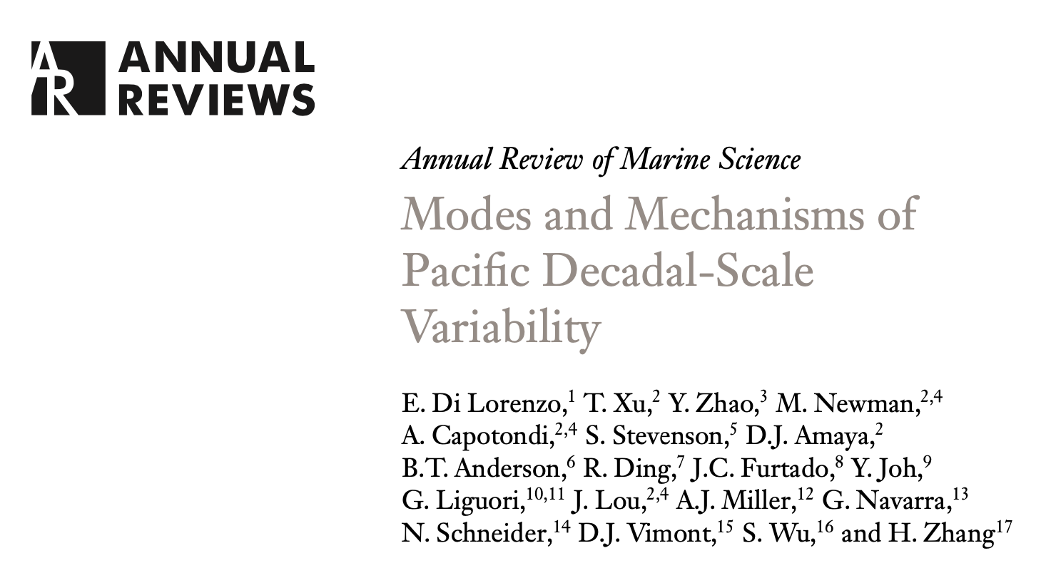
Modes and Mechanisms of Pacific Decadal-Scale Variability
www.pdv-tools.org
Di Lorenzo, E., et al. (2023), Modes and Mechanisms of Pacific Decadal-Scale Variability, Annual Review of Marine Science, 15(1), 249-275, doi:10.1146/annurev-marine-040422-084555.

Slide 2
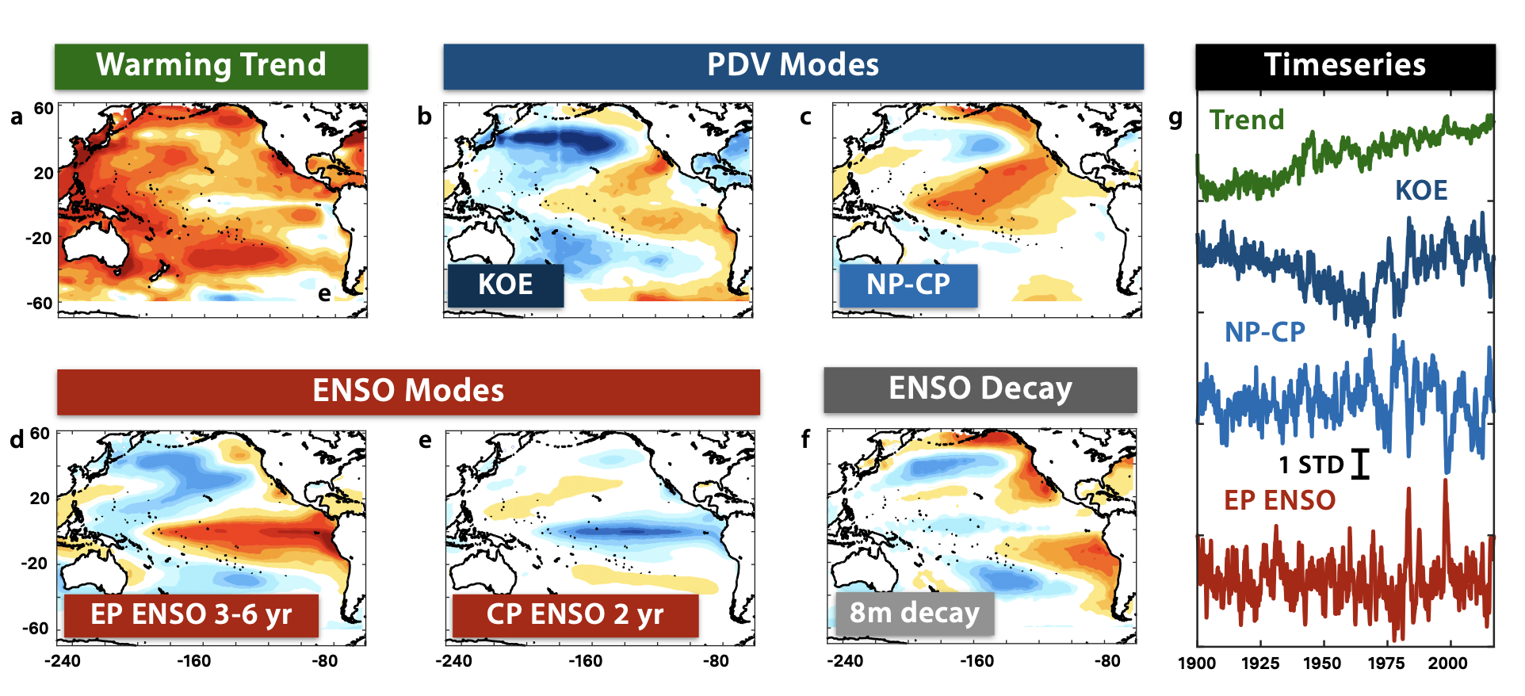
We use a Linear Inverse Model (LIM)
to Diagnose the PDV modes in observations and models
Di Lorenzo, E., et al. (2023), Modes and Mechanisms of Pacific Decadal-Scale Variability, Annual Review of Marine Science, 15(1), 249-275, doi:10.1146/annurev-marine-040422-084555.

Slide 3
Two PDV mechanisms emerge as dominant
NP-CP Mode
North Pacific-Central Pacific Mode

Slide 4
Two PDV mechanisms emerge as dominant
NP-CP Mode
North Pacific-Central Pacific Mode
KOE Mode
see Song, Stevenson et al. 2024, in prep

Slide 5
The NP-CP mode energizes a large 70% to Central Tropical Decadal Variability
Zhao, Y. Y., E. Di Lorenzo, D. X. Sun, and S. Stevenson (2021), Tropical Pacific Decadal Variability and ENSO Precursor in CMIP5 Models, J. Clim., 34(3), 1023-1045, doi:10.1175/jcli-d-20-0158.1.
Multi-state LIM Diagnostic
State 1: Tropics State 2: Extra-tropical
NP-CP Mode
North Pacific-Central Pacific Mode

Slide 6
However, North Pacific has little control on Tropical Interannual Variability
Zhao, Y., D. Sun, E. Di Lorenzo, G. Liu and S. Wu: Separate the Role of Southern and Northern Extra-tropical Pacific in Tropical Pacific Climate Variability. Geophysical Research Letters, accepted.
Multi-state LIM Diagnostic
State 1: Tropics State 2: North Pacific State 3: South Pacific
NP-CP Mode
North Pacific-Central Pacific Mode

Slide 7
Separating the North and South Pacific Contribution to TPDV
Tropical Decadal Variability (TPDV)
Zhao, Y., D. Sun, E. Di Lorenzo, G. Liu and S. Wu: Separate the Role of Southern and Northern Extra-tropical Pacific in Tropical Pacific Climate Variability. Geophysical Research Letters, accepted.
South Pacific contribution
North Pacific contribution

Slide 8
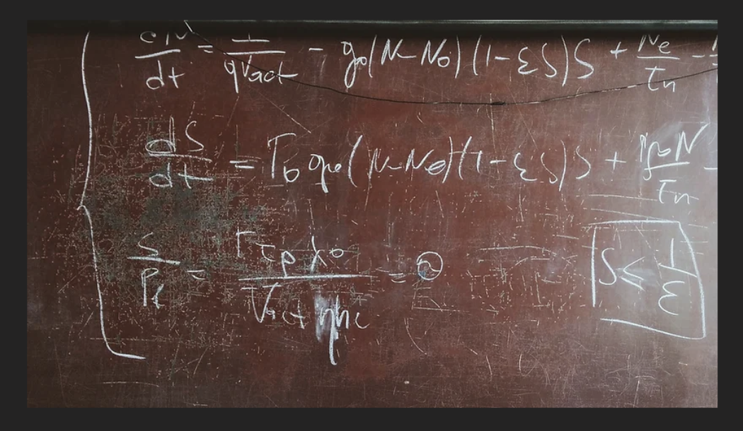
Multi-state LIM Diagnostic for Pacific Climate Variability
State 1: Tropics State 2: North Pacific State 3: South Pacific
Zhao, Y. Y., E. Di Lorenzo, D. X. Sun, and S. Stevenson (2021), Tropical Pacific Decadal Variability and ENSO Precursor in CMIP5 Models, J. Clim., 34(3), 1023-1045, doi:10.1175/jcli-d-20-0158.1.
Zhao, Y., D. Sun, E. Di Lorenzo, G. Liu and S. Wu: Separate the Role of Southern and Northern Extra-tropical Pacific in Tropical Pacific Climate Variability. Geophysical Research Letters, accepted.
Di Lorenzo, E., et al. (2023), Modes and Mechanisms of Pacific Decadal-Scale Variability, Annual Review of Marine Science, 15(1), 249-275, doi:10.1146/annurev-marine-040422-084555.
CMIP model with weak NP-CP representation
no realistic TPDV
less realistic ENSO

Slide 9
Modes and Mechanisms of Pacific Decadal-Scale Variability
www.pdv-tools.org

Slide 10
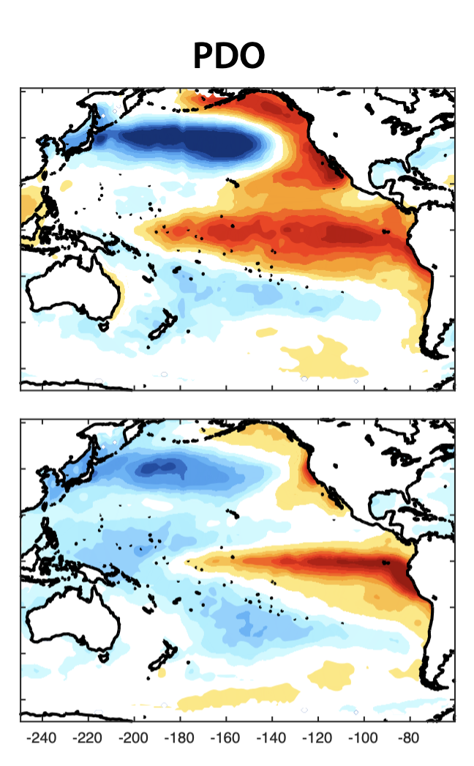
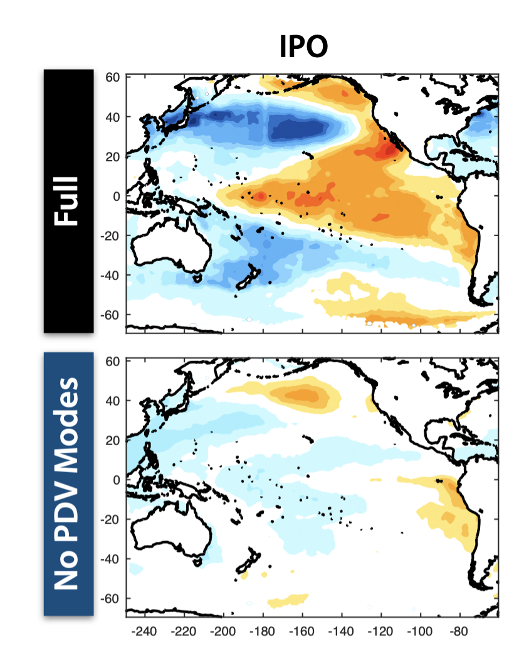
LIM Dynamic Filtering
We examine the impact of the PDV modes on statistical modes like the PDO
Pacific Decadal Oscillation (PDO) =
KOE Mode
+
NP-CP Mode
+
ENSO Mode

Slide 11
LIM Dynamic Filtering
The relative contribution of the “dynamical modes” to PDV can change

Slide 12
LIM Dynamic Filtering
The relative contribution of the “dynamical modes” to PDV can change
We find that this is true also in CMIP6 models
ENSO and NP-CP Modes become stronger in warming climate
see Wu et al. 2024, Nature CC, in review

Slide 13
LIM Dynamic Filtering
We examine the impact of the PDV modes on statistical modes like the PDO
The NP-CP mode is also responsible for the multi-year duration of North Pacific Marine Heatwaves
see Capotondi et al. 2024, in prep

Slide 14
Modes and Mechanisms of Pacific Decadal-Scale Variability
www.pdv-tools.org

