Slide 1






The Influence of Land-Surface Conditions on the 2020-21 Western US Drought
2024 DOE EESM PI Meeting
Yelin Jiang (yjiang@ldeo.columbia.edu)
Lamont-Doherty Earth Observatory of Columbia University
Jason Smerdon, Richard Seager, Guiling Wang, Benjamin Cook, Cheng Zheng, Justin Mankin, and Park Williams
7th August 2024
Bethesda, Maryland

Slide 2
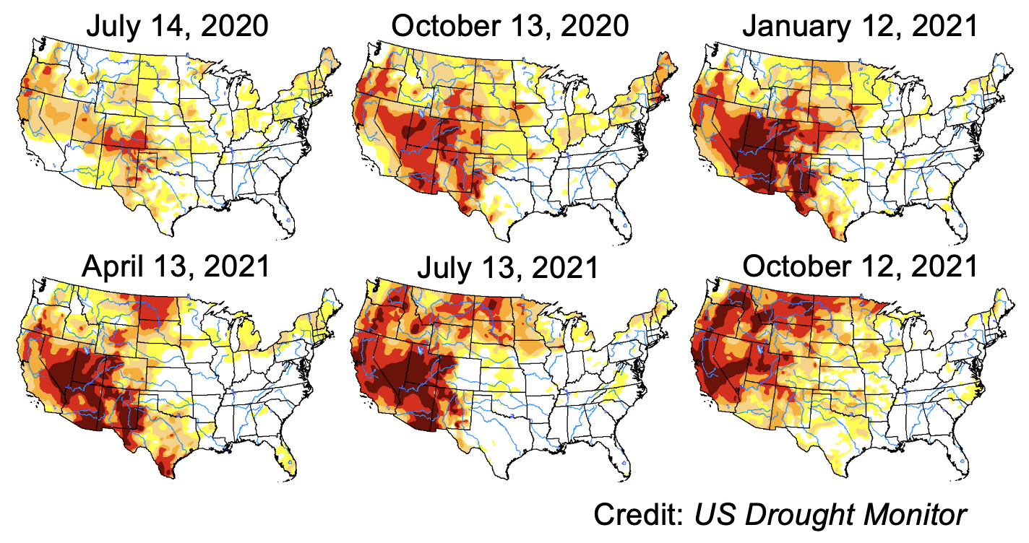
2020-21 Western US Drought
2

Slide 3
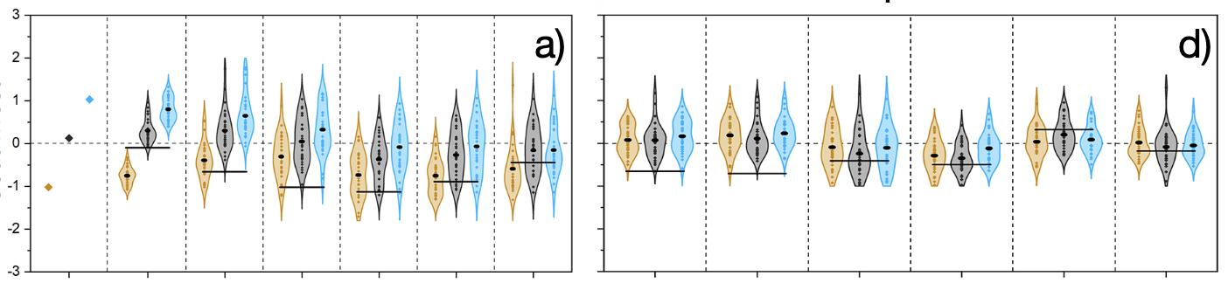

Simulated Impacts of Initial Soil Moisture
Soil Moisture
Precipitation
Wetter soil: delay or even nullify the impact of La Niña-driven meteorological droughts
Drier soil: more severe, persistent, and impactful soil droughts

Slide 4
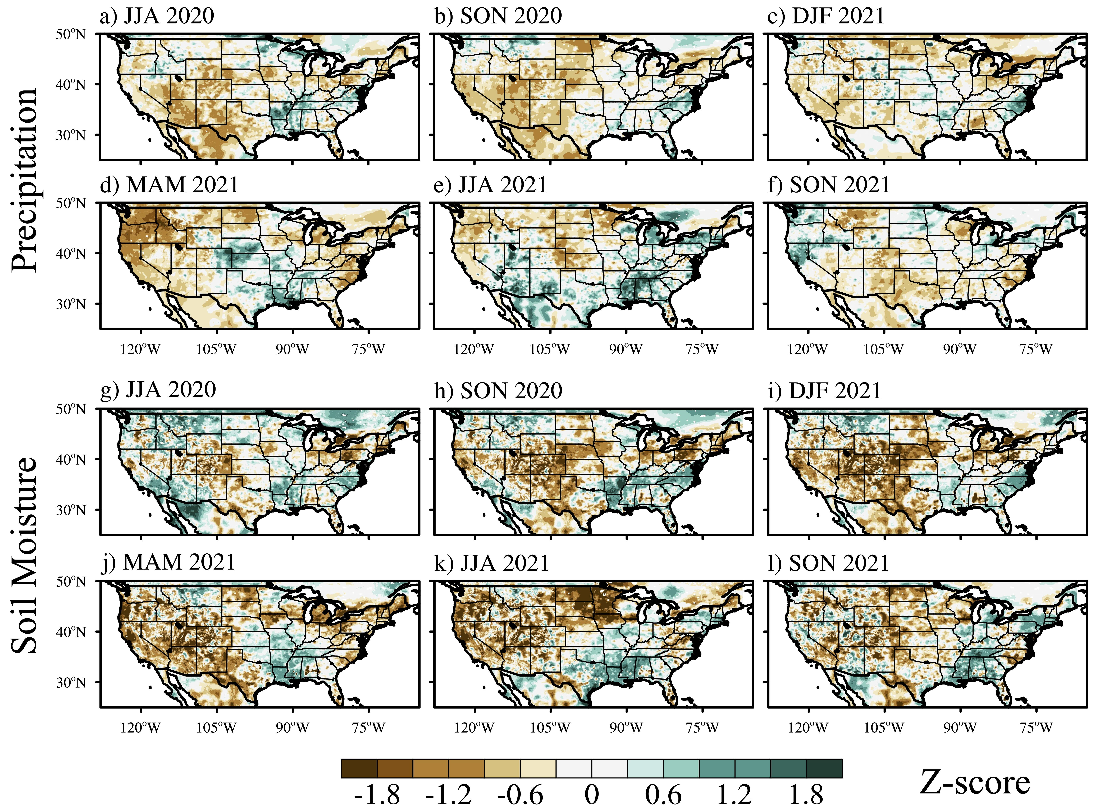
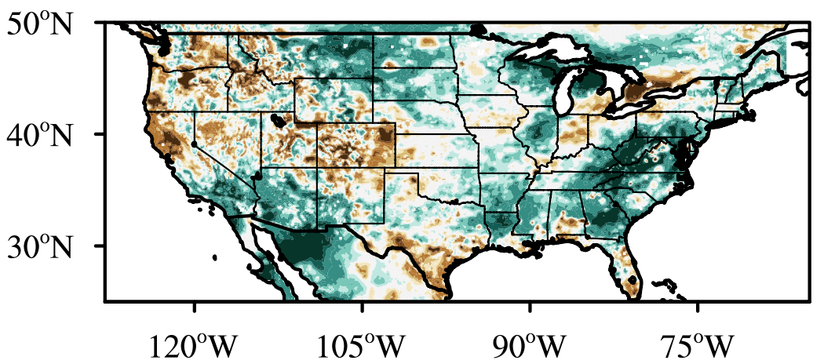
Observational Evidence for Soil Moisture Impact
Precipitation
Soil Moisture
Soil Moisture May 2020
Southern California: did not emerge until DJF 2021
Northern California, Nevada, Texas, and the Four Corner states: initiated as early as JJA 2020

Slide 5
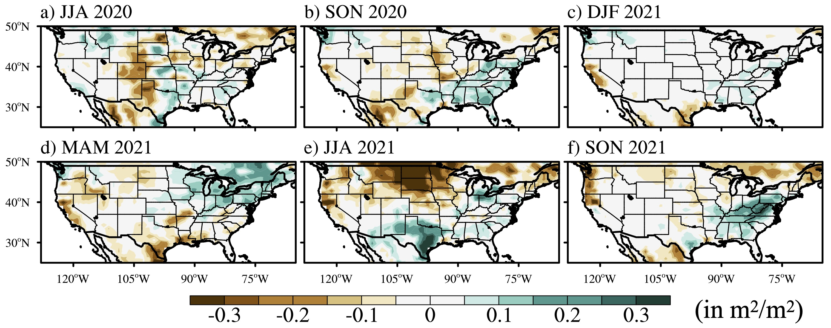
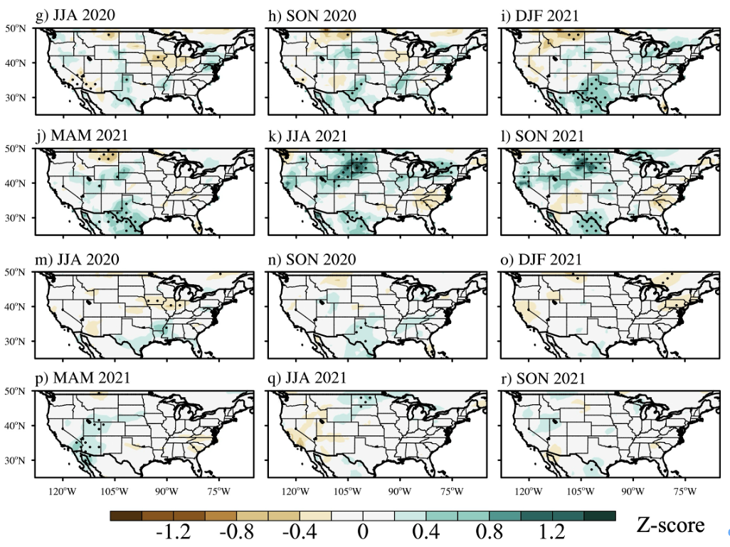
Simulated Impacts of Vegetation Variations
LAI Difference: VEG Ensemble – CTL Ensemble
Soil Moisture Response: VEG Ensemble – CTL Ensemble

Slide 6
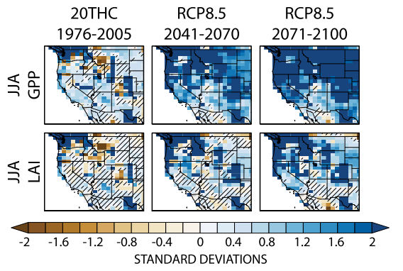
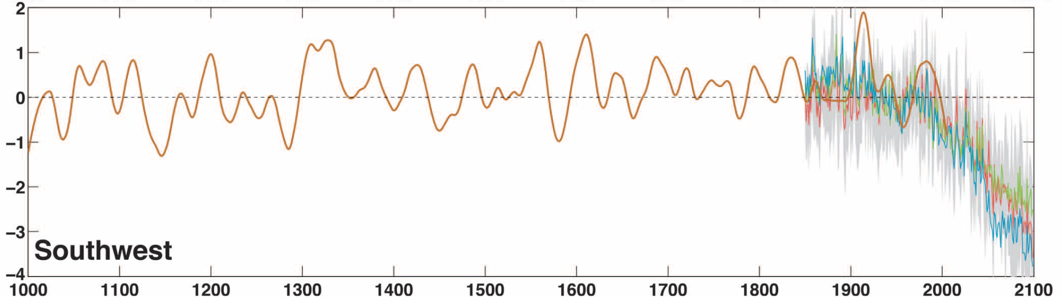
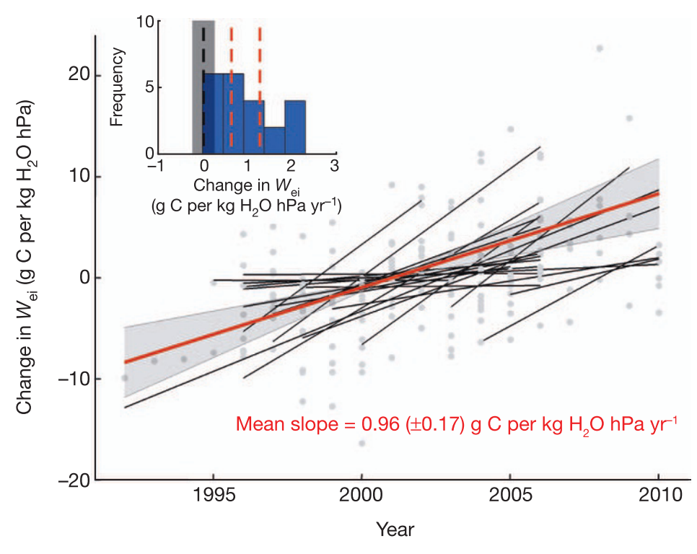
Drier and Greener Western US in the Future
Cook, Ault & Smerdon, Sci. Adv., 2015
Mankin et al., JCLI, 2017
Enhanced plant WUE due to the partial closure of leaf stomata in response to higher CO₂
Accelerate the transition from meteorological to soil droughts, leading to more rapid, severe, and persistent soil droughts in the future
Keenan et al., Nature, 2013

Slide 7
Grand Challenges in Understanding and Simulating Vegetation Impact on Extremes
1) Lack of long-term reliable observational records:
Satellite observations: Since the 1980s; Unreliable in cloudy and aerosol-heavy areas
In-situ observations: Sparse distribution; No data in hard-to-access regions (e.g., Amazon)
2) Insufficient detailed representation of sub-grid and grid level processes:
Absence of species-specific responses due to the use of aggregated PFTs
Lack of representation of vegetation competition within grid cells
Simplified soil-vegetation interactions (e.g., root dynamics, nutrient cycling)
Difficulty in accurately capturing microclimate variations
3) Uncertainties in future projections of vegetation:
Future socio-economic developments (CO₂ levels and Land-use practices)
Decadal oceanic variability (PDO and AMO)
Vegetation adaptations
Nutrient limitations

Slide 8
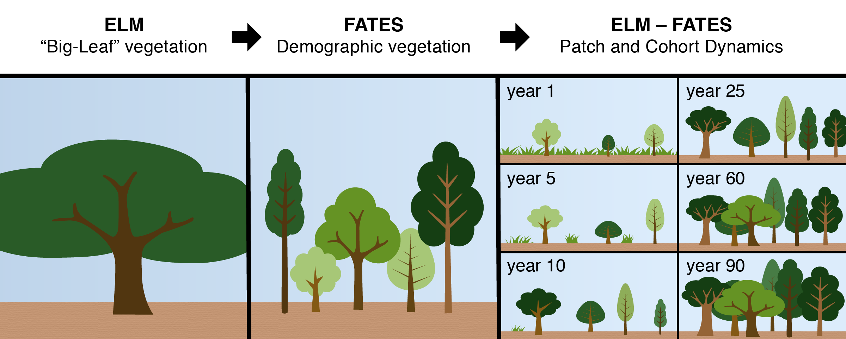
The Current and Unique Strengths of DOE
The Functionally Assembled Terrestrial Ecosystem Simulator (FATES)
Credits: Jennifer Holm, LBNL

Slide 9
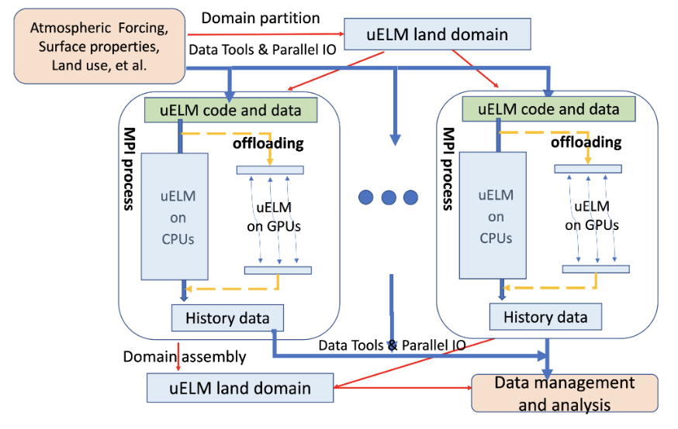
The Current and Unique Strengths of DOE
Ultrahigh Resolution ELM via GPUs
Wang et al., CiSE, 2022
E3SM Land Team, E3SM tutorial, 2024

Slide 10

More Information
Funded by RGMA Program: The Role of Vegetation in Past and Future Global Hydroclimatic Change
For more information, please visit:
https://smerdon.ldeo.columbia.edu/people/yelin-jiang
or contact:
yjiang@ldeo.Columbia.edu

