Slide 1
The E3SMv2.1 Seasonal-to-Multiyear Large Ensemble (SMYLE) Forecast System A Comparative Global Skill Assessment
NCAR/CATALYST: Steve Yeager¹, Gerald Meehl¹, Yaga Richter¹, Nan Rosenbloom¹, Sasha Glanville¹, Gary Strand¹, Julie Caron¹
DOE/E3SM: Luke Van Roekel², LeAnn Conlon², Walter Hannah³, Chris Golaz³
¹NSF National Center for Atmospheric Research, Boulder, CO
²DOE Los Alamos National Laboratory, Los Alamos, NM
³DOE Lawrence Livermore National Laboratory, Livermore, CA

Slide 2
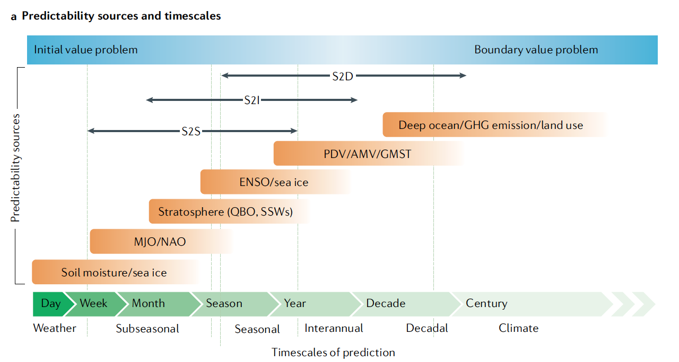
Extended Seasonal (S2I) Prediction
Predictability knowledge gap for timescales in-between traditional seasonal (0-12 month) and decadal (1-10 year) efforts
New experimental protocol needed to fill that gap:
Seasonal: 12-month hindcasts initialized monthly
Ext-Seasonal: 24+-month hindcasts initialized quarterly
Decadal: 10-year hindcasts initialized yearly
Predictability Sources and Timescales:
Yeager et al. (2022, Geosci Mod Dev, 10.5194/gmd-15-6451-2022)
Meehl et al. (2021, Nature Reviews, 10.1038/s43017-021-00155- x)

Slide 3
Extended Seasonal (S2I) Prediction
(2023, Communications Earth & Environment)
(2023, Science Advances)
(2023, Earth’s Future)
(2024, Nature Geoscience, in review)
(2024, Mon Wea Rev)
(2023, Earth’s Future)
Yeager et al. (2022, Geosci Mod Dev, 10.5194/gmd-15-6451-2022)

Slide 4
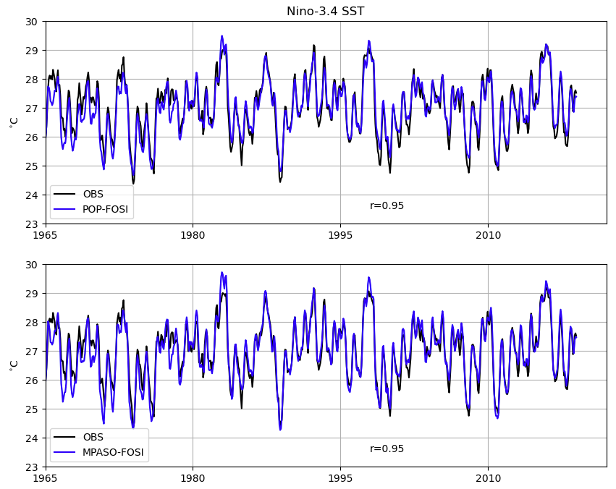
Seasonal-to-MultiYear Large Ensemble
Hindcast Experiments
 | CESM2 SMYLE | E3SMv2.1 SMYLE
Model -ocean -atmosphere -land -sea ice | CESM2 POP2 (1°, 60L) CAM6-FV (1°, 32L) CLM5 (1°) CICE5 (1°) | E3SMv2.1 MPAS-O (1°, 60L) EAMv2 (1°, 72L) ELMv2 (1°) MPAS-SI (1°)
Forcing -through 2014 -2015 onwards | CMIP6 SMBB historical RCP3.70 | CMIP6 SMBB historical RCP3.70
Initialization -ocean -atmosphere -land -sea ice | Full field POP2 FOSI (1°, OMIP2) JRA55 forced CLM5 (CRU-JRA) POP2 FOSI (1°, OMIP2) | Full field MPAS-O FOSI (1°, OMIP2) ERA5 forced ELMv2 (CRU-NCEP) MPAS-O FOSI (1°, OMIP2)
Hindcasts -start dates -initialization years -length -ensemble size | 1st of Nov, Feb, May, Aug 1970-2019 24 months 20 | 1st of Nov, Feb, May, Aug 1970-2019 28 months 20
CESM2
POP FOSI:
E3SMv2.1
MPAS-O FOSI:
Forced Ocean/Sea-Ice (FOSI) simulations yield reasonable reproduction of historical ocean/sea-ice states (in particular, tropical Pacific)

Slide 5
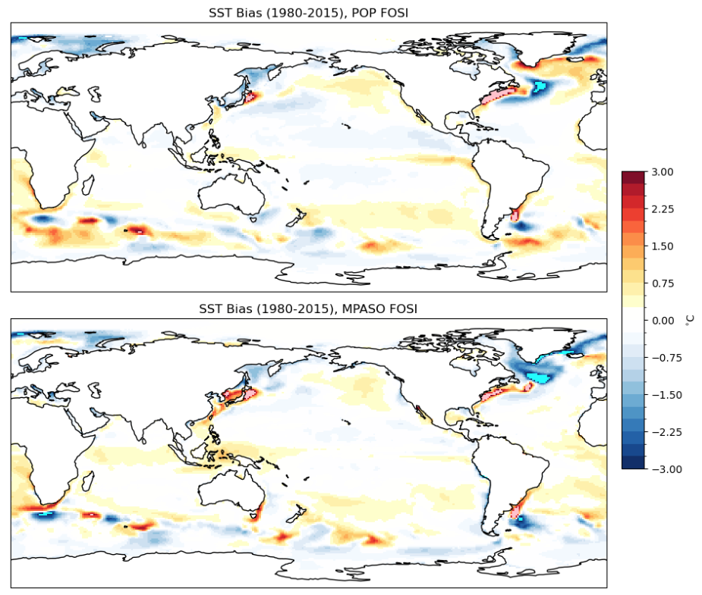
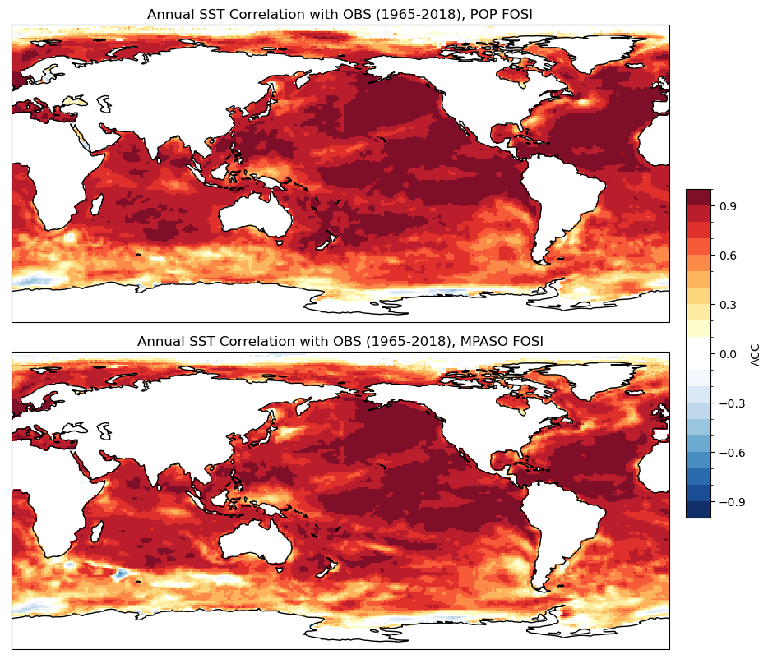
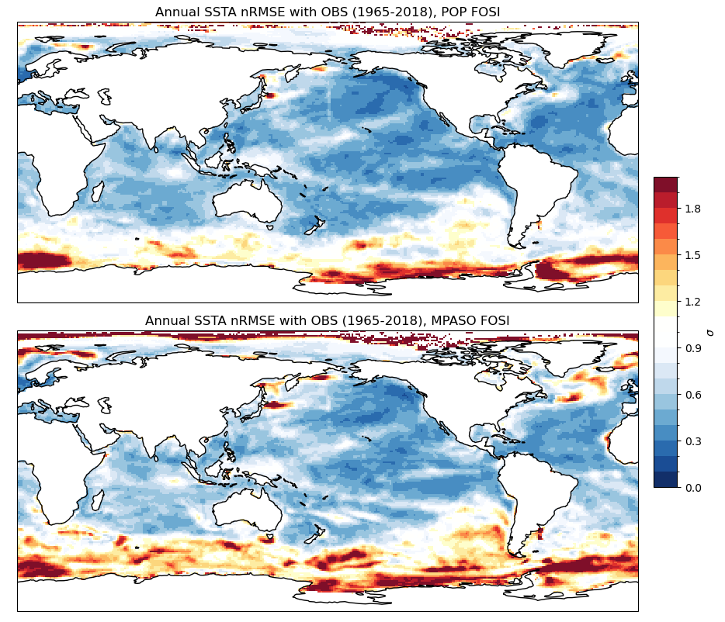
Fidelity of Ocean Initial Conditions
Mean SST Bias:
SST Correlation:
SST RMSE:
“Poor man’s data assimilation” for ocean/sea-ice → far from perfect!
Ocean initial conditions for E3SMv2.1-SMYLE are comparable to those used for CESM2-SMYLE
TOP ROW: POP2
BOTTOM ROW: MPAS-O

Slide 6
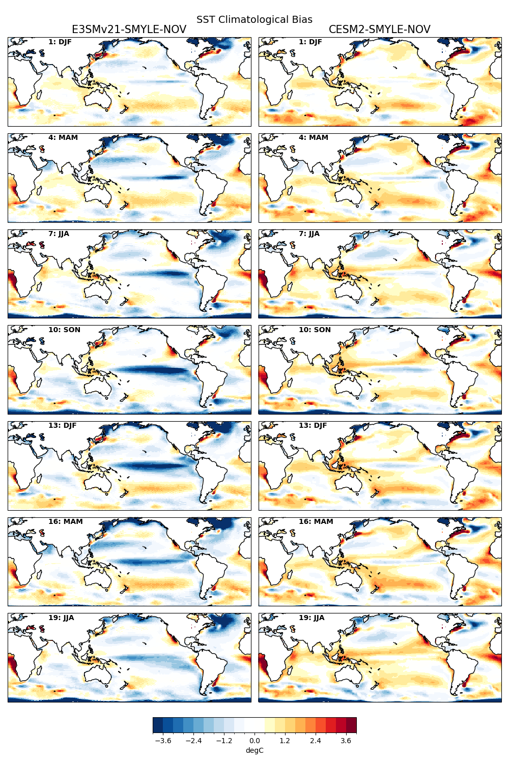
Hindcast Drift
SST Bias (Coupled Hindcasts):
SST Bias (FOSI):
Forecast Leadtime
POP2
MPAS-O
Coupled model systematic bias develops rapidly
Very different lead-dependent bias patterns in E3SMv2.1 and CESM2

Slide 7
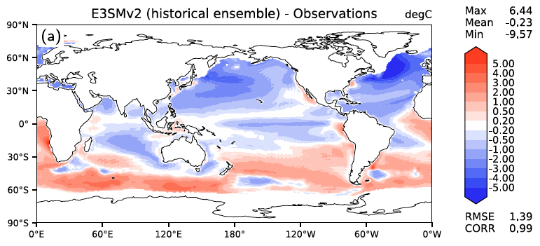
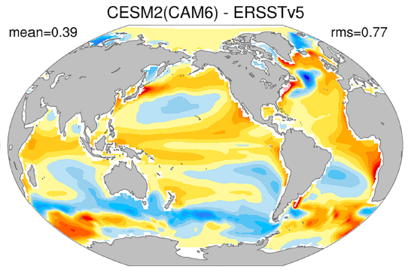
Hindcast Drift
SST Bias (Coupled Hindcasts):
SST Bias (Coupled Historical):
E3SMv2
CESM2
Golaz et al. (2022, JAMES, 10.1029/2022MS003156)
Danabasoglu et al. (2020, JAMES, 10.1029/2019MS001916)

Slide 8
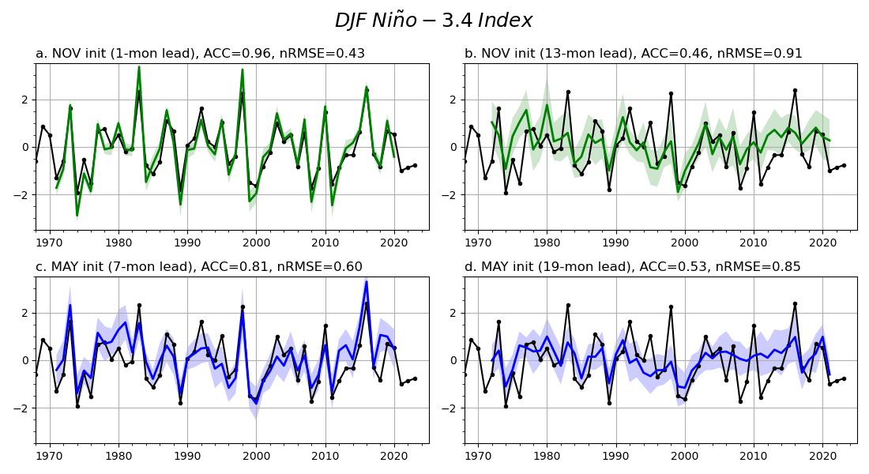
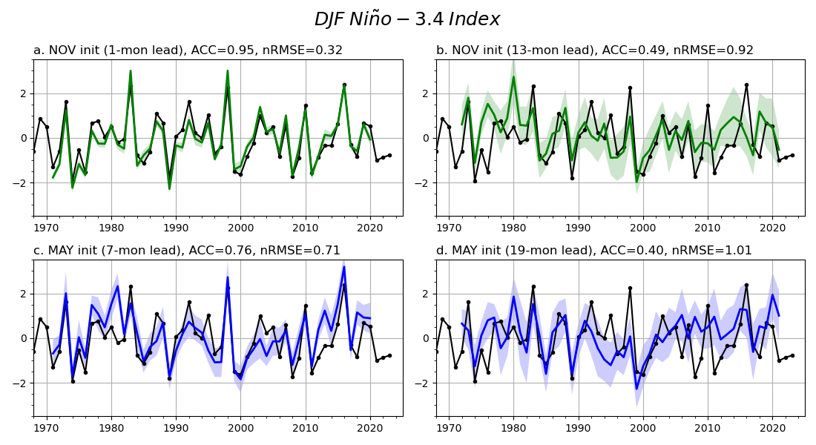
ENSO Prediction Skill
E3SMv2.1-SMYLE
CESM2-SMYLE
1-month lead
13-month lead
1-month lead
13-month lead
7-month lead
19-month lead
7-month lead
19-month lead
Remarkably similar ENSO skill despite very different mean model biases
Both systems are competitive with the NMME multi-model mean
Evidence of robust multiyear-lead ENSO forecasts-of-opportunity

Slide 9
ENSO Prediction Skill
Start-month dependence on skill comparison
E3SMv2.1 outperforms CESM2 for MAY hindcasts

Slide 10
ENSO Prediction Skill
Improved Niño3.4 skill in E3SMv2.1 due to improved prediction of Bjerknes feedback (SLP over MC/IO)?

Slide 11
ENSO Impacts Skill
Anomaly Correlation Coefficient (after detrending):
E3SMv2.1
CESM2
E3SMv2.1-CESM2
SAT:
SLP:
PRE:
Skill comparison for seasonal impacts is mixed

Slide 12
ENSO Impacts Skill
Anomaly Correlation Coefficient (after detrending):
COMBINED- E3SMv2.1
COMBINED - CESM2
SAT:
SLP:
PRE:
Combined 40-member multi-model system appears generally superior to individual systems

Slide 13
Summary
Extended-seasonal initialized prediction hindcasts using E3SMv2.1 have been completed through CATALYST/E3SM collaboration
E3SMv2.1-SMYLE skill for ENSO is similar to that from CESM2-SMYLE despite different background mean state bias
Promising potential to explore seasonal predictability dependence on model structure & process representation

