Slide 1





RGMA Project: “Representation of the interactions between the MJO and the Maritime Continent in the Regionally-refined SCREAM”
A critical role of the land-atmosphere interaction for the MJO damping effect
over the Maritime Continent
Xianan Jiang^{1,2} & Hsi-Yen Ma³
¹Joint Institute for Regional Earth System Sci. & Engineering / Univ. of California, Los Angeles
²Jet Propulsion Laboratory / California Institute of Technology
³Lawrence Livermore National Laboratory
POC: xianan@ucla.edu
2024 EESM PI Meeting, August 6-9 2024, Maryland
The Regional & Global Model Analysis (RGMA) Program / U.S. Department of Energy

Slide 2
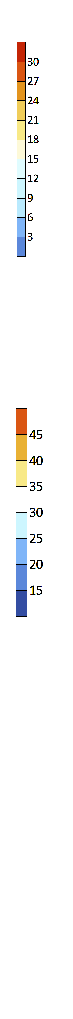



The MC Barrier Effect on MJO propagation
Idealized aqua-planet AGCM simulations
Simulated MC damping effect on the MJO
a) SST ( Q_{obs} )
b) SST ( Q_{obs} ) + MC
MJO Convective Precipitation
mm day⁻¹
Q_{OBS}
Precipitation (mm day⁻¹)
Precipitation (mm day⁻¹)
Q_{OBS} + MC
Jiang et al. (2019)
Jiang et al. (2020)
Q_{OBS} :
$$\frac{3.71}{4.23} \sim 89\%$$
Q_{OBS} + MC:
$$\frac{2.15}{4.87} \sim 54\%$$
ECHAM4.6 AGCM (T106 ~ 1 deg)
Forced by idealized SST pattern (Q_{OBS})
Perpetual March runs
Realistic MC islands (land-sea, topography,
& vegetation, and land-atmosphere coupling)
Poor understanding of the
underlying physics
“MC MJO prediction barrier”
Total MC damping effect:
89% - 54% = 35%

Slide 3



Experiments to understand the MJO damping effect over the MC
Relative roles for the MC damping effect
MJO Convective Precipitation
100%
Q_{OBS} (No MC)
(89%)
76%
MC damping effect
MC land
total MC
damping
mm day⁻¹
23%
29%
Q_{OBS} + MC
(54%)
Total
Topography
Diurnal cycle
Land-coupling
Land-atmosphere interaction plays a crucial role for MJO damping over MC.
MC
topography
22LT
(3ºS-3ºN)
$$Precip$$
$$(shaded)$$
A critical role of shortwave Q_{R} - surface T - convection feedback in generating the MC damping effect for the MJO, which is optimized by the diurnal cycle.
19LT
$$QR$$
mm day⁻¹
Q_{OBS} + Flat MC (62%)
16LT
13LT
Diurnal
cycle
Local time
10LT
07LT
$$TS$$
Q_{OBS} + Flat MC
No diurnal cycle
(72%)
Jiang et al. (2024)
04LT
01LT
22LT
Indian Ocean
MC
Notes:
Topography
Diurnal cycle
Surface latent heat flux
Or else?

Slide 4
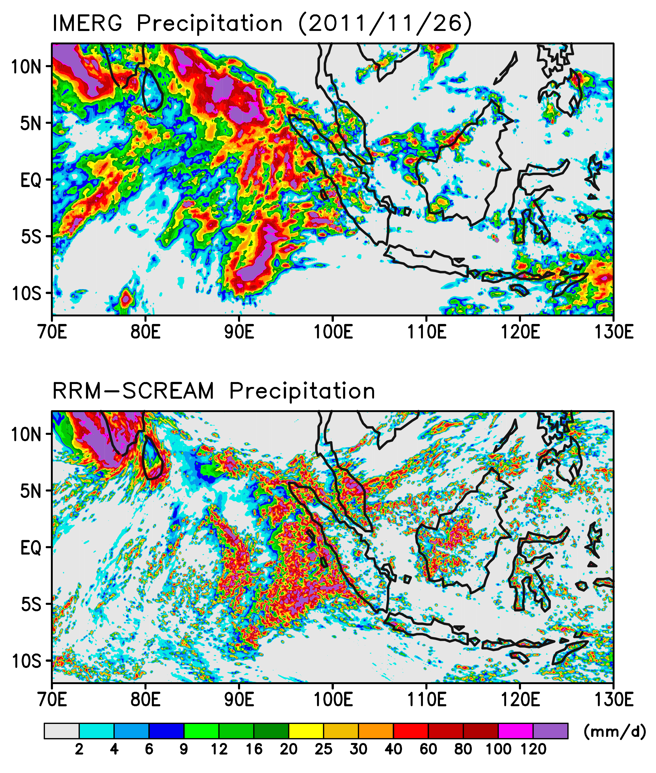
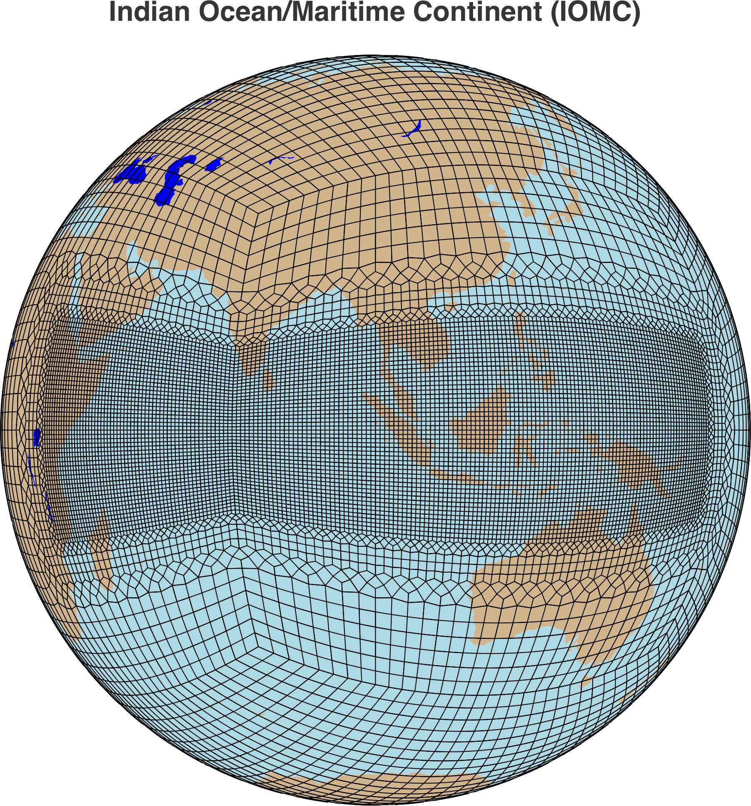
The MC barrier effect on the MJO in SCREAM simulations
Indian Ocean/MC RRM-SCREAM
A case study during the DYNAMO period (2011.11.24-2011.12.02)
Inner domain ~3.25 km, free-running.
Outer domain ~100 km, dynamical fields nudged toward the ERA5 reanalysis.
Multi-scale convection organization, e.g., the MJO over the MC region.
See “Methodological Breakout Session: Local/Regional Testbeds” for details (Hsi-Yen Ma, Thursday 1:12–1:19 pm)

