Slide 1
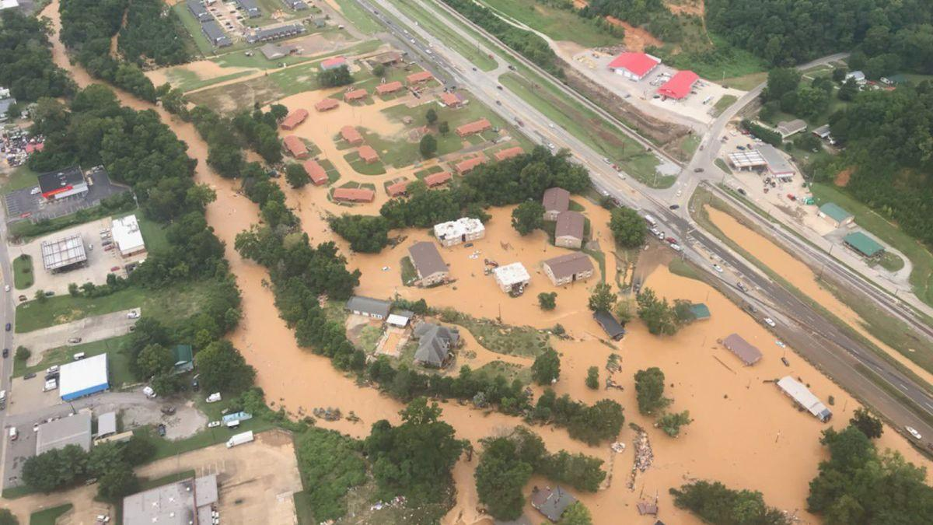
Extreme Precipitation Scaling with Temperature at the Weather Timescale and Implications for Climate Prediction
Guiling Wang¹, Hongchen Qin¹, Faisal Alvee¹,
Xiaoming Sun², Huancui Hu³, Ruby L. Leung³
1. University of Connecticut
2. Los Alamos National Laboratory
3. Pacific Northwest National Laboratory
2024 EESM PI Meeting, Bethesda, MD, August 6th – 9th

Slide 2
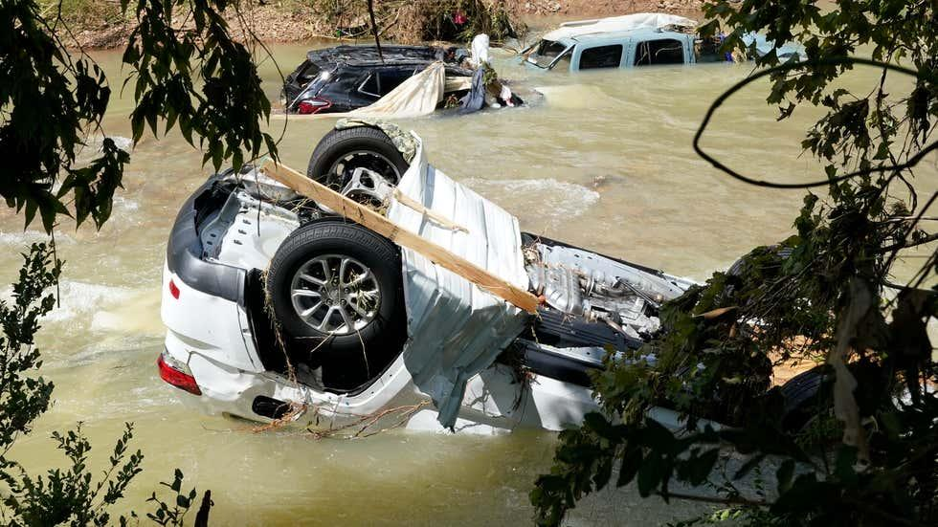
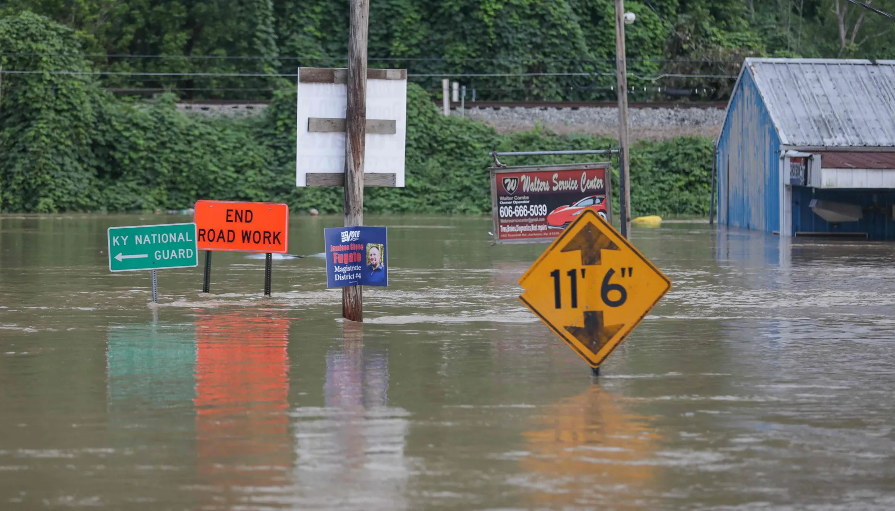
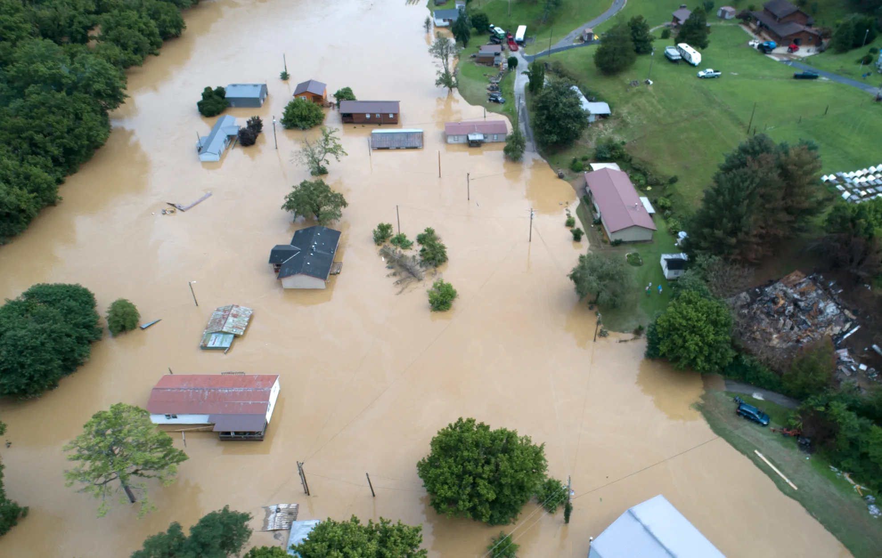
Tennessee, August 2021 (425mm or 17inches in 24 hrs)
Kentucky, July 28, 2022 (peak rain rate > 4 inches/hour)

Slide 3
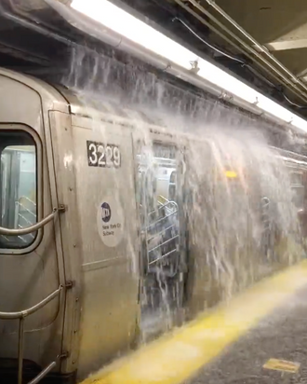
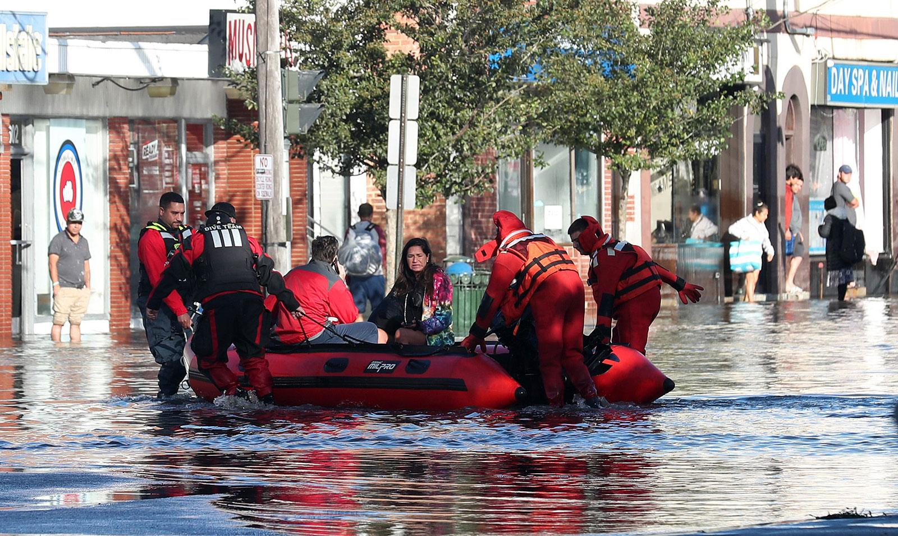
New York City, September 2021 (tropical storm Ida) (record rain intensity at central park: 79mm (3.15 inches) per hour)

Slide 4
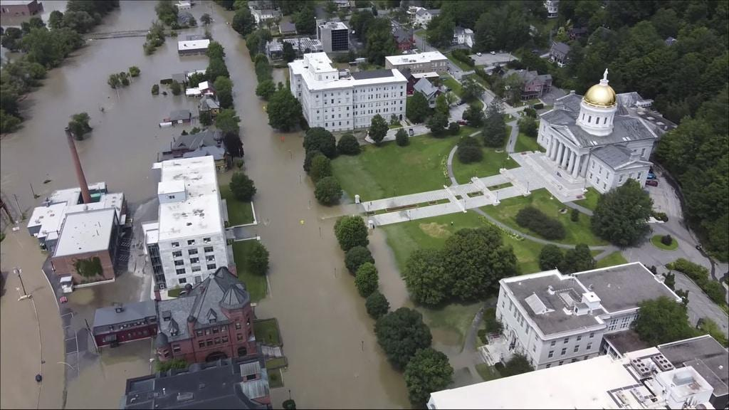
July 10-11, Northeast, 2023 (48 hr total up to 10.49 inches)
Accurate and locally relevant quantitative prediction/projection of extreme precipitation changes are needed to guide and support the increasingly urgent climate adaptation efforts.

Slide 5
Extreme Precipitation on the rise: Observations & Theoretical predictions
Marvel et al. (2023, 5th National Climate Assessment)
Observed changes of precipitation on the heaviest 1% of days, during 1958-2021
Thermodynamics: rain intensity increasing with temperature exponentially, at ~7% K⁻¹ (C-C relationship)
Further modification due to changes of atmospheric dynamics, etc

Slide 6
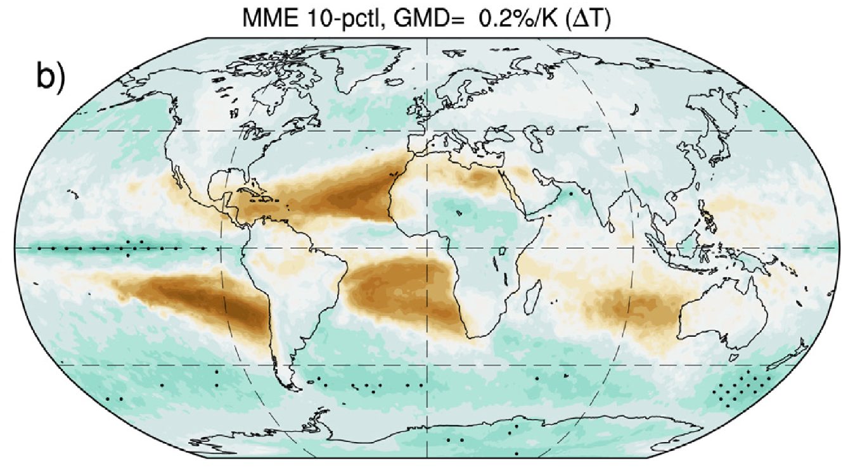
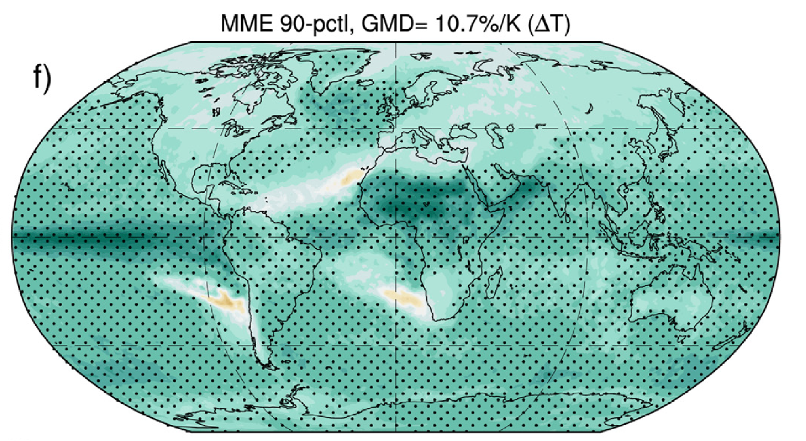
Extreme Precipitation on the rise: Predictions from CMIP6 ESMs (John et al., 2022)
Projected relative changes (in % /K) of 20-year return values of Rx1day show a strong model dependence:
MME 10th Percentile MME 90th Percentile
Challenge: How to reduce the uncertainties of future projections?
Improving ESM physics and dynamics (long-term effort)
Constraining model-projected future changes using emergent constraints

Slide 7
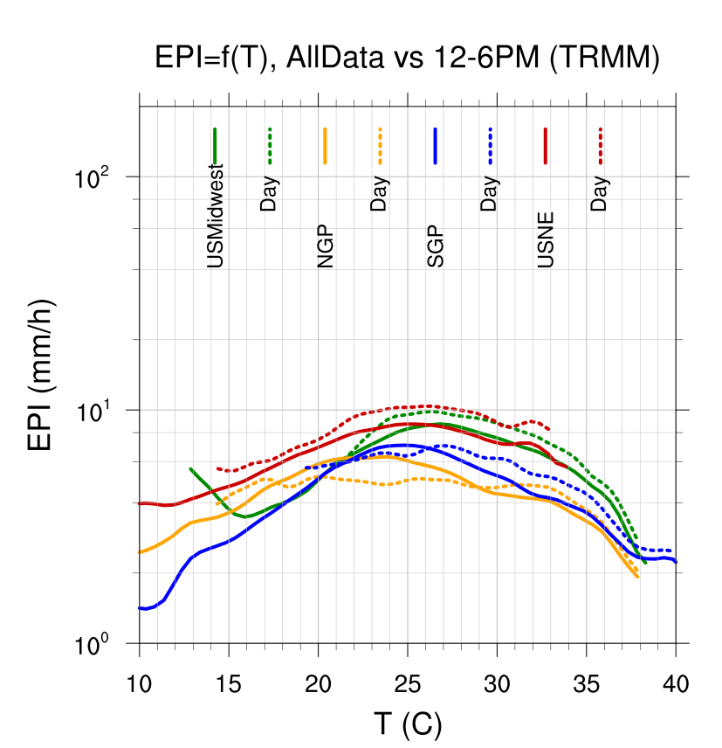
At the weather timescale:
Negative scaling of Extreme Precipitation Intensity (EPI) at High Temperatures
JJA, TRMM 3-hourly,
all time (solid) & 12-6pm only (dashed)
Peak precipitation intensity (P_{peak}) & temperature at which it peaks (T_{peak}); negative scaling for T> T_{peak}
EPI (mm/day)
(Wang et al., 2017)
(Alvee et al., in prep)

Slide 8
Causes for the Negative Scaling at the Weather Timescale
Atmospheric moisture limitation (primary cause over land,
Wang & Sun, 2022): High air temperature leads to a large saturation deficit (SD), which suppresses heavy precipitation through multiple mechanisms (e.g., raising LCL, dry air entrainment, hydrometeor re-evaporation)
Other factors:
Different precipitation types (e.g., MCS vs. non-MCS) (Hu et al., in review)
Precipitation-induced cooling (primary cause over ocean) (Sun & Wang, 2022)
Anti-cyclonic warming
….
Notes:
Many factors influence the negative scaling of EPI at high temperatures, including for example storm type, precipitation-induced cooling ..
However, over most land regions, the dominant cause is the saturation deficit induced by high temperature, which suppress heavy precipitation by …

Slide 9
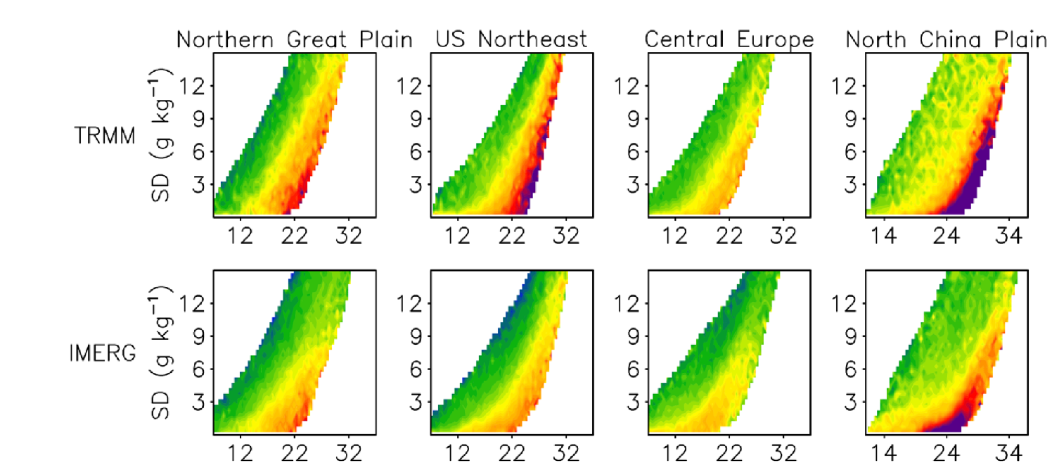
EPI (T, SD) relationship, based on TRMM /IMERG precipitation paired with T & SD from re-analysis (Wang & Sun, 2022)
EPI-T Scaling in Saturated Atmosphere (SD < 0.5 g/kg)
Monotonic increase of EPI with T under fixed SD!

Slide 10
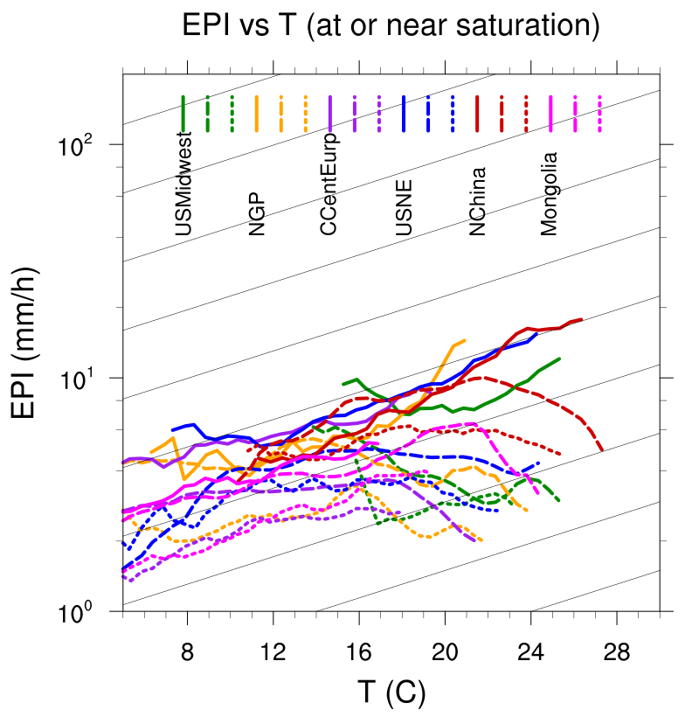
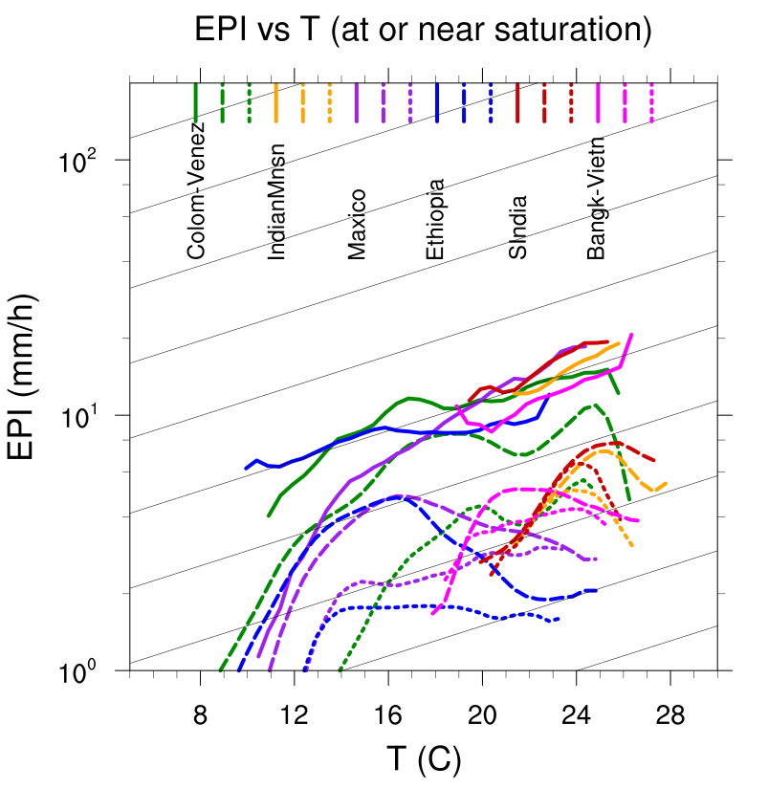
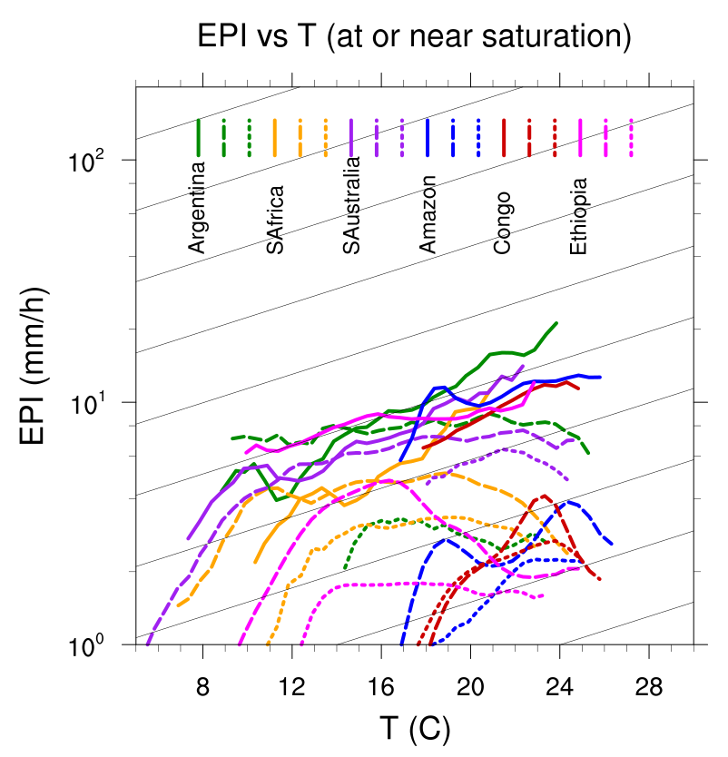
EPI-T In Saturated Atmosphere (E3SM, 18 sample regions) (Extremes defined as those exceeding the 99.9th percentile of 3-hourly precipitation)
NH mid-latitudes regions Other Regions (tropics, subtropics, & SH)
(Alvee et al., in prep)
TRMM (solid lines) E3SM 0.25° (dashed) E3SM 1° (dotted)
Would convection-permitting model make a difference?
-- work in progress based on output from SCREAM (DYAMOND)
HighRes E3SM (0.25°) produces more realistic precipitation characteristics (e.g., higher rain intensity), but does not show clear improvement of the EPI-T scaling relationship.

Slide 11
EPI-T In Saturated Atmosphere (WRF, 5 sub-regions of U.S.)
(Extremes defined as those exceeding the 99.9th percentile of hourly precipitation)
WRF-TGW (12km) CONUS404 (4km) IMERG
Scaling ratio is similar between 12km (with cumulus parameterization) and 4km (convection permitting) simulations.
(Qin et al., Thursday Poster #072)

Slide 12
Questions
What may have caused the model biases in simulating the EPI-T scaling rate at the weather timescale?
Spatial resolution? ( probably not)
Model physics & dynamics?
Background climate (e.g., wet bias/dry bias)?
Is the weather-timescale EPI-T relationship relevant for climate changes? (Can it be used as an emergent constraint for future changes)?
Would regions/models with a higher scaling rate at the weather timescale experience faster extreme precipitation changes at the climate timescale?
Would the weather-scale biases propagate to influence the model projected future changes?

Slide 13
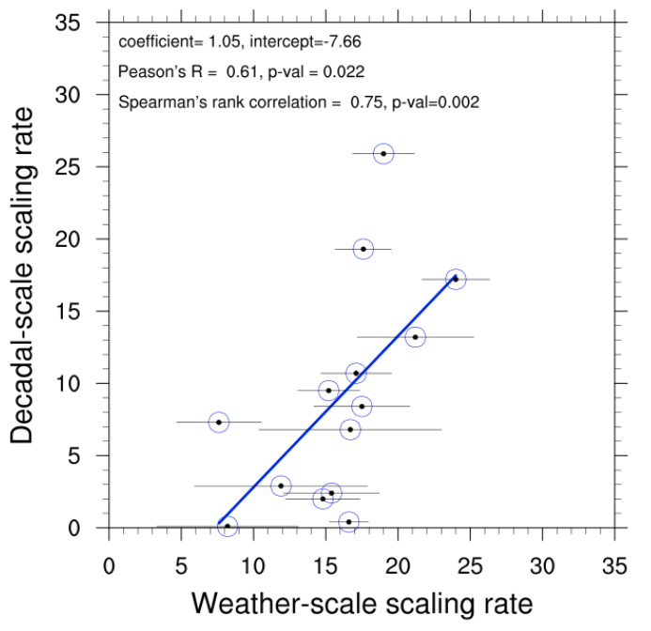
Scaling: Climate vs. weather (based on CONUS404)
16 sub-regions of the U.S.
Statistically significant (albeit weak) positive correlation between decadal-scale and weather-scale scaling rates.
(Qin et al., in prep; Thursday Poster #072)

Slide 14
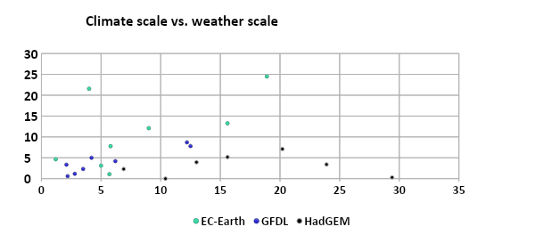
Scaling Rates at Climate Timescale vs. Weather Timescale (based on ESMs output for Warm Season)
Y-axis: R1d_{max} changes scaled by local warming (%/K) (4XCO2 – piControl)
X-axis: Weather-scale p99 3hrly EPI-T scaling ratio under saturation (%/K) (piControl)

Slide 15
Thank you!
Attending AMS Annual Meeting (New Orleans, January 12-16, 2025)?
Consider submitting an abstract to the 39th Conference on Hydrology
Abstract due date: August 15, 2024
Session Topical Area: “The Earth's Water Cycle: Variability, Changes, and Extremes”
Invited Speakers: L. Ruby Leung (PNNL), Kristen Findell (GFDL)
Conveners: Guiling Wang (UConn), Kyle Knipper (USDA ARS & UC Davis)

