Slide 1
Kilometer-scale E3SM Land Model Development, Integration, and Applications
Dali Wang, Peter Schwartz , Fengming Yuan,, Shih-Chieh Kao, Michele Thornton, Daniel Ricciuto, Peter Thornton, Qinglei Cao, Chen Wang, and others
EESMPI2024 breakout session
August 7, 2024

Slide 2
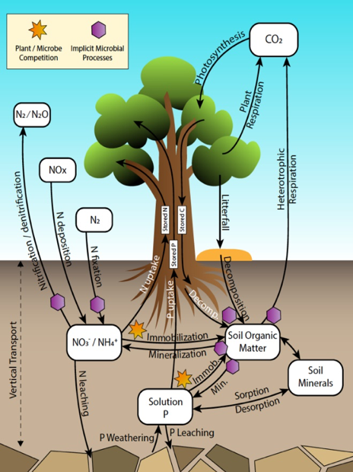
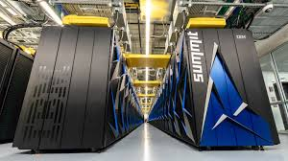

Objective
Develop ultrahigh-resolution ELM (uELM) to understand hydrologic cycles, biogeophysics, and ecosystem dynamics using start-of-the-art datasets
  Large-scale: continent and beyond (e.g., NA, Pan-arctic)
  Ultrahigh-resolution (1-3 km resolution)
  HPCs, including exascale computers (Summit and Frontier)

Slide 3
Background: ELM is a data-centric application
Notes:
Embarrassingly parallel among land cells, Extensive use of global arrays with filters (active subgrid components)

Slide 4
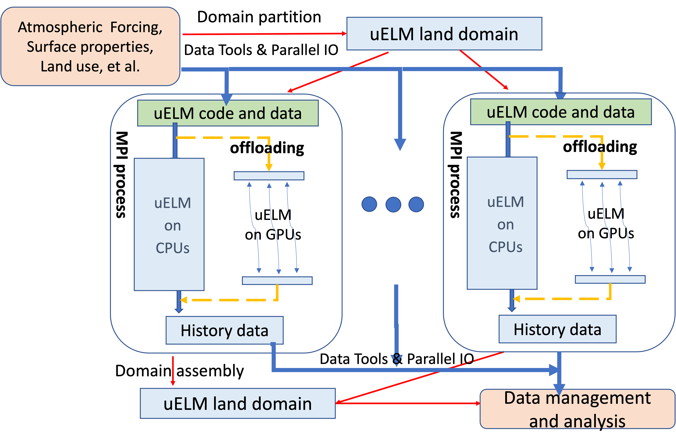
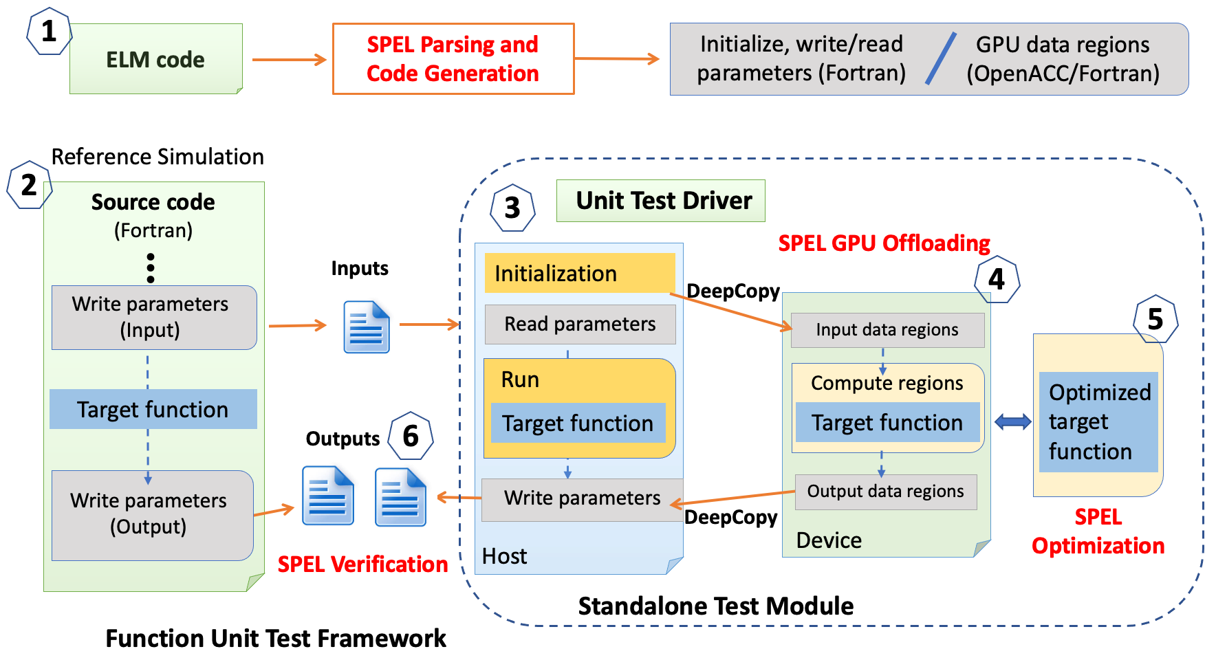
Background: Computational model and code porting
SPEL: Software tool for Porting ELM

Slide 5
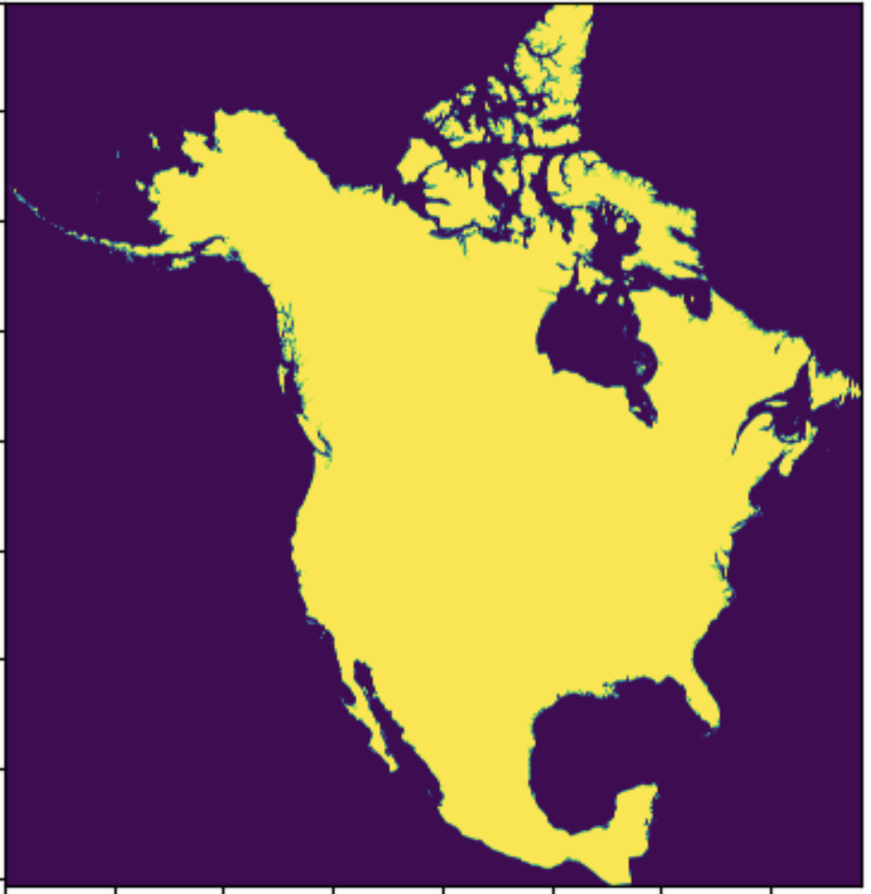
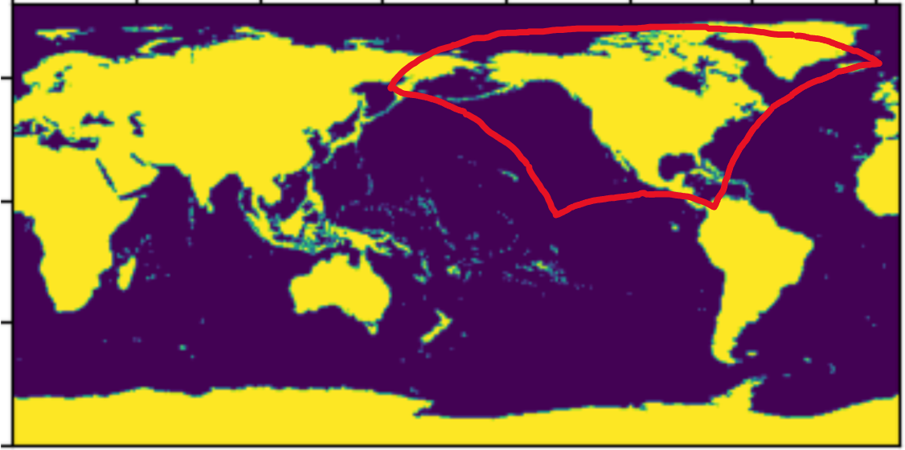
High resolution datasets
North America
  Climate Forcing (3-Hourly Daymet (1980-present)) (50 TB)
  Surface properties (interpolation and HR data fusion) (120GB)
  Land use and change dataset (700 GB)
  Others (e.g., ndep, pdep, population density, lighting frequency)
1km x 1km
Total: 63.1 M (8075*7814)
Land: 21.5 M
Lambert Conformal Conic / WGS84
  ~ 350 times LT 62K (total land cells at a 0.5x0.5 resolution simulation)

Slide 6
Offline uELM simulation preparation with kiloCraft
Mapping and interpolation
Data mode
E3SM Coupler
E3SM Atmosphere Model
interpolation
E3SM Land Model
On-the-fly interpolation
Atmospheric Forcing
Surface prosperities
P, N deposition, LULC, Fire, etc.
uELM Domain
kiloCrraft
Multi-resolution, regridding, data checking
Target large-scale simulation on high-performance computers
Easy adoption of state-of-the-art data products

Slide 7
Create uELM cases
User define the AOIs (gridID or coordinates)
Create domain/surfdata/forcing with kiloCraft scripts (interactive or batch mode)
Link AOI data with the name convention required by CIME and DATM mode (Daymet_uELM)
Create and run the uELM case with user-defined dataset and data ATM (ELM_USRDAT)

Slide 8
Next: Code and data development
uELM simulation on Summit and Perlmutter
  72 million gridcells (CPU: 84000 cores) (* GPU code scale up to 120 GPUs)
  Target 130 million gridcells (4000 nodes/Summit)
  KM-scale data integration and uELM input datasets (kiloCraft)
uELM GBC spin-up acceleration on Frontier
  ORBIT: AI foundation model
  Exascale Emulator: statistical inference
uELM input data preparation:
  Atmospheric forcing (Daymet-GSWPS, and Daymet-ERA5) (Kao, et all)
  Surface properties data (continental level) (TESSFAs and others)

Slide 9
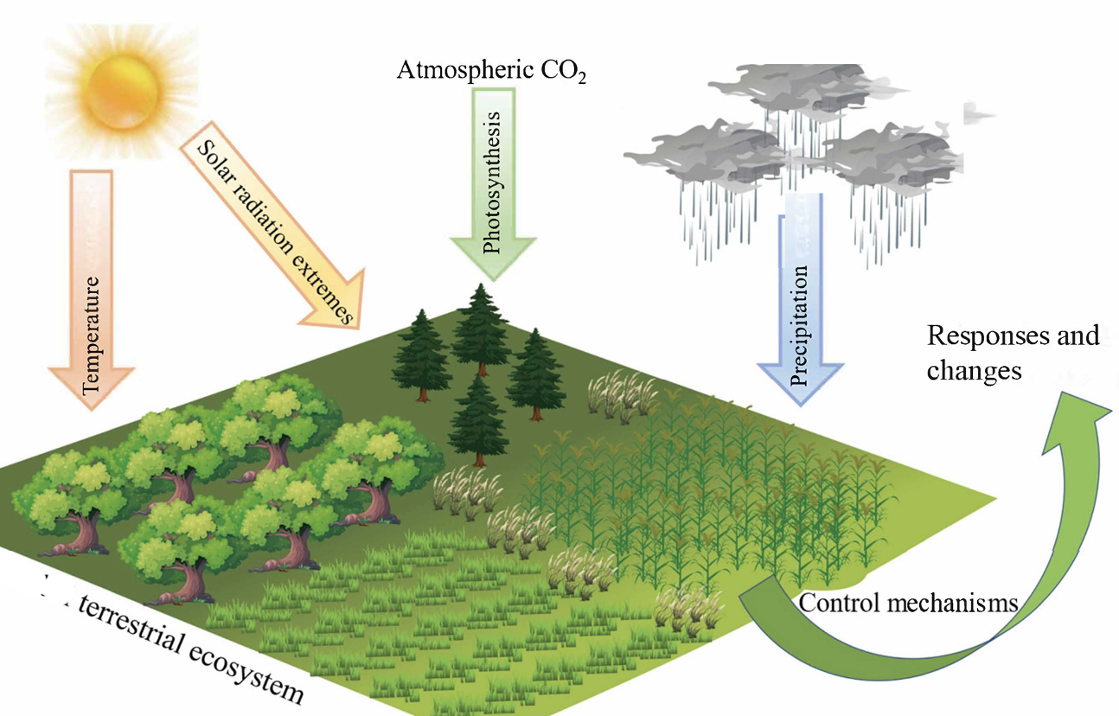
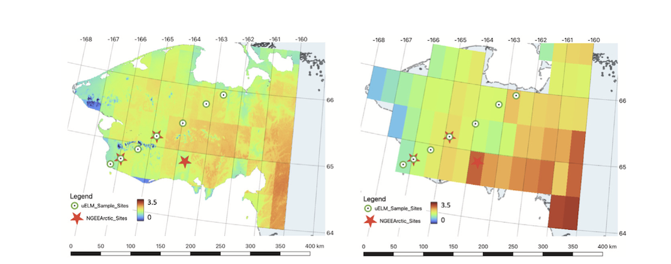
Next: Program integration and applications
Activities
  Pan-arctic simulation (1km x 1km)
  Regional peatland simulation (4kmx4km)
  NetZero-Armada (TVA 2050 pathways, 1km x 1km)
  Urban studies (Chicago, New Orleans,
  Atlanta, Baltimore)
  Trustworthy AI foundation model (ORBIT)

Slide 10
Acknowledgement
Energy Exascale Earth System Model (E3SM) project.
NGEE Arctic, TES-SFA, and NASA:ESDIS/TE
Computing resources from OLCF, NERSC, ORNL-cloud, OLCF-baseline, etc.

