Slide 1
Xarray Climate Data Analysis Tools
A Python Package for Simple and Robust Analysis of Climate Data
2024 EESM PI Meeting (08/08/2024)
Tom Vo, Stephen Po-Chedley, Jason Boutte, Jiwoo Lee, and Jill Zhang
With thanks to Peter Gleckler, Paul Durack, Karl Taylor, and Chris Golaz
This work is performed under the auspices of the U. S. DOE by Lawrence Livermore National Laboratory under contract No. DE-AC52-07NA27344.
LLNL-PRES-867521

Slide 2
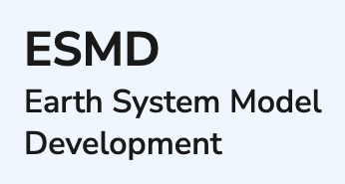
Thank you to our project funders at
BER (Office of Biological Environmental Research)
EESSD (Earth and Environmental Systems Sciences Division)
PM: Renu Joseph
PM: Xujing Davis

Slide 3
An Overview of this Talk
Driving forces
Principle goals
Key features
How to started and get involved
What’s in store for xCDAT?

Slide 4
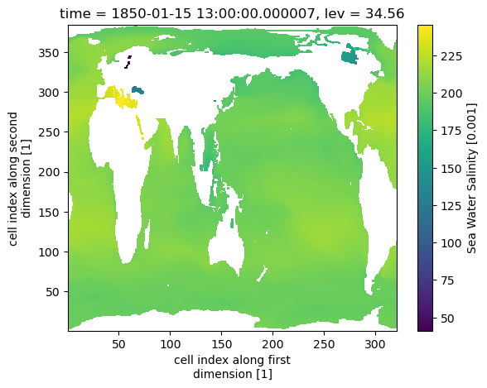
The Driving Forces Behind xCDAT
Growing volume of climate data
A larger pool of data products
Increasing spatiotemporal resolution of model and observational data
Data analysis requires highly performant, core operations
Reading and writing netCDF files
Regridding
Spatial and temporal averaging
CDAT (Community Data Analysis Tools) library is end-of-life since Dec/2023
Provided climate data analysis and visualization packages for over 20 years
Many users and software packages (e.g., E3SM Diagnostics, PCMDI Metrics) depend on CDAT

Slide 5
xCDAT addresses these challenges by….
Combining the power of Xarray with geospatial analysis features inspired by CDAT
=
+

Slide 6
: Xarray Climate Data Analysis Tools
xCDAT is an extension of Xarray in the climate science domain
Scope focused on routine climate data analysis operations on structured grids
Leverages and/or extends the capabilities other powerful Xarray-based packages such as xESMF, xgcm, and CF-xarray
Developed by team of climate scientists and software engineers from Lawrence Livermore National Laboratory

Slide 7
What are the principle goals of xCDAT?
Use modern technologies (Xarray, Dask)
Capable of handling large datasets
Lazy operations, parallelism
Similar core capabilities to CDAT
e.g., spatial averaging, temporal averaging, regridding
Promote software sustainability and reproducible science
Maintainable, extensible, and easy-to-use
Emphasize Climate and Forecast (CF) Metadata Conventions
Foster open-source community
Serve the needs of the climate community in the long-term
Community engagement efforts (e.g., Pangeo, ESGF)

Slide 8
: N-D labeled arrays and datasets in Python
Why is Xarray the core technology of xCDAT?
Modern, mature, and widely adopted
Stable – funding from NumFocus
Introduces labels for dimensions, coordinates, and attributes on top of raw NumPy-like arrays
User experience is intuitive, concise, less error-prone (compared to raw NumPy)
Key features of Xarray
File I/O – netCDF, Iris, OPeNDAP, Zarr, more
Array manipulation – Indexing, selecting, interpolating, grouping, aggregating, parallelism via Dask, plotting
Interoperable with scientific Python ecosystem

Slide 9
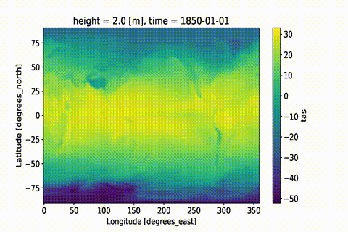
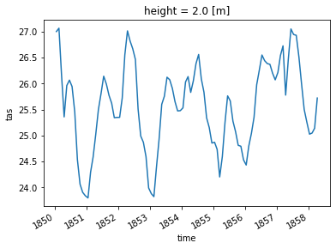
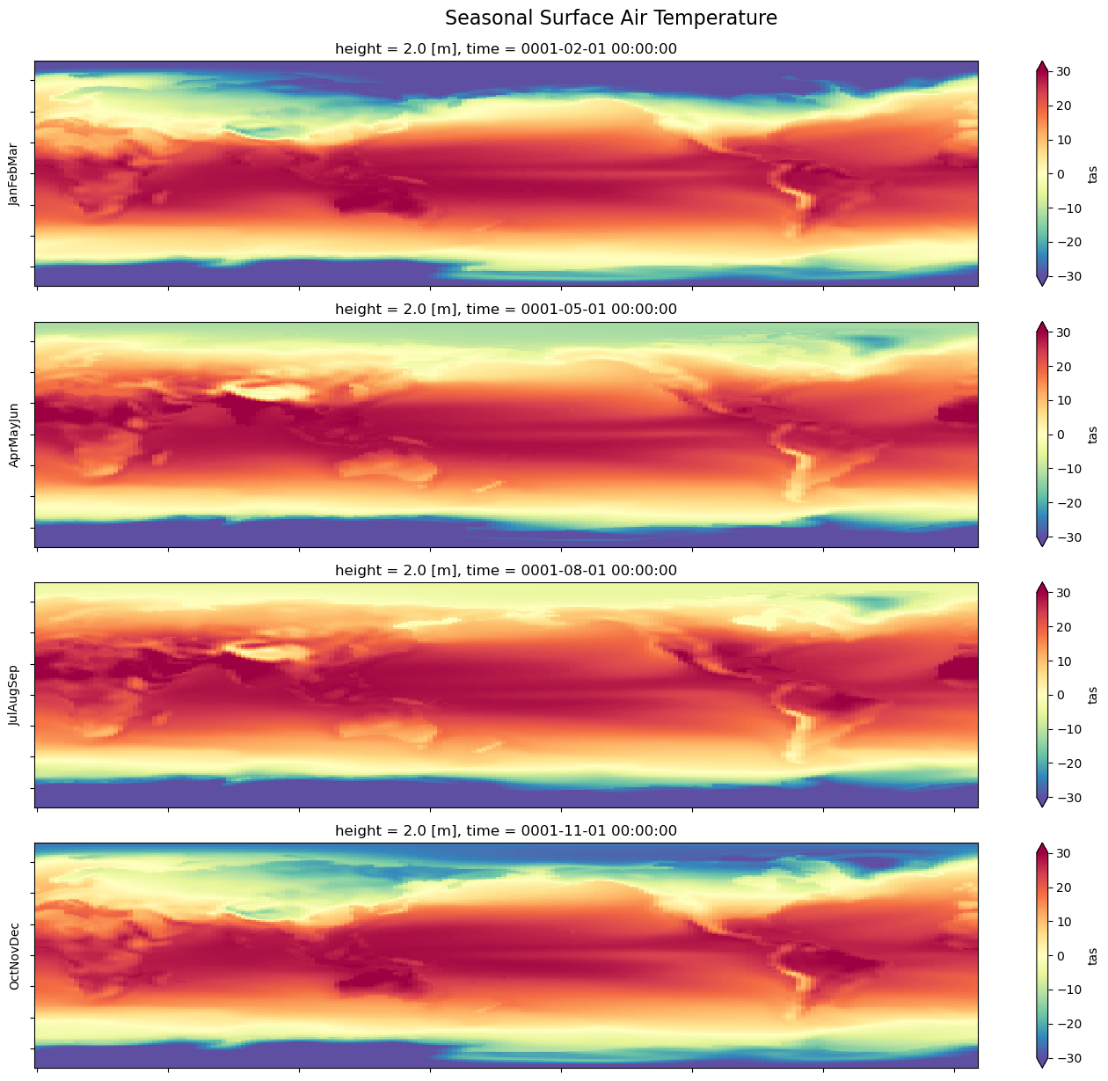
tools for simple and robust analysis code
I/O and Metadata
Xarray dataset I/O with post-processing options
Generate missing bounds, center time coords, convert lon axis orientation
Robust handling of coordinate bounds
Interpret Climate and Forecast (CF) compliant metadata (via cf-xarray)
Computations
Spatial averaging
Temporal averaging, climatologies, departures
Horizontal regridding (extension of xESMF and Python port of Regrid2)
Vertical regridding (extension of xgcm)
Parallelizable through Xarray’s support for

Slide 10
How to use xCDAT
xCDAT extends Xarray Dataset objects via “accessor” classes.
Accessors classes include:
spatial – .average, .get_weights
temporal – .average, .group_average, .climatology, .departures
regridding – horizontal, vertical
bounds – .get_bounds, .add_bounds, .add_missing_bounds
Functions include:
open_dataset, open_mfdataset
center_times, decode_time
swap_lon_axis
create_axis
create_grid
get_dim_coords
get_dim_keys
Visit the API Reference page for a complete list: https://xcdat.readthedocs.io/en/latest/api.html

Slide 11
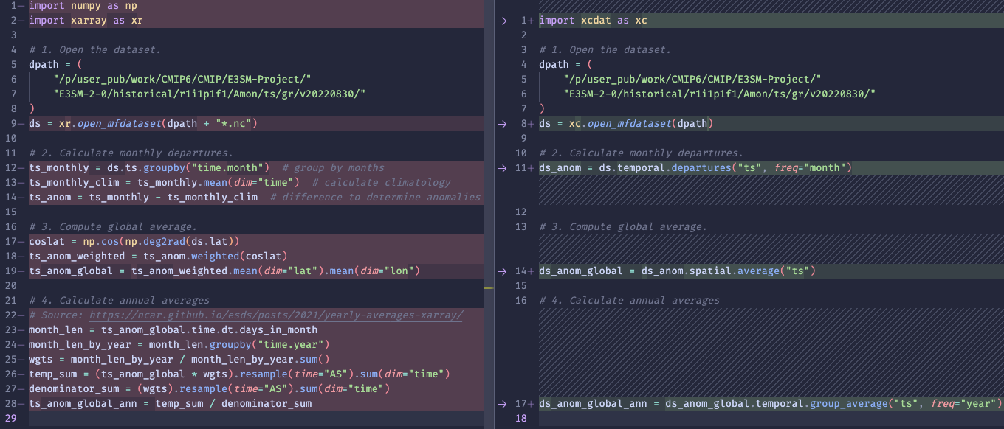
xCDAT simplifies Xarray code for specific operations
Example: calculate global-mean, weighted monthly anomalies
Less code
More flexible
Easier to read/write

Slide 12
xCDAT’s Growing Adoption in the Scientific Community
16,000+ total downloads* on Anaconda
100+ stars* on GitHub
Global usage in various projects and organizations
LLNL (Lawrence Livermore National Lab)
NASA (National Aeronautics and Space Administration)
IPSL (Institut Pierre-Simon Laplace)
Data processing engine for PCMDI Metrics Package and E3SM Diagnostics Package
Post-processing and analysis tool in E3SM Unified Environment
* As of Aug 2024

Slide 13
Get Involved in xCDAT!
xCDAT is distributed via Anaconda
Any and all contribution is welcome!
Code
Documentation
Submit and/or address tickets
Forum discussions

Slide 14
What’s in store for xCDAT?
Collaborate with UXarray for interoperation to support end-to-end and more streamlined operation on unstructured (i.e. E3SM native output) datasets.
Continue assisting integration in DOE funded projects including PCMDI Metrics Package, E3SM Diags
Explore other DOE funded projects to integrate xCDAT for analysis capabilities

Slide 15
Recap
xCDAT is an extension of Xarray for climate data analysis on structured grids, a modern successor to the Community Data Analysis Tools (CDAT) library
Focused on routine climate research analysis operations, such as temporal averaging, spatial averaging, and regridding.
Designed to promote software sustainability and reproducible science
Parallelizable through Xarray’s support for Dask

Slide 16
Supplemental Slides

Slide 17
The Software Design Philosophy of
Encourage software sustainability and reproducible science
Well-documented and configurable features allow scientists to rapidly develop robust, reusable, less-error prone, more maintainable code
Contribute to Pangeo’s effort of fostering an ecosystem of mutually compatible geoscience Python packages

Slide 18
Code Example: Calculate Geospatial Weighted Average
Xarray
xCDAT
import xarray as xr
import numpy as np
# 1. Open the dataset
path = "input/tas_3hr_ACCESS-ESM1-5_historical_r10i1p1f1_gn_201001010300-201501010000.nc"
ds = xr.open_dataset(path)
# 2. Convert air temperature to Celsius
ds["tas"] = ds["tas"] - 273.15
# 3. Calculate weights and apply to data
weights = np.cos(np.deg2rad(ds["tas"].lat))
weights.name = "weights"
tas_weighted = ds["tas"].weighted(weights)
# 4. Calculate the weighted mean
weighted_mean = tas_weighted.mean(("lon", "lat"))
import xcdat as xc
# 1. Open the dataset
path = "input/tas_3hr_ACCESS-ESM1-5_historical_r10i1p1f1_gn_201001010300-201501010000.nc"
ds = xc.open_dataset(path)
# 2. Convert air temperature to Celsius
ds["tas"] = ds["tas"] - 273.15
# 3. Calculate the weighted mean
weighted_mean = ds.spatial.average("tas", axis=["X", "Y"], keep_weights=True)["tas"]
Note: xcdat does a lot more, including handling regional averages
Notes:
# Example: https://docs.xarray.dev/en/stable/examples/area_weighted_temperature.html#Compare-weighted-and-unweighted-mean-temperature

Slide 19
Code Example: Calculate Monthly Temperature Departures
Xarray
xCDAT
import xarray as xr
# 1. Open the dataset
path = "ts_Amon_ACCESS1-0_historical_r1i1p1_185001-200512.nc"
ds = xr.open_dataset(path)
# 2. Calculate the weights
month_len = ds.time.dt.days_in_month
weights = (
month_len.groupby("time.month") / month_len.groupby("time.month").sum()
)
# 2. Calculate the monthly climatology
ts_climo = (ds["ts"] * weights).groupby("time.month").sum(dim="time")
# 3. Calculate the monthly anomalies
ts_anomalies = ds["ts"].groupby("time.month") - ts_climo
import xcdat as xc
# 1. Open the dataset
path = "ts_Amon_ACCESS1-0_historical_r1i1p1_185001-200512.nc"
ds = xc.open_dataset(path)
# 2. Calculate the monthly anomalies
# Note, we extract “ts” from the xr.Dataset object with [“ts”]
ts_anomalies = ds.temporal.departures("ts", freq="month", weighted=True)["ts"]

Slide 20
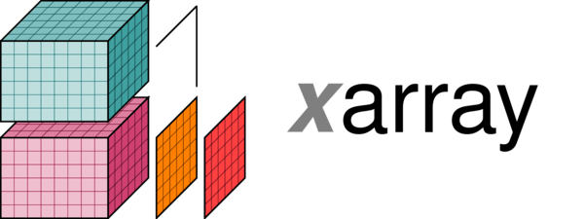
Parallelism with +
Why does Xarray integrate with Dask?
For datasets that don’t fit into memory, support parallel computations and streaming computation
Dask is an optional feature, but might become a required dependency — https://docs.xarray.dev/en/stable/use
Which Xarray features support Dask?
Nearly all existing xarray methods have been extended to work automatically with Dask arrays
Indexing, computation, concatenating and grouped operations — https://docs.xarray.dev/en/stable/user-guide/dask.html#using-dask-with-xarray
What is the default Dask behavior for distributing work on compute hardware?
By default, dask uses its multi-threaded scheduler distributes work across multiple cores and allows for processing some datasets that do not fit into memory
Optionally, setup the distributed scheduler for running across a cluster — https://docs.xarray.dev/en/stable/user-guide/dask.html#using-dask-with-xarray
How do xCDAT APIs work with Dask?
Many core xCDAT APIs inherit Xarray's Dask support by operating on xarray.Dataset objects and making calls to parallelized Xarray APIs.
xCDAT users just need chunk the xarray.Dataset object before calling any of the parallelizable xCDAT APIs.

Slide 21
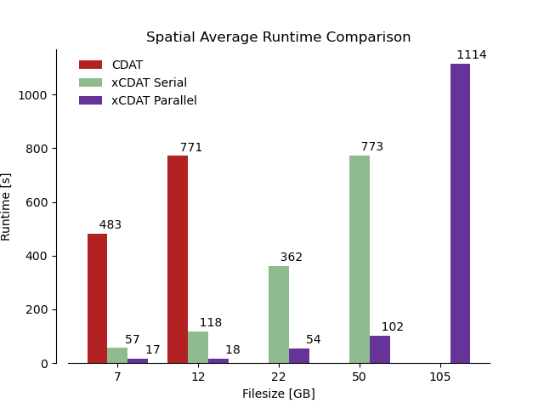
xCDAT is parallelizable through Xarray and Dask
Most Xarray methods extended to work automatically with Dask arrays
e.g., indexing, computation, concatenating and grouped operations
xCDAT inherits Xarray’s support for parallelism
xCDAT outperforms the older CDAT library by much large margins in some cases, such as global spatial averaging

Slide 22
How do I activate Dask with Xarray/xCDAT?
Load the data from a netCDF file or files with open_dataset() or open_mfdataset()
Specify the chunks argument
DISCLAIMER: open_mfdataset() will chunk each netCDF file into a single Dask array by default, so it is important set the chunks argument if the dataset is large
Note, Xarray maintains a Dask array until it is not possible. It will raise an exception instead of implicitly loading the array into memory.
import xarray as xr
filepath = "http://esgf.nci.org.au/thredds/dodsC/master/CMIP6/CMIP/CSIRO/ACCESS-ESM1-5/historical/r10i1p1f1/Amon/tas/gn/v20200605/tas_Amon_ACCESS-ESM1-5_historical_r10i1p1f1_gn_185001-201412.nc"
ds = xr.open_mfdataset(filepath, chunks={"time": "10"})
tas_daily = ds.tas.groupby(ds.time.dt.day).mean()

