Slide 1
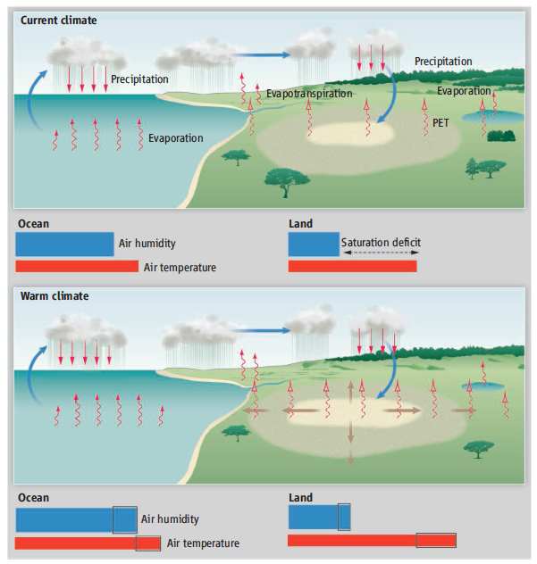
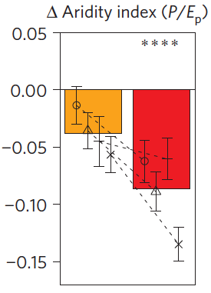
V2/V3 - Water Cycle
Moisture supply for precipitation over land
What are the moisture sources for precipitation over land?
How will they change in a warmer climate?
Ocean / atmosphere processes dominate aridity changes
Land-atmosphere feedbacks amplify aridity
(Sherwood and Fu 2014, Science)
(Berg et al. 2016, Nature Climate Change)

Slide 2
Water Cycle V2/V3 Features
Non-hydrostatic atmosphere dycore for convection permitting modeling with variable resolution configurations
Eddy resolving ocean
Land with advanced hierarchical structure to capture subgrid heterogeneity
Isotopic or water tracers for quantification of moisture sources for land precipitation
Improved capability for:
Scale-aware parameterizations
Land-atmosphere interactions (e.g., lateral flow, plant hydraulics)
Air-sea interactions (e.g., response to buoyancy/wind stress forcing)
Response to forcing (e.g., aerosol-cloud-radiation interactions and effects of LULCC such as irrigation)

Slide 3
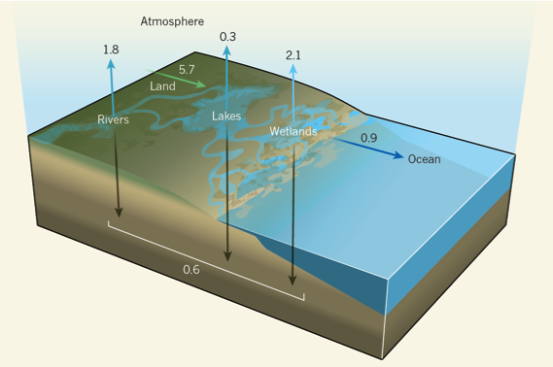
V2/V3 - Biogeochemistry
Impacts of carbon reduction pathways on carbon sink and water availability
What are the impacts of different carbon reduction pathways on the carbon sink and water availability?
How might terrestrial-aquatic processes influence the net carbon sink and the effectiveness of mitigation scenarios?
CMIP5 models projected future drought risks exceeding the driest centuries of the Medieval Climate Anomaly (1100–1300CE)
Carbon fluxes related to inland aquatic ecosystems (Streams, Rivers, Lakes, and Wetlands) have the potential to explain a large portion of the unknown residual land sink
(Cook et al. 2015 Sci. Rep.)
Increased irrigation water demand from bioenergy crops increases water deficits
Water deficit as a fraction of demand
(Hejazi et al. 2015 PNAS)
(Wehrli, 2013, Nature; Raymond et al., 2013, Nature)

Slide 4
Biogeochemistry
Improved modeling of processes that control the land carbon sink
Nitrogen cycle across earth system components for C-N modeling and connection to human activities
Ocean biogeochemistry (MARBL) and coupling with atmosphere
Representations of the energy-water-land nexus (e.g., land and water management)
Terrestrial carbon fluxes to inland waters
Carbon filtering across the terrestrial aquatic interface, coastal ocean processes and the ocean carbon cycle
Modeling natural and anthropogenic methane sources and sinks
Scenario development

Slide 5
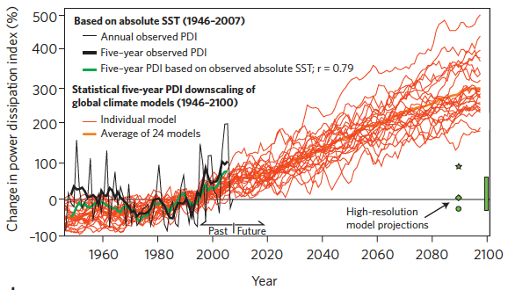
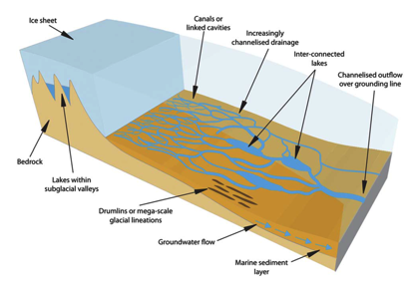
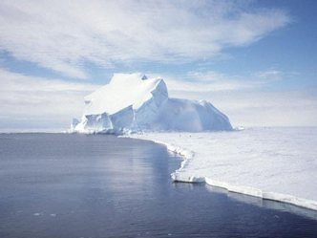
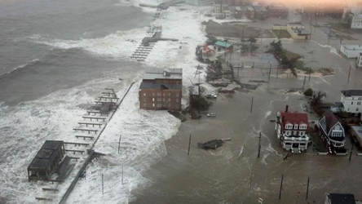
V2/V3 - Cryosphere Systems
Regional sea level rise and implications to coastal inundation
What processes contribute to key uncertainty in projecting regional SLR?
What are the implications to coastal inundation that result from interactions between SLR and extreme storms?
Projected increase in Atlantic hurricane intensity
Sources of uncertainty in SLR
Water mass transformation and deep water creation around Antarctica
Solid and liquid discharge from ice sheets
Snow processes on sea ice
(Knutson et al., 2010, Nature Geosci.)
(Ashmore and Bingham 2014)

Slide 6
Cryosphere
Improved modeling of SLR:
Wetting and drying algorithm
Self gravitation and isostatic adjustment
Coastal modeling
Modeling ice damage, fracture, and calving
Subglacial hydrology
Initialization of ice sheet model
Snow-on-seaice, including blowing snow and compaction and metamorphosis
New formulation of sea-ice dynamics
Improved modeling of tropical and extratropical storms
Improved river modeling (e.g., inundation)

