Slide 1
Tropics-Relevant ALMv1 and v2 Capabilities
W.J. Riley
G. Bisht, K. Calvin, J.A. Holm, R.G. Knox, C.D. Koven, P.E. Thornton, X. Yang, Q. Zhu

Slide 2
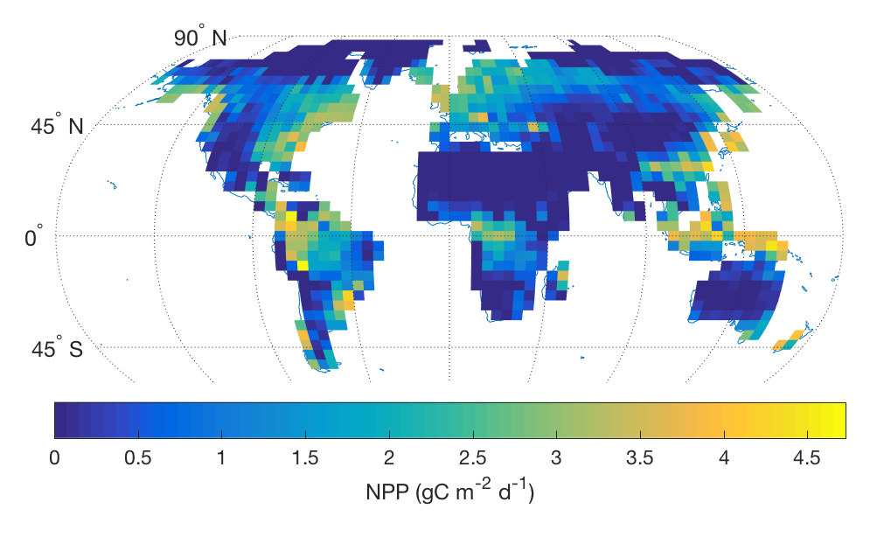
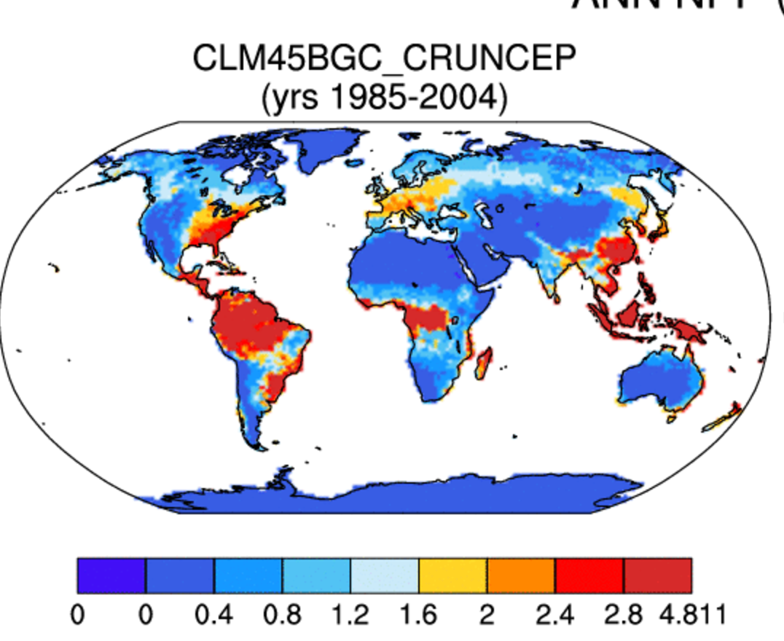
ALM-FATES v2 Capabilities & Goals
Successful CMDV effort
Robust global simulations using ALM-FATES (dynamic vegetation), including tropical biomass estimates across gradients.
Ideas for Tropical Coupled Experiment =
    Investigate biophysical effects on temperature, precipitation, and albedo due to tropical forest land cover change.
    Quantify how biophysical effects vary as a function of changes in tropical BGC.
Initial NPP results using ALM-FATES, showing comparable results to biogeochemistry “big-leaf” models
ALM-FATES

Slide 3
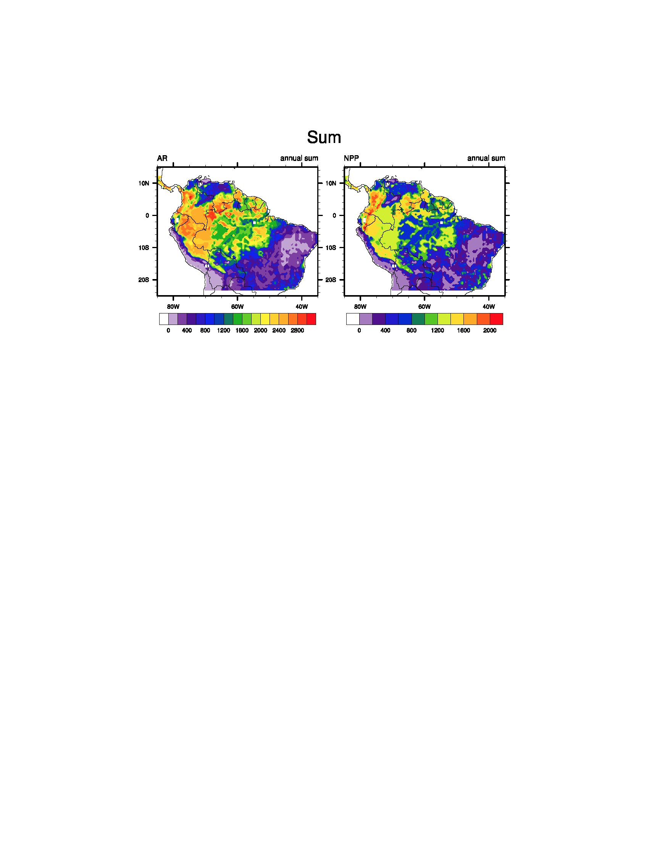
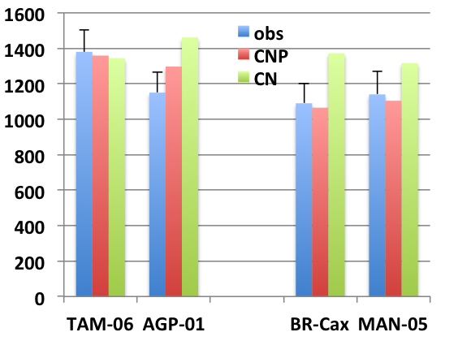
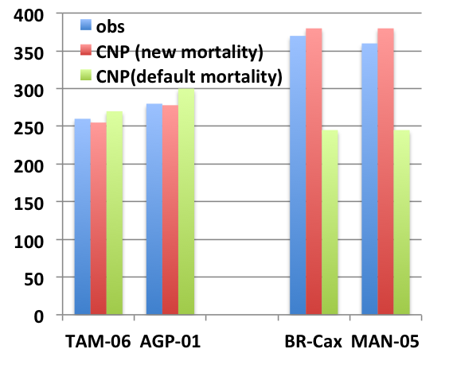
ALM-CTC-CNP captures the spatial variation of NPP and aboveground biomass in the Amazon region
NPP( g C m⁻²a ⁻¹)
Field observations show that productivity decreases from west to east and aboveground biomass increases from west to east across the Amazon basin
Through the inclusion of P limitation, ALM-CTC-CNP improves simulated NPP and captures the overall trend in NPP along the P availability gradient
By considering the effect of soil type on mortality, ALM-CTC-CNP captures the increasing trend of aboveground biomass from west to east in Amazonia
ABG Biomass(*100 g C m⁻²)
West: high P
East and central: low P

Slide 4
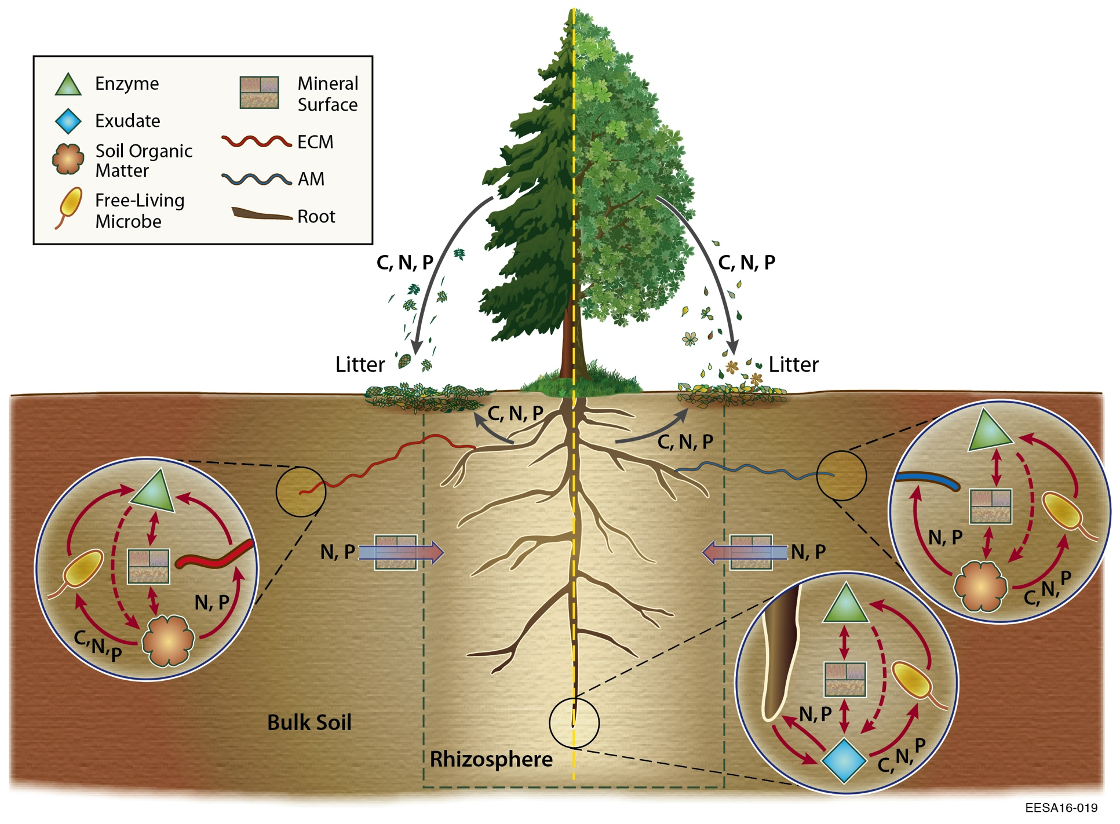
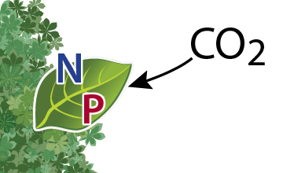
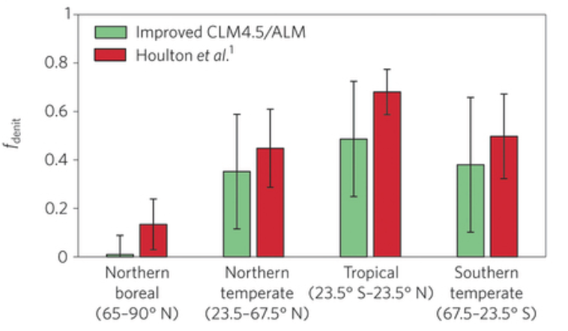
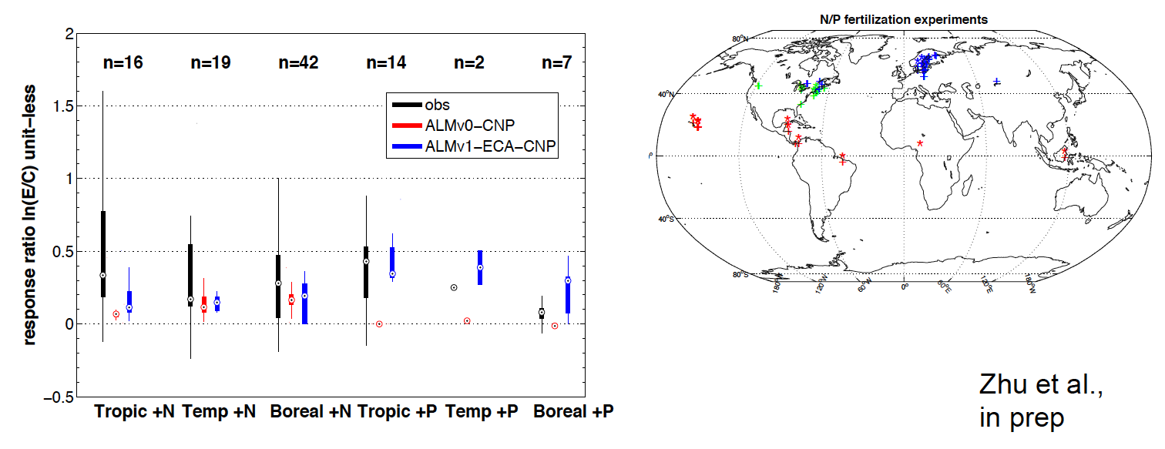
ALM-ECA-CNP
ALMv1-ECA-CNP
New nutrient and C cycle coupling model
  Coupled with VSFM and BeTR
  Comparisons with observational metrics
    ILAMB
    Site-level C stocks, nutrient experiments and gradients
  Participating in Amazon FACE MIP
Zhu and Riley 2015
F(N) lost as N₂O

Slide 5
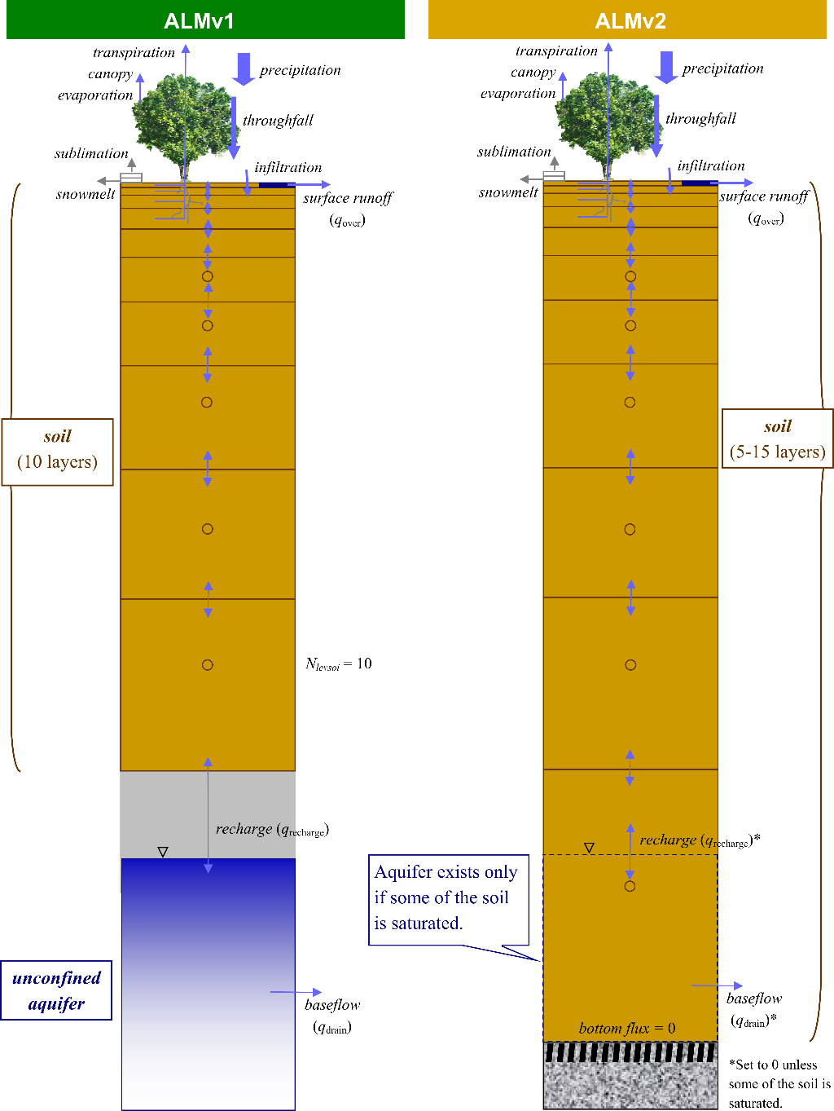
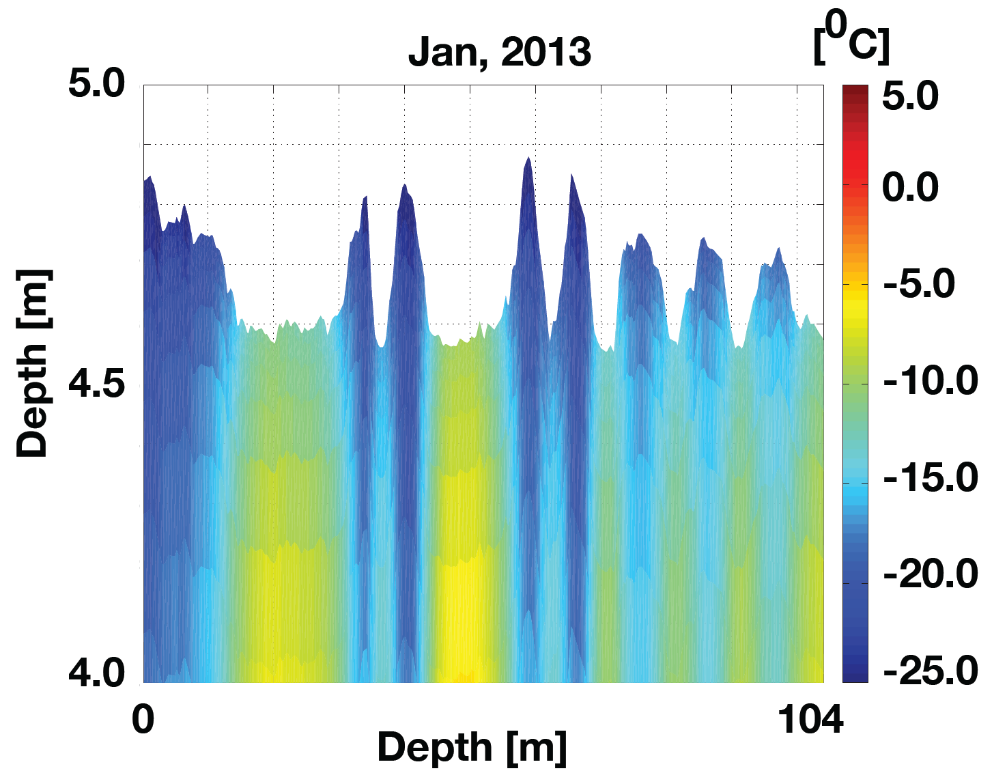
Hydrology
Globally distributed VSFM tuned for accurate GW depth prediction
Depth to bedrock
FATES vegetation hydrology
Extension of VSFM to the soil-root-xylem continuum
VSFTM: Extension of VSFM to Thermal and 3D
ALM-3D
ALM-3D
Bisht & Riley (in review)
Transect Distance [m]
Bisht and Riley (in review)
Brunke et al. (in prep)

Slide 6
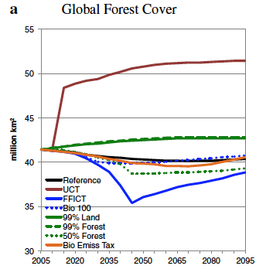
Developing Scenarios of Future Energy & Land Use
The future scenarios used by CMIP (e.g., RCPs) have been developed using a suite of models as part of an international process. These scenarios have been designed to satisfy a large range of communities and goals. However, they may not be the most appropriate to address ACME’s questions.
GCAM (developed at PNNL) has participated in all of those development processes. As part of ACME, we can develop new scenarios tailored to the ACME science questions.
Source: Calvin et al. (2014)

