Slide 1
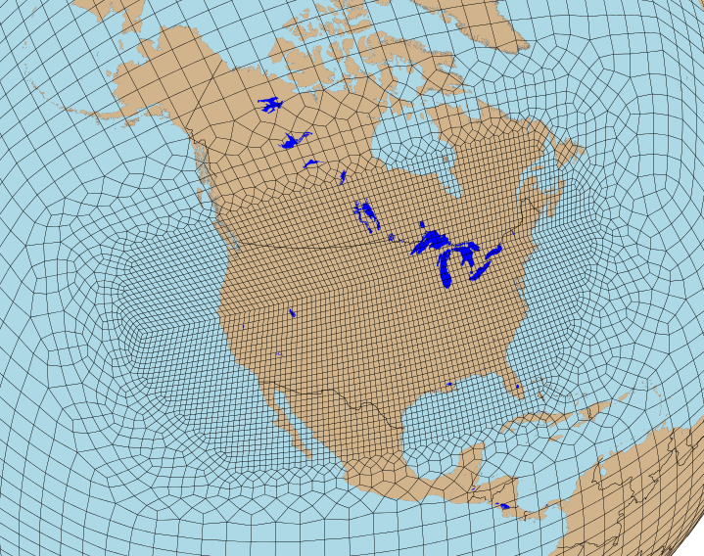
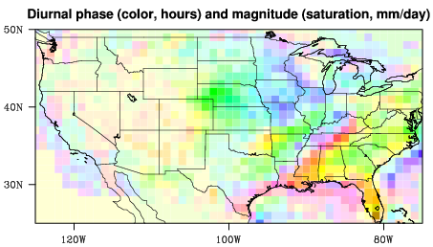
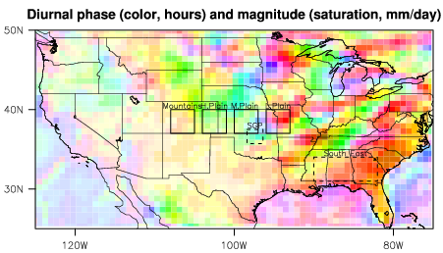
Regionally Refined ACME V1 Model over the
Contiguous United States
Qi Tang¹ (tang30@llnl.gov), Erika Roesler², Wuyin Lin³, Xue Zheng¹, and Mark Taylor²
¹Lawrence Livermore National Laboratory, ²Sandia National Laboratory, ³Brookhaven National Laboratory
Overview
GPCP (obs)
Precipitation
V0
V1
Introduction
RRM provides an economical way to study the behavior
of a global uniform high-resolution model in refined area.
We focus on documenting long-standing, remaining climate
model issues (i.e., warm bias, precipitation diurnal cycle) in
ACME V1 CONUS RRM.
Free run mean AMJJ total precipitation (mm/day)
Both versions simulate mean precipitation well.
V1 - V0
V1 – GPCP
Methodology & Results
NEXRAD (obs)
V0
V1
Simulations
CONUS (conusx4v1) RRM resolution: high-res region: 0.25º, low-res region: 1.0º
5-year free-running and 8-month (2011/01-08) nudging simulations
Nudged U & V to the ECMWF-Interim analysis data over the low-resolution region
Model versions: V0 (v0.2-268-g66bc3bc), V1 (v1.0.0-beta)
Nudging mean 2011 AMJJ total precipitation.
V1 captures intense precipitation over Eastern US better than V0.
V1 - V0
V1 – NEXRAD
JRA25
Warm Bias
V0
V1
NEXRAD (obs)
Precipitation Diurnal Cycle
V0
V1
Free run mean AMJJ T_{2m} (K)
V1 shows less warm bias than V0 over most of the CONUS.
V1 - V0
V1 – JRA25
2011 AMJJ nudging results (2D map and line plots)
V1 simulates better maximum precipitation magnitude than V0.
Both model versions fail to capture the nocturnal peak precipitation in the Central US.
V1 shows degraded precipitation phase, especially over middle and low Plains.
Model results are similar for other selected regions.
NOAA (obs)
V0
V1
Hovmöller of nudging results for MC3E period (2011/4/22-6/6)
Model does not simulate the correct propagation speed and intensity, particularly in late May.
Large scale precipitation dominates the signal.
Nudging mean 2011 AMJJ T_{2m}
Similar to free-run, less warm bias in V1 than V0
Warm bias is reduced with nudging.
V1 - V0
V1 – NOAA
This work was performed under the auspices of the U. S. Department of Energy by Lawrence Livermore National Laboratory under contract DE-AC52-07NA27344. LLNL-POST-732412
climatemodeling.science.energy.gov/acme

