Slide 1
Persistent Differences in Simulated and Observed Tropical Tropospheric Warming
Stephen Po-Chedley, Ben Santer, John Fasullo, Stephan Fueglistaler, Nick Siler, Qiang Fu, Elizabeth Barnes, Zack Labe, Mark Zelinka, Céline Bonfils, Philip Cameron-Smith, Jeff Painter
Observed warming is muted
compared to ~90% of simulations
Observations
Number of Simulations
Tropical Tropospheric Warming [K decade⁻¹]
*1979 - 2014

Slide 2
=
Persistent Differences in Simulated and Observed Tropical Tropospheric Warming
Stephen Po-Chedley, Ben Santer, John Fasullo, Stephan Fueglistaler, Nick Siler, Qiang Fu, Elizabeth Barnes, Zack Labe, Mark Zelinka, Céline Bonfils, Philip Cameron-Smith, Jeff Painter
Observed warming is muted
compared to ~90% of simulations
Pattern of warming indicates internal
variability suppressed observed warming
CESM1 Muted Warming Member
Observations
Number of Simulations
Observations
Tropical Tropospheric Warming [K decade⁻¹]
*1979 - 2014

Slide 3
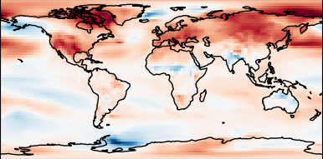
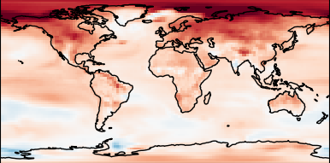
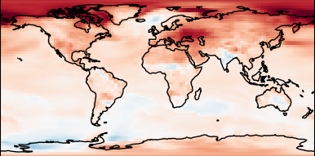
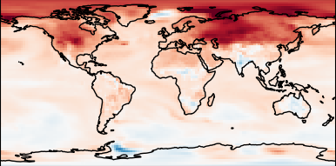
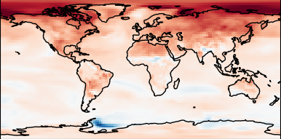
Persistent Differences in Simulated and Observed Tropical Tropospheric Warming
Stephen Po-Chedley, Ben Santer, John Fasullo, Stephan Fueglistaler, Nick Siler, Qiang Fu, Elizabeth Barnes, Zack Labe, Mark Zelinka, Céline Bonfils, Philip Cameron-Smith, Jeff Painter
Task ML to estimate internal variability
Model Warming Patterns

Slide 4
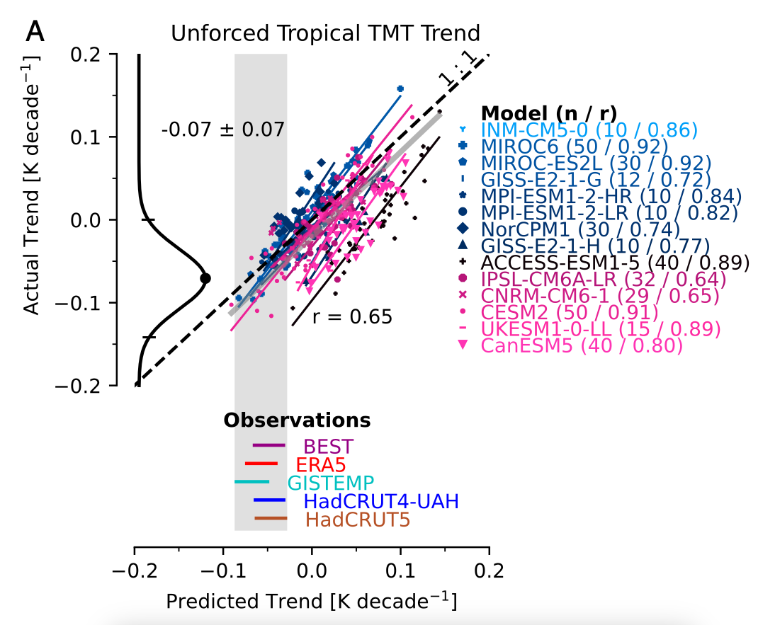
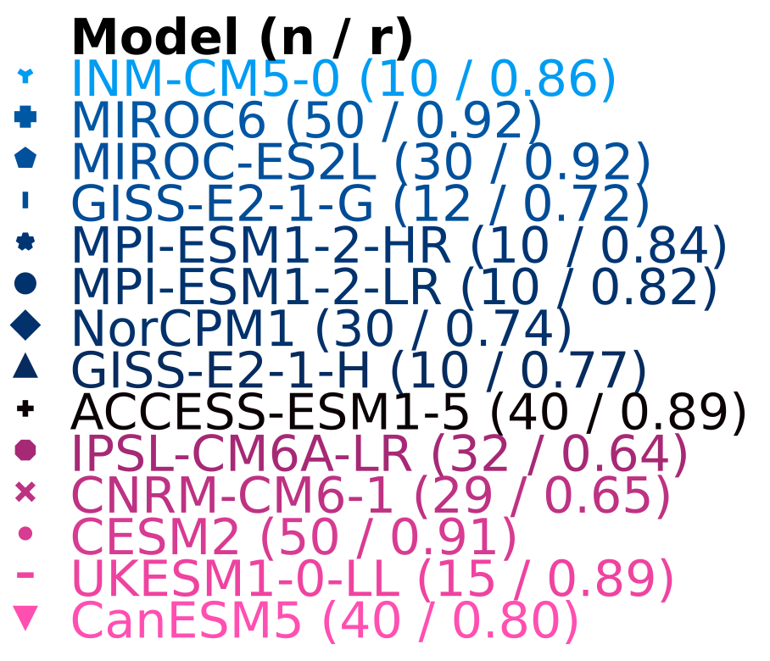
Persistent Differences in Simulated and Observed Tropical Tropospheric Warming
Stephen Po-Chedley, Ben Santer, John Fasullo, Stephan Fueglistaler, Nick Siler, Qiang Fu, Elizabeth Barnes, Zack Labe, Mark Zelinka, Céline Bonfils, Philip Cameron-Smith, Jeff Painter
Task ML to estimate internal variability
Model Warming Patterns
Internal Variability Impact
Tropical tropospheric warming (1979 - 2014)
Observational
Estimate

Slide 5
Persistent Differences in Simulated and Observed Tropical Tropospheric Warming
Stephen Po-Chedley, Ben Santer, John Fasullo, Stephan Fueglistaler, Nick Siler, Qiang Fu, Elizabeth Barnes, Zack Labe, Mark Zelinka, Céline Bonfils, Philip Cameron-Smith, Jeff Painter
Task ML to estimate internal variability
Internal Variability Helps
Explain Model-Satellite Differences
Model Warming Patterns
Internal Variability Impact
Tropical tropospheric warming (1979 - 2014)
Observational
Estimate
Number of Simulations
Observations
Tropical Tropospheric Warming [K decade⁻¹]
*1979 - 2014

Slide 6
Persistent Differences in Simulated and Observed Tropical Tropospheric Warming
Stephen Po-Chedley, Ben Santer, John Fasullo, Stephan Fueglistaler, Nick Siler, Qiang Fu, Elizabeth Barnes, Zack Labe, Mark Zelinka, Céline Bonfils, Philip Cameron-Smith, Jeff Painter
Task ML to estimate internal variability
Internal Variability Helps
Explain Model-Satellite Differences
Model Warming Patterns
Internal Variability Impact
Tropical tropospheric warming (1979 - 2014)
Observational
Estimate
Number of Simulations
Observations
Tropical Tropospheric Warming [K decade⁻¹]
*1979 - 2014

Slide 7
Persistent Differences in Simulated and Observed Tropical Tropospheric Warming
Stephen Po-Chedley, Ben Santer, John Fasullo, Stephan Fueglistaler, Nick Siler, Qiang Fu, Elizabeth Barnes, Zack Labe, Mark Zelinka, Céline Bonfils, Philip Cameron-Smith, Jeff Painter
Ongoing Work…
Decadal variability
contributors
Observational inter-consistency
ForceSMIP
OHU efficiency
Climate
feedbacks
:: Project to estimate forced/unforced
climate response

