Slide 1
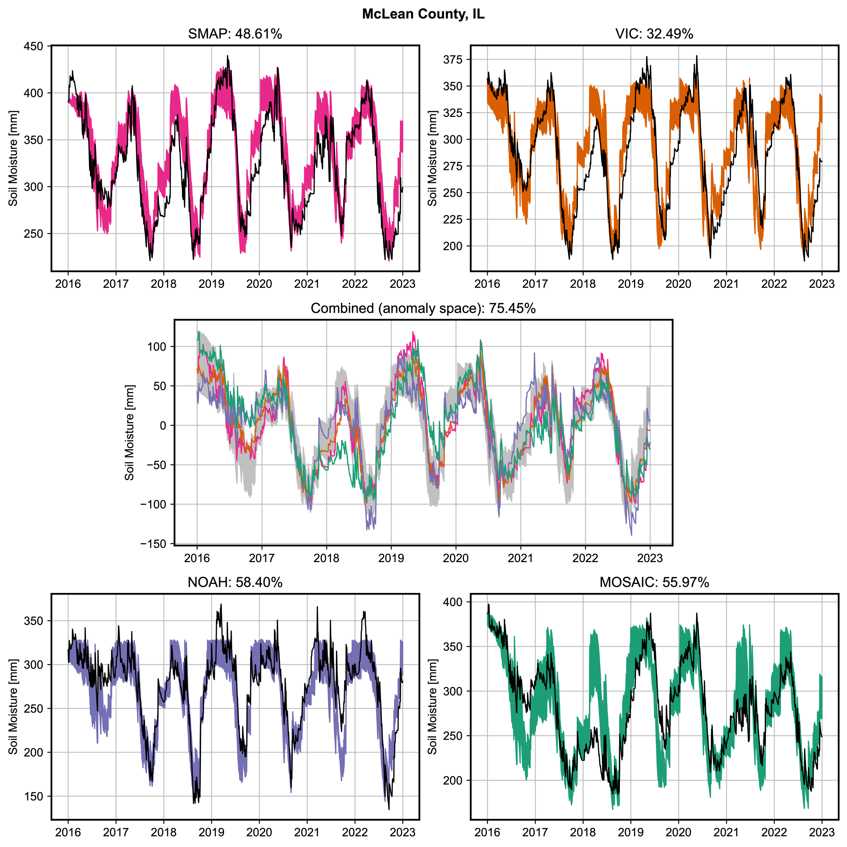
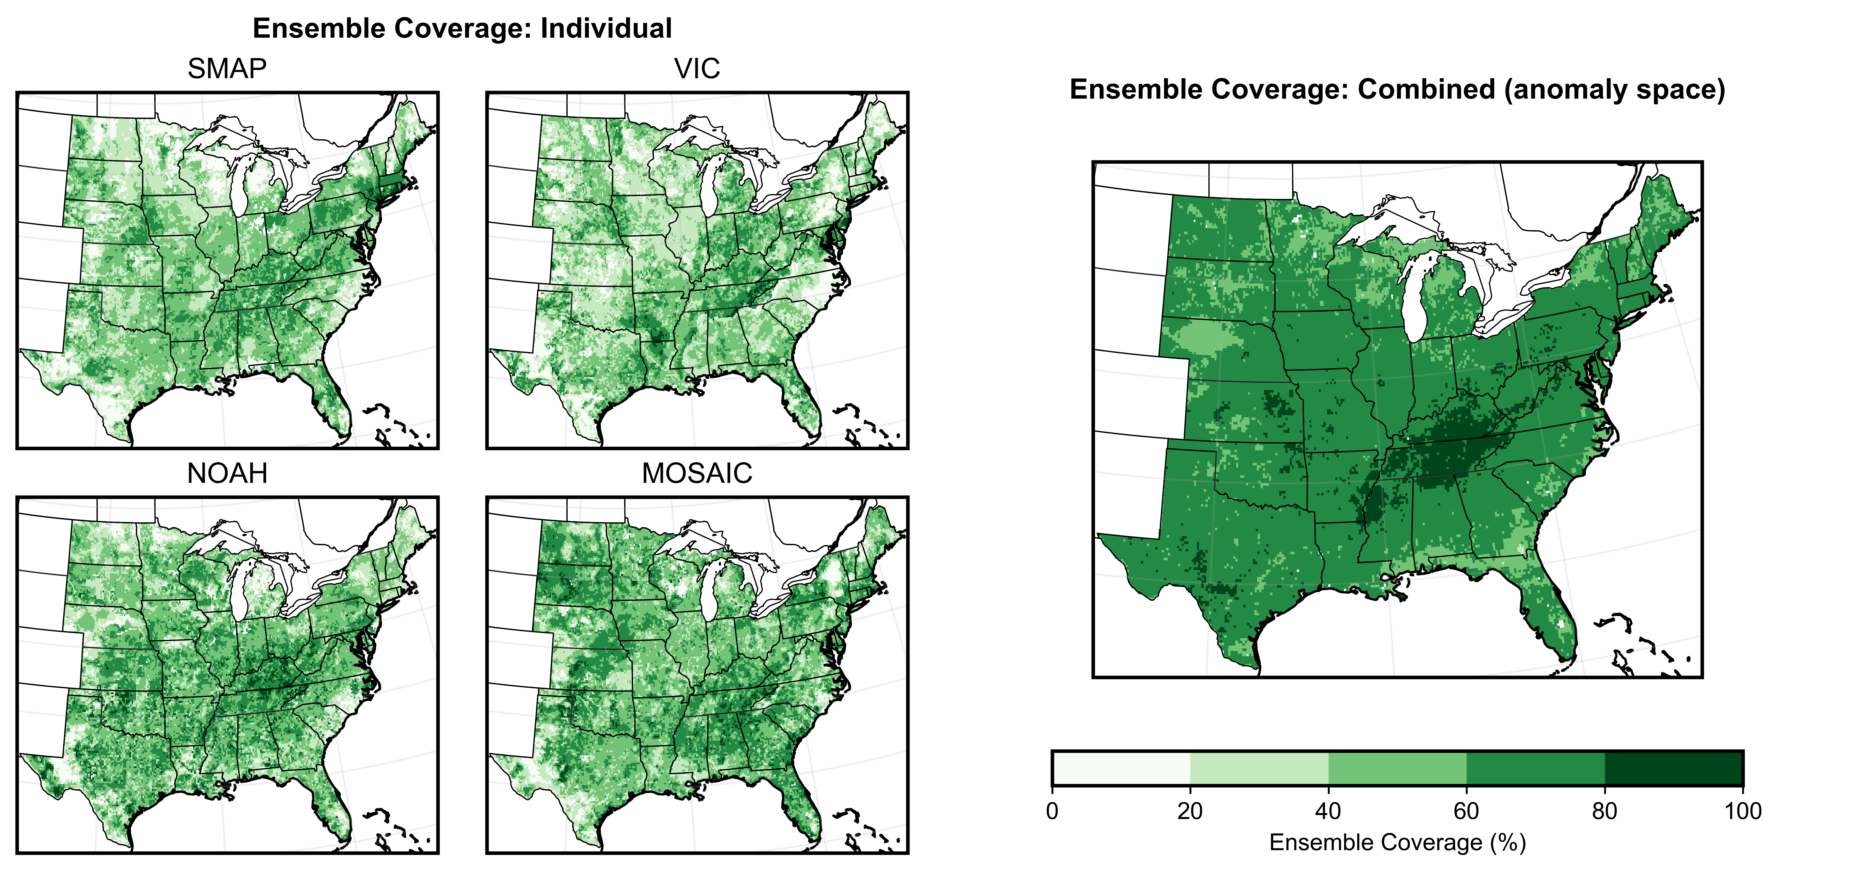
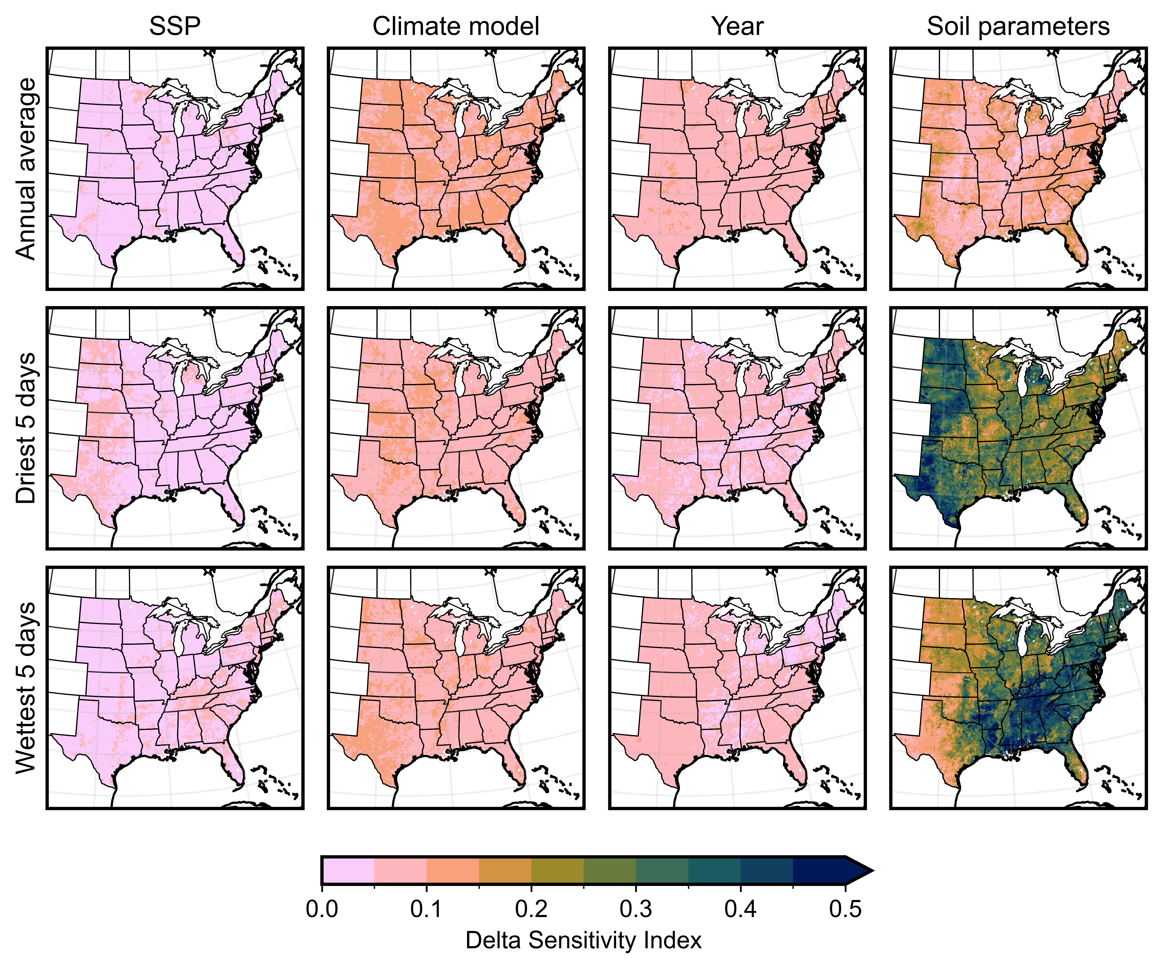
Combined climate and hydrologic uncertainties shape projections of future soil moisture
David Lafferty & Ryan Sriver (UIUC)
Danielle Grogan & Shan Zuidema (UNH)
Atieh Alipour & Klaus Keller (Dartmouth)
Iman Haqiqi (Purdue)
1. Motivation
3. calibration
Models involving soil moisture are crucial to understanding the evolution of many coupled natural-human systems under climate change. However, projecting long-term changes in soil moisture is difficult due to uncertainties surrounding soil dynamics and the representation of past and future climate.
We calibrate pyWBM parameters using four pseudo-observational products: VIC, MOSAIC, and NOAH model outputs from NLDAS-2, and the SMAP satellite L4 product. The ensemble is convolved with LOCA2 downscaled projections to produce a large (~2200) ensemble of long-term (2030-2100) soil moisture simulations and high spatial ( 12.5 km) and temporal (daily) resolution.
The simple model can reproduce each observational product over most of the domain and can generate an ensemble with reasonable coverage. Specific regions with large disagreements may require structural model changes.
2. Soil moisture model pyWBM
We use a new Python-implementation of the soil moisture module pyWBM within the University of New Hampshire Water Balance Model [1]. pyWBM is a simple 1-dimensional representation of water fluxes within the active soil layer. Uncertain parameters include:
alpha (efficiency of evapotranspiration)
beta_{HBV} (efficiency of runoff)
wiltingp (wilting point)
awCap (water capacity of the active layer)
Precipitation
& snowfall
Evapotranspiration
Fig. 2: Ensemble coverage statistics across the entire domain. The coverage is defined as the percentage of observational values falling within the ensemble range.
Fig. 3: Hindcast results for a single gridpoint in McLean County, Illinois. In each plot, the solid black line shows the observations and the colored bands show the range of hindcast simulation across the parameter sets for each product. Percentages denote fraction of data within model range.
Snowpack
Canopy
4. Uncertainty
5. Future work
Runoff
We apply the delta moment-independent measure for uncertainty analysis, which estimates sensitivity indices by calculating the normalized expected shift in the outcome distribution induced by changing a given uncertain factor. Soil parameters are the primary source of uncertainty in extreme dry/wet conditions
We plan to explore how the combined influence of hydrologic and climate uncertainty affects representations of past and future soil moisture, focusing on metrics relevant for agriculture in the central US. Better constraining these uncertainties can facilitate improved long-term decision-making regarding infrastructure investments and water management strategies in the agricultural sector.
Available water capacity
Active soil layer
Wilting point
Unavailable water
Fig. 1: Schematic representation of water fluxes within the simple soil moisture model. Additional details can be found in [1].
[1] Grogan, D.S., et. al., Water balance model (WBM) v.1.0.0: a scalable gridded global hydrologic model with water-tracking functionality, Geosci. Model Dev. (2022). https://doi.org/10.5194/gmd-15-7287-2022
Fig. 4: Spatial distribution of Delta sensitivity indices for soil moisture variables (rows), grouped by different sources of uncertainty (columns).
Website: david0811.github.io
Email: davidcl2@illinois.edu
This work was supported by the U.S. Department of Energy, Office of Science, Biological and Environmental Research Program, Earth and Environmental Systems Modeling, MultiSector Dynamics under Cooperative Agreement DE-SC0022141. This work was partially supported by the Thayer School of Engineering at Dartmouth College. Any findings or recommendations expressed in this material are those of the author(s).
Notes:
Notes:
In Powerpoint, click View > Guides
Keep text within gutter guides.
Author list: Don’t split names onto two lines (e.g., “Jimmy [break] Smith”). If that happens, use a new line, unless you need the space. Bold the first names of anybody who’s presenting in person.
Intro/methods/result: Do not drop below font size 28, but if you have extra space, jack up the font size until the space is full.
Do not use color in the sidebars except in graphs/figures. It’ll pull attention from the center and slow interpretation for passersby.

