Slide 1
Nonlinear carbon feedbacks in CMIP6 and their impacts on future freshwater availability
Jason E. Smerdon
Columbia Climate School, Columbia University
Co-Investigators:
Justin Mankin¹, Richard Seager², Park Williams³, Ben Cook⁴ and Kate Marvel⁴
¹Dartmouth College, ²Columbia University, ³University of California, ⁴Los Angeles, ⁵NASA GISS
DOE Project:
The Role of Vegetation in Past and Future Global Hydroclimate Change

Slide 2
How will plants affect water availability at the land surface in the future?

Slide 3
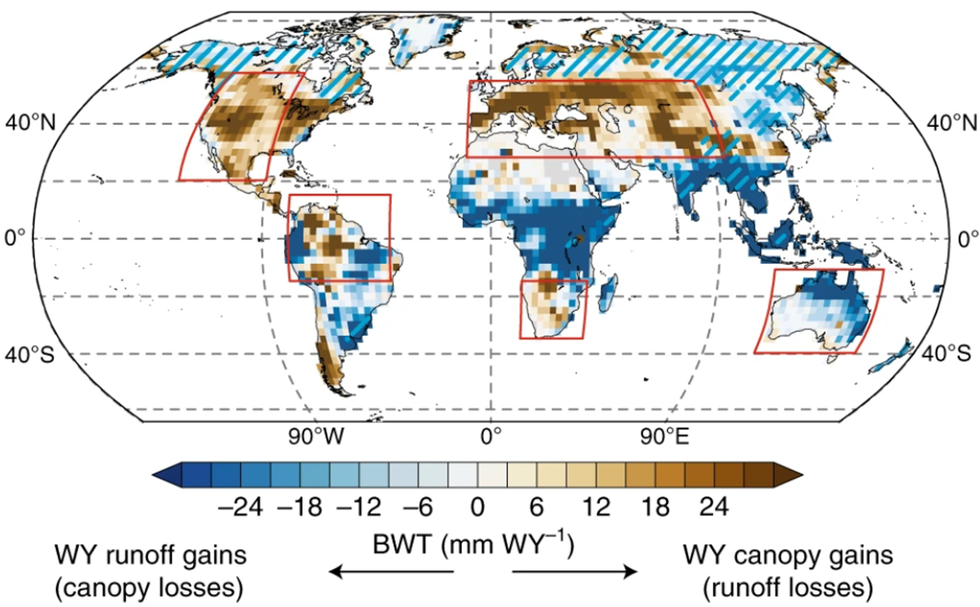
Mid-latitude freshwater availability reduced by projected vegetation responses to climate change
Mankin, J.S., R. Seager, J.E. Smerdon, B. I. Cook, and A. P. Williams, Nature Geoscience, 12, 983–988, 2019.

Slide 4
13 CMIP6 Models
7 CMIP5 Models
COU
$$≈$$
BGC
+
RAD
NL
+
1pctCO2->140yrs
4XCO₂
Fully Coupled
1pctCO2->140yrs
4XCO₂
Biochemical Scheme
1pctCO2->140yrs
4XCO₂
Radiative Scheme
J. S. Mankin, N. Siegert, J. E. Smerdon, B. I. Cook, R. Seager, A. P. Williams, C. Lesk, Z. Li, H. Singh, and E. Martinez, Nonlinear carbon feedbacks in CMIP6 and their impacts on future freshwater availability, Journal of Climate, in review.

Slide 5
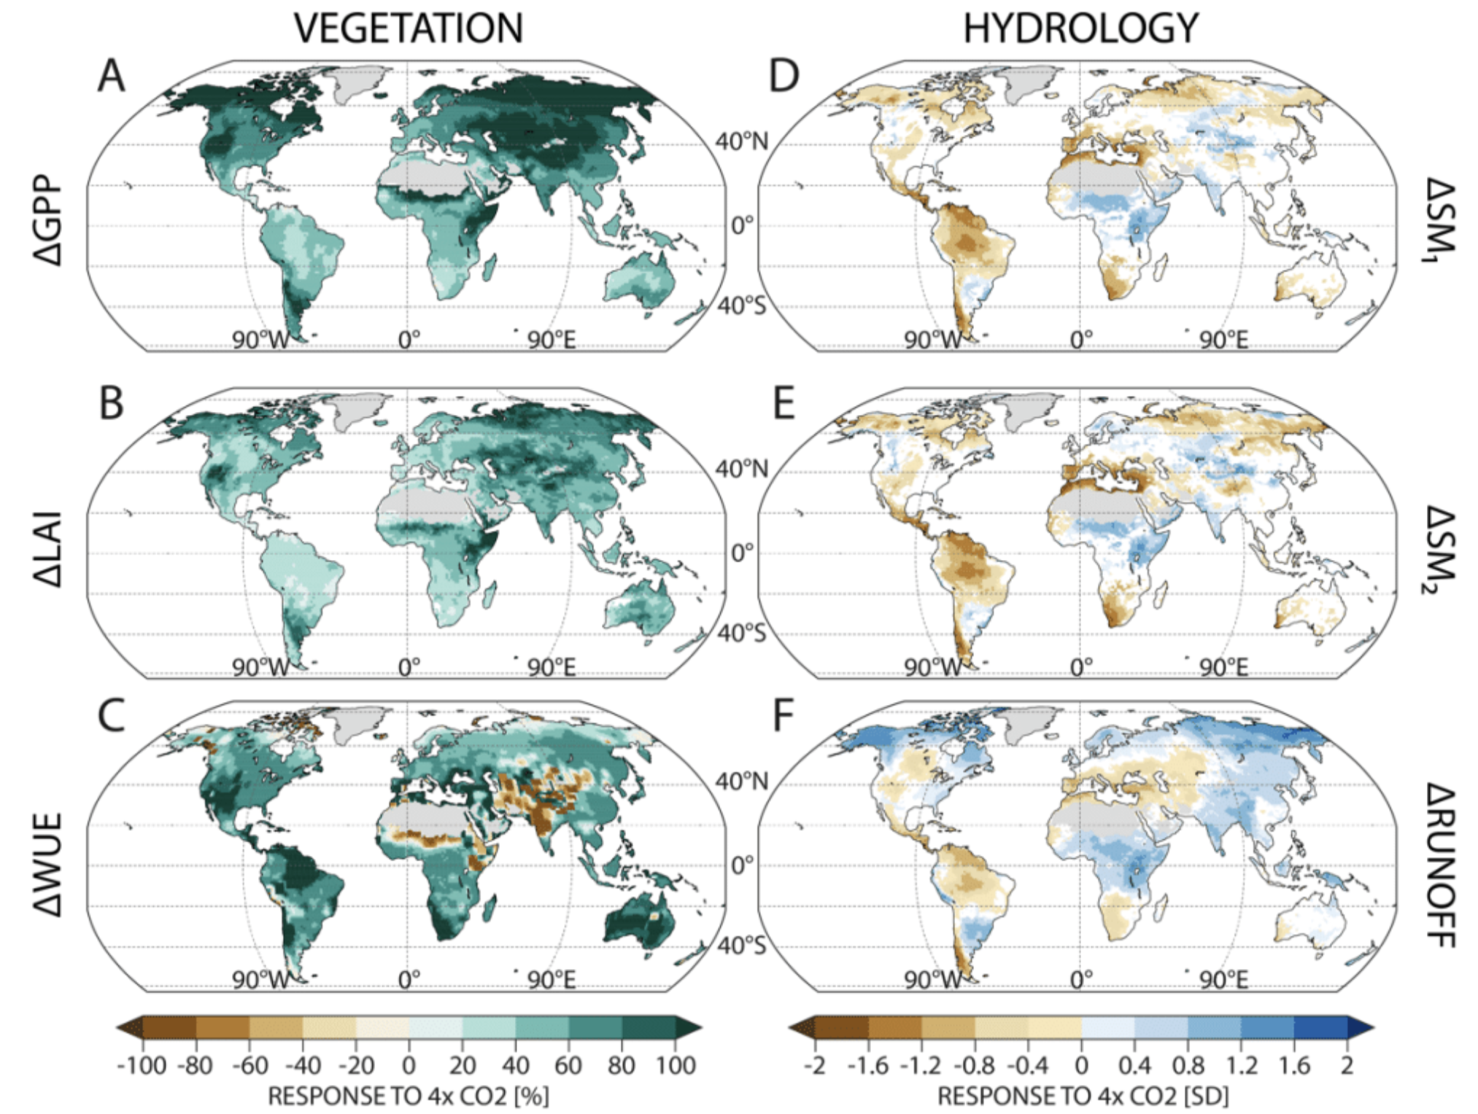
Simultaneous Greening and Drying
Changes In
Changes In
Gross Primary Productivity
Soil Moisture (1 m)
+68%
~50%
Soil Moisture (2 m)
1st 30 yrs – Last 30 yrs
Leaf Area Index
+53%
~50%
Runoff
Water Use Efficiency
+57%
~40%

Slide 6
Emergent Nonlinear Term in Vegetation Productivity
~25%

Slide 7
Model Uncertainties in Vegetation Productivity

Slide 8
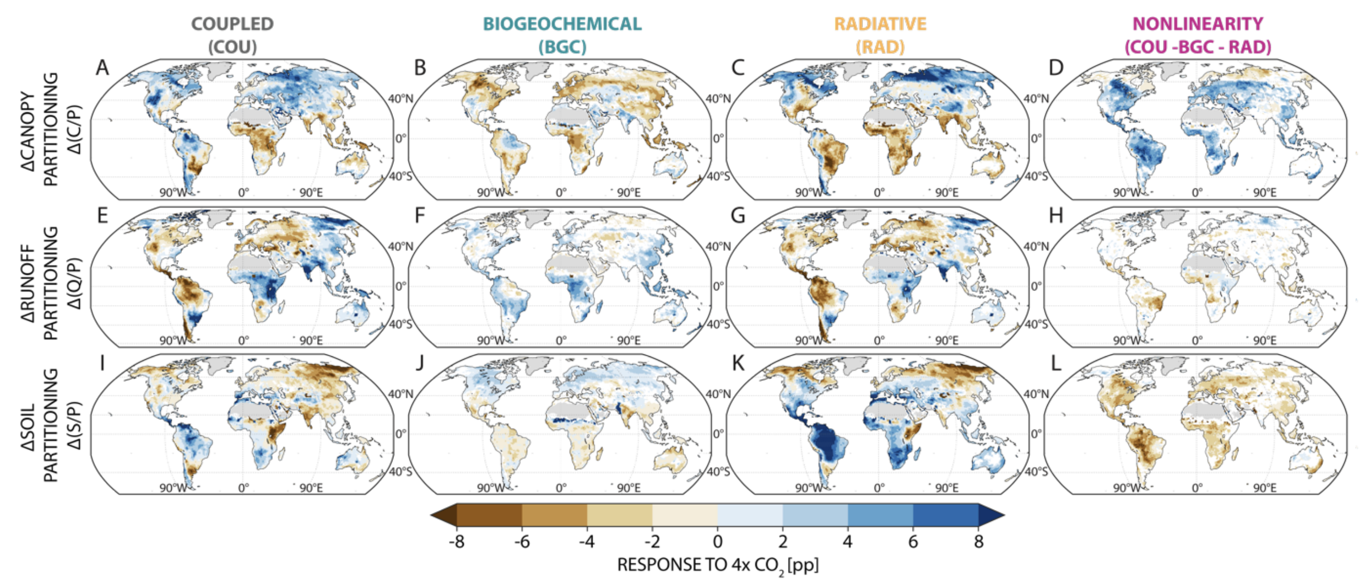
Water Partitioning in the Future

Slide 9
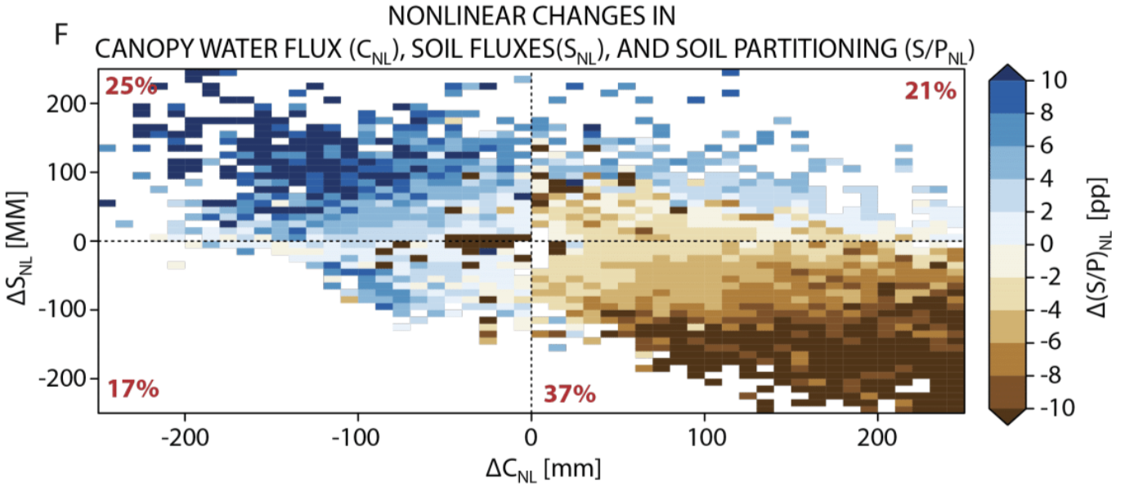
BGC
Reduced Stomatal
Conductance
Increased LAI
Reduced Runoff and Soil Moisture
RAD
Longer and warmer growing seasons
NL
Increased LAI + Longer Growing Seasons

Slide 10
Is any of this correct and how do we know?
Process-driven investigations across a hierarchy of models
Perturbed parameter ensembles and global variance-based sensitivity studies
Observations, observations, observations…

