Slide 1
Agricultural labor under future heat stress: productivity shocks and global agroeconomic consequences
Di Sheng, Xin Zhao, Jae Edmonds, Stephanie Waldhoff, Pralit Patel, Brian O’Neill, Claudia Tebaldi, Marshall Wise
Joint Global Change Research Institute, Pacific Northwest National Laboratory | Correspondence: di.sheng@pnnl.gov
06 August 2024
Acknowledgments: This research was supported by the U.S. Department of Energy, Office of Science, as part of research in MultiSector Dynamics, Earth and Environmental System Modeling Program.
Notes:
Good afternoon, everyone. Thank you for joining us today. My name is Di Sheng, and I am a post-doc at the joint global change research institute at PNNL. Today, I am excited to discuss the team work on

Slide 2
Motivation
Agriculture is particularly vulnerable to climate change through multiple pathways
Pathway 1: changes to crop yields from changes to temperature, precipitation, CO₂, etc. (Lobell et al., 2011; Nelson et al., 2014; Jägermeyr et al., 2021)
Pathway 2: changes to labor productivity resulting from heat stress (Kjellstrom et al., 2009; Dunne et al., 2013)
Agricultural labor is severely heat stressed
More intensive, frequent, and regionally heterogeneous heat waves projected later in the century
Research question
What’s the additional climate impact on agriculture through the labor pathway & the combined climate impact through both pathways?
Notes:
Ag is particularly vulnerable to climate change through two pathways
Climate induced crop yield changes, mainly due to changes in temp, prep, and CO2, this pathway has been the main focus in previous assessments of climate impact on agriculture. is a rich literature addressing this pathway
With growing evidence of decreasing labor productivity under heat stress, labor productivity here is measured as output per worker in a given working time period, it raise attention on the second pathway: Climate induced labor productivity changes, supported by
Agricultural labor accounts for more than 25% of the current global employment, and they are particularly sensitive to heat stress due to high work intensity and outdoor working environment
Given heat waves are projected to be more intensive and frequent, and disproportionately affect tropics.
We are interested in answer the research question:

Slide 3
Experimental Design
1: Ref SSP2 & RCP6.0 No Biophysical Response | 3: Labor-only Ref + Labor Response
2: Crop-only Ref + Crop Response | 4: Combined Ref + Crop & Labor Response
Notes:
We design 4 experiments to answer our research questions
We start with a reference scenario with SSP2, and no biophysical response in crop and labor to climate change
Then we have the crop-only experiment to represent the widely-addressed crop pathway
Next, we have the labor-only experiment to incorporate labor pathway
The last experiment include both pathways
We obtain agricultural market outcomes from each experiment, and compare the outcomes across experiments relative to the reference to evaluate the climate impact on agriculture through alternative pathways.

Slide 4
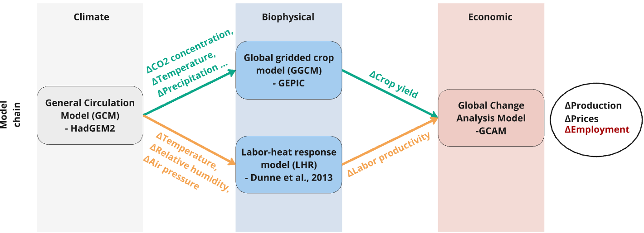
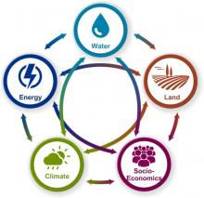
Methodology
$∆$ Labor productivity (%) =
${25∙[\max\left(0, WBGT−25\right)]}^{2/3}$
Notes:
In this study, we adopt climate projections and crop yield projections from ISIMIP2b data, we take the climate projections as input and derive heat stress and the associated labor productivity loss following the Dunne et al paper.
We adopt the Global Change Analysis Model (GCAM), to conduct the experiments. GCAM is multi-sector dynamic model, which integrates both earth and human systems,.
While in our paper we have conducted all experiments in with alternative model and input choices, In this presentation, we focus on one scenario, where the climate projections are based on HadGEM2, crop yield projection is from GEPIC, and labor-heat response function is based on Dunne. All the following results are experiments conducted with this set of choices of models.

Slide 5
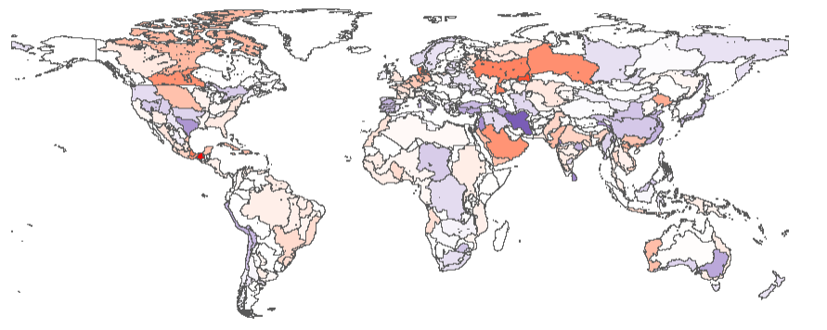
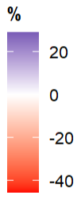
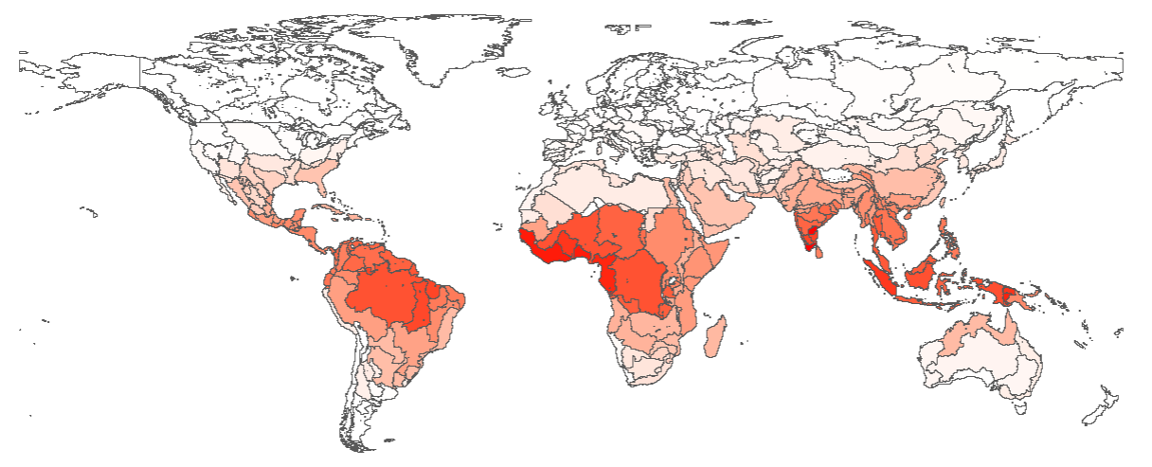
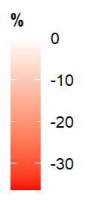
Regional Climate Impacts on Crop Yields and Labor Productivity, SSP2-RCP6.0: 2100
By the end of century, global mean crop yield (weighted by initial land allocation) is projected to decrease by 2.67% with RCP 6.0
Change in Crop yield by Water Basin (HadGEM2-GEPIC)
By the end of century, global mean agricultural labor productivity (weighted by initial labor allocation) decline by 18% with RCP 6.0
Most severe impacts in Southeast Asia (27%), Africa (23%), and South Asia (20%)
Change in Labor Productivity by Water Basin due to Heat Stress
Notes:
This slide presents the biophysical response to future climate change
The top map plots the water-basin level average crop yield changes under RCP 6.0, where we observe large heterogeneity across regions in terms of magnitude and direction, while at the global level, crop yield is projected to decrease by 2.67% compared to the reference in 2100.
The bottom map plots the water-basin level average agricultural labor productivity loss under RCP 6.0, and the global ag labor productivity can decline by 18%. With the key regions.

Slide 6
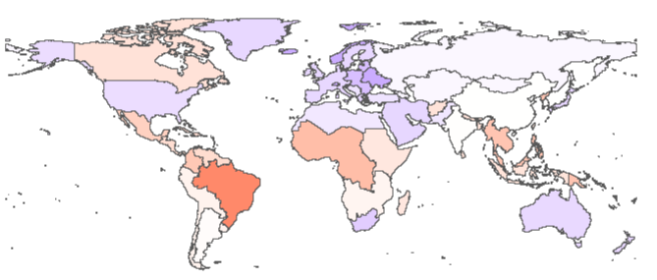
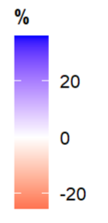
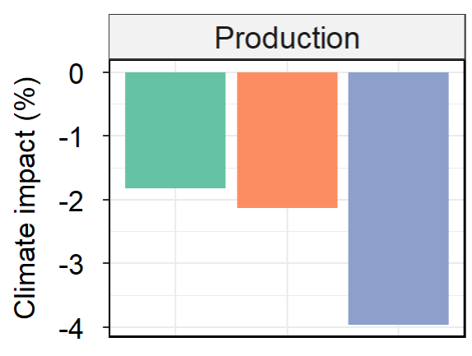
Combined Impacts on
Major Crop Production: 2100
Regional Change: 2100
Global Aggregate Change: 2100
Major crop production shifts out from tropics and Canada
International trade alleviates climate impact on global major crop production
Crop-only
Labor-only
Combined
Notes:
With the climate-induced crop yield and labor productivity changes, we further observe fluctuation in the market outcomes.
Left hand side represent regional combined climate impact on major crop production. Major crop consists of corn, wheat rice and soybean.
First, the major crop production is projected to shift out from tropics and Canada to the rest of the world, heterogeneity across regions encourage agricultural trade. The global production decline by 4%
To decompose the combined impact, we find crop and labor pathways both introduce about 2% impact.

Slide 7
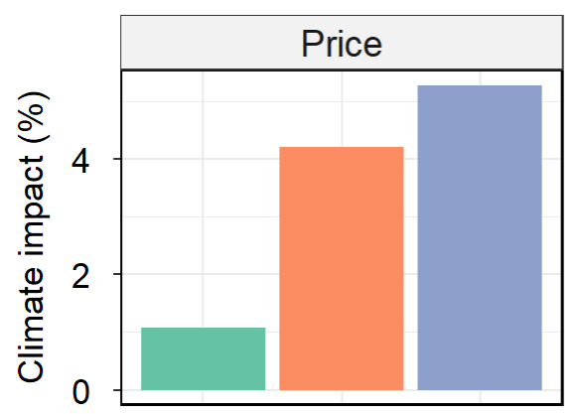
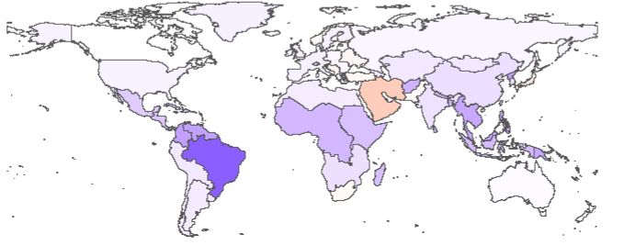
Combined Impacts on
Food Price: 2100
Regional Change: 2100
Global Aggregate Change: 2100
Food price increases in most regions, except Middle East and South Africa
Crop-only
Labor-only
Combined
Notes:
Global production reduction introduce food price increase in most regions, Middle East and South Africa have less than 0.3% reduction in food price

Slide 8
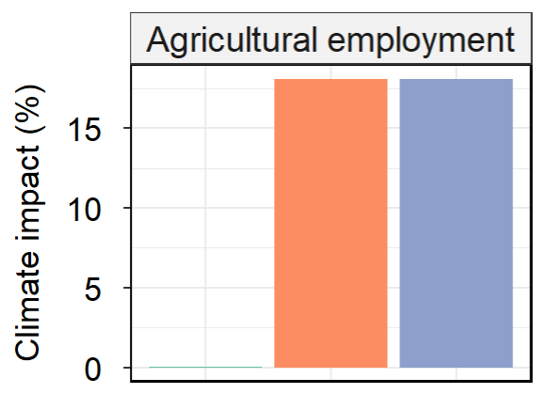
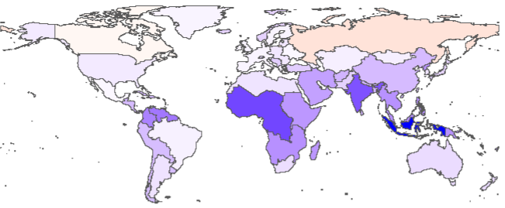
Combined Impacts on
Agricultural Employment: 2100
Regional Change: 2100
Global Aggregate Change: 2100
Agricultural employment increases in most regions, except Canada (-2%) and Russia (-5%)
Crop-only
Labor-only
Combined
Notes:
To compensate the reduced labor productivity, agricultural draws labor from the rest of economy

Slide 9
Including Heat Stress on Agricultural Labor
Is particularly acute in tropical regions
Reduces global food production and increases global food prices
Shifts workers into agriculture and out of the rest of the economy, particularly in the tropics
Future work
Explore other climate scenarios
Region-specific labor-heat response functions
Include heat stress on livestock
Couple to the macroeconomy
Wednesday Poster Session
#029
Notes:
I will present the poster of this study this Wednesday, and happy to discuss more details of this study.
Here I am closing the presentation with a few key insights and welcome discussion with future studies,
Our results show that
First,
Second, climate impact through labor and crop response are sensitive to the input model and function choices, and
Third,
Looking forwards, we advocate studies to further include heat stress impact on livestock, and also other non-ag sectors. We’d also be excited to see how labor response to climate playing a role in answering the long-lasting question: how climate impact on the GDP

Slide 10
SI

Slide 11
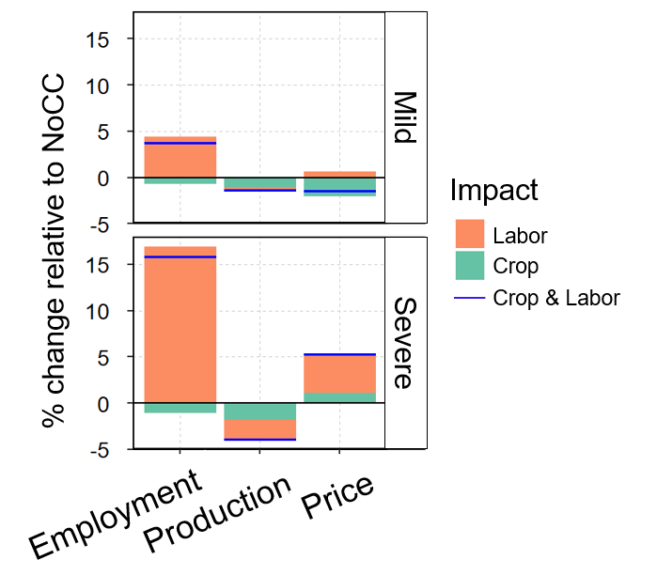
Severe vs Mild
Notes:
Global 2020 GDP = $86 trillion
U.S. 2020 GDP = $21 trillion

Slide 12
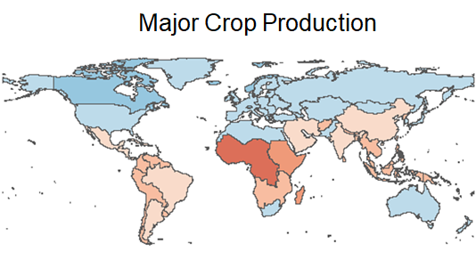
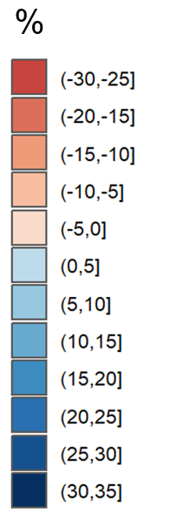
Climate Impacts on
Major Crop Production: 2100
Regional Change due to Labor pathway: 2100
Global Aggregate Change: 2100
Major crop production shifts out from tropics
International trade alleviates climate impact on global major crop production
Crop-only
Labor-only
Combined
Notes:
With the climate-induced crop yield and labor productivity changes, we further observe fluctuation in the market outcomes.
First, the major crop production is projected to shift out from tropics to the rest of the world, which encourage international trade. The global production declines by 4%, and the trade
In the severe scenario,
Global production – 2%, shifts out of the tropics
Global major crop producer prices increases as a result
Globally, major crop production decreases by 2%, price increases by 4%
regional major crop production can decrease by up to 16% and regional crop price can increase by 13% in 2100.

Slide 13
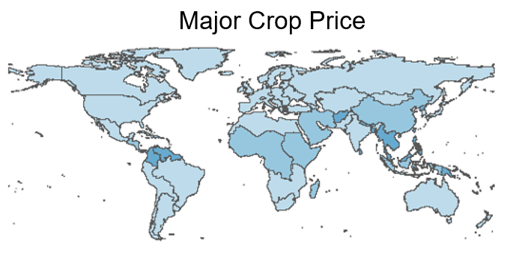
Combined Impacts on
Food Prices: 2100
Regional Change: 2100
Global Aggregate Change: 2100
Food price increases across regions
Crop-only
Labor-only
Combined
Notes:
In the severe scenario,
Global production – 2%, shifts out of the tropics
Global major crop producer prices increases as a result
Globally, major crop production decreases by 2%, price increases by 4%
regional major crop production can decrease by up to 16% and regional crop price can increase by 13% in 2100.

Slide 14
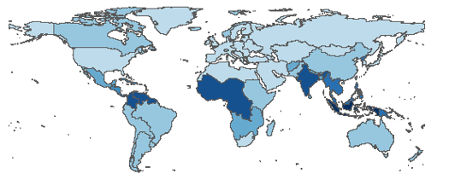
Climate Impacts on
Agricultural Employment: 2100
Regional Change due to Labor pathway: 2100
Global Aggregate Change: 2100
Agricultural employment increases across regions
Crop-only
Labor-only
Combined
Notes:
In the severe scenario,
Global production – 2%, shifts out of the tropics
Global major crop producer prices increases as a result
Globally, major crop production decreases by 2%, price increases by 4%
regional major crop production can decrease by up to 16% and regional crop price can increase by 13% in 2100.

Slide 15
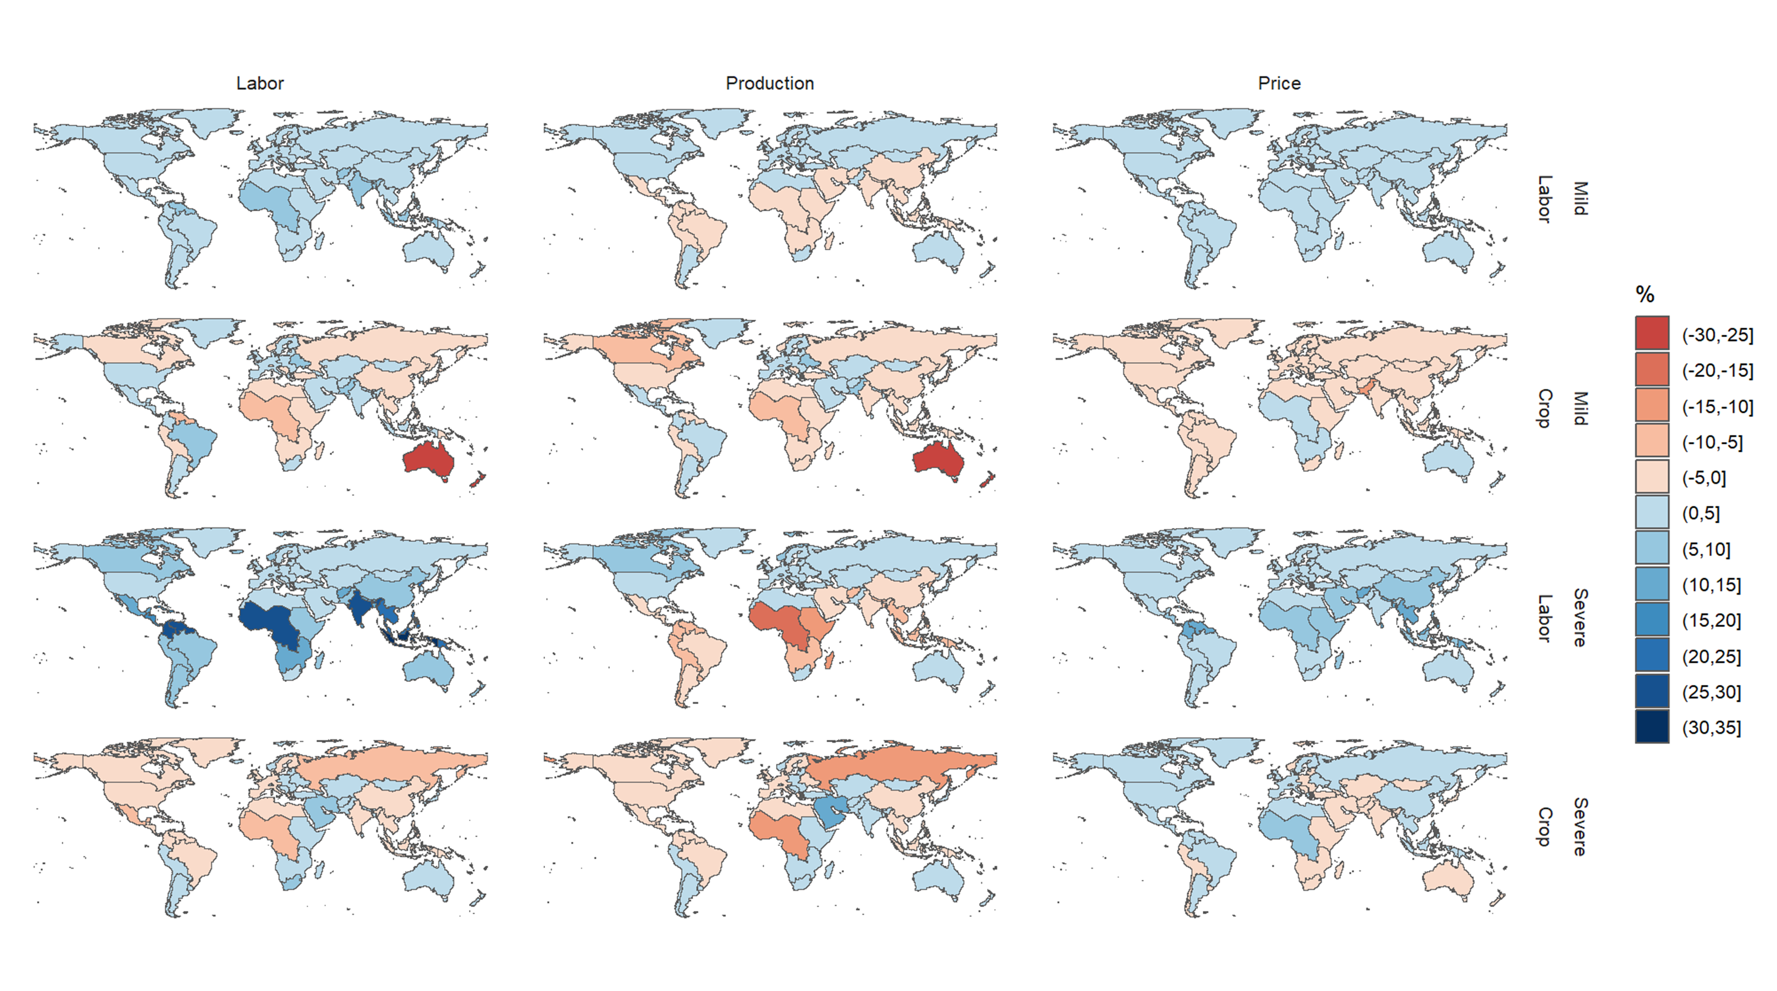
Comparisons across scenarios
Employment
Crop Production
Crop Price
Notes:
Global 2020 GDP = $86 trillion
U.S. 2020 GDP = $21 trillion

Slide 16
Incorporating Biophysical Responses in MSD
Source: Nelson et al. (2014)
Notes:
The framework of studies that solely addresses crop response to climate change entails three components
Choose a future climate
Estimate the crop yield response to climate change
Apply the crop yield response into an economic model and explore the market response

