Slide 1
Exploring multisectoral drought vulnerability in Colorado’s West Slope Basins
Theme 2: Advancing Regional Modeling to Better Capture risks and Impacts
Patrick Reed, David Gold, Rohini Gupta
Cornell University

Slide 2
Theme 2 Risks & Impacts – Questions
Q1: What is needed to improve the decision relevance of regional projections and better capture system shocks?
Q2: What are the bottlenecks for advancing regional modeling to better capture risks and impacts?

Slide 3
Theme 2 Risks & Impacts – What is needed
What is needed to improve the decision relevance of regional projections and better capture system shocks?
We need to more holistically engage with the drivers and determinants of regional risks
Better quantify highly uncertain extremes that could be experienced from both internal variability & anthropogenically forced climate changes
Decision relevance requires representation of institutionally complex human systems (e.g., water rights & infrastructure in the US West)

Slide 4
Theme 2 Risks & Impacts – A Broader View of risk
Systemic failures, extreme events and ‘hyper-risks’ emerge as a result of the highly complex and highly interconnected human-Earth systems
Dynamic relationships between agents, systems and sectors transmit risk for one to another
Drivers can amplify or buffer existing threats
Hazard
Vulnerability
+
RISK
—
Exposure
Response
4
Adapted from Simpson et al. (2021). https://www.cell.com/one-earth/abstract/S2590-3322(21)00179-2

Slide 5
Theme 2 Risks & Impacts – A Broader View of risk
Need to Capture Compounding or Cascading Risks
Interacting risks can emerge across scales, systems, and sectors
Human responses can be strong determinants of risk
Combinations of multiple risks pose challenges for model-based insights
Figure adapted from Simpson et al. (2021). “A framework for complex climate change risk assessment”. In: One Earth 4.4,
1648 pages 489–501. ISSN: 2590-3322.
5

Slide 6
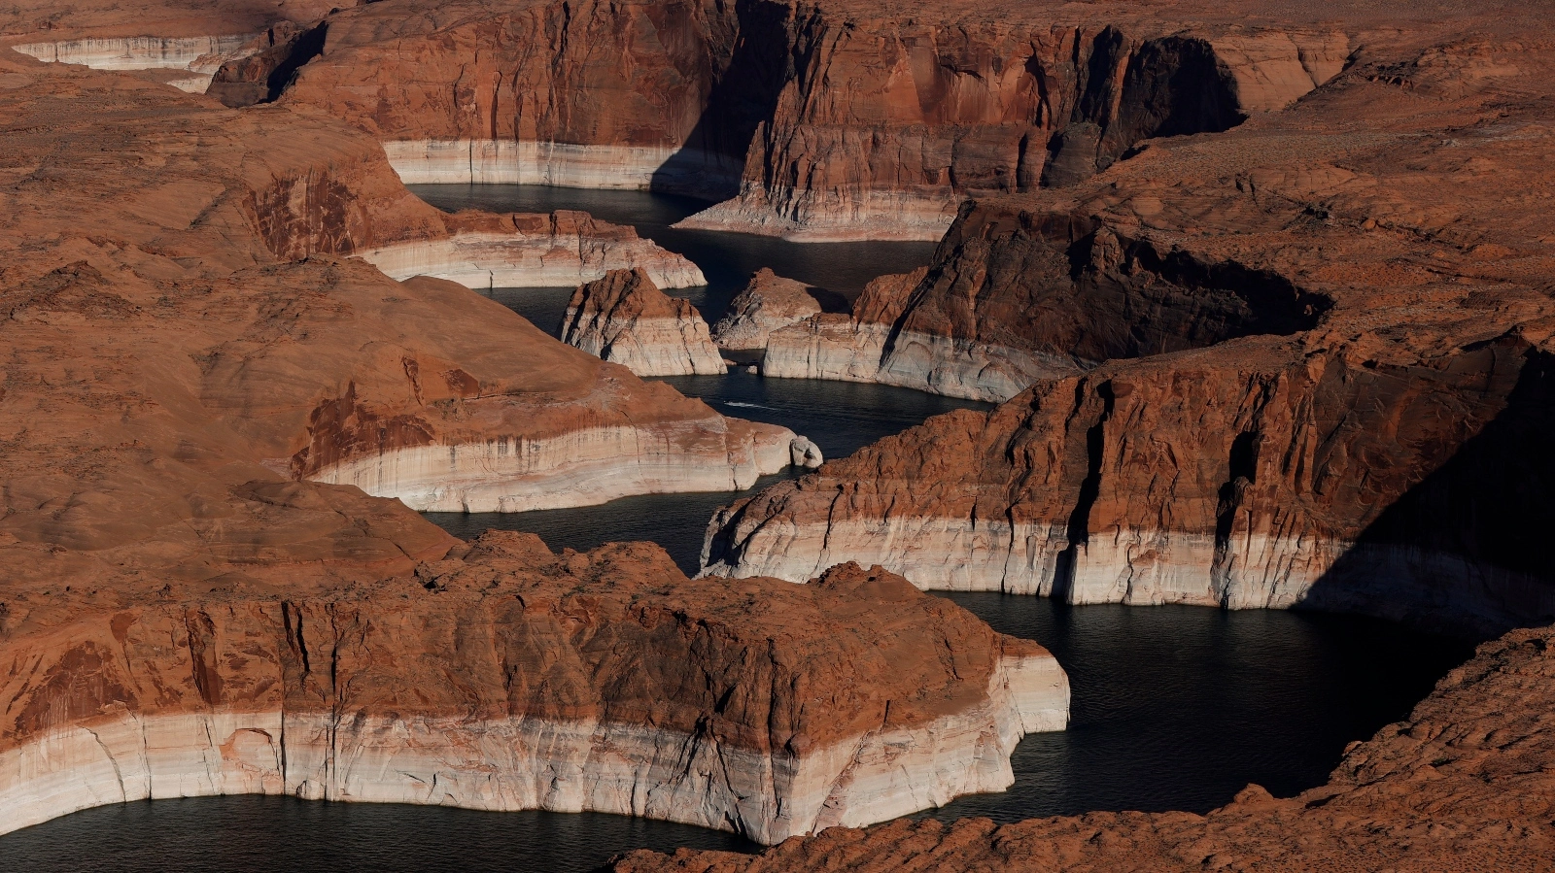
Gold et al (In Revision) Earth’s Future, https://doi.org/10.22541/essoar.171466633.31829337/v1

Slide 7
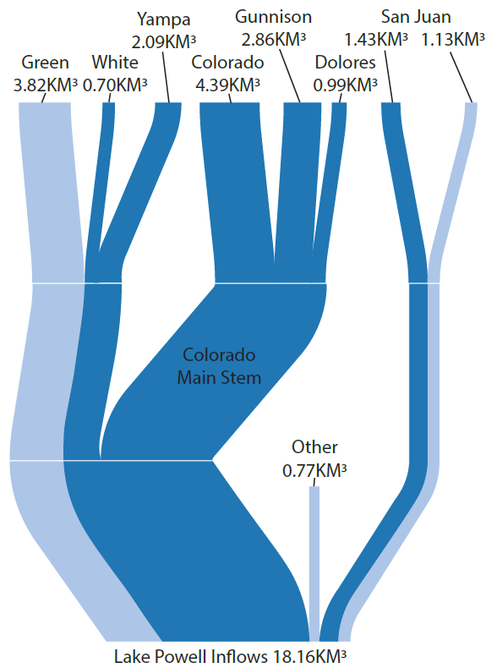
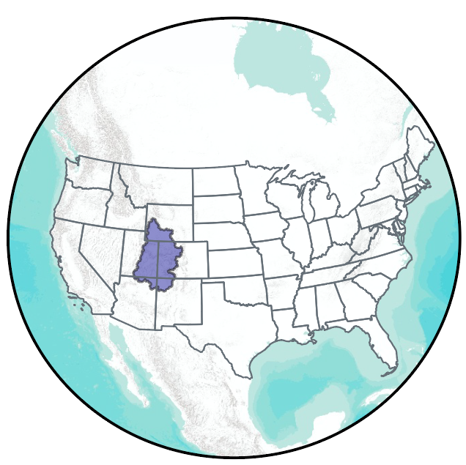
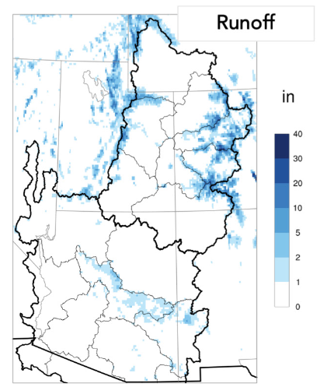
Colorado’s west Slope Basins
Nearly 70% of the inflow to Lake Powell originates in Colorado’s West Slope Basins
Utah
Colorado
New
Mexico
Arizona
West Slope
Data from: US Bureau of Reclamation (2020). 1909-2020 streamflow data for the Salt and Colorado River
Other
Lukas, J. J., & Payton, E. A. (2020). Colorado River Basin climate and hydrology: State of the science.

Slide 8
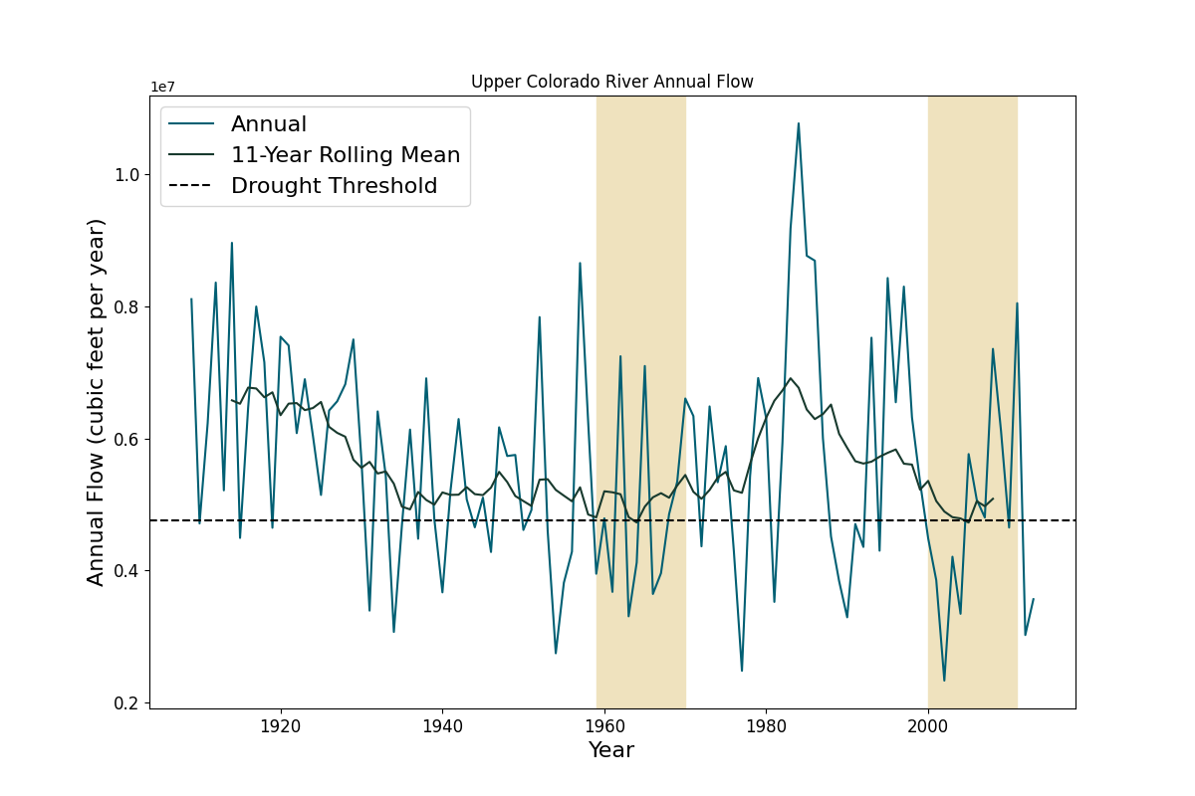
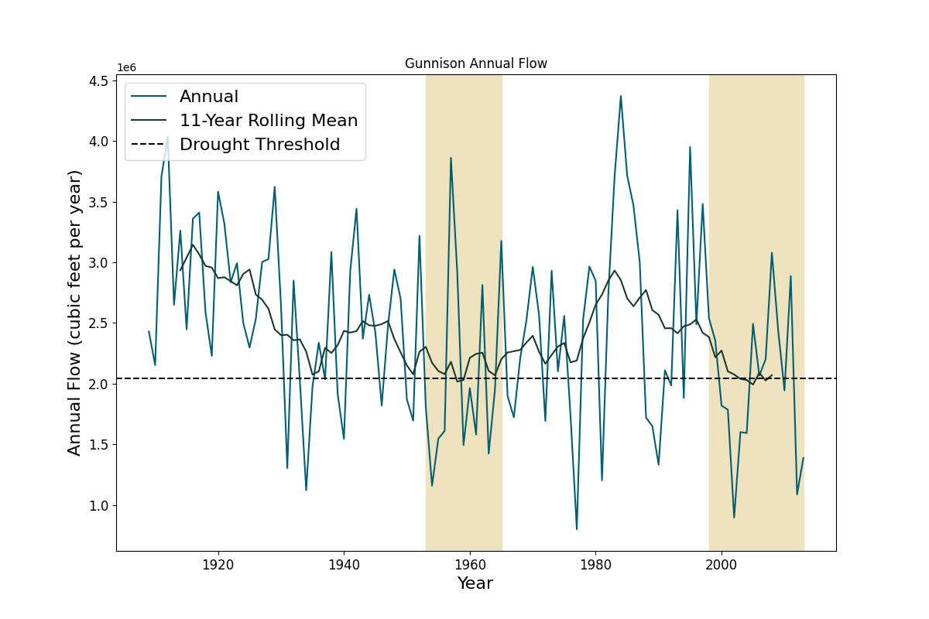
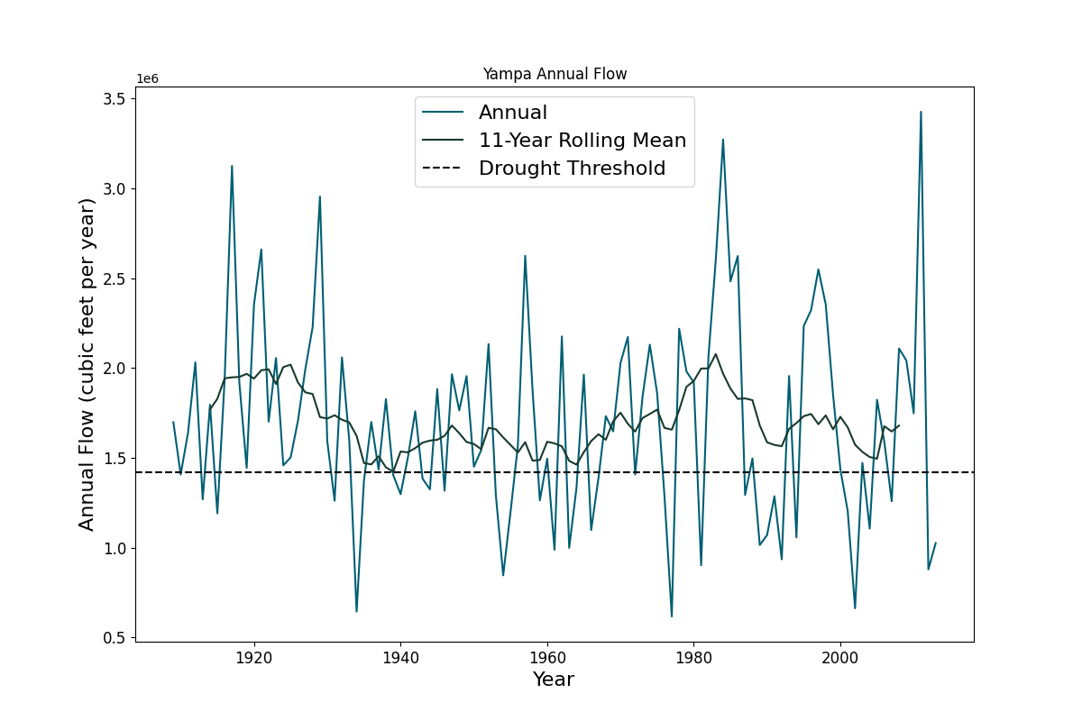
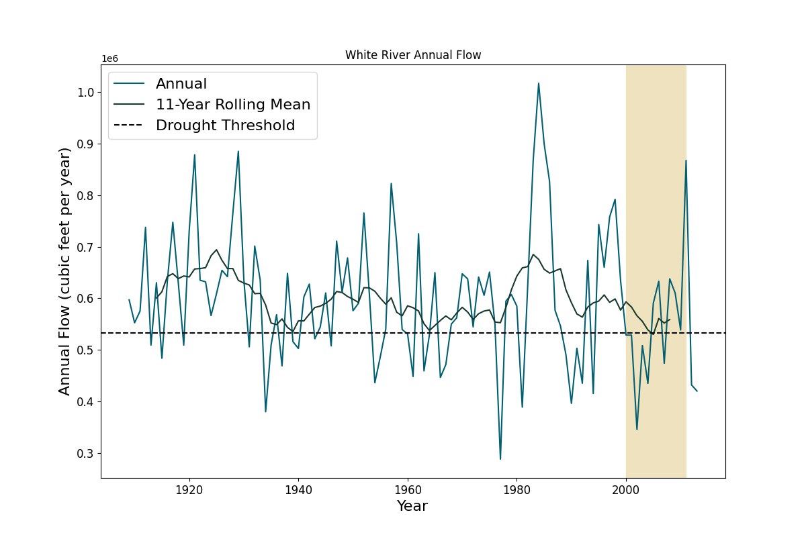
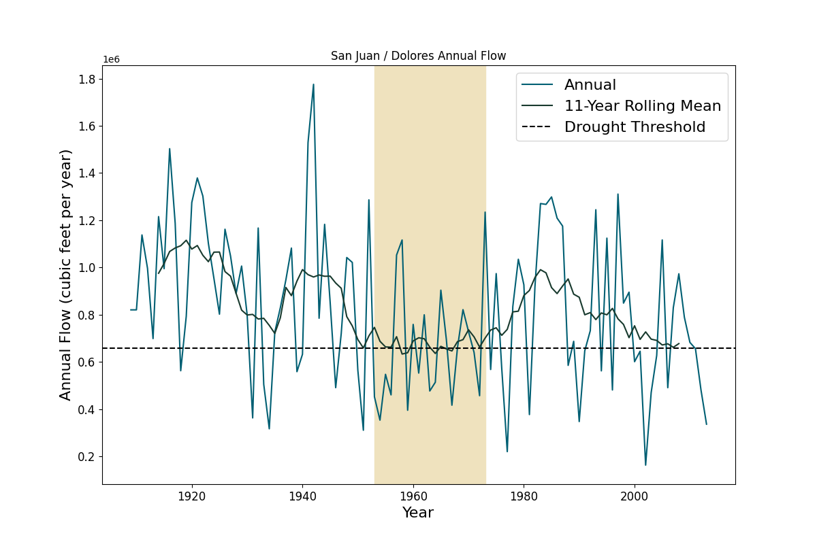
Historical decadal droughts
Upper Colorado River
Gunnison River
Yampa River
Annual Flow (ft³ /year)
White River
Southwest
Annual Flow (ft³ /year)

Slide 9
Historical decadal droughts
v
Upper Colorado River
Gunnison River
Yampa River
How could drought risks evolve for this region by 2050?
Annual Flow (ft³ /year)
White River
Southwest
Annual Flow (ft³ /year)

Slide 10
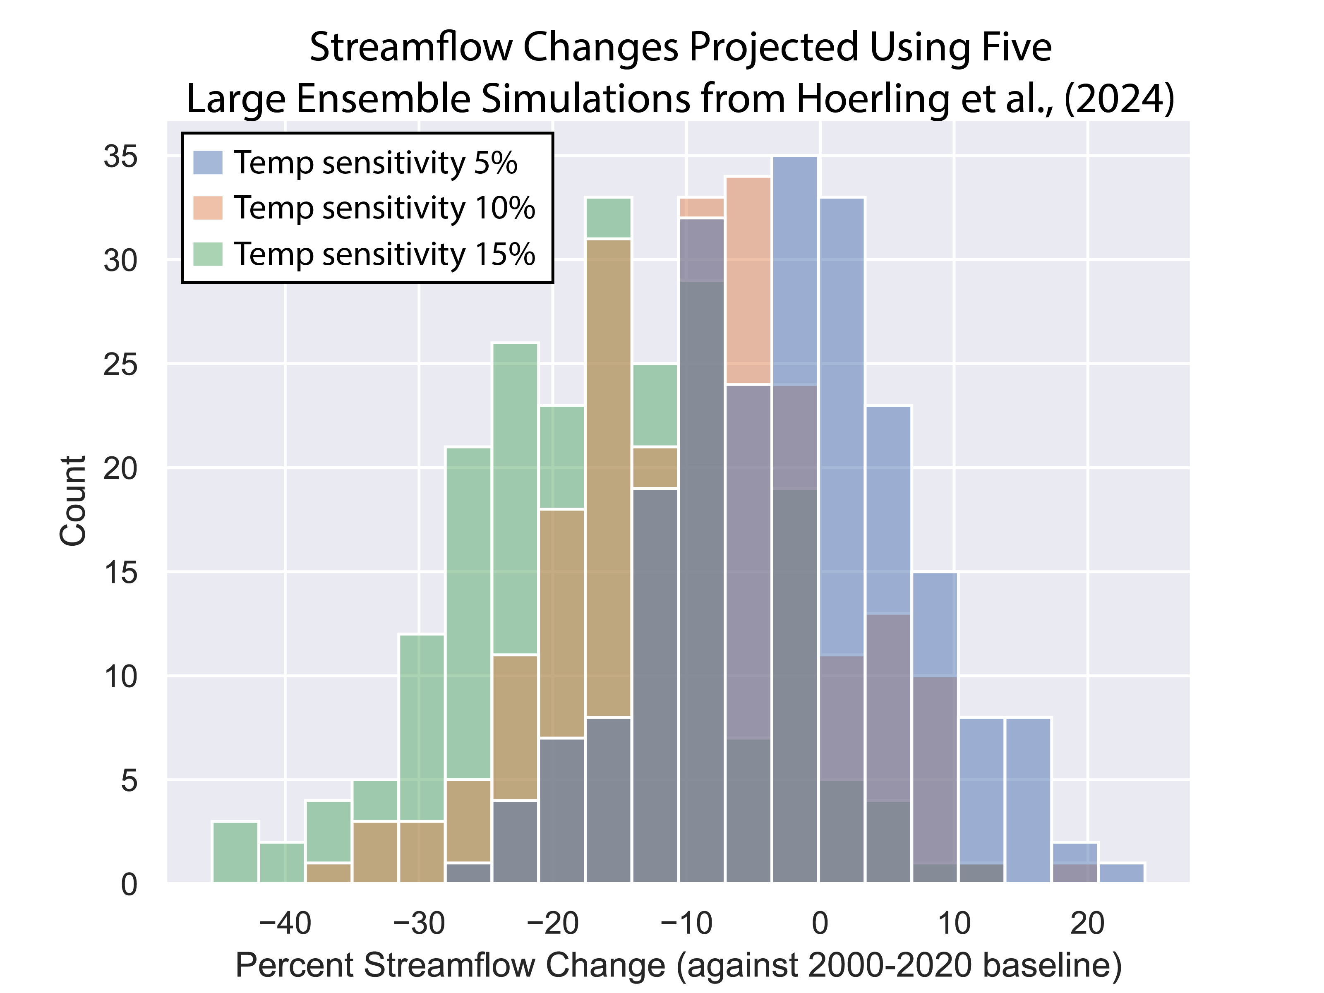
A middle-of-the-road climate scenario
Hoerling et al (2024) Journal of Climate, https://doi.org/10.1175/JCLI-D-23-0617.1

Slide 11
A middle-of-the-road climate scenario
A mid-century average 7% reduction in outflows is relatively optimistic & middle of road
Hoerling et al (2024) Journal of Climate, https://doi.org/10.1175/JCLI-D-23-0617.1

Slide 12
Theme 2 Risks & Impacts – Better capture extremes
The modern observation record of the last century is limited in its ability to capture persistent drought extremes and the internal variability of the system
What if we had a 1000 replicate centuries of record? How different would we perceive persistent drought risks?
What if these 1000 replicate centuries experienced 7% reductions of streamflow due to climate change?

Slide 13
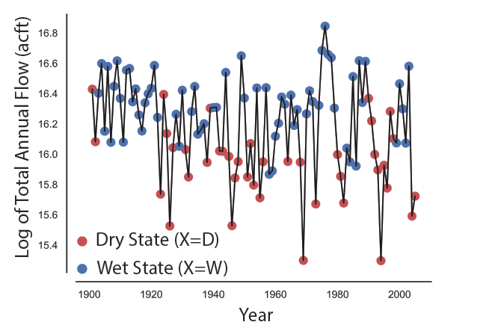
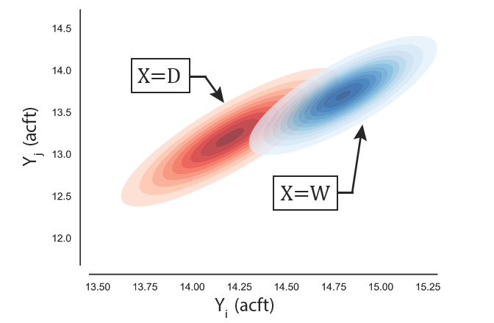
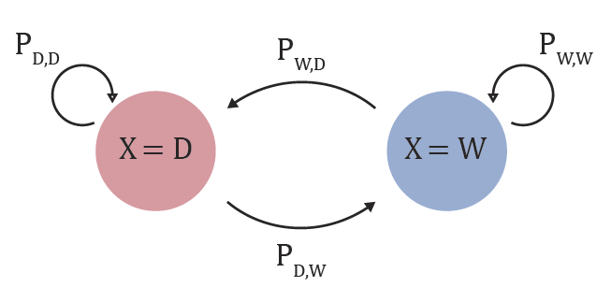
A hidden Markov model-base stochastic streamflow generator to capture internal variability
I. Classify historical record into two states (wet and dry)
II. Fit a multivariate Gaussian dist. to the log flows in each state
III. Determine the transition probabilities between states

Slide 14
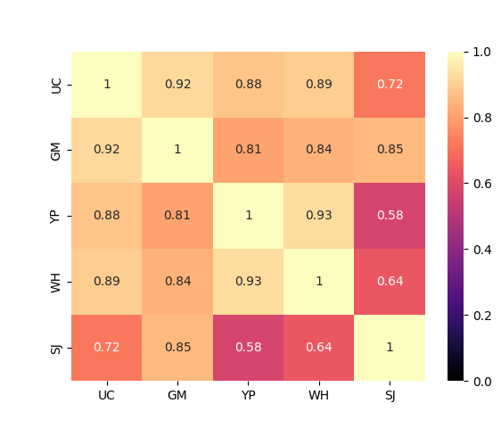
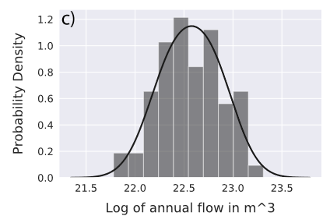
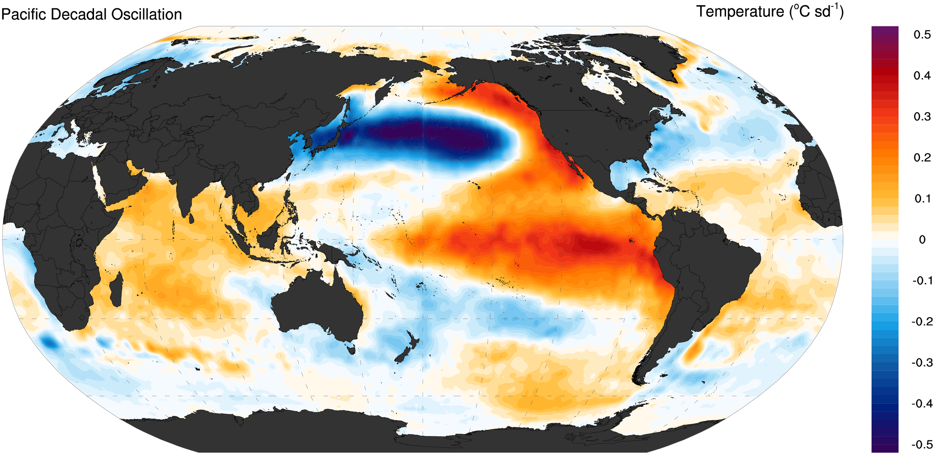
Capturing internal variability
Historical Correlation Matrix
UC
Preserve statistical properties of the historical record
Replicate spatial correlation between basins
Capture persistence caused by large scale climate phenomena a
Flows
GN
YP
Correlation Coeff.
WH
SW
UC
GN
YP
WH
SW

Slide 15
Stationary Envelopes (No Climate change)

Slide 16
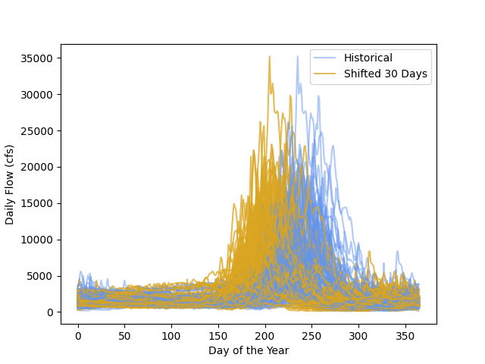
Capturing climate change
Perturb HMM parameters to reflect plausible changes in climate:
Scale means of dry and wet state distributions
Shift the timing of peak flows to capture changes to snowmelt
Probability Density
Annual Flow

Slide 17
Computational experiment
Run “baseline” and “climate-adjusted” ensembles through a planning model
Each ensemble has 1,000 105 year records
Total of 210,000 years of streamflow
Notes:
https://www.watereducation.org/western-water-excerpt/1922-2007-85-years-colorado-river-compact

Slide 18
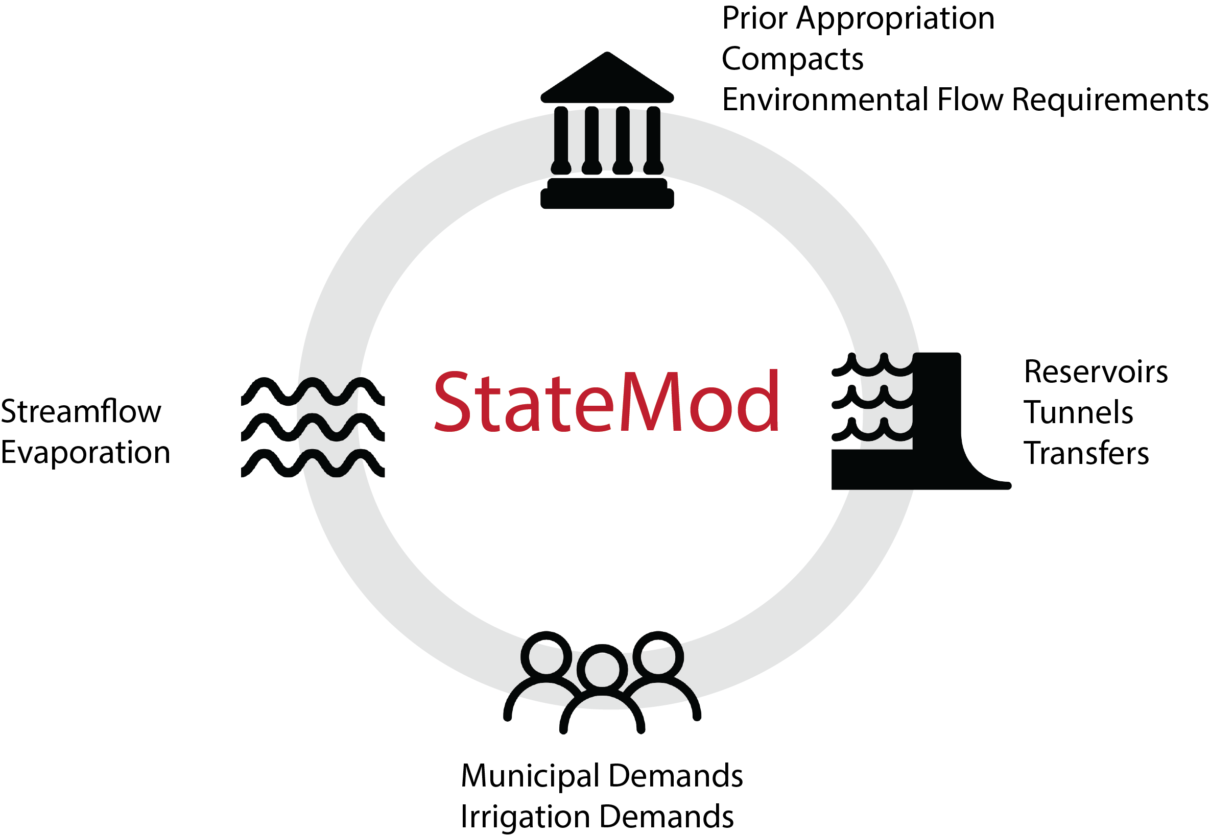
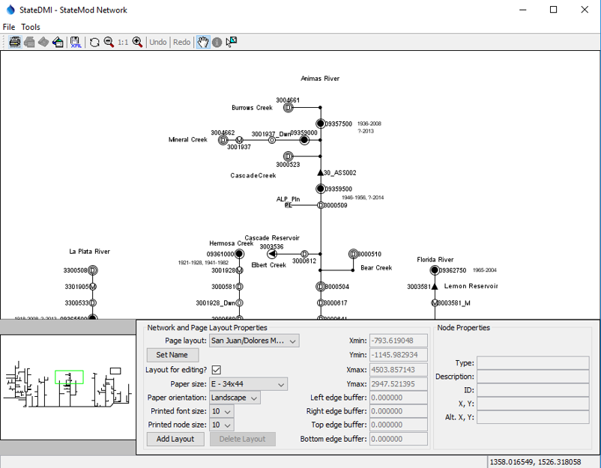
Statemod: Colorado’s water planning model
Notes:
https://www.watereducation.org/western-water-excerpt/1922-2007-85-years-colorado-river-compact

Slide 19
Statemod VS MOSART-WM scale representation illustration
Illustration for the Upper Colorado Basin where the grid represents 1/8-degree spatial resolution
Hadjimichael et al 2023 JWRPM, https://ascelibrary.org/doi/abs/10.1061/JWRMD5.WRENG-5522

Slide 20
Statemod VS MOSART-WM scale representation illustration
v
Illustration for the Upper Colorado Basin where the grid represents 1/8-degree spatial resolution
Our HMM full natural flow modeling is at the scale of 1000+ points of diversion across the West Slope Basins (so 1000 centuries at ~1000 node locations)
Hadjimichael et al 2023 JWRPM, https://ascelibrary.org/doi/abs/10.1061/JWRMD5.WRENG-5522

Slide 21
Deliveries to lake powell
Flow (million m³)

Slide 22
Deliveries to lake powell
Cumulative deliveries from all basins
Flow (million m³)

Slide 23
Deliveries to lake powell
Driest 5-year period
A
Flow (million m³)

Slide 24
Deliveries to lake powell
Driest 10-year period
B
A
Flow (million m³)

Slide 25
Deliveries to lake powell
B
A
Flow (million m³)
B
A
Flow (million m³)

Slide 26
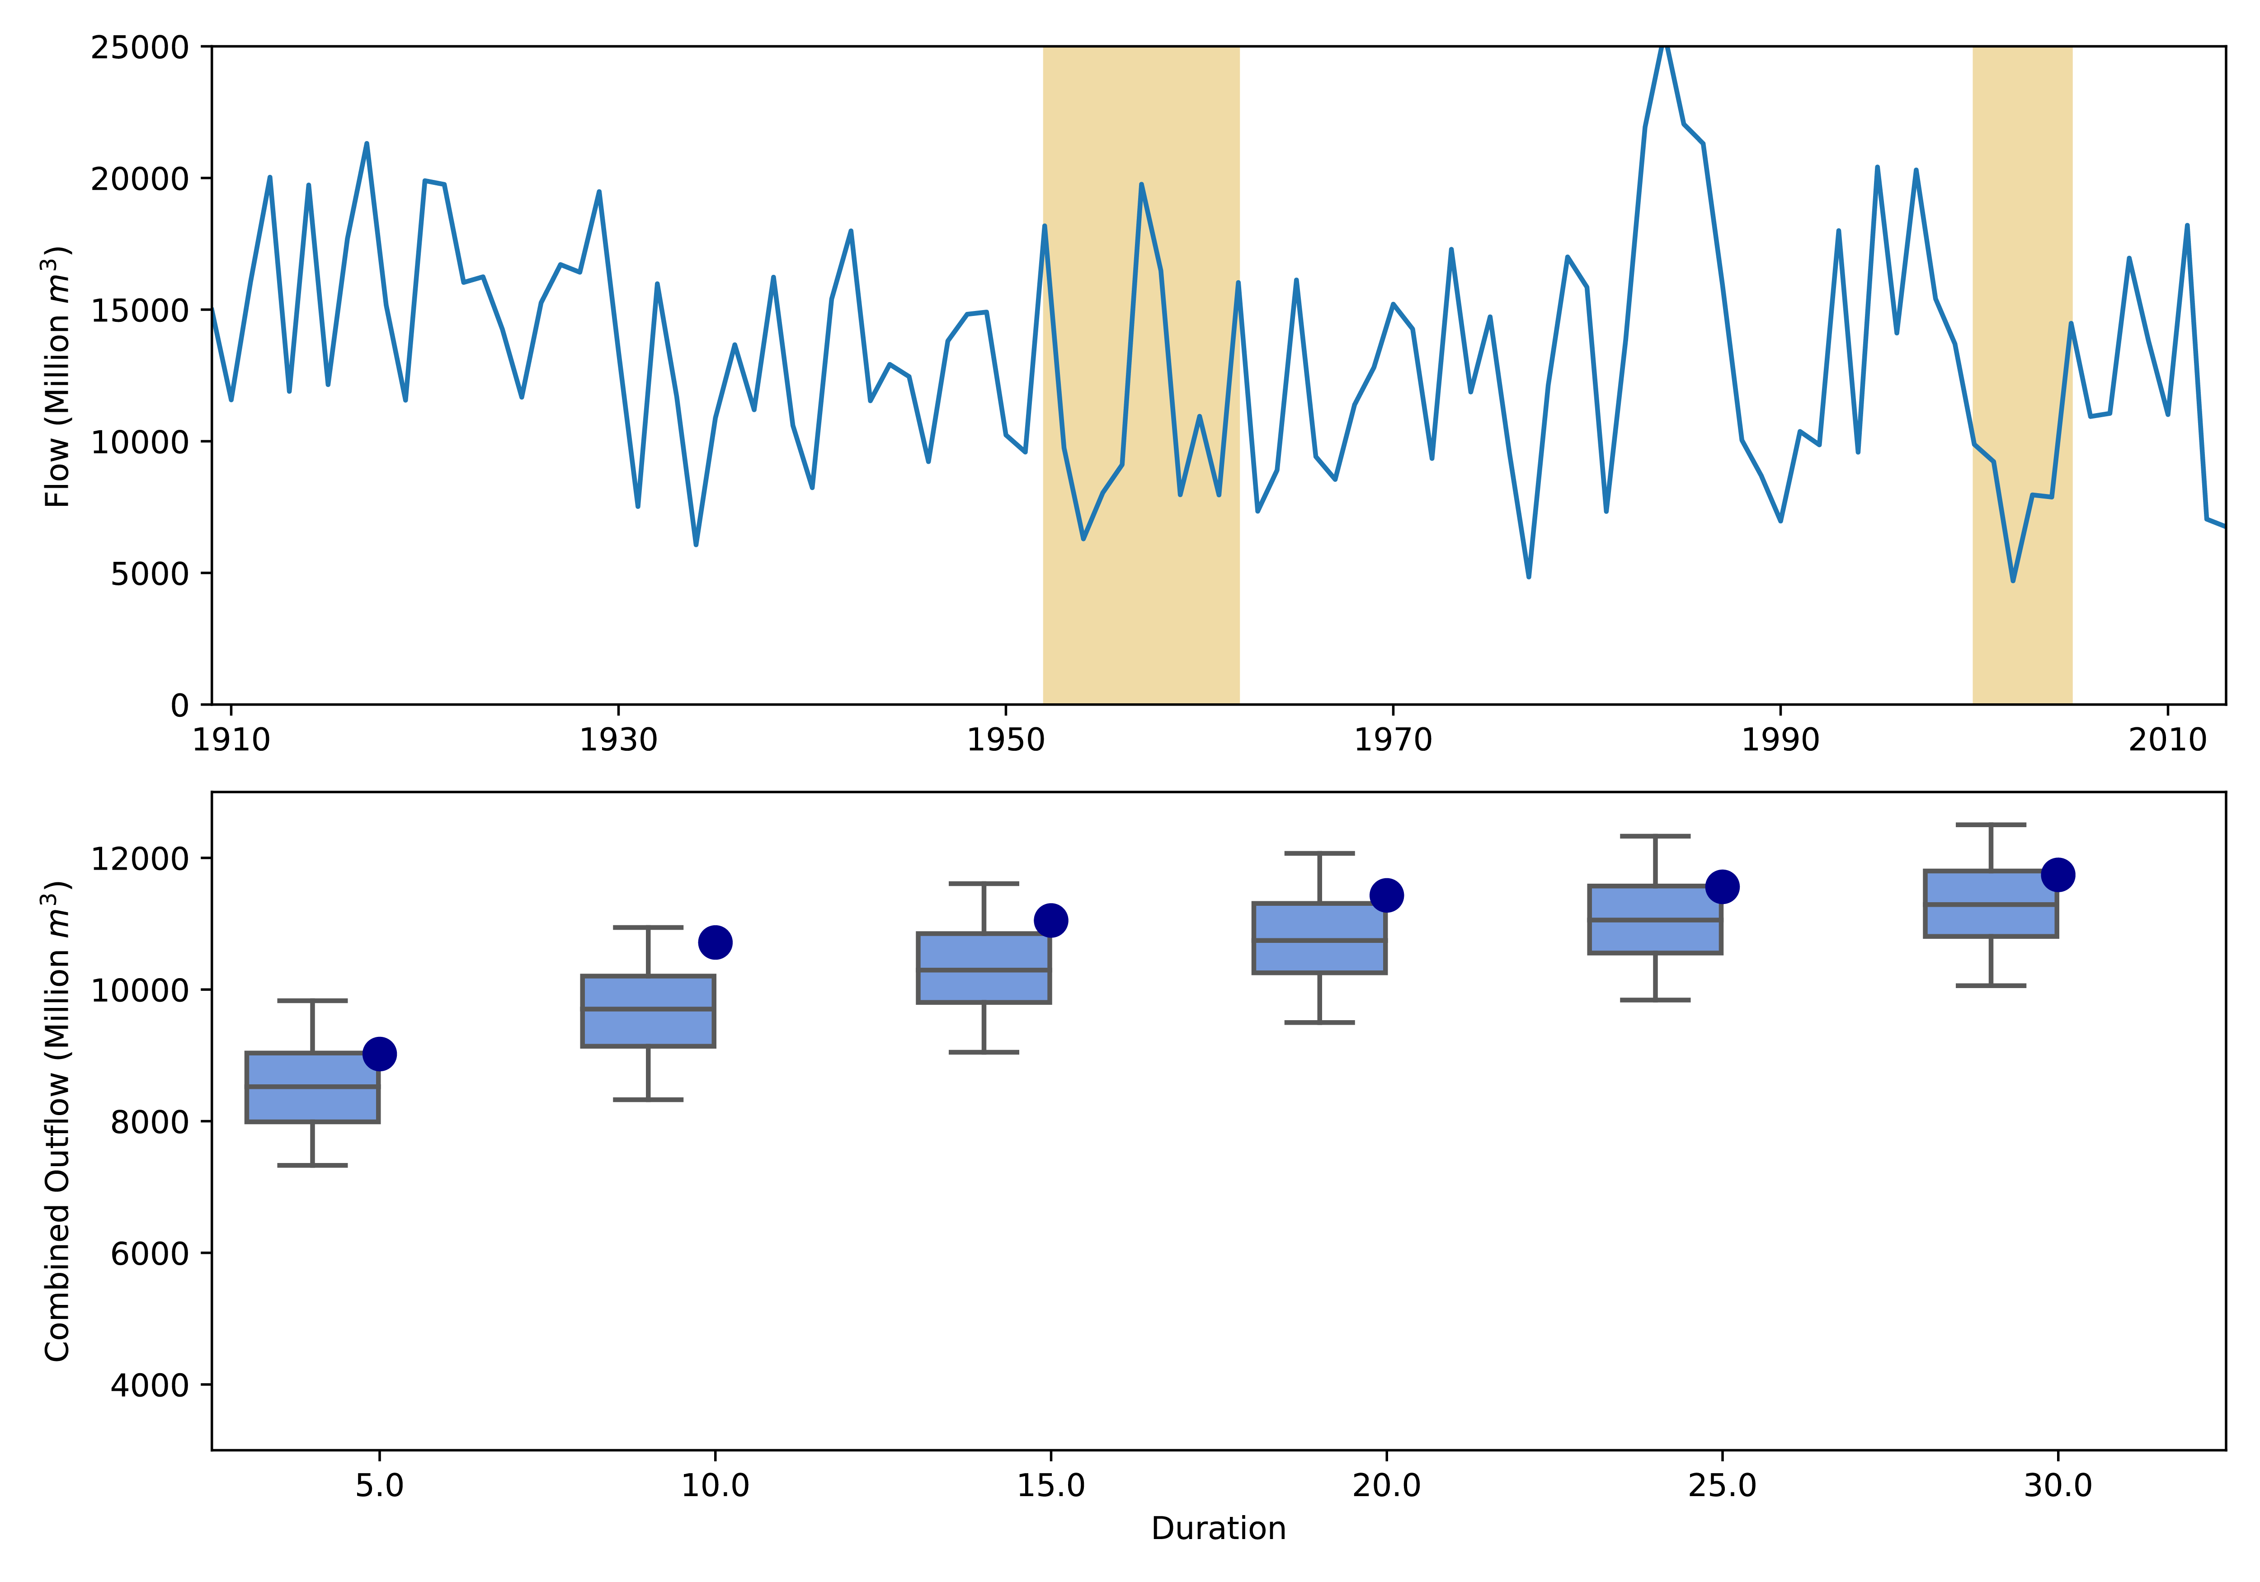
Deliveries to lake powell
B
A
Flow (million m³)
B
A
Flow (million m³)
Baseline HMM

Slide 27
Deliveries to lake powell
B
A
Flow (million m³)
B
A
Flow (million m³)
Ensemble median
Baseline HMM

Slide 28
Deliveries to lake powell
B
A
Flow (million m³)
B
A
Flow (million m³)
Ensemble 25th percentile
Baseline HMM

Slide 29
Deliveries to lake powell
B
A
Flow (million m³)
B
A
Flow (million m³)
Ensemble 5th percentile
Baseline HMM

Slide 30
Deliveries to lake powell
B
A
Extreme events that emerge from sampling internal variability are drier and more persistent than the observed historical record
Flow (million m³)
B
A
Flow (million m³)
Baseline HMM

Slide 31
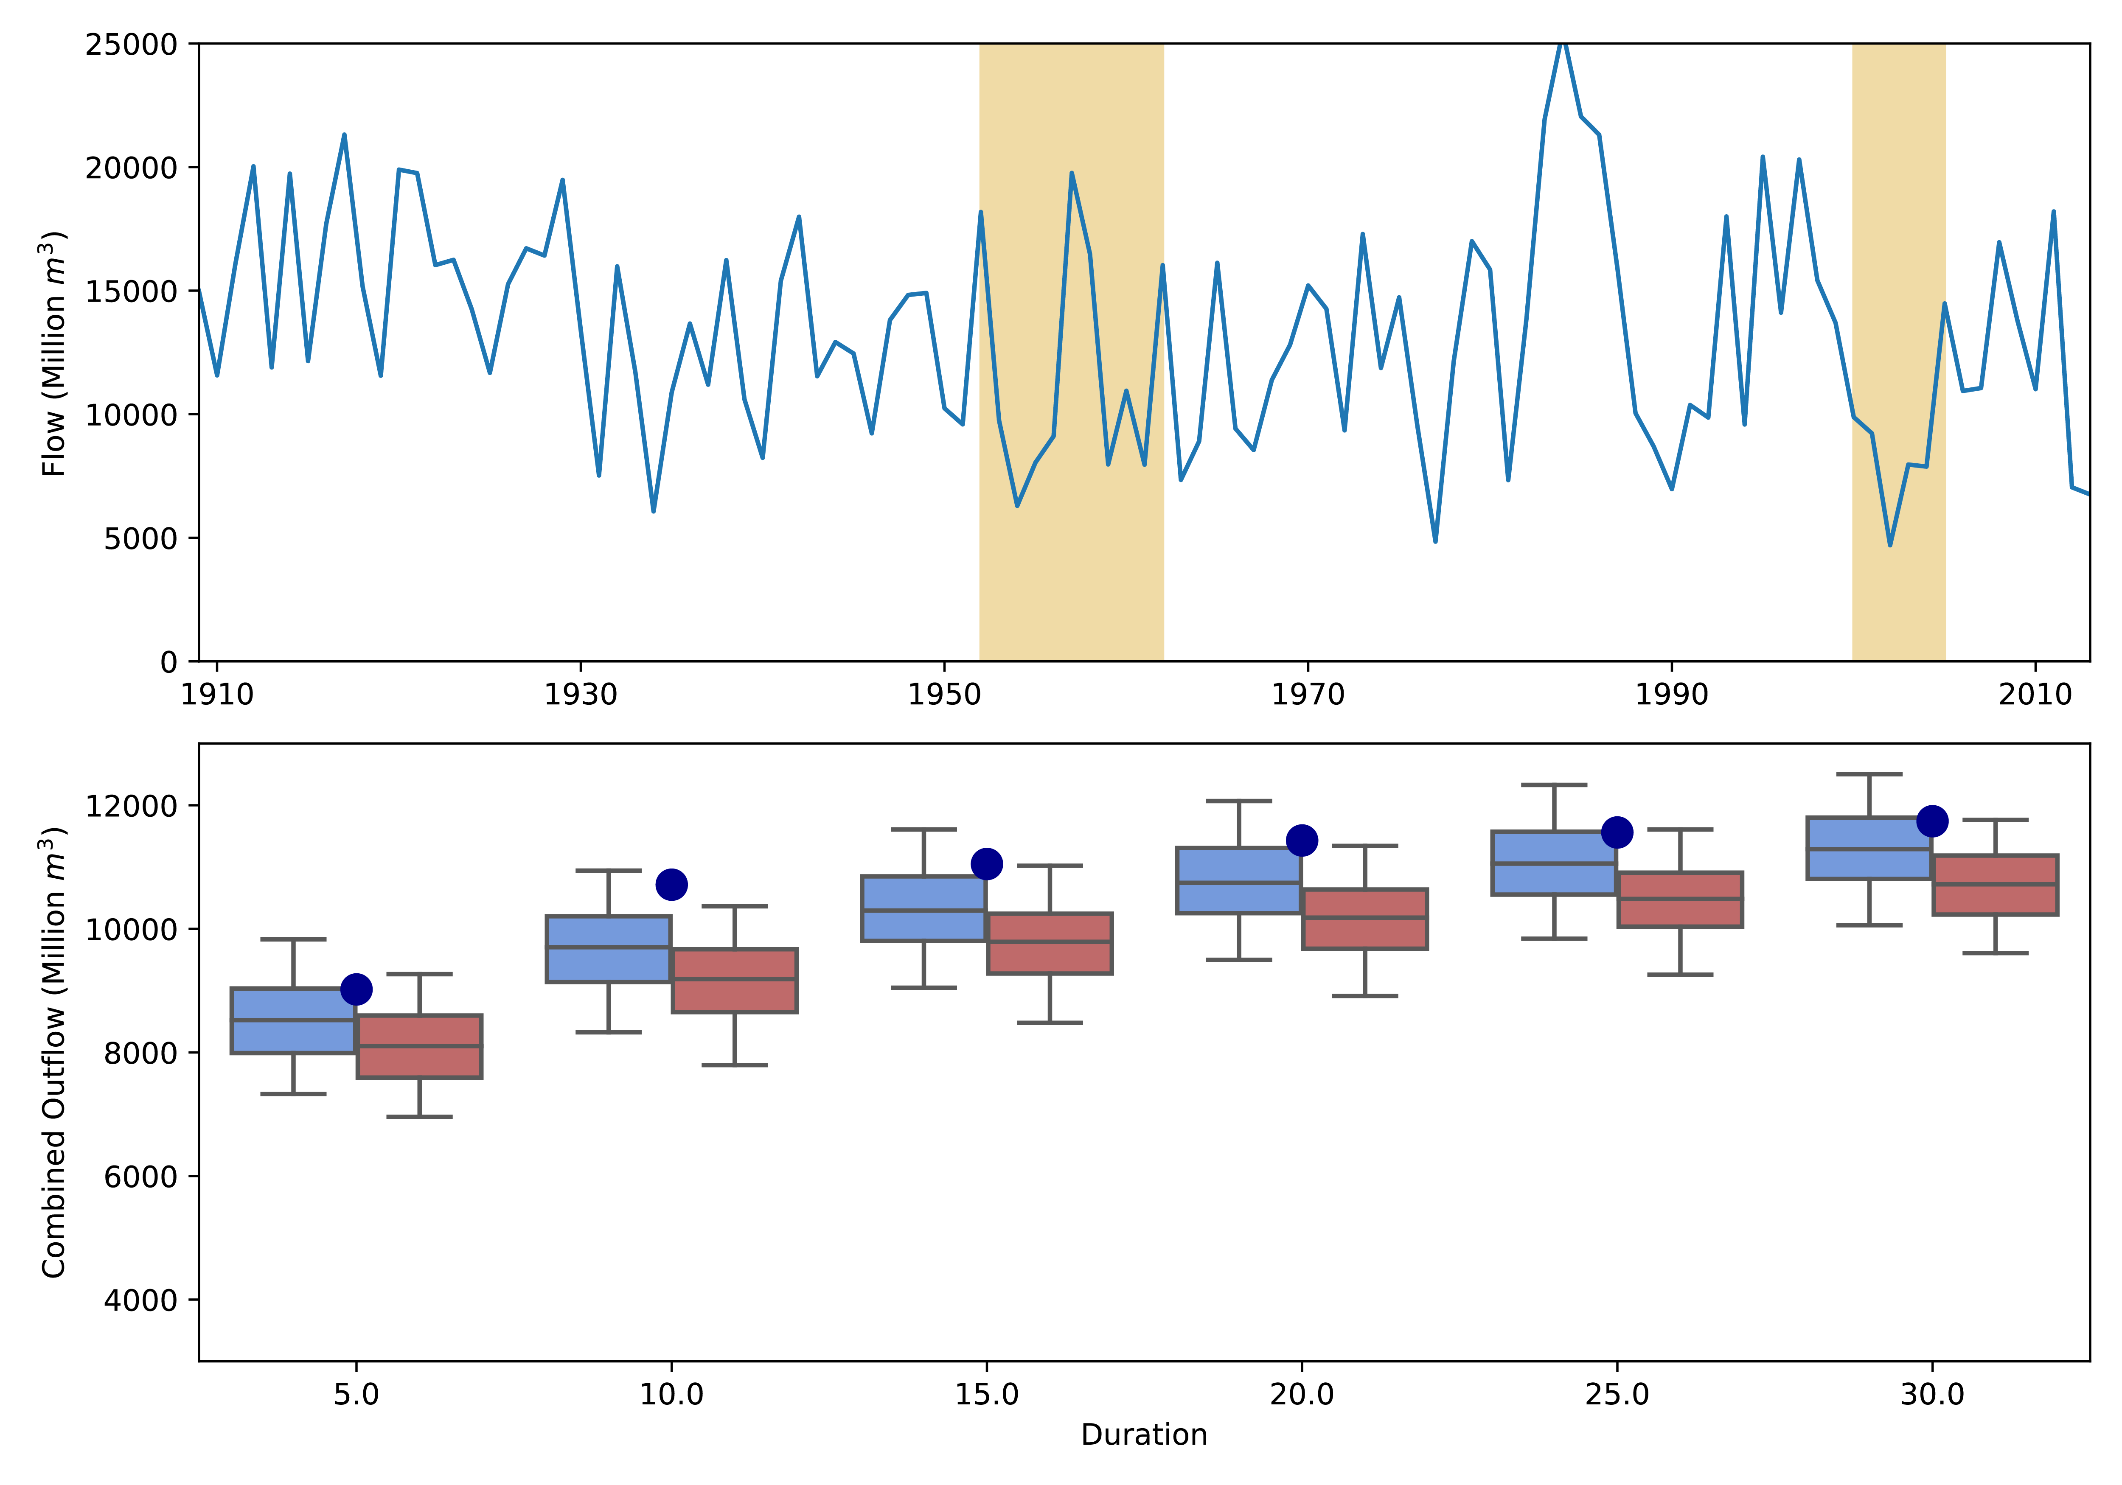
Deliveries to lake powell
B
A
Flow (million m³)
B
A
Flow (million m³)
Baseline HMM
Climate-adjusted HMM

Slide 32
Deliveries to lake powell
B
A
The ‘optimistic’ climate-adjusted ensemble yields a regime change to persistently severe dry periods
Flow (million m³)
B
A
Flow (million m³)
Baseline HMM
Climate-adjusted HMM

Slide 33
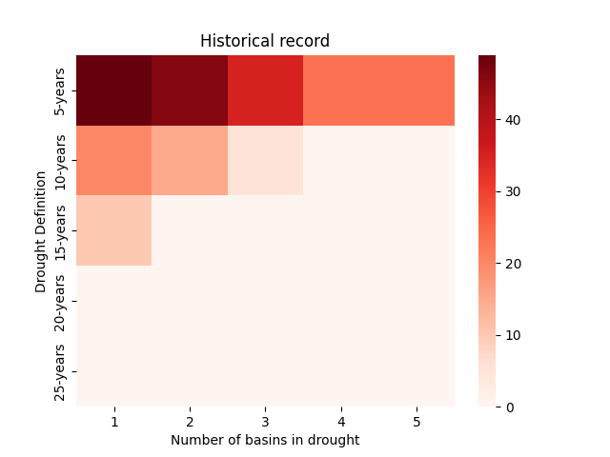
Changes in spatially compounding drought?
Number of drought years

Slide 34
Changes in spatially compounding drought?
Temporal definitions of drought
Number of drought years

Slide 35
Changes in spatially compounding drought?
Number of drought years
Spatial extent of drought

Slide 36
Changes in spatially compounding drought?
Number of years classified as drought
Number of drought years

Slide 37
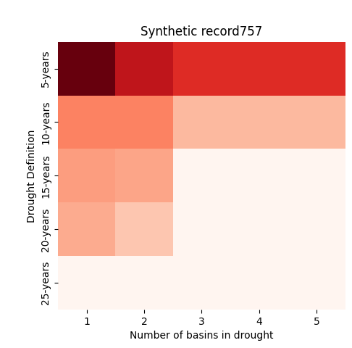
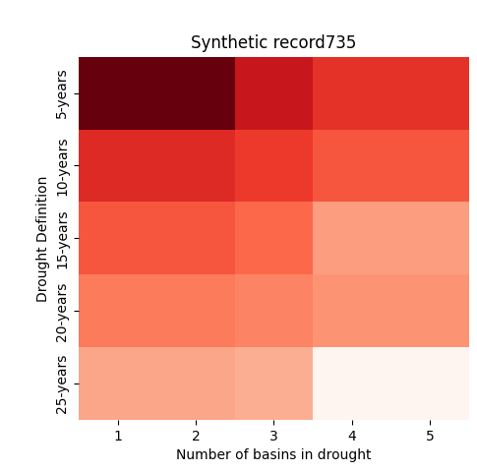
Changes in spatially compounding drought?
Baseline Median
Baseline 99th percentile
5
5
10
10
15
15
20
20
25
25
1
2
3
4
5
1
2
3
4
5
Number of drought years

Slide 38
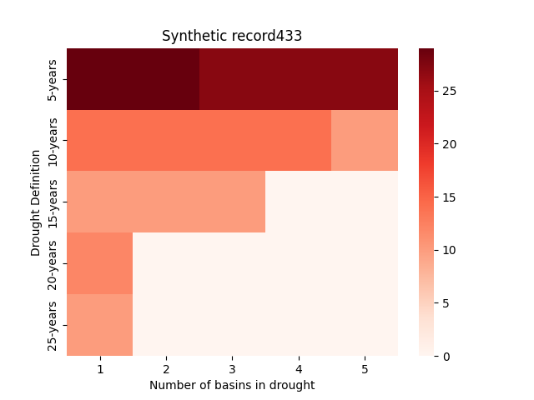
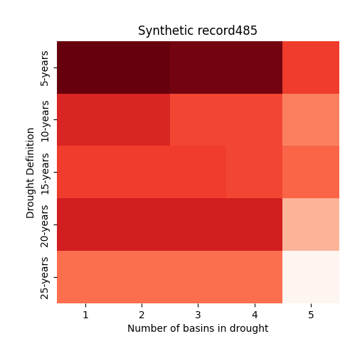
Changes in spatially compounding drought?
Baseline Median
Baseline 99th percentile
5
5
10
10
15
15
20
20
25
25
1
2
3
4
5
1
2
3
4
5
Number of drought years
Climate Median
Climate 99th percentile
5
5
10
10
15
15
20
20
25
25
1
2
3
4
5
1
2
3
4
5

Slide 39
Changes in spatially compounding drought?
v
Baseline Median
Baseline 99th percentile
5
5
Even a middle-of-the-road climate change case yields substantial risk for change to long lived spatially extensive drought regimes.
10
10
15
15
20
20
25
25
1
2
3
4
5
1
2
3
4
5
Number of drought years
Climate Median
Climate 99th percentile
5
5
10
10
15
15
20
20
25
25
1
2
3
4
5
1
2
3
4
5

Slide 40
Theme 2 Risks & Impacts – What is needed
What are the bottlenecks for advancing regional modeling to better capture risks and impacts?
There is a computational bottleneck in utilizing large ensemble ESM and/or regional runs at the scales needed
It take time and effort to capture ‘holistic treatments’ of risk beyond characterizing natural hazards
Decision relevance requires perspectives beyond ‘modelers modeling’
There needs to be a better bridge between the physical and statistical modeling communities in better capturing extremes and risks

Slide 41
v
Thank you! Happy to follow up in our discussion.

Slide 42
Additional Slides

Slide 43
Fitting the hmm
Dry state
.
Wet state
.

Slide 44
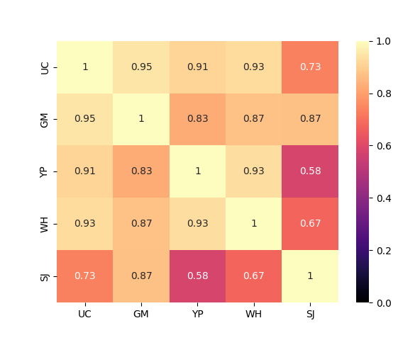
Capturing Spatial correlation
Historical Correlation Matrix
Synthetic Correlation Matrix
UC
UC
GN
GN
YP
Correlation Coeff.
YP
Correlation Coeff.
WH
WH
SW
SW
UC
GN
YP
WH
SW
UC
GN
YP
WH
SW

Slide 45
Identifying drought
Drought
A period when the 5-year rolling mean flow drops more than ½ standard deviation below the mean of the entire record
$$μ_{11}<μ_{hist}−0.5{ σ}_{hist}$$
5

