Slide 1
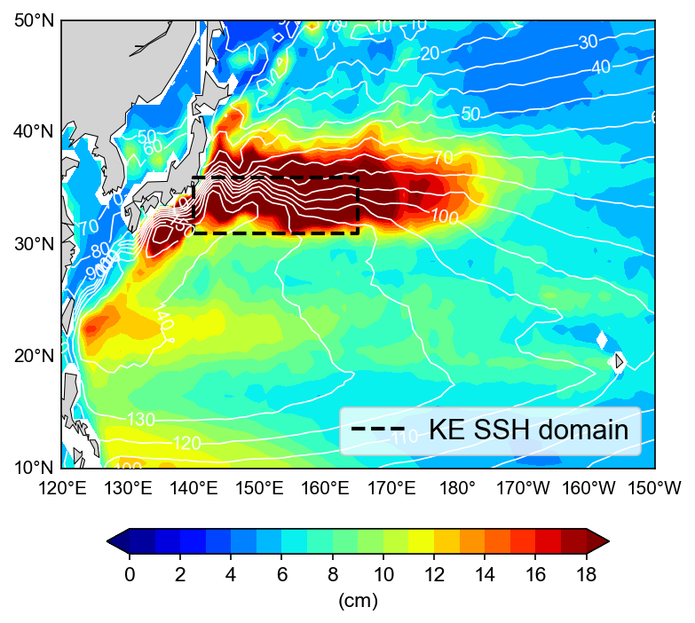
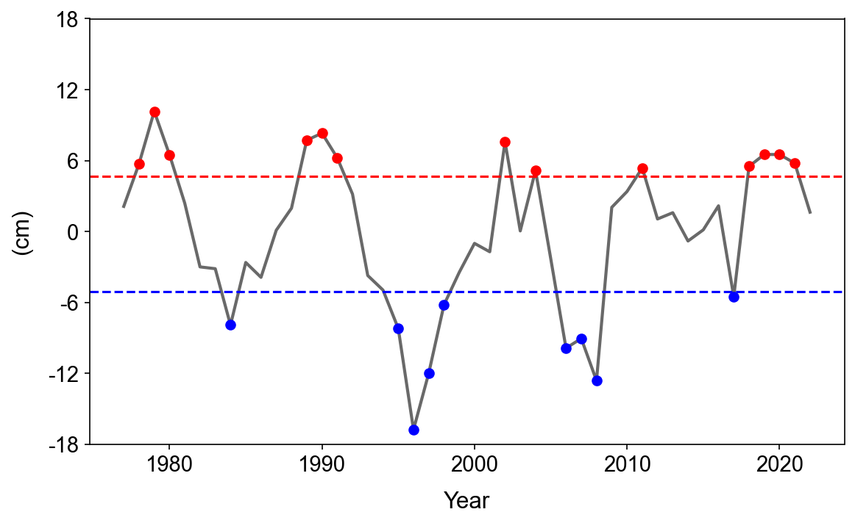
Kuroshio Extension (KE) Decadal Variability
Se-Yong Song
SSH variability (shading) & mean SSH (contour)
SON KE index (satellite + ocean hindcast/reanalysis)
(1977-1998)
(1999-2022)
How does the decadal KE dynamic state
affect the overlying atmospheric circulation?

Slide 2
Downstream impacts of KE decadal variability ① (1977-1998)
NDJ SST
NDJ upward THF
NDJ storm tack
Northward shifted SST front
Weaker THF response to SST
Poleward migration of storm track
SST front anchoring effect

Slide 3
Downstream impacts of KE decadal variability ② (1999-2022)
NDJ SST
NDJ upward THF
NDJ convective P & SLP
Dampened by the upward THF
Stronger THF response to SST
Evaporation from the ocean
Diabatic heating - cyclonic SLP
Moist baroclinic instability

Slide 4
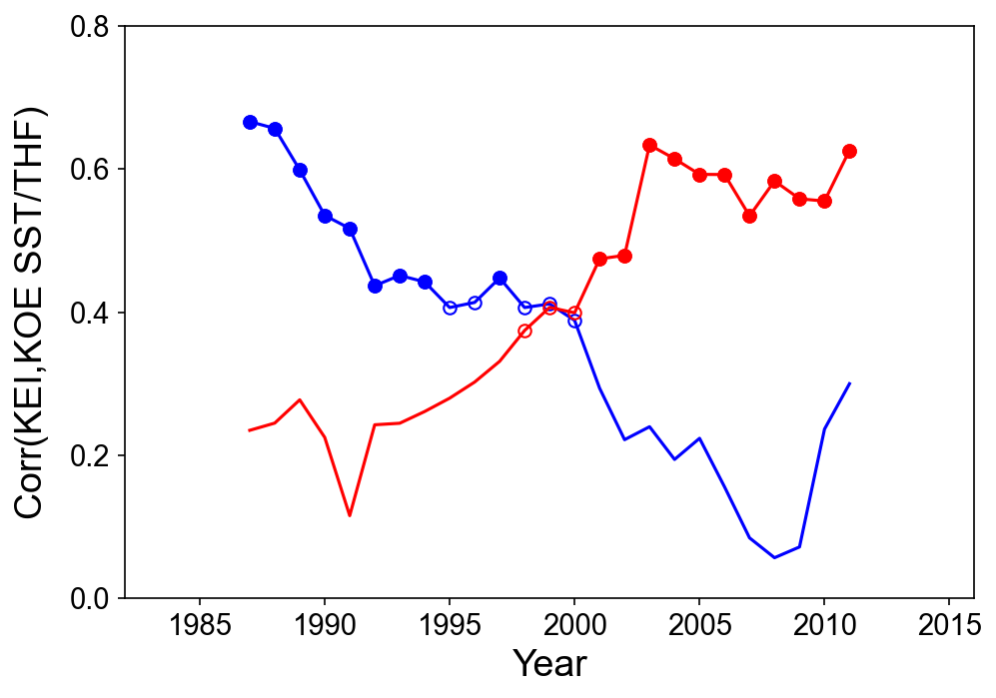
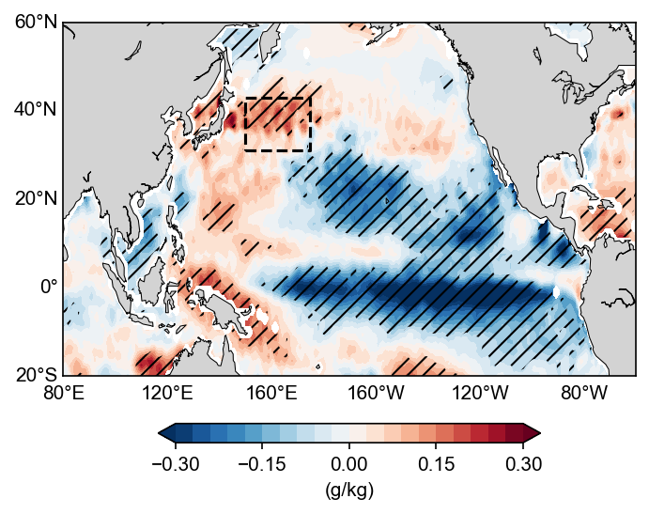
Changes in the KE air-sea coupled dynamics
Relationship b/w the KEI & KOE SST/THF indices
PDO-related sea-air humidity difference
(1977-1998)
(1999-2022)
r (KEI,KOE THF) ↑
r (KEI,KOE SST) ↓

