Slide 1
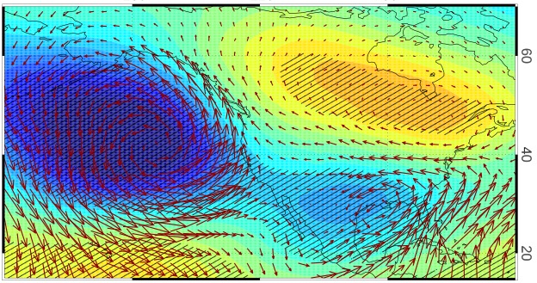
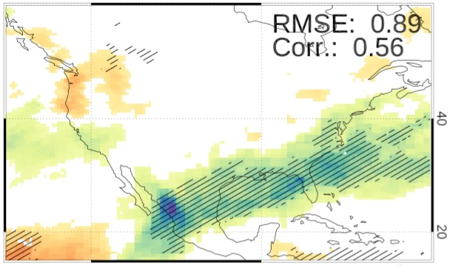
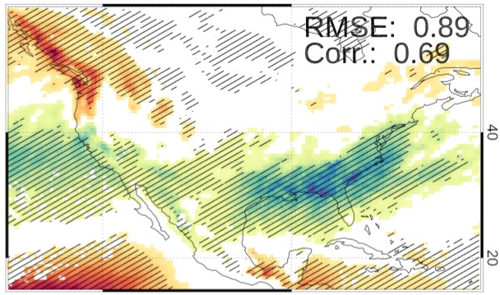
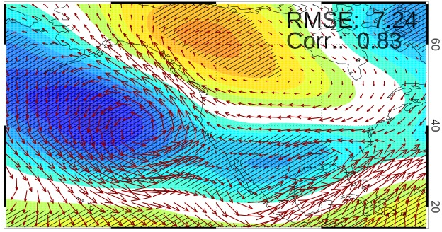
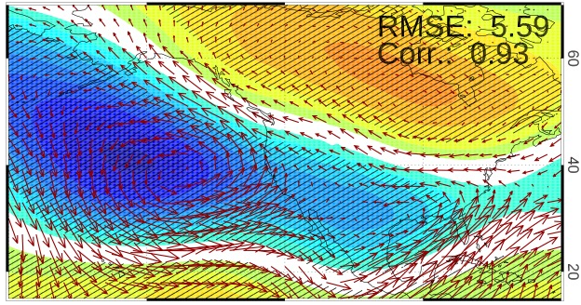
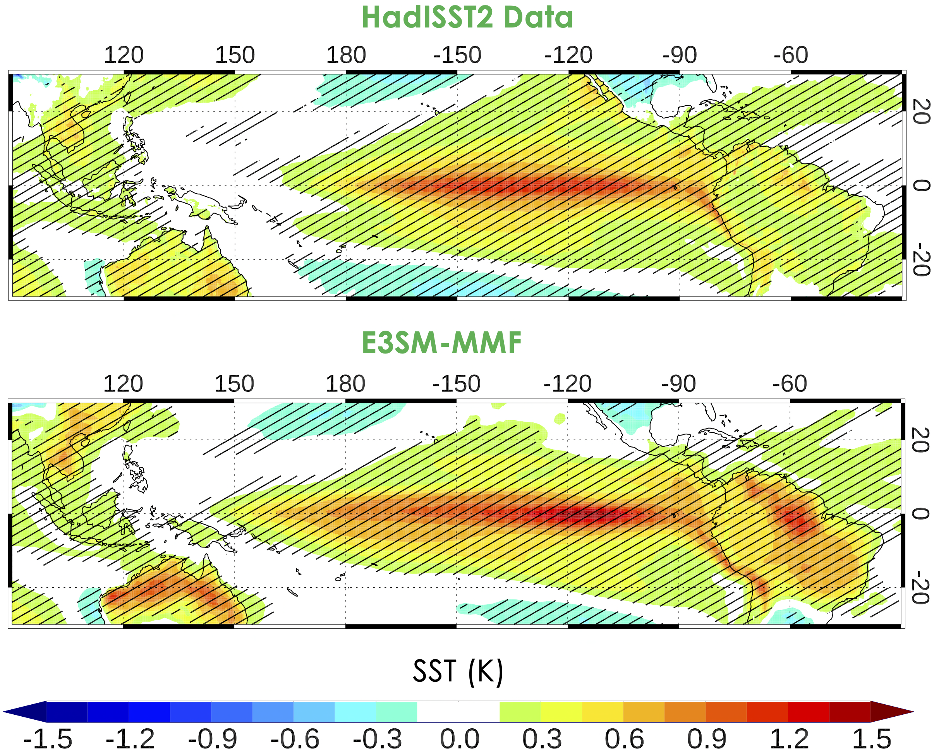
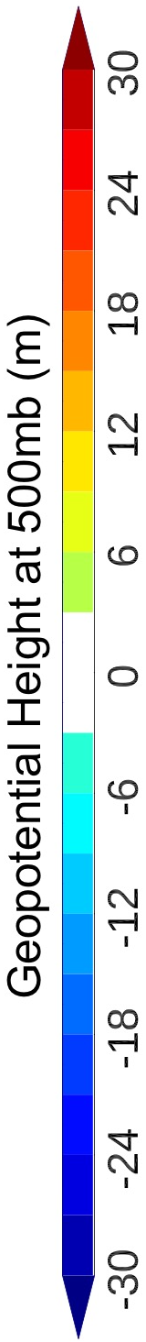
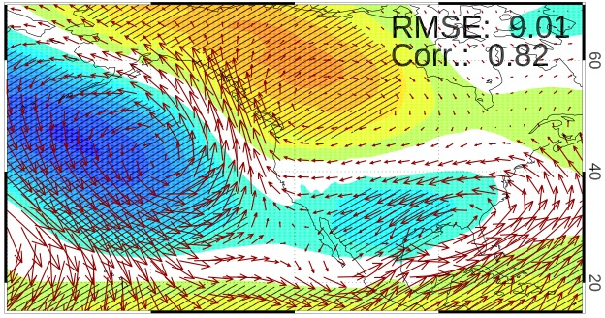
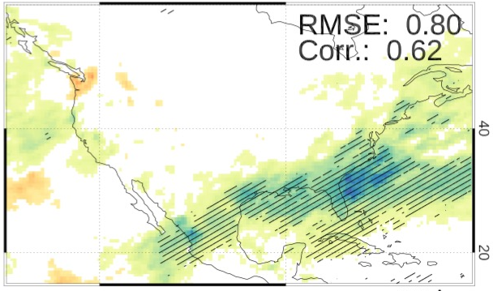
Simulated ENSO Teleconnections to US Winter Precipitation Extremes in a Model Resolution (complexity) Hierarchy
Salil Mahajan, Qi Tang, Walter Hannah, Noel Keen, Chris Golaz and Luke van-Roekel
ENSO Diversity and Biases
Teleconnections to Extremes (GEV)
Physical Drivers (Moisture Transport)
ENSO Longitudinal Index (ELI):
Avg. long. location of Tropical Pacific deep convection
CPC Data
ERA5 Data
E3SMv1-LR
E3SMv1-HR
E3SMv1-LR
E3SMv1-HR
Regression of SST against the Nino3.4 Index
E3SMv2-NARRM
E3SM-MMF
E3SMv2-NARRM
E3SM-MMF
ENSO Dependence of Precipitation Extremes (mm/day)

