Slide 1
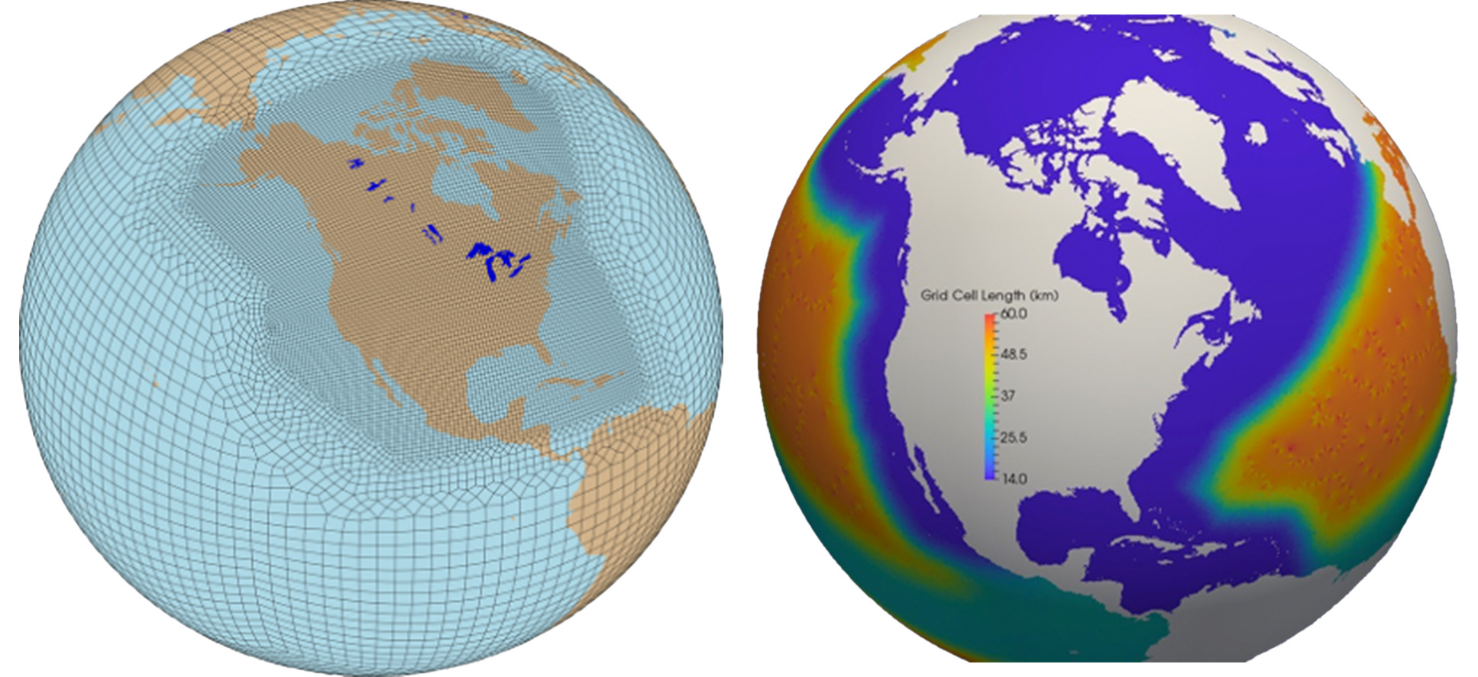
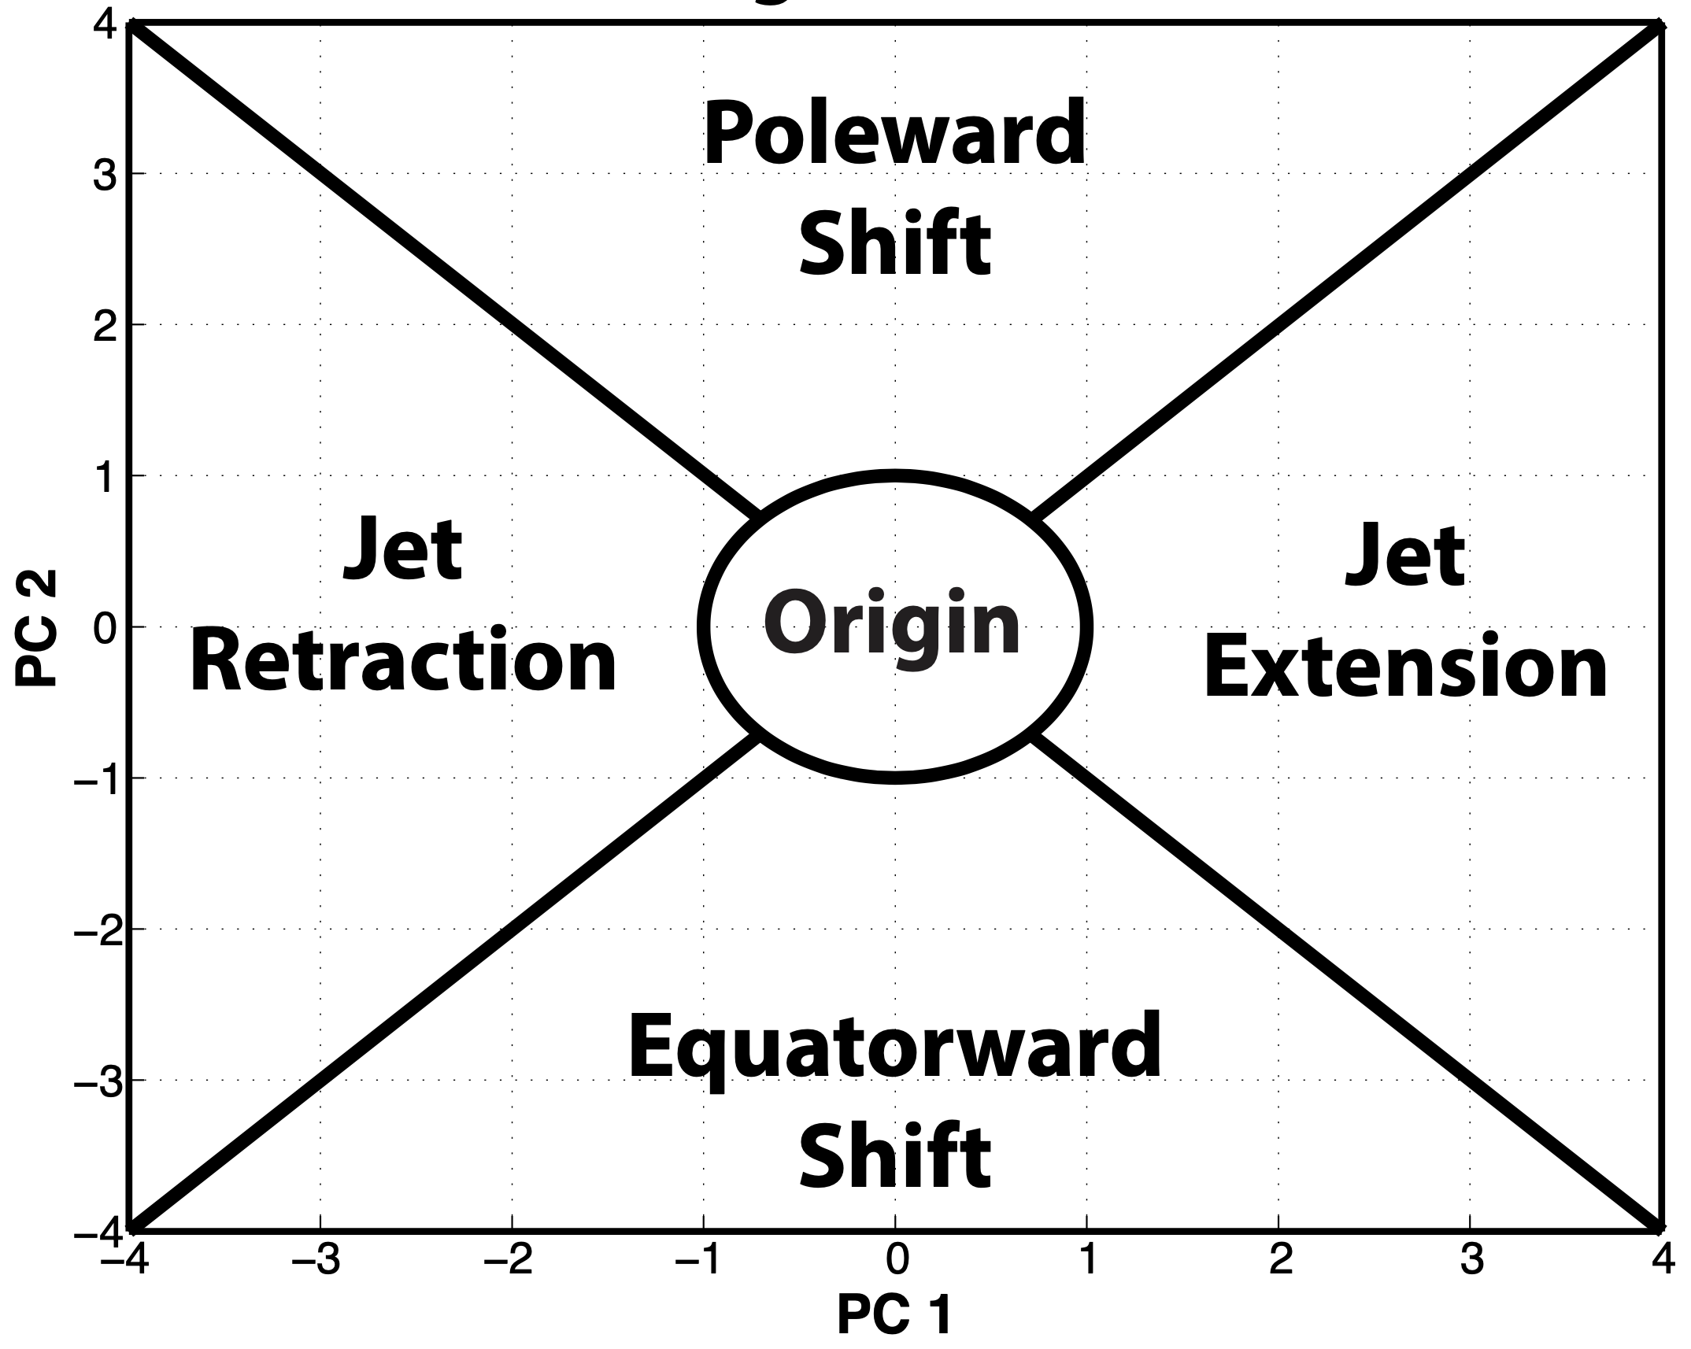

Elevated Land Surface Heat Anomalies as Sources of U.S. Summer Hydroclimate Predictability:
E3SMv2 Low-Level Jet and Precursor Event Sensitivities
Ryan D. Torn, Qi Tang, Andrew Winters
Objectives
Identify and diagnose systematic E3SMv2 time-mean model biases in land states, teleconnections
Quantify and spatially demarcate E3SMv2 ENSO and PDO-related December–March land surface anomalies in CONUS
Understand how elevated surface heating anomalies modulate E3SMv2’s representation of the western Asia–North America teleconnection.
Evaluate E3SMv2 S2S forecast skill and how elevated anomalies impact forecasts
Integrate supporting tools into E3SM Diagnostic Tools
Digital Version of the Poster:

