Slide 1
CMDV-CM⁴ Overview
- Who we are
- What we are trying to do
- Summary of observational techniques
- Summary of parameterization development

Slide 2
CMDV-CM⁴ Collaborators
David Romps Lead PI LBNL
Andrew Vogelmann Co-PI BNL
Christopher Bretherton Co-PI U Washington
Charles Jackson Co-PI UT Austin
Michael Jensen Co-I BNL
Pavlos Kollias Co-I BNL
Rusen Oktem Co-I LBNL

Slide 3
What we are trying to do
CM4 will use new ARM observations of shallow clouds and the lower-tropospheric state to evaluate the current CLUBB representation of shallow clouds in ACME, develop a shallow-cloud scheme for the SPM, and tune and validate those shallow-cloud schemes in single-column-model (SCM) simulations.
Obs
Param
ACME

Slide 4
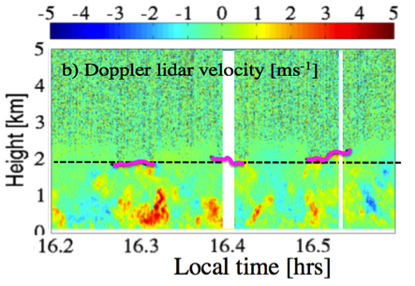
Obs
Subcloud turbulence structure from Doppler lidar (BNL)

Slide 5
Obs
Thermodynamic structure and stability from AERI/MWR and Raman lidar (BNL)
Cloud-base mass flux from KAZR Doppler (BNL)
In-cloud w and TKE from KAZR (BNL)
Liquid water from KAZR and MWR (BNL)

Slide 6
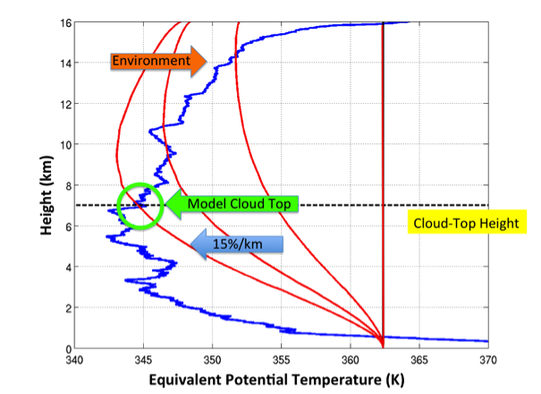
Obs
Bulk convective entrainment rate (BNL)

Slide 7
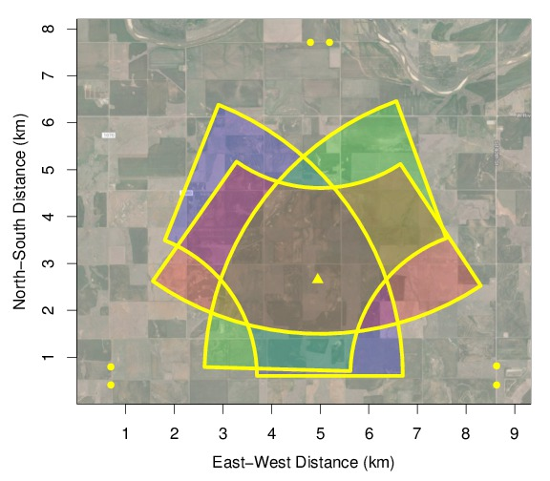
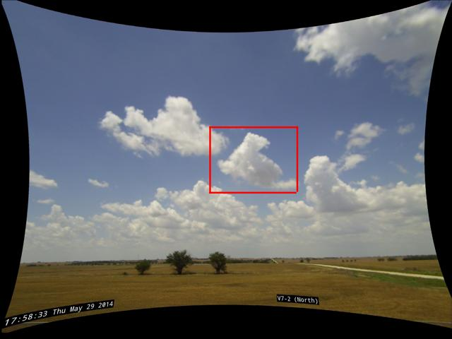
Obs
Gridded binary cloud field from stereo cameras (LBNL)

Slide 8
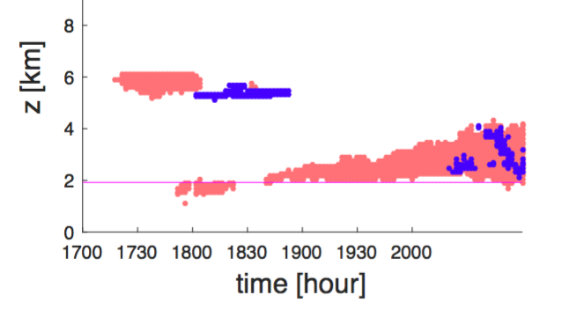
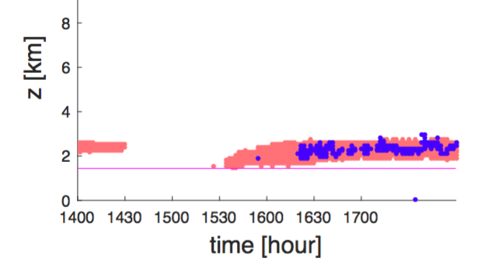
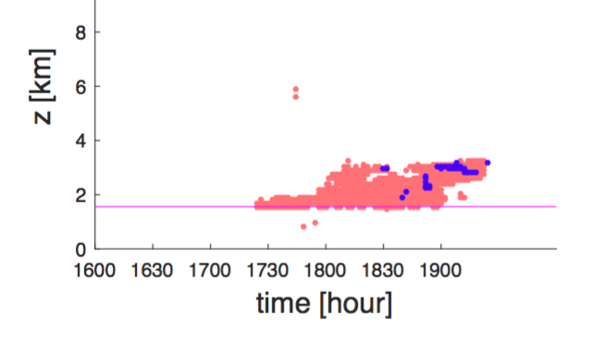
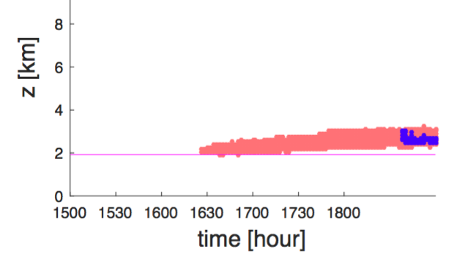
Detection of shallow clouds by stereo cameras and lidar

Slide 9
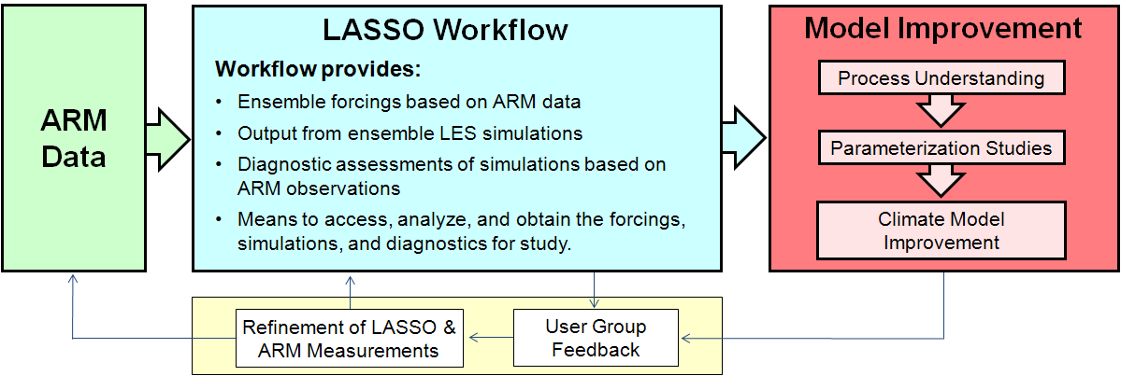
“Obs”
CM4 LES, borrowing LASSO methodologies, at ~25-m and ~5-min resolutions (BNL)

Slide 10
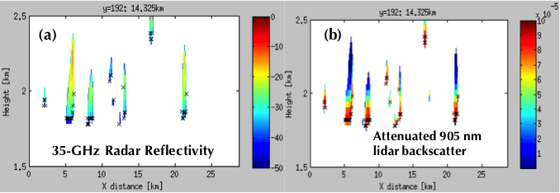
“Obs”
CRM cloud-radar simulator; CR-SIM (BNL)

Slide 11
Param
Stochastic Parcel Model (SPM) convective parameterization (LBNL)

Slide 13
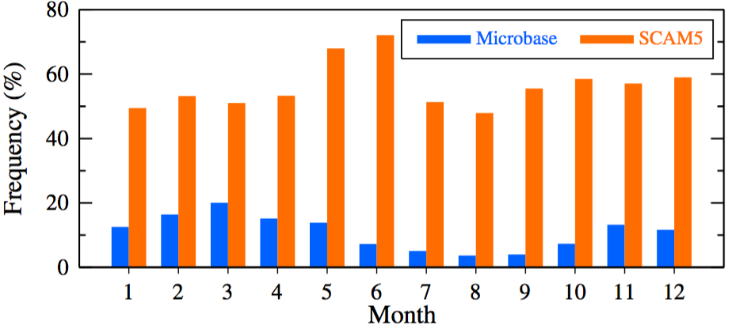
Param
Framework for evaluating ACME shallow convection against RACORO (U Washington)

Slide 14
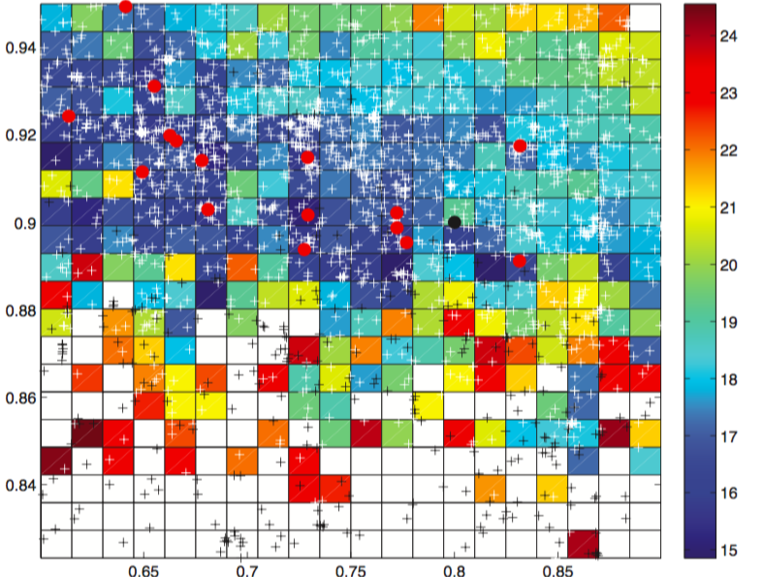
Param
UQ infrastructure for ACME in single-column mode (UT Austin)
|Model – Obs|
Critical RH for low clouds
Critical RH for high clouds

Slide 15
What we could use
Updated ACME SCM code
Any upgrades to CLUBB from other projects
Help with tuning and evaluation in global ACME simulations
Help investigating of process-coupling errors

Slide 16
CMDV-CM⁴ Collaborators
David Romps Lead PI LBNL
Andrew Vogelmann Co-PI BNL
Christopher Bretherton Co-PI U Washington
Charles Jackson Co-PI UT Austin
Michael Jensen Co-I BNL
Pavlos Kollias Co-I BNL
Rusen Oktem Co-I LBNL

