Slide 1
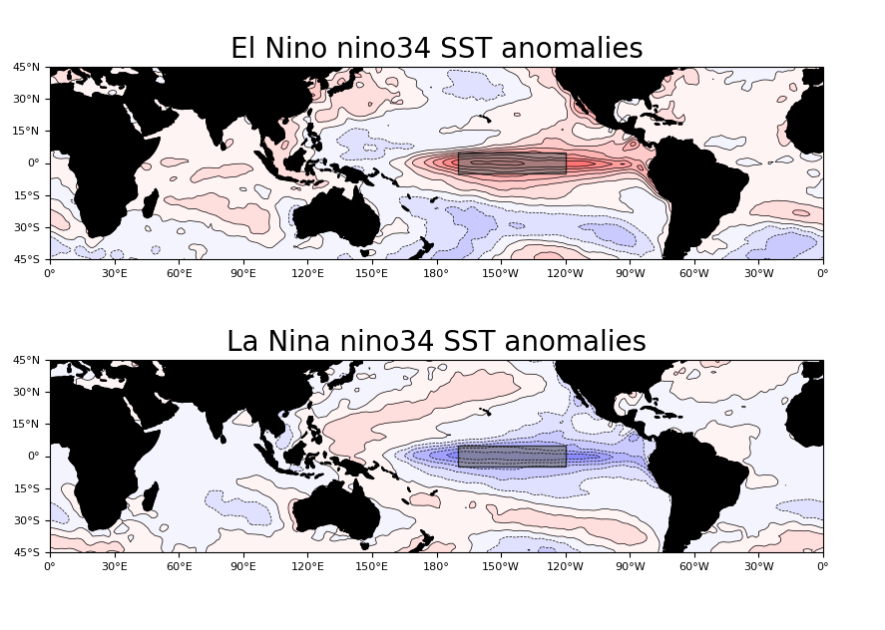
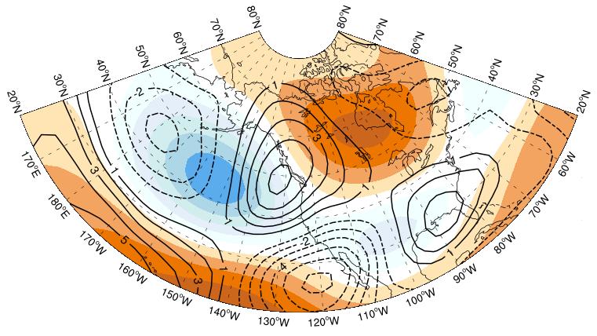
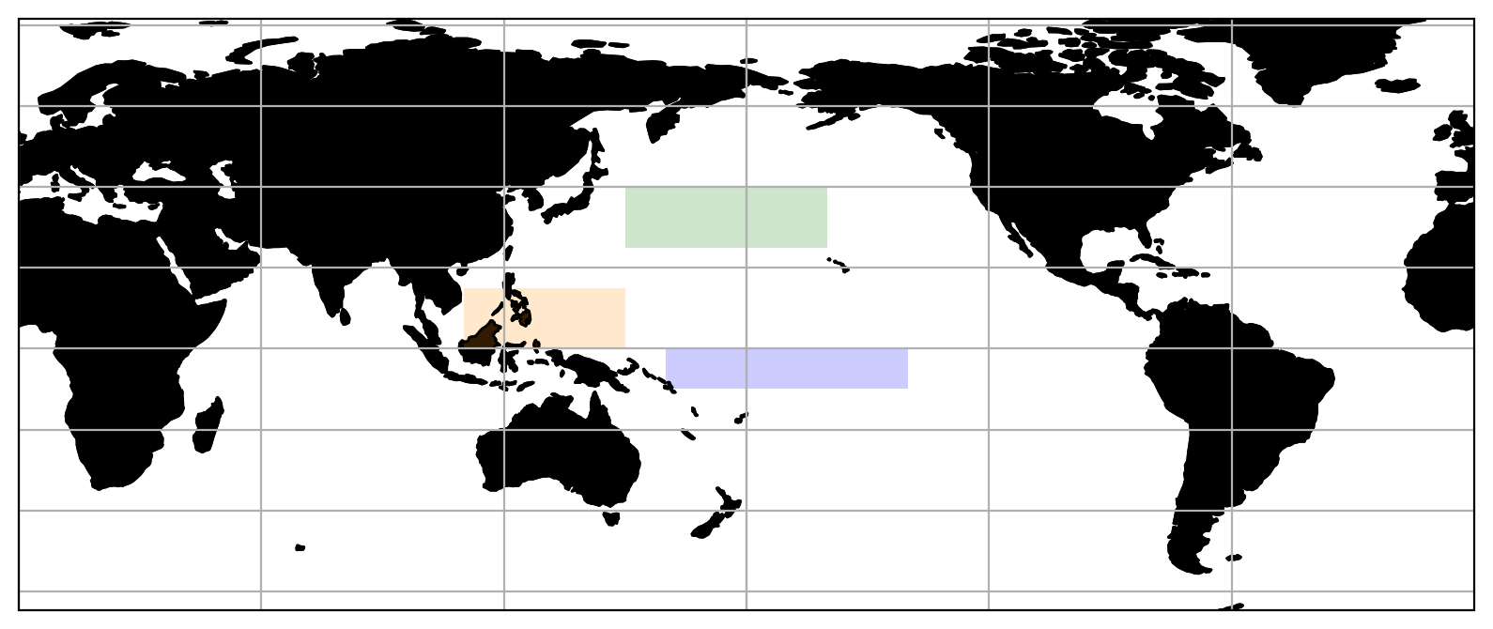
Connecting Variability in the Tropical ENSO Column Response and the Remote Pacific Response in E3SM and CESM Large Ensembles. Rich Neale (NCAR) and H Annamalai (U. Hawaii)
ERA5
200 hPa, composite El Nino, DJF
Geopotential Height (shaded)
Meridional Wind (contours)
Convergence Min
What are the tropical diabatic processes that determine the divergence source terms in the Rossby Wave Source response during ENSO?
West Pacific – Nino Dry
Central Pacific – Nino Wet

Slide 2
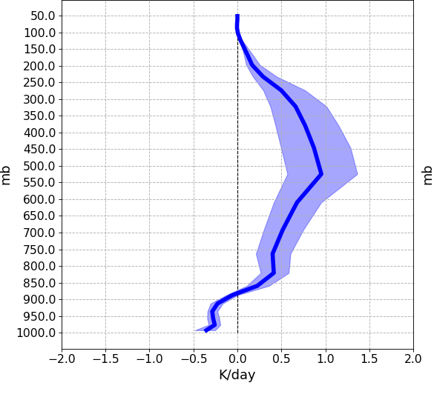
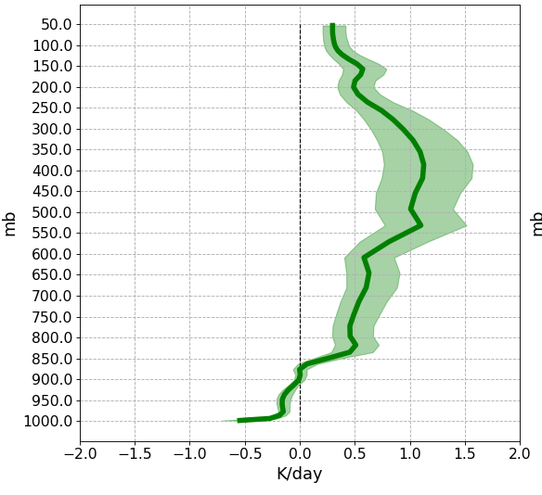
Connecting Variability in the Tropical ENSO Column Response and the Remote Pacific Response in E3SM and CESM Large Ensembles. Rich Neale (NCAR) and H Annamalai (U. Hawaii)
Reanalysis uncertainty
As large as model internal variability
Mean convection depth
Mean heating maximum
Model response varies by
  50% divergence
  100% heating
Divergence (s⁻¹)
Central Pacific – Nino Wet
20 ensemble members
1979-2005
Composite El Nino
400mb
525mb
Convective
Heating (K/day)
Annamalai, H., R. B. Neale, J. Hafner, 2023: ENSO-induced teleconnection: process-oriented diagnostics to assess Rossby wave sources and ambient flow properties in climate models, J. Climate, 36, 3015–3041 https://doi.org/10.1175/JCLI-D-22-0346.1

