Slide 1
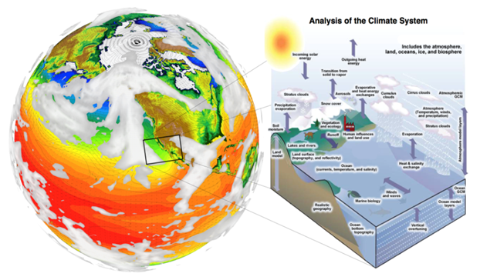
Regional and Global Climate Modeling Program and
Potential Interactions with the ACME Community
June 5, 2017

Slide 2
RGCM program - Overview
FY 10 | FY 11 | FY 12 | FY 13 | FY 14 | FY 15 | FY 16 | FY 17 | FY 18
28M | 31M | 28M | 29M | 28M | 26M | 30M | 30M | 12M
Goal is to enhance a predictive and process- and system-level understanding of the modes of variability and change within the Earth system by advancing capabilities to design, evaluate, diagnose, and analyze global and regional Earth system models informed by observations.
Developing frameworks using a hierarchy of models ranging complex very high resolution to less complex system models or idealized configurations of complex models, and reduced complexity models for
  Hypothesis testing addressing scientific questions.
  Holistic uncertainty characterization
Systematic comparison with observations, quantifiable metrics and novel diagnostics enables 1) advancing understanding of the Earth system; 2) improving models; and 3) reducing uncertainties that exist in current Earth system models.

Slide 3
RGCM Overview
Analysis to enhance
understanding of predictability at regional and global scales
SFAs, CAs, and University Projects contribute to these
Modes of Variability& Change
Cloud Processes
High Latitude Feedbacks
Water Cycle
Extremes
Analysis of BGC feedbacks
Cross-cutting Foundational and
Enabling Capabilities
Foundational Capabilities

Slide 4
The portfolio as it relates to…..
CVC and Cloud Processes
CESD Priorities
5 Research Challenges
Drivers and Responses
High Latitude
Integrated Water Cycle
Biogeochemistry
Data-Model Integration
High Latitude Feedbacks
Water Cycle
Extremes
Analysis of BGC feedbacks

Slide 5

The portfolio as it relates to…..
CVC and Cloud Processes
4 Research Challenges
Decadal variability and predictability
Polar climate changes
Climate extremes
Climate and marine carbon/biogeochemistry
High Latitude Feedbacks
Water Cycle
Extremes
Analysis of BGC feedbacks

Slide 6

The portfolio as it relates to…..
CVC and Cloud Processes
Research Challenges
Clouds, Circulation and Climate Sensitivity
Sea-level Rise and Regional Impacts
Cryosphere in a Changing Climate
Changes in Water Availability
Science Underpinning the Prediction and Attribution of Extreme Events
Regional Climate Information
High Latitude Feedbacks
Water Cycle
Extremes
Analysis of BGC feedbacks

Slide 7
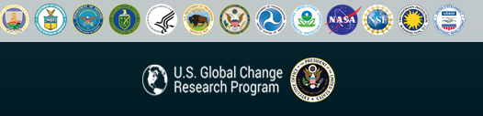
The portfolio as it relates to…..
CVC and Cloud Processes
Prediction (FY15 Priority)
Integrated Research on Coupled Earth
and Human Systems (FY14)
Extremes Thresholds and Tipping Points (FY14)
Drought (FY15)
Arctic Research (FY15)
High Latitude Feedbacks
Water Cycle
Extremes
Analysis of BGC feedbacks

Slide 8
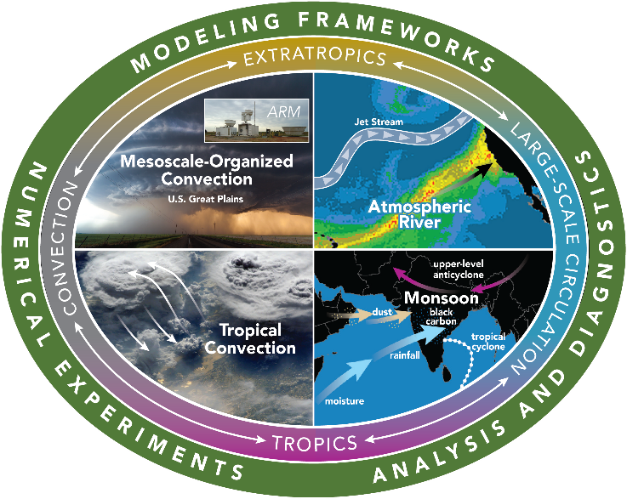
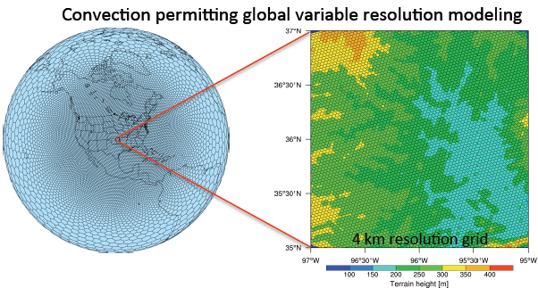
Water Cycle Theme:
(WACCEM) SFA (PI: LR Leung)
Water Cycle: To advance predictive understanding of multiscale water cycle processes and hydrologic extremes and their response to perturbations
Apply WACCEM developed metrics for monsoon, atmospheric rivers, and MCS to ACME water cycle experiments at low and high resolution for evaluation and comparison with MPAS and CMIP5 models
Use ACME model for hypothesis testing
  Test hypothesis of how changes in dust concentrations during warm and cool phases of ENSO modulate monsoon onset and strength
Collaborations: PNNL (Leung), NCAR (Skamarock), ORNL (Evans), UMD (Lau), UW (Houze)

Slide 9
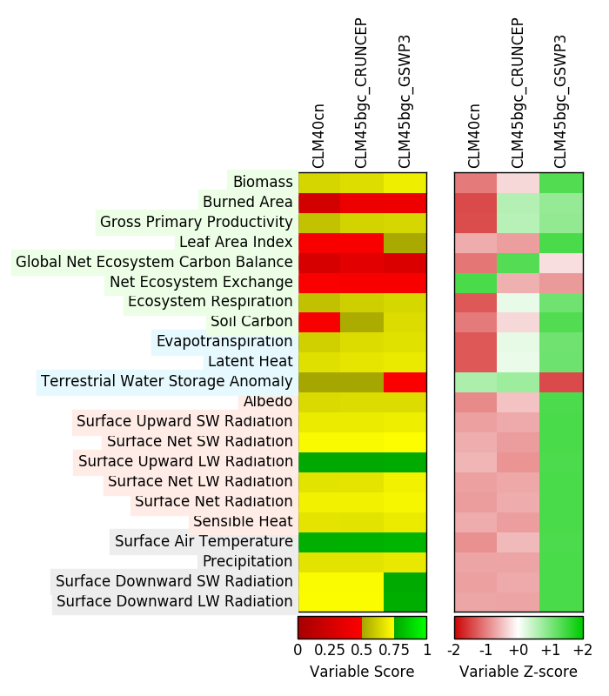







BGC Processes & Feedbacks: BGC SFA
(Forrest Hoffman, Bill Riley, Jim Randerson)
The ILAMB Benchmarking System (v2) Release
BGC Processes and Feedbacks: To identify and quantify feedbacks between biogeochemical cycles and the climate system and to quantify and reduce the uncertainties in ESMs associated with these feedback processes.
Approach:
Software framework written in python that compares model outputs to benchmark observational datasets in parallel on leadership-class supercomputers.
Provides the community a means to comprehensively and routinely assess land model fidelity through comparison of 24 variables with 60 observational datasets.
Results/Impacts:
Framework provides an abstraction that allows groups to develop plugins to extend its functionality.
New datasets and comparisons are easily added, encouraging routine use by modeling centers across the globe.
Package is currently used by ACME and CESM to evaluate new model developments.
Collier, N. et al. (2016), The ILAMB Benchmarking System, doi:10.18139/ILAMB.v002.00/1251621.
BGC Feedbacks
Notes:
.

Slide 10
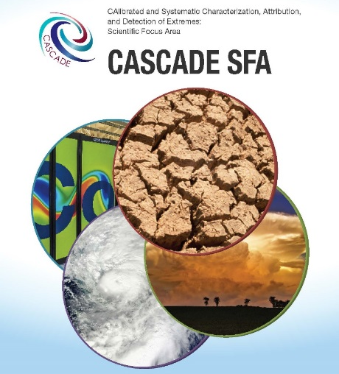
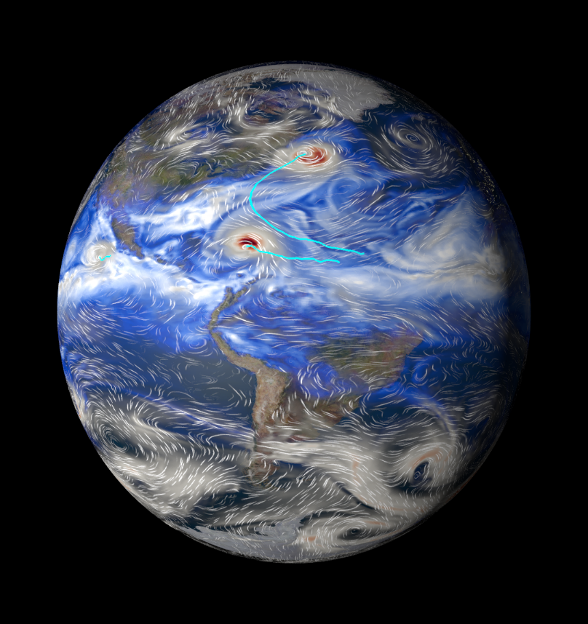
Extremes: CASCADE SFA
LRM: Bill Collins, TCM: Travis O’Brien
Extreme Events: develops predictive understanding of extreme weather events, especially droughts and floods, with a focus on understanding the physical mechanisms that drive variability and long-term changes in extremes
Tests of extremes simulated by ACME using ILIAD
Incorporation of ACME into C20C+ multi-model ensemble of extreme hindcasts
Incorporation of TECA and climextRemes as integral parts of the ACME diagnostics
Contributions with ACME to DAMIP and ARTMIP (TBD)?

Slide 11

High Latitude Processes and Feedbacks: HiLAT-RASM [POCs: Wilbert Weijer, Phil Rasch, Wieslaw Maslowski)
High Latitude Processes and Feedbacks: To better understand the processes driving rapid change at high latitudes and the interactions with the lower latitudes
Science
Roles of regional processes and feedbacks on the high-latitude Earth System (variability and trends)
Coupling between Low and High Latitudes
How do interactions between Land-Ice, Ocean, and Atm affect SLR?
How does high latitude environment change affect BGC interactions in the Earth System?
Tools:
Satellite emulator for ICESAT 2

Slide 12
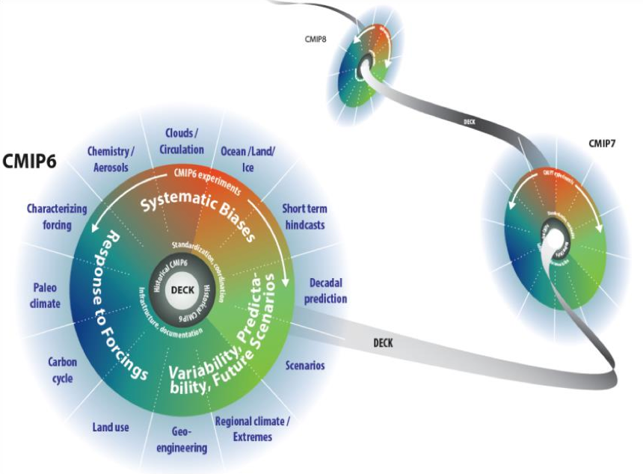
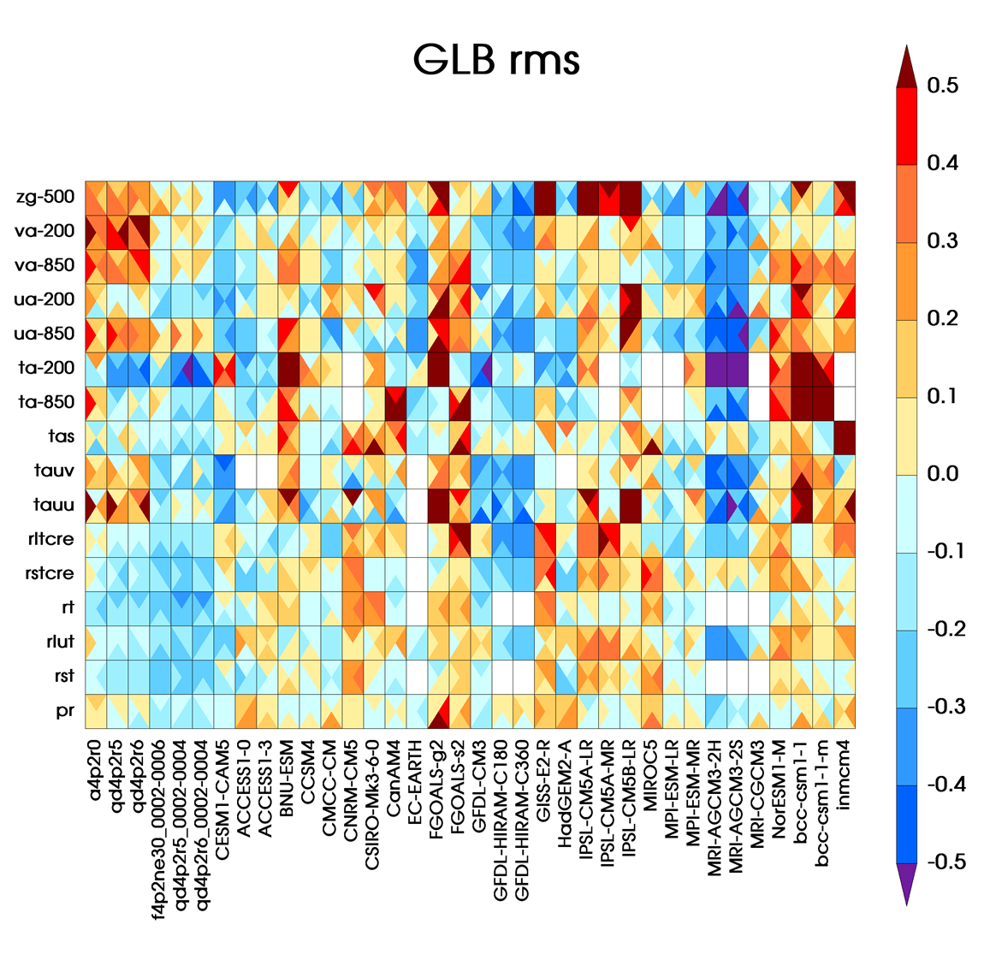
Modes of Variability and Change : PCMDI & UCAR CA (POC: Dave Bader, Karl Taylor)
Modes of Variability and Change in the Earth system: To provide insight into the interplay between internally generated natural variability and externally forced response for improved understanding of near-term decadal predictability and predictions in the context of longer term projections of anthropogenic
climate change
Current use
  ACME is using the PMP to produce climatological summary statistics that are directly compared with results from all models contributed to CMIP5
Near term enhanced collaborations
  A diverse suite of new metrics being incorporated into the PMP in 2017 will enable ACME to gauge: inter-annual modes of variability, sector-scale sea ice, monsoon precipitation, cloud properties and the diurnal cycle of precipitation
Via the PMP, objective comparisons with other leading CMIP models identifies strengths and weaknesses that can be useful for prioritizing ACME model development
Figure developed by CMIP Panel and WGCM

Slide 13
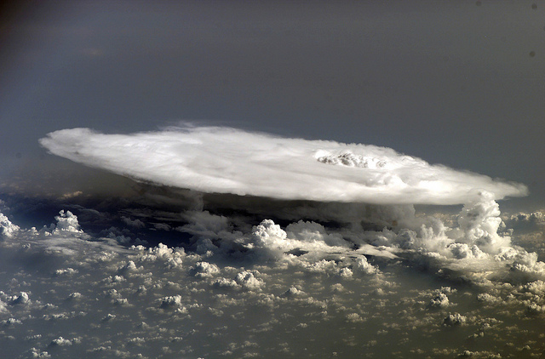
Cloud Processes and Feedbacks- LLNL SFA & UCAR CA
POCs (Dave Bader, Steve Klein)
Clouds Processes and Feedbacks: To improve simulation accuracy through better cloud representations in models and determine the real-world cloud feedbacks in the Earth System
Current Interactions
Cloud-Associated Parameterizations Testbed
  ACME is already using hindcasts for model development (for high-resolution)
COSP (Satellite Simulators for Cloud Evaluation)
  ACME already uses COSP for model evaluation
Potential Future Interactions
Coupled CAPT- once developed can use it for help identify biases in ACME
Analysis of Cloud feedbacks with short atmosphere-only simulations for ACME

Slide 14
RGCM-ACME interactions
What can RGCM do for ACME?
Develop and provide tools that could help in model development
  Metrics
  Diagnostics Tools
Analyze, evaluate, diagnose ACME and other ESMs (Coupled or components of ESMs)
What can ACME provide RGCM?
A high resolution ESM that is credible and one incorporates important and unique processes relevant for addressing interesting science questions
Interact with RGCM in addressing science questions
Facilitate development of metrics for the newly developed components
Feedback on the metrics and diagnostic tools developed by RGCM scientists

Slide 15

Regional and Global Climate Modeling
Six Science Themes align with CESD Strategic Plan, CLIVAR, USGCRP, WCRP priorities:
Water Cycle and Climate Extremes
Cloud Processes and Feedbacks
BGC Processes Feedbacks
High Latitude Processes and Feedbacks
Modes of Variability and Change
Extremes
Tools include:
Advanced (multivariate) model metrics
  (ILAMB, PMP)
Observation-based diagnostics
  (COSP, ICESAT-2 simulators)
Techniques:
  CAPT, ILIAD
Overview:
1) Established five SFA’s addressing the six science themes
2) Approximately 10-15 Nature/Science publications /year
3) Metrics activities gaining prominence for CMIP6 (e.g., International LAnd Model Benchmarking -ILAMB; PCMDI Metrics Package -PMP)
4) Continued leadership contributions to CMIP, CLIVAR, WCRP activities

Slide 16
RGCM has six science themes
Water Cycle: To advance predictive understanding of multiscale water cycle processes and hydrologic extremes and their response to perturbations
Clouds Processes and Feedbacks: To improve simulation accuracy through better cloud representations in models and determine the real-world cloud feedbacks in the Earth System
BGC Processes and Feedbacks: To identify and quantify feedbacks between biogeochemical cycles and the climate system and to quantify and reduce the uncertainties in ESMs associated with these feedback processes.
High Latitude Processes and Feedbacks: To better understand the processes driving rapid climate change at high latitudes and the interactions with the lower latitudes
Modes of Variability and Change in the Earth system: To provide insight into the interplay between internally generated natural variability and externally forced response for improved understanding of near-term decadal predictability and predictions in the context of longer term projections of anthropogenic climate change
Extreme Events: develops predictive understanding of extreme weather events, especially droughts and floods, with a focus on understanding the physical mechanisms that drive variability and long-term changes in extremes

