Slide 1
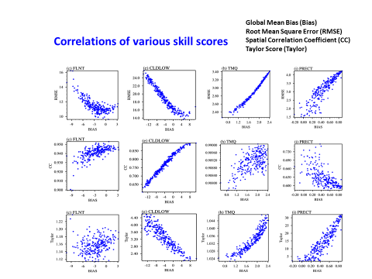
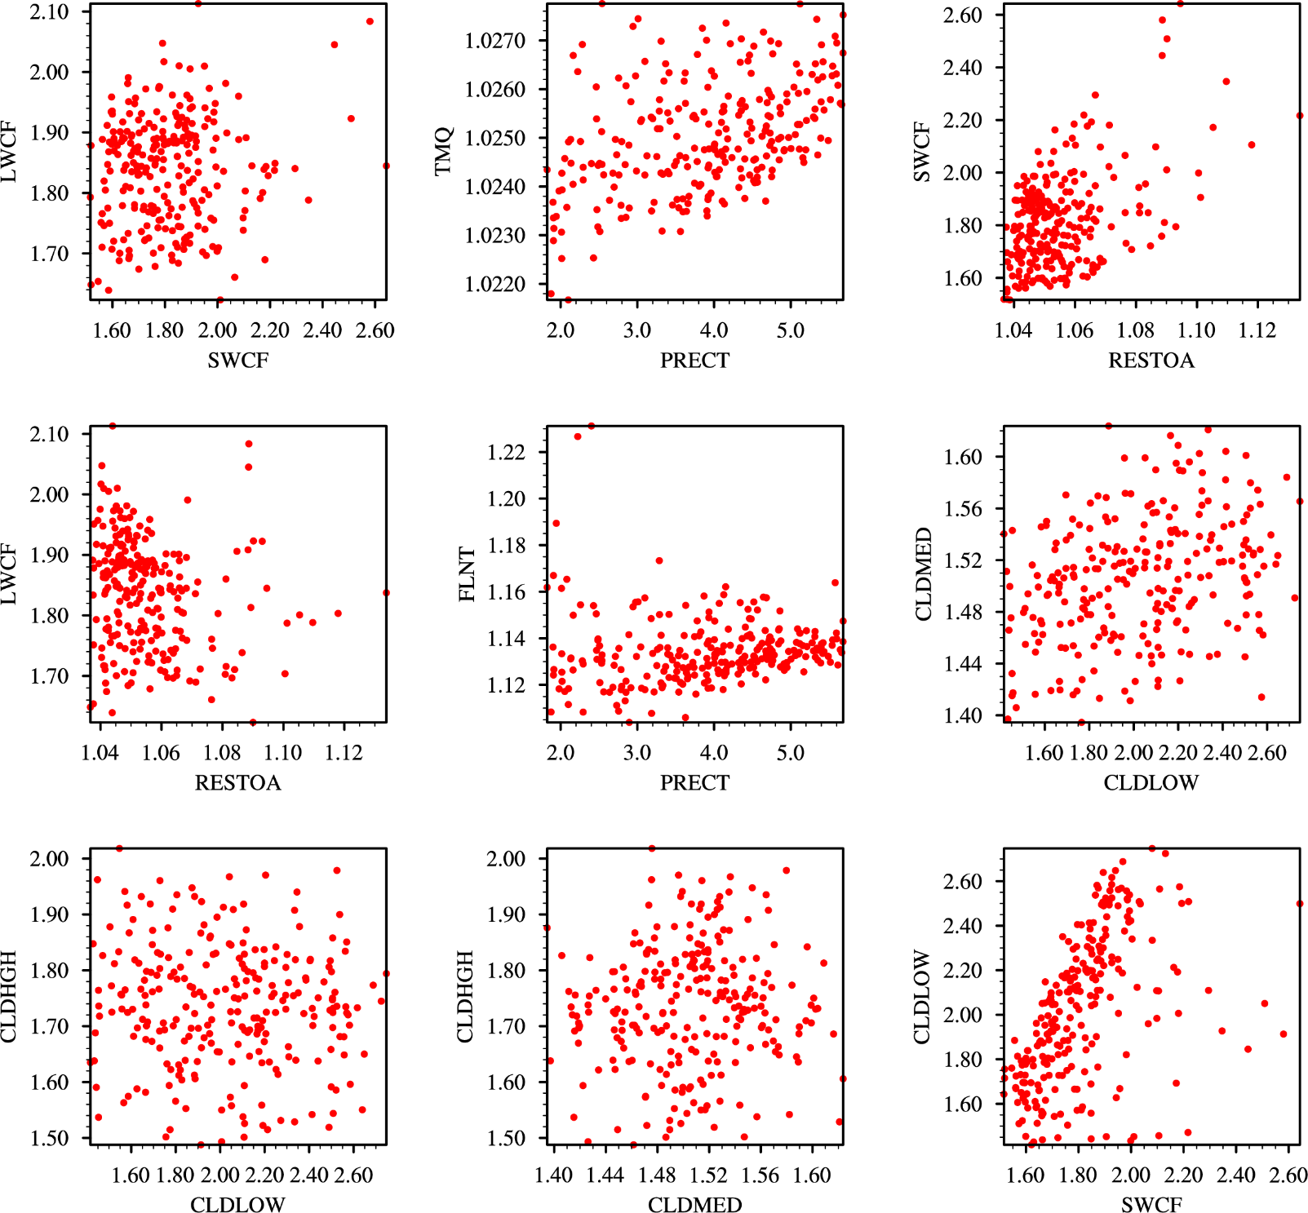
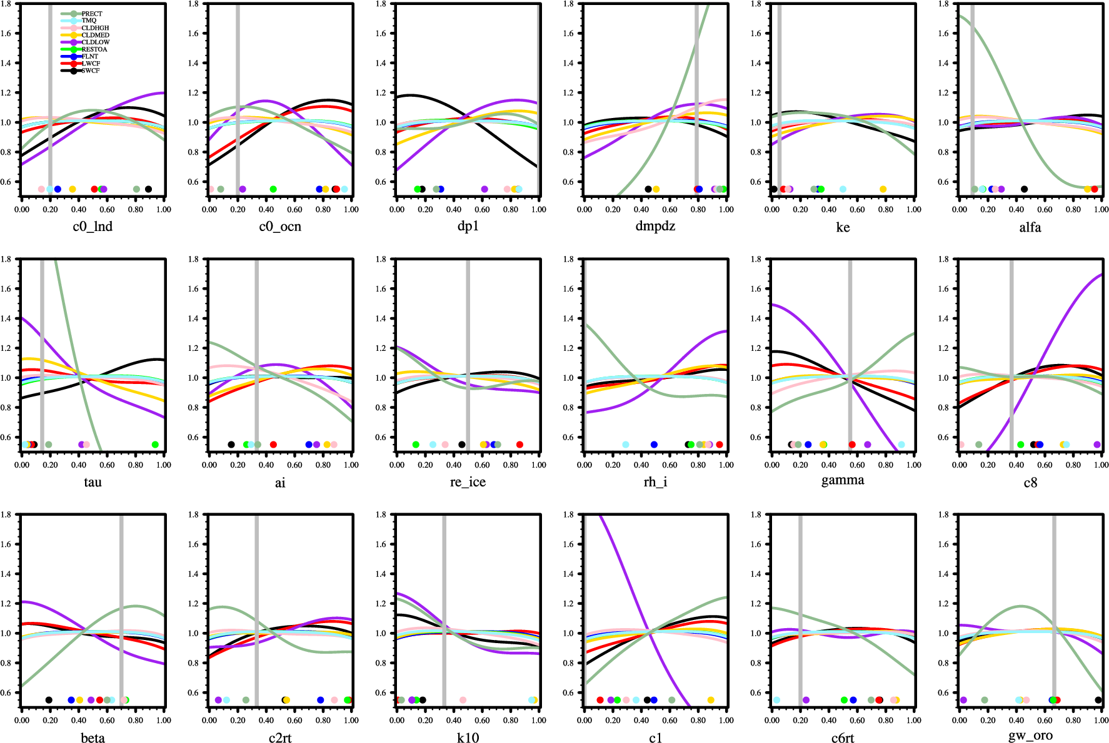
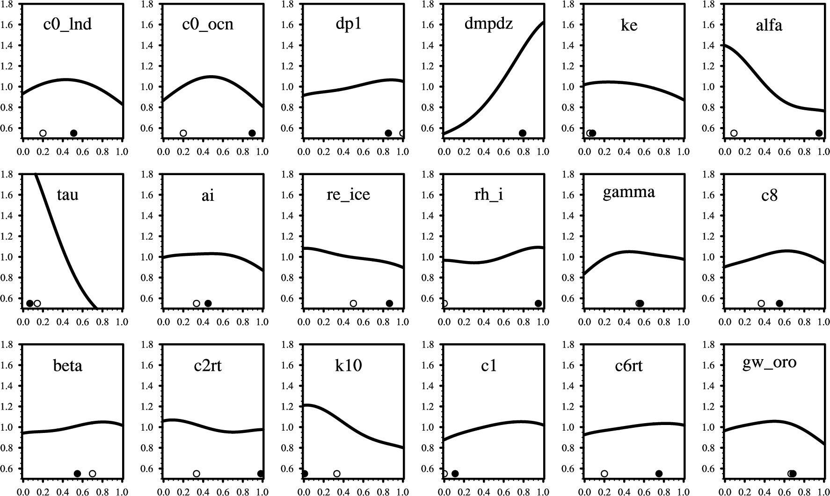
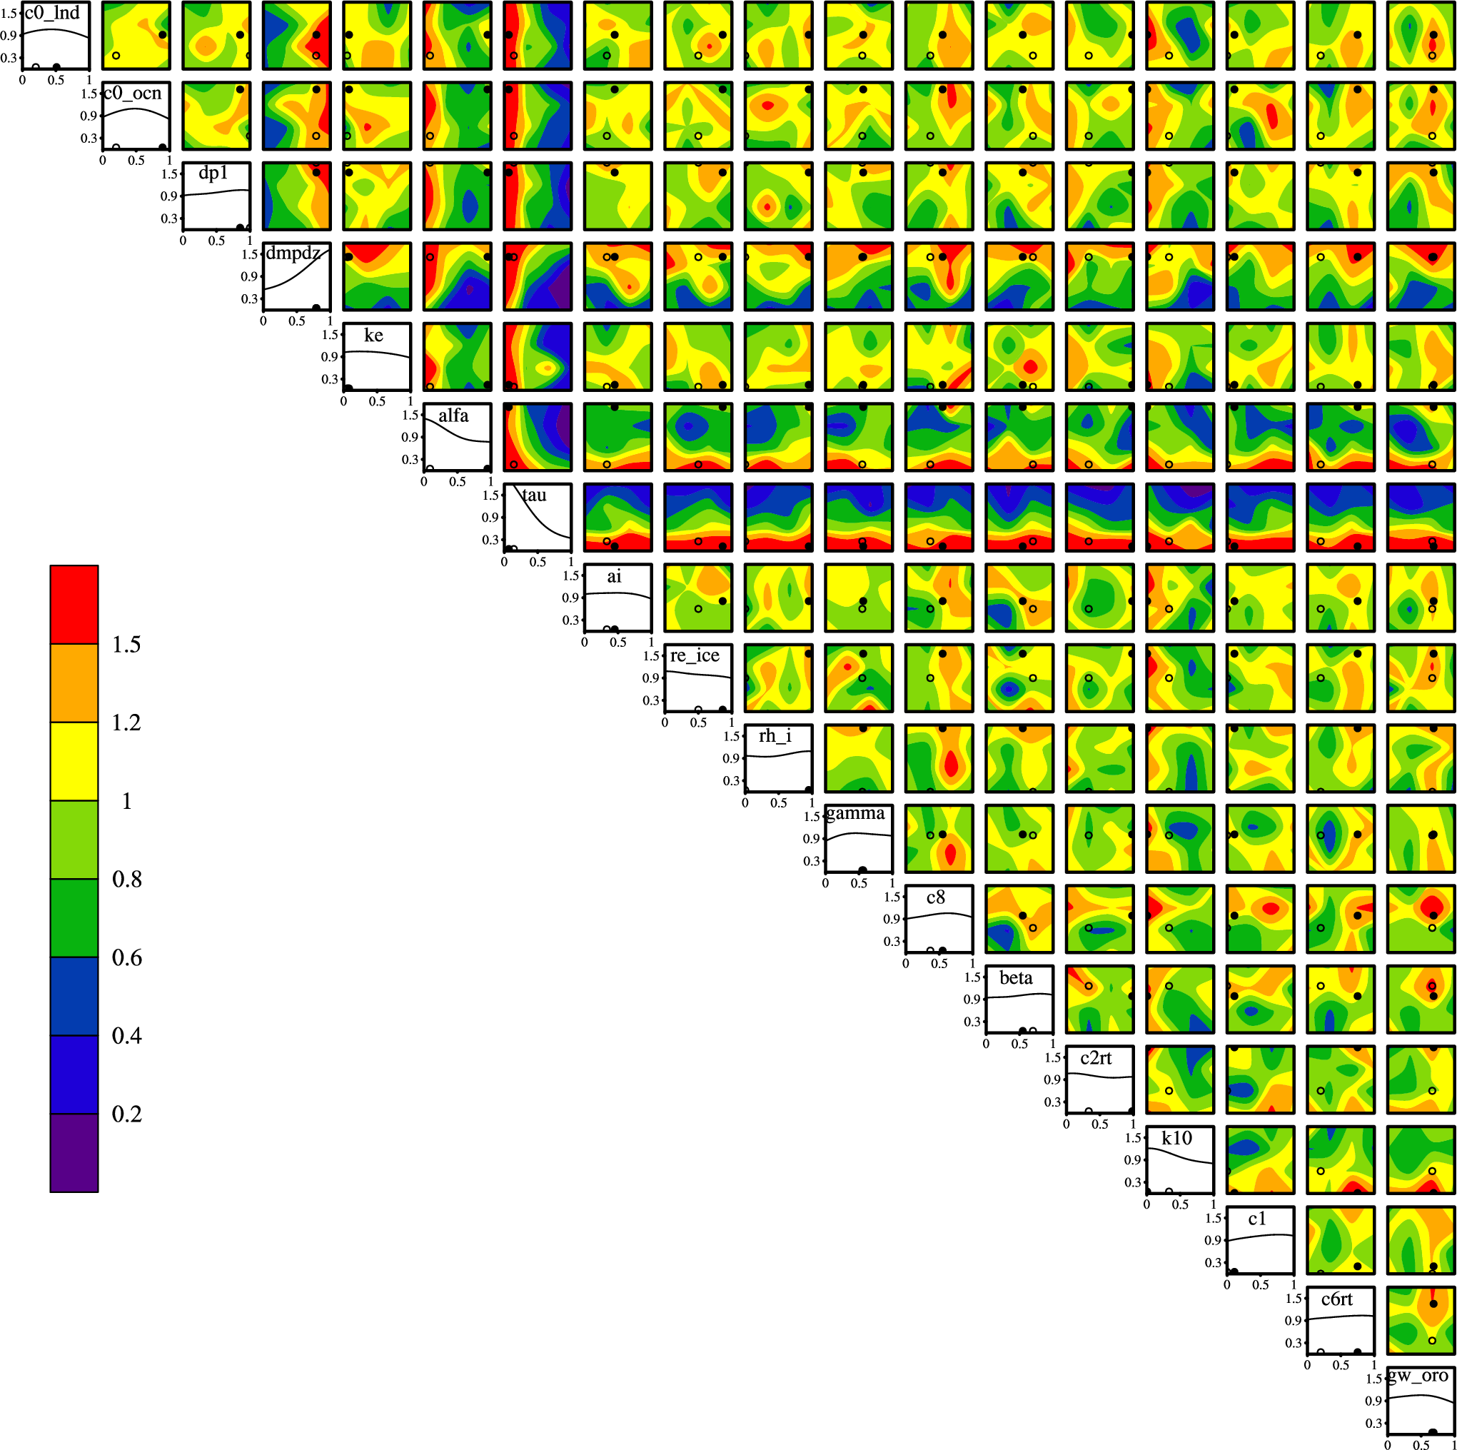
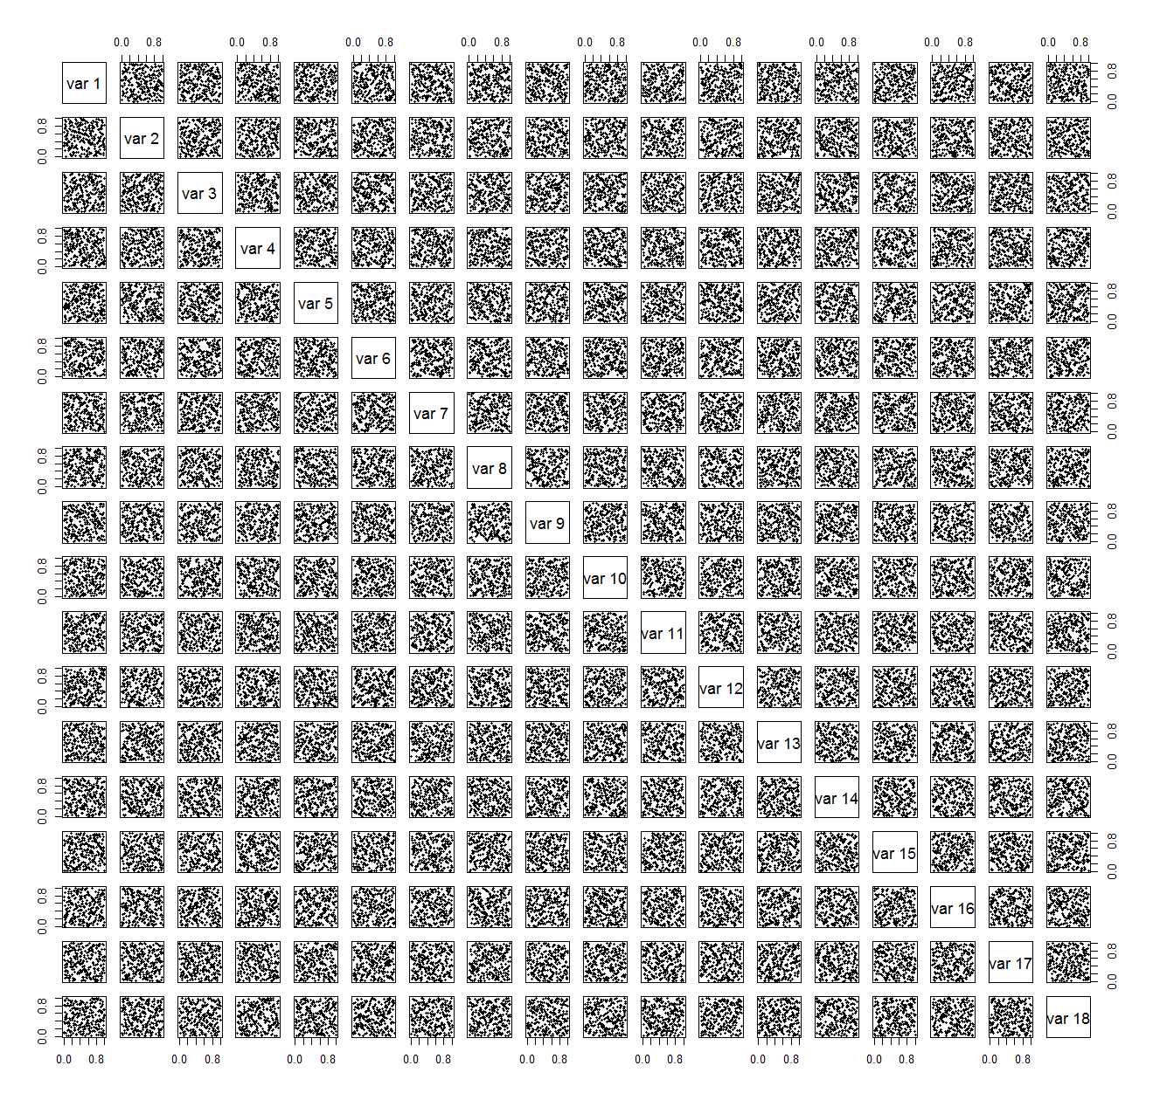
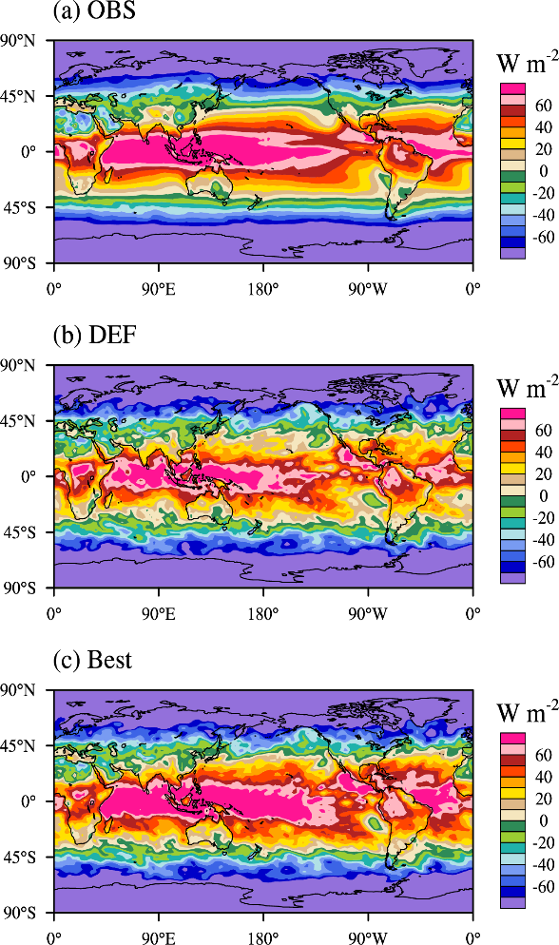
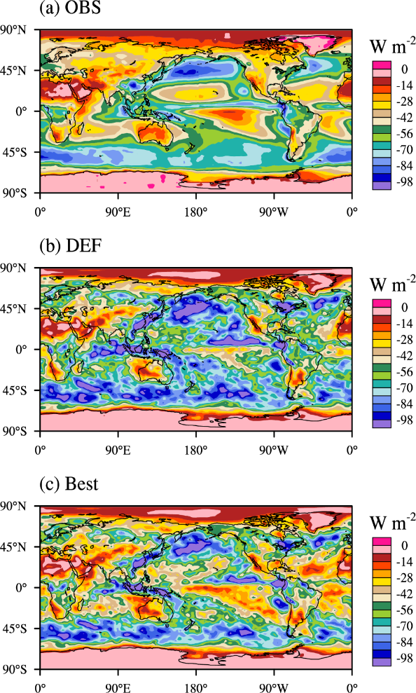
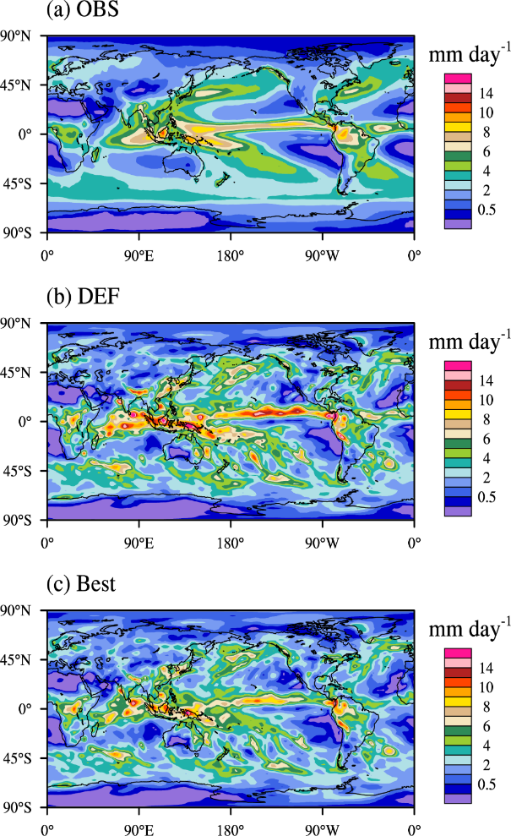

Parametric sensitivity and tuning in ACME-V1 atmosphere model
based on short Perturbed Parameters Ensemble (PPE) simulations:
Method, application and limitations
Yun Qian, Hui Wan, Phil Rasch, Shaocheng Xie, Wuyin Lin, Kai Zhang, Po-Lun Ma, Balwinder Singh, Rich Neale, Vince Larson, Chris Golaz, and Hailong Wang
Motivation
Results
1. Difficulties in one-at-a-time model tuning, e.g. the tuning of one parameter leading to an offset of the accomplishment from the tuning of another parameter; the improvement in one target variable leading to degradation of model fidelity in another target variable.
2. Computational resource bottleneck in high-resolution and/or long-term PPE simulations.
3. Poor understanding of ACME-v1 model behaviors and physics associated with model parameters and their interactions.
PDFs of low and high cloud fraction for global, land and ocean mean
Correlations of various skill scores (Taylor Score)
Correlations of skill scores between different variables
Low Cloud Fraction
High Cloud Fraction
Approach
18 perturbed parameters.
256 sampling points from the parameter space.
Latin Hypercube sampling method.
12 ensemble members corresponding to 12 months for each sampling point.
5-day long simulation and day-3 results analyzed.
Finished two 256x12 ensemble simulations at a rather modest cost and within 5 days of wall clock time.
18 perturbed parameters in ACME-V1-ne30L72 PPE simulations
Maximum likelihood of model parameter space for 9 objective variables based on Taylor Score
Posterior PDF for 9 individual objectives
1d Posterior PDF for overall 9-objective
2d Posterior PDF for overall 9-objetcive
Latin Hypercube Sampling of the 18D parameter space. 256 sampling points are shown in the figure
Default value
Optimal value
Parametric sensitivity across different time scales and horizontal resolutions
Observation, default and best simulations
Changing parameter One-at-a-time (OAT) experiment (high - Low)
5-year (long) vs 3-day (short)
RESTOM
SWCF
Precipitation
Impact
Identifying the most influential parameters, quantifying the model response to those parameters, and estimating the maximum likelihood of model parameter space for a number of important fidelity metrics.
Providing a more complete picture of the ACME-V1 atmosphere model behavior and information on the tuning potential of different parameters, thus helping guide the tuning activities.
Improving our understanding of model physics associated with model parameters and their interactions.
Parametric sensitivity of precipitation in ne30 (left) vs. ne120 (right)
5-year simulations (TAU_high – TAU_low)
For additional information, contact:
Yun Qian
Pacific Northwest National Laboratory
509 372-6404
yun.qian@pnnl.gov

