Slide 1
Changes in crop production and irrigation management with groundwater restrictions in the U.S. West
Femeena Pandara Valappil, Ph.D., P.E.
Assistant Research Professor
Earth and Environmental Systems Institute
Penn State University
Contributing authors: Danielle Grogan, Kathryn Daenzer, Steve Frolking, Kate Calvin, Jeff Nucciarone, Karen Fisher-Vanden, Richard B. Lammers
Notes:
Hello everyone, I am going to present the work we did as part of the PCHES project, looking at changes in crop production with groundwater restrictions in the U.S west and how the farming industry would adopt different irrigation management strategies to cope with such water shortage.

Slide 2
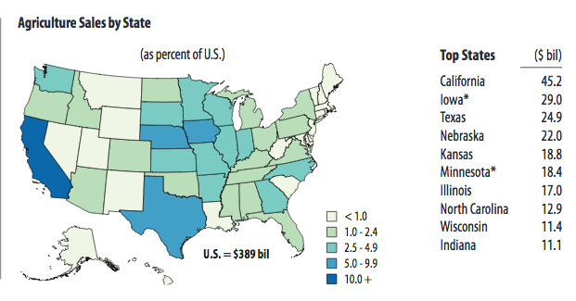
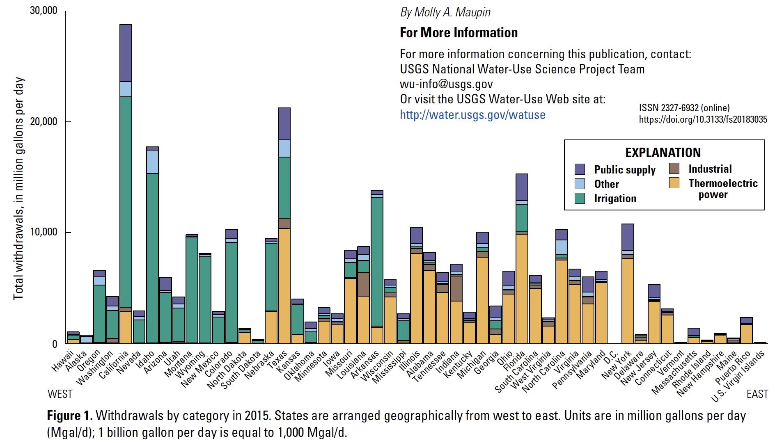
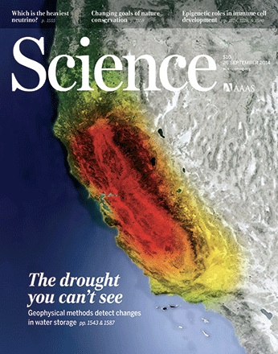
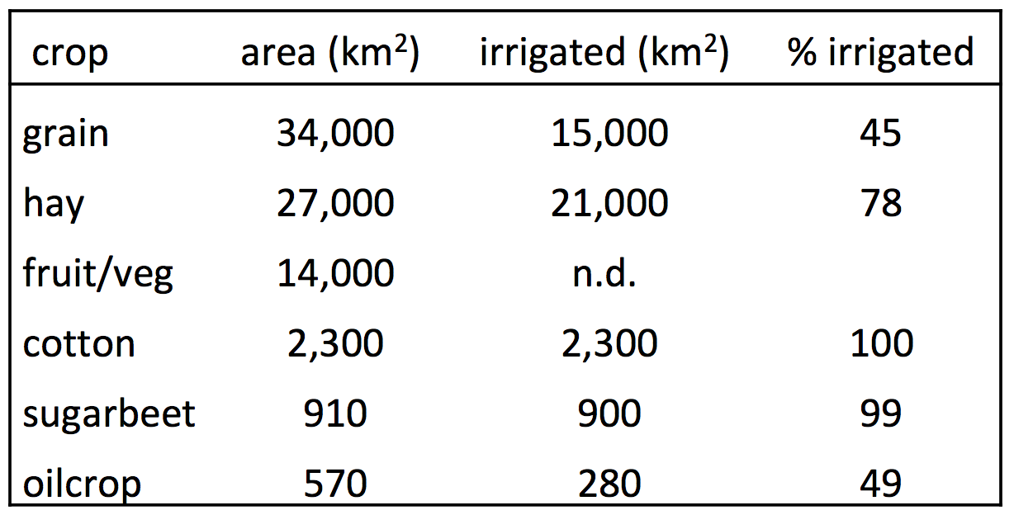
The US west account for a major portion of the nation’s irrigation water withdrawals
USDA NASS 2012 Ag. Census
Water withdrawals in 2015
USGS Fact Sheet 2018-3035
*
*
*
*
*
Irrigation: 67% consumptive
*
*
*
*
*
*
Groundwater: an important but declining resource
NEW California Groundwater Regulation: CA Sustainable Groundwater Management Act:
as of 2020, most basins in CA must “manage and use groundwater without causing undesirable results”, which includes groundwater-storage reductions.
(ca.water.usgs.gov/sustainable-groundwater-management)
Crop area & % irrigated
Notes:
The motivation for the study comes from the fact that the U.S west, as we all know, accounts for a large share of the nation’s irrigation water withdrawals. Efforts are being made to restrict the use of unsustainable groundwater, one example being the Sustainable Groundwater Management Act passed by California.

Slide 3
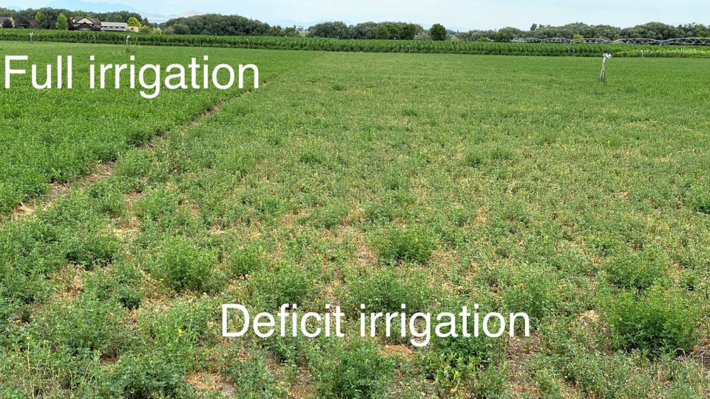
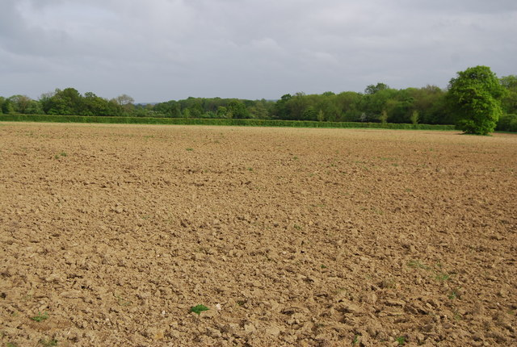
Motivating Questions
How will crop production in the US West change under water scarce conditions?
What kind of adaptation strategies will be optimal under such conditions?
Changes in irrigated cropland
Fallow land and decrease in total crop production
Movement of crop production across states
Deficit irrigation
If restrictions are applied on unsustainable groundwater withdrawals, will deficit irrigation be an optimal strategy to sustain production, while maximizing profits?
Irrigation deficit
Applying water below full crop-water requirements, without significantly impacting crop yield
Notes:
The primary question we try to address through this study is “How will crop production in the US West change under water scarce conditions”. Specifically, we wanted to look at different strategies that the farmers would adapt, if hypothetically, all states in the US West were required to stop unsustainable groundwater withdrawals. Typical strategies in this situation would be to reduce irrigated land, move the production to another location with less water scarcity, or to even fallow the land completely. One strategy that is not so popular in the US, but is practiced in Asian and African countries is that of deficit irrigation, which involves applying water below the full crop-water requirements, without significantly impacting crop yields. In this study, we also test if deficit irrigation will prove to be the optimal strategy to sustain production, while maximizing profits.

Slide 4
We coupled four existing models to quantify agricultural impacts of water limitations in the US West
GCAMland
(Global Change Analysis Model- Land)
WBM
(Water Balance Model)
DNDCe
(Crop yield emulator)
DREM
(Dynamic Regional Economic Model)
Economic, land use, and crop yield impacts
Notes:
The methodology involves coupling four different models to quantify economic, land use, and crop yield impacts of groundwater restrictions- 1. The Water Balance model to simulate hydrology and irrigation withdrawals, 2. an emulator of the DNDCe crop yield model that will determine yield deficit arising from any irrigation water deficit, 3. the dynamic regional economic model to predict crop prices and demand, and 4. the land module of GCAM to model land reallocation with changes in crop prices and yield.

Slide 5
We generated an irrigation water shock that resembles the absence of unsustainable or non-renewable groundwater
4: GCAMland
Δ crop yields
Δ crop prices
Δ irrigated & rainfed crops
Δ irrigated crop areas
Irrigation shock
1: WBM
Δ irrigation water
2: DNDCe
Δ crop yields
SPATIAL DOMAIN: 11 western states
CROPS: Cotton, Grain, Oilseed, Sugar,
Vegfruit, Other (fodder crops)
Model run for 10 iterations
3. Regional Economic Model
Δ irrigated & rainfed crop areas
Economic, land use, and crop yield impacts
Notes:
The coupled model was run for 11 western US states and we looked at four aggregated crop categories (cotton, grain, oilseed, sugar, vegetables&fruits, and other (which mainly includes fodder crops)). We used an iterative approach for the coupled system to reach a market equilibrium such that the crop prices remain stable at the end of the iterations. When the irrigation shock is applied (in this case meaning the absence of unsustainable or non-renewable groundwater), DNDCe would take the irrigation deficit from WBM and provide the corresponding yield deficit and that gets translated to change in crop prices and land allocation through the GCAMland and economic models.

Slide 6
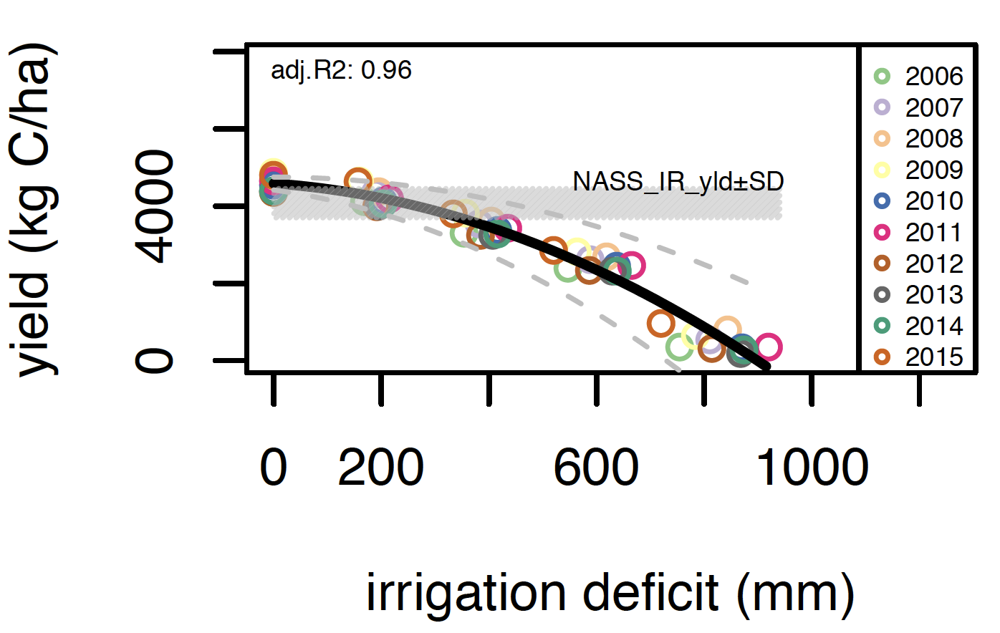
Reducing available water can result in deficit irrigation or reduction in irrigated land as optimal management strategies
Baseline Total Irrigation Water Request (mm/yr)
Change in Unsustainable Irrigation Water Request at the end of iteration runs (%)
DNDC emulator
fallow land
maximizes profits
Baseline Unsustainable Irrigation Water Request (mm/yr)
deficit irrigation maximizes profits
full irrigation maximizes profits
Yellow to orange: Deficit irrigation is the optimal management, given a shock to water supply
Dark red: Decrease in irrigated land area can reduce unsustainable groundwater demand.
Source: Manning et al, 2018; Figure modified by S Frolking
Notes:
This slide gives an overall picture of baseline irrigation water request (on your left) and the change in unsustainable irrigation water request at the end of iteration runs. The main takeaway message on this slide comes from the graph on your right that demonstrates the different adaption strategies, depending on irrigation water cost and crop price. If the crop prices are high enough and the yield deficit is not significant, farmers may still be able to deficit irrigate and maximize their profits. See the yellow to orange colors on the center spatial map, that’s the places where we could use deficit irrigation as an optimal strategy (the middle wedge on the chart). As you go into deeper red shade, those are locations that will require a decrease in irrigated land to maximize profits.

Slide 7
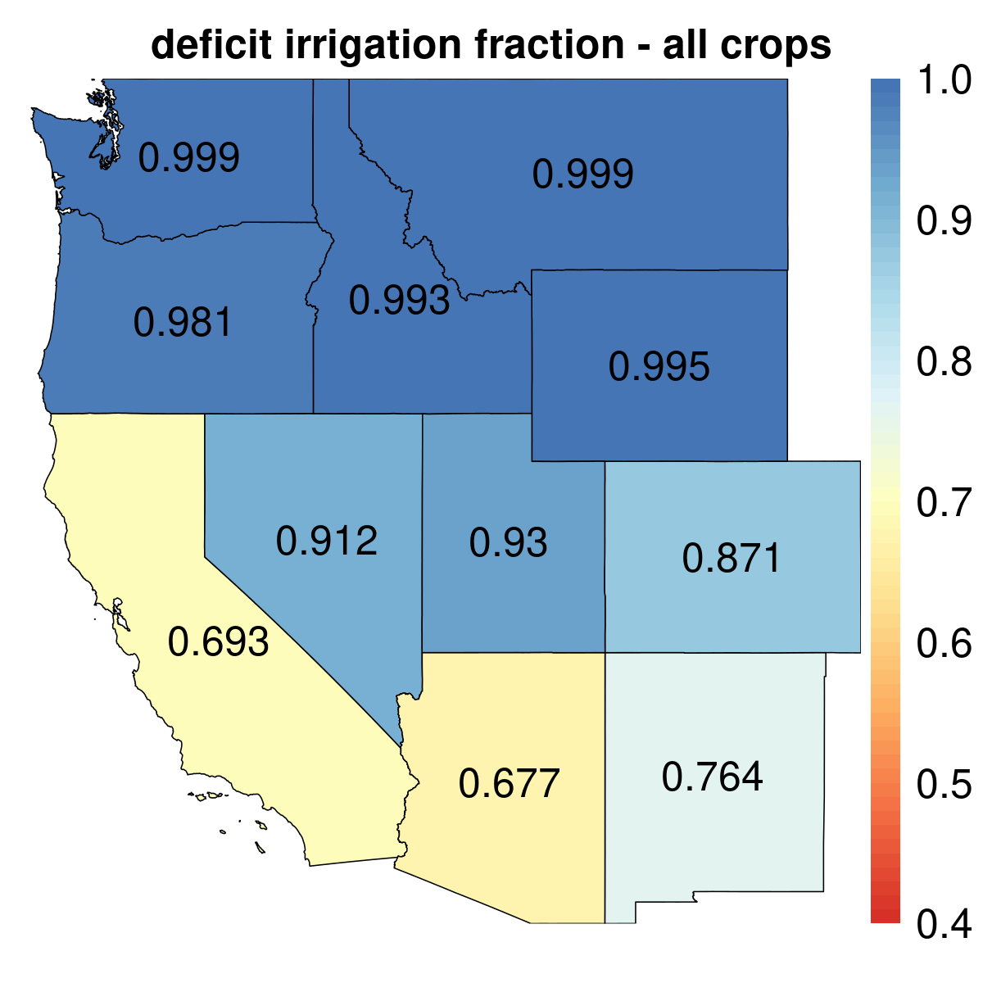
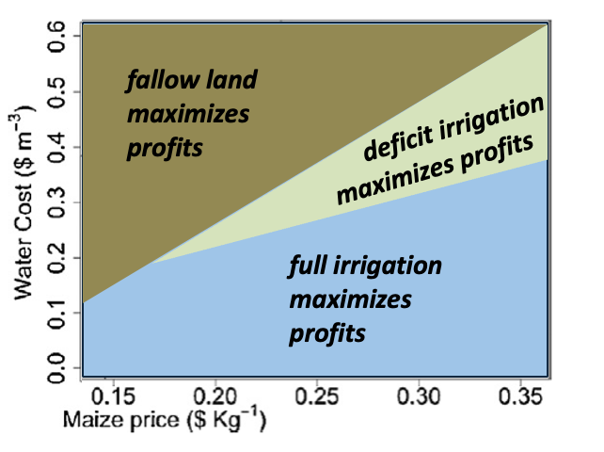
Most states with irrigation water shortage could benefit from deficit irrigation without causing major yield loss
Optimal deficit irrigation strategy that maximizes profit (all crops)
Yield deficit v/s Irrigation deficit (all crops)
(1 = Max yield)
1 = Full irrigation water request met
< 1 indicate a deficit due to the shock
Notes:
Looking at state-level results (on your left), we find that states like California, Arizona, and New Mexico would benefit the most from deficit irrigation strategy. Here, value of 1 means that the full irrigation water request in met and anything below 1 indicates a deficit due to the shock. States with colors that are not dark blue are the ones that can adopt an optimal deficit irrigation strategy (think the middle wedge in the previous figure). The chart on your right shows how the irrigation deficits get translated to yield deficit for different crops and states. It is evident that except for certain crops in Arizona, in most cases, yield deficit is in the range of 0.9-1, indicating that there is no significant loss of yield when using deficit irrigation.

Slide 8
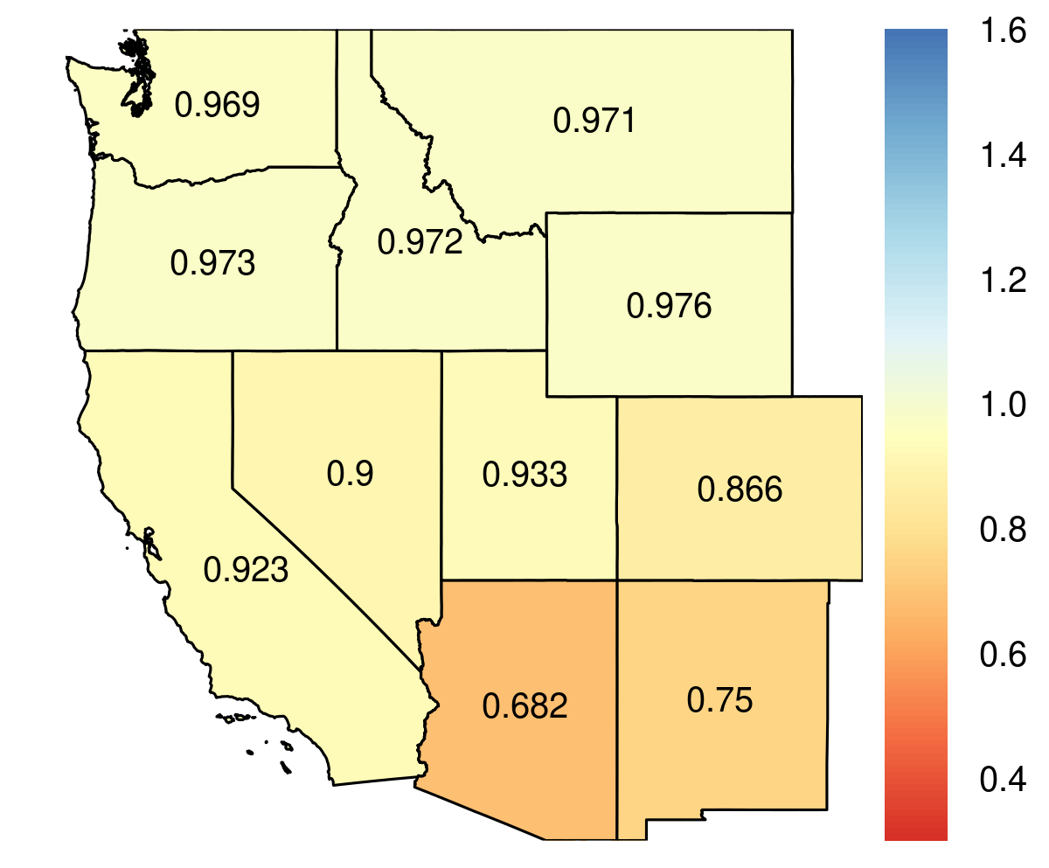
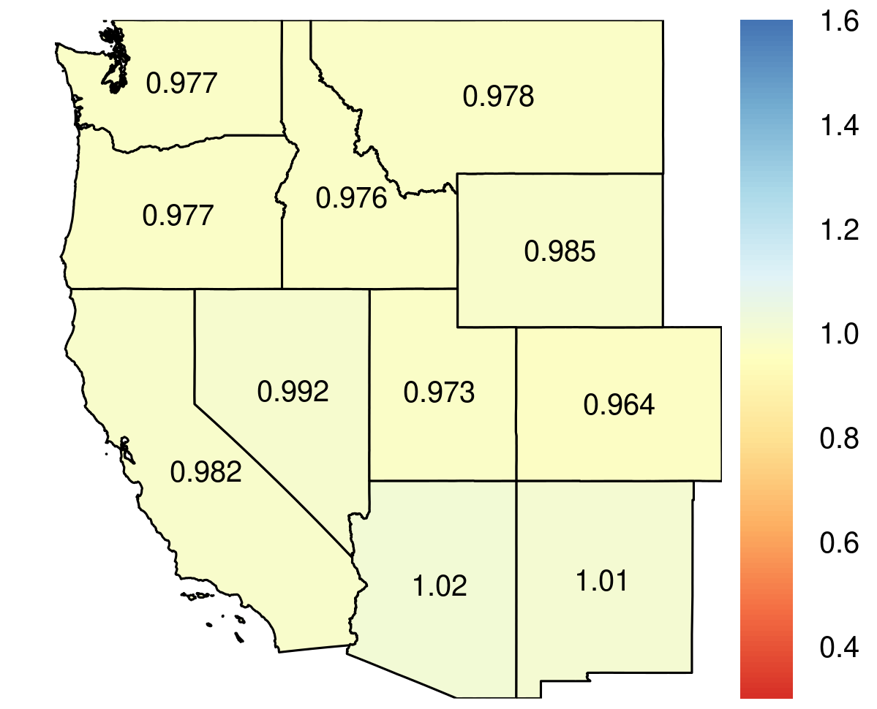
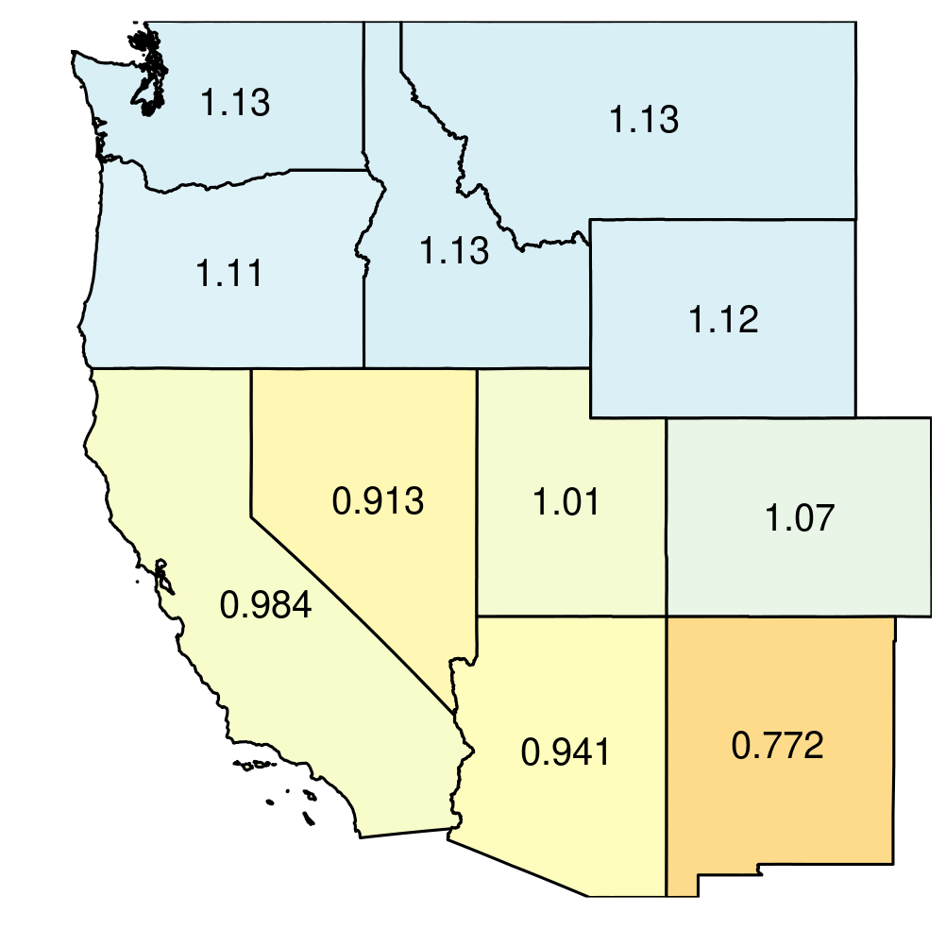
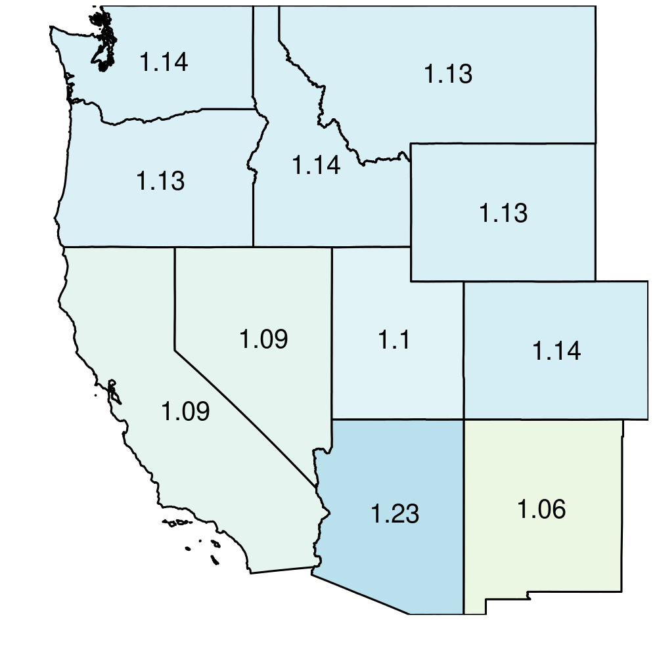
Irrigated land decreases mainly in southwestern US, with significant reductions seen for grain, cotton, and oilseed crops
Change in irrigated and rainfed land area, compared to Business-As-Usual (BAU) scenario
> 1 → increase in land area
< 1 → decrease in land area
Change in total irrigated land
Change in total rainfed land
Vegetables and fruits
Irrigated
Rainfed
States may reallocate their production from one crop to the other (Vegfruit sees increase in cropland, unlike other crops)
Irrigated crop production shifts to northwestern states that do not need to deficit irrigate due to relying less on unsustainable groundwater
Notes:
Coming to the other strategy of reducing irrigated land, we find that southwestern states (Arizona and New Mexico) sees the largest reduction in irrigated land. Here, values >1 means increase in irrigated land and values <1 means decrease in irrigated land from Business-as-usual (no shock) scenario. Although we see an overall reduction in irrigated and rainfed land for all states, vegfruit category is the one where we see a different pattern. This points towards how the states may reallocate their production from one crop to another, depending on which ones rely more on unsustainable groundwater (for example, reducing cotton production and increasing the production of vegetable and fruits, since cotton is heavily dependent on groundwater irrigation). Another observation is how the production may shift from southwestern states to northwestern states, since there isn’t much water deficit in the northern parts.

Slide 9
Takeaways
Many states in the US west could maximize profits with deficit irrigation strategy without causing major yield loss
A combination of mitigation strategies may be needed to cope with water shortage (eg: Southwestern US could adopt deficit irrigation along with reducing irrigated land)
Water shortage and yield deficit
Deficit irrigation
Reduce irrigated land
Remove all irrigated land
Adopted strategy depends on whether increased crop prices can cover production costs
Notes:
In summary, we found that many states in the US west could maximize profits with deficit irrigation strategy without causing major yield loss. In southwestern states, a combination of deficit irrigation and reduction in irrigated land may be required to fully cope with water shortages. Ultimately, the decision to deficit irrigate or reduce/remove all irrigated land would depend on whether the increased crop prices can cover production costs, taking into account lower yields and irrigation water costs

Slide 10
Discussion points
How well will the larger state-level impacts translate to local implementation of strategies, considering other socio-economic-cultural factors?
- Irrigation costs, hesitancy towards changing crops and irrigation management, etc.
Expanding the boundaries of multi-sectoral studies
Incorporating energy sector (less pumping of irrigation water means more energy savings)
Climate and impact of extreme events such as drought
How do the uncertainties and risks compound across the multiple models that are at different spatial, temporal, and sectoral scales?
- Understanding the tradeoff between model complexity and uncertainty
Notes:
These are some lessons learned and limitations from our study that could also serve as points for further discussion.

Slide 11
THANK YOU!!
femeena@psu.edu
@femipv

Slide 12
EXTRA SLIDES

Slide 13
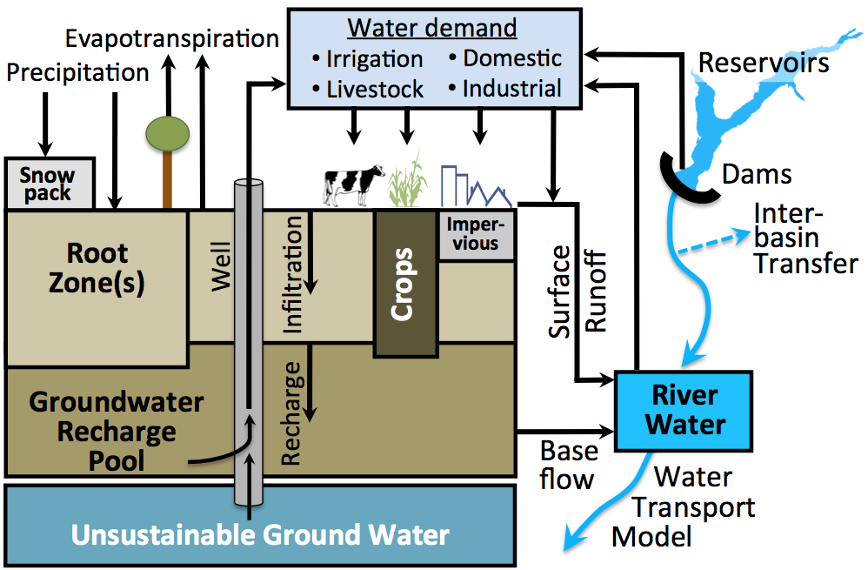
1. Water Balance Model (WBM) to simulate hydrology and irrigation water quantity
GCAMland
Δ crop yields
WBM
Δ irrigation water
2: DNDC*
INPUT: weather data; crops; irrigated areas.
OUTPUT: irrigation water deficit by state.
INPUT: irrigation water deficit.
OUTPUT: deficit irrigation crop yields.
* deficit irrigation yield emulator
DREM

Slide 14
2. DNDC-emulator to predict yield deficit corresponding to irrigation water shortage
GCAMland
Δ crop yields
Δ crop prices
Δ irrigated & rainfed crops
Δ irrigated crop areas
Arizona - corn
1: WBM
Δ irrigation water
DNDC*
INPUT: scenario; weather data; irrigated areas.
OUTPUT: irrigation water deficit by state.
INPUT: irrigation water deficit.
OUTPUT: deficit irrigation crop yields.
Δ crop yields
3. Regional Economic Model

Slide 15
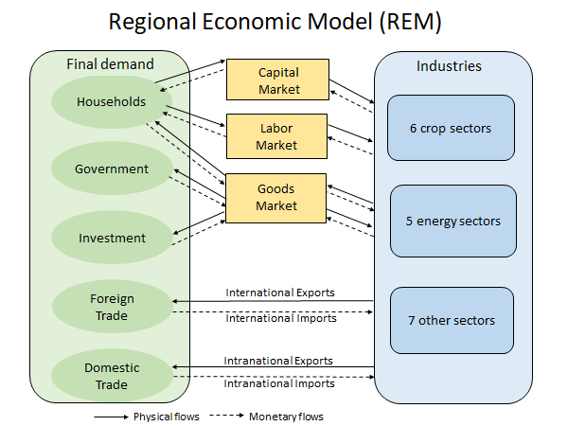
3. Regional Economic Model to estimate crop prices and demands
GCAMland
Δ crop yields
Δ crop prices
Δ irrigated crop areas
4: GCAMland
WBM
Δ irrigated & rainfed crops
2: DNDC*
Δ irrigation water
DREM
Δ crop yields
INPUT: crop yields; rainfed:irrigated crop areas
OUTPUT: crop prices, demand for crops.
Notes:
The Regional Economic Model is a state-level computable general equilibrium model of the US, capturing all agents of the economy and international trade and interstate trade across regions in the US

Slide 16
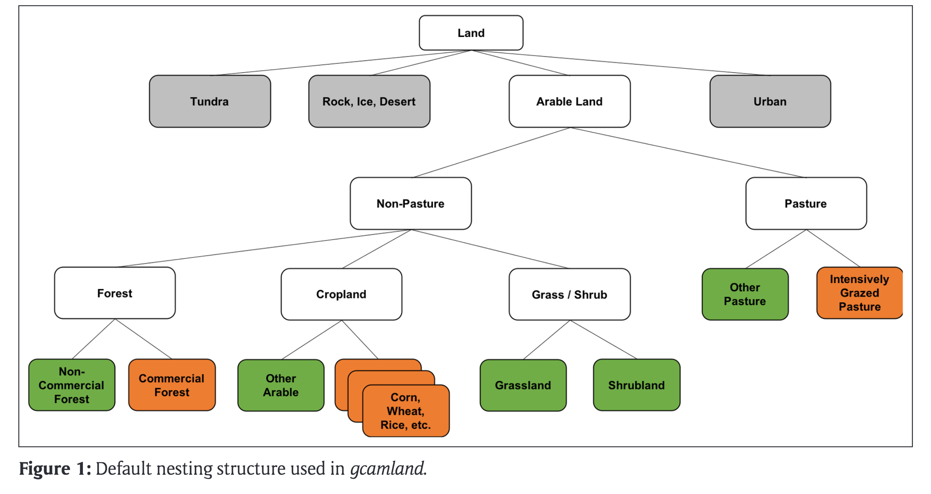
4. GCAMland to model land allocation changes in response to shifts in crop prices and yields
INPUT: crop yields; crop prices.
OUTPUT: irrigated and rainfed crop land reallocation.
GCAMland
Δ crop yields
Δ crop prices
Δ irrigated & rainfed crops
Δ irrigated crop areas
1: WBM
Δ irrigation water
DNDC*
INPUT: scenario; weather data; irrigated areas.
OUTPUT: irrigation water deficit by state.
Δ crop yields
3. Regional Economic Model
Δ irrigated & rainfed crop areas
INPUT: crop yields; rainfed:irrigated crop areas.
OUTPUT: crop prices, demand for crops.
• aggregated to 6 crop sectors.
• partitioned into irrigated and rainfed.

Slide 17
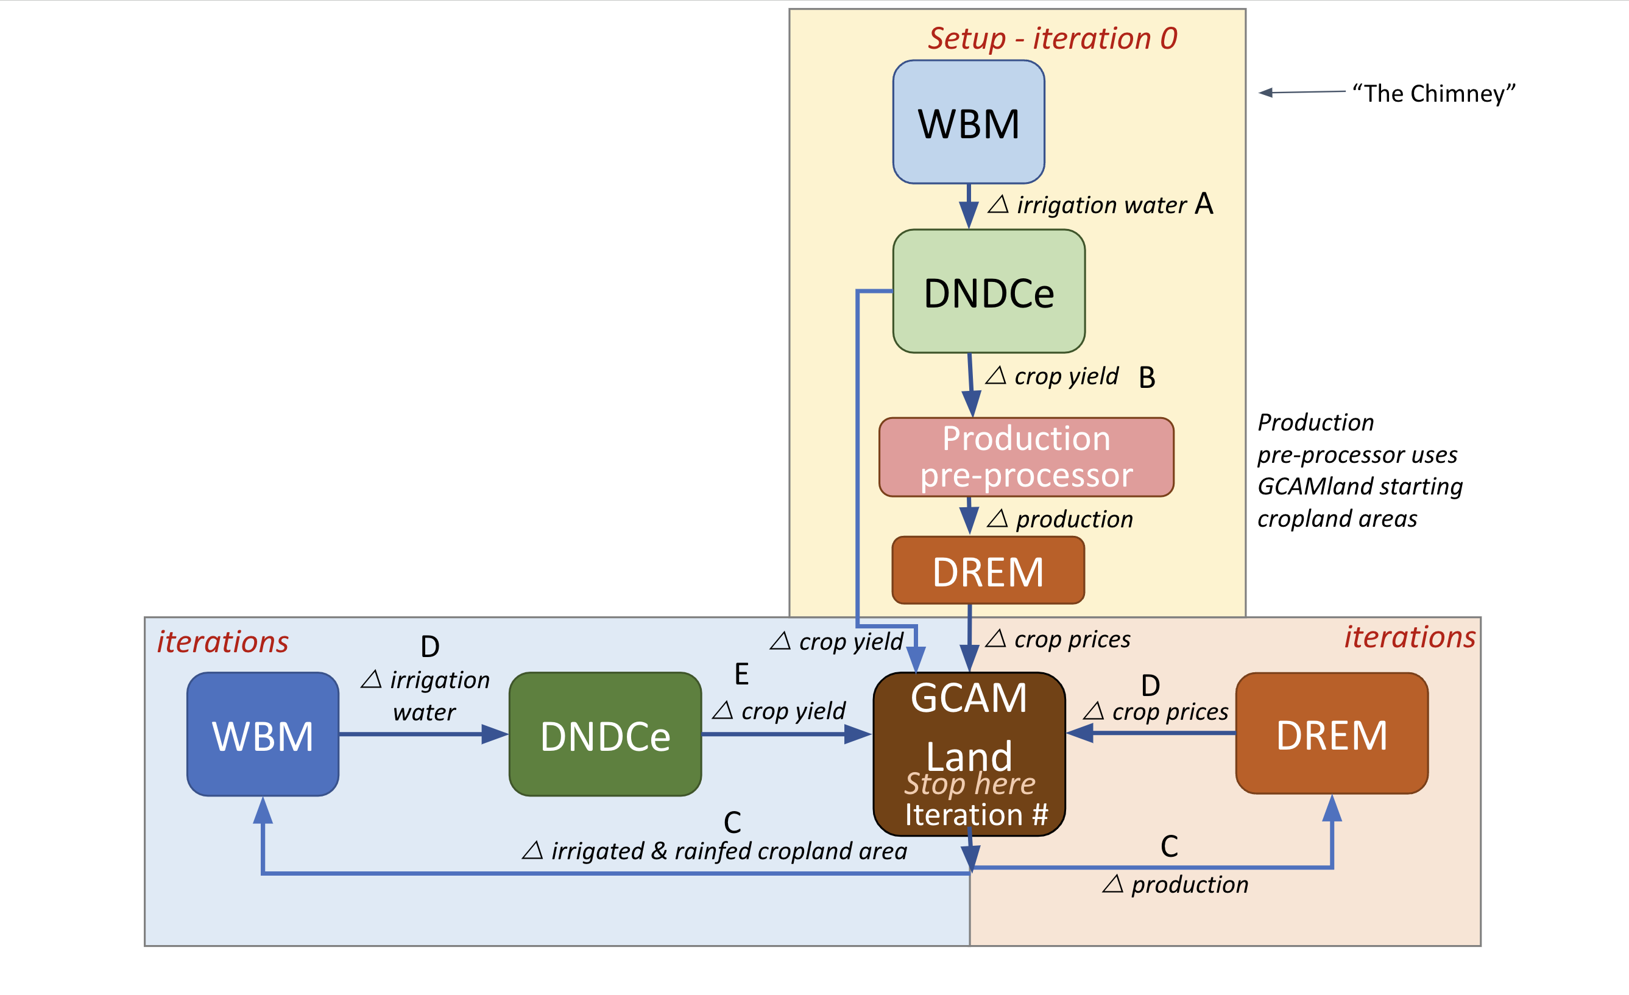
Through this study, we tested if the coupled model system will converge after a substantial water deficit shock
Warm-up phase
Iterative phase

Slide 18
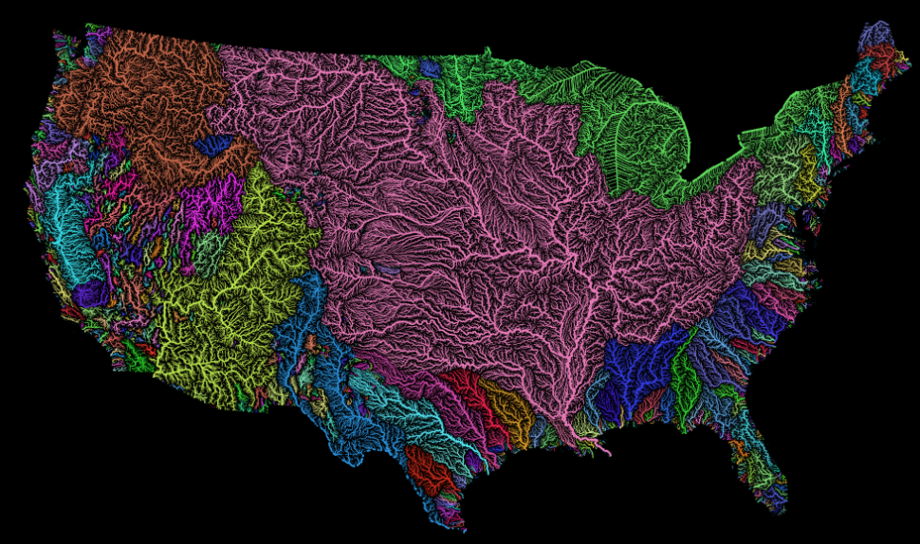
Model harmonization was required to couple the models across different spatial and temporal resolutions
Spatial
GCAMland: Regional/river basin
DREM: State level -> regional
WBM: 6’-grid -> State means
DNDC: Plot level -> State -> Regional means
Temporal
WBM: Gridded representation of drainage basins and river networks; Daily time step; 2010-2015; Mean annual.
GCAMland & DREM: 5-year equilibrium runs (shock to 2010 base).
Crops
Harmonized baseline (2010) crop shares in GCAMland and DREM;
Aggregated DNDC crop yields to 6-crop harmonized list – Grain, vegfruit, sugar, cotton, others

Slide 19
Model harmonization was required to couple the models across different spatial, temporal, and sectoral resolutions
DREM | GCAMland | WBM | DNDC
Grain | Wheat, corn, rice, OtherGrain | Maize, wheat_1, wheat_2, rice, barley, sorghum, rye | Corn, winter_wheat, spring_wheat, oats, barley, sorghum, paddy_rice
Oilseed | OilCrop | Sunflower | Sunflower
Cotton | Cotton | Cotton | Cotton
Sugar | SugarCrop | Sugarbeet | Beet
Vegetables and fruits | Root_tuber, fruit/vege- tables | Potato&sweetpotato, pulses, Vegetables, Other Perennials, Other Annuals | Potato, melon, beans, onion, lettuce, tomato, cabbage, carrots, berries, citrus, grape, apples, nut_tree
OtherCrop | FodderGrass | Foddercrops | Alfalfa, non-legume hay

Slide 20
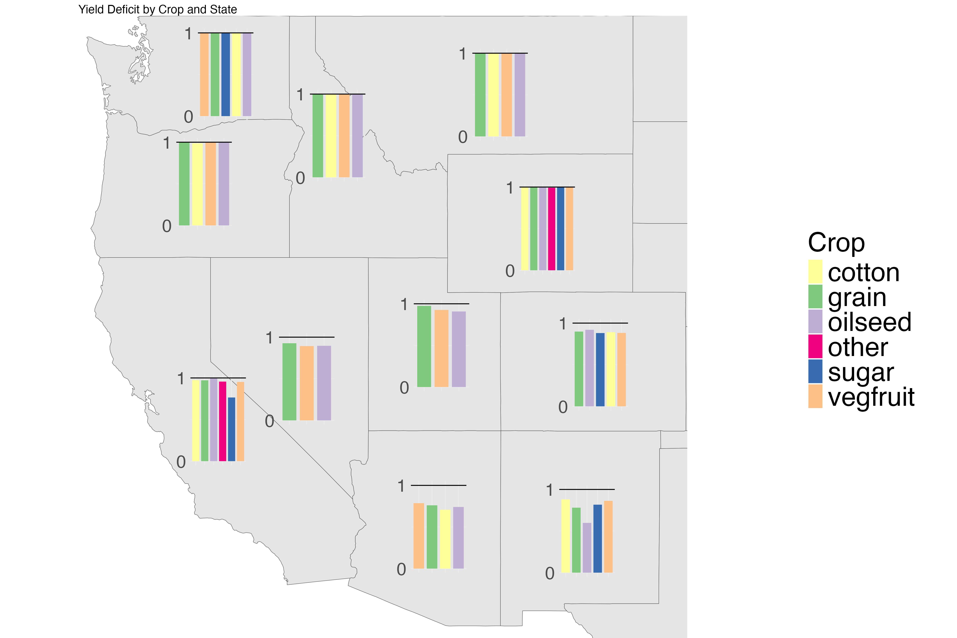
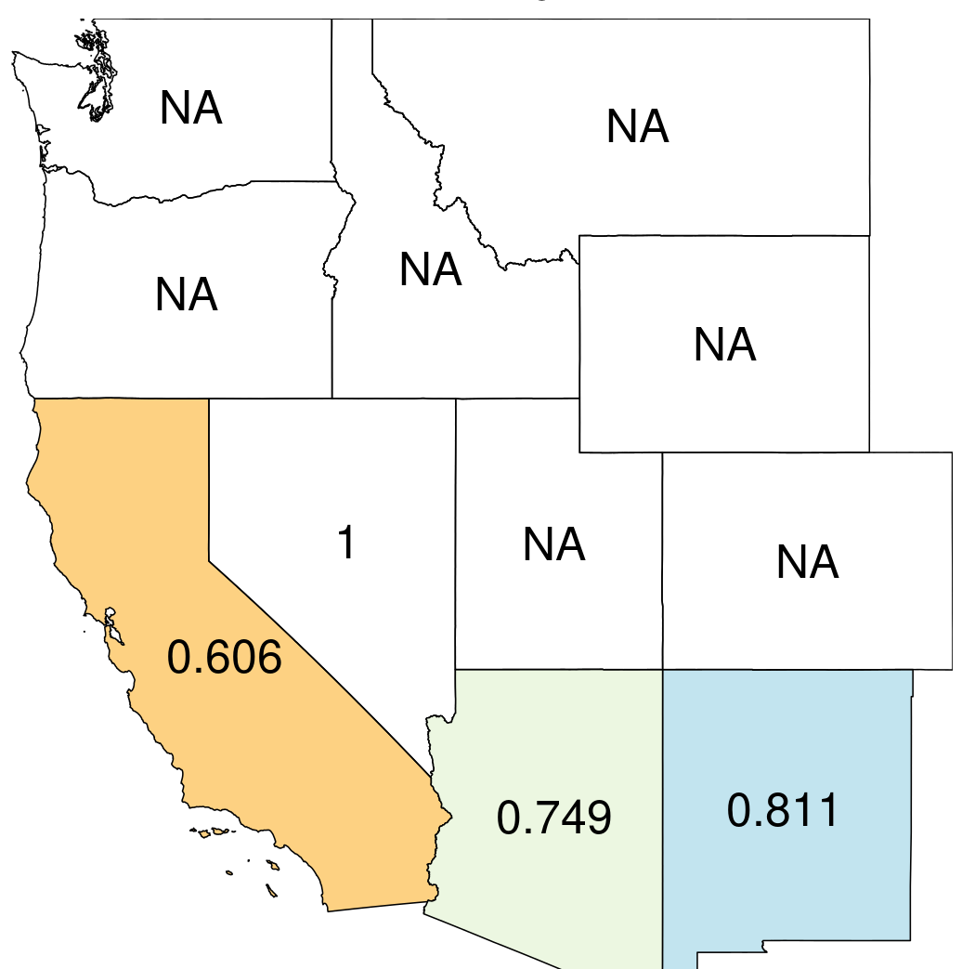
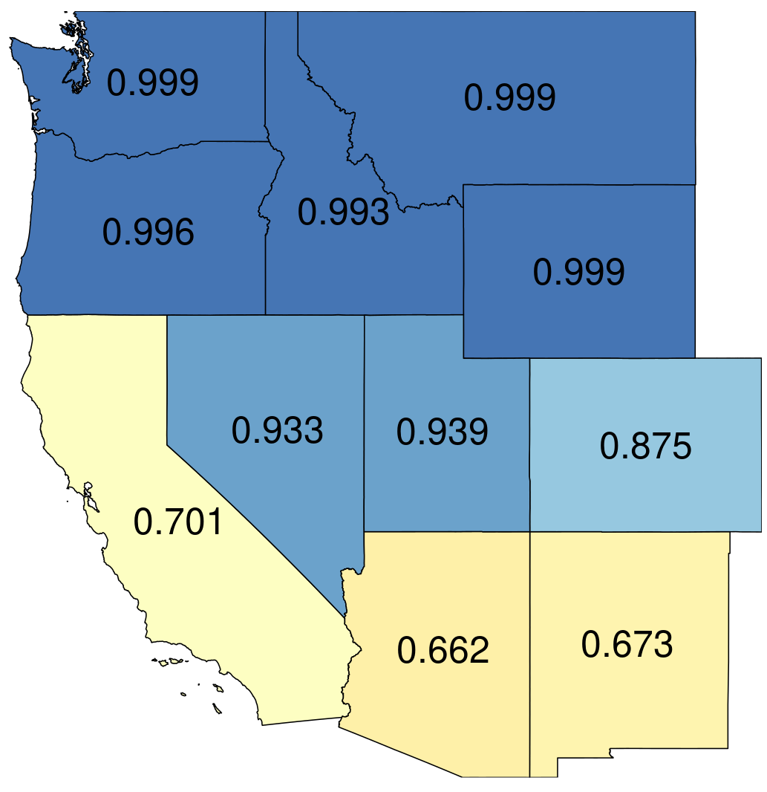
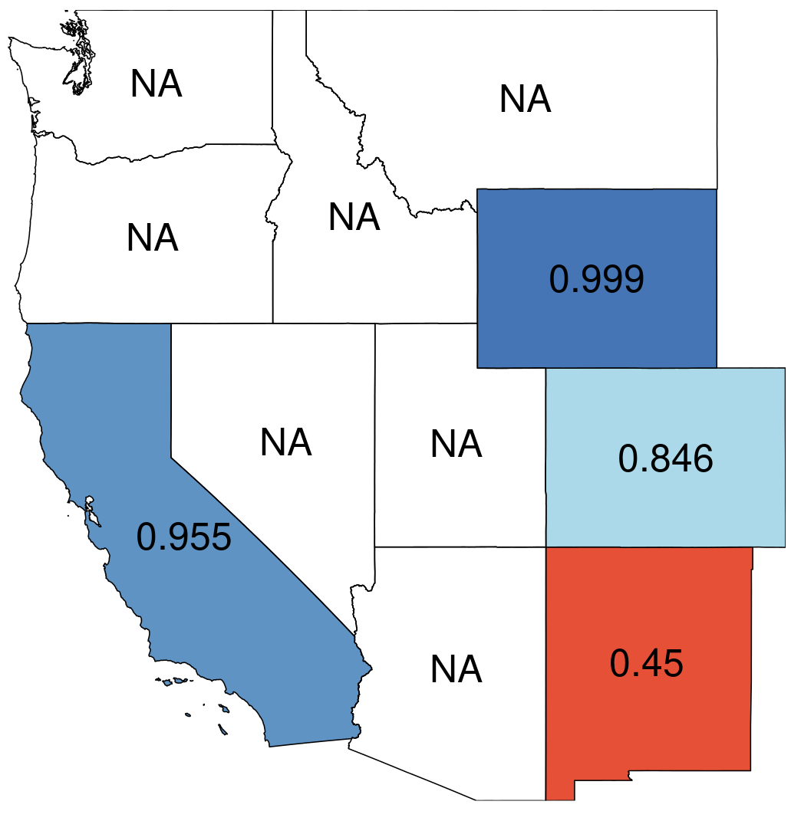
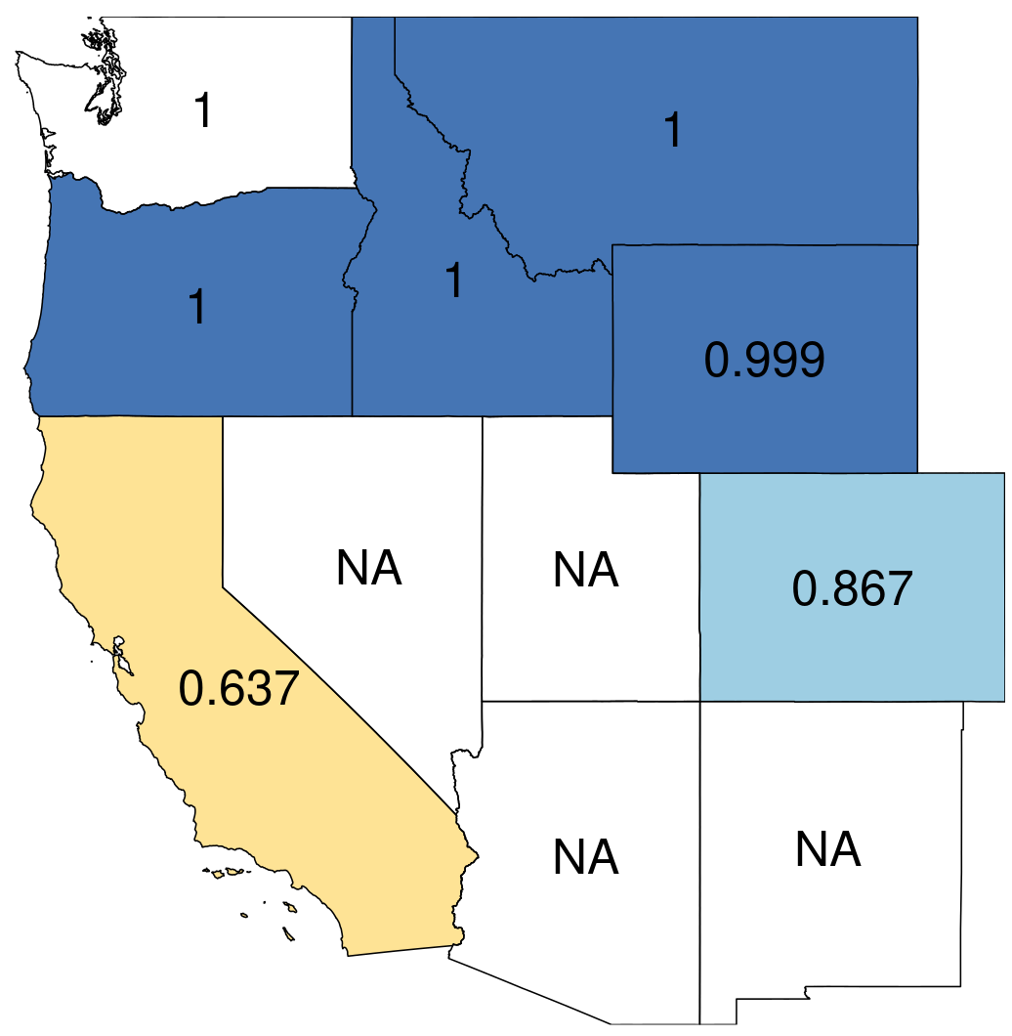
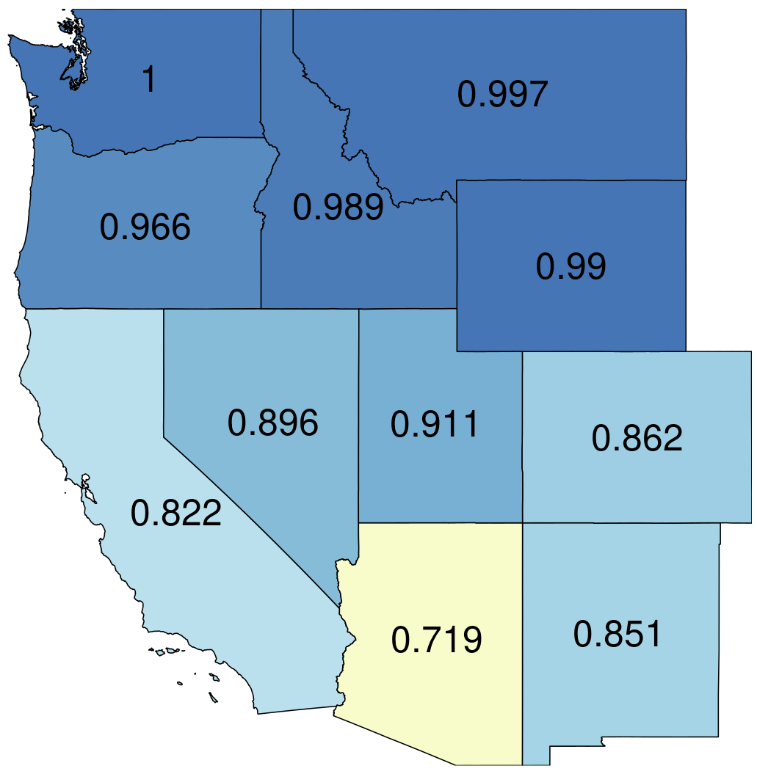
Deficit irrigation can serve as a good strategy in southwestern states to cope with water shortage
Deficit irrigation (1=no shortage of irrigation water)
Yield deficit (1= max yield)
Cotton
Grain
Oilseed
Sugar
Vegfruit
Other

Slide 21
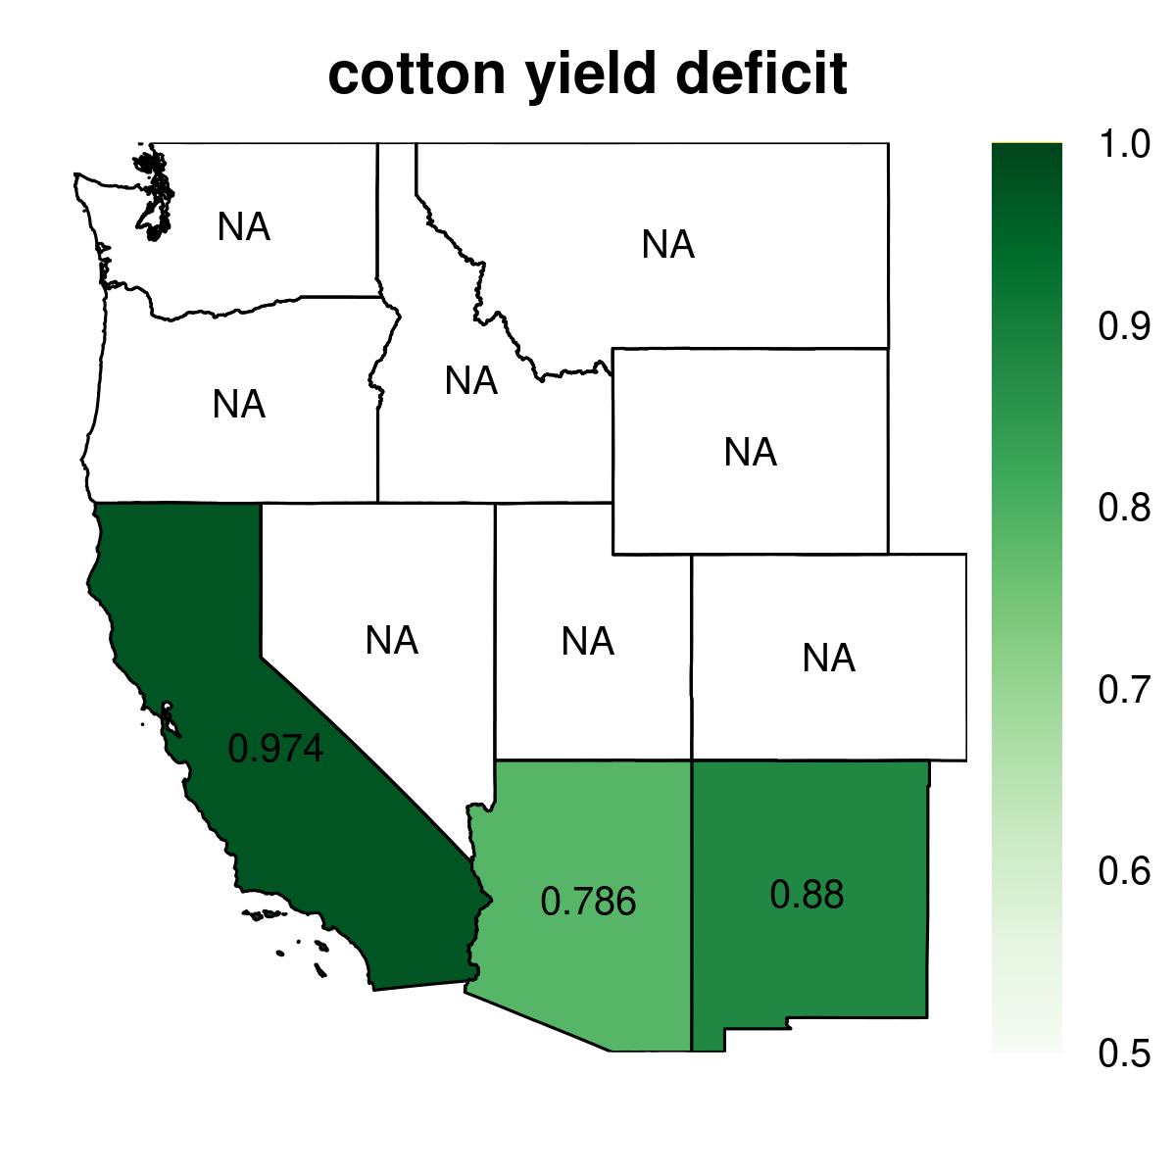
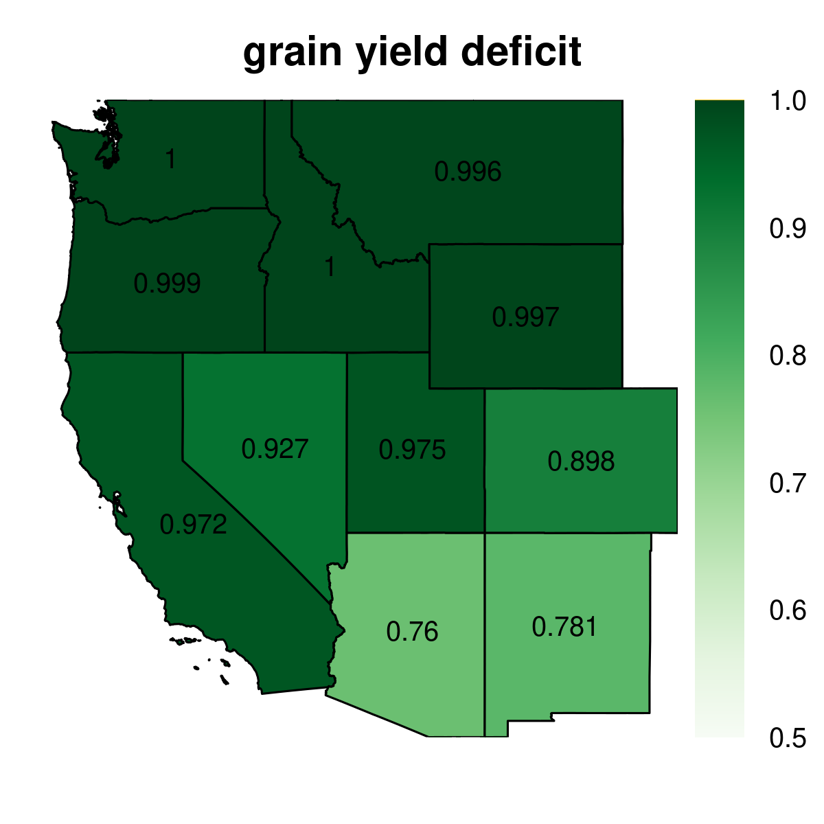
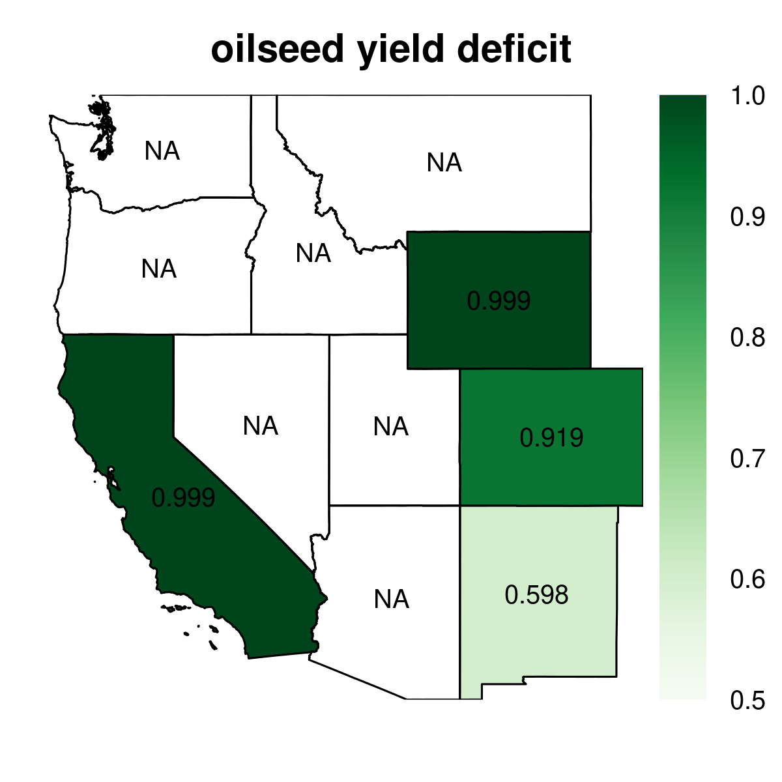
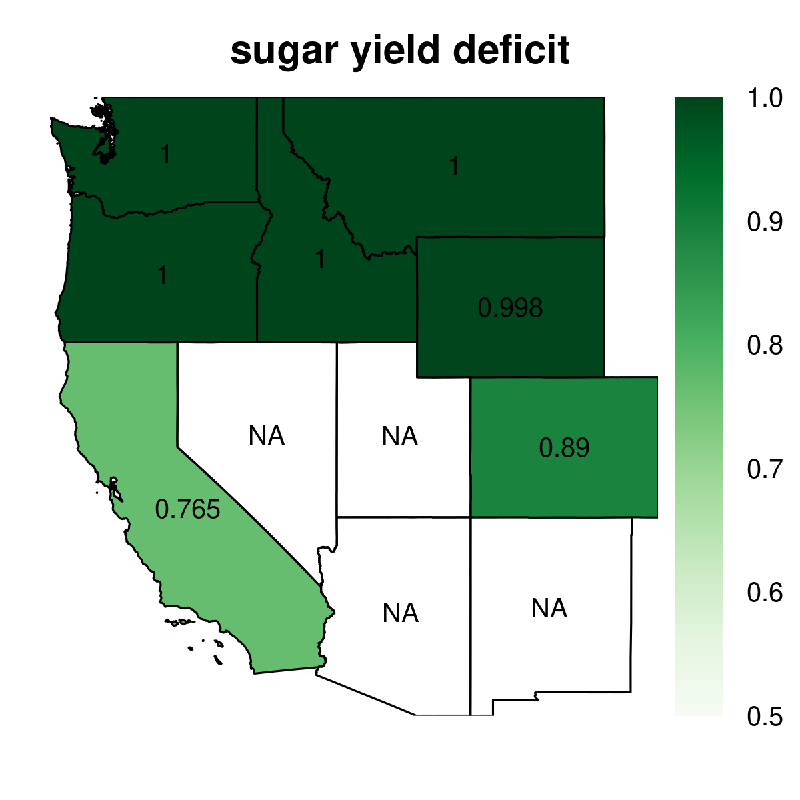
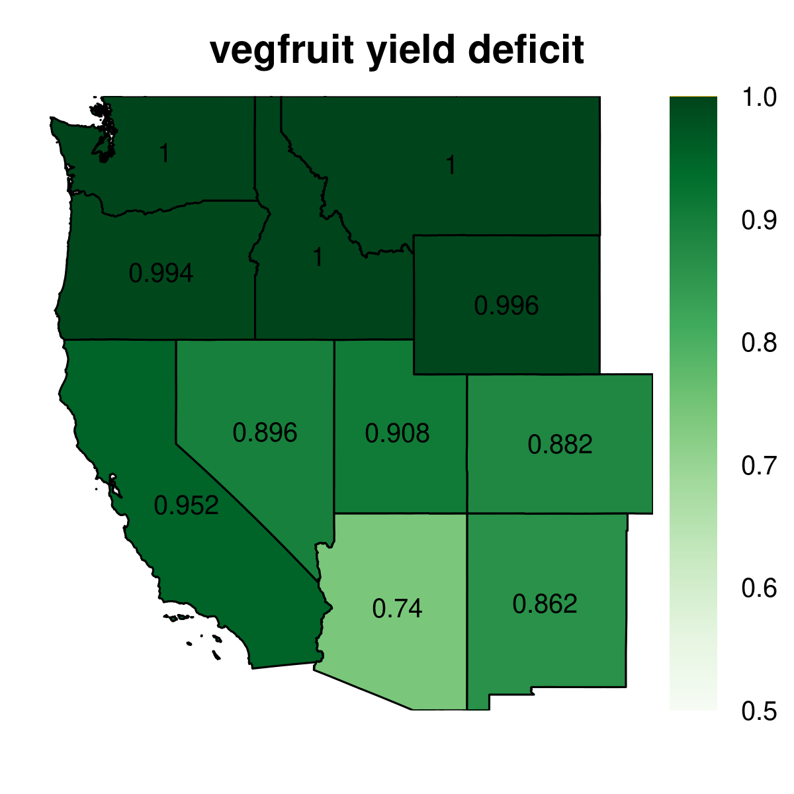
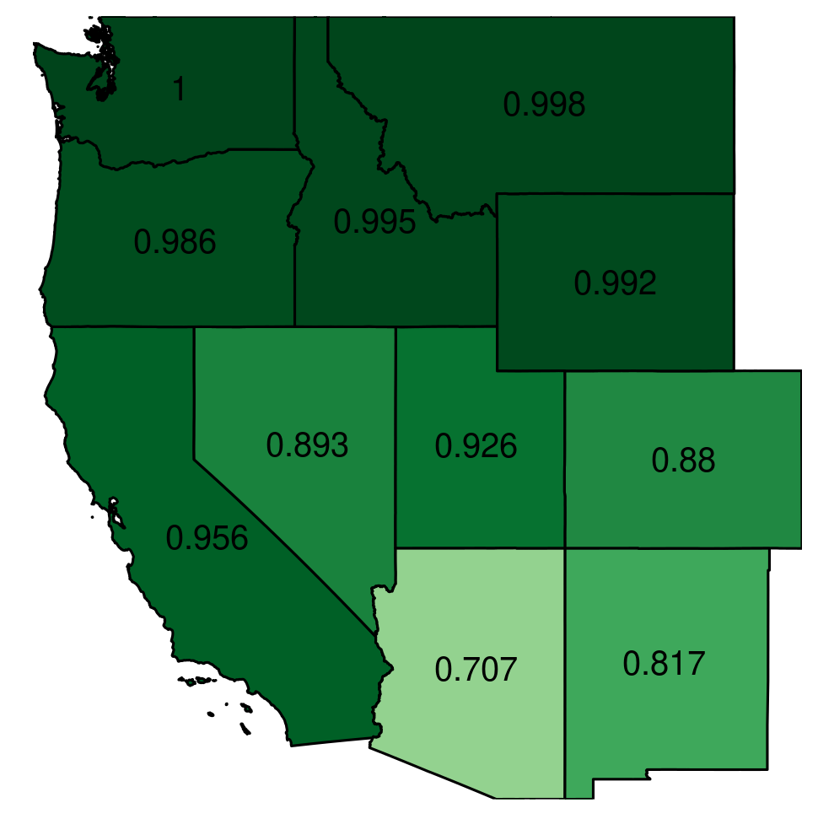
Yield deficit maps
Cotton
Grain
Oilseed
Sugar
Vegfruit
Other

Slide 22
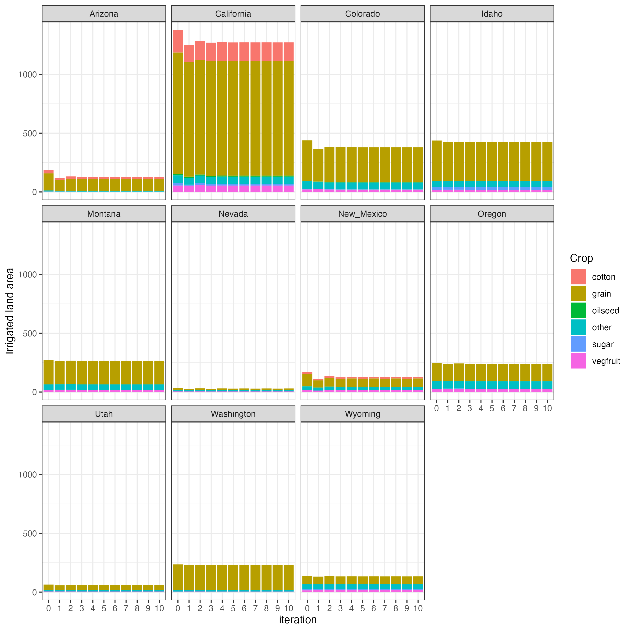
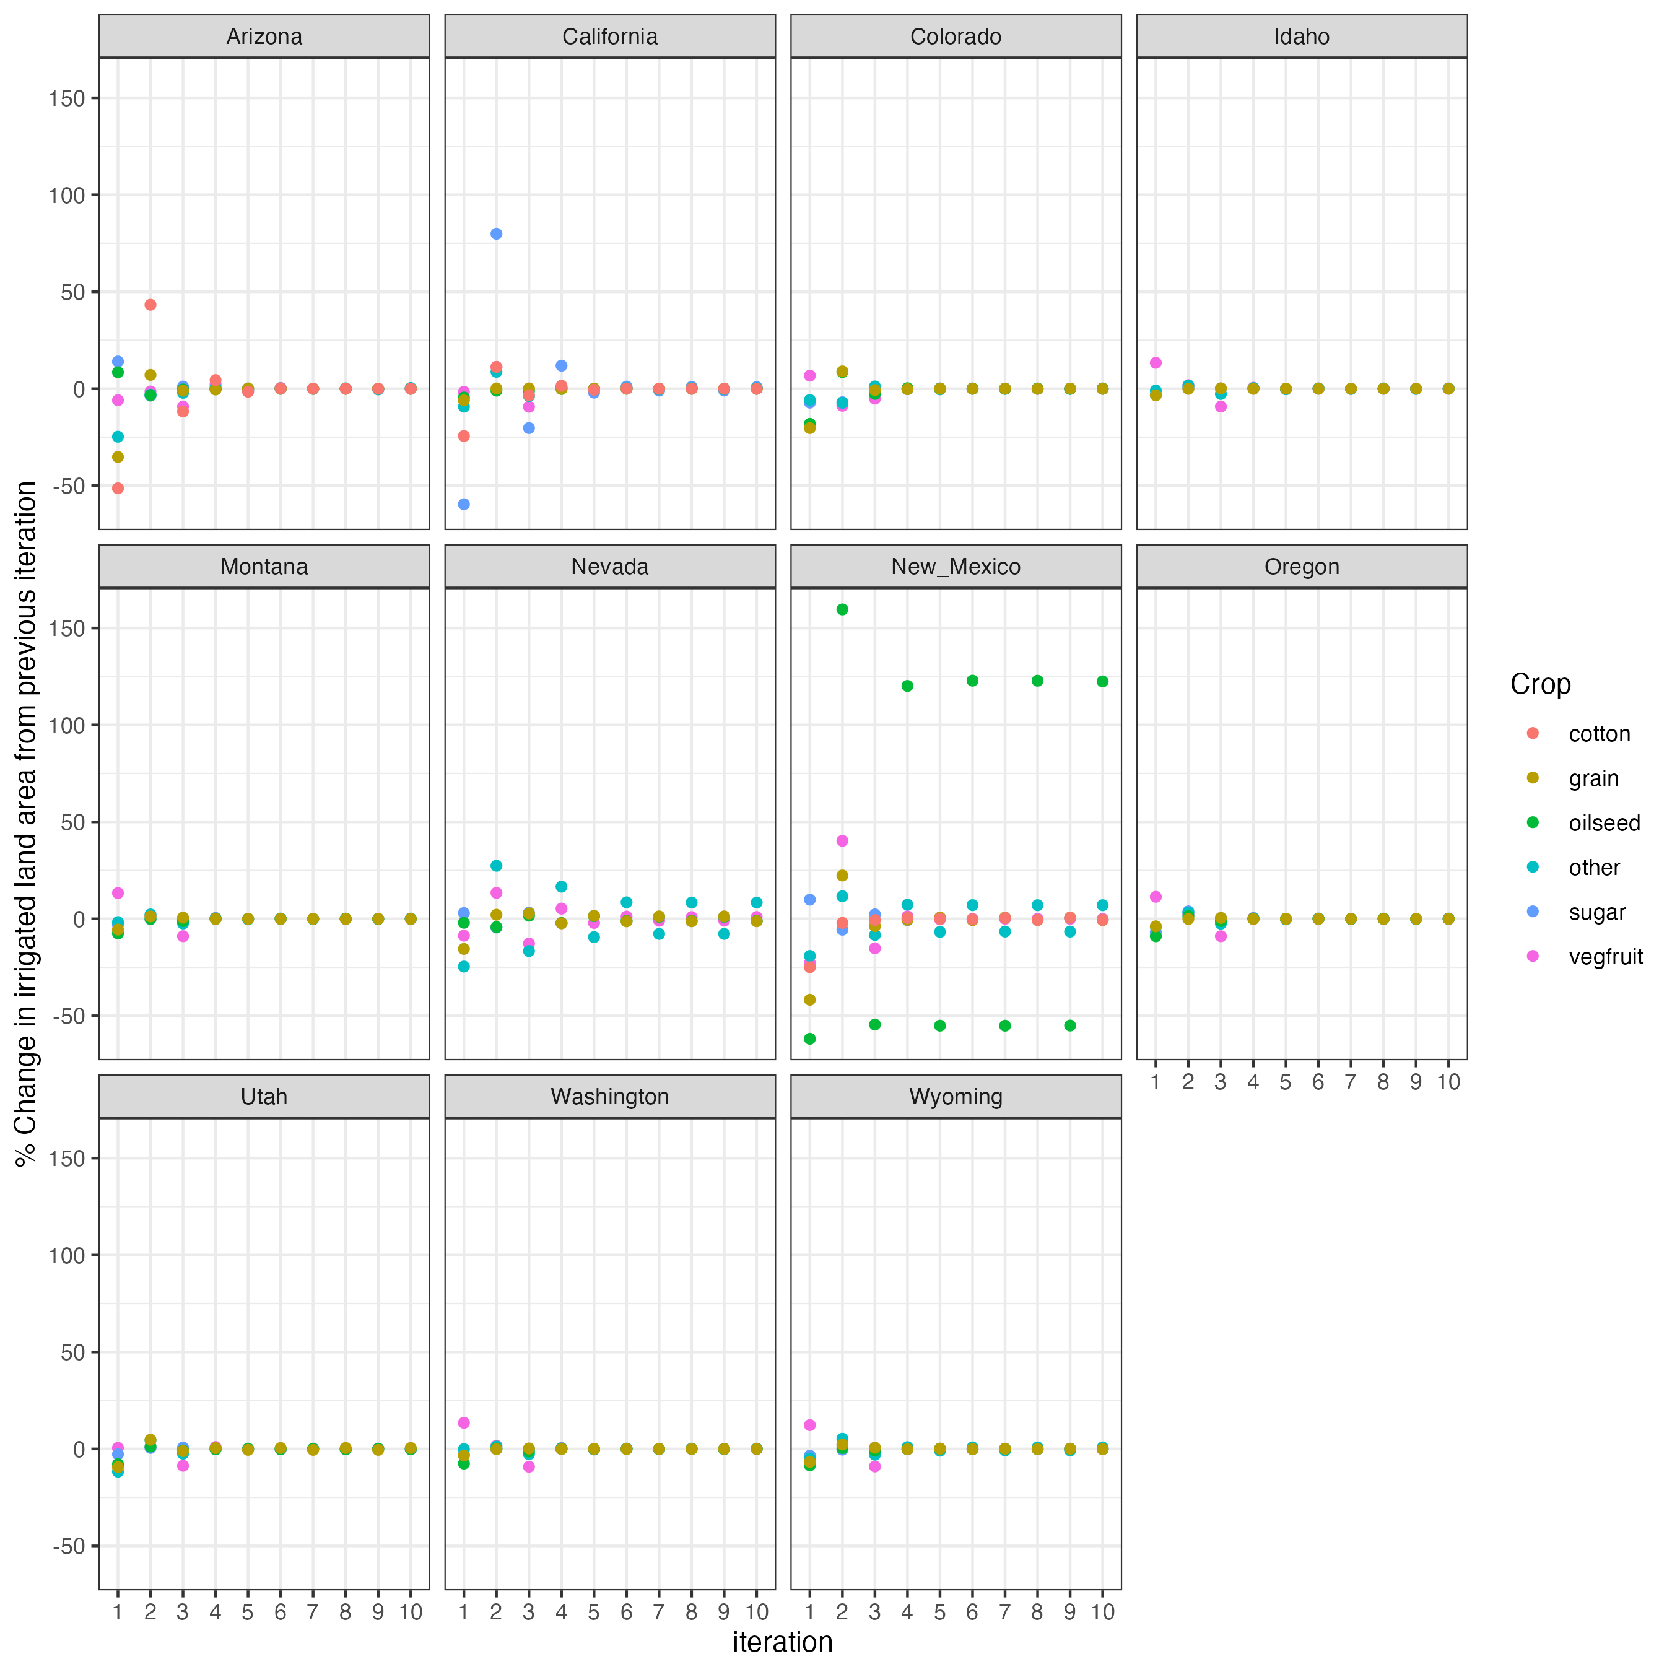
Irrigated land area

Slide 23
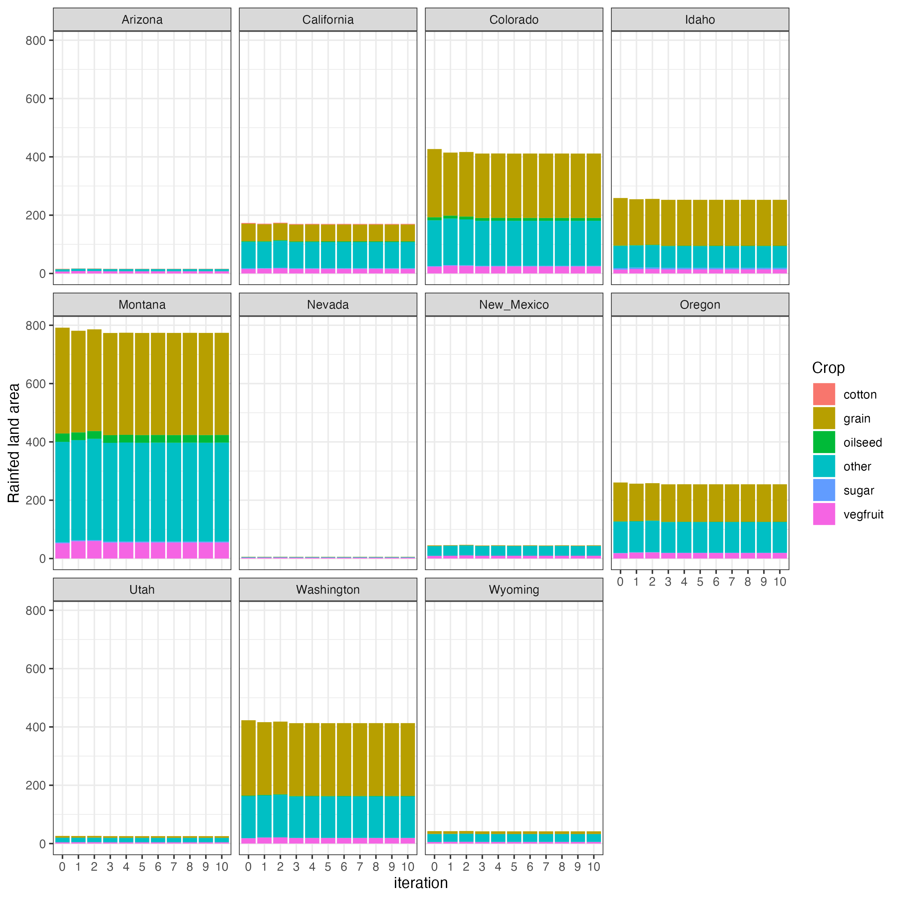
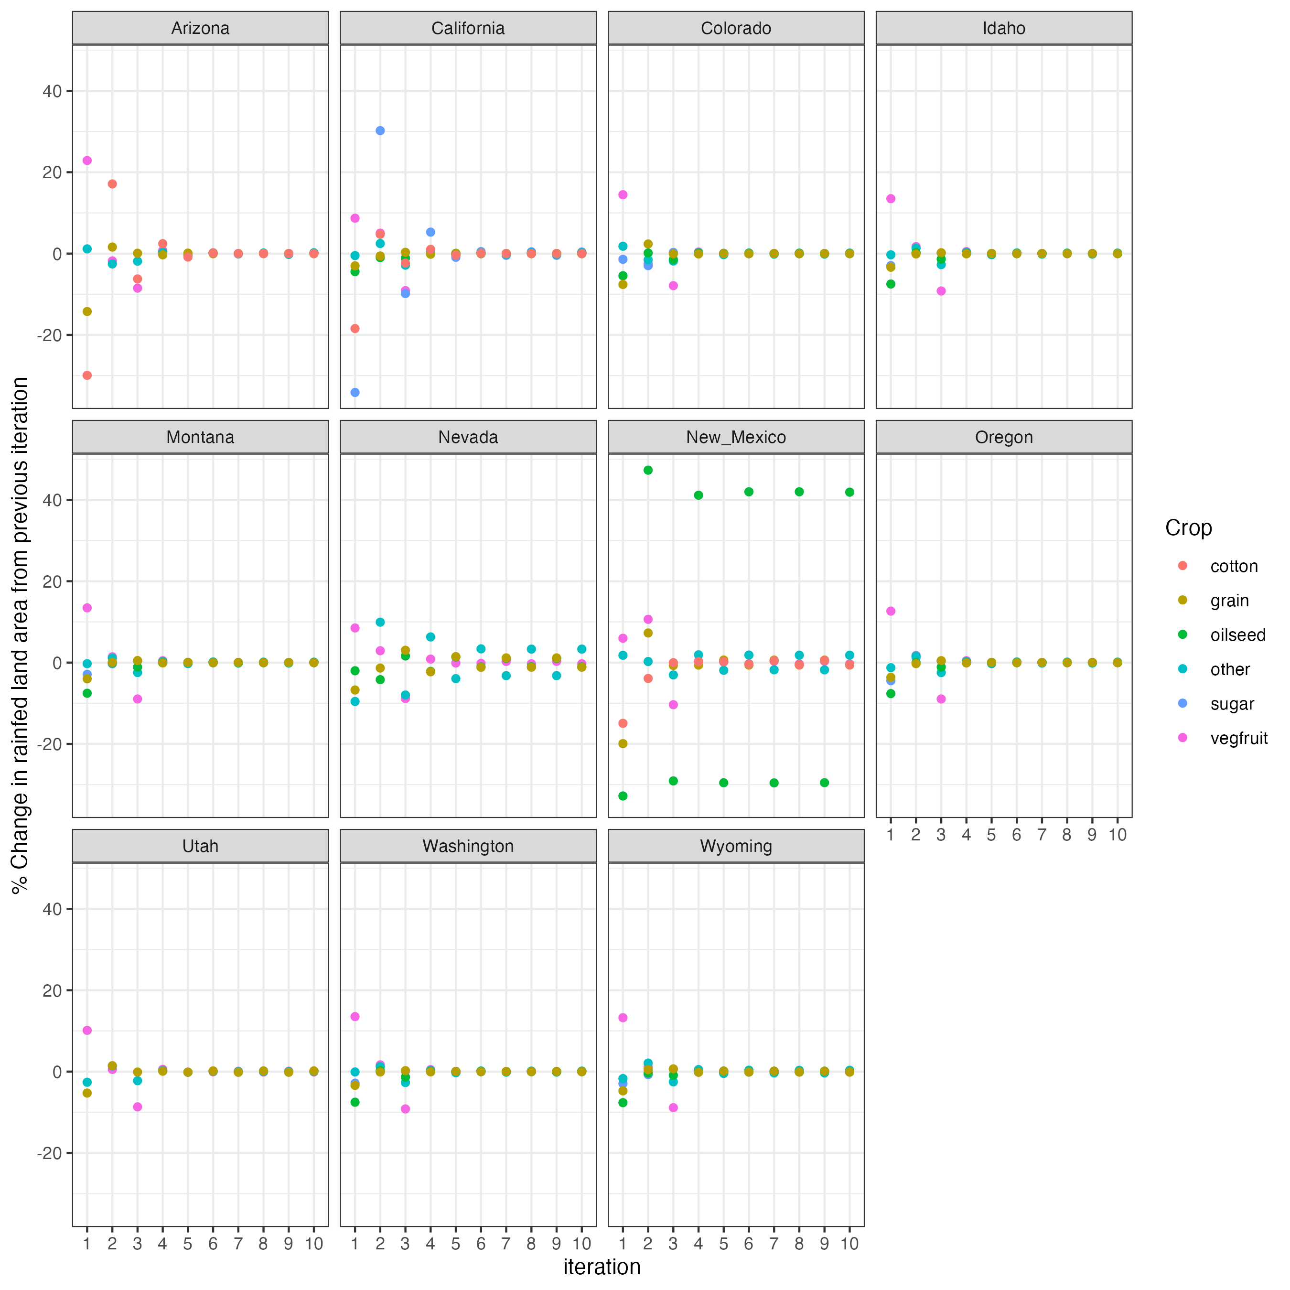
Rainfed land area

Slide 24
Vegetables and fruits are the highest impacted crop category in terms of total production loss followed by grain

Slide 25
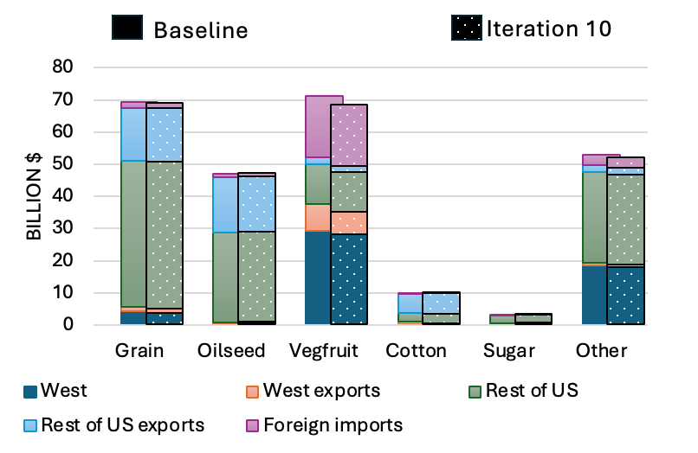
Loss in crop production and exports in the west is to be compensated by increased production in the rest of the country
Decreased grain production in the west increases production in the rest of the US, although the same is not true for vegetables and fruits

Slide 26
WBM model
Gridded water balance and transport.
Daily water balance and flows, including crop water demand and use.
Irrigation water source: surface, shallow groundwater, deep groundwater.
Water management inputs: irrigation and rainfed crop maps, storage/transport infrastructure, domestic/industry/livestock demand.
Drivers: daily weather.
Application in this project:
For a given scenario, determine irrigation water supply shock.

Slide 27
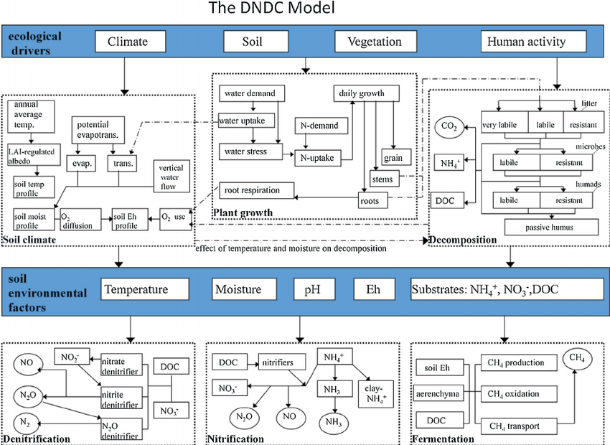
DNDC model emulator
Agroecosystem biogeochemistry.
Carbon, nitrogen, water cycles.
Crop yields, crop water and N use.
Greenhouse gas emissions.
Crop/field management inputs: irrigation, fertilizer, tillage, manure, residue management.
Drivers: daily weather, soils, mgmt.
Application in this project:
Deficit irrigation yield impact.
Run as an emulator.

Slide 28
DNDC model emulator
Agroecosystem carbon, nitrogen, water cycles.
Crop yields, crop water and N use.
Greenhouse gas emissions.
Crop/field management inputs: irrigation, fertilizer, tillage, manure, residue management.
Drivers: daily weather, soils, mgmt.
Application in this project:
Deficit irrigation yield impact.
Run as an emulator.
DNDC deficit-irrigation yield emulator – state-level example
Arizona - corn
Yield deficit
Irrigation deficit
Irrigation deficit = amount less than full irrigation water demand for the particular year that was added under deficit irrigation.

Slide 29
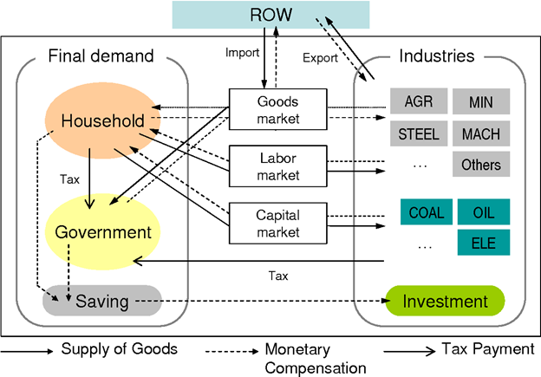
Regional Economic Model
Regional computable general equilibrium model based on the modeling framework of Rausch and Rutherford (2009)
Calibrated to state-level data from the IMPLAN (IMpact analysis for PLANning) group, LLC.
All four economic agents (producers, consumers, government, and trade sector) represented.
Captures inter-industry linkages across all 18 producing sectors— 6 crop sectors, 5 energy sectors, and 7 other sectors.
Aggregated to five regions: Arizona, California, Pacific Northwest, Nevada-Utah, and rest of US
Intra- and international trade represented.
Okagawa and Ban, 2008
Application in this project:
Generate changes in commodity prices and demand in response to change in crop yields from DNDCe and GCAMland

Slide 30
GCAMland model
• Allocates land across variety of uses based on changes in agricultural yield and commodity price.
• The land allocation algorithm is based on the Global Change Analysis Model (GCAM).
Application in this project:
• INPUT: yield shocks (as fraction from baseline) from DNDC.
• INPUT: commodity prices from Regional Economic Model.
• OUTPUT: reallocates irrigated and rainfed cropland in 5 regions (4 study regions + Rest of USA).
NOTE: cropland is partitioned into irrigated and rainfed for each crop.

