Slide 1
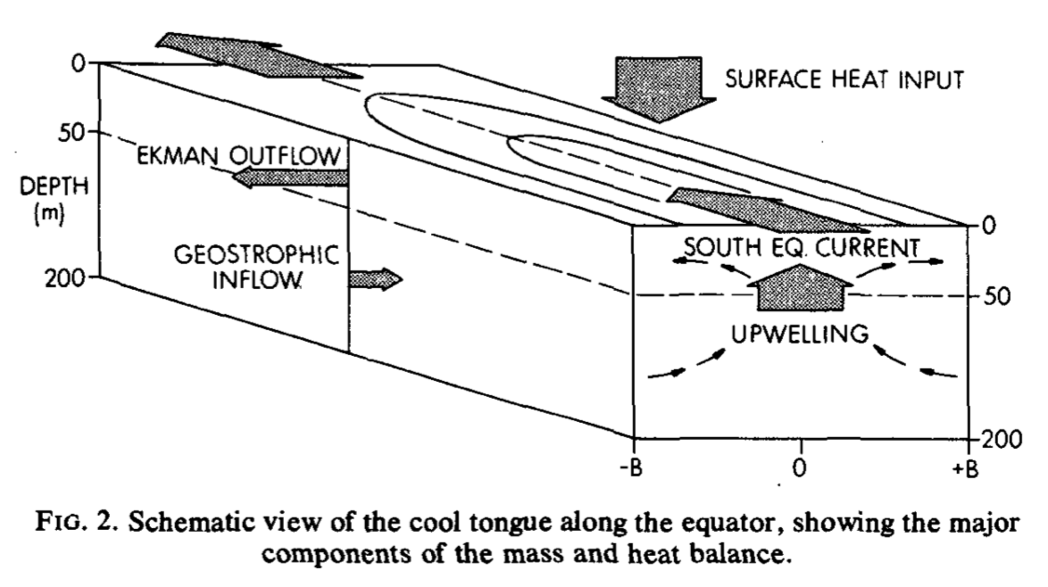
Equatorial upwelling:
pulled from above or pushed from below?
Work by: N. Brizuela, C.Y. Lee, A.H. Sobel, R. Seager, S.J. Camargo, J. Zhuo
Popular understanding tries to explain vertical motion using horizontal forces.
ENSO theory argues upwelling is pulled from above by wind-driven divergence.
Decadal variability studies assume that upwelling can be pushed from below.
Wyrtki (1981)

Slide 2
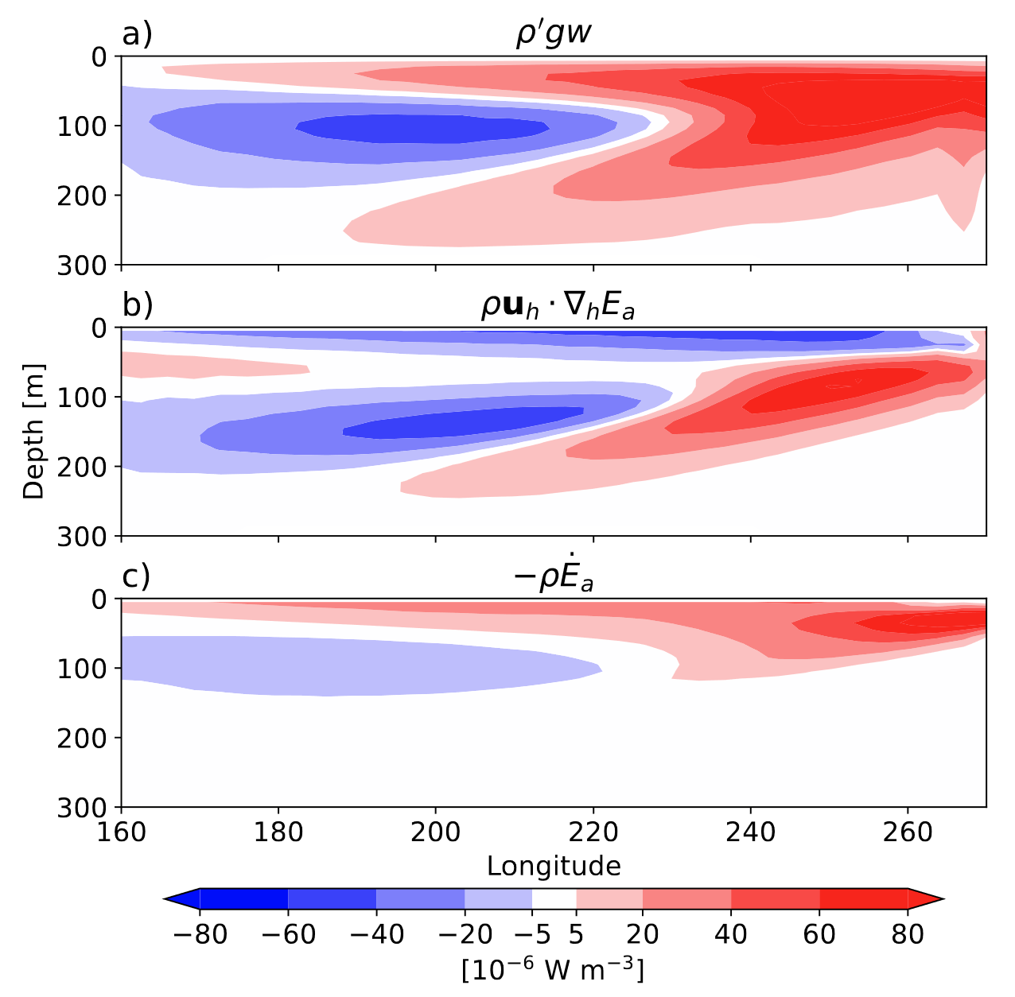
20-50% of Pacific equatorial upwelling is pushed from below
Work by: N. Brizuela, C.Y. Lee, A.H. Sobel, R. Seager, S.J. Camargo, J. Zhuo
Energetic cost of upwelling
Push from below happens in blue area
(upwelling produces KE here)
Potential energy supplied by advection
Potential energy that enables this is produced by off-equatorial downwelling.
Diabatic potential energy supply
Energy cycle implies that off-equatorial momentum and buoyancy forcings shape equatorial w.

