Slide 1
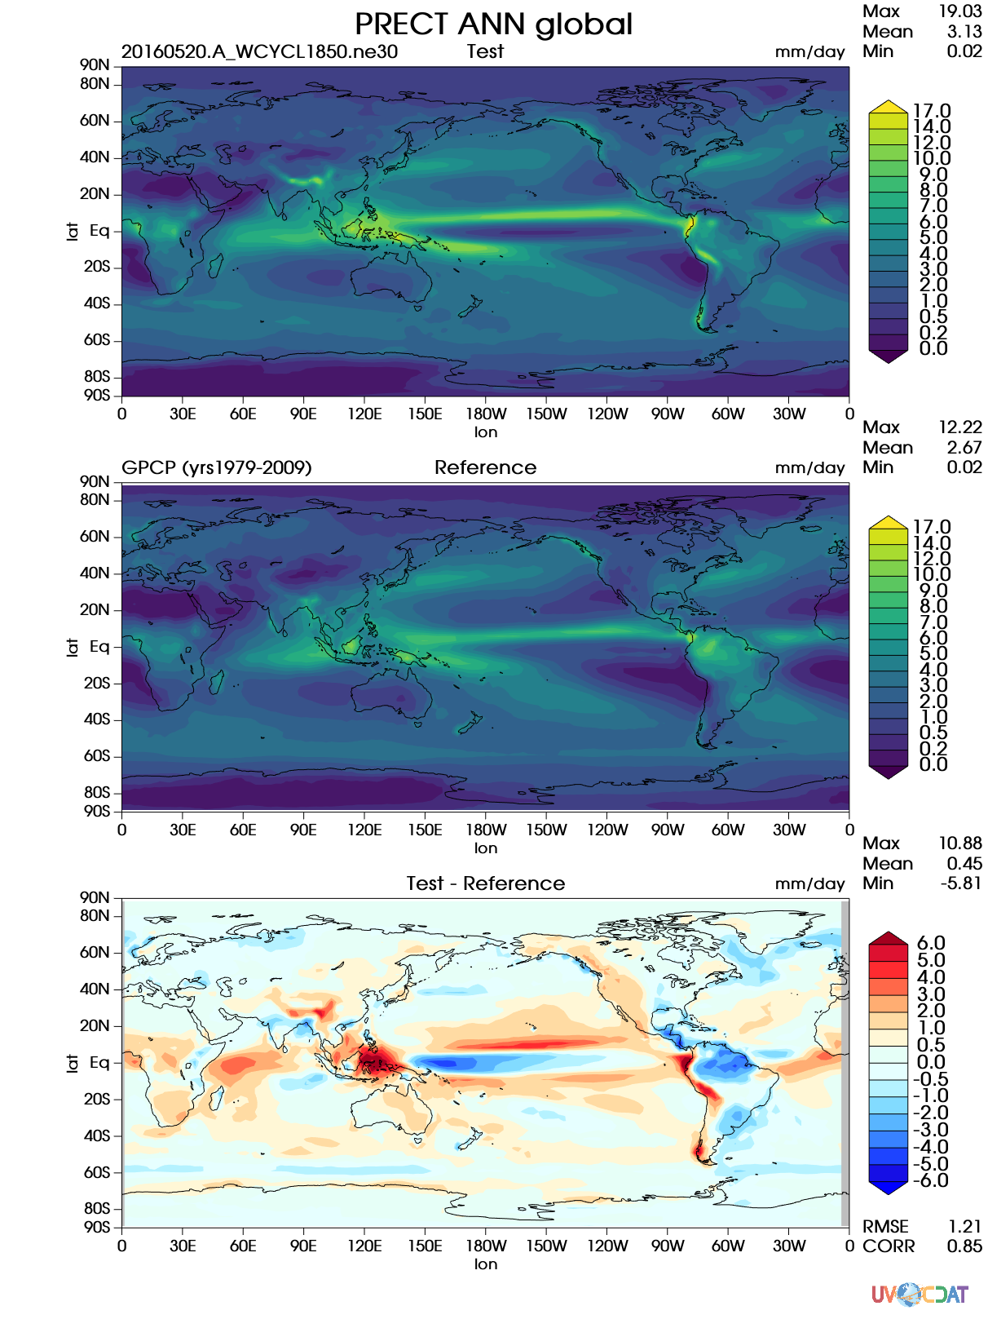
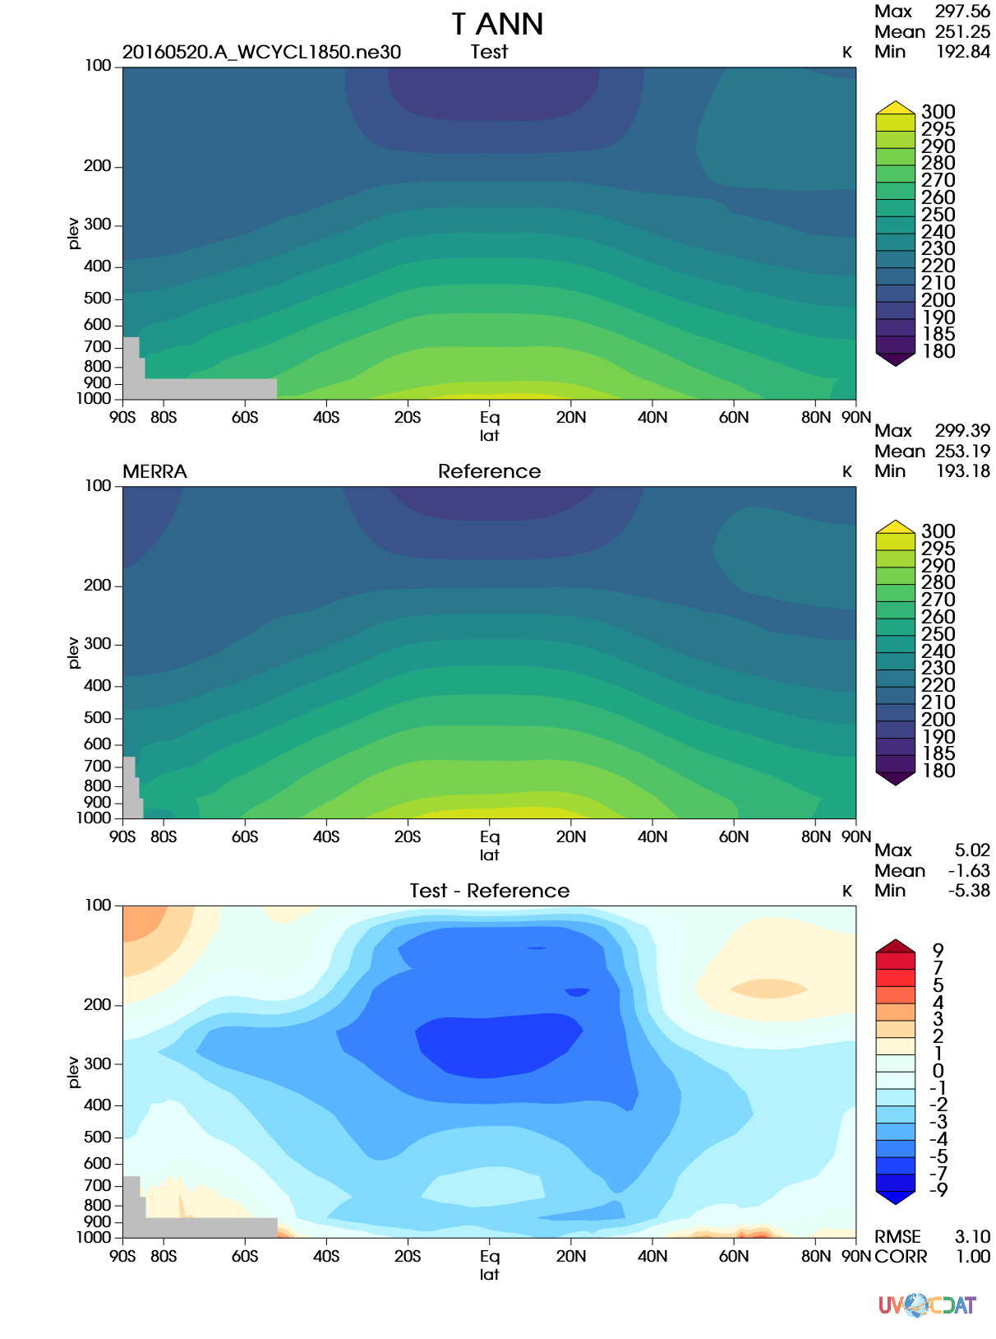
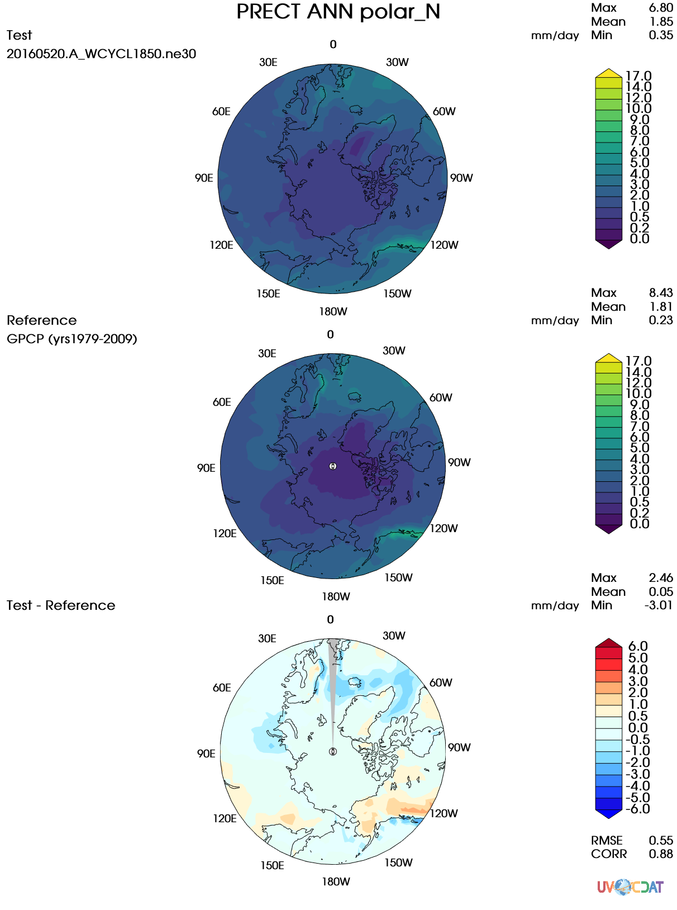
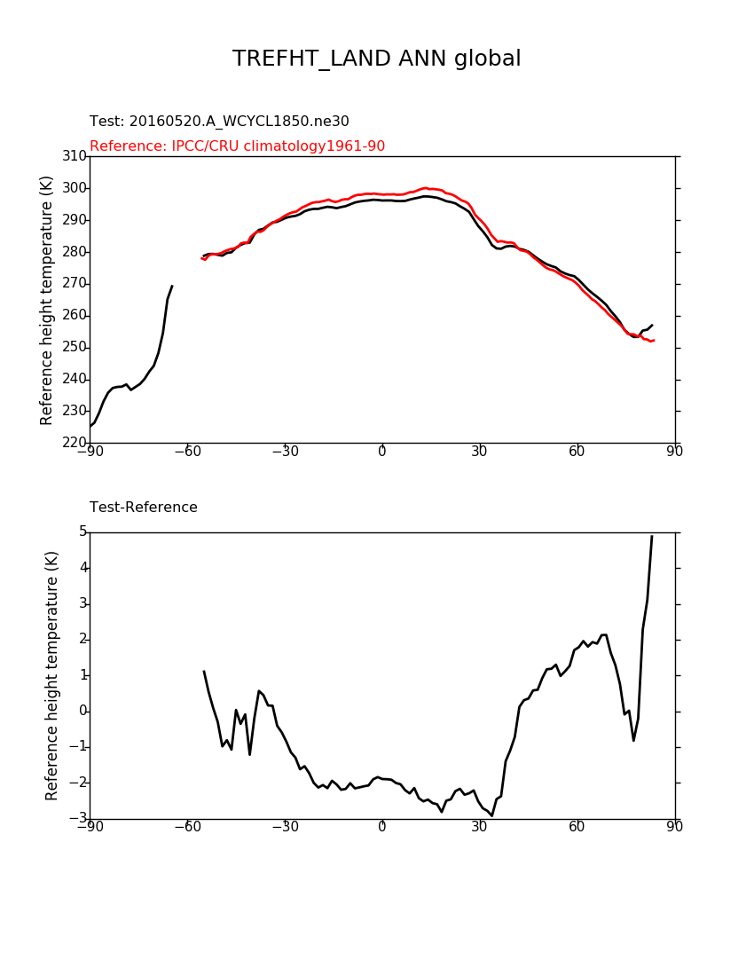
The New ACME Diagnostics Package
Chengzhu Zhang, Zeshawn Shaheen, Chris Golaz, Jerry Potter
Lawrence Livermore National Lab
Thanks to: Charles Doutriaux, Jim McEnerney, Jeff Painter, Denis Nadeau, Charlie Zender,
Renata McCoy and Dean N. Williams
Objective
Feature 2: Flexible configuration
A comprehensive diagnostics package that:
Developed in Python
Fully implements the functionality of AMWG diagnostics package
Delivers valuable diagnostics developed from ACME to the community
Maintains repo for most updated observational datasets, including remote sensing,
reanalysis and in-situ datasets
Is flexible for adding user-specified diagnostics
Interacts effectively with the PCMDI's metrics package PMP and the ARM diagnostics
package through a unified framework: Community Diagnostics Package (CDP).
A python script: myparams.py
reference_data_path = '/space1/obs_data_20140804/'
test_data_path = '/space/golaz1/ACME_simulations/' test_name = '20160520.A_WCYCL1850.ne30
_oEC.edison.alpha6_01 '
sets = [5]
diff_colormap = 'bl_to_darkred'
seasons =[“ANN”, "DJF", "MAM", "JJA", "SON"]
backend = ‘cartopy'
More parameters
Path to obs/model data
Set number (3, 4, 5, 7)
Variables
Seasons
Regions
Pressure levels
Regridding tool/method
more
Plotting:
Titles
Backend (vcs, matplotlib)
Output format (png, pdf, svg)
Colormap
more
A json script: mydiags.json
{"mydiags":
[ { "case_id": "set5_GPCP",
"variables": ["PRECT"],
"ref_name": "GPCP",
"reference_name": "GPCP (yrs1979-2009)",
"regions": ["global”, "ocean_TROPICS","TRMM_region"],
"contour_levels": [0, 0.2, 0.5, 1, 2, 3, 4, 5, 6, 7, 8, 9, 10],
"diff_levels": [-6, -5, -4, -3, -2, -1, -0.5, 0, 0.5, 1, 2, 3, 4] }
Current State and Features
Completed 4 sets of diagnostics from AMWG with mod. vs mod., mod. vs obs.:
Lat-Lon contour
Zonal mean contour
Polar projection
Zonal mean line
Feature 3: Flexible for adding derived variables
Derived variables: variable(s) needing preprocessing before calculation. i.e. total precipitation rate [PRECT]
  PRECT = PRECL + PRECC
  Unit conversion: into mm/day
Built-in derived variables list for ACME output, adjustable for CMIP conventions.
User expandable in configuration files
Examples selected from hundreds of plots for each set of diagnostics
Reproduce and complete these sets with metrics matched and differences understood compared to AMWG
Required metrics [RMSE, correlation] as scalars of model performance
NetCDF files can be downloaded from server side
Flexible architecture for implementing new diagnostics: i.e., some tier 1, 2 diagnostics from the atmosphere group.
User’s guide
Installation and Running:
One command to install:
  conda install acme_diags -c acme -c conda-forge -c uvcdat
Edit scripts for configuration
Multiple Uses:
1. Default AMWG set run
  acme_diags_driver.py -p myparam.py
2. Modify json file to have a subset of AMWG run
  acme_diags_driver.py -p myparam.py –d modified_AMWG.json
3. Create customized json to include new observational data.
Documentation available on GitHub
Please contact zhang40@llnl.gov or shaheen2@llnl.gov for technical support
Feature 1: Clean and simple design
acme_diags/
acme_diags_driver.py # main driver which calls individual drivers of each set
driver/ # individual driver to do file I/O, calculation, save data and metrics
set5_driver.py
set7_driver.py
plot/ # plotting based on data and metrics
vcs/ # vcs graphing back end
set5.py
cartopy/ # matplotlib/cartopy graphing back end
set5.py
acme_parameter.py # Supported parameters for configuration
acme_parser.py # Supported command line options
acme_viewer.py # Create output viewer to view and share results.
derivations/…
This work was performed under the auspices of the U.S. Department of Energy by Lawrence Livermore National
Laboratory under contract DE-AC52-07NA27344. Lawrence Livermore National Security, LLC
For additional information, contact:
Staff Member: Chengzhu Zhang
Title: Staff Scientist
Institution or Organization: Lawrence Livermore National
Laboratory
(925) 424-4573
zhang40@llnl.gov
climatemodeling.science.energy.gov/acme

