Slide 1
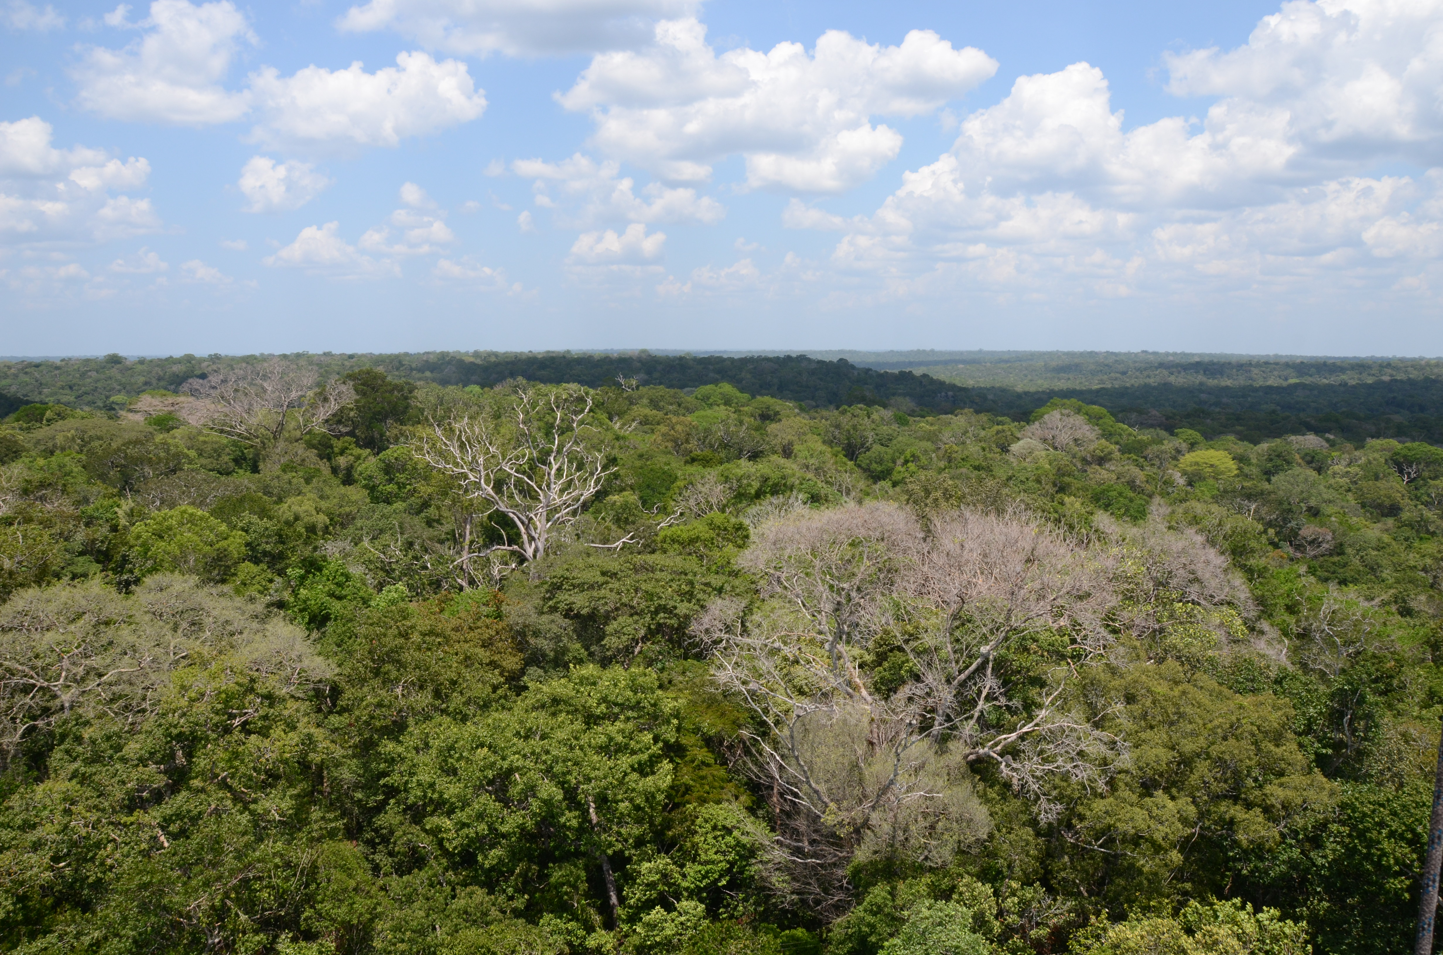


NGEE-Tropics Interests and Capabilities in coupled ACME V2-V3 simulations
C. Koven, J. Chambers, L. Kueppers, R. Fisher, R. Leung, C. Xu, B. Christoffersen, R. G. Knox, J. A. Holm, G. Bisht, Y. Fang,
And the NGEE-Tropics team
And collaborators: G. J. Kooperman, Y. Chen, F. M. Hoffman, K. Lindsay, M. S. Pritchard, A. L. S. Swann, J. T. Randerson
ACME Annual Meeting
6/5/2017

Slide 2
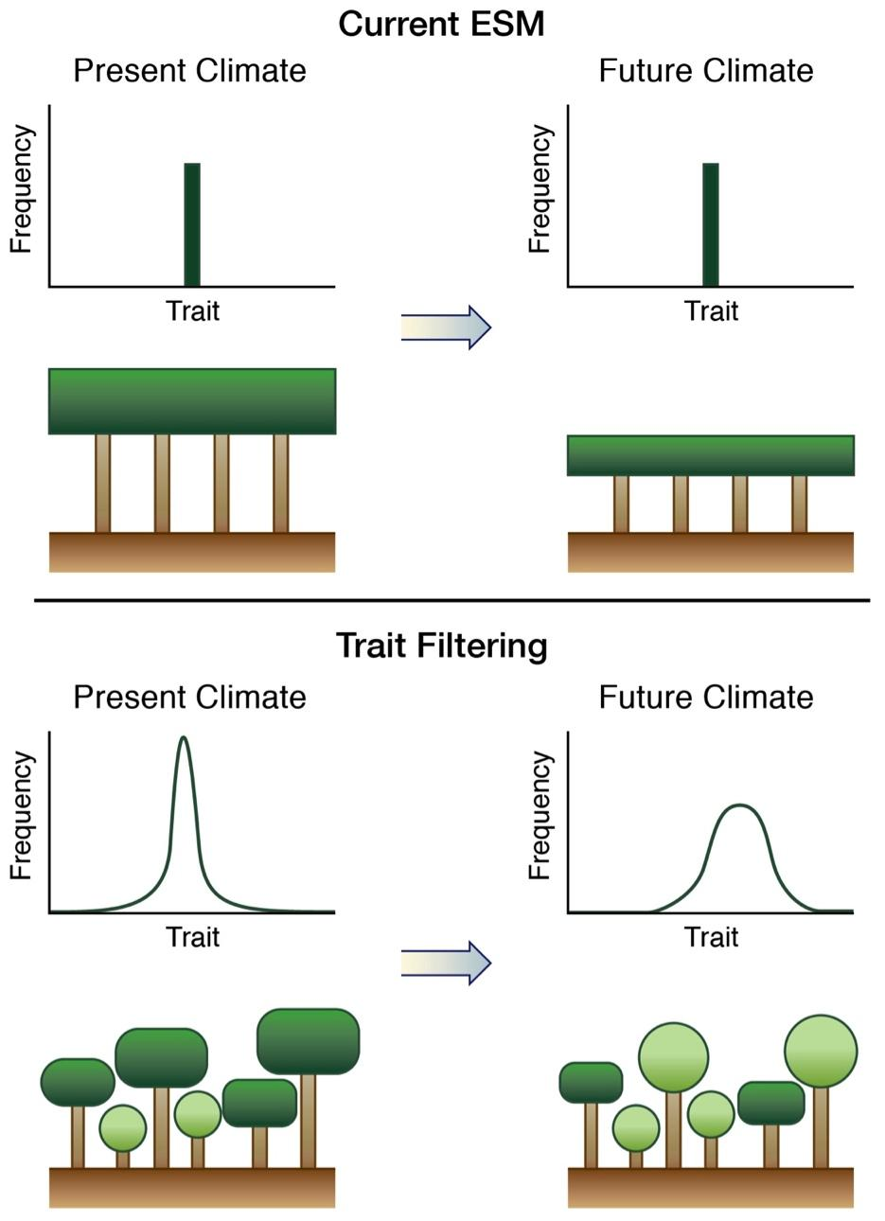
NGEE-Tropics core modeling platform: FATES vegetation module for ACME
Demographic vegetation structure based on ED model: resolves size, age of individual trees
Individuals interact and compete for resources: light, water
Structured ecosystem resolves patches with differing time since disturbance
Flexible definition of PFTs to allow for succession and other ecological dynamics
Improved representation of hydrology and surface energy exchange via plant hydraulics
ALM
ALM-FATES
“Big-Leaf” vegetation
Demographic Vegetation

Slide 3
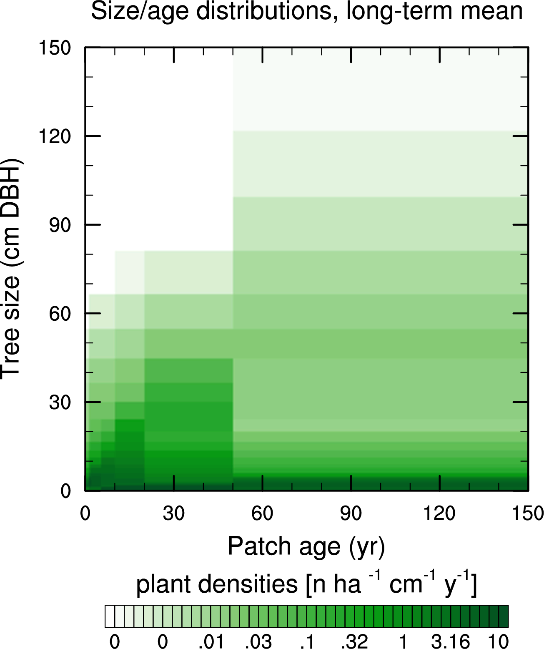
Structured Vegetation: FATES resolves heterogeneity in patch age, tree size, canopy strata. Affects multiple ecosystem properties (e.g. roughness length)
Canopy Growth Trajectory
Disturbance-survivors
Demoted trees
Understory Growth Trajectory

Slide 4
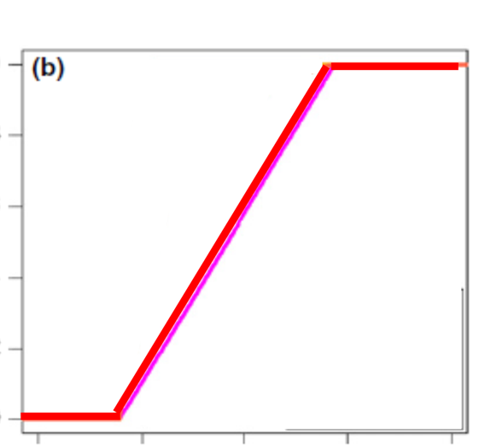
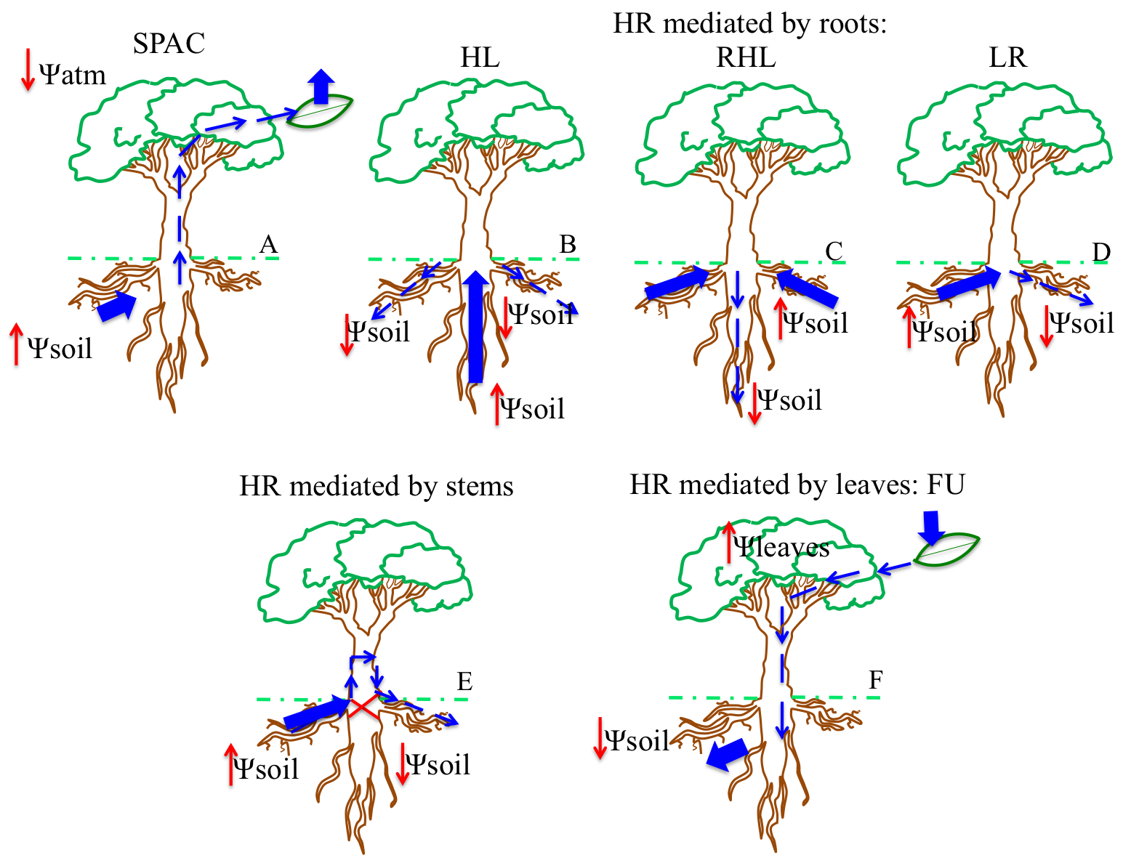
Plant hydraulics
ACME and other ESMs currently reduce carbon assimilation and transpiration by “Btran” factor, which is a function of soil moisture => assume instant connectivity between soil and leaves
In reality, water needs to travel from the soil into roots, through roots, stem, branches, and leaves before it can be transpired
Hydraulic models explicitly resolve these connections through the vegetation, and therefore include the lags and plant tissue controls on moisture dynamics
Current Generation ESMs
Next Generation ESMs
1.0
0.8
0.6
0.4
0.2
0.0
leaf
moisture response (-)
leaf
stem xylem & storage
soil
0.05 0.10 0.15 0.20 0.25
root xylem
soil moisture (m³ m⁻³)
soil
rhizosphere

Slide 5
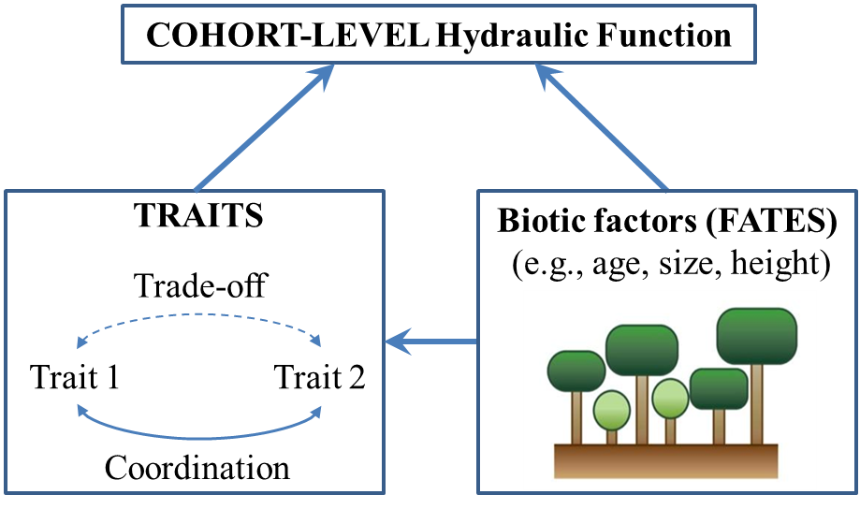
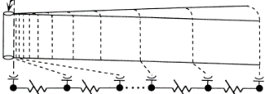
FATES-hydro model structure
Hydrodynamics:
(water acquisition, transport, retention)
Size- and Trait-Scaling:
stomata
leaf storage
stem xylem
stem storage
stem xylem
SOIL SURFACE
Transport root
Absorbing root
root
xylem
…
PLANT
Christoffersen, et al. (2016) GMD
McDowell & Xu (2017) New Phytologist
RHIZOSPHERE

Slide 6
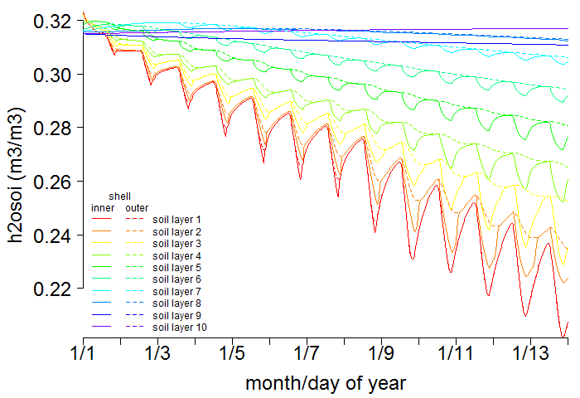
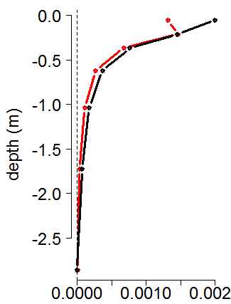
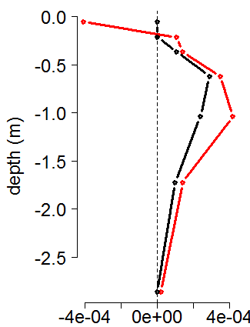

Example dynamics of FATES-Hydro
Soil-root water potential gradients & hydraulic redistribution under drought
Soil moisture
Root uptake
control
drought
deep
shallow
soil-root gradients
ALM default
FATES-Hydro
Strong diurnal cycling of near-root soils, which leads to diurnal asymmetry in transpiration rates
Christoffersen et al., in prep

Slide 7
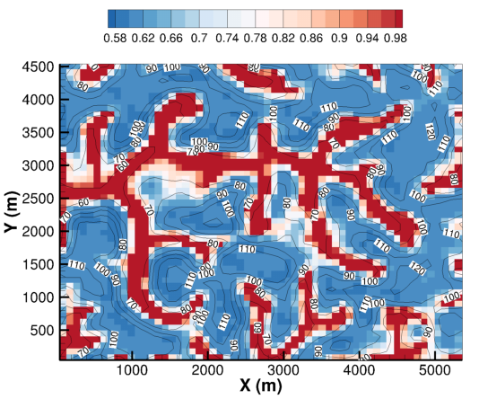
NGEE-Tropics also coordinating datasets for testing of fine-scale hydrologic models in tropical forests
Fang et al., in prep
Fine-scale soil-moisture variation in watershed near Manaus

Slide 8
NGEE-Tropics interests in coupled ACME experiments
How do tropical forest ecosystems govern surface exchange of water and energy, and influence coupled land-atmosphere system?
  Diurnal and seasonal cycle changes induced by plant hydraulics
  Ecosystem heterogeneity effects
How will ecosystems mediate global change forcers to influence coupled system changes?

Slide 9
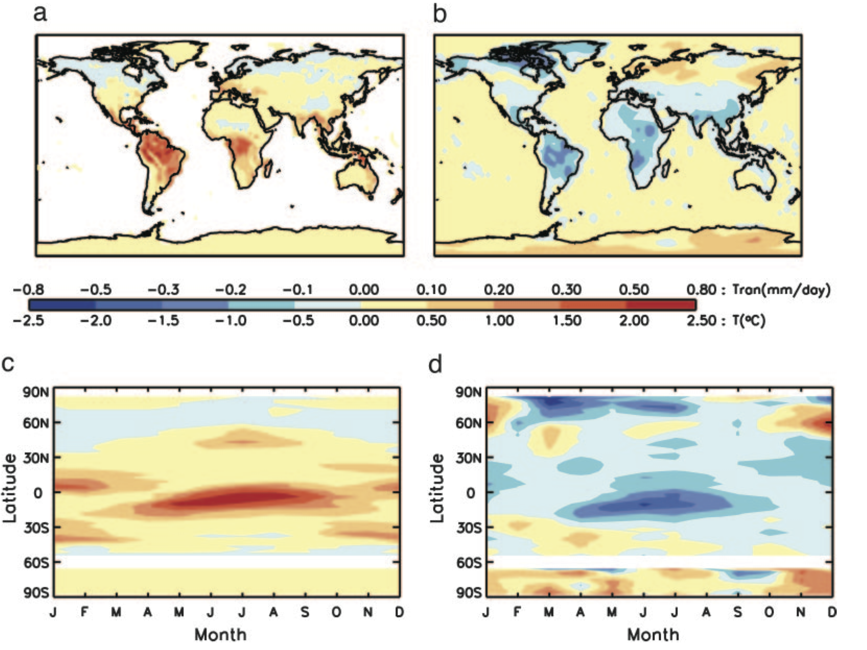
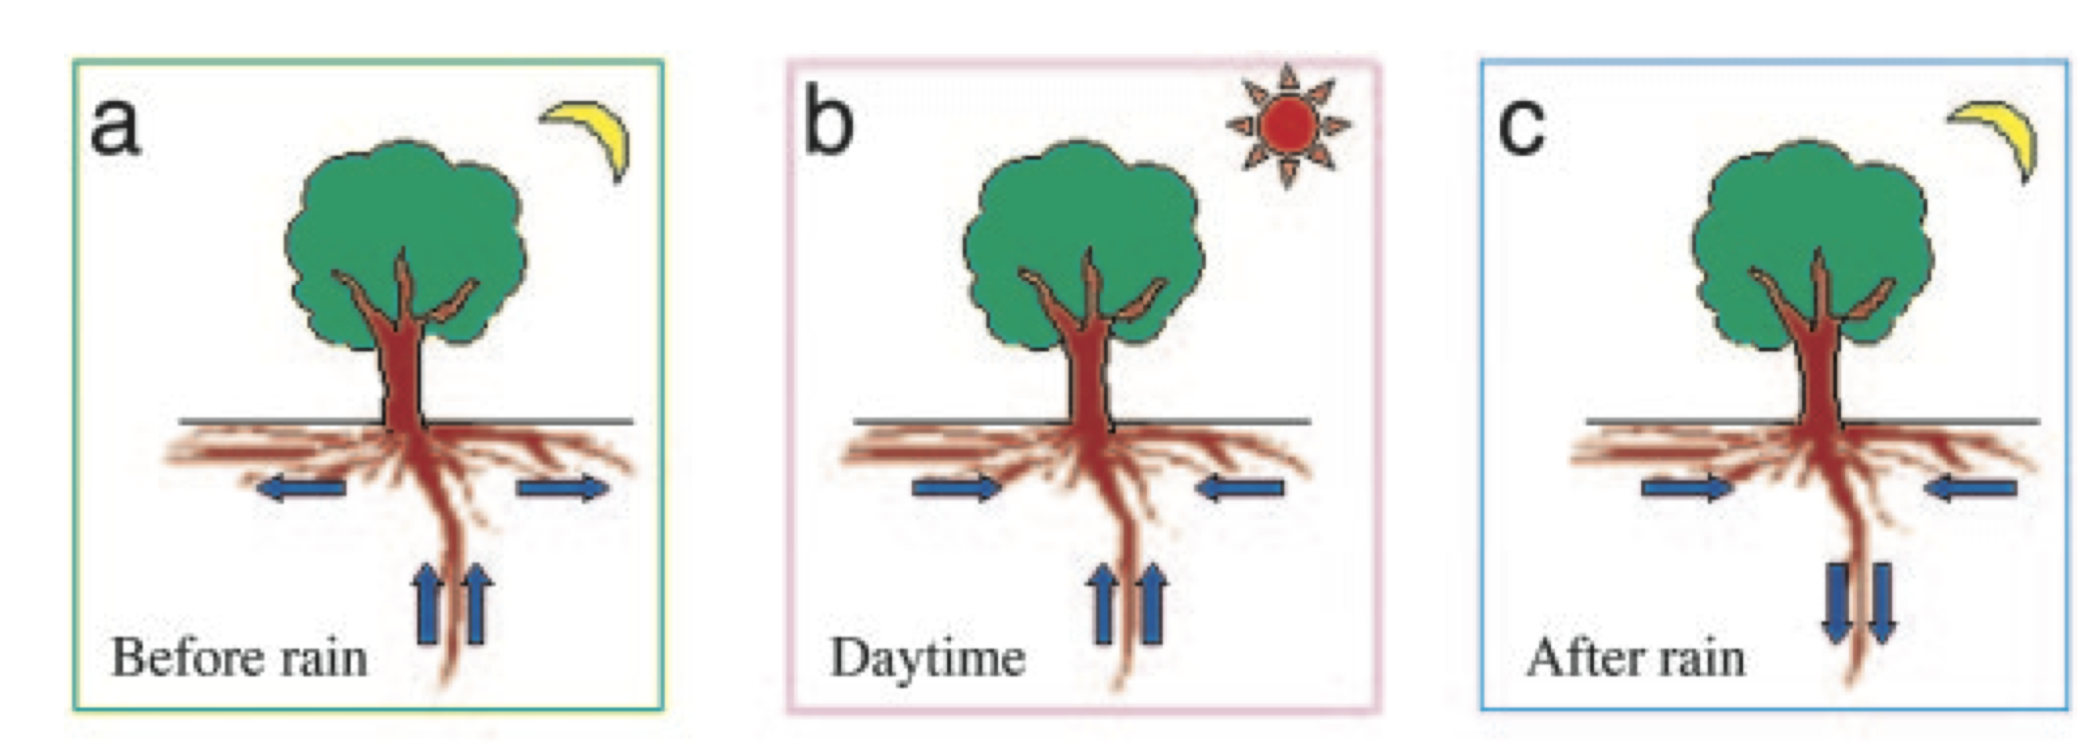
Hydraulic redistribution (one component of plant hydraulics) has been shown to affect seasonal cycles of precipitation
Precip anoms
Temp anoms
Lee et al., 2005

Slide 10
Amazon future precipitation reductions driven by biophysics
Precipitation change:
Elevated CO2 minus control
Kooperman et al., in review

Slide 11
Regionally differentiated coupled-system response to local biophysical perturbations
How sensitive are these dynamics to representation of water flow through the soil-plant-atmosphere system?
Amazon Drying
Africa and SE Asia Moistening
Precipitation change:
Elevated CO2 minus control
Kooperman et al., in review

Slide 12
Summary
NGEE-Tropics Capabilities
  FATES and FATES-hydro models for ALM
  Datasets (stream hydrology, fluxes, traits) for assessing coupled system dynamics
NGEE-Tropics Interests
  Understanding effect of structural heterogeneity, plant hydraulics, and plant functional variation on coupled system behavior:
    Mean-state diurnal and seasonal cycles of water and energy
    Forced response of precipitation to biophysical CO₂ effects

