Slide 1
Scenario Discovery for Probabilistic Ensembles of a Coupled Human-Earth System Model
Jen Morris
and
Kenny Cox
MIT Joint Program on the Science and Policy of Global Change
August 8, 2024
MultiSector Dynamics
BIOLOGICAL AND ENVIRONMENTAL RESEARCH
Earth and Environmental System Modeling

Slide 2
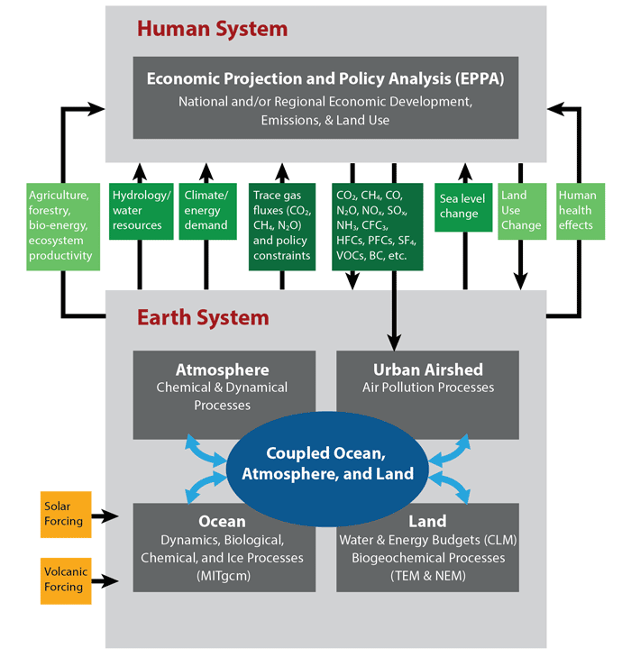
Coupled Human-Earth System Models
MIT Integrated Global System Modeling (IGSM) Framework
Used to explore potential future outcomes for emissions, economics, energy, land, water, climate, etc.
Uncertainty is often represented through sensitivity analysis, scenarios and model comparisons, which do not provide a probabilistic interpretation
We take a probabilistic approach to uncertainty, creating probabilistic integrated socio-economic and climate projections
http://globalchange.mit.edu/
Notes:
-Many coupled human-Earth system models have been developed to explore potential future energy, emissions, climate and other outcomes of interest. The MIT Integrated Global System Modeling Framework is one such model.
-While these exercises are useful and can provide great insights, they can limit the uncertainty space explored and they also provide no probabilistic interpretation.

Slide 3
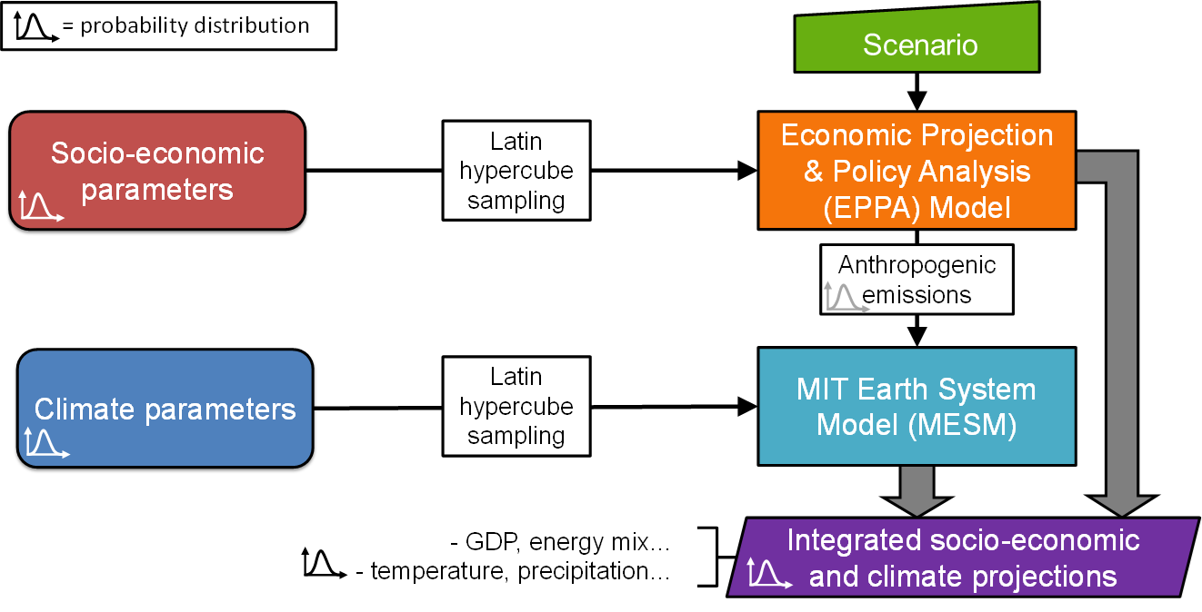
Uncertainty Quantification via Traditional Monte Carlo Approach
Probability distributions for socio-economic & climate input parameters are developed & sampled
Simulated through MIT integrated models to explore a range of possible future outcomes
For a set of ensemble scenarios with different long-term temperature targets
Labor/Capital Productivity
Population
Energy Technology Costs
Energy Efficiency Improvements
Fossil Fuel Resource Availability
Rate of Technology Penetration
Elasticities of Substitution
Land Productivity
Climate Sensitivity
Ocean Heat Uptake
Aerosol Forcing

Slide 4
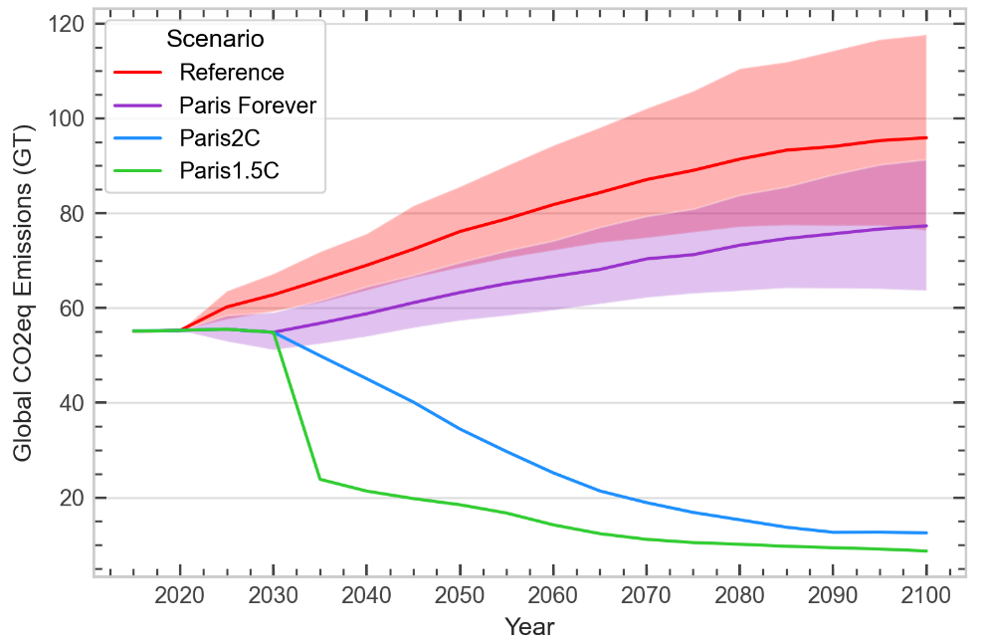
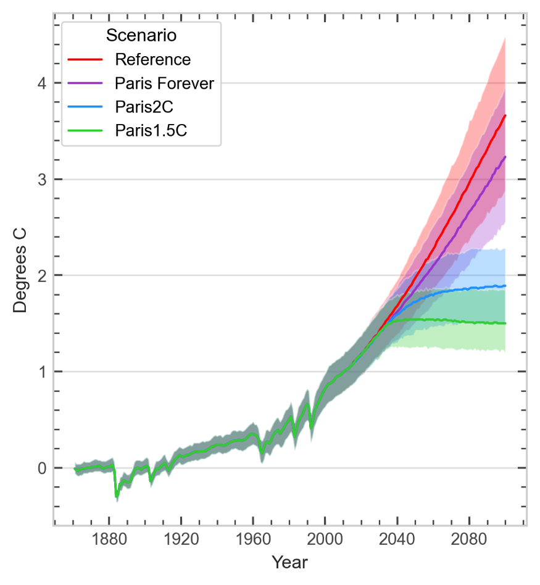
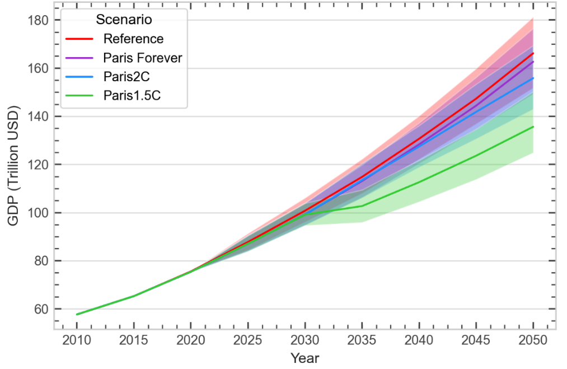
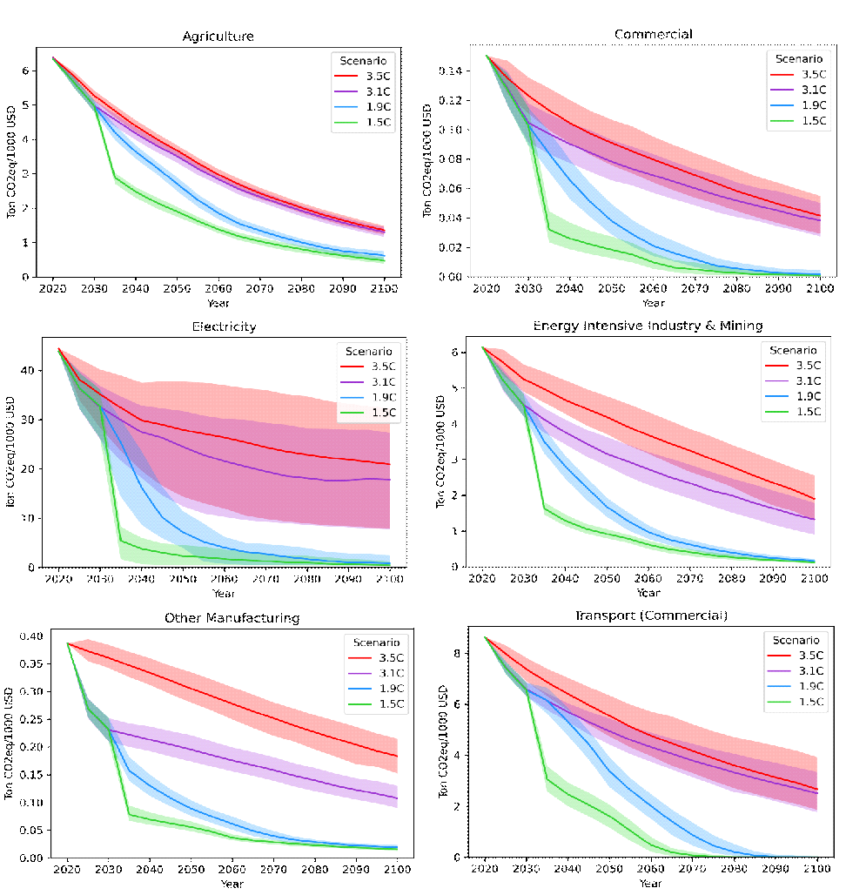
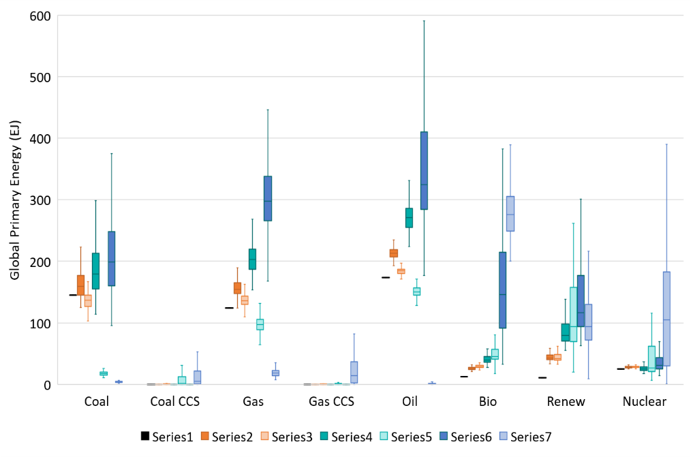
Distributions of Key Results
Morris et al. (2022)
Emissions
Temperature
GDP
Sectoral Emissions Intensity
Energy Mix
Precipitation; Sectoral Output; Air Pollutants; Land Use; Water Demand….

Slide 5
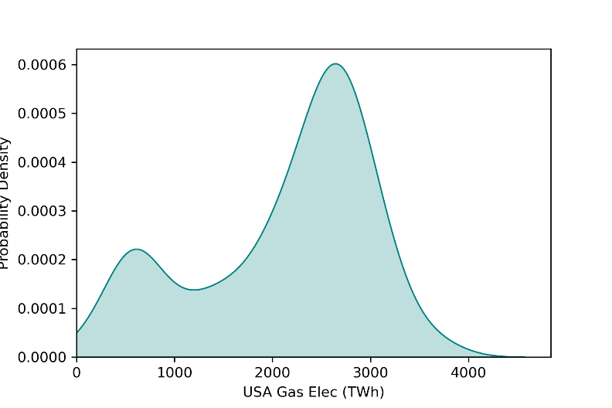
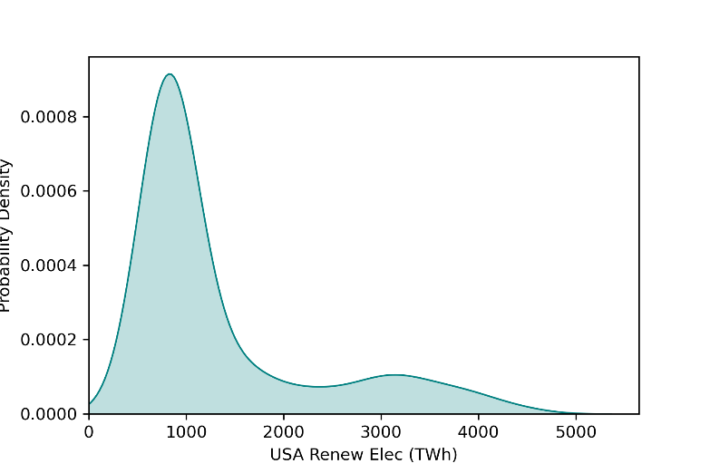
Probabilistic Ensembles
Probabilistic Ensembles
Approach more fully and systematically explores uncertainty space compared to limited number of scenarios and provides insight about likelihood of outcomes
BUT, some challenges:
1) Produces a lot of data- difficult to explore and extract insights
2) Distributions of each outcome are separately characterized and so relationships that may exist over time or among outcomes are lost
🡪 Scenario discovery can address these issues
USA Gas Elec 2050
USA Renew Elec 2050

Slide 6
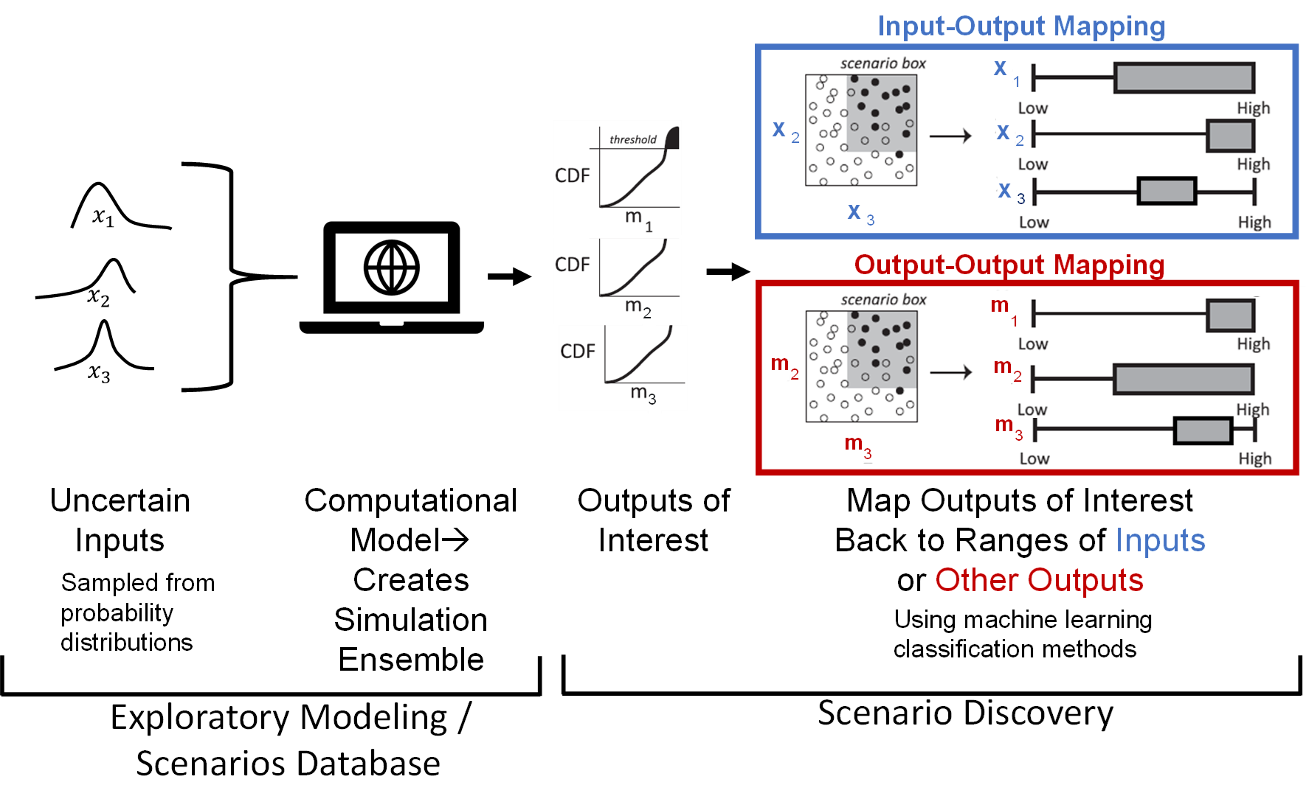
Scenario Discovery
Tools for screening databases of model simulations to identify outcomes of interest and their conditions for occurring
(e.g. Classification and Regression Trees (CART), Random Forest Classifiers, etc. )

Slide 7
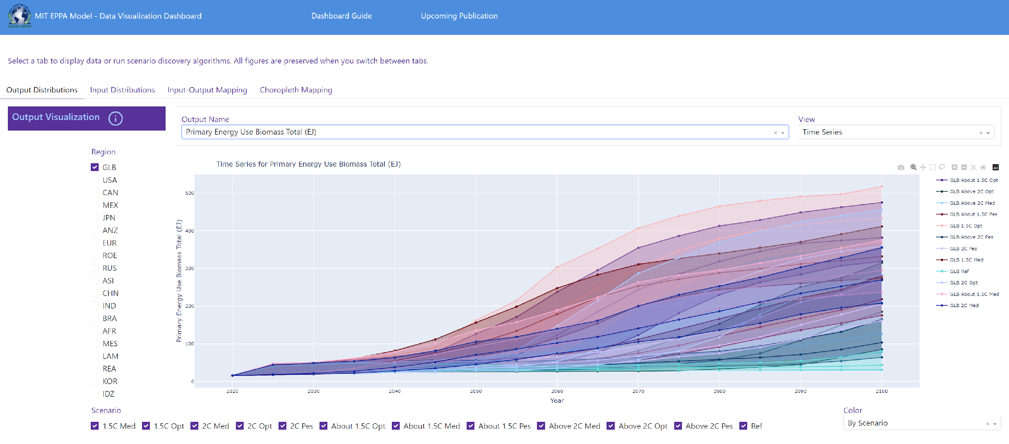
Scenario Discovery Visualization Tool
scenariodiscovery.mit.edu
(beta version: work in progress)
Interactive Web-Based Platform to:
Visualize results of ensembles
Elucidate how different outcomes and inputs are related
Identify individual scenarios of interest for particular studies
Steps:
Create database of large ensembles of model scenarios
Create flexible web-based platform that calls from database and allows users to visualize results and relationships among selected variables
Tool enables quick exploration and analysis of:
distributions of model outputs
input distributions driving ensembles
relationships between inputs and outputs, and how they change over time, across regions and scenarios
relationships between different outputs and potential tradeoffs
output patterns over time and their drivers
geographic maps of outputs
http://globalchange.mit.edu/

Slide 8
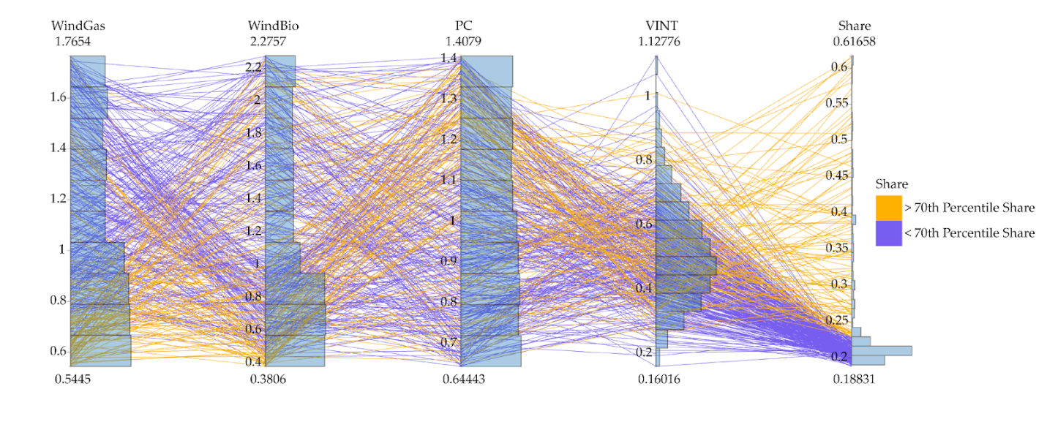
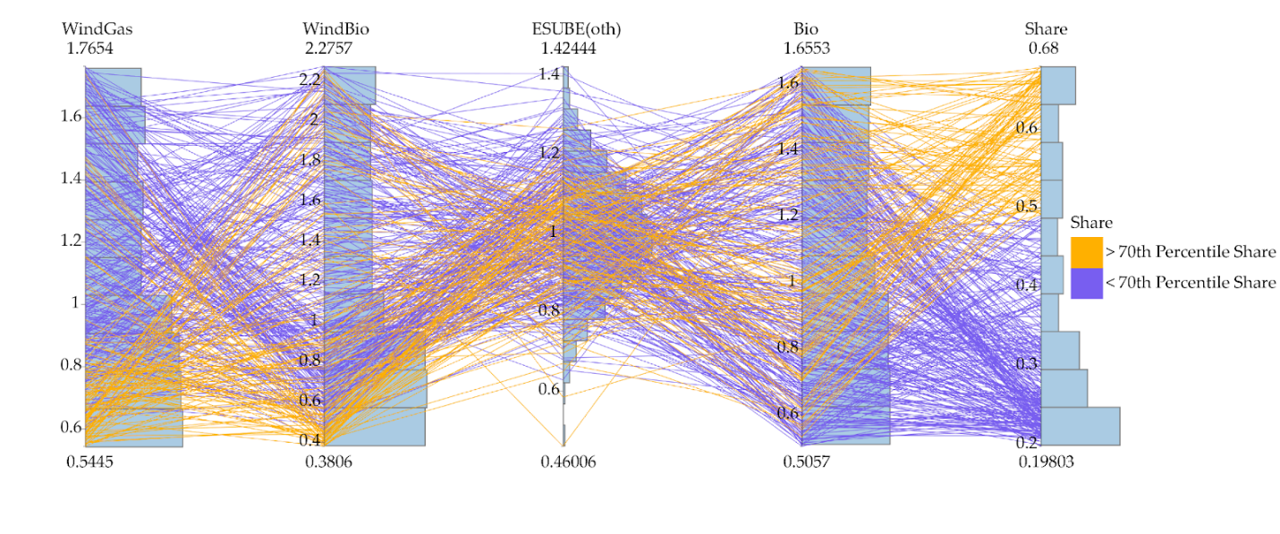
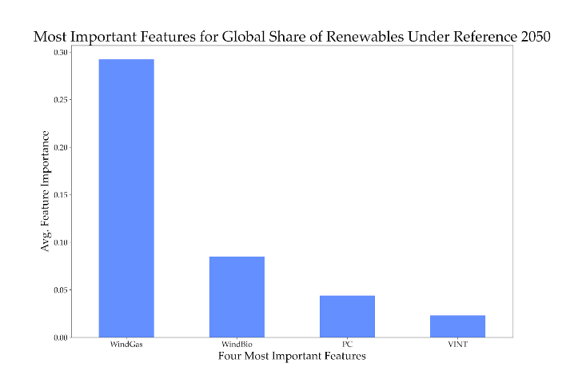
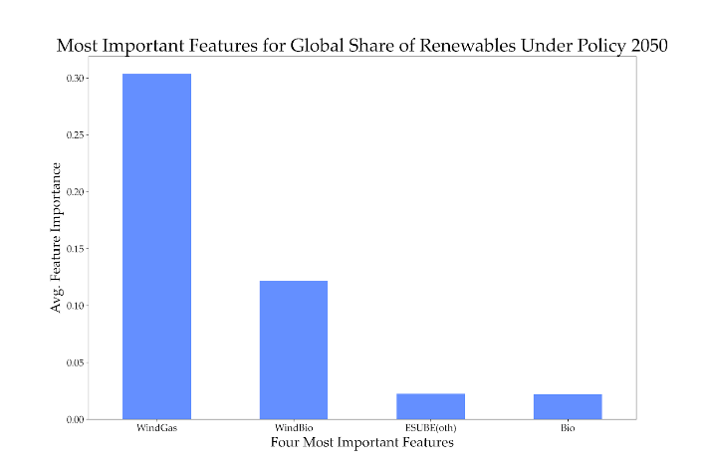
Application to Renewable Energy Penetration
Input-Output mapping: Identifies key drivers of outcome of interest
Reference Scenario in 2050
2C Scenario in 2050
Cost Wind+Gas
Cost Wind+Bio
Cost
Coal Elec
Capital Vintaging
% Renew
Cost Wind+Gas
Cost Wind+Bio
Fuel Substitution
Cost
Bio
% Renew
>70th
<70th
>70th
<70th
Reference Feature Importance Scores
2C Feature Importance Scores
Wind+Gas
Wind+Bio
Coal
Vintaging
Wind+Gas
Wind+Bio
Fuel Sub
Bio

Slide 9
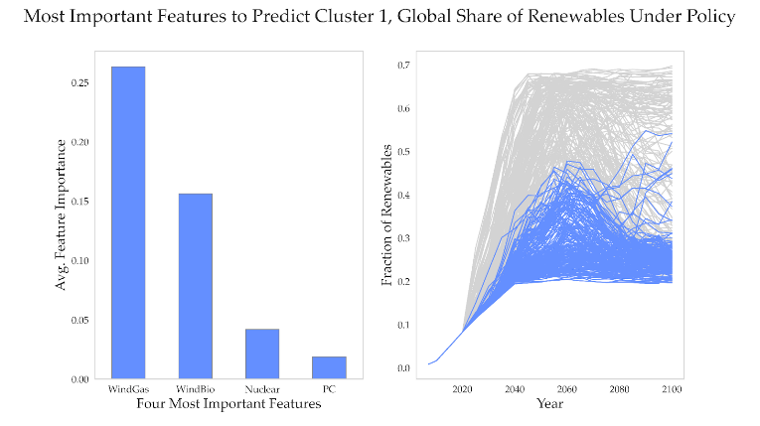
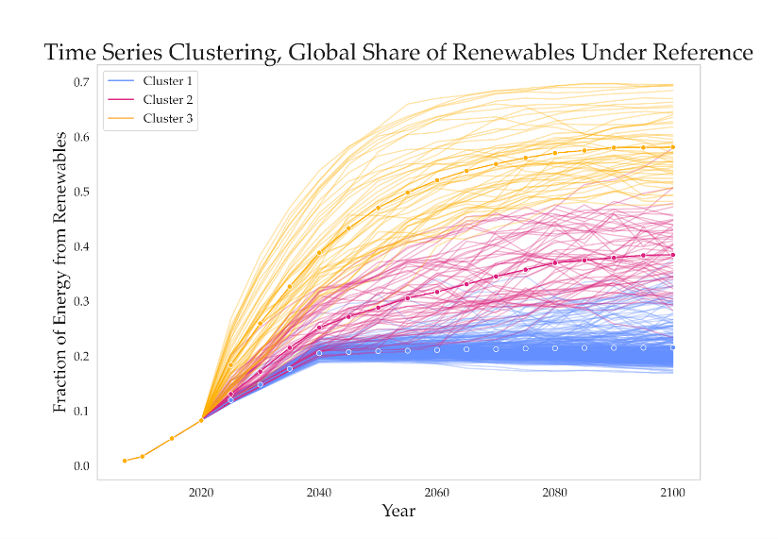
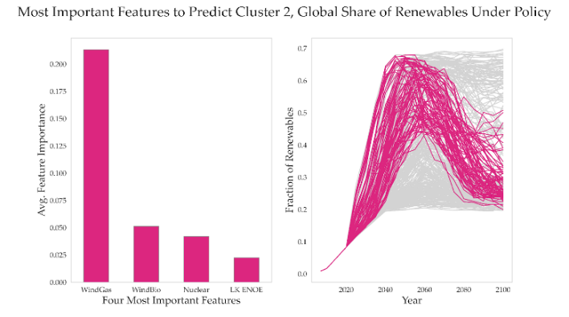
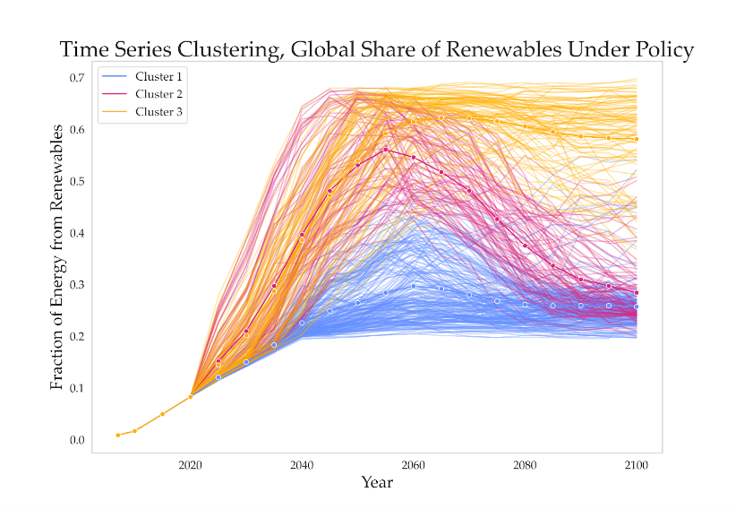
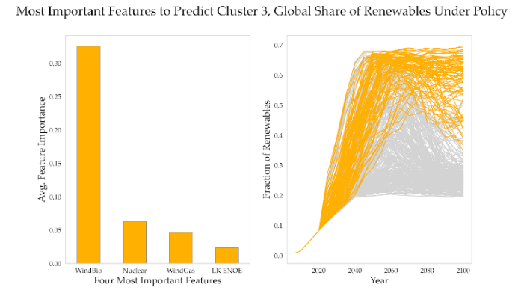
Application to Renewable Energy Penetration
Times series clustering: Identifies dynamics missed by looking at individual years, and main drivers of each cluster
Reference
Drivers of Cluster 1 in 2°C Case
Coal
Wind+Gas
Nuclear
Wind+Bio
Drivers of Cluster 2 in 2°C Case
2C
2C
Nuclear
Wind+Bio
L-K Elas
Wind+Gas
Drivers of Cluster 3 in 2°C Case
Nuclear
Wind+Gas
Wind+Bio
L-K Elas

Slide 10
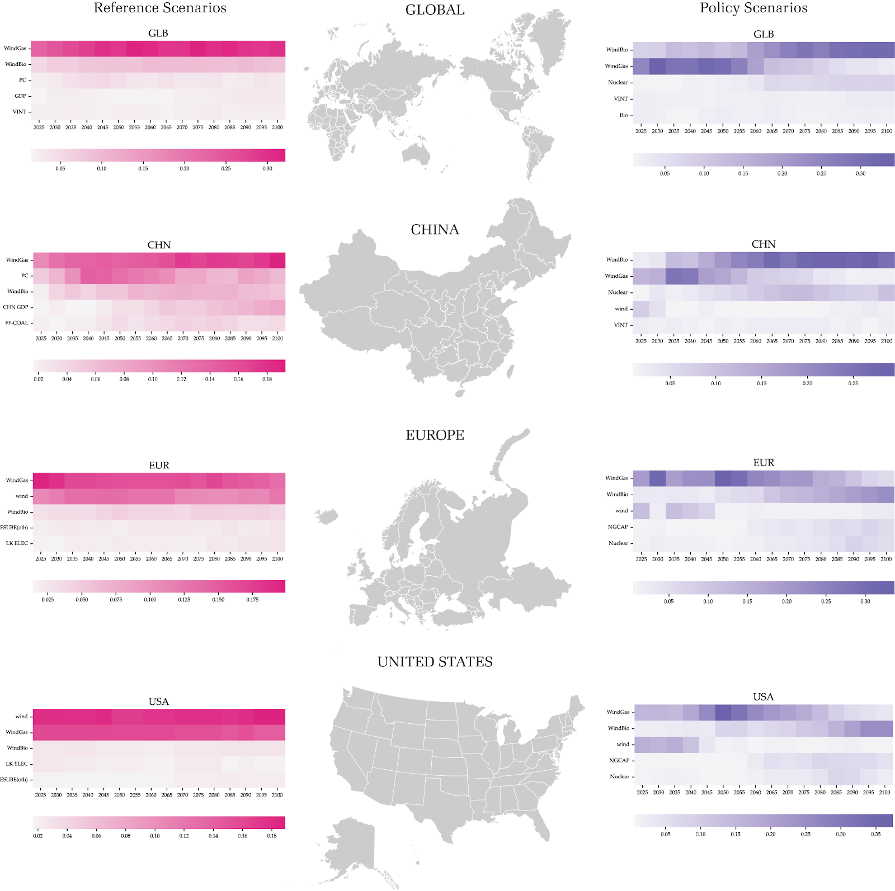
Application to Renewable Energy Penetration
Reference
2C
Wind+Gas
Wind+Bio
Coal
GDP
Vintaging
Wind+Bio
Wind+Gas
Nuclear
Vintaging
Bio
Time
Time
Comprehensive assessment of how key drivers vary by region, time and scenario
Wind+Gas
Coal
Wind+Bio
GDP
Coal Supply
Wind+Bio
Wind+Gas
Nuclear
Wind
Vintaging
Time
Time
Wind+Gas
Wind
Wind+Bio
Fuel Elas
L-K Elas
Wind+Gas
Wind+Bio
Wind
Gas CCS
Nuclear
Time
Time
Wind
Wind+Gas
Wind+Bio
L-K Elas
Fuel Elas
Wind+Gas
Wind+Bio
Wind
Gas CCS
Nuclear
Time
Time

Slide 11
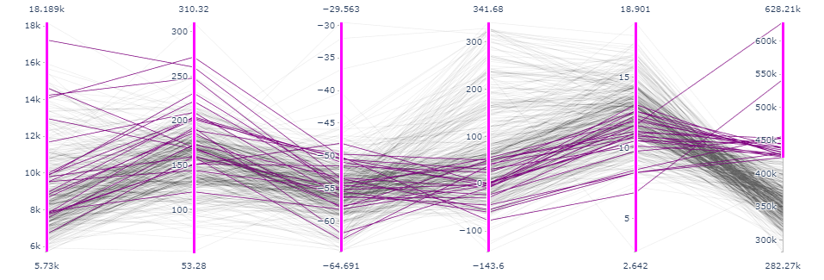
Application to Renewable Energy Penetration
Output-Output mapping: Identifies relationships and tradeoffs across outputs
Global: 2C Scenario in 2100
Emissions Intensity of Energy
Renew Elec
Bioenergyw/ CCS
Natural Forest Land
Crop
Land
GDP

Slide 12
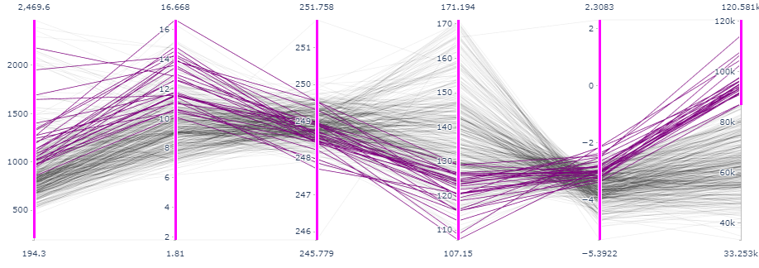
Application to Renewable Energy Penetration
Output-Output mapping: Identifies relationships and tradeoffs across outputs
USA: 2C Scenario in 2100
Emissions Intensity of Energy
Renew Elec
Bioenergyw/ CCS
Natural Forest Land
Crop
Land
GDP

Slide 13
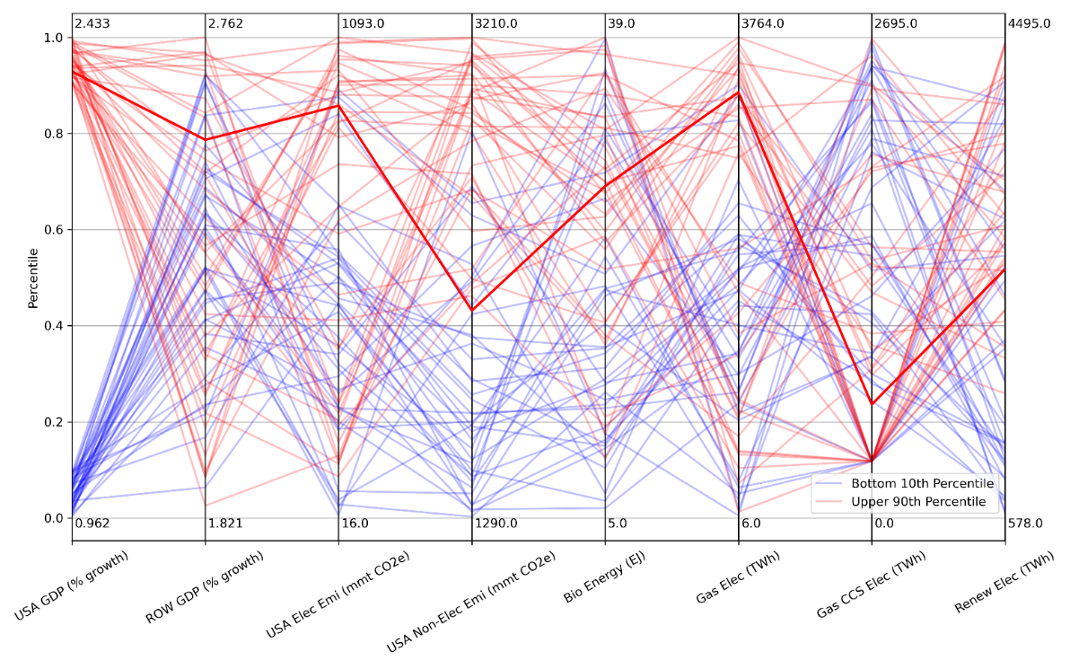
Connecting to the STRESS Platform
Scenariodiscovery.mit.edu
https://est.mit.edu/

Slide 14
Benefits of Approach
Ability to explore full range of outcomes with associated likelihoods while also maintaining intact individual scenarios
Explore if there are prevailing storylines behind outcomes of interest
Identify individual scenarios that are defined by specific combinations of outcomes to further explore… look at tradeoffs
Develop smaller sets of scenarios that include a wide variety of possible futures and/or span a range of particular outcomes of interest… to use in finer scale models
Help avoid potential biases in perceptions of what “needs” to happen to achieve certain outcomes
Challenges
Scale!
Model Connections & Feedbacks
Dynamics and Metrics
Deep Uncertainties

Slide 15
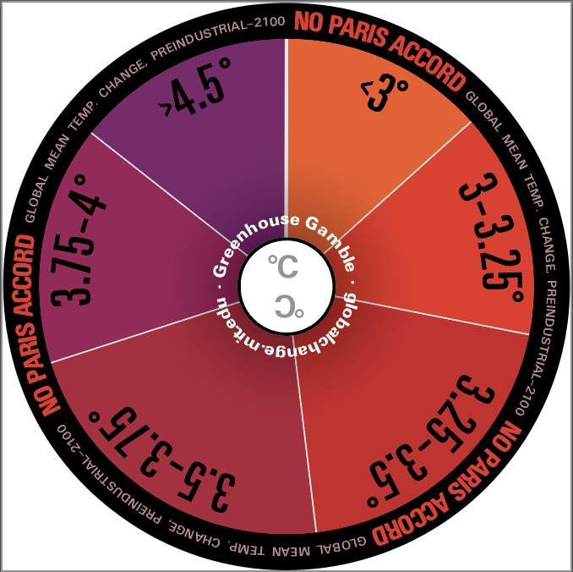
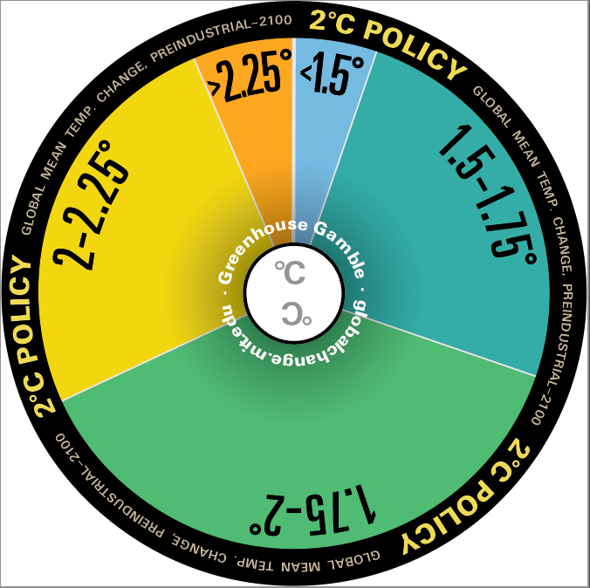
Thank you!
Jennifer Morris, MIT
holak@mit.edu
Uncertainty is unavoidable… but we can quantify where possible and make decisions accordingly
Notes:
‹#›

