Slide 1
Fire, dust, air and water: Improving aerosol biogeochemistry interactions in ACME (part2)
Nitrogen, phosphorus, iron, and silicon are the nutrients that limit phytoplankton growth.
They directly impact biological productivity and the export of carbon (biological pump),
which modifies air-sea CO₂ flux and climate.
To capture the carbon-climate feedbacks, we must simulate N, P, Fe and Si well.

Slide 2
Magnitude of External Iron Sources Highly Uncertain
Fe Inputs from 10 Global Ocean Models (Tabliabue et al. 2016)
GmolFe/yr
Atmospheric Deposition: 1.4 – 87
Sedimentary Sources: 0.6 - 194
Hydrothermal Vents: 11 - 18
Riverine Sources: 0.06 – 2.5
Total Iron Inputs: 1.4 - 195
Atmospheric source is the most temporally variable, impacted by climate and anthropogenic activities.

Slide 3
Task 4 : Improve Fe Cycle – External Fe Sources
4a. Add the hydrothermal vent iron source to ACME.
4b. Constrain and optimize external iron sources using model
simulations with observational datasets (GEOTRACES).
4c. GEOTRACES datasets will constrain atmospheric inputs of
mineral dust and dissolved Fe, but also N, Si and P.
4c. Optimized model will quantify how varying nutrient
deposition modifies carbon and air-sea CO₂ exchange.
5c. Coupled and ocean-only simulations will allow us to isolate natural and anthropogenic impacts on marine biogeochemistry and quantify the climate feedbacks.

Slide 4
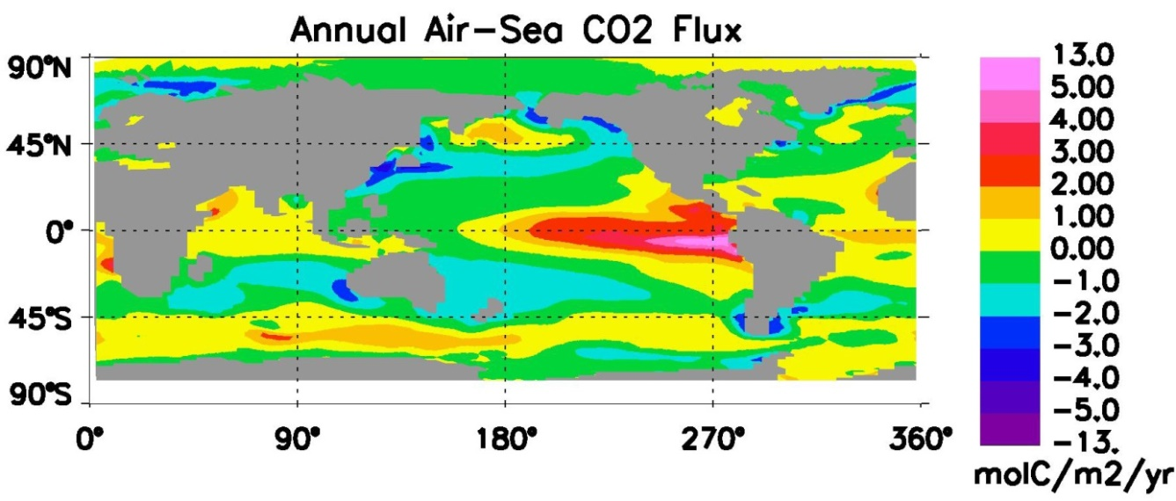
Improving Marine Biogeochemistry-Climate Feedbacks in ACME
Prof. J. Keith Moore, PI
Prof. Francois Primeau, Co-I
Dr. Rob Letscher, Co-I
University of California,Irvine
Capturing Biogeochemistry-Climate Feedbacks in ACME
1) Implement new Fe-Ligand Model, Optimize Fe/C Stoichiometry
2) Improve Carbon, Nitrogen, Oxygen Interactions (N₂O)
3) Explicit Treatment of Dissolved Organic Matter
4) Variable Stoichiometry in all Organic Pools
5) Develop and Apply Offline and Inverse Tools for Development,
Parameter Optimization and Initialization

Slide 5
Tasks 1,4,5: Implement new Fe Model, Optimize Fe Quotas (Moore, Primeau)
1) Implement new marine Fe model that includes explicit, dynamic
treatment of the organic ligands that influence iron losses.
2) Optimize iron quotas (Fe/C ratios) in the plankton. Optimize
the Fe/C in sinking exported organic matter, with inverse approach using extensive new observational datasets. Compliments ongoing similar efforts for N, P, Si, and O quotas in the sinking material.
3) The iron quota of the sinking particles constrains the total iron
removal by biological uptake and abiotically scavenged onto the sinking particles. Field observations of plankton quotas will help separate the two effects.

Slide 6
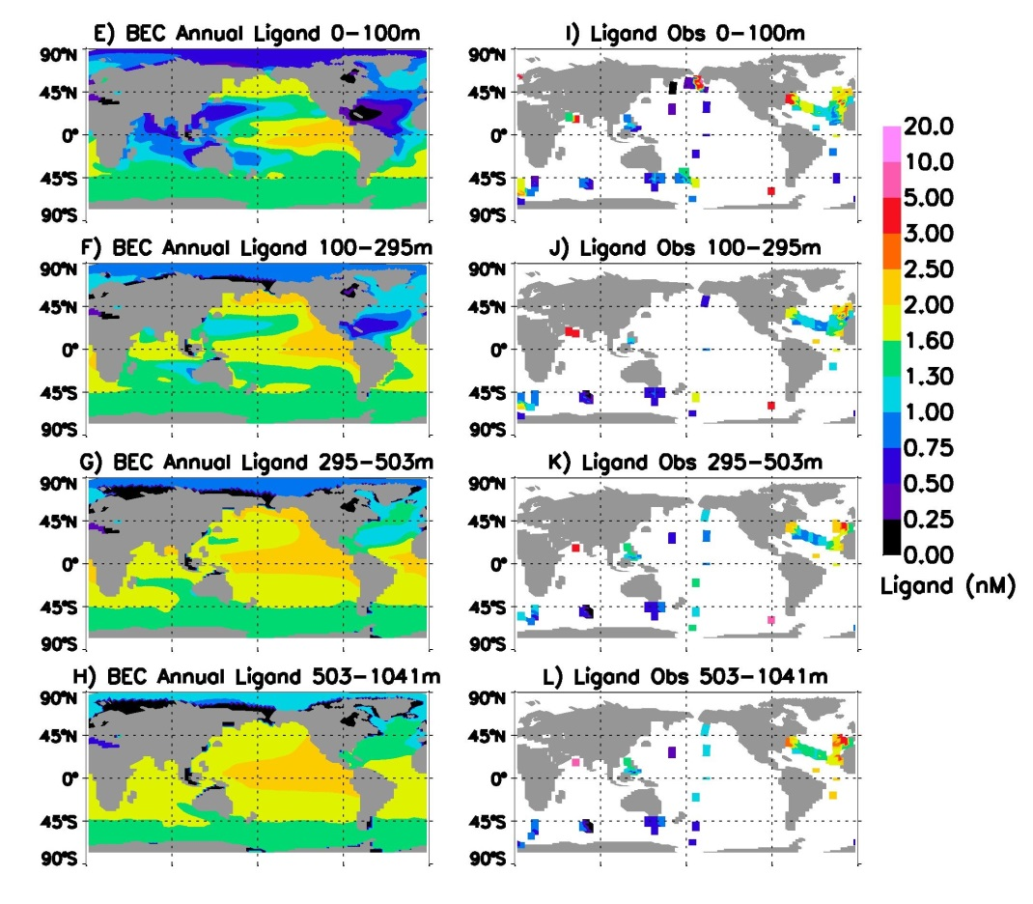
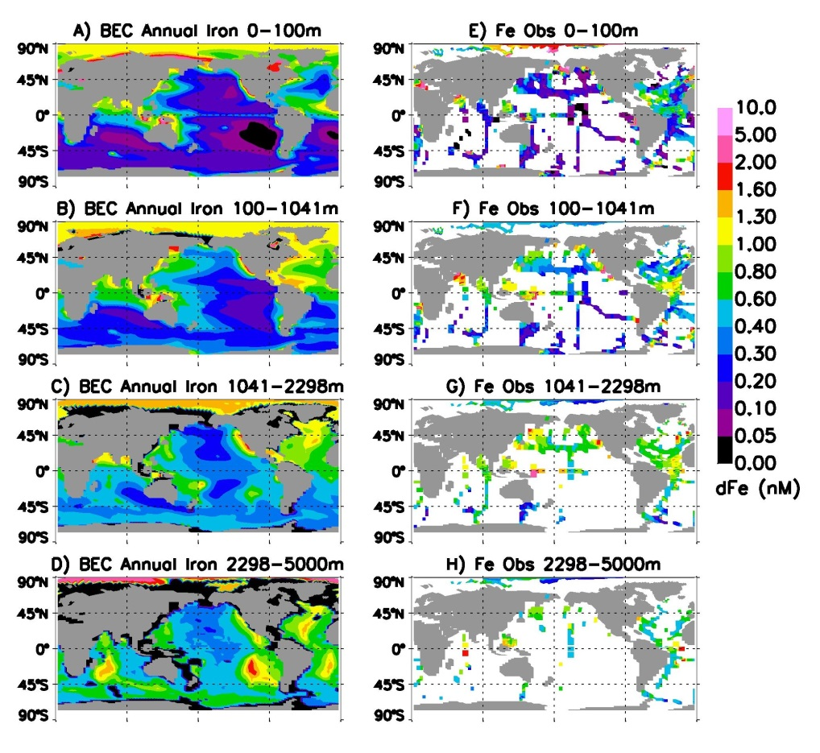
Task 1: Implement new marine Fe model,
Optimize Fe Quotas (Moore, Primeau)
Ligands treated implicitly in CESM 1 and ACME 1, the explicit ligand model should better capture shifts in iron distributions
with changing climate and ocean biogeochemistry.

Slide 7
Tasks 2 and 5: Improve Carbon, Nitrogen, Oxygen Interactions (Moore, Primeau)
1) Quantify and optimize the low oxygen effect on the efficiency of downward transport of sinking organic matter in the Oxygen Minimum Zones (OMZs).
2) Optimize rates and locations of nitrogen fixation and denitrification using constraints from nutrient and NSTAR distributions (NSTAR relates nitrate to phosphate concentrations).
3) Add a new tracer for N₂O to represent oceanic sources from
nitrification and denitrification, and emission to atmosphere. Ocean production may account for 40% of all natural sources, similar magnitude to anthropogenic sources.
N₂O is a key greenhouse gas, directly impacting climate.

Slide 8
Marine N Cycle
Atmospheric and
continental inputs
N₂
Fixation
N₂, N₂O
Surface
ocean
Oxygen
Deficient
Zones
Zoo-
plankton
Phyto-
plankton
NO₃⁻
NH₃
N₂O
Upwelling
NO₃⁻
Biological Pump
Export
Nitrification
NH₃
NO₂⁻
NO₃⁻
NO₂⁻
Denitrification
NH₃
NO
NO
Deep
ocean
N₂O
N₂O
Anammox
N₂
Sediments
Burial
Benthic denitrification
Notes:
POINT OUT THE IMPORTANCE OF NITRIFICATION IN LINKING THE REDUCED AND OXIDIZED SPECIES

Slide 9
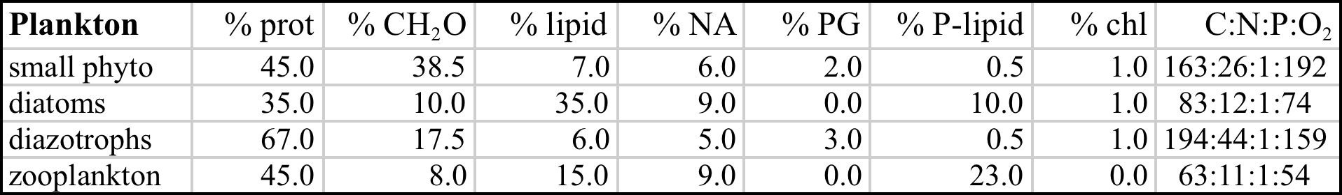
Tasks 3 and 4: Realistic Treatment of Dissolved Organic Matter (Letscher)
1) The goal is to move beyond bulk DOC, DON, and DOP pools to simulate instead the macromolecular constituents.
2) Account for these consitutents within plankton as well, leading their constiuents (relative amounts) to determine stoichiometry.
3) These efforts will improve our estimates of DOM export vertically, but also lateral transports (an important nutrient source for the subtropical gyres). Also, links with ongoing ACEM efforts to simulate organic aerosol emissions.

Slide 10
Task 5 Development of offline and inverse tools for ACME (Primeau)
1) Couple MPAS-O derived tracer transport matrices with MARBL. The code to produce the transport matrices is currently being developed as part of our SciDAC award.
2) Once MARBL and the MPAS-O transport matrices become available we will explore the feasibility of developing a “black-box” solver for MARBL coupled to tracer transport matrices.
3) Optimize key ACME parameter values associated with the prescribed remineralization vs. depth profiles, accounting for O₂ effects. Also, constrain the stoichiometry and Fe content of the sinking material using the model in conjunction with observations.

Slide 11

Improving Marine Biogeochemistry-Climate Feedbacks in ACME
Prof. J. Keith Moore, PI
Prof. Francois Primeau, Co-I
Dr. Rob Letscher, Co-I
University of California,Irvine
The improved marine biogeochemistry in ACME will:
1) allow ACME to better capture biogeochemistry-climate feedbacks associated with the biological pump.
2) incorporate oceanic N₂O production and emisssions.
3) provide more realistic treatment of plankton stoichiometry and the dissoled organic pools, which improves nutrient distributions and the carbon cycle response to global change.
4) allow for study of several biogeochemistry-climate feedbacks involving the nitrogen cycle and the oxygen minimum zones.

Slide 12
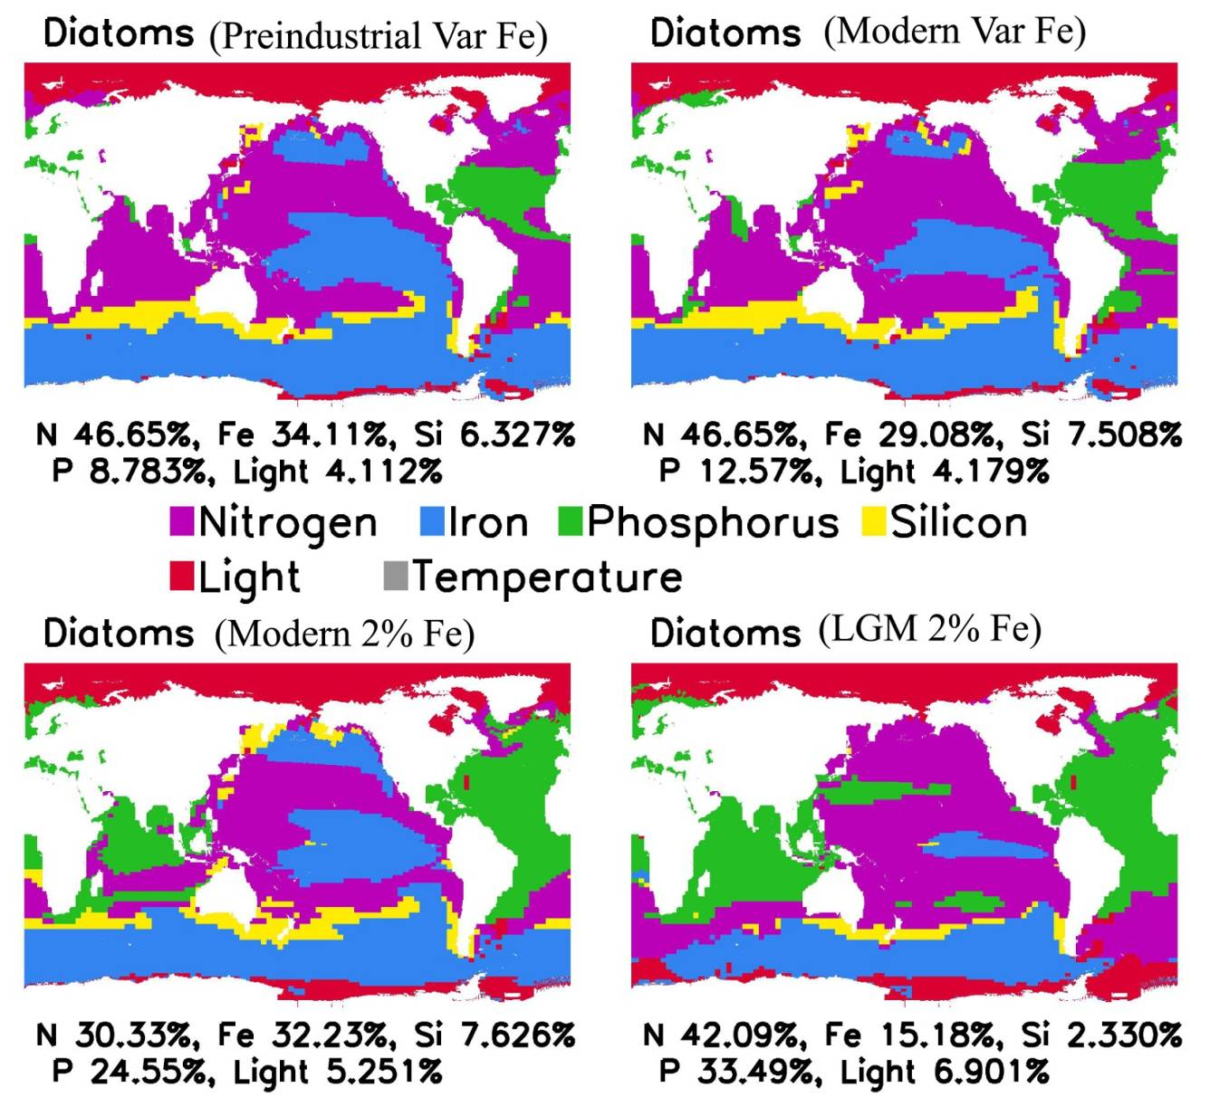
Patterns of nutrient limitation for the diatom group under
the four Fe atmospheric deposition scenarios.
(from Krishnamurthy et al., 2010, JGR-Biogeosciences)
Notes:
12

Slide 13

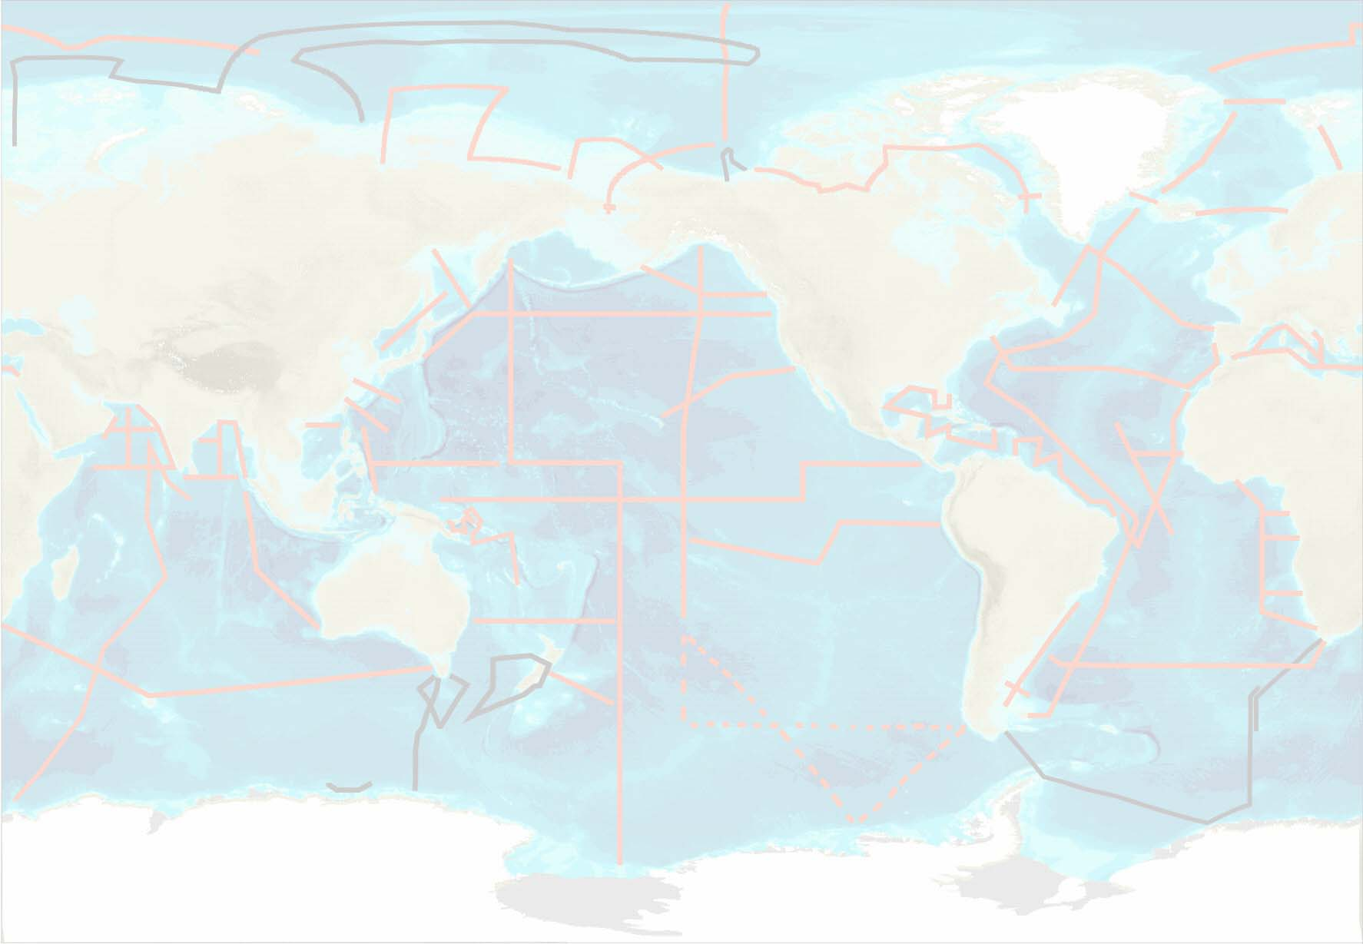
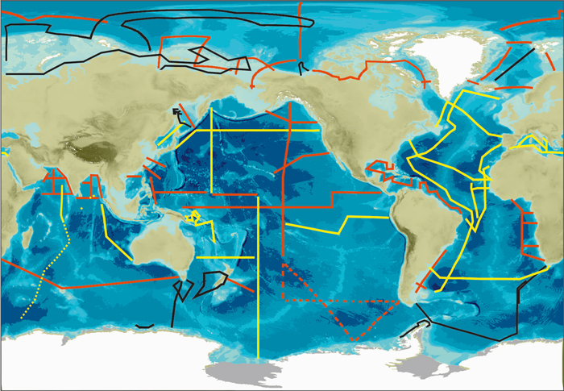


GEOTRACES
International Programme in Marine Geochemistry
Progress toward global coverage
Summary of GEOTRACES “section” cruises by 15 contributing national GEOTRACES programmes
• IPY cruises (black; 2007 - 2009)
• Completed sections (yellow; 2010 - 2015)
• Desired future sections (red)

Slide 14
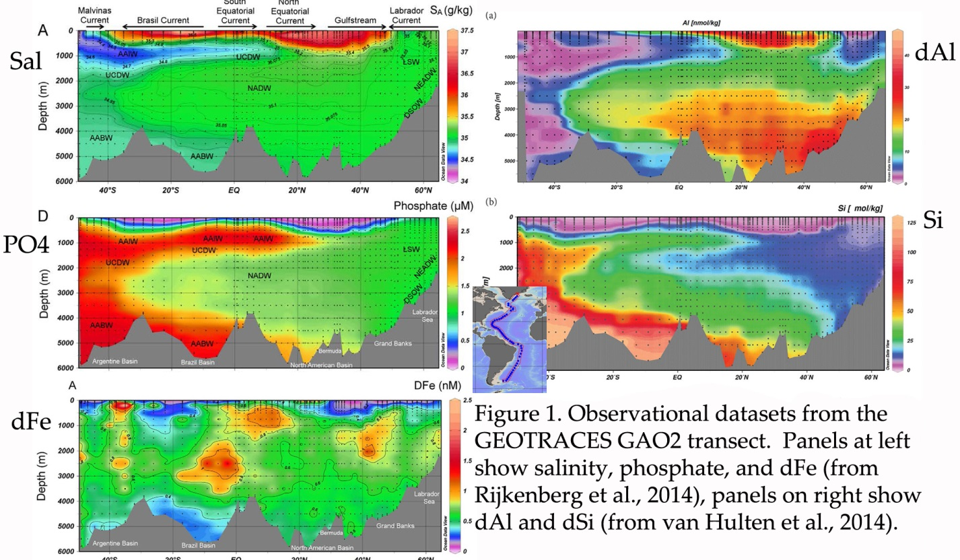
Benefits of the GEOTRACES Multi-tracer Approach
Dissolved Fe distributions reflect local-regional sources and sinks.
Aluminum provides information on dust inputs and particle scavenging that complements Fe. Thorium isotopes constrain particle scavenging rates and intensity. Aerosol composition and solubilites also measured.

Slide 15
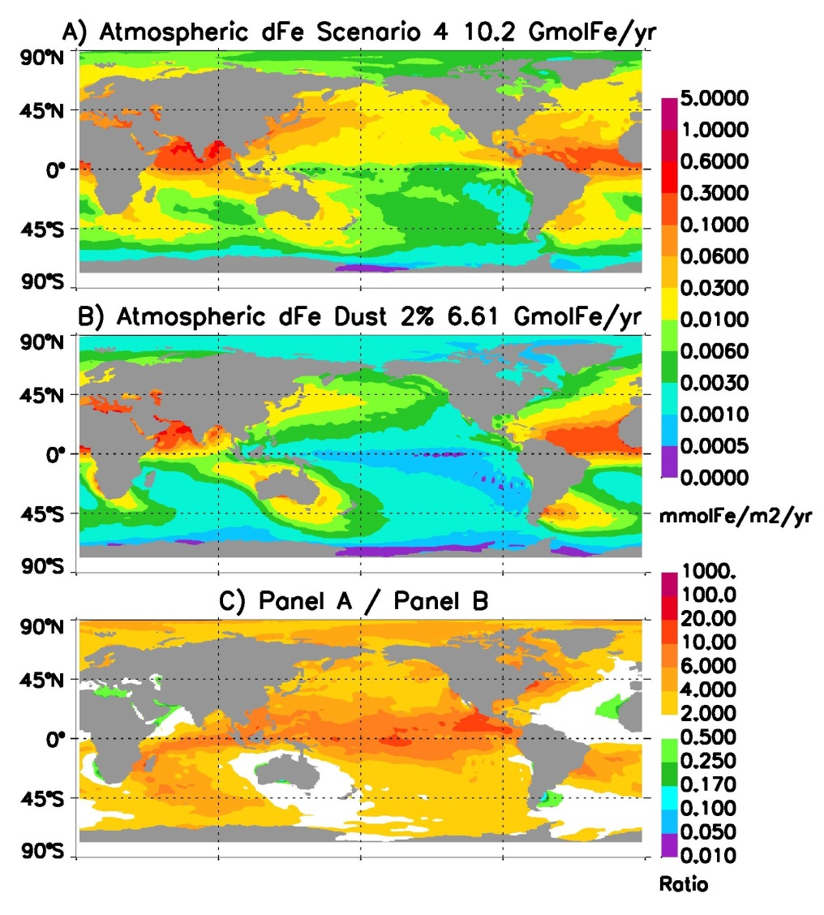
Comparing Surface Soluble Iron Deposition Patterns
Including the combustion-sourced iron and variable aerosol iron solubility (panel A), results in a very different deposition than assuming a fixed 2% solubility, with iron coming only from mineral dust (panel B).

Slide 16
Improving variable stoichiometry in marine plankton and DOM:
Implementing macromolecule cycling
(Co-I Robert Letscher)
Incorporate recent advances in known % contribution of different macromolecules to plankton and dissolved organic matter composition
Explicit tracers for 1) proteins, 2) polysaccharides, and 3) lipids
  Implicitly include N-containing peptidoglycan + chlorophyll and P-containing nucleic acids + phospholipids
Each macromolecule type has unique C:N:P:O₂ stoichiometry
Macromolecule lifetimes to be optimized with offline tools and tracer obs
Improvements:
  Capture biome-level shifts in nutrient/plankton stoichiometry with feedbacks to climate
  Dynamic simulation of marine organic aerosol precursors
  Explore linkages to dynamic Fe-Ligand cycling
  Explore linkages to particle aggregation and/or TEP parameterizations

Slide 17
Primeau Research Plan
Diagnose patterns of Fe/C uptake ratios using an inverse modeling framework to help constrain planktonic Fe/C ratios in the ACME ocean biogeochemistry model.
Optimize depth-dependent particulate organic matter remineralization curves using the offline model.
Couple MPAS-O derived tracer transport matrices with MARBL. The code to produce the transport matrices is currently being developed as part of our SciDAC award.
Once MARBL and the MPAS-O transport matrices become available we will explore the feasibility of developing a “black-box” solver for MARBL coupled to tracer transport matrices.

