Slide 1

Uncovering the Interannual Predictability of the 2003 European Summer Heatwave and its Connection to the Tibetan Plateau
L. Ruby Leung
Pacific Northwest National Laboratory

Slide 2
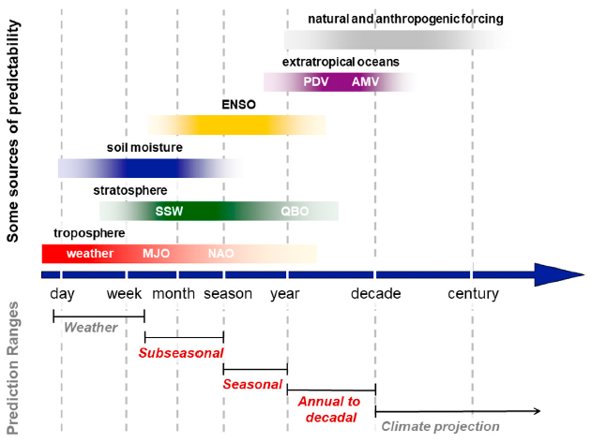
Sources of predictability at different timescales
Could soil moisture and temperature provide predictability at interannual-to-decadal timescale through longer memory land processes and/or their influence on ocean with longer memory?
(Merryfield et al. 2020 BAMS)

Slide 3
Land as a source of predictability at decadal timescale
A weakly coupled land data assimilation system based on 4DEnVar
Experiment | Description
CTRL | Free running fully coupled simulation
ASSIM_G and ASSIM | Assimilate monthly mean soil moisture and temperature globally (ASSIM_G) and over Tibetan Plateau only (ASSIM) into a fully coupled climate simulation
HCAST_G and HCAST | Initialized using the coupled model states from ASSIM_G and ASSIM to perform hindcast simulations
FGOALS/E3SMv2
CTRL, ASSIM_G, and ASSIM: 36-year long continuous simulations (1980-2015)
HCAST_G and HCAST: 5-year long simulations consisting of 10 ensemble members initialized one month apart (April – Jan) and separated by 5 years (1981, 1986, 1991, 1996, 2001, 2006) using restart files from ASSIM_G and ASSIM as initial conditions, respectively
(Shi et al. 2021 Earth’s Future; Shi et al. 2024 GMD; Shi et al. in review)

Slide 4
HCAST_G reproduces the observed Rossby wave train and anomalous warming in Europe
Surface temperature and 500 hPa anomalies
OBS
FGOALS
E3SMv2

Slide 5
HCAST initialized in 2001 captures the 2003 European summer heatwave
Barotropic structure of height anomalies indicate long-range propagation

Slide 6
Hindcast sensitivity experiments to isolate the sources of predictability
Pattern correlation between experiments and observation of surface temperature over Europe in 2003
Impact of land
Impact of ocean

Slide 7
Large differences in snow cover and surface temperature between SNS1 (from CTRL) and SNS2 (from ASSIM) in spring 2003
Reduced snow cover and warmer surface temperature in spring of 2003 when initialized from ASSIM in 2001

Slide 8
Large differences in the SST initial conditions between SNS3 (from CTRL) and SNS4 (from ASSIM) in 2001 that persist in 2003
SST anomalies in January 2001
SST anomalies in January 2003

Slide 9
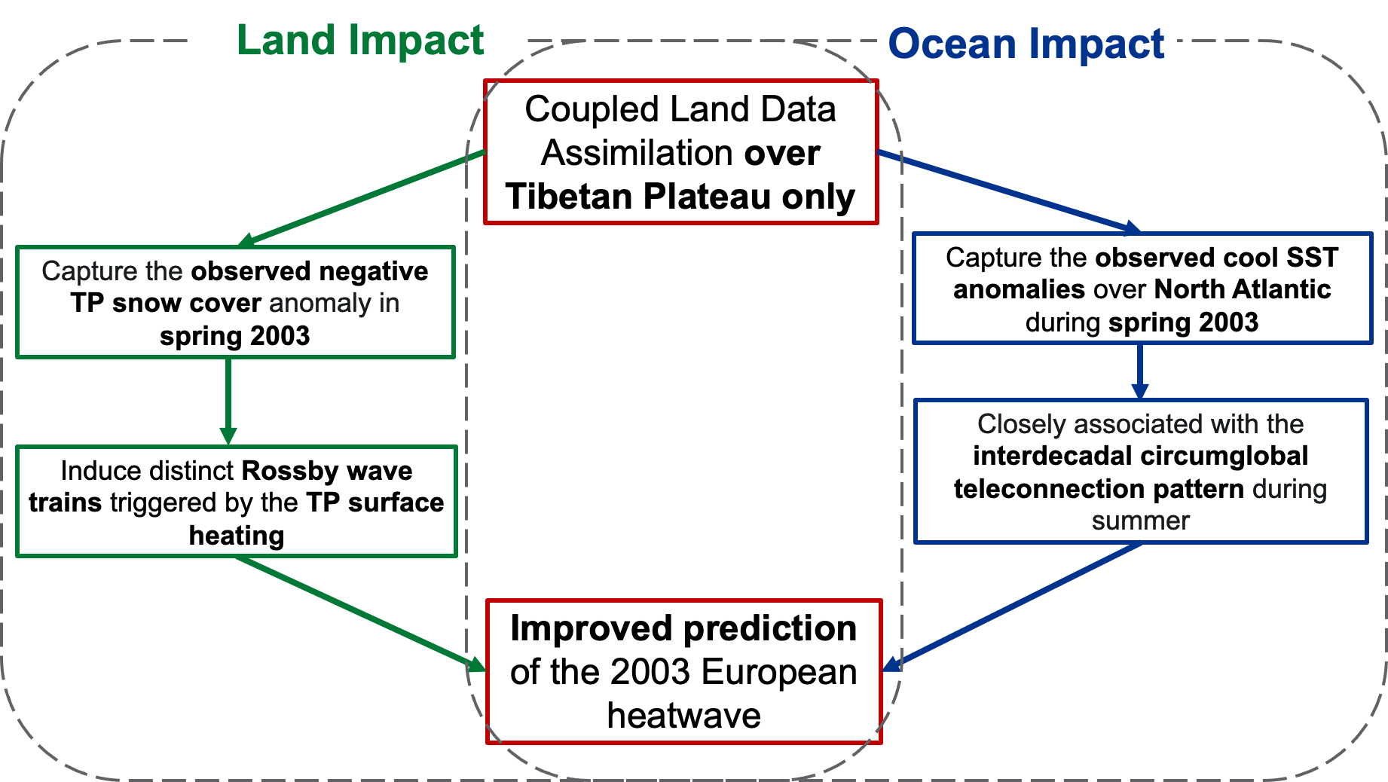
Mechanistic connections: remote influence of land over land and ocean
(Shi et al. in review)

Slide 10
Gaps and Opportunities
Data assimilation can play an important role in hindcast experiments to understand predictability and improve predictions of extreme events
Data assimilation approaches may have different impacts (e.g., uncoupled or coupled, 3D vs. 4D approaches) – more systematic analysis and comparison with hindcast experiments are needed to understand the impacts of DA
How land influence atmosphere/ocean locally and remotely to provide predictability of extreme events needs more research
A model hierarchy can help understand predictability of extreme events
Extreme events in the extratropics are strongly influenced by atmospheric circulations – storyline simulations that isolate the thermodynamics effects may be insufficient to provide actionable information about future changes in extreme events (probability and intensity)

Slide 11
Summary
Soil moisture and temperature has important effects on interannual-to-decadal variability
Assimilating soil moisture and temperature over the TP alone improves hindcast of the 2003 European summer heatwave in both FGOALS and E3SMv2
  HCAST initialized from ASSIM in 2001 better predicts anomalies of snow cover (low) and surface temperature (warm) over the TP and North Atlantic SST anomalies (cool), contributing to predictability of the 2003 European heatwave 2 years in advance
  Initializing hindcasts using the balanced states from ASSIM enhances skill
DRP-4DVar implemented in FGOALS and E3SM confirmed that DRP-4DVar reduces model drift by assimilating analysis data through fitting them to the trajectory of the coupled model in the one-month assimilation window (He et al. 2017)

