Slide 1
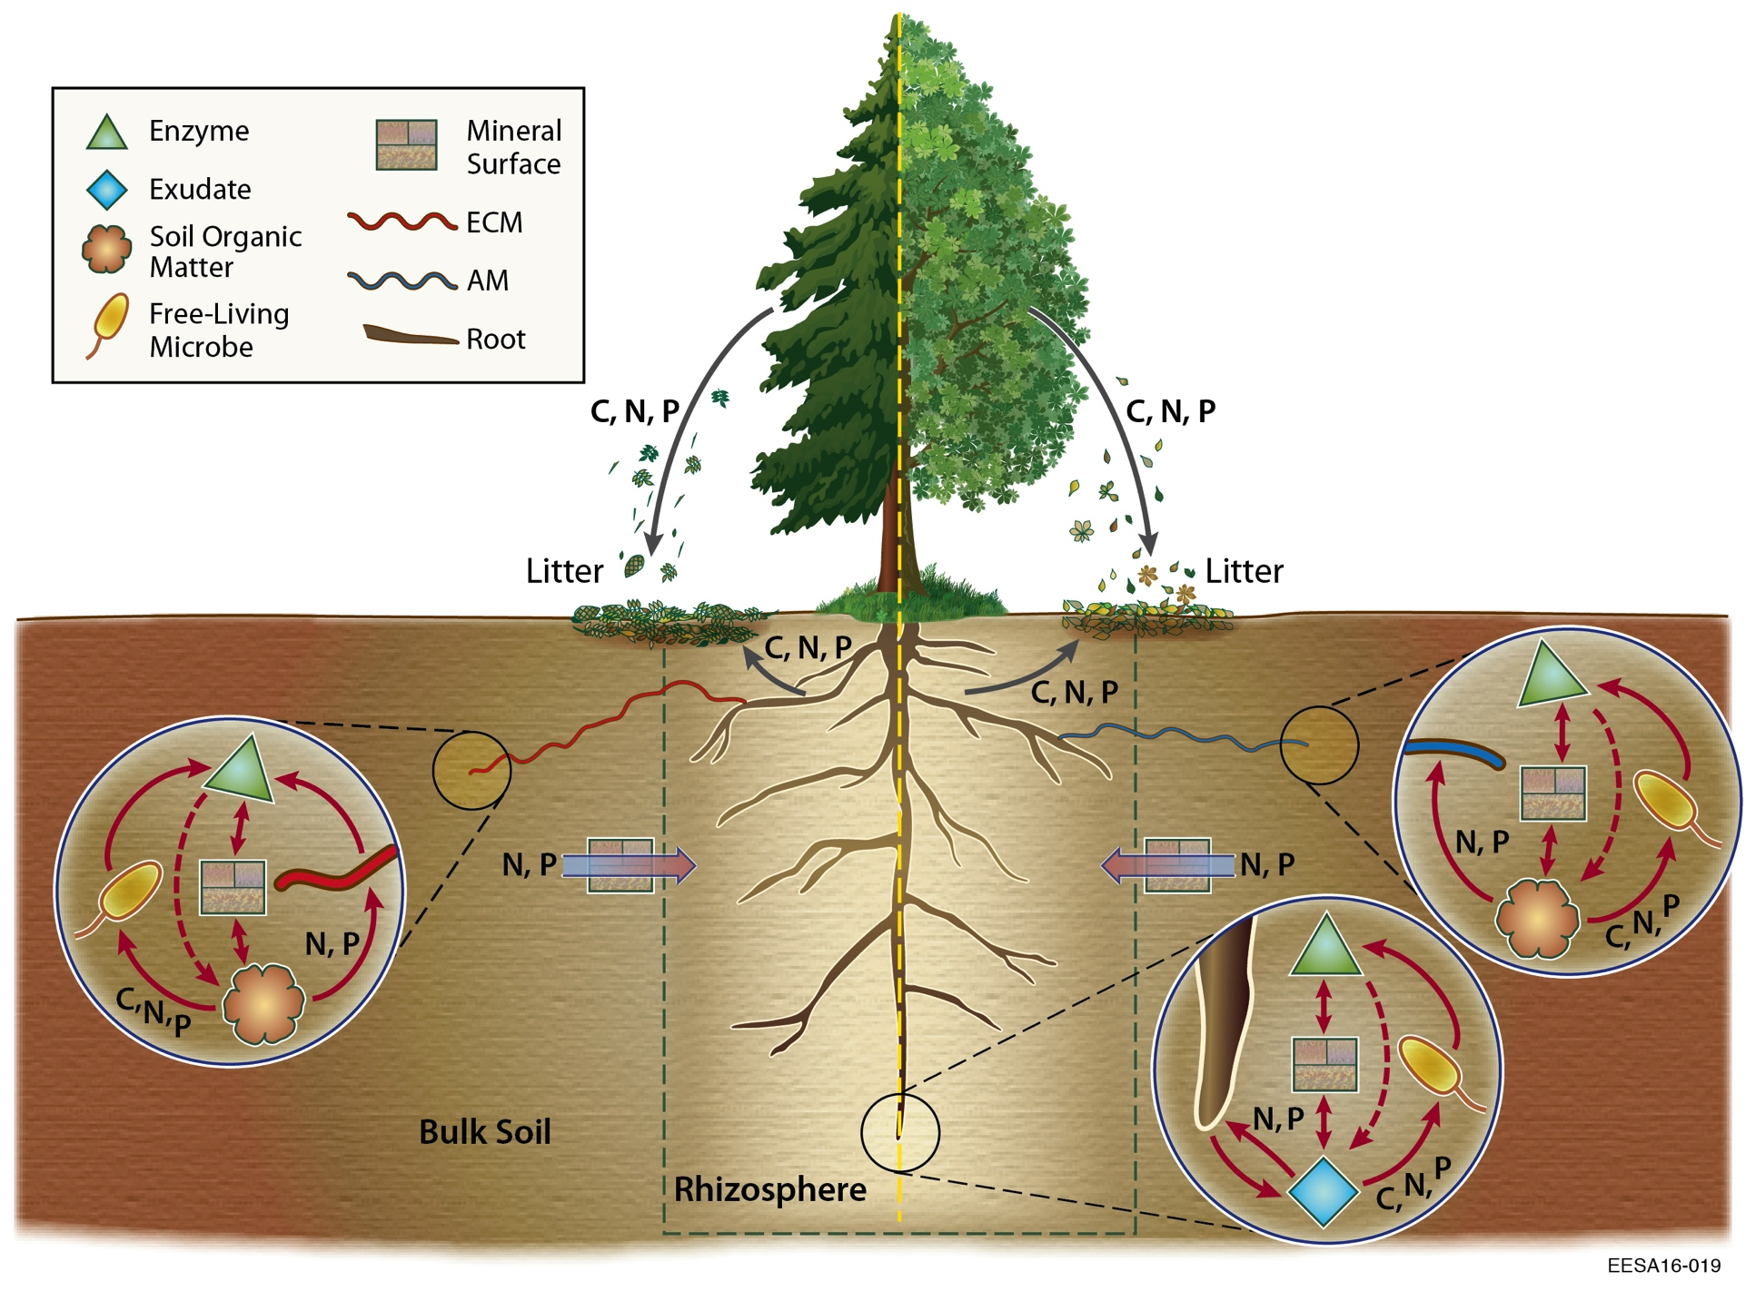
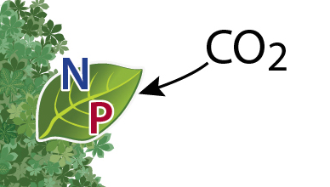
Plant N & P Uptake is De-Coupled from Demand: Implications for the BGC Inter-Comparison
W.J. Riley, Q. Zhu, J.Y. Tang (Berkeley Lab)
Objective
The ACME BGC inter-comparison will evaluate two fundamentall different representations of N&P controls on the terrestrial C cycle:
ALMv1-ECA-CNP and ALMv1-CTC-CNP
We focus here on one important difference: nutrient competition and acquisition at the root-soil interface
Equilibrium Chemistry Approximation (ECA) versus Relative Demand (RD)
Figure. ALMv1-ECA-CNP prediction that about half of all global N and P plant uptake occurs during periods with zero photosynthetic demand.
Approach
Decades of observations indicate that plant nutrient uptake is de-coupled from instantaneous photosynthetic nutrient demand
We use the ALMv1-ECA-CNP model to illustrate the implications of ignoring this effect on nutrient retention and C cycling
Impact
Ignoring nighttime and non-growing season uptake, as is done in Relative Demand approaches, leads to:
Very large biases in N&P losses (> 300%)
Very large biases in C cycle dynamics
ALMv1 should adopt strategies that both
Realistically represent processes
Benchmark well against observations (e.g., using ILAMB)
ALMv1-ECA-CNP is based on several ACME publications (Zhu and Riley 2015; Zhu et al. 2016a,b, 2017; Tang and Riley 2017)
Flexible stoichiometry
Dynamic allocation
Multiple element co-limitation, ECA
BeTR reactive transport solver
For additional information, contact:
Staff Member
Title
Institution or Organization
(555) 555-1234
staff.member@email.gov
climatemodeling.science.energy.gov/acme

