Slide 1

Accelerated Climate Model for Energy
“Most-Hands” Meeting
November 9-11, 2016
Denver, CO
Dorothy Koch
Earth System Modeling
Climate and Environmental Sciences Division
November 9, 2016

Slide 2

ACME news
Computational:
ALCC 211M hrs (158M ALCF, 53M OLCF) 2016
INCITE 278M hrs (128M ALCF, 150M OLCF) 2017
NESAP – NERSC-Cori early access
CAAR – OLCF-Summit early access
ECP “Exascale Computing Program” (ASCR-facilities program) proposal award [SNL-Taylor is PI]
ACME “Anvil” 120 nodes on ANL’s Blues cluster, for debugging and short simulations
NESAP and CAAR projects both need postdocs – people with computational-climate expertise to work at LBNL and ORNL with ACME codes
DOE-SC Graduate Student Research Program
Topic on computational climate modeling, supports graduate student time at DOE Laboratory, applications due Nov 21!

Slide 3
ACME review and timeline
Project started July 2014
Review (6 month) January 2015
Review (18 months) June 2016
  Relaxation of timeline for model release and next proposal
    Sep 2017 whitepaper for ACME II
    Dec 2017 v1 release
    Feb 2018 ACME II proposal due
  Clear and concise articulation of ACME’s unique (science and software) capabilities needed
  Concerns about tuning and initialization challenges for high-resolution model
  Performance progress and strategy
  Integration of CMDV-SM project with ACME

Slide 4
ACME challenges, simulation and science plan?
“Tuning”, “initialization” of high-resolution model
V1 Model release plans, documentation and “support”
Individual’s commitment to the project – does phase II need a different configuration of project team, with a core group of full-time committed individuals?
Computer resources – reality check
High-resolution coupled model
  ALCF, OLCF allocations: about 190 years of simulation
  E.g. 50 years of debugging, 30 years of stabilization
  Maybe 100 years of 1850 simulation?
  Science? Phenomena of interest: synoptic features, tropical cyclones, orographic effects, precipitation diurnal cycle, mesoscale eddy-resolution effects, boundary current resolution and transports
Low-resolution coupled model (NERSC – with Cori-2 early access??)
  CMIP deck 60M
  Water cycle (3 scenarios, 3 ensembles, 100 years) 45M
  RR (N-Am and Asia) 90M
BGC experiments – not yet accounted for – ensembles on ALCF/OLCF or use part of NERSC or expansion of Blues-Anvil???

Slide 5
ACME management updates
ACME Council
Dave Bader, Chair
Executive Committee: R. Leung, M. Taylor
R. Jacob, P. Jones, P. Rasch, P. Thornton, D. Williams, T. Ringler, W. Riley
Ex Officio: J. Hack, W. Large, E. Ng
Executive Committee
Chair: D. Bader
Chief Scientist: Ruby Leung
Chief Computational Scientist: Mark Taylor
Project Engineer
Renata McCoy
Land Group
Peter Thornton
William Riley
Kate Calvin
Atmosphere Group
Phil Rasch
Shaocheng Xie
Software Eng./Coupler Group
Rob Jacob
Andy Salinger
Workflow
Group
Dean Williams
Val Anantharaj
Land Task
Leaders
Atmosphere Task Leaders
SE/Coupler Task Leaders
Workflow Task Leaders
Ocean/Ice
Group
Todd Ringler
Steve Price
Coupled Simulation Group
Performance/ Algorithms Group
Phil Jones
Pat Worley
Ocean/Ice Task Leaders
Coupled Sim. Task Leaders
Perf. / Alg. Task Leaders

Slide 6
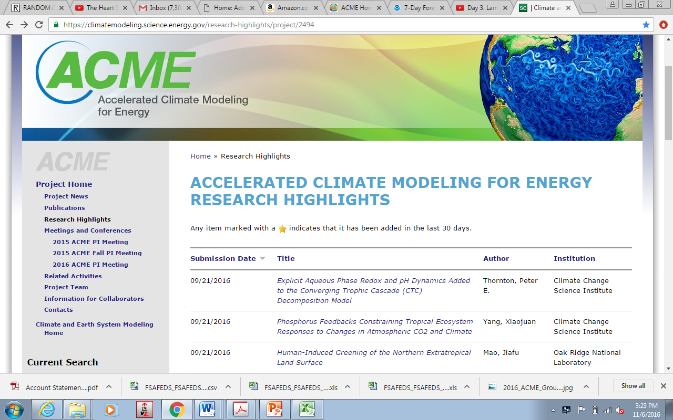
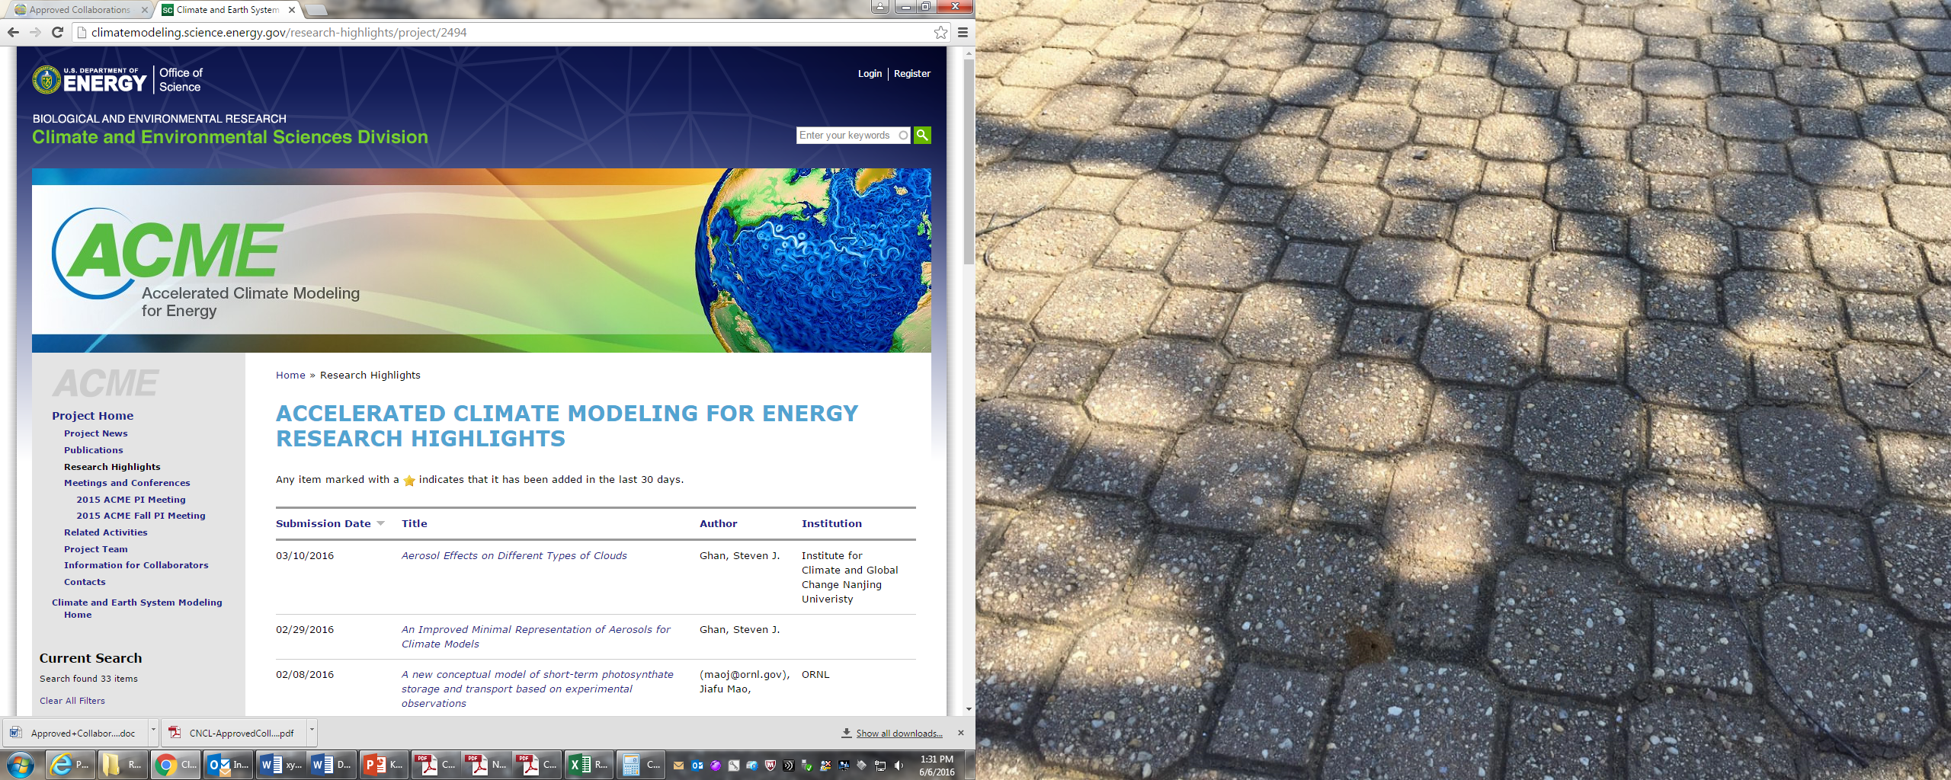

Slide 7
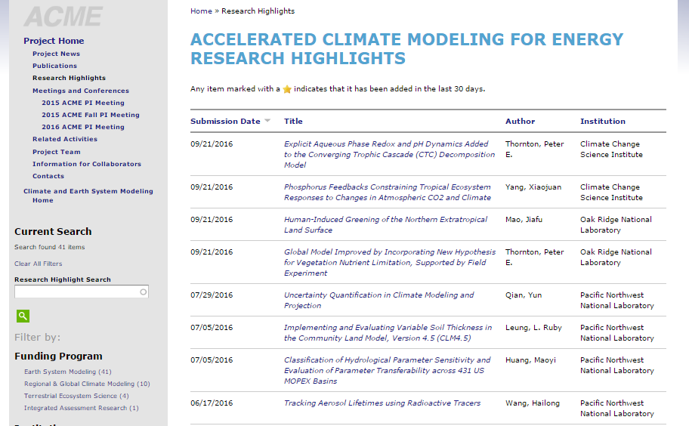
8 ACME publication highlights since June 2016

Slide 8
Publications
Acknowledge DOE-Office of Science- BER-ACME (see Confluence website for wording)
Upload a highlight to the modeling website using their new format
https://climatemodeling.science.energy.gov/
Send me a copy of the highlight (ppt, paragraph-description and pdf of the paper)
Also make highlights for major capabilities or software releases!

Slide 9
ESM and ACME community activity update
ACME:
CIME - Software infrastructure, scripts, mapping capabilities, so far CSEG and ACME-software groups
CICE Consortium – kick-off meeting in October 2016, many climate/operational centers
ESM:
CEDS (Steve Smith et al): Emissions Data System
MARBL (Matt Long et al): Modular Ocean BGC
LULC history (Hurtt et al): new land-use dataset for CMIP6

Slide 10
New ACME collaborators
FOA1482 University projects
Implementation of a Quasi-3D Multiscale Modeling Framework to ACME:
David Randall, Celal Konor
Agricultural Impacts on Nitrogen Cycling: Climate and Air Pollution: Peter Hess, Cynthia Nevison
Fire, dust, air and water: Improving aerosol biogeochemistry interactions in ACME: Natalie Mahowald, Hess, Moore, Bond, Randerson (**Yan Feng new from ANL)
Improving Marine Biogeochemistry-Climate Feedbacks in ACME: Keith Moore
Investigating the impacts of changes in land cover and land management on climate using ACME: Atul Jain
Improving tide-estuary representation in MPAS-Ocean: Joseph Zhang, Fei Chai, Fei Ye
Grid generation, coupling strategies, and spatially-dependent time stepping for ocean-tidal/estuary systems and other ESM components: Max Gunzburger, Lili Ju
Improving the interface processes in the DOE/ACME model: Xubin Zeng, Michael Brunke
Improved Efficiency and Coupling of the Radiation Code in the ACME Earth System Model:
Eli Mlawer, Robert Pincus
CMDV (Climate Model Development and Validation) projects
ACME-SM: A Global Climate Model Software Modernization Surge: Salinger
CMDV-MCS: Use of Remote Sensing and In-situ Observations to Develop and Evaluate Improved Representations of Convection and Clouds for the Accelerated Climate Model for Energy: Ghan
CMDV-RRM: Representation of clouds and convection across scales in ACME: Golaz
CMDV-CM4: Coupling Mechanistically the Convective Motions and Cloud Macrophysics in a Climate Model: Romps
CMDV-Land: Facilitating model development collaboration between NGEEArctic, NGEE-Tropics, and ACME: Riley, Liaisons are Ryan Knox, Teklu Tesfa, Jennifer Holm & Gangsheng Wang

Slide 11
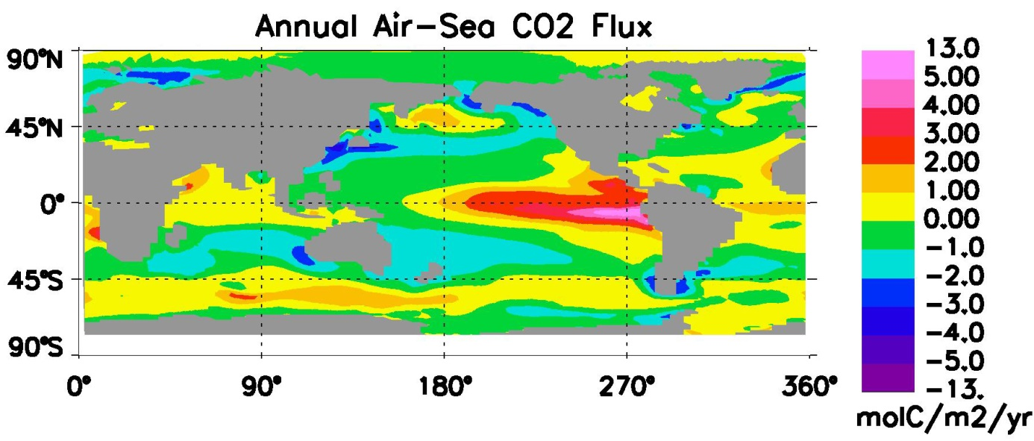
Improving Marine Biogeochemistry-Climate Feedbacks in ACME
Prof. J. Keith Moore*, PI
Prof. Francois Primeau, Co-I
Dr. Rob Letscher, Co-I
University of California, Irvine
* - attending meeting
Capturing Biogeochemistry-Climate Feedbacks in ACME
1) Improve Marine Fe Cycle and links to Carbon
2) Carbon, Nitrogen, Oxygen Cycle Interactions
3) Improve Treatment of Dissolved Organic Matter
4) Variable Stoichiometry in all Organic Pools
5) Develop and Apply Offline and Inverse Tools for
Parameter Optimization and Initialization

Slide 12
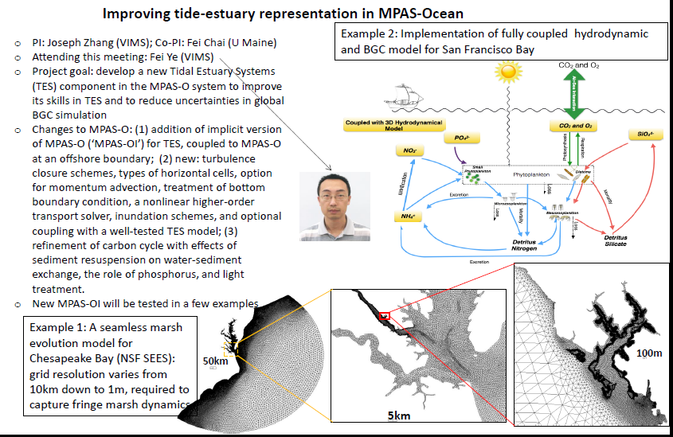

Slide 13
Fire, dust, air and water: Improving aerosol biogeochemistry interactions in ACME.
Tasks:
Improve Fe and P emission inventories for combustion
Improve fires in ALM
Apply soluble Fe and P atmospheric processing; use elemental information about dust sources
Improve Fe and P cycling in oceans
Couple land/atmosphere/ocean to look at impact on climate
Natalie Mahowald, Cornell University (Principal Investigator)
Peter Hess *, Cornell University (Co-Investigator)
J. Keith Moore* and James Randerson, University of California, Irvine (Co-Investigators)
Tami Bond, University of Illinois (Co-Investigator)
*Attending this meeting

Slide 14

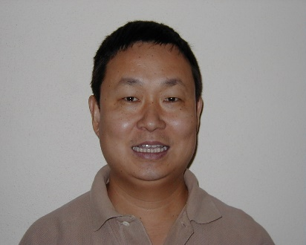
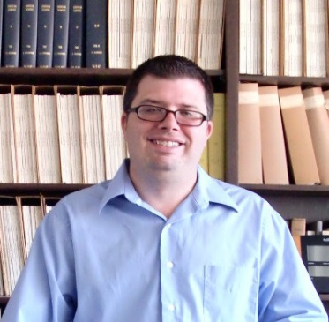
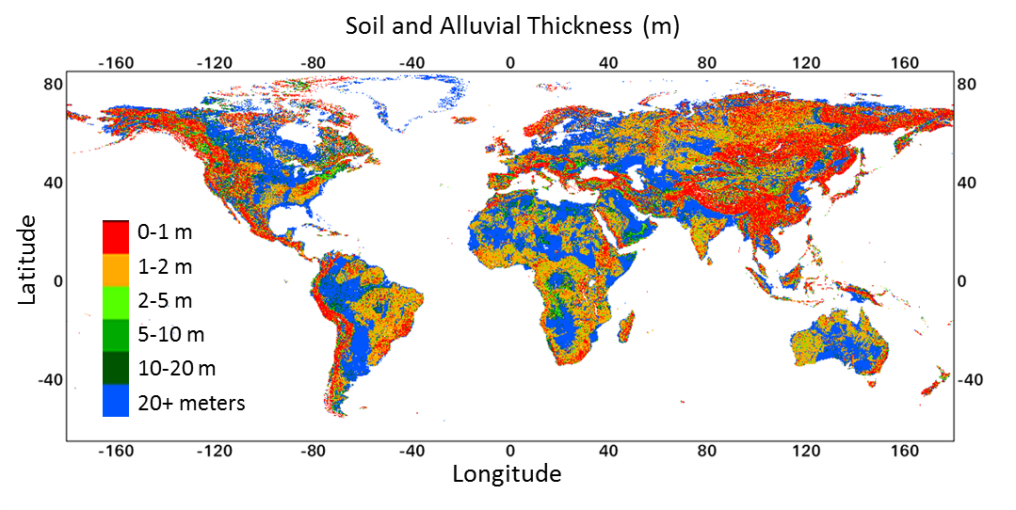
Improving the interface processes
in the DOE/ACME model
PI: Xubin Zeng, University of Arizona (UA)
Members: Michael Brunke, Pieter Hazenberg, Jack Eyre (UA)
ACME meeting: Xubin Zeng (Wed), Michael Brunke (all days)
We will carry out four tasks:
Primary Task 1 (land-atmosphere coupling): to implement and test elevation classes (including dynamic topography over land ice sheets)
Task 2 (ocean-atmosphere coupling): to evaluate ocean surface fluxes, implement and test ocean skin temperature scheme, and improve turbulence schemes
Task 3 (land-ocean coupling): to
improve river transport model (to allow
for land-ocean exchange of water).
Task 4: (snow-sea ice coupling): to help
evaluate and improve snow density
parameterization over sea ice
Global map of soil and alluvial thickness
(Pelletier et al. 2016).

Slide 15
Investigating the Impacts of Changes in Land Cover and Land Management on Climate Using ACME
PI: Atul Jain, University of Illinois
OBJECTIVES
To advance the treatment of land disturbance, particularly LULCCs and land management practices, within GCAM and couple it with ACME to fully explore the potential contribution of LULCC and land management practices to future emissions and mitigation opportunities, and terrestrial carbon sources and sinks, and climate change.
To achieve our objective, we propose to pursue the following specific tasks:
  Improving the Historical Distribution of LULCC.
  Implementation of Global-Scale Spatial Dynamic Allocation Model (SDAM) of Agricultural Land use Change in GCAM-ACME Coupled Modeling Framework.
  Modeling Land Management Practices that Influence Carbon Sinks in Terrestrial Agriculture and Forest Ecosystems and Mitigate Climate Change.

Slide 16
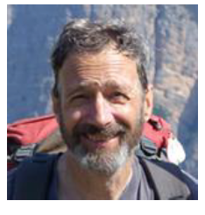
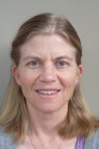
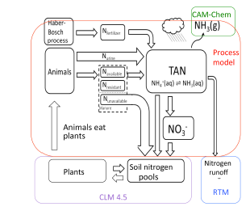

Agricultural Impacts on Nitrogen Cycling:
Climate and Air Pollution
Peter Hess (PI), Jeff Melkonian, Cynthia Nevison
What are the climate and air-quality impacts of agricultural practices on the nitrogen cycle and how will these change with climate, with changes in agricultural practices and with increases in food demand?

Slide 17
Upcoming activities
BER SciDAC4 Opportunities 1681 (Lab-led) and 1682 (Lab or University), pre-proposals Jan 17, proposals March 15
RGCM PI meeting (ACME “Town Hall” and GL-SFA-lead side meeting) – coordination with RGCM analysis activities
AGU – informal ACME gatherings
AGU Town Hall on DOE-NSF-NASA ice sheet modeling and observations (Thursday at 12:30)
ACME Spring all-hands meeting June 5-7, 2017
Ice sheet modeling/observation workshop (Sep 2017)
ACME II whitepaper (Sep 2017)
ACME v1 release (Dec 2017)
ACME II proposal due (Feb 2018)
ESM – IPA or Lab-detailee search to help with ESM program (email your interest before AGU)

Slide 18
Meeting goals
Science results
V1 tuning and debugging challenges
V1 science products
publications
capabilities
softwares
support for v1-release
V2-v3 science and simulation plan updates
Integration and coordination with new ESM1482 projects and CMDV projects
Software “education” needs for project (CMDV-SM, Heroux)
CIME – what is CIME? (Rob and Marianna)
Workflow – Group plans and project plans/hopes

Slide 19
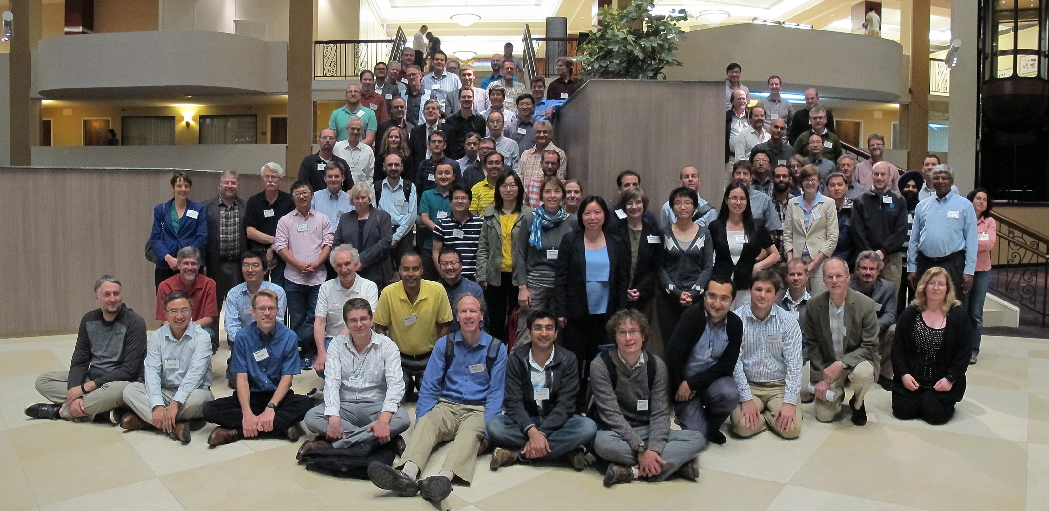
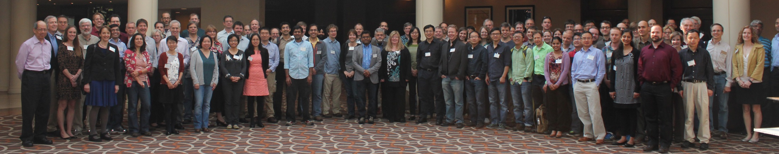
Thanks!
New ACME team members?
Guests?

Slide 20
Dorothy.Koch@science.doe.gov
ACME: http://climatemodeling.science.energy.gov/projects/accelerated-climate-modeling-energy
Earth System Modeling:
http://science.energy.gov/ber/research/cesd/earth-system-modeling-program/

