Slide 1

Accelerated Climate Model for Energy
All-hands, Principal Investigator Meeting
June 5-7, 2017
Potomac, MD
Dorothy Koch
Earth System Modeling
Climate and Environmental Sciences Division
June 5, 2017

Slide 2

ACME news
Challenges:
V1 tuning,
infrastructure,
V2/v3 planning and development
Publication preparation
collaborator-integration
Computational:
ALCC 147M hrs (ocean/ice and BGC: 25M Theta, 120M NERSC) 2017
INCITE 278M hrs (128M ALCF, 150M OLCF) 2017
NESAP – NERSC-Cori early access
CAAR – OLCF-Summit early access
ECP “Exascale Computing Project” (ASCR-facilities project) proposal award [SNL-Taylor is PI] – focus on MMF configuration
Additional nodes for ACME “Anvil” 120x2 = 240 nodes on ANL’s Blues cluster
Additional capability in performance to be added
NESAP and CAAR projects both need postdocs – people with computational-climate expertise
Todd Ringler is ¼ time Detailee: technical element integration, ACME partners, messaging (website and flyer project information); interagency activities. Todd.Ringler@science.doe.gov

Slide 3
ACME review timeline
July 2014: Project start
Jan 2015: Review (6 month)
Jun 2016: Review (18 months)
Jul 2017: Annual progress report, strategic plan and project structure plan due
Sep 2017: phase 2 whitepaper due
Dec 2017: v1 release
Feb 2018: phase 2 proposal due
Apr 2018: phase 2 proposal review
Suggested project goals before proposal review:
A very good v1 low resolution model release
Early successes with coupled high-res, coupled BGC
Clear computational performance metrics and strategies
Lots of v1 publications (in review, accepted)

Slide 4
ACME management
ACME Council
Dave Bader, Chair
Executive Committee: R. Leung, M. Taylor
R. Jacob, P. Jones, P. Rasch, P. Thornton, D. Williams, T. Ringler, W. Riley
Ex Officio: J. Hack, W. Large, E. Ng
Executive Committee
Chair: Dave Bader
Chief Scientist: Ruby Leung
Chief Computational Scientist: Mark Taylor
Project Engineer
Renata McCoy
Land Group
Peter Thornton
William Riley
Kate Calvin
Atmosphere Group
Phil Rasch
Shaocheng Xie
Software Eng./Coupler Group
Rob Jacob
Andy Salinger
Workflow
Group
Dean Williams
Val Anantharaj
Land Task
Leaders
Atmosphere Task Leaders
SE/Coupler Task Leaders
Workflow Task Leaders
Ocean/Ice
Group
Todd Ringler
Steve Price
Coupled Simulation Group
Performance/ Algorithms Group
Phil Jones
Pat Worley
Ocean/Ice Task Leaders
Coupled Sim. Task Leaders
Perf. / Alg. Task Leaders

Slide 5
Budget
ESM budget
FY17: 35.5M (roughly 20M for ACME project)
Presidents FY18: ESM 12.6M
House/Senate will propose in coming months
ACME planning project restructuring by required capabilities:
Define 10M (core group with 75% commitment), 15M and 20M project scenarios add extra science and capabilities
New model name pending final budget:
Energy Exascale Earth System Model (E3SM)
Science priorities in the budget language include:
High resolution, coupled
Computation performance, portability, alignment toward exascale, provenance
Non-hydrostatic atmosphere
Extreme phenomena
Complex and multi-scale processes
Dynamic ocean-ice coupling
Uncertainty analysis, validation
Basin-sub-basin land
Informing energy strategies
V1 release and broadened use

Slide 6
ACME collaborators
FOA1482 University projects
Implementation of a Quasi-3D Multiscale Modeling Framework to ACME:
David Randall, Celal Konor
Agricultural Impacts on Nitrogen Cycling: Climate and Air Pollution: Peter Hess, Cynthia Nevison
Fire, dust, air and water: Improving aerosol biogeochemistry interactions in ACME: Natalie Mahowald, Hess, Moore, Bond, Randerson
Improving Marine Biogeochemistry-Climate Feedbacks in ACME: Keith Moore
Investigating the impacts of changes in land cover and land management on climate using ACME: Atul Jain
Improving tide-estuary representation in MPAS-Ocean: Joseph Zhang, Fei Chai, Fei Ye
Grid generation, coupling strategies, and spatially-dependent time stepping for ocean-tidal/estuary systems and other ESM components: Max Gunzburger, Lili Ju
Improving the interface processes in the DOE/ACME model: Xubin Zeng, Michael Brunke
Improved Efficiency and Coupling of the Radiation Code in the ACME Earth System Model:
Eli Mlawer, Robert Pincus
CMDV (Climate Model Development and Validation) projects
ACME-SM: A Global Climate Model Software Modernization Surge: Salinger
CMDV-MCS: Use of Remote Sensing and In-situ Observations to Develop and Evaluate Improved Representations of Convection and Clouds for the Accelerated Climate Model for Energy: Ghan
CMDV-RRM: Representation of clouds and convection across scales in ACME: Golaz
CMDV-CM4: Coupling Mechanistically the Convective Motions and Cloud Macrophysics in a Climate Model: Romps
CMDV-Land: Facilitating model development collaboration between NGEEArctic, NGEE-Tropics, and ACME: Riley, Liaisons are Ryan Knox, Teklu Tesfa, Jennifer Holm & Gangsheng Wang

Slide 7
ACME collaborators
CESD Projects
NGEE-Tropics (Charlie Koven)
NGEE-Arctic (Stan Wullschleger)
HiLAT (Wilbert Weijer)
RASM (Wieslaw Maslowski)
BGC-feedbacks
PCMDI
ESGF
Community-softwares
CICE Consortium
CIME
UV-CDAT

Slide 8
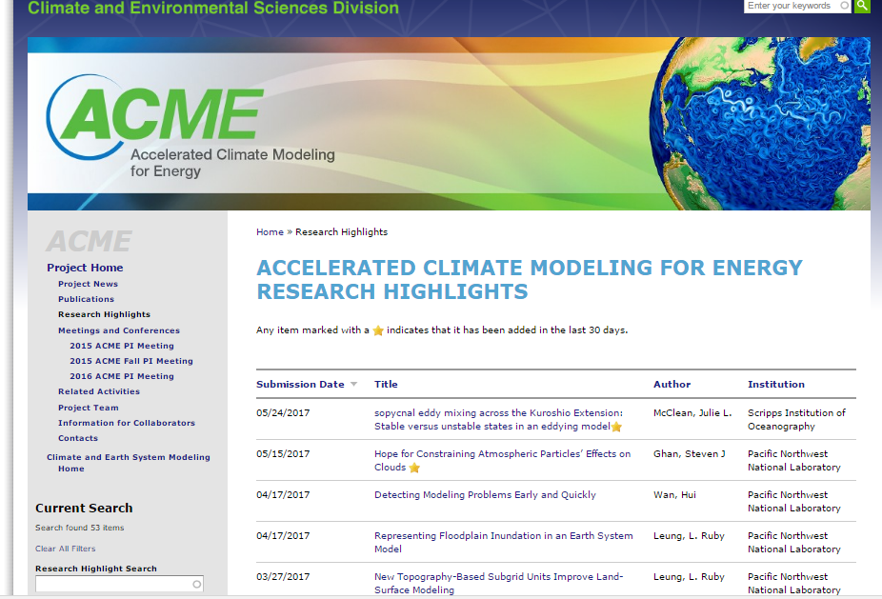
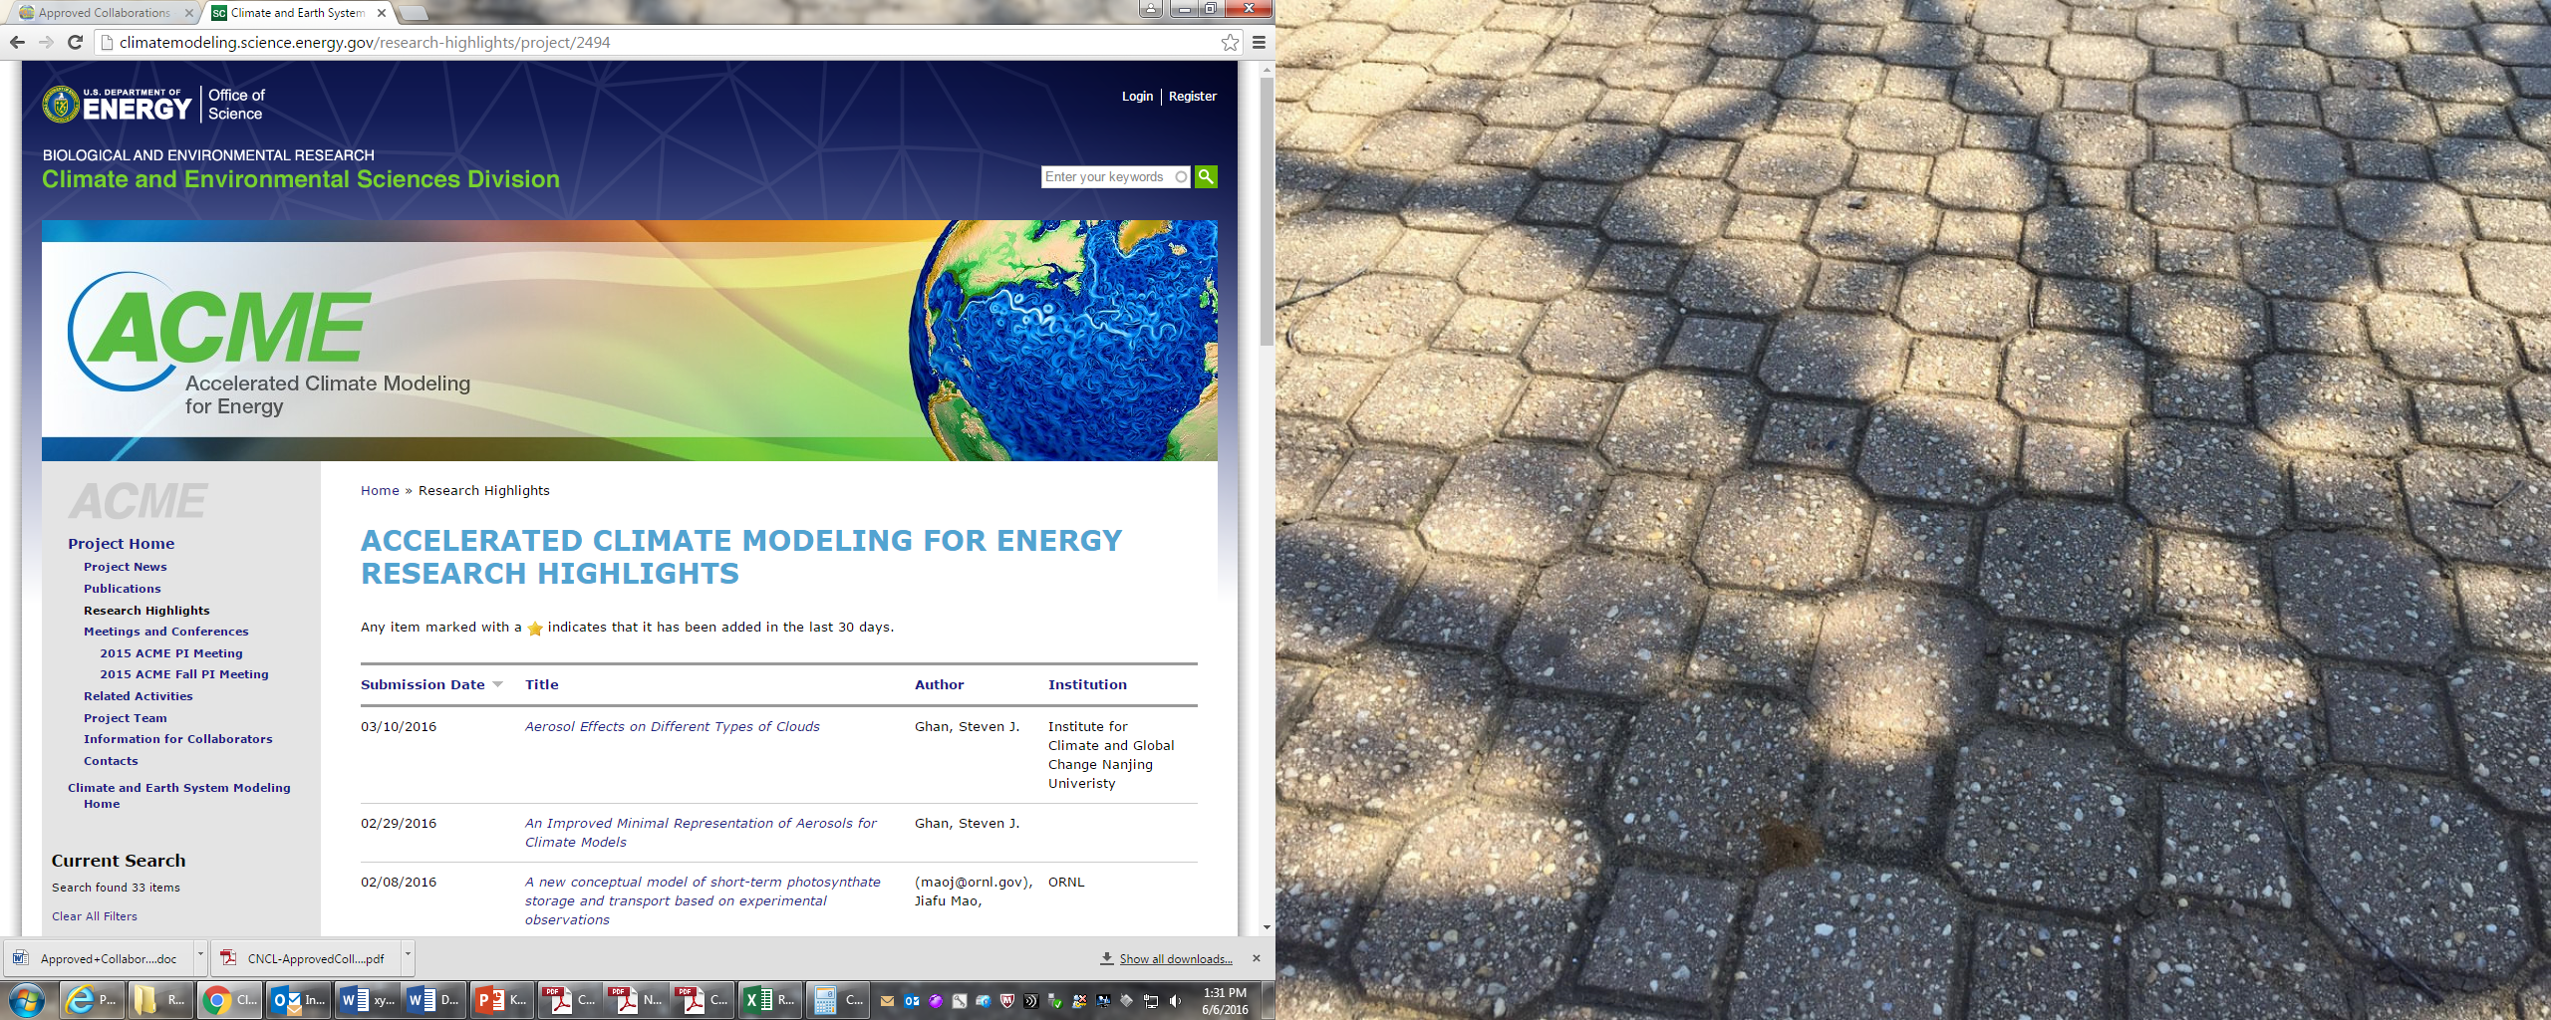

Slide 9
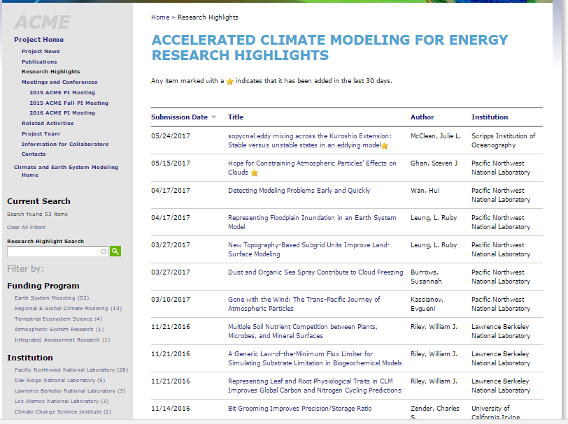
10 ACME publication highlights since Nov 2016
PNNL 7
LBNL 2
Scripps 1
UC-I 1 (2)

Slide 10
Publications: capabilities for ACME
Land:
Ghimire et al: Representing Leaf and Root Traits Improves Carbon and Nitrogen Cycling Predictions
Tang and Riley: A generic law-of-the-minimum flux limiter for simulating substrate limitation in biogeochemical models
Luo et al: Representing Floodplain Inundation in an Earth System Model
Tesfa and Leung: New Topography-Based Subgrid Units Improve Land-Surface Modeling
Leng et al: Significant impacts of irrigation water sources and methods on modeling irrigation effects in ACME Land Model
Atmosphere:
Vergara-Temprado et al: Marine Organic Spray an Important Contributor to Cloud Freezing at High Latitudes (OA and feldspar as IN!)
Numerics/analytics:
Wan et al: A New Method for Testing the Reproducibility of Atmosphere Model Results
Workflow:
Zender; Silver and Zender: Bit Grooming Improves Precision/Storage Ratio

Slide 11
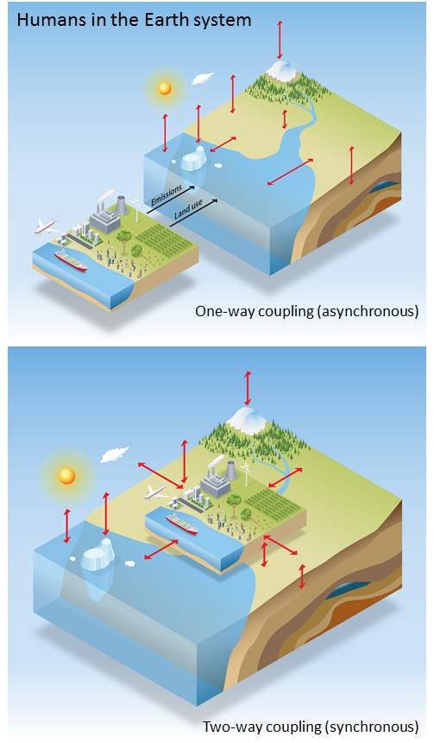
Biospheric feedback effects in a synchronously coupled model of human and Earth systems
Synchronous coupling an Earth system model with an energy-economics model eliminates important sources of climate and human system prediction uncertainty
Objective | Identify and quantify inconsistencies associated with asynchronous, one-way coupling of human and Earth system models, and eliminate those inconsistencies by designing and implementing a synchronous two-way coupled model of human and Earth system processes.
New science | By passing information on biospheric processes from the Earth system model to the human system model, impacts of climate change are allowed to influence the energy-economic systems. Higher CO₂ concentrations lead to increased vegetation productivity, higher crop yields (including biomass energy crops), lower crop prices, and reduced conversion of forest to cropland.
Significance | Feedbacks in the energy system lead to reduced fossil fuel emissions and feedbacks in the climate system lead to increased land carbon storage.
Thornton, P. E., K. Calvin, A. D. Jones, A. V. Di Vittorio, B. Bond-Lamberty, L. Chini, X. Shi, J. Mao, W. D. Collins, J. Edmonds, A. Thomson, J. Truesdale, A. Craig, M. Branstetter and G. Hurtt 2017. Nature Clim. Change in press
Notes:
DOE PM: Dan Stover
PI Stan Wullschleger
Key message: Fully 3-D biogeochemical reactive transport model coupled with Land model; allows for including key mechanisms across scales
PFLOTRAN is an open source, state-of-the-art massively parallel subsurface flow and reactive transport model for describing surface and subsurface processes.
Science. Examined the numerical challenges of introducing a reactive transport model (i.e., PFLOTRAN) into the land surface model of a Earth System Model (like ACME).
Significance. PFLOTRAN provides accurate and mechanistic representation of terrestrial biogeochemistry processes and a flexible framework to test and implement new reaction networks.

Slide 12
Meeting goals
Thanks to Renata as well as active engagement in meeting planning!
V1 tuning and debugging challenges
V1 science products
  publications
  Capabilities, softwares
  support for v1-release
Launch of Coupled BGC activity
V2-v3 science and simulation plan updates, Updating ACME Strategic Plan
  Tropical science
  Arctic science
Integration and coordination with ESM1482 University and CMDV projects
Proliferation of software repos
Management meeting
Best Poster Awards, in addition to Outstanding Contribution. Winning posters will be displayed in halls of BER! Vote before midnight Tuesday.

Slide 13

Final points and Upcoming activities
V1 release planning – focus of fall meeting
CESM tutorial, Renata and Rob will attend and explore potential joint CESM/ACME tutorial for future
Office of Science Graduate Research Opportunity (due Nov 2017) https://science.energy.gov/wdts/scgsr/
**Topic on Computational Climate modeling
BER SciDAC4 “1681 and 1682” up to 9 awards, but probably delayed with budget uncertainty
AXICCS Workshop in Sep 2016
Report is 228 pp:
https://science.energy.gov/ber/community-resources/
BER Exascale Requirements Review
Workshop in March 2016
Report is 366pp:
http://exascaleage.org/ber/
Thanks to all who contributed to these!
Important content that will be influential going forward.

Slide 14
Thanks!!!
Renata McCoy
Andrew Flatness, DOE
Marie Asher, ORISE
Special CESD guest presentations:
Shaima Nasiri (ASR)
Renu Joseph (RGCM)
Bob Vallario (IAR)
Dorothy.Koch@science.doe.gov
ACME: http://climatemodeling.science.energy.gov/projects/accelerated-climate-modeling-energy
Earth System Modeling:
http://science.energy.gov/ber/research/cesd/earth-system-modeling-program/

