Slide 1
MJO Diversity in E3SMv2
Kai Huang¹, Jadwiga Richter¹, and Chih-Chieh-Jack Chen¹
¹Climate and Global Dynamics, National Center for Atmospheric Research, Boulder CO, 80301

Slide 2
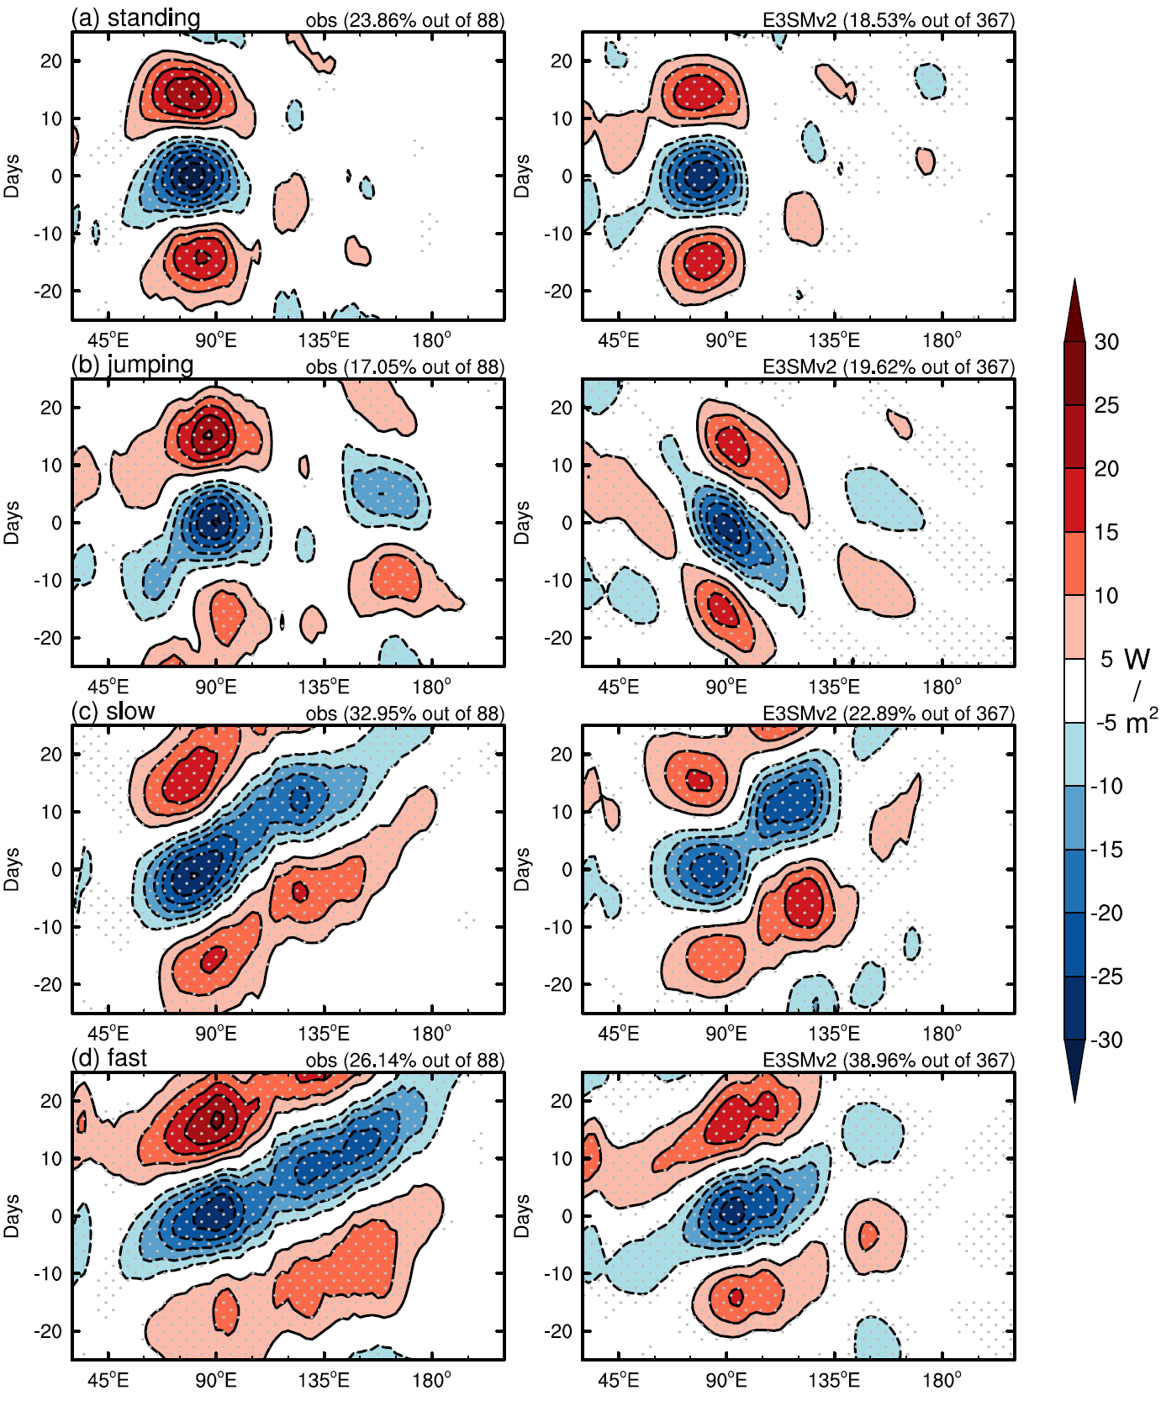
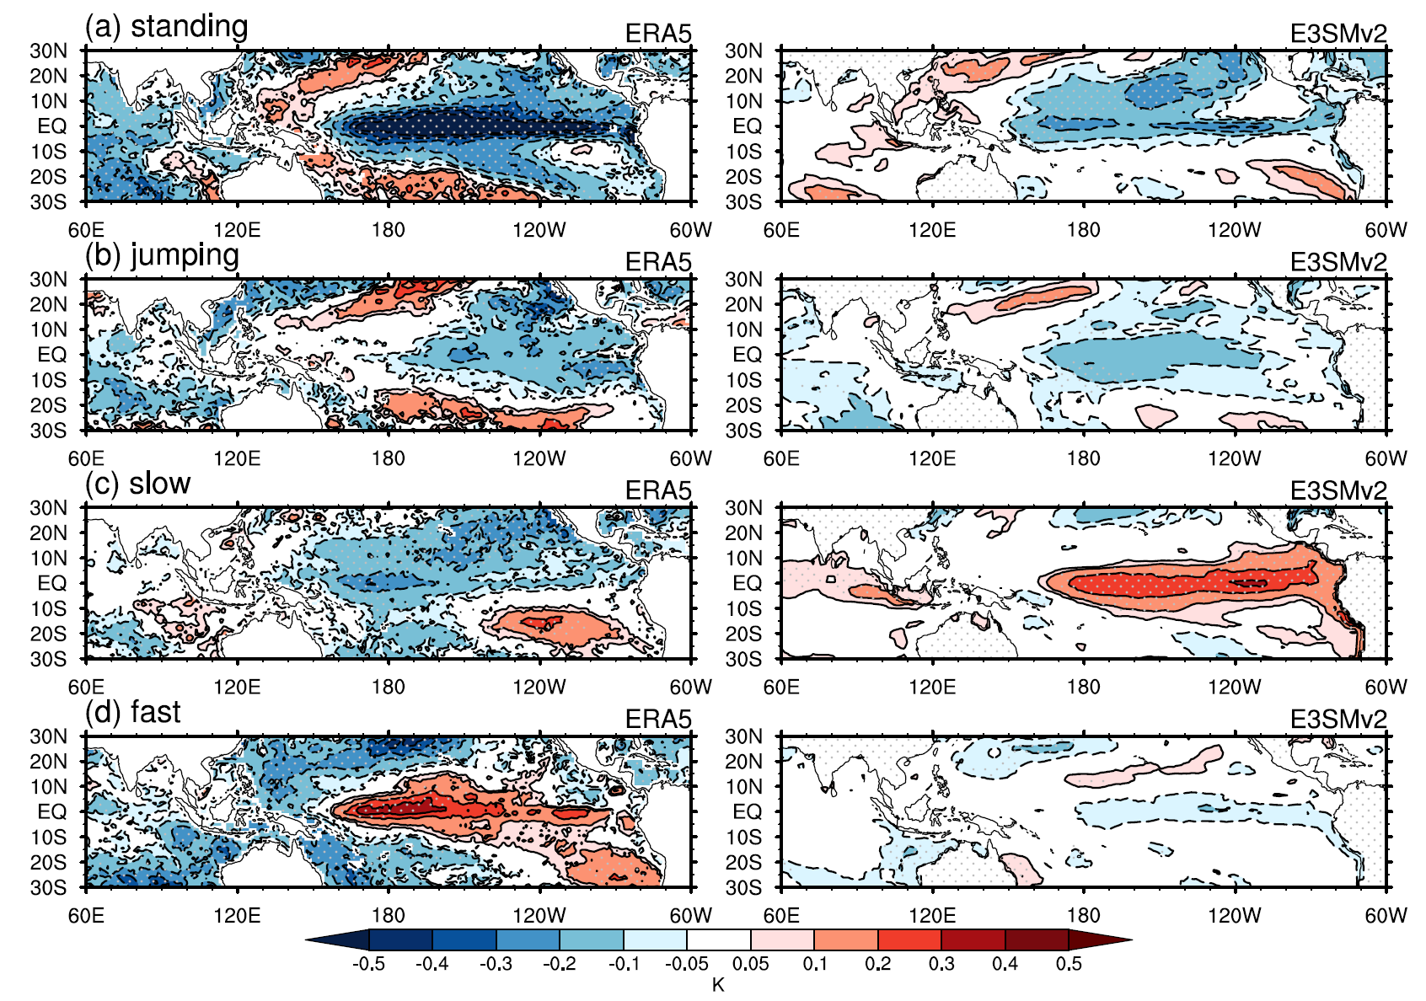
Composited OLR Hovmöllor diagrams (10S-10N)
90-day-mean SST Anomalies
standing
jumping
slow
(too less)
E3SMv2 captures four types of MJO but with biases in
propagating direction/ranges
portions of the four MJO types
ENSO phase locking
vertical structure (not shown here)
fast
(too many)
OBS
E3SMv2

Slide 3
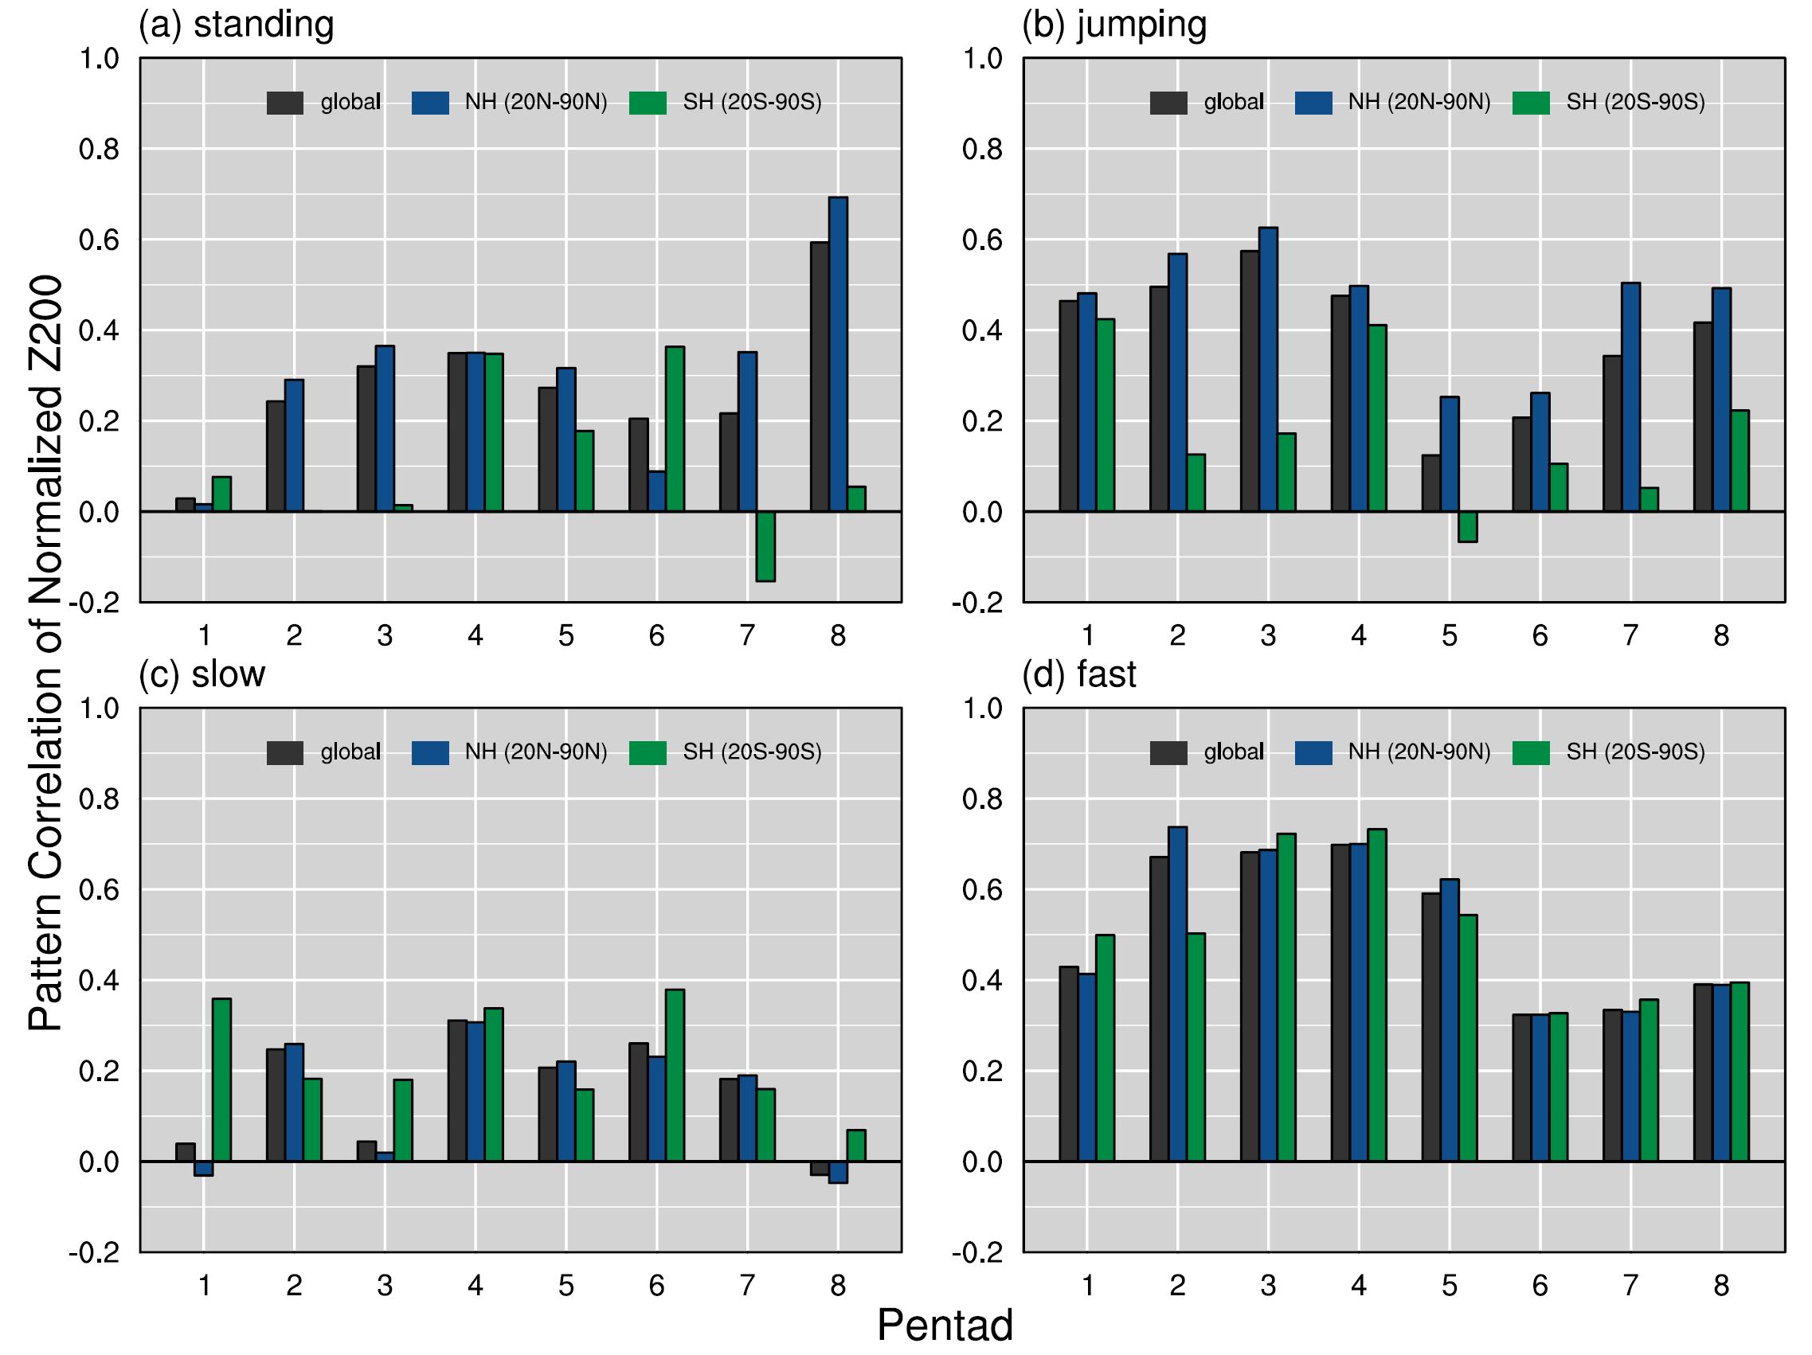
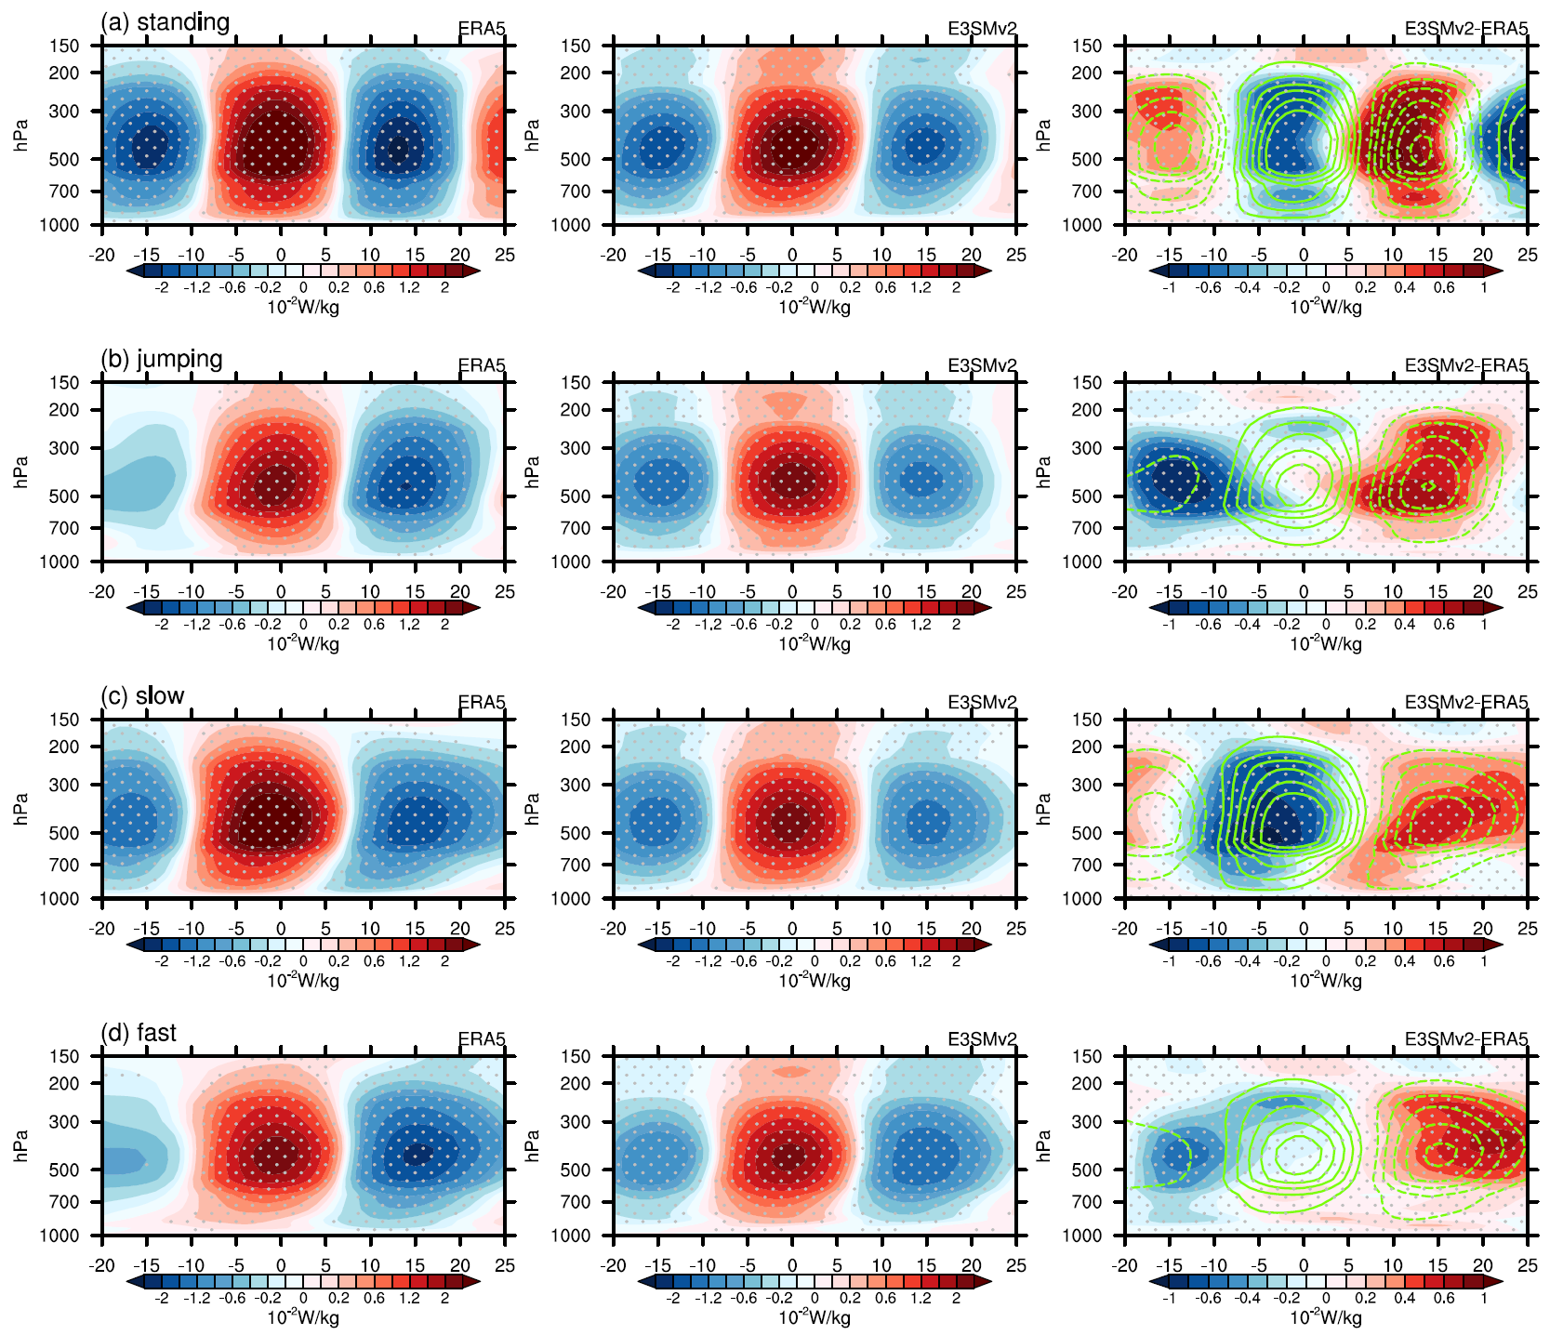
E3SMv2 Skill in Simulating the MJO Teleconnection (pattern correlations of the z200 pentad-anomalies)
Q1 Profiles over the Tropical Indian Ocean Domain (10S-10N, 80E-100E)
standing
jumping
slow
fast
Model skill in simulating MJO teleconnection patterns varies among four MJO types.
most model skill comes from the fast MJO
obs
E3SMv2
E3SMv2-obs
Model capability in simulating the MJO convective heating profile evolution might be the key.

