Slide 1
Climate Responses to Recent Major Wildfires as Simulated in E3SM2 and CESM2
Recent Results from both Large Ensembles and SMYLEs
John Fasullo
Project Scientist, NCAR

Slide 2
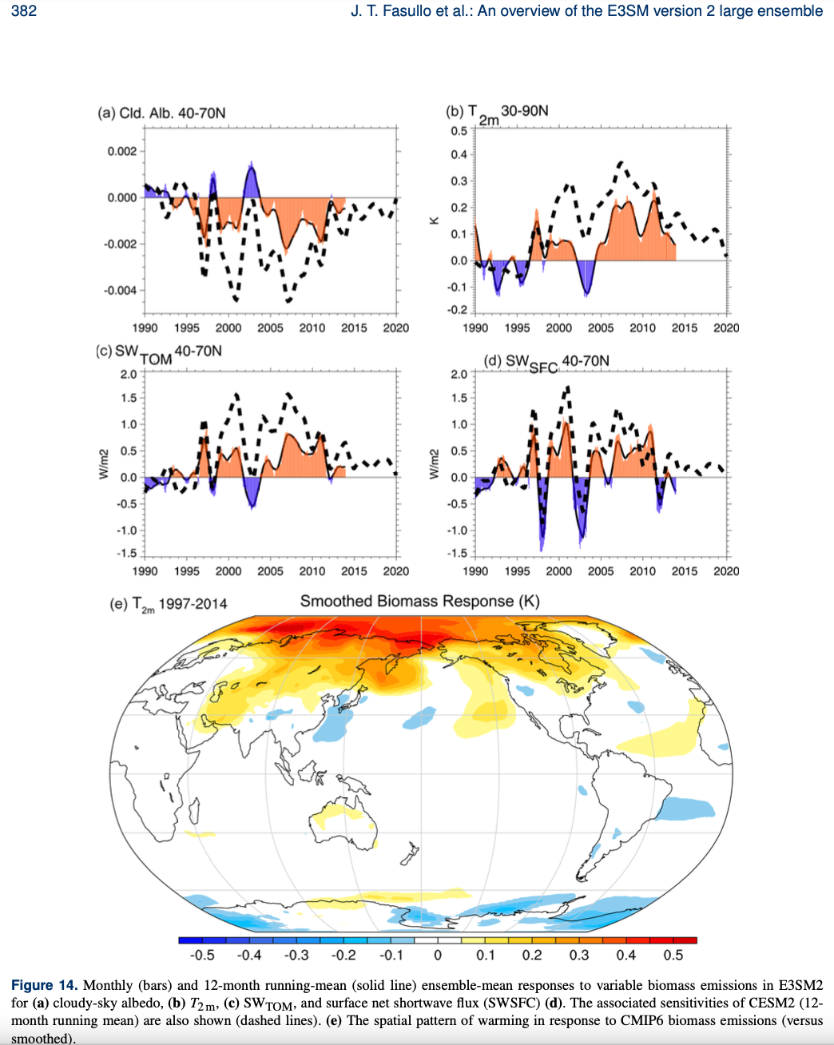
E3SM2 Response to CMIP6 Biomass Burning Emissions
Fasullo et al. 2024, ESD Figure 14
Darker Clouds
Warming
Key Point: E3SM2 exhibits spurious warming to CMIP6 biomass emissions (post 1997)
Fasullo et al. 2022 GRL: demonstrated NH extratropical warming in response to CMIP6 biomass emissions during GFED
Fasullo et al. 2024 ESD: demonstrates a similar sensitivity in E3SM2 LE (right)
Users of E3SM2 should exercise caution.
See poster by Julie Caron.
Increased SW⇩
Increased SW⇩

Slide 3
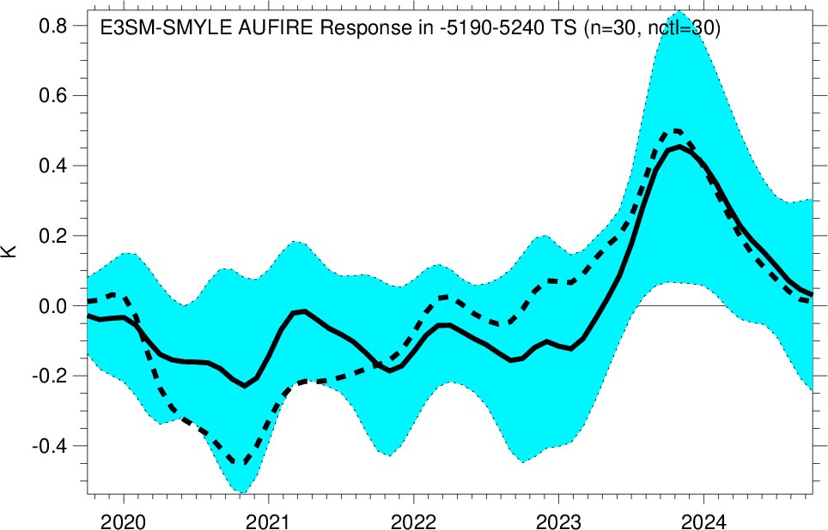
Climate Response to 2019-2020 Aus Wildfires in E3SM2
Fasullo et al., in prep.
Key Point: E3SM2 corroborates CESM2 in simulating a multi-year cooling due to the Aus wildfires.
Fasullo et al. 2023 Sci Adv: identified a prolonged La Niña response to the fires in CESM2-SMYLE.
Here we reproduce that result using E3SM2-SMYLE. The initial response is a modest prolonged cooling (~0.2 K) followed in 2023/24 by a warming in 2023-24.
The fire exert a detectible influence on ENSO through 2024.

Slide 4
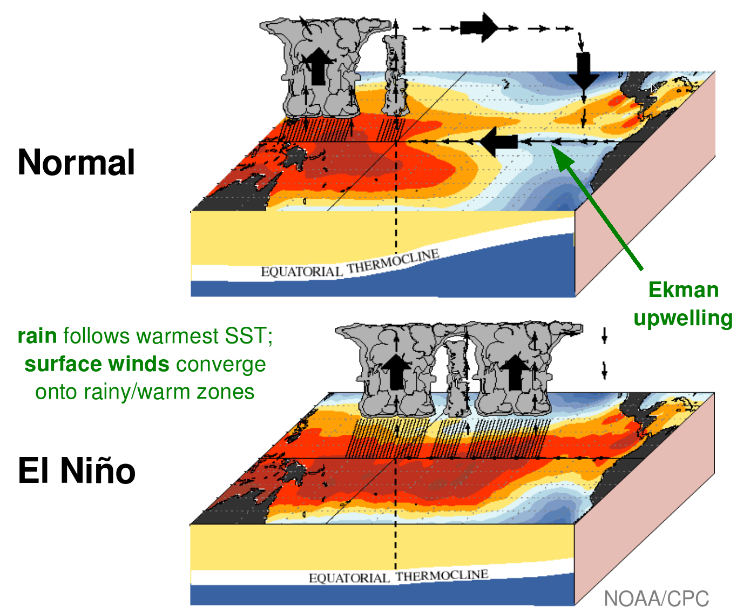
ENSO-wildfire Interactions
Fasullo et al. 2024, J. Clim., in review.
Key Point: Wildfire is an important aspect of ENSO.
ENSO impacts drought and fire weather globally – what role does fire play in coupled ENSO evolution?
In Fasullo et al. 2024 (JCLIM) the effects of biomass emissions on the coupled evolution of ENSO are examined in CESM2.
Coupled fire improves CESM2’s ENSO: 1) less variance, 2) greater asymmetry.
🔥
🔥
🔥

