Slide 1
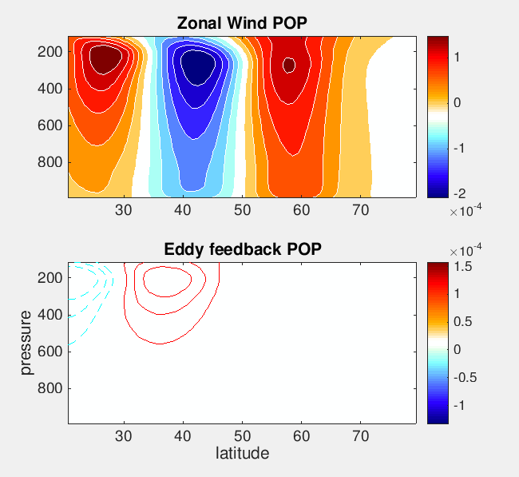
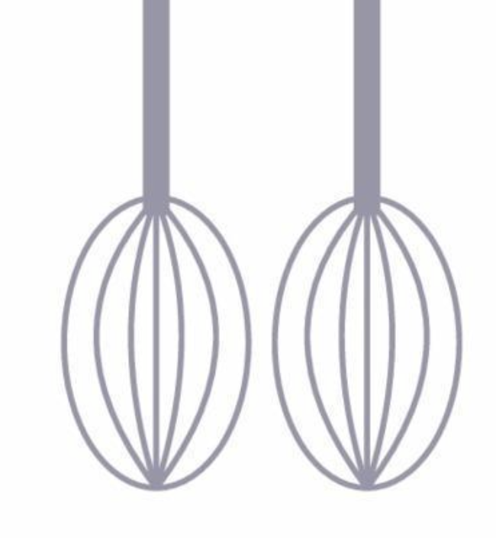
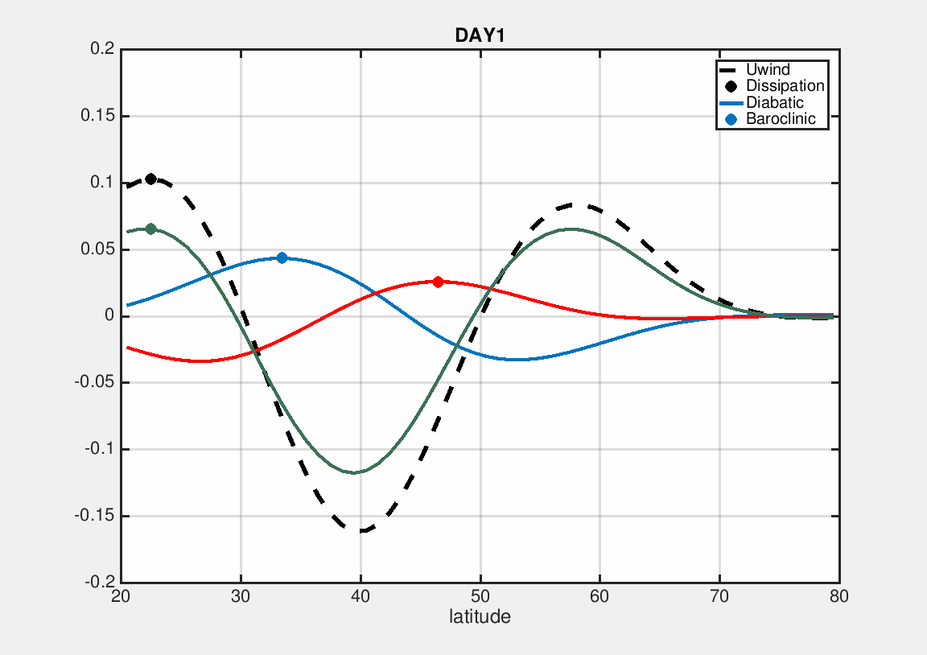
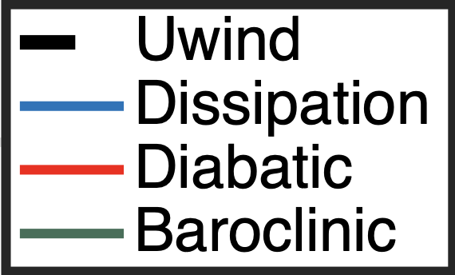
Cloud feedback hinders the propagation of the SAM Jian Lu
INPUTS
CTRL
ATM/LND
E3SM
OUTPUTS
The leading propagation POP for SAM
2000 SST
Cloud Data
INPUTS
CLOCK
T0C0
Cloud fields decorrelated
Cloud Data→ → Cloud Data*
2000 SST
CTRL Cloud*
Pos+ role of CRE in the persistence of EOF1
Hinderance to SAM propagation
Interactive CRE reduces SAM predictability
Challenge for E3SM to capture the coherent cloud structures
Notes:
About a year ago, we encounter a data-driven powerful tool---called Block DMD. We can input the budget terms in the budget equations to the BDMD structure and study the feedbacks to the leading prop annular mode.

Slide 2
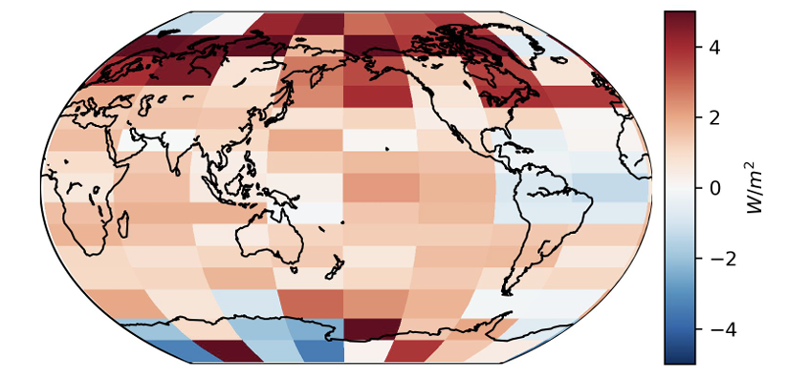
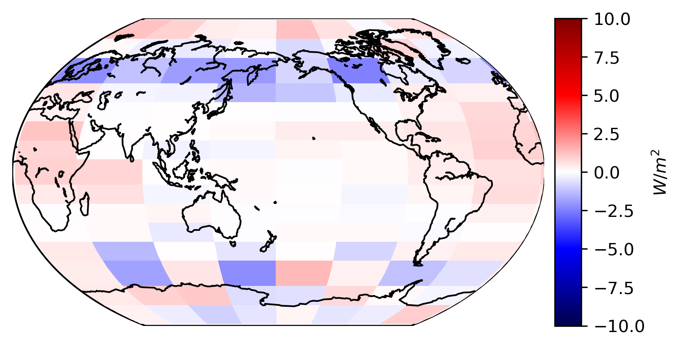
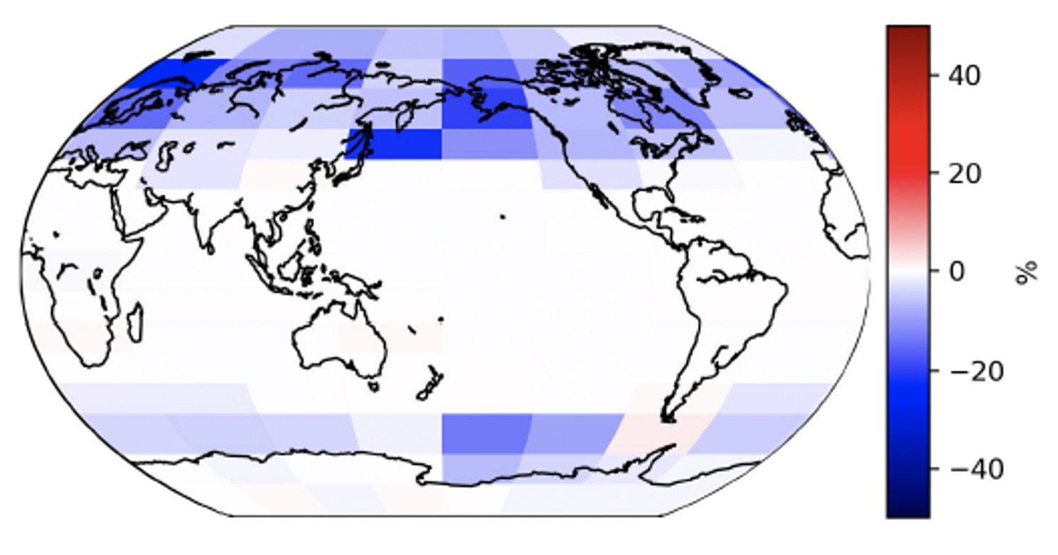
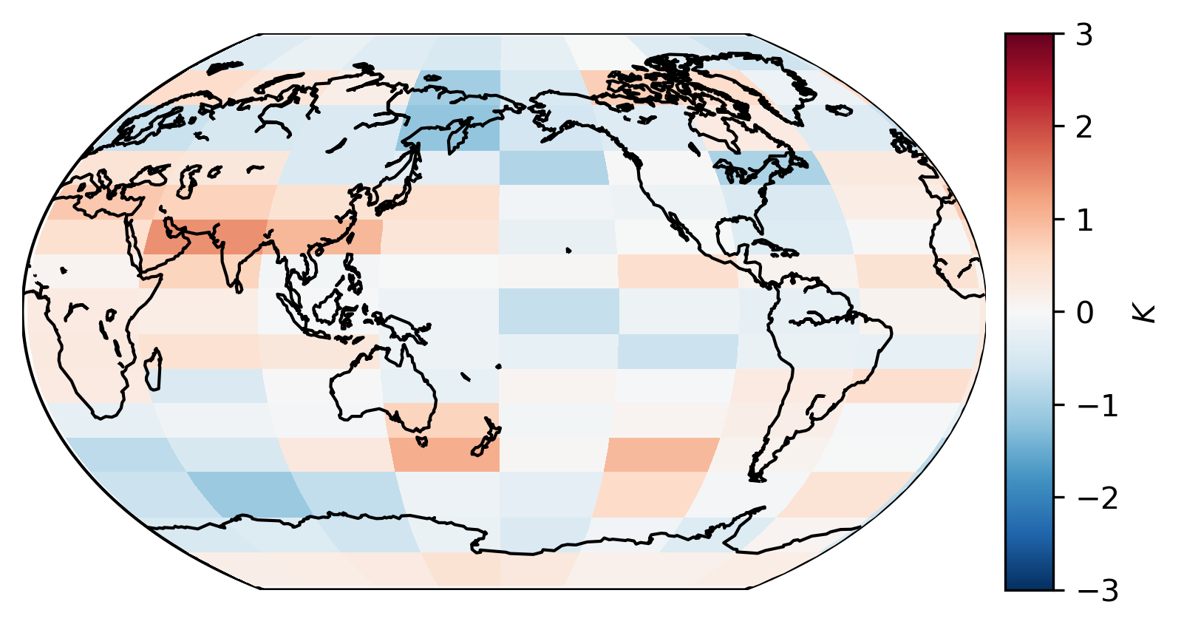
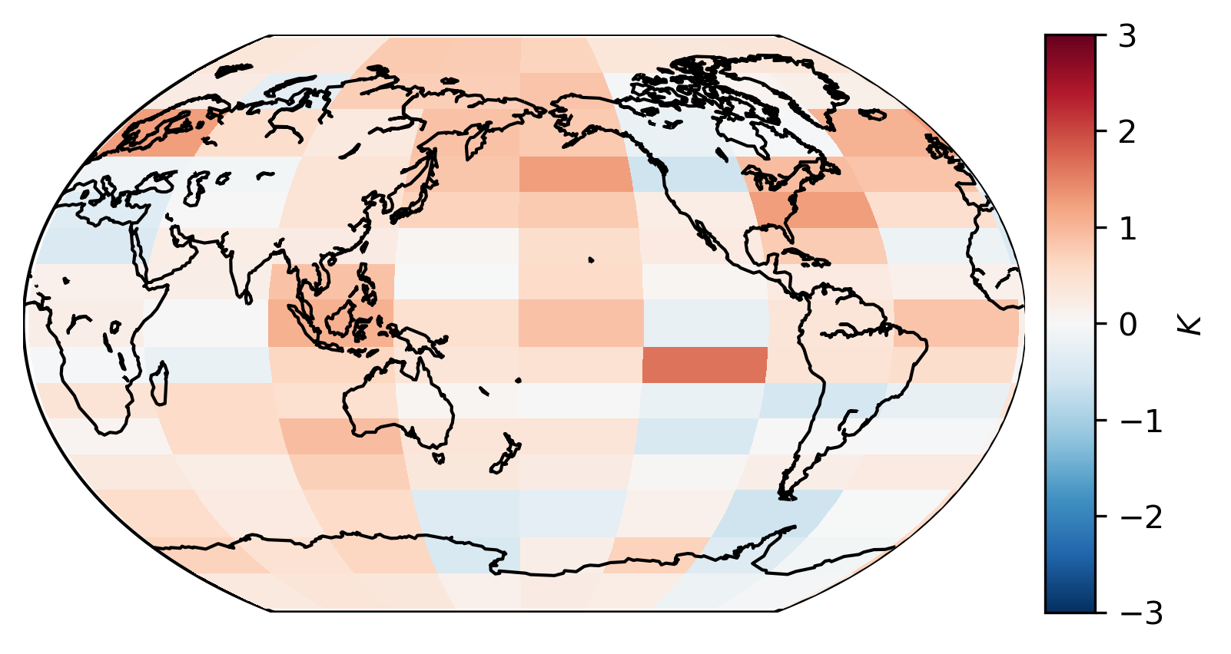
A non-local pattern-aware feedback framework
Feedback from the lens of dyn modes
Data-driven analytics
Forcing ($U_{1}$)
ALB
Dynamics and modes
Close-loop feedbacks

